Slide 1
CS5604 - Information Storage and Retrieval Virginia Tech, Blacksburg, VA 24061 Integration and Implementation Team
Final Project Presentation
Dec. 10, 2019
Rahul Agarwal, Hadeel Albahar, Eric Roth,
Malabika Sen, Lixing Yu

Slide 2
Outline
Introduction
Objective
Background
Timeline and Milestones
Approach
Implementation
Testing and Evaluation
Challenges
Future Work
Summary

Slide 3
Introduction
Let’s build a state-of-the-art IR system using latest technology
Docker container cluster; Rancher; Kubernetes / Kubectl
ElasticSearch - info retrieval; Kibana - visualization
Use this system to support two collections:
ETDs
Tobacco Settlement Documents
Project Teams: CME (ETDs); CMT (Tobacco); ELS (ElasticSearch); FEK (Front-end & Kibana); TML (Text Analysis & ML); INT (Integration & Implementation)

Slide 4
Objectives
Design and deploy Docker containers (containerize an IR system)
Manage the Kubernetes cluster on the CS Cloud via Docker, kubectl, and Rancher
Facilitate and manage data sharing between containers and Tobacco & ETDs VMs by using Ceph storage
Facilitate the evaluation and testing (CI/CD) of cluster components
Support a pipeline for ingestion of new collection documents (Kafka)
Deploy all cluster components seamlessly

Slide 5
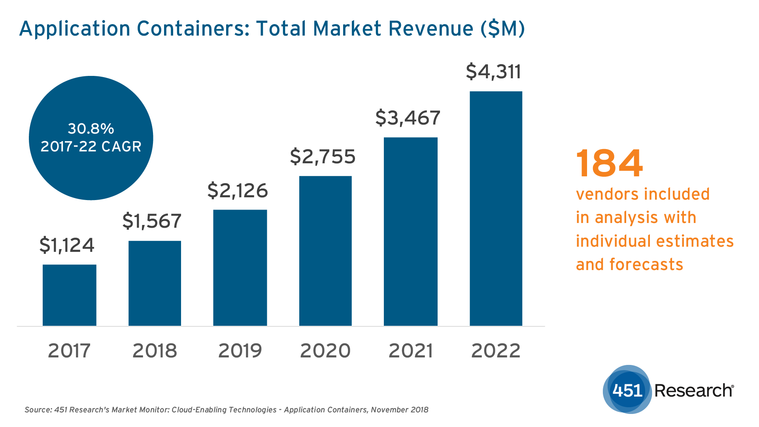
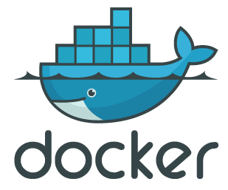
Background: Containers
A lightweight alternative to VMs
Linux cgroups (resource limitation) and namespaces (container visibility, isolation)
Enable a quick, reliable, & consistent application deployment regardless of deployment environment.
Docker is the leading container management framework.
Source: 451 Research

Slide 6
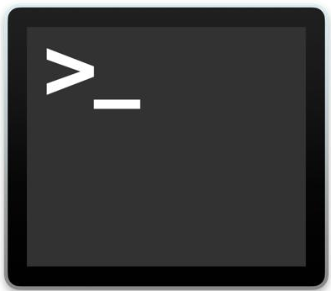

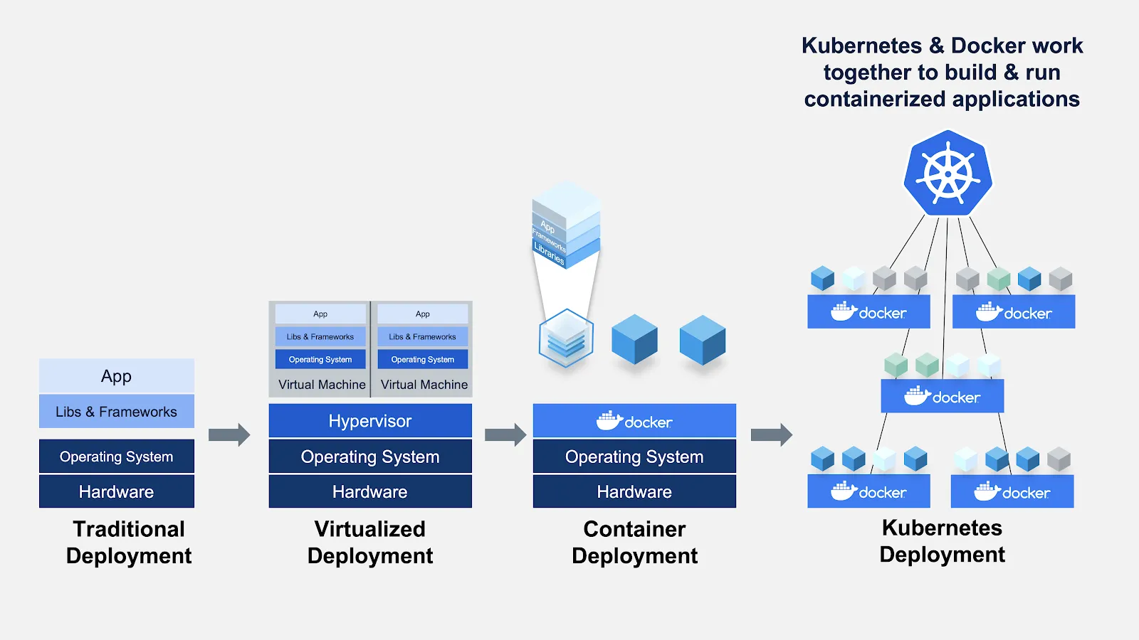

Infrastructure
Source: Docker Blog
kubectl
/mnt/ceph
Tobacco VM
ETDs VM

Slide 7
Timeline
Namespaces and Projects
Assigned teams to respective workspace on Rancher’s testing cluster.
Expose Service as LoadBalancer
Exposed services deployed through external IP and documented the approach
Sept
Oct
Sept
Oct
CentOS Container and Kubectl
Deployed the basic CentOS container and configured kubectl
Custom Docker Deployment
Deployed various custom dockers via Dockerfile, Rancher Catalog and Docker Hub

Slide 8
Timeline continued
CI/CD and Stress Testing
Researched and presented a demo on how to leverage GitLab’s CI/CD pipeline
Used Locust for stress testing frontend application
Changes to ElasticSearch Configuration
Researched and implemented the changes requested onto ES container by FEK team
Nov
Dec
Nov
Nov
MySQL and Frontend Application
Deployed the first version of the frontend application
Kafka
Deployed Kafka as a service and built a framework to be used by other teams

Slide 9
Approach
Containers
Pull existing containers (e.g., Docker Hub, Rancher Catalogs, Helm charts, etc.)
Create, push and pull custom containers (Dockerfile)
Shared Storage (mounting a Ceph volume)
Unit tests → as part of a CI/CD framework via GitLab
Stress testing → Locust
Automated Data Pipeline → Kafka
Monitoring changes to directory → inotify

Slide 10
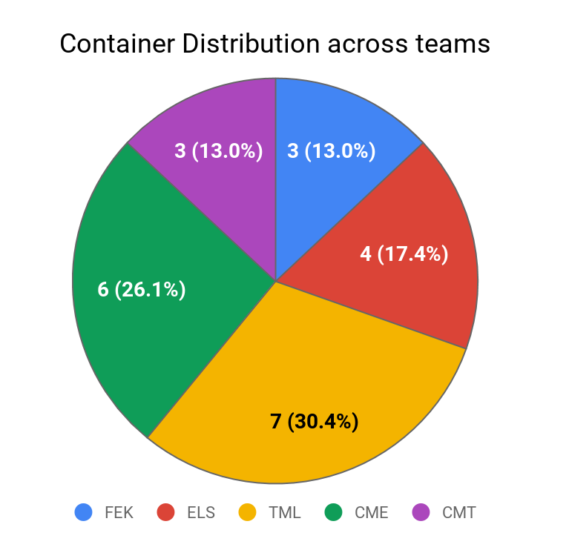
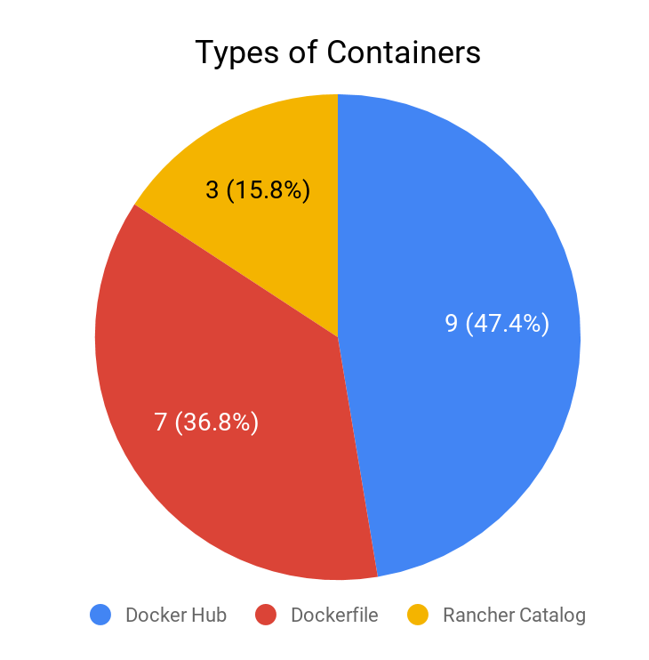
Implementation
Total Number of containers deployed : 19

Slide 11
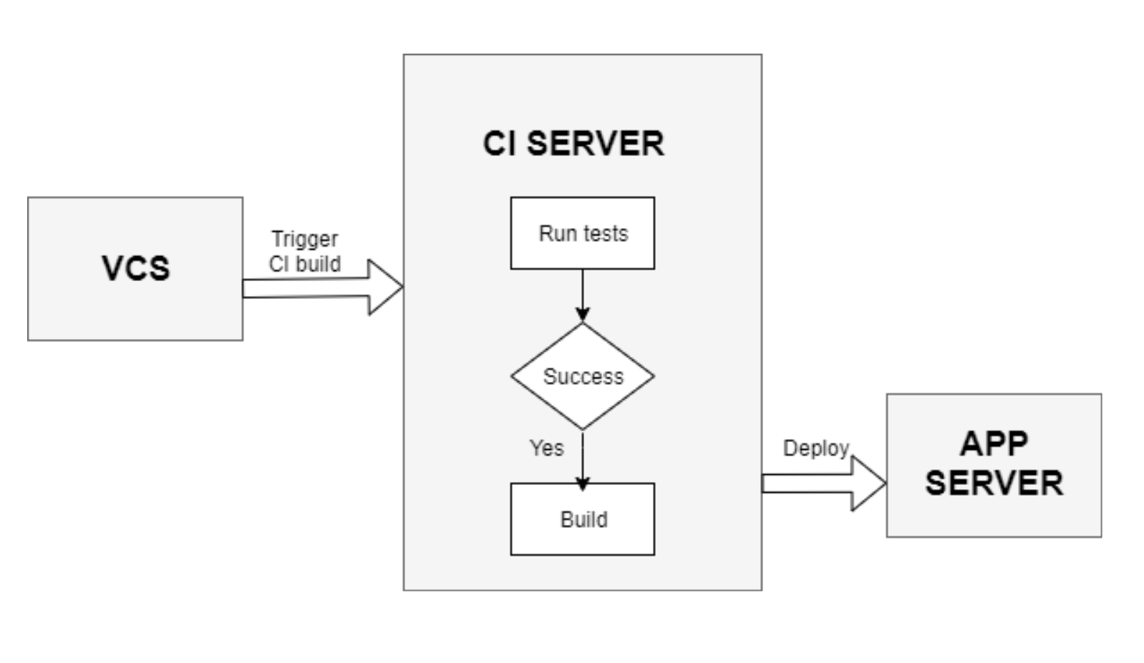
Testing and Evaluation - CI/CD
Small features released quickly
Test cases ensure system does not break
Follows the Build → Test → Deploy model
Examples of CI/CD pipelines:
Travis CI
Jenkins
GitLab
Notes:
CI/CD lays out some practices to follow in order for the code you write to more quickly and safely get to your users and ultimately generate value.
Run automatic code quality scans on it and generate a report of how well your latest changes adhere to good coding practices
Build the code and run any automated tests that you might have written to make sure your changes didn’t break any functionality
Generate and publish a test coverage report to get an idea of how thorough your automated tests are

Slide 12
CI/CD Options
 | GitLab | Travis | Jenkins
Ease of Setup | .yml file helps set it up | Setting up is as easy as creating a config file | Needs elaborate setup
Hosted Service | Yes | No | Yes
Performance | Supports public and private repositories along with a lot of other options like supporting container registry. | Best choice for open-source project because of ease of use and setup. | Has unlimited customization options.
Usage | Free for Virginia Tech-owned services | Free for Open Source Project and paid for Enterprise | Free
Server Machine | Cloud-based | Cloud-based | Server-based

Slide 13
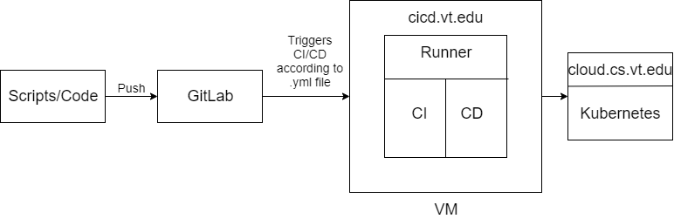
GitLab Pipeline

Slide 14
Testing and Evaluation - Stress Test
Performance testing or “Negative Testing”
Focuses on robustness, availability and error-handling under a heavy load
Different types of stress testing:
CPU stress testing
Load testing
Notes:
Stress testing is a type of performance testing which validates the highest limit of your computer, device, program, or network with an extreme load.
Stress testing tries to break the system under test by overwhelming its resources or by taking resources away from it (in which case it is sometimes called negative testing). The main purpose of this process is to make sure that the system fails and recovers gracefully—a quality known as recoverability.
CPU stress testing is performed to check the CPU’s performance after running it at a full speed completely up to maximum temperature. When CPU stress testing is performed, all the cores of the multi-core system will get used. CPU will get tested with the compatible and justified workload.

Slide 15
Stress Testing Tools
 | JMeter | Locust
Scripting | Supports GUI and scripting | Supports Python coding
Best For | Performance testing of web applications. | It provides a functionality to check the simultaneous number the system can handle.
Capability | It works for web applications, servers, group of servers, and network. | It can perform load testing on multiple distributed machines.
Pricing | Free | Free
Notes:
Introduce all considered options: JMeter and Locust
We chose locust
Then display test results

Slide 16
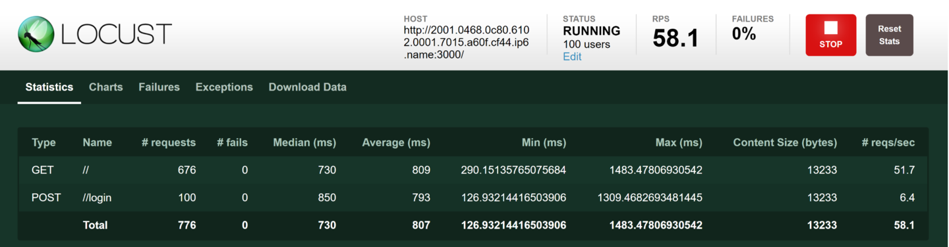
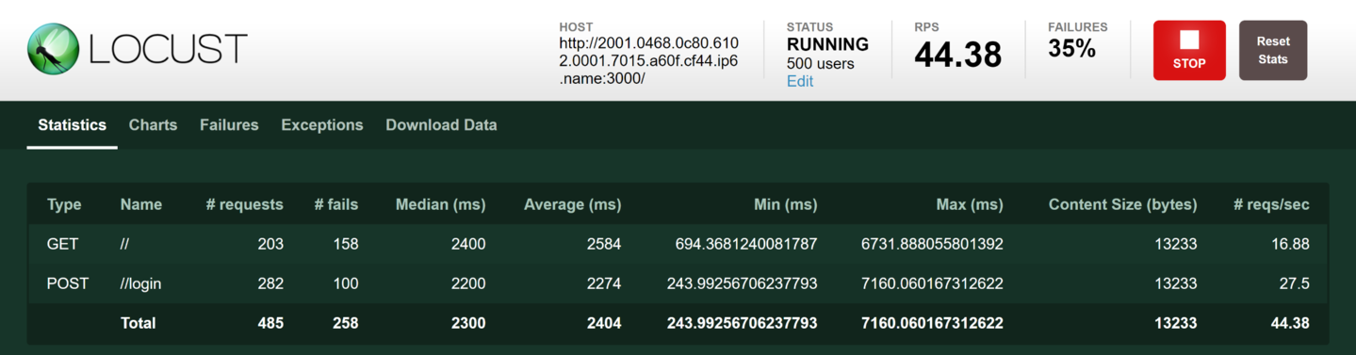
Results - Load Testing
Notes:
100 users on 1 instance v/s 500 users on 1 instance

Slide 17
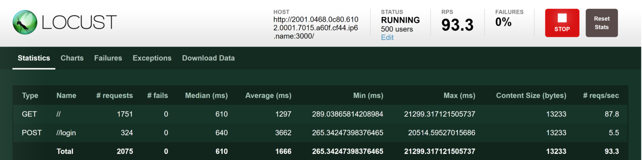
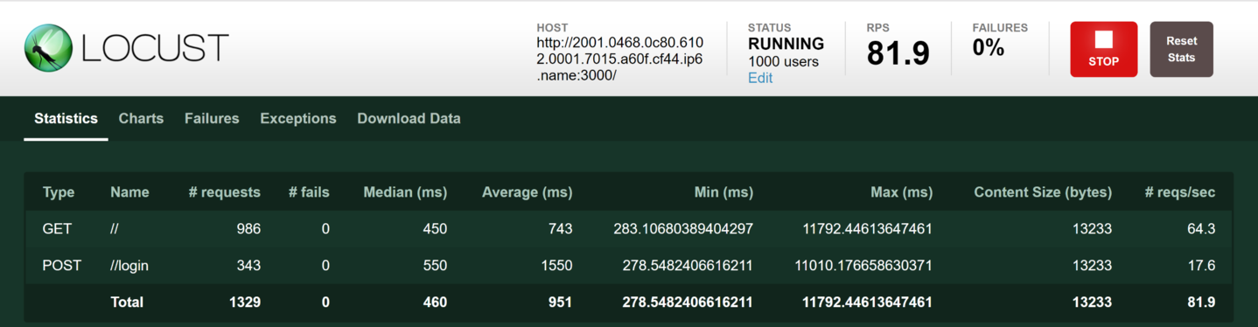
Results - Load Testing (contd)
Notes:
500 users on 2 instances and 1000 users on 2 instances

Slide 18
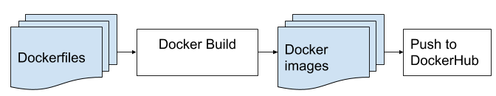
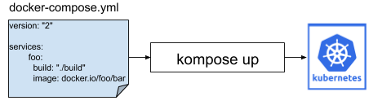
Migration to Production Cluster

Slide 19
Implementation Challenges / Limitations
CS cloud and hosted container cluster is always in flux
Unstable cloud/cluster led to many issues across all teams, which we had to address
Containers: Some teams based their development in VMs; therefore, parameters for container creation were not available
Unit tests not available in time to implement full system CI/CD
Ingestion was not a design priority early enough for it to be connected with Kafka; earlier collection efforts had to be prioritized for doc processing
Production environment (teaching cluster) was not sufficient
We lost a team member early in the semester

Slide 20
Conclusion
Designed and deployed Docker containers
Facilitated and manage data sharing between containers and Tobacco & ETDs VMs by using Ceph File System
Facilitated the evaluation and testing (CI/CD) of cluster components
System stress test proved Front End’s robustness
Deployed Kafka infrastructure and designed data ingestion pipeline
Successfully handled support requests from other teams

Slide 21
Future Work
Complete the containerization of cluster components
Integrate Kafka (Kafkacat producer and consumers) into all the producers and consumers scripts to enable an automated data pipeline
Motivate teams to adopt GitLab
Deploy CI/CD pipeline for each team
Base new system tests on sample user logs
Deploy all IR system components in Teaching cluster (Production)

Slide 22
Thank You
Questions?

