Slide 1

Problematising the Sublime:
Affective Archives within Landscape Design
Shaun Rosier, PhD
Assistant Professor, Landscape Architecture
shaunrosier@vt.edu
Notes:
Good afternoon everyone, thank you for being here. I’m Shaun Rosier, an Assistant Professor of Landscape Architecture at Virginia Tech’s School of Design. Today I’m going to be sharing some of the tinking and work around a particular problem I’ve been grappling with in my own discipline where affect and assemblage thinking has proven quite productive.

Slide 2
Problematising the Sublime
Deferral from the Ground
Affective Archives within Design
The [landscape]Sublime as a ‘Limit Case’
Toward Method and Technique
Notes:
At the core of this and my other research is a drive to show that the aesthetic concept of the sublime, which we’ve culturally largely written off as something mystical and distinctly unserious is in fact quite concrete and tangible. Landscape architecture has its own relationship to the sublime, which was previously productive territory, but along with aesthetics in general, it is now viewed with suspicion or derision.
In this context, I’m going to introduce you to a body of thought and creative practice I’ve been developing that makes an argument for the sublime as an encounter with a disruptive sensation, understood through Deleuze’s notion of Intensity. To bring things full circle, I’ll walk you through an example of this kineaesthetic encounter can be documented in a concrete manner through landscape architectural techniques and methods.

Slide 3
Deferral from the Ground
Notes:
First, I would like to contextualise my following argument in relation to a discursive undercurrent that argues for a wider re-engagement with the aesthetic and political dimensions of landscape. The 1990s saw a massive disciplinary swing toward viewing and engaging with landscape as a complex system to be understood through technoscientific means.

Slide 4
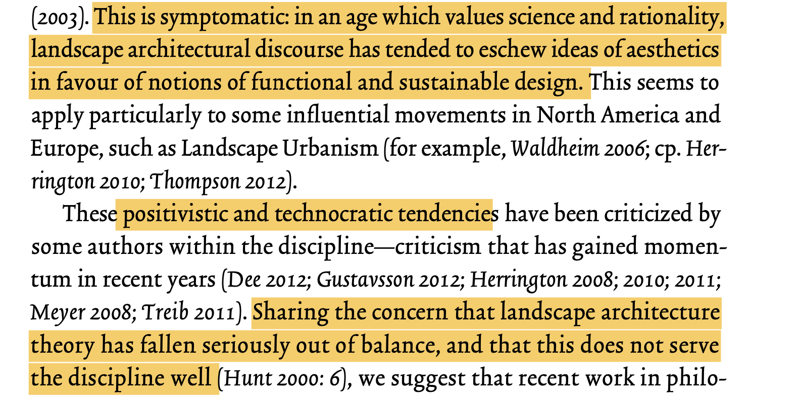
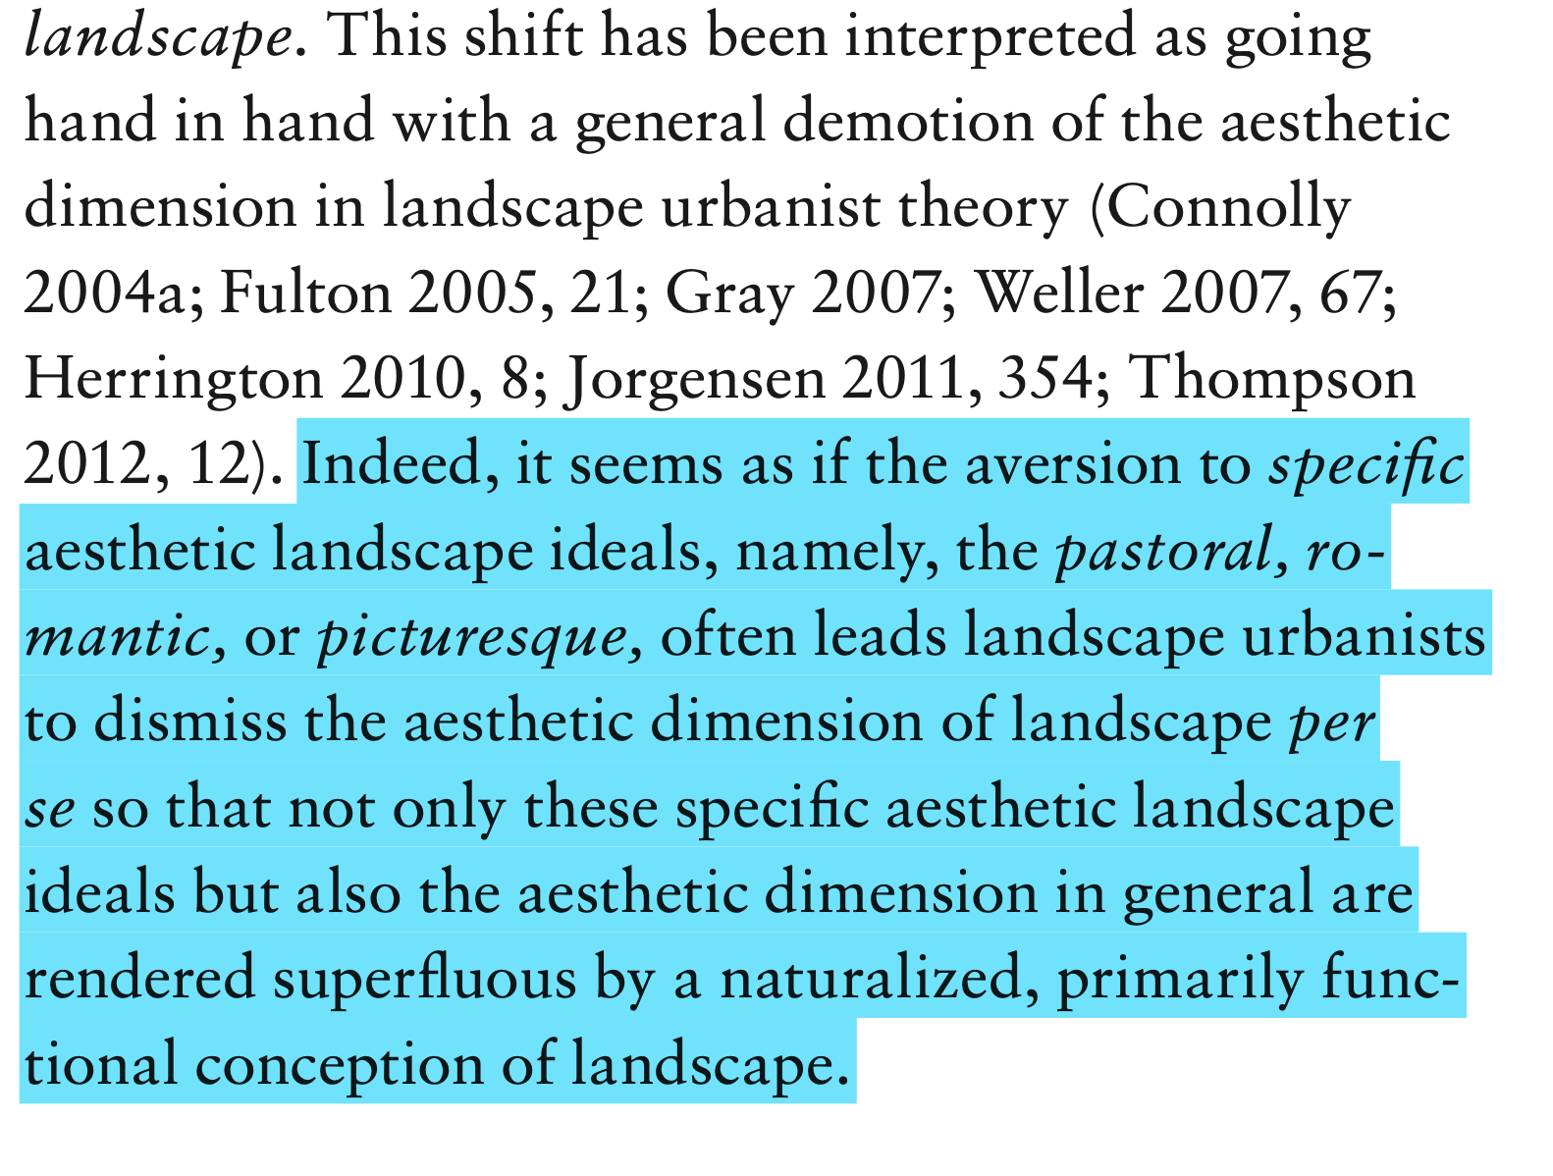
Van Etteger, Rudi, Ian H Thompson, and Vera Vicenzotti. "Aesthetic Creation Theory and Landscape Architecture." Journal of Landscape Architecture 11, no. 1 (2016): 80-91. pg. 80
Vicenzotti, Vera. "The Landscape of Landscape Urbanism." Landscape Journal 36, no. 1 (2017): 75-86. pg. 82
Notes:
Several European and Australasian authors have commented on a value shift in the discipline that is more reflective of STEM rather than the traditional humanities basis that landscape architecture has historically drawn from. Perhaps most concerning for these authors and myself is the desire to view design and the products of designing through almost exclusively through a positivist or post-positivist epistimiology.

Slide 5
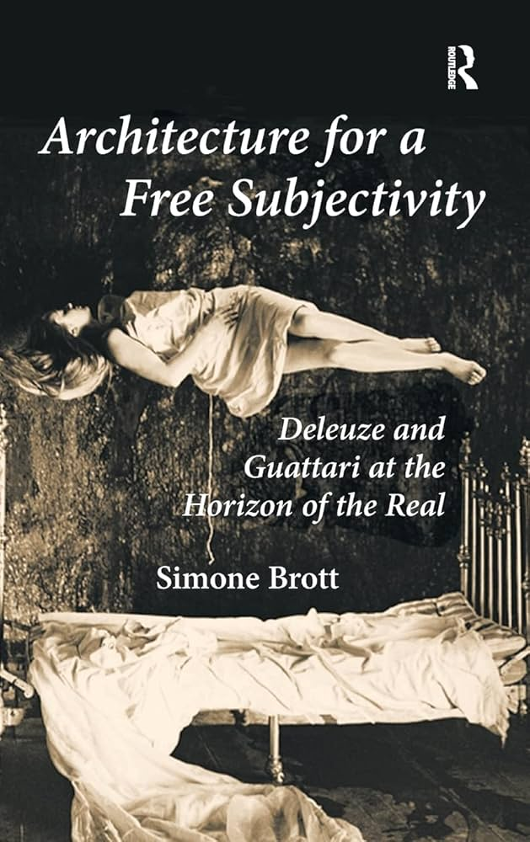
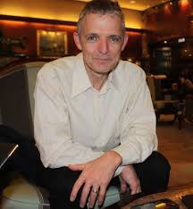
Peter Connolly, Landscape Architecture Theorist
Notes:
Two Australian design scholars, Peter Connolly, who I owe an intellectual debt to, and Simone Brott identified this shift stemming from interpretations of Deleuze and Deleuze and Guattari’s work in the 1970s by architectural theorists who avoided affect and affectivity.

Slide 6
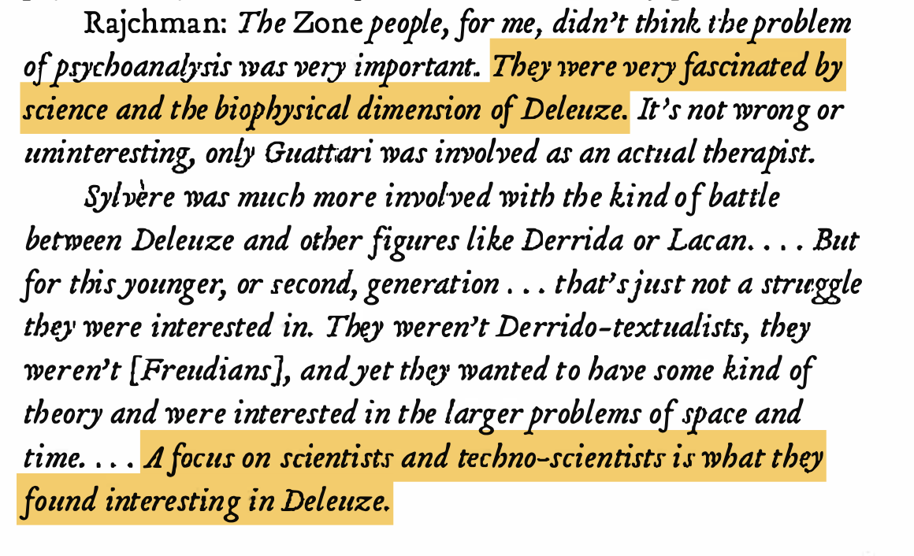
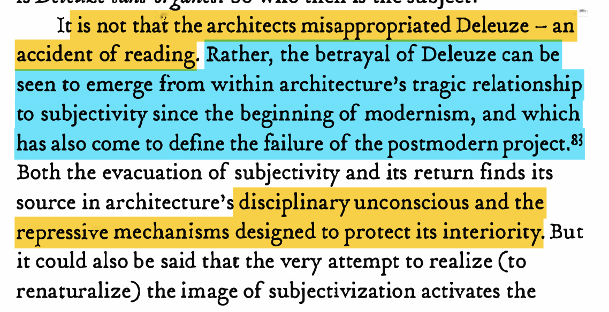
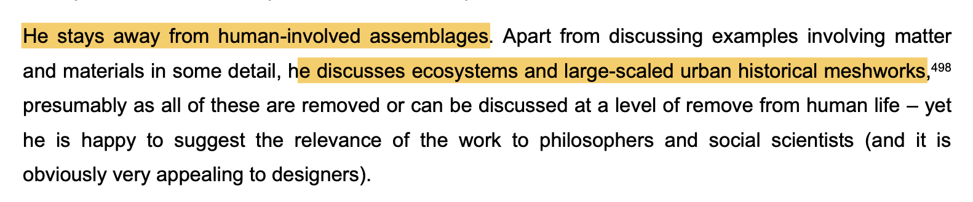
Brott, Simone. "Deleuze and 'the Intercessors'." Log, no. 18 (2010): 135-51. pg. 143, 150.
Manuel DeLanda
Connolly, Peter. "An Affirmative Open Systems Conception of How to Design Landscape." Doctor of Philosophy PhD Dissertation, RMIT, 2012. pg. 190
Notes:
More specifically, Brott points to these early designerly engagements focusing on the technoscientific dimensions, and Connolly identifies in Manuel De Landa, one of the main theorists in this area, a deferral away from the human or organism at large, as well as the aesthetics of affect and encounter in Deleuze and Guattari’s work.

Slide 7
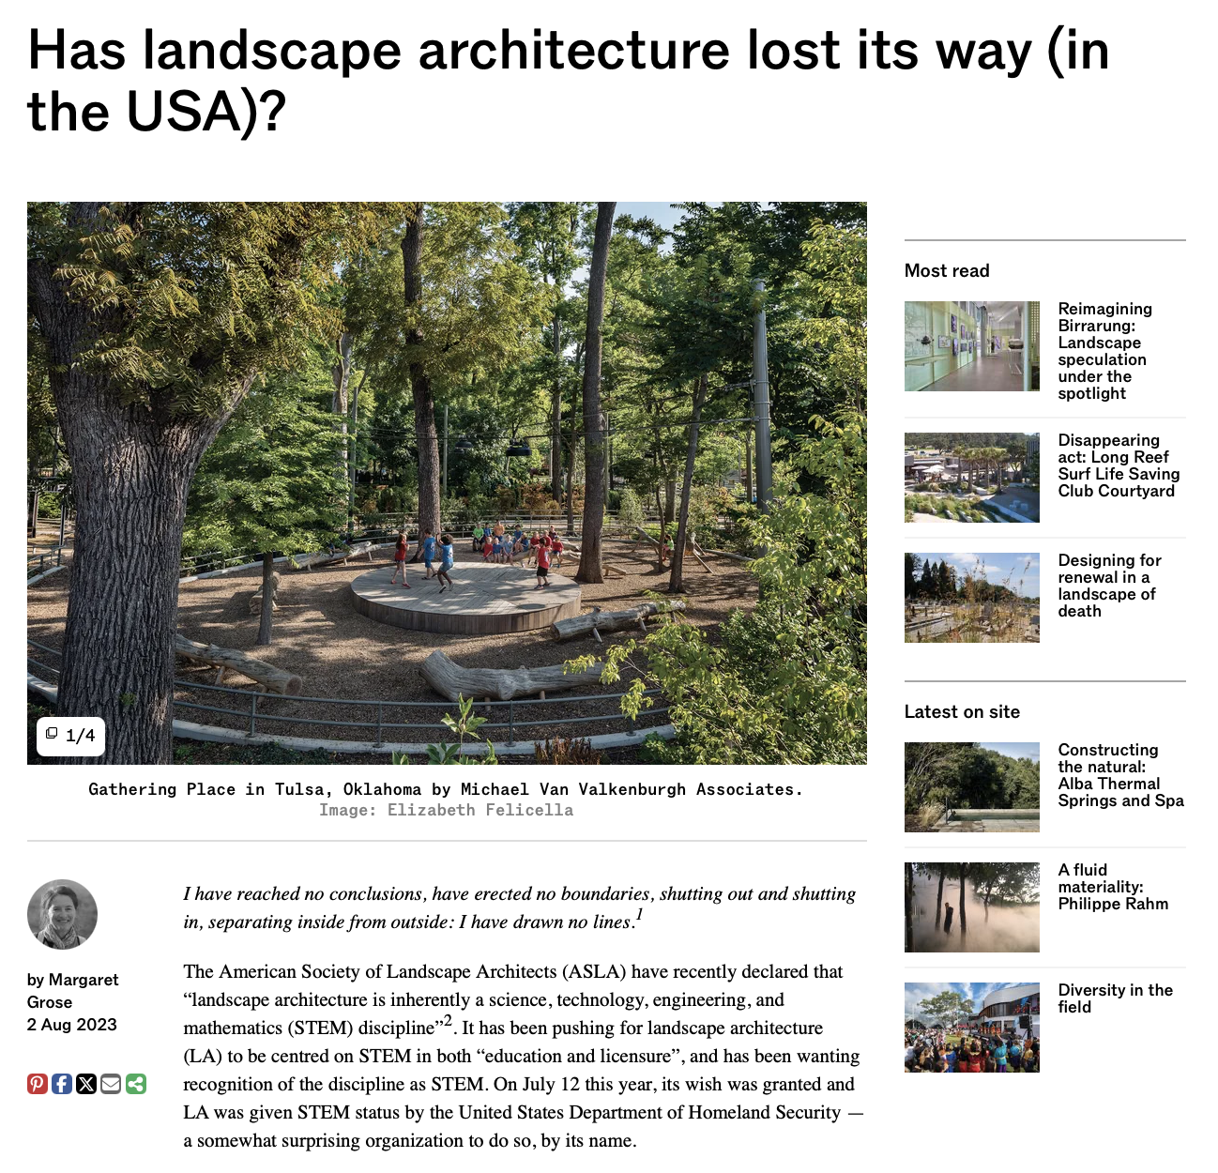
Notes:
Whilst this might sound quite narrow, it has created a disciplinary culture and discourse that has largely deferred away from the aesthetic, political, and experiential dimensions of landscape. Margaret Grose recently published this article calling to attention the complete, almost dogmatic swing, towards STEM within landscape architecture which she argues risks losing what value design has to offer the world.

Slide 8
Affective Archives within Design
Notes:
In response to this and what I’ve seen in my own and several other design programmes, I’ve been grappling with how to conceptualise a landscape design method and theory that at the very least honors our aesthetic experiences in the world, and ideally pushes further into figuring how we might design new aesthetic futures.

Slide 9

Notes:
When working on a design project I nearly always get my students to start off with articulating their initial intuitions, hunch, or gut feel based entirely on their memory of what was striking about this landscape. In doing so I’m asking them to trust their memory, particularly their bodily memories. What was it like to walk through this place, where did they feel sensations of spatial contraction and expansion, where did things feel calm, mysterious. Not only recalling those sensations, but then manipulating those memories through making design moves is all about drawing upon one’s affective archives or the memory images we carry with us.

Slide 10
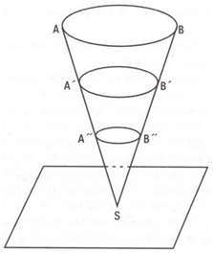
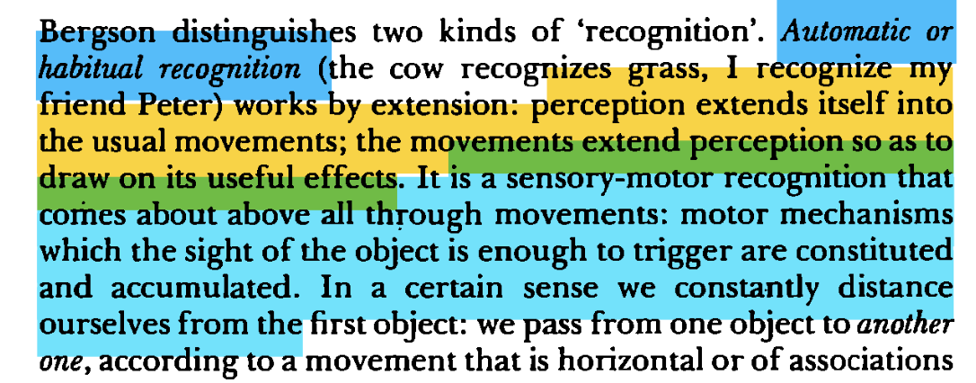
Deleuze, Gilles. Cinema 2: The Time-Image. Translated by Hugh Tomlinson and Robert Galeta. Minneapolis: University of Minnesota Press, 1997. Pg. 45.
Bergson’s diagram for his schema of memory, in ‘Matter and Memory’, 1896/2004, p162.
Notes:
This approach draws upon Bergson and Deleuze’s construction of memory images, represented here by Bergson’s well known cone diagram. In a sensory and perceptual present, we are constantly drawing upon our previous memories in order to determine an action. Bergson recognizes this mechanism having two forms, habitual recognition and attentive recognition. The former is as Deleuze writes in Cinema 2: “a sensory-motor recognition that comes about - above all - through movements”. Further, the object of our perception in this mode is of much less interest to the body as we’re heavily drawing upon our affective archives to move between perception and movement.

Slide 11
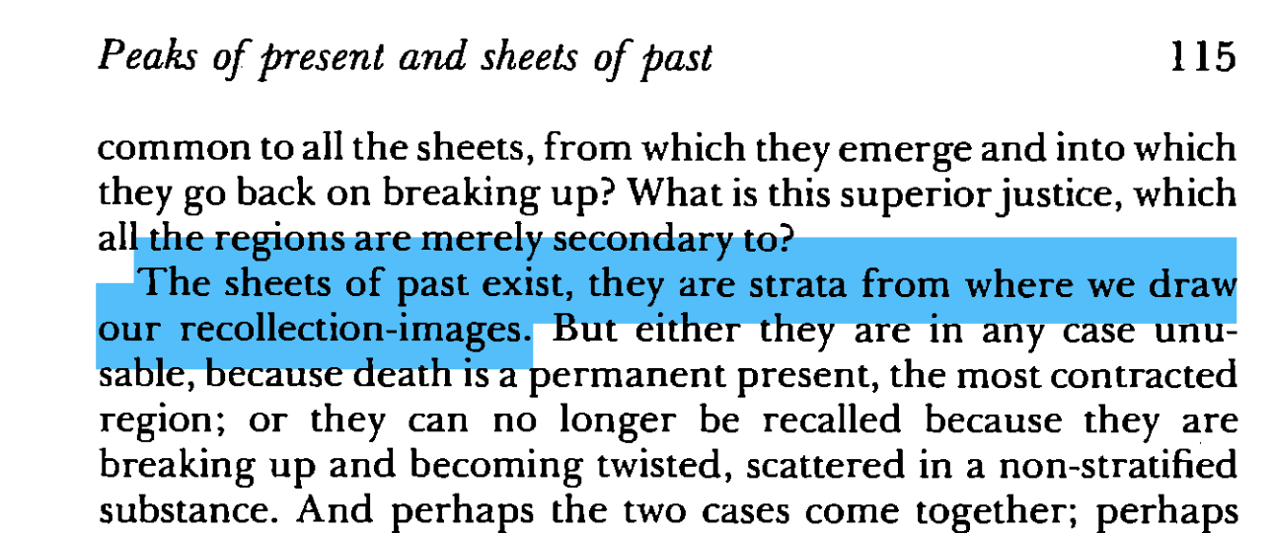
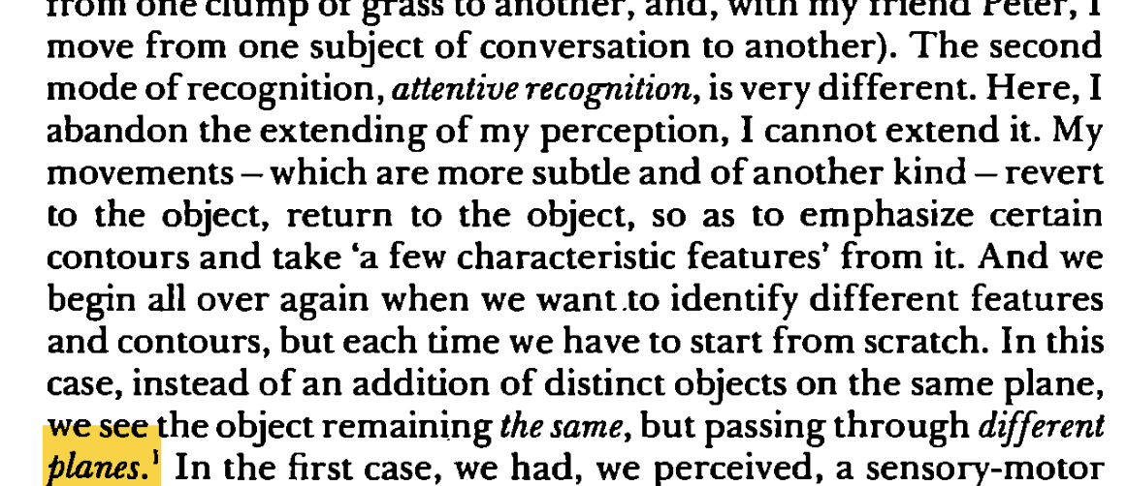
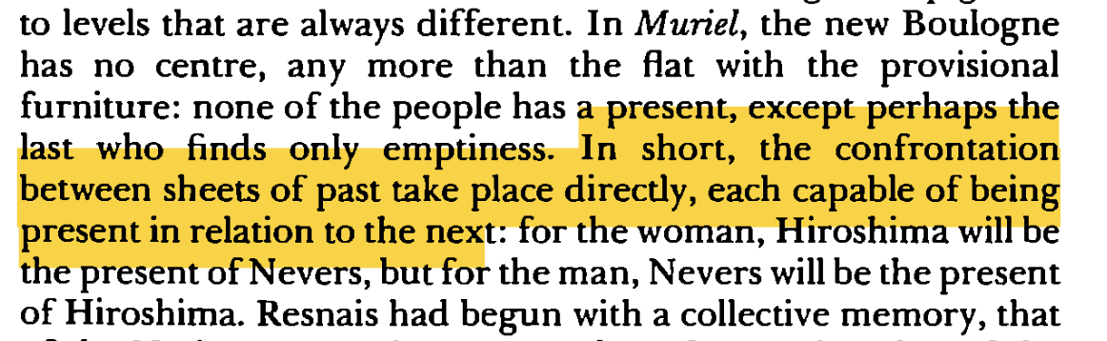
Deleuze, Gilles. Cinema 2: The Time-Image. Translated by Hugh Tomlinson and Robert Galeta. Minneapolis: University of Minnesota Press, 1997. Pg. 115.
Deleuze, Gilles. Cinema 2: The Time-Image. Translated by Hugh Tomlinson and Robert Galeta. Minneapolis: University of Minnesota Press, 1997. Pg. 46.
Deleuze, Gilles. Cinema 2: The Time-Image. Translated by Hugh Tomlinson and Robert Galeta. Minneapolis: University of Minnesota Press, 1997. Pg. 116.
Notes:
Attentive recognition on the other hand is entirely engrossed with the object or situation at hand. This is a closer, more narrow form of perception as Deleuze describes it, where we always has to start from scratch. One must draw on a variety of planes, sheets, or archival rows in order to constellate a suitable action movement. This involves our entire being, its past, present, and possible futures, as well as the extended space-time of our environment.

Slide 12
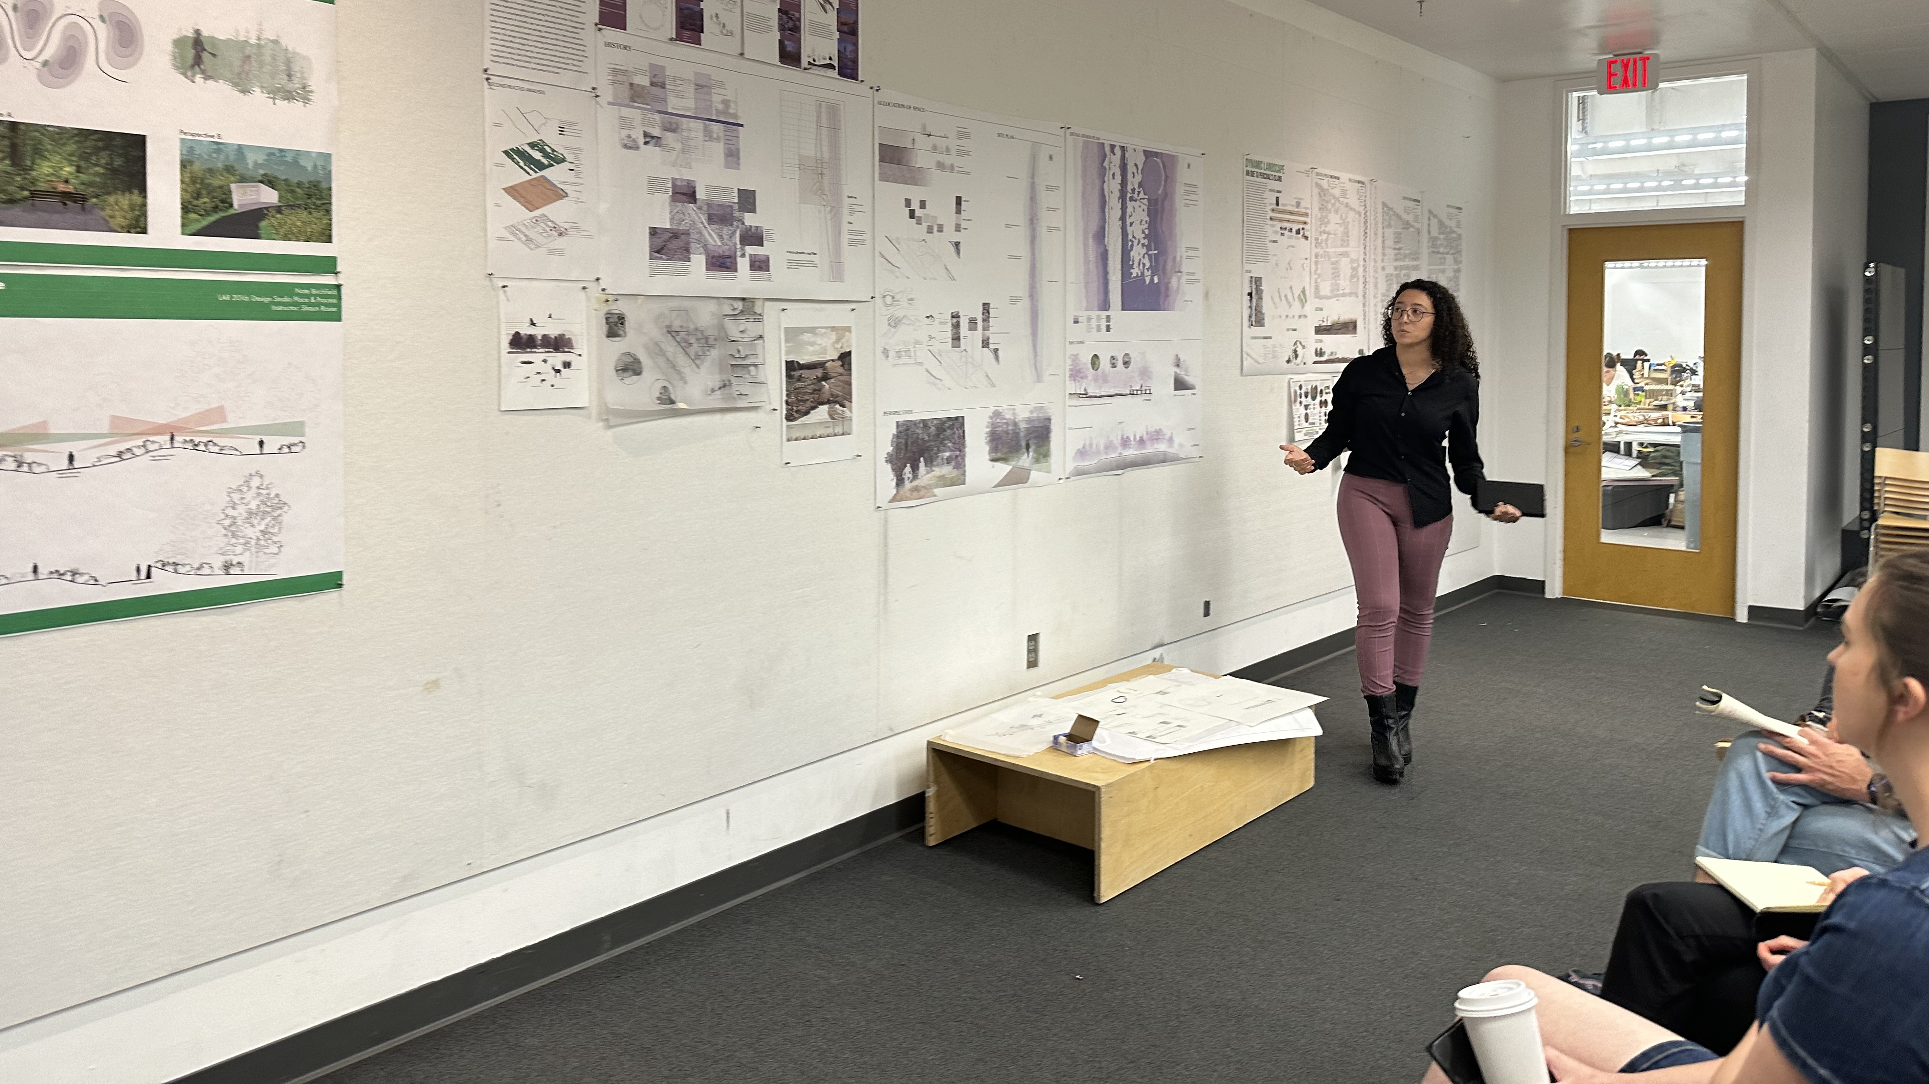
Notes:
Unfortunately communicating the experience of landscape is often not quite so easy or straightforward. Landscapes are radically open, weird, involving all manner of things and beings at a variety of scales and times. Common sense, best practice, standards and regulations tend to cloud or obscure our relationships to site, disempowering the designer to draw on their affective archives by making these exterior forms of site knowledge more authoritative in comparison to a so-called subjective opinion.
Much of my time and effort is dedicated towards conceptualizing how we can more concretely engage with the thisness or singular nature of a given landscape which in essence involves championing our affective relationship to it.

Slide 13
The [landscape]Sublime as a ‘Limit Case’
Notes:
And so I’ve turned to the sublime as the means with which to mount this counter argument for the validity of aesthetic material and knowledge in landscape design. Despite being regarded as a bit outdated or 18th century for our contemporary issues, I’ve found it an incredibly productive area to mine for greater insight into our relational situatedness with the environment.

Slide 14
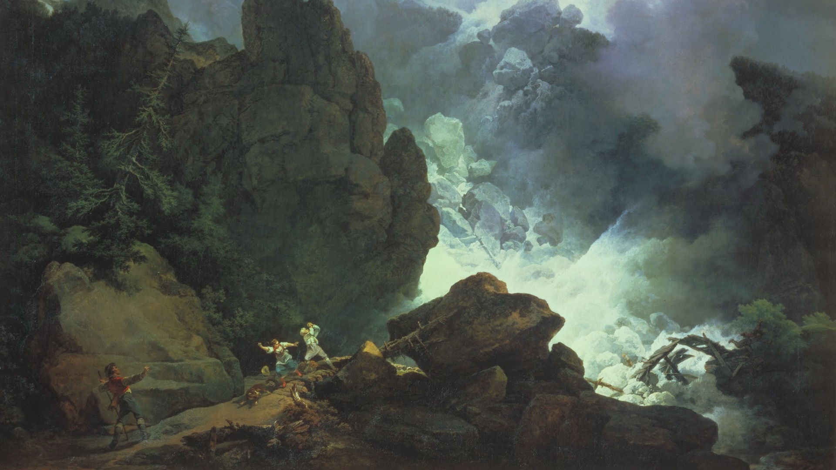
An Avalanche in the Alps (1803), Philip James De Loutherbourg. www.tate.org.uk/art/artworks/de-loutherbourg-an-avalanche-in-the-alps-t00772
Notes:
In contrast to its 18th century brethren the picturesque and the beautiful, the sublime is typically described as an aesthetic force beyond representation, reason, and thought

Slide 15
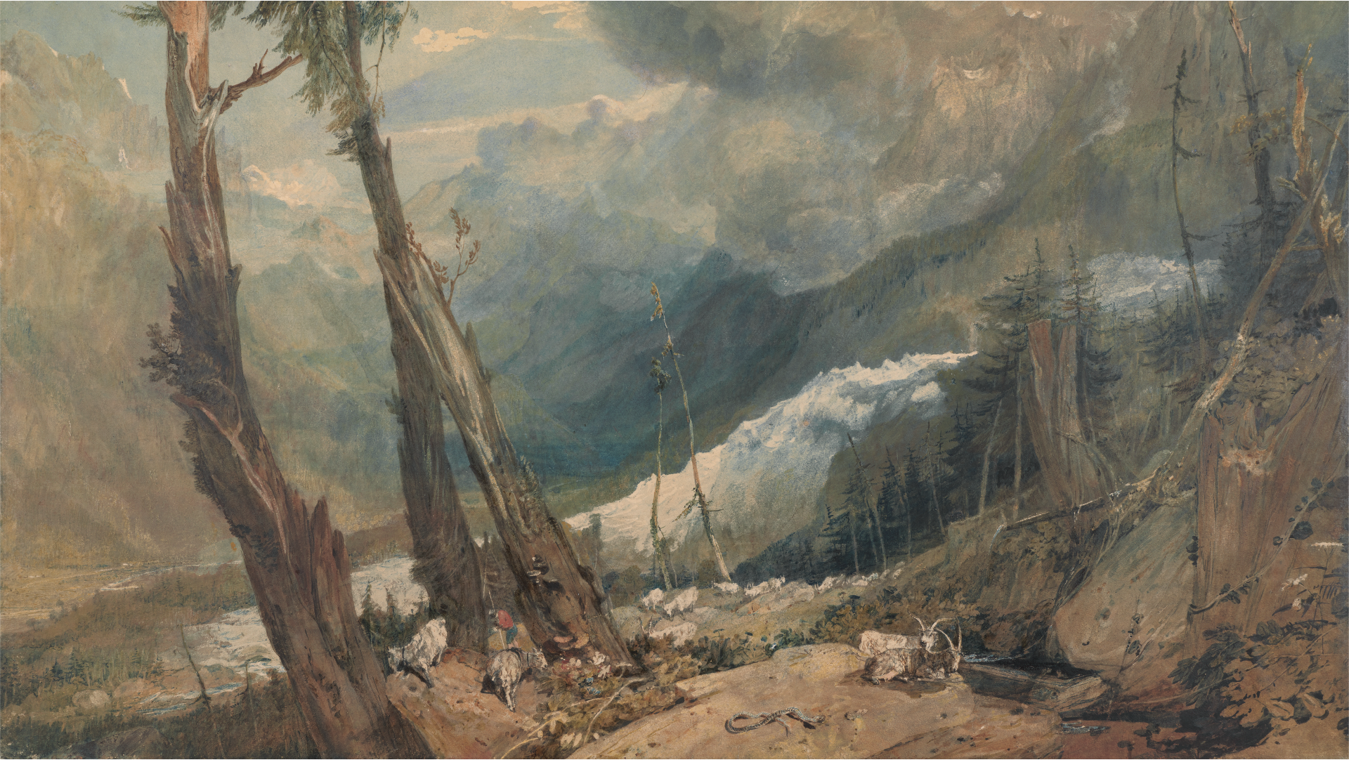
Mer de Glace, in the Valley of Chamonix (1803), Joseph Mallord William Turner. https://collections.britishart.yale.edu/catalog/tms:5485
Notes:
It emerged as a distinct aesthetic concept in tandem with landscape architecture becoming a separate profession and discourse from architecture. Both landscape architecture and the sublime sought to grapple with aspects of the world that escaped the grasp of Enlightenment thinking.

Slide 16
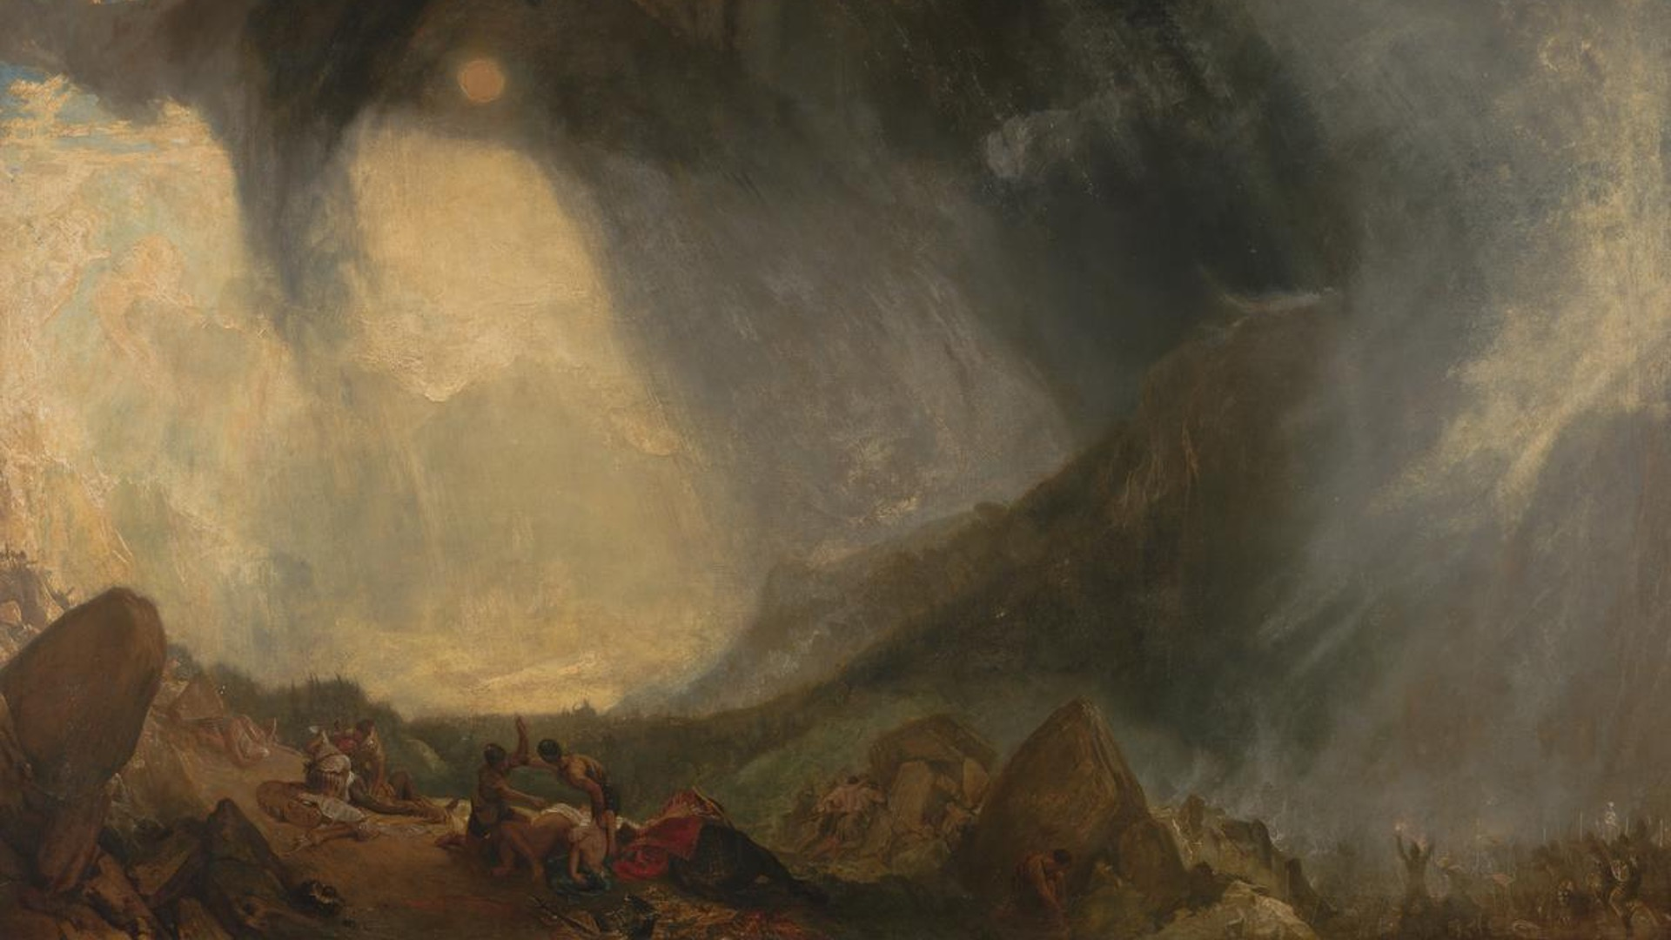
Snow Storm: Hannibal and his Army Crossing the Alps (1812), Joseph Mallord William Turner. https://www.tate.org.uk/art/artworks/turner-snow-storm-hannibal-and-his-army-crossing-the-alps-n00490
Notes:
However, the sublime fell into what Andrew Ashfield and Peter de Bolla described as a “quibbling over terms” in the 19th century, where describing what was or wasn’t sublime took precedence over its aesthetic mechanics. Since then, it has largely been unattended to, rarely being invoked with in a concrete manner even with landscape discourse.
However, I argue that approaching the landscape sublime through Deleuze’s notion of affect offers a way forward where it becomes surprisingly tangible, relatable, and designable.

Slide 17
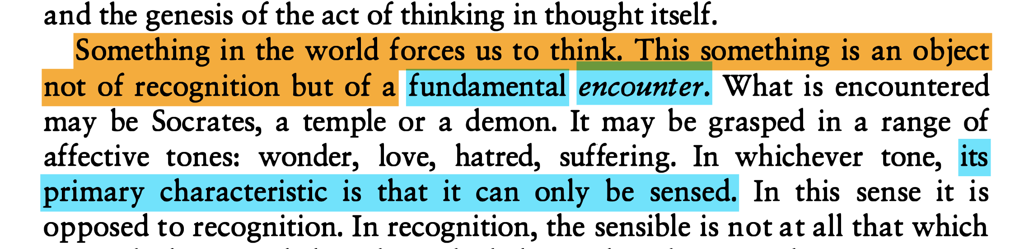
Deleuze, Gilles. Difference and Repetition. Translated by Paul Patton. London: Athlone Press, 1994. 1968. pg. 139.
Notes:
This quote, perhaps my favorite from Deleuze, strikes at the core of the landscape sublime. Here, Deleuze highlights that it is not our own consciousness that determines thought or action, but a forceful encounter with sensation, or perhaps more accurately, an encounter with intensity.

Slide 18
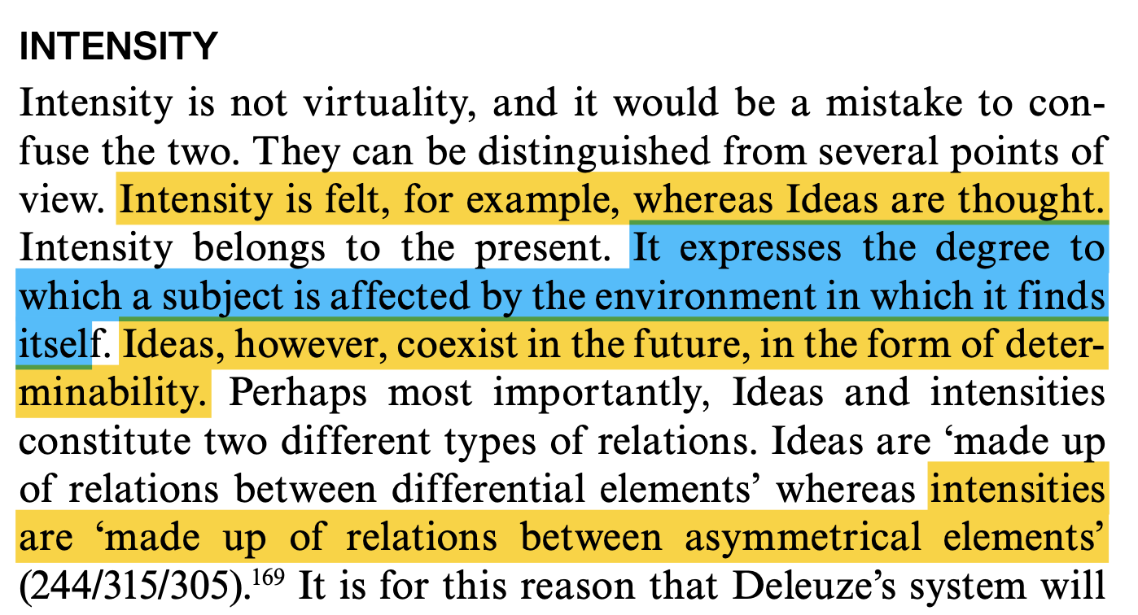
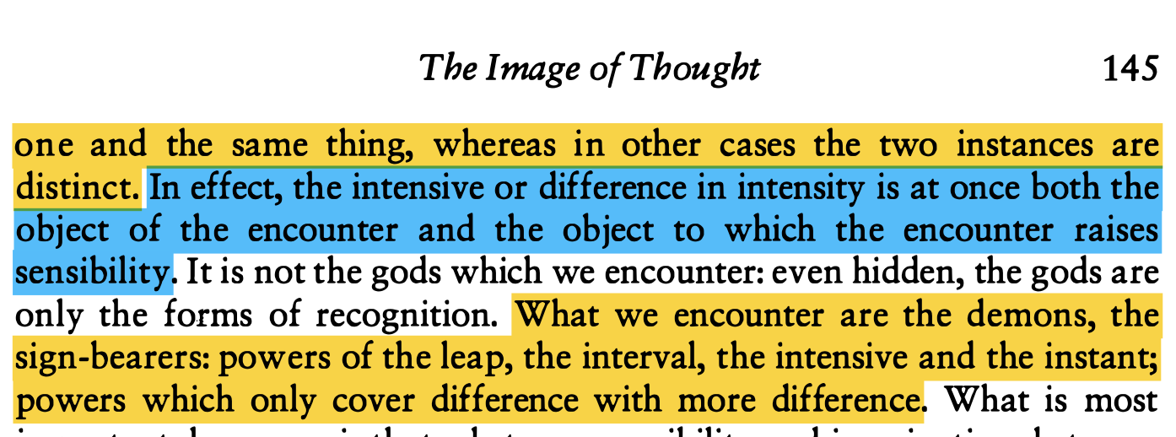
Hughes, Joe. Deleuze's ‘Difference and Repetition': A Reader's Guide. London & New York: Bloomsbury Publishing, 2009. pg. 150.
Deleuze, Gilles. Difference and Repetition. Translated by Paul Patton. London: Athlone Press, 1994. 1968. pg. 145
Notes:
Lets take a moment to very quickly dive into what intensity is, at least within this context of landscape experience. Joe Hughes writes that intensity “expresses the degree to which a subject is affected by the environment in which it finds itself”, being birthed from an asymmetrical affective relationship.
Intensity is a difference that becomes felt – this is important as most of our experience in the world barely enters consciousness, if at all, by being filtered by habit. Those sensations that are felt, intensities if you will, are a difference that makes a difference, it forces a change in our bodily composition and movement.

Slide 19
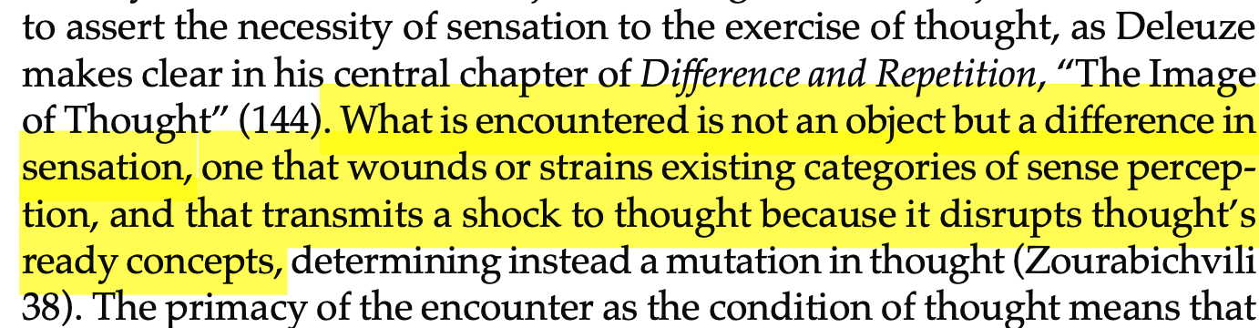
Wasser, Audrey. "A Relentless Spinozism: Deleuze's Encounter with Beckett." SubStance 41, no. 1 (2012): 124-36. Pg. 124.
Notes:
The landscape sublime emerges when an organism, in our case humans, encounters an intensity that poses a significant problem. As I showed earlier via Bergson and Deleuze, the vast majority of our movements and experiences in the world draw from our affective archives to determine an action. We move based on past experiences of similar situations. However, there are some encounters that disrupt this process. When perceiving a particularly alien intensity, our body and being searches through sheets of memory to determine how to act. But it cannot find an at-the-ready response.
This difference is too different. Our body is halted by this disruption, and we feel this perplexion as a straining attempt to connect points across memory sheets but also an experimentation-in-action. A useful example of this we’ve likely all gone through is that horrifying experience of learning how to swim – we can’t learn that through a book but only through connecting the points of the water with the movements of our arms and legs till we create an affective strategy for movement. In the landscape sublime, like swimming, as we struggle and strain to determine action, we ultimately find a sense of joy in this creative act as we reveal to ourselves what we can do beyond habit.

Slide 20
Toward Method and Technique
Notes:
By approaching the sublime from this basis of affective relations between body and space, I’d argue that we can engage with it in a surprisingly concrete way. Whilst we cannot represent affects, we can give them expression by bringing them to life through representation. Through the following slides I’d like to show an example of a fieldwork and drawing study that attempts to bring to life some sense of the sublime through an assemblage of representation and then show some quick examples of how landscape design can appropriate an encounter with the sublime in a serious way, which, at least to me, points towards the power of using our affective archives in design.

Slide 21
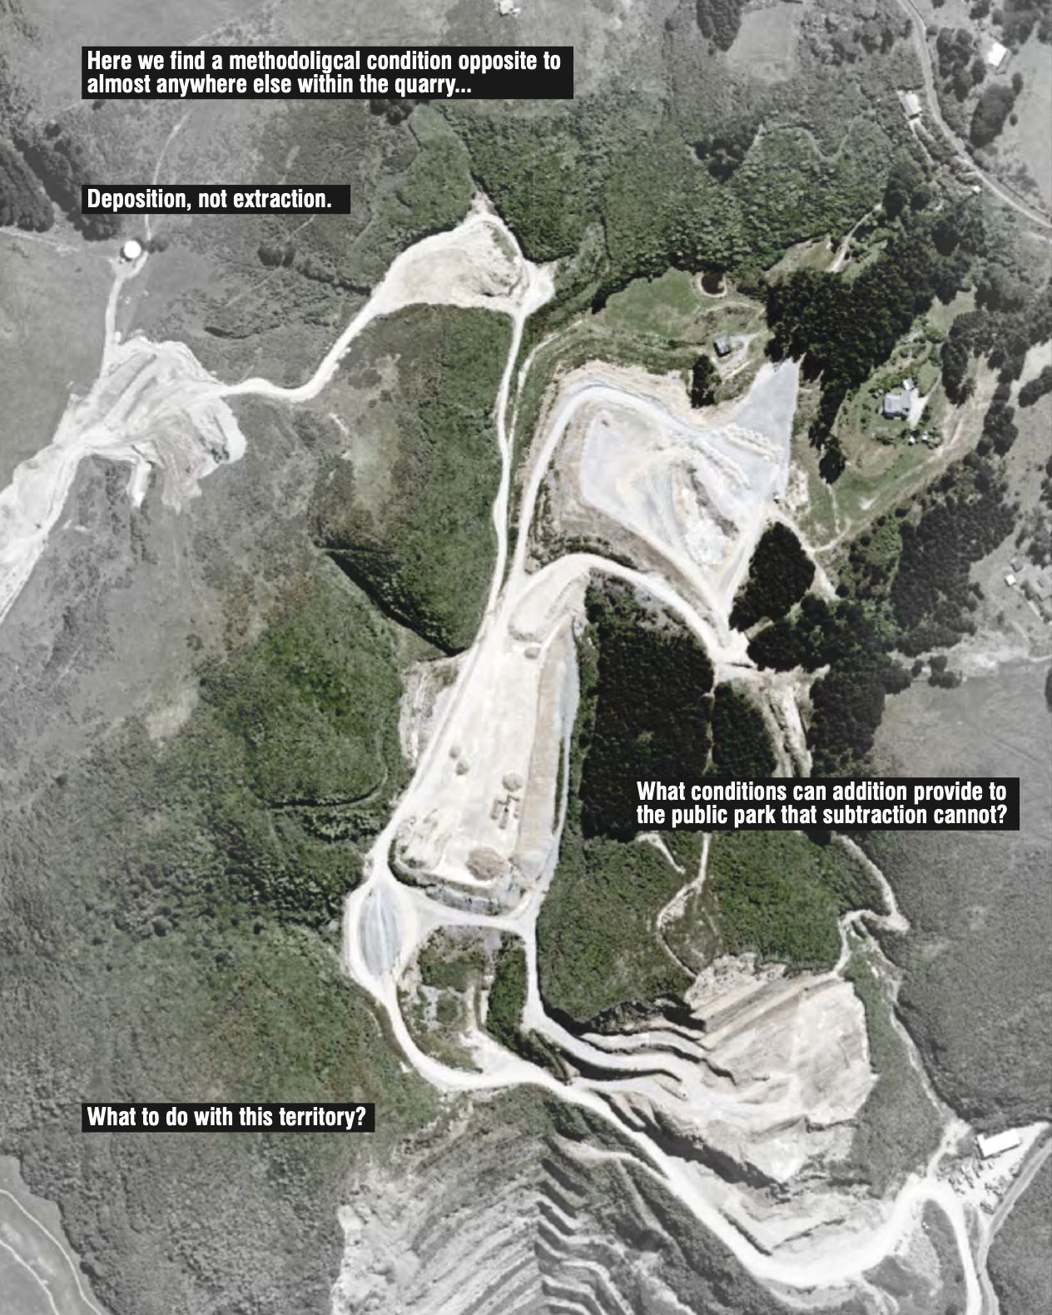

Slide 22
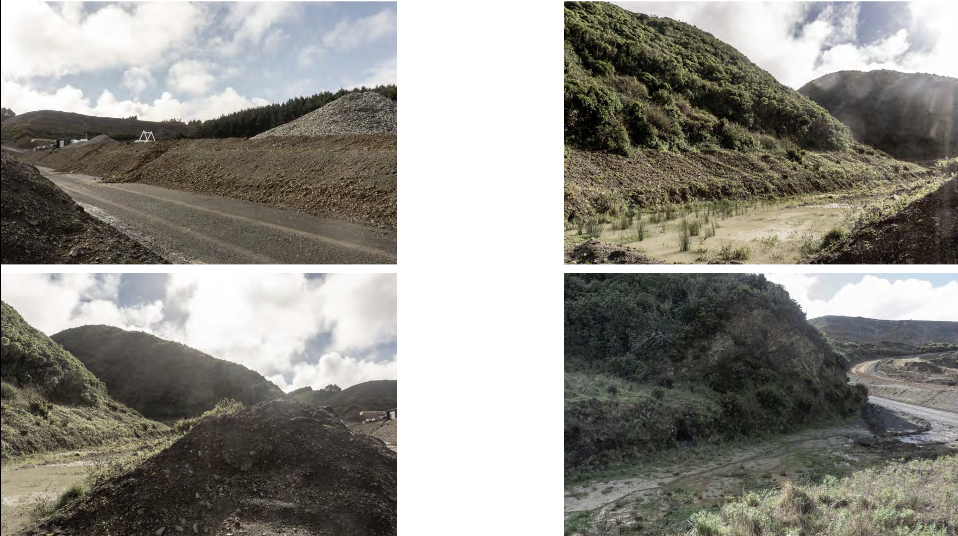

Slide 23
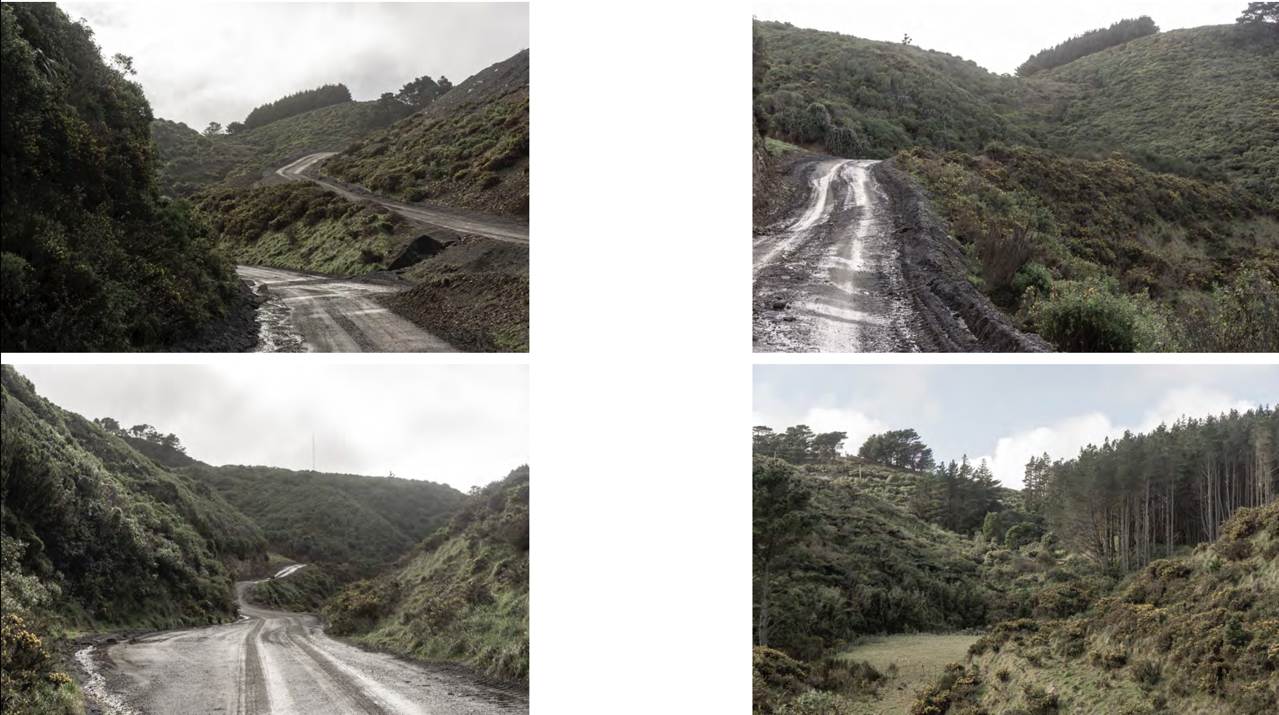

Slide 24
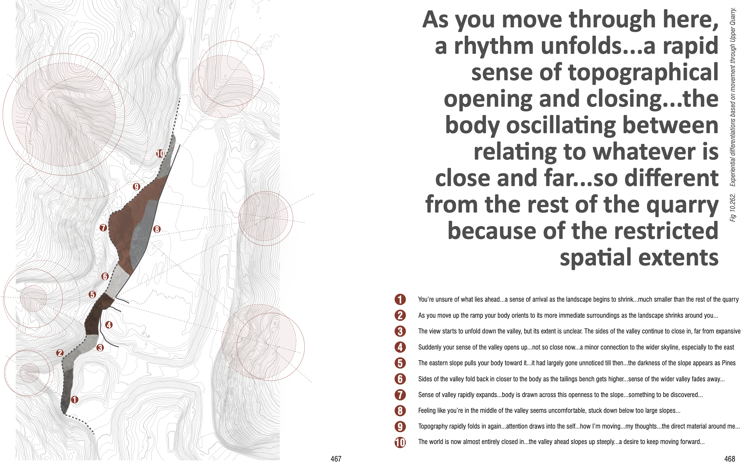
v
v

Slide 25
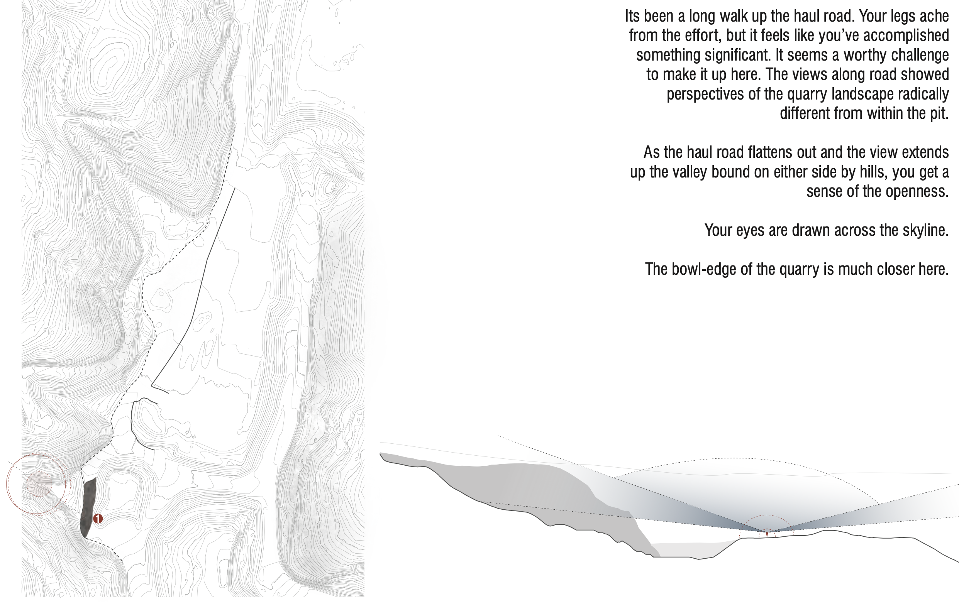

Slide 26
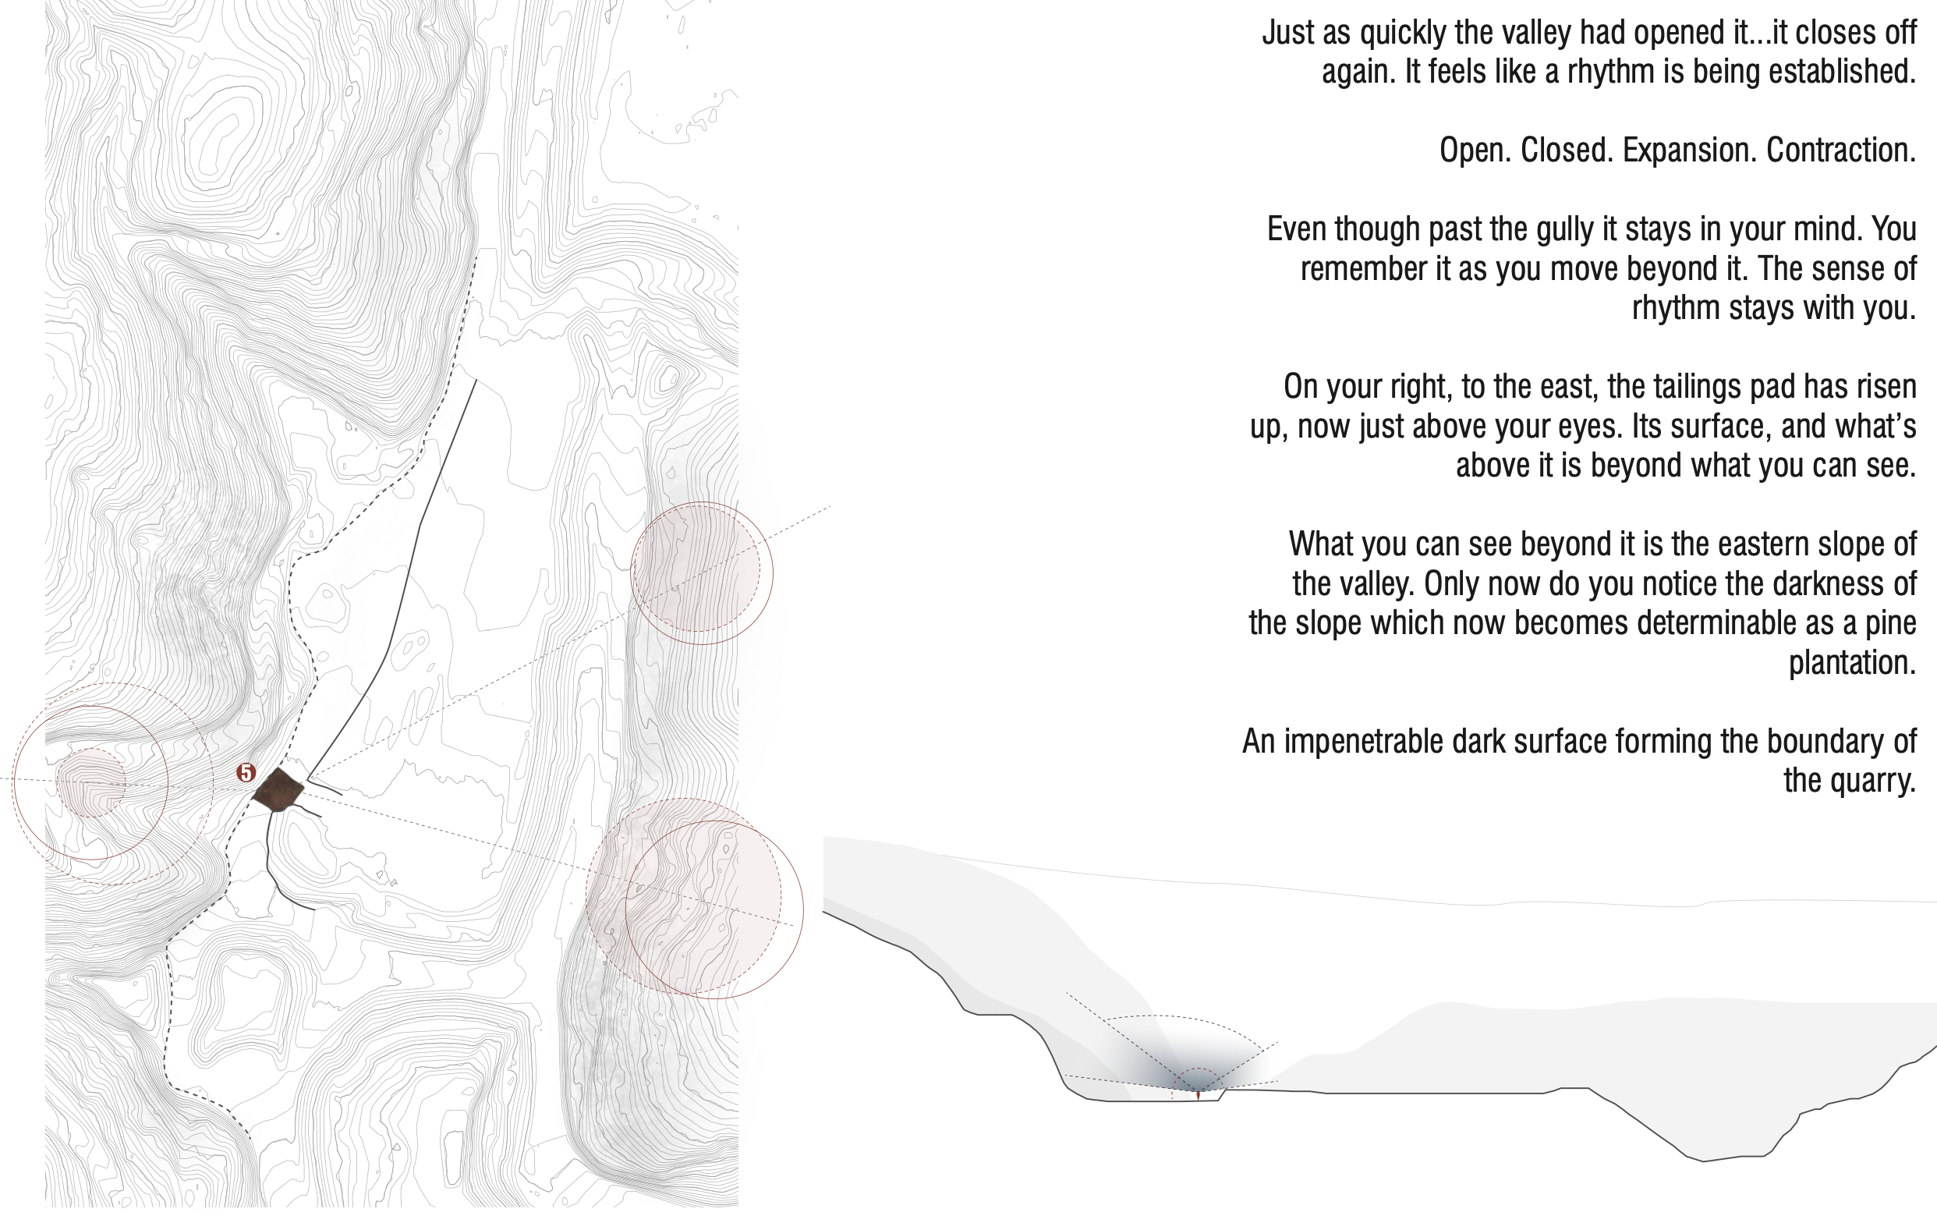

Slide 27
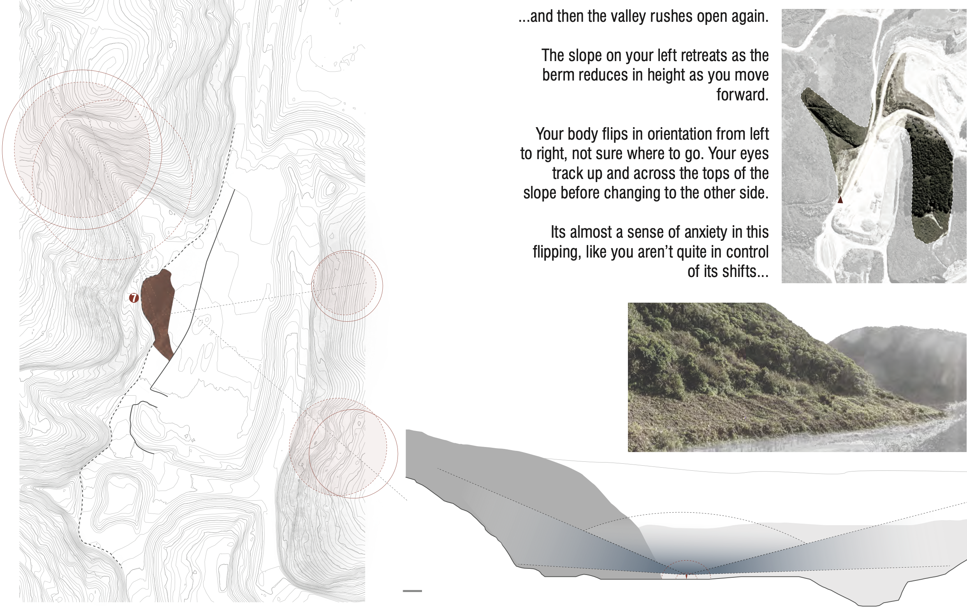

Slide 28
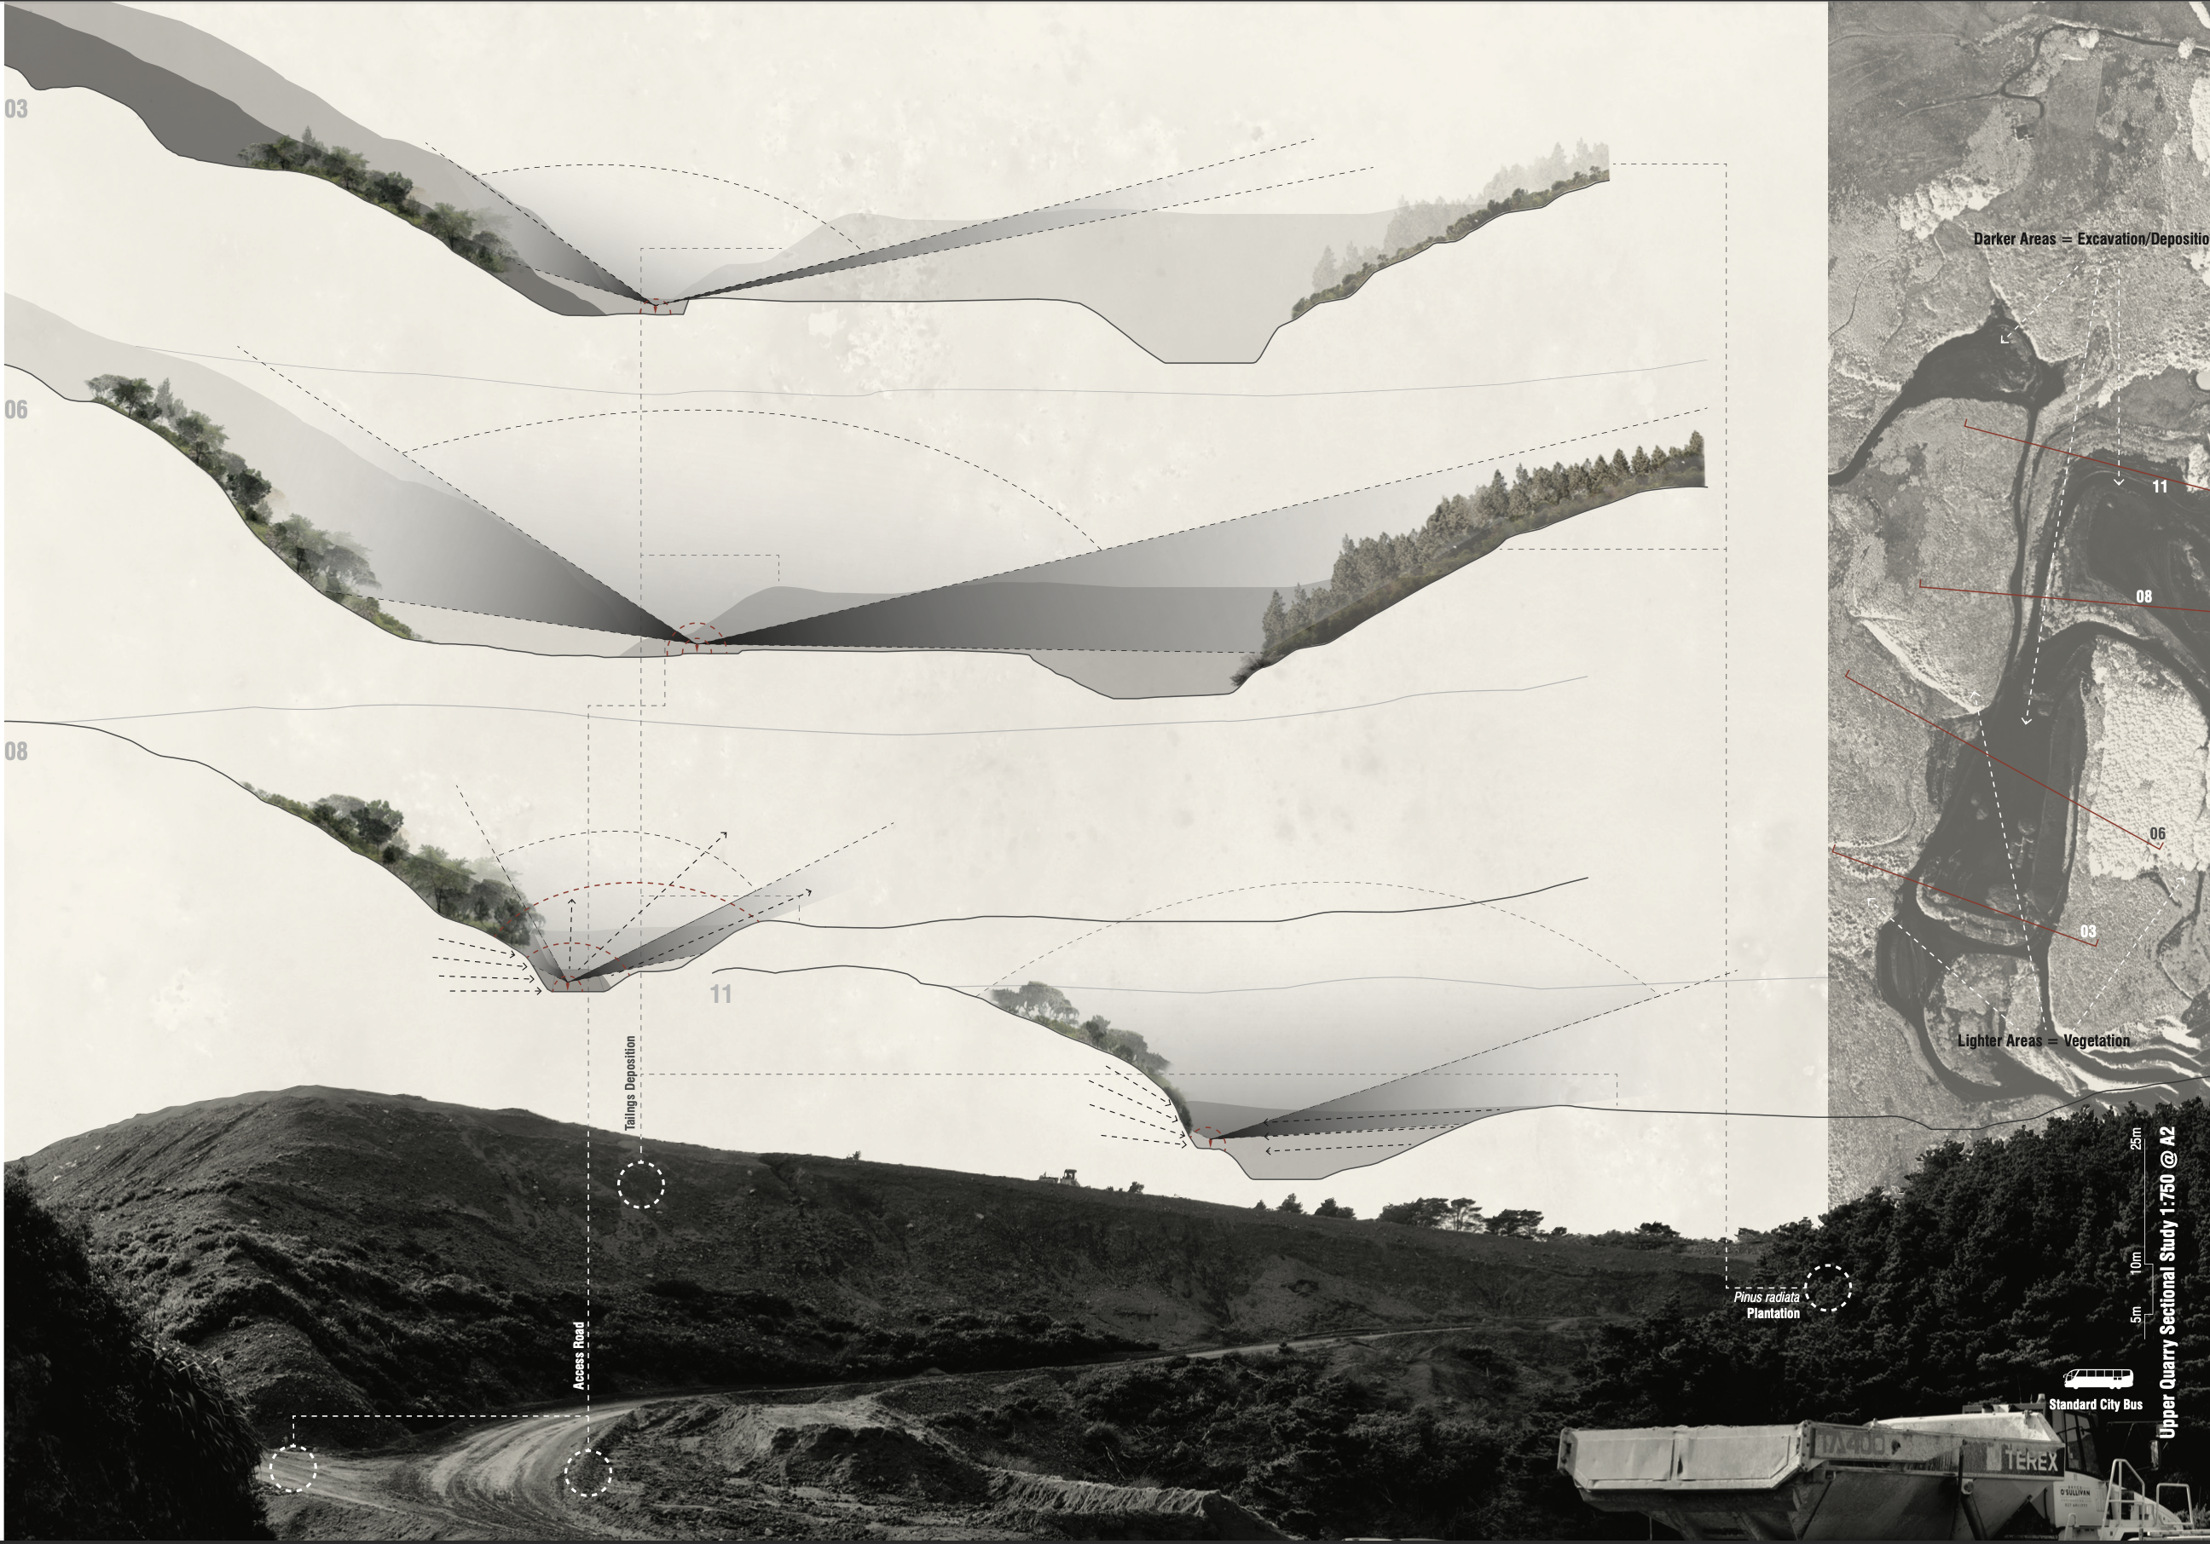

Slide 29
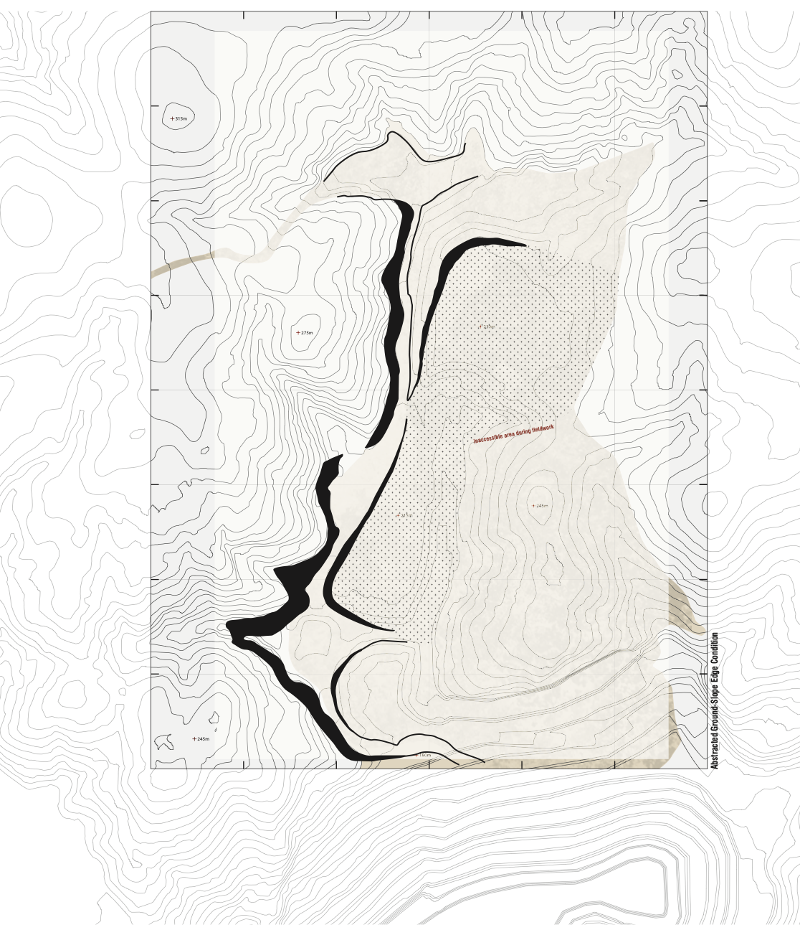
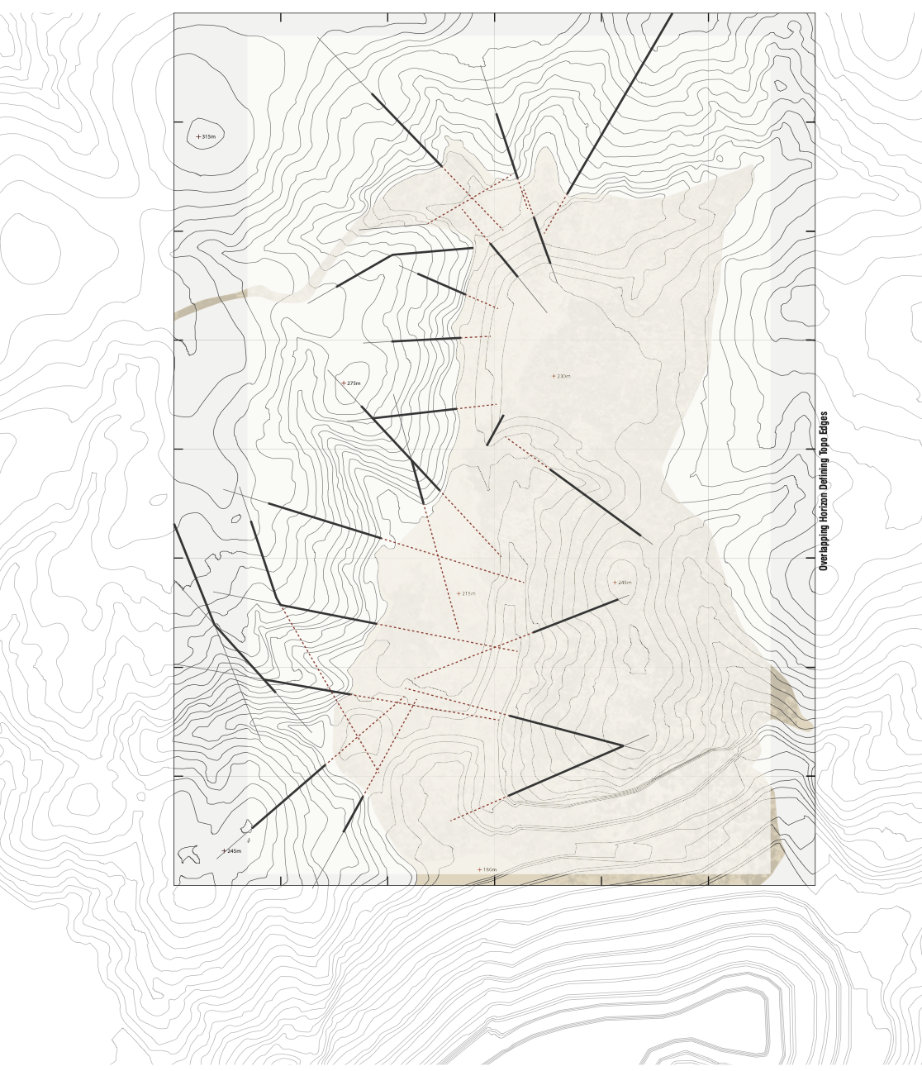
Notes:
Abstracted graphic showing the edge between ground and slope + overlapping horizon defining spurs and topographic edges

Slide 30
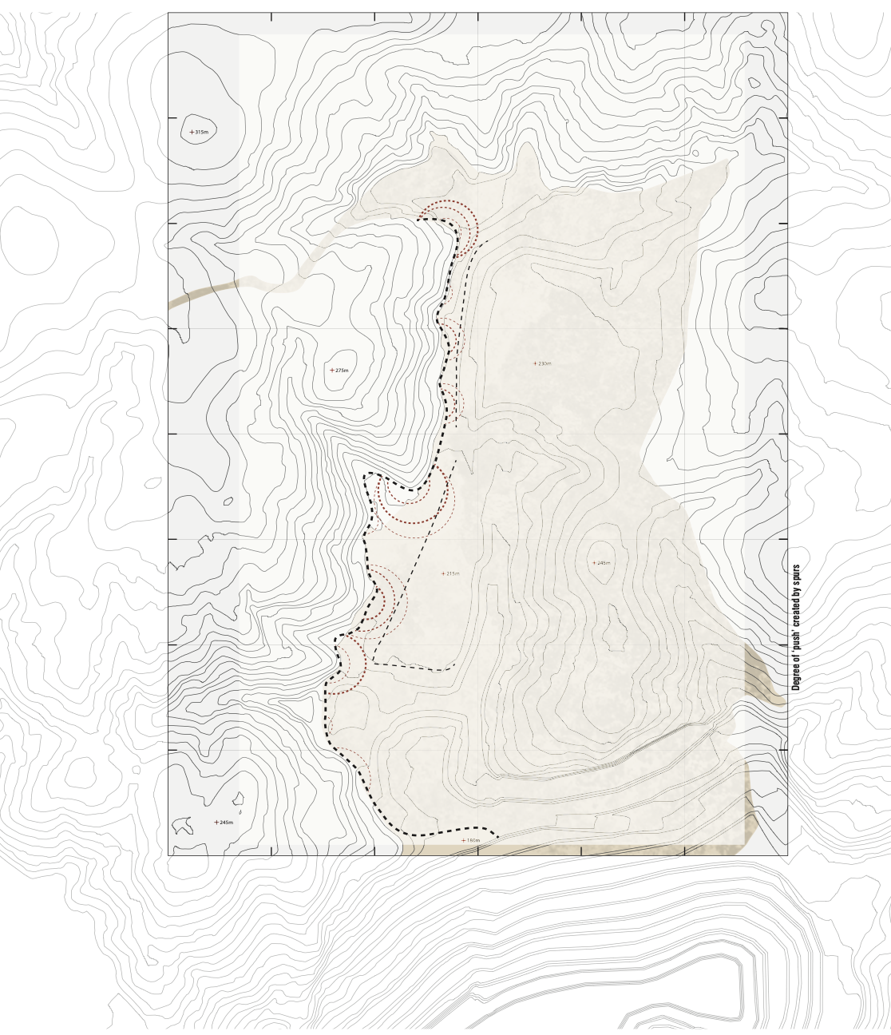
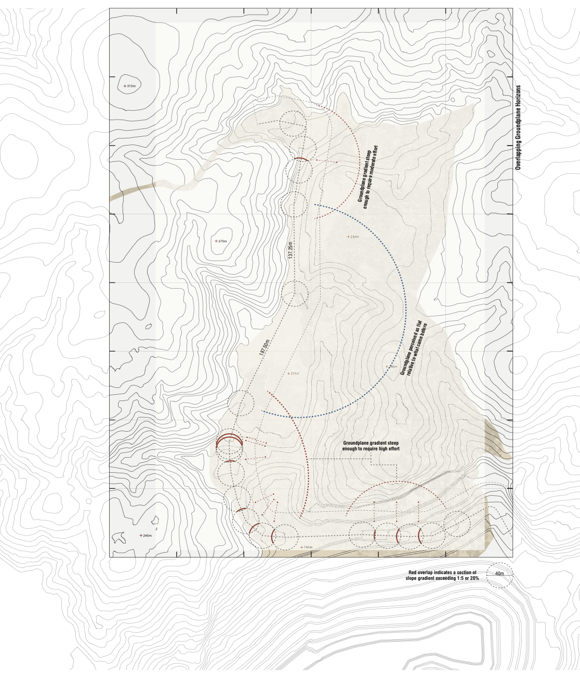
Notes:
Degree of push you feel as you move through the valley + Overlapping ground plane horizons and the degree of effort required as you walk up the slope

Slide 31
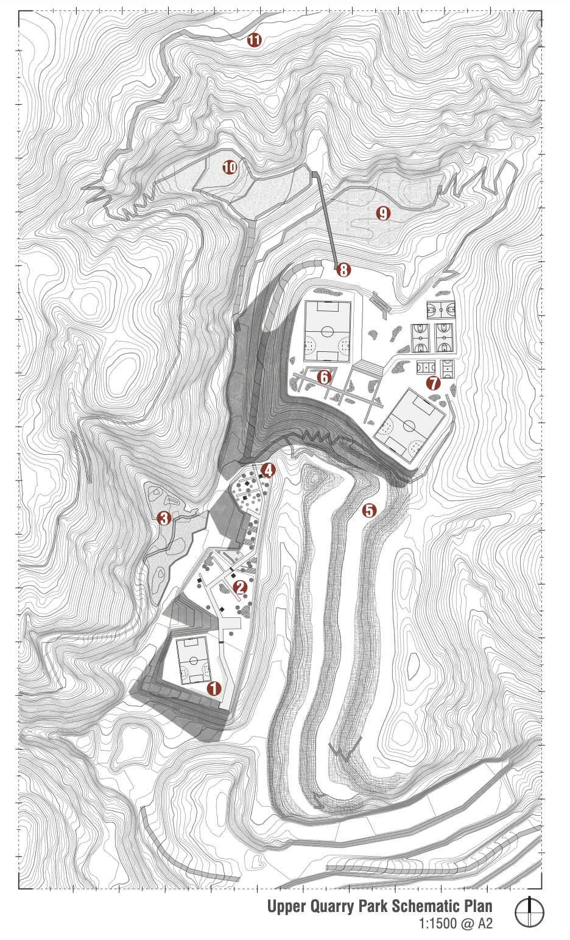

Slide 32
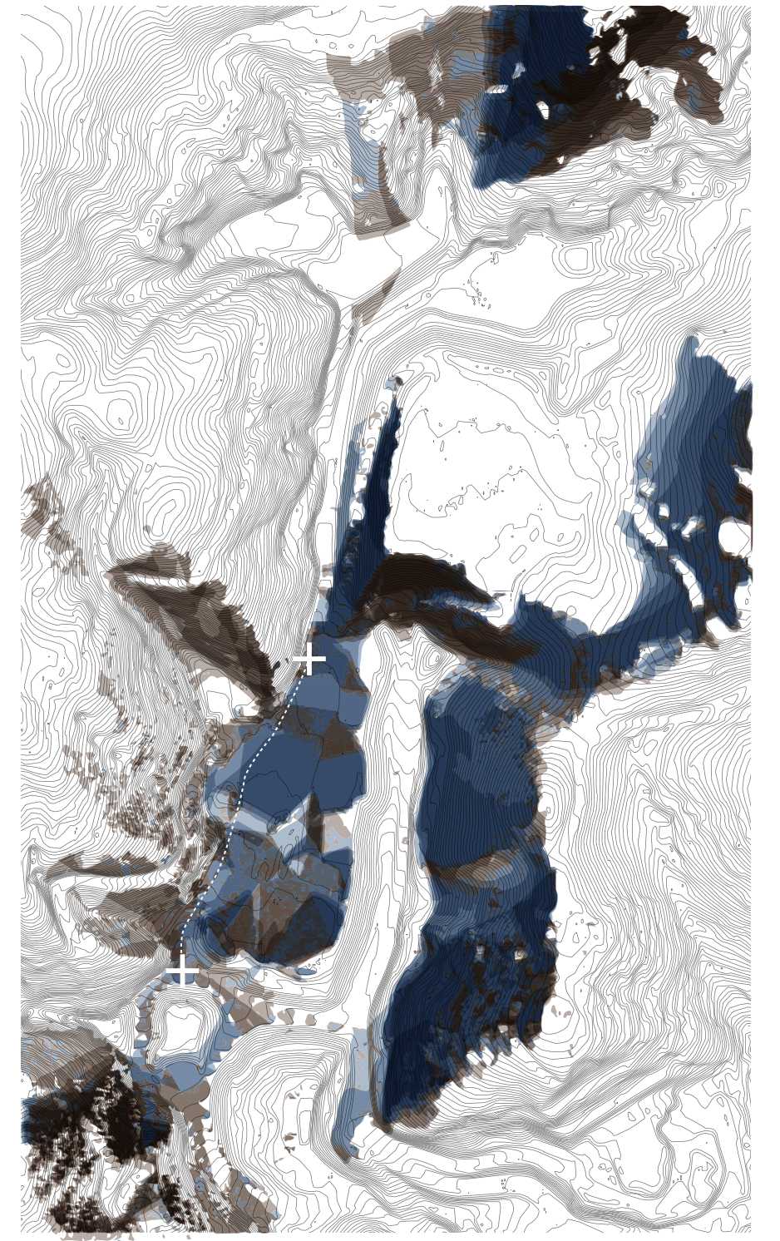
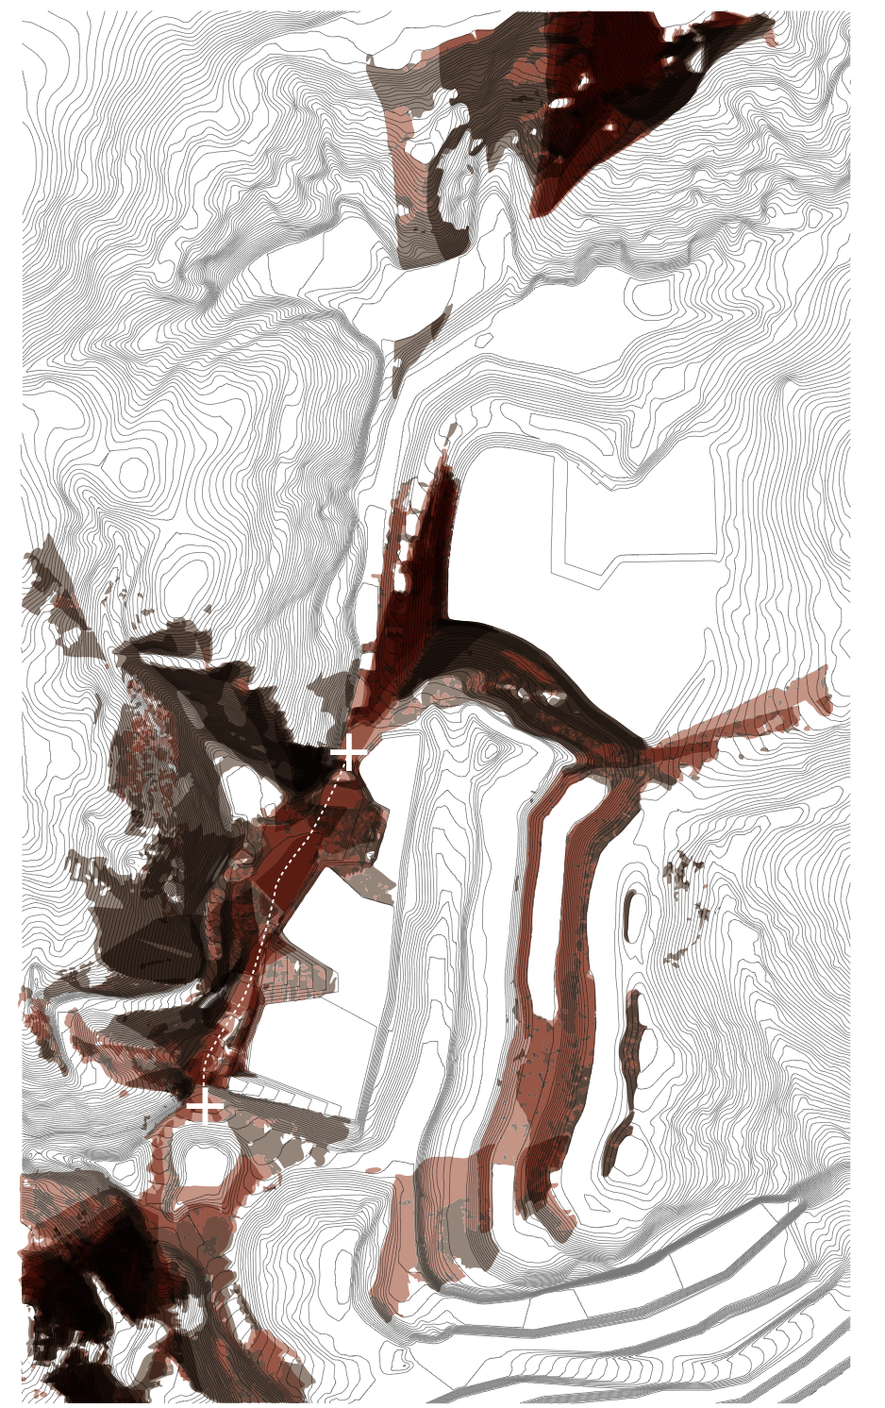

Slide 33
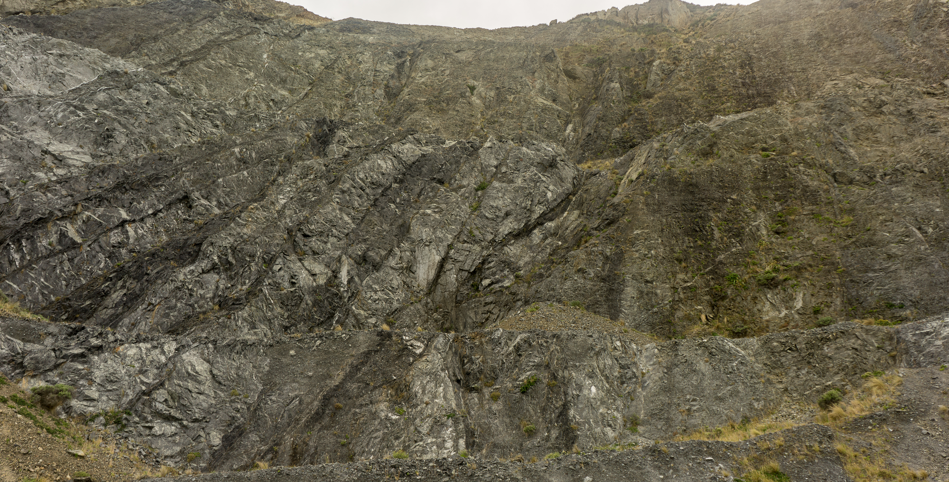
Notes:
So, to return to where I started, there is a problem in landscape architectural theory and practice where the world has been re-constructed as definable technoscientific objects or forces – quite frankly in many ways it has been inattentive to real landscapes. In reponse to this condition, what I have found so exciting and productive about the sublime was that when confronted with this aesthetic force in the landscape you’re obliged to go beyond common sense, text-book responses or explanation. You must grapple with the material affectivity of landscape affects and intensities.
It also forces contact and experimentation with our affective archives both within that moment of encounter, but also throughout the design process as it stresses or simply short circuits our habitual responses.
The original thinkers on the sublime in 18th century were interested in the sublime’s ability to illuminate a greater sense of divinity, self, or morality that was beyond the clutches of enlightenment science ability to grasp. Given our collective sleepwalking into environmental and social disaster perhaps encounters with the sublime and its ability to creatively constellate novel relations and actions is what we need right now.
Thank you.

Slide 34
Problematising the Sublime:
Affective Archives within Landscape Design
Shaun Rosier, PhD
Assistant Professor, Landscape Architecture
shaunrosier@vt.edu

Slide 35
To understand a milieu is one of the reflexes in a landscaping project: as though before using one’s brain, there had to be a primitive relationship between one and the landscape, reproduced by hand, or thanks to a camera, on paper through the act of drawing or of producing a picture. The relation to the landscape concerns the whole being and all the space that surrounds it.
Interwoven with virtuality, with what is not immediately apparent, interwoven with time and vital energy, the visible and present space is subjected to everything which is not there, human memory, vegetal, mineral and animal memory.
Claramunt, Marc, and Mosbach, Catherine. "Nature of a Landscape Project." Pages Paysage 7, no. Anamorphose (1999): 54-63. Pg. 58.

Slide 36
Following a perception, we begin a process of recollection
based on some specific information suited to addressing the currently
confused perception or sensation
Create a diagram to explain this process
Preconscious appraisal of an event/sensation/perception – survey of previous events/sensations to determine a SMS response – leading to action
Notes:
Herbivore sees grass and eats it, I see a cup and drink, crossing the road without thinking

Slide 37
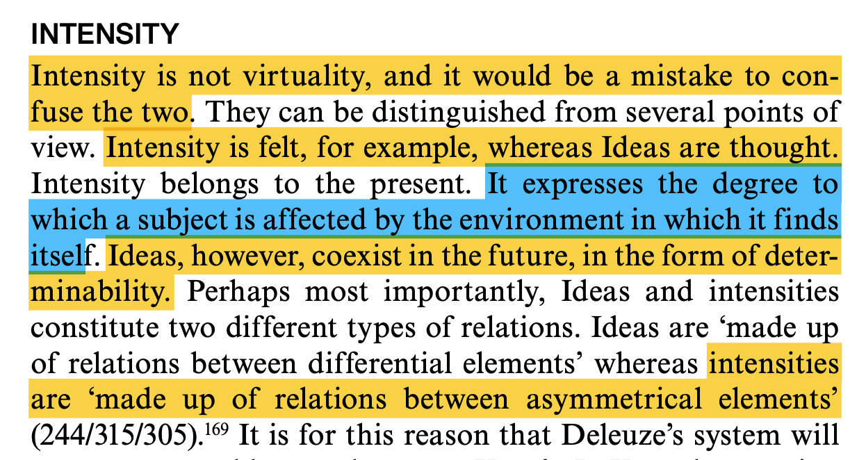
Hughes, Joe. Deleuze's ‘Difference and Repetition': A Reader's Guide. London & New York: Bloomsbury Publishing, 2009. Pg. 150.

Slide 38
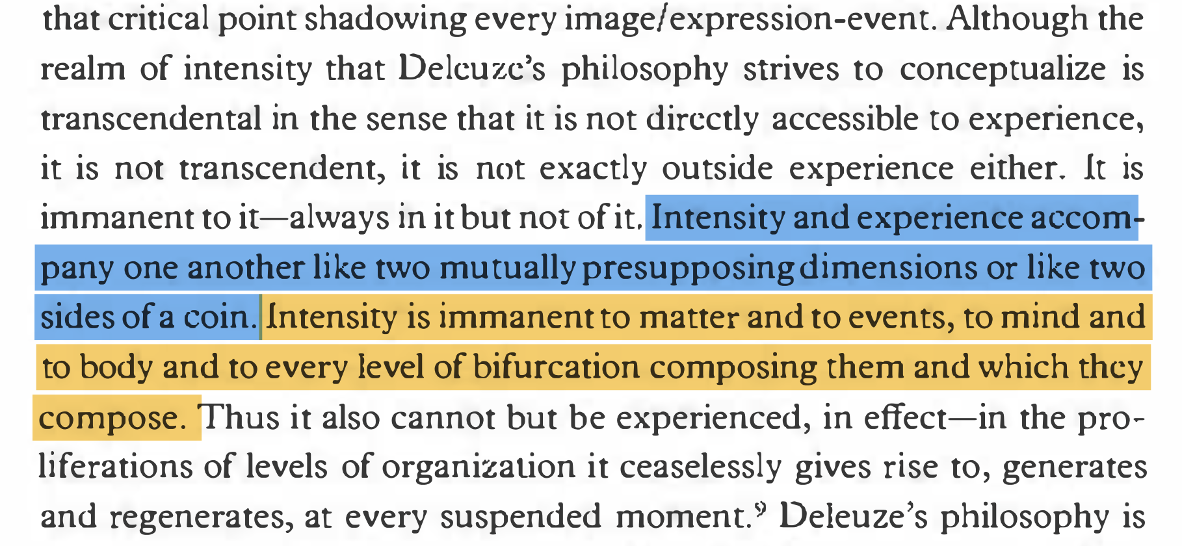
Massumi, Brian. Parables for the Virtual: Movement, Affect, Sensation. Durham & London: Duke University Press, 2002. pg. 33

Slide 39
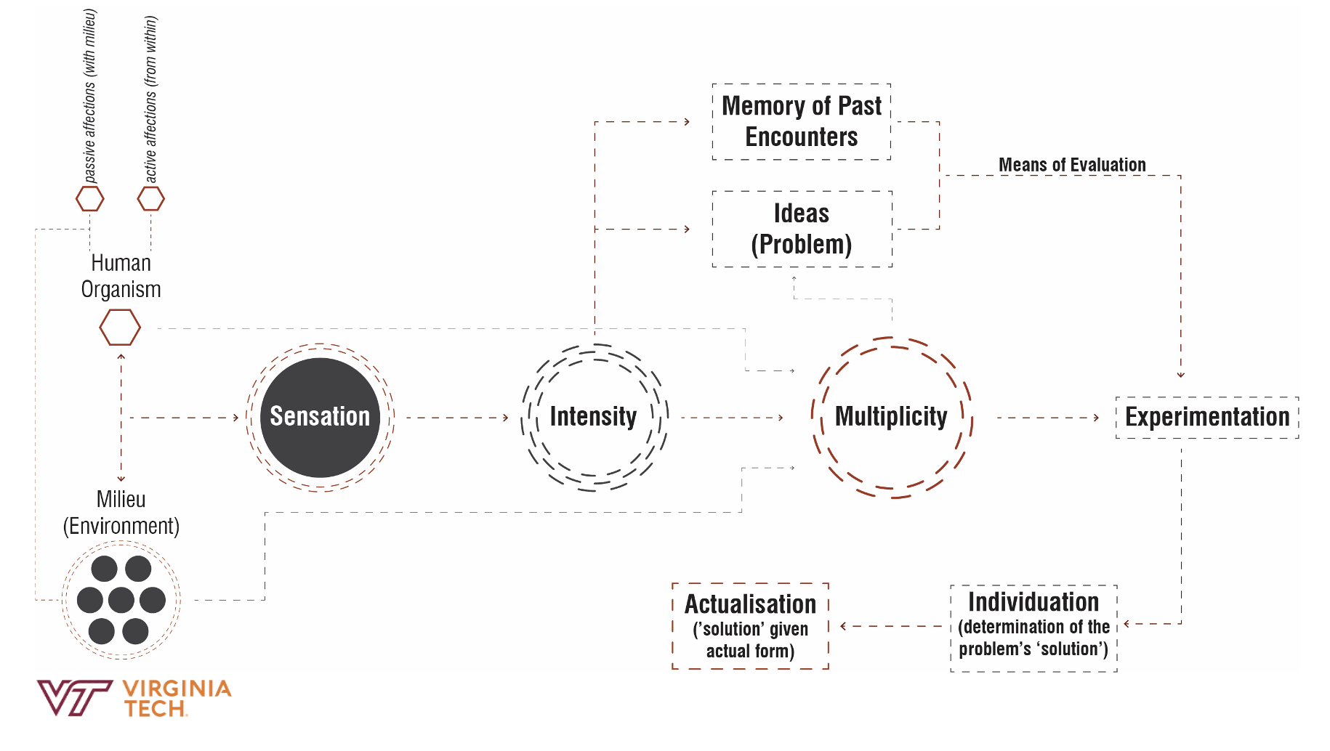
Wasser, Audrey. "A Relentless Spinozism: Deleuze's Encounter with Beckett." SubStance 41, no. 1 (2012): 124-36. Pg. 124.
Notes:
Not just thoughts concepts, but our biological responses (Damasio)

