Slide 1


Strategic Management
Chapter 9
International Strategy
Unless otherwise noted, this slide deck is (c) Virginia Polytechnic Institute and State University. It is released under a Creative Commons Attribution NonCommercial ShareAlike 3.0 license (CC BY NC-SA 3.0)
Instructor Name | Name of Institution
http://hdl.handle.net/10919/102735
Photo by Jon Sailer on Unsplash

Slide 2
Today’s Objectives – Date Here
What are the main benefits and risks of competing in international markets?
What is the “diamond model,” and how does it help explain why some firms compete better in international markets than others?
How does the CAGE framework help a firm predict its degree of success in doing business in another country?
What are the four global strategies that firms can adopt, and what are the two pressures that define these strategies?
What methods of entry are available to firms that seek to compete in international markets?
http://hdl.handle.net/10919/102735

Slide 3
What is Globalization?
Globalization is a process of closer integration and exchange between different countries and peoples worldwide.
Made possible by?
  Falling trade and investment barriers
  Advanced telecommunications
  Reduced transportation costs
  Importance of MNEs and FDIs
http://hdl.handle.net/10919/102735

Slide 4
What is Globalization? (Cont’d)
Multinational Enterprise (MNE)
  Deploys resources and capabilities in the procurement, production, and distribution in at least two countries
    Less than 1% of firms, BUT employ 19% of U.S. workforce
      74% of private sector R&D spending
Foreign Direct Investment (FDI)
  Investments in value chain activities abroad
International Strategy
  To sustain a competitive advantage
  Competing against foreign and domestic companies around the world
http://hdl.handle.net/10919/102735

Slide 5
International Strategy Questions to Ask
Why ? Why go international?
What ?
Where ?
How ?
http://hdl.handle.net/10919/102735

Slide 6

Why Go Global? – The Good
Gain access to a larger market
  Capitalize on market potential, such as China, India, and emerging economies
Gain access to low-cost input factors
  Labor, natural resources, technology, logistics
Diversify business risk
Develop new competencies
  Unique locational advantages
Image Source: © DonkeyHotey “Earth-Illustration” CC BY 2.0
http://hdl.handle.net/10919/102735

Slide 7
Disadvantages of Expanding Globally?
Liability of foreignness
  Additional cost of doing business in an unfamiliar cultural and economic environment
  Cost of coordinating across geographic distance
  Economic development in host country may increase the cost of doing business
    Rising wages with improved living standards
    Difficulty in protecting intellectual property
http://hdl.handle.net/10919/102735

Slide 8
Potential Risks in Expanding Internationally
Political Risk
  Differing laws
  Lack of enforcement of contracts and laws
  Government interference
  Unrest in military or civil sectors
  Terrorism or other threats of violence
http://hdl.handle.net/10919/102735

Slide 9
Risk Rankings: The Best
Country risk rankings Q4 2017 The least-risky countries for investment
Rank | Rank change | Country | Overall score
1 | - | Singapore | 88.6
2 | - | Norway | 87.66
3 | - | Switzerland | 87.64
4 | - | Denmark | 85.67
5 | ▲2 | Sweden | 85.59
6 | ▼1 | Luxembourg | 83.85
7 | ▼1 | Netherlands | 83.76
8 | ▲4 | Finland | 83.1
9 | - | Canada | 82.98
10 | ▲1 | Australia | 82.18
Score out of 100. Rank change to previous quarter. Source: Euromoney Country Risk - published January 2018. ^{[1}
http://hdl.handle.net/10919/102735
Notes:
Hmmmm? Where’s the USA???

Slide 10
Risk Rankings: The Best
Afghanistan
Central African Republic
Libya
Somalia
Sudan
South Sudan
Syria
Cuba
Eritrea
North Korea
Venezuela
Zimbabwe
Source: Credendo, 7/18/2019
http://hdl.handle.net/10919/102735
Notes:
Underlined = active war
Not underlined = no active war

Slide 11
Potential Risks in Expanding Internationally (Cont.)
Economic Risks
  Currency exchange fluctuations
  Property rights
  National and local economic policies
  Appreciation of the U.S. dollar
Loss of Intellectual Property
Cultural Risks
  Cultural mistakes
  Lack of understanding of customs
  Language barriers
http://hdl.handle.net/10919/102735

Slide 12
International Strategy Questions to Ask
Why ? Why go international?
What ? How to create CA
Where ?
How ?
http://hdl.handle.net/10919/102735
Notes:
Determine their international strategy choice
CA, competitive advantage

Slide 13
New Tool for Corporate Strategy
“The Determinants of National Advantage”
Also called Porter’s Diamond
Measures the ability of the companies in an industry shoes origin is in a particular country to be successful in the international area
http://hdl.handle.net/10919/102735

Slide 14
Porter’s Diamond Framework
National Competitive Advantage
Factor Conditions
Related & Supporting Industries
Demand Conditions
Strategy, Structure & Rivalry
http://hdl.handle.net/10919/102735

Slide 15
What? Porter’s National Diamond
Factor Conditions. Importance of local and specialized resources, especially developed rather than natural endowments (e.g. Swiss pharmaceuticals)
Related & Supporting Industries. Competitive advantage occurs with local inputs (e.g., Italian leather goods.)
Demand Conditions. Fussy domestic customers drive quality & innovation (e.g., Japanese cars)
Strategy, Structure, & Rivalry. Strong domestic rivalry drives innovation, efficiency, & improvements (e.g. US fast food restaurants)
http://hdl.handle.net/10919/102735
Notes:
Ex: Selling Virginia wine in France

Slide 16
Examples of Factor Conditions
Hollywood’s preeminence in film production: local concentration of skilled labor, including the roles of UCLA and USC schools
In post-war Japan, raw material shortages spurred miniaturization and low-defect manufacturing
Italy: restrictive labor laws have stimulated automation
http://hdl.handle.net/10919/102735

Slide 17
Examples of Related and Supporting Industries
Clusters of industries:
  USA: cluster strength in semiconductors, computers, and computer software
  Germany: a mutually supporting cluster exists around chemicals, synthetic dyes, textiles and textile machinery.
http://hdl.handle.net/10919/102735

Slide 18
Examples of Demand Conditions
The preeminence of Swiss watches may be attributed to the obsessive punctuality of the Swiss.
The dominance of the world market for cameras by Japanese companies owes much to Japanese consumers’ enthusiasm for amateur photography and their eager adoption of innovation in cameras.
German companies’ (Mercedes, BMW, Porsche) dominance of the high-performance segment of the world automobile industry may be linked to German motorists’ love of quality engineering and their irrepressible urge to drive on autobahns at terrifying speeds.
http://hdl.handle.net/10919/102735

Slide 19
Examples of Strategy, Structure, and Rivalry
The success of Japanese auto industry may reflect the presence of nine companies in Japan, all of which compete fiercely within the domestic market.
The weak position of European companies in many hi-tech industries may be a result of European governments’ propensity to kill domestic competition by creating “national champions”
http://hdl.handle.net/10919/102735

Slide 20
International Strategies: The Integration-Responsiveness Framework
Four strategies & two pressures
High Pressure for Cost Reduction & Efficiency
Global Strategy
Transnational Strategy
Lays Potato Chips
Intel Processors
McDonalds
Movie Productions
Low Pressure for Local Responsiveness
High Pressure for Local Responsiveness
International
Strategy
Multidomestic
Strategy
Starbucks
Harley Davidson
Netflix
Heinz Food Products
Low Pressure for Cost Reduction & Efficiency

Slide 21
Four Global Strategies
International strategy
  Leveraging home-based core competencies
  Selling the same products or services in both domestic and foreign markets
    Belgium chocolate exporters do not lower their price when exporting to the American market to compete with Hershey’s, nor do they adapt their product to American tastes.
Multidomestic strategy
  Maximize local responsiveness
  Consumers will perceive them to be domestic companies
    Ex: Netflix customizes the programming that is shown on its channels within dozens of countries, including New Zealand, Portugal, Pakistan, and India
http://hdl.handle.net/10919/102735

Slide 22
Four Global Strategies (Cont.)
Global-standardization strategy
  Economies of scale and location economies
  Pursuing a global division of labor based on best-of-class capabilities reside at the lowest cost
    Microsoft, for example, offers the same software programs around the world but adjusts the programs to match local languages.
Transnational strategy
  Combination of localization strategy (high responsiveness) with global standardization strategy (lowest cost position attainable)
  Glocalization
    Ex: McDonald’s relies on the same brand name and core menu items but make concessions to local tastes too (offering wine on the menu in France)
http://hdl.handle.net/10919/102735

Slide 23
International Strategy Questions to Ask
Why ?
What ?
Where ?
How ?
http://hdl.handle.net/10919/102735

Slide 24
WHERE? How to Decide?
What is an attractive market?
1. Pre-screening of potential countries, based on approximate evaluation of their market potential
2. Screening based on country-by-country comparison analysis (CAGE) with exhaustive evaluation of each country’s market potential
3. Final choice based on the sales and potential return on investment
http://hdl.handle.net/10919/102735

Slide 25
CAGE Framework
C A G E
Cultural Administrative Geographic Economic
Distance & Political Distance Distance
Distance
http://hdl.handle.net/10919/102735

Slide 26
CAGE Framework (Cont.)
 | C Cultural Distance | A Administrative Distance | G Geographic Distance | E Economic Distance
Distance between two countries increases with | Different religions, languages, ethnicities Lack of mutual trust Lack of social networks | Lack of shared currency Lack of colonial ties Lack of trade or political association | 1. Absence of common borders or communication links Different time zones Physical distance | Different per capita incomes Different costs structures
http://hdl.handle.net/10919/102735

Slide 27
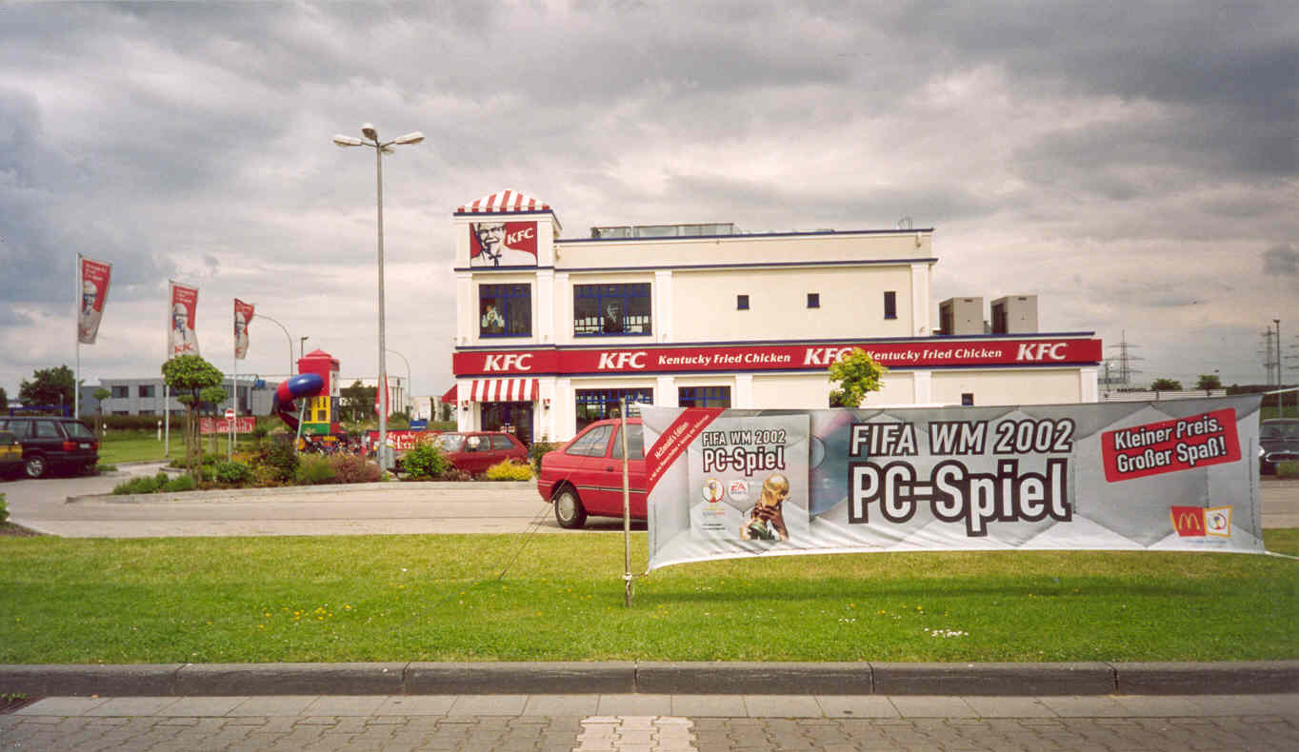

KFC Goes ‘Global’
KFC in Germany
KFC in France
Source: https://commons.wikimedia.org/wiki/File:KFC_W%C3%BCrselen.jpg
Source: https://commons.wikimedia.org/wiki/File:KFC_Paris_November_2,_2009.jpg
Notes:
How should McDonald’s organize their international strategy?
For antiglobalization activists, McDonald’s is a demon of globalization: it crushes national cuisines and small, traditional family businesses with the juggernaut of US fast-food corporate imperialism. In reality, McDonald’s global strategy is a careful blend of global standardization and local adaptation.
McDonald’s menus include a number of globally standardized items – the Big Mac and potato fries are international features – however, in most countries McDonald’s menus feature an increasing number of locally developed items. These include (from the top left):
France – Croque McDo
Saudi Arabia – McArabia Kofta
India – McAloo Tikkaa Burger
Hong Kong – Rice burger
UK – Oat-So-Simple Porridge
McDonalds is not multi-domestic. They change the food items, but the standardized restaurant process remains the same. They made tactical changes but not strategic changes. There are no servers coming to your table.

Slide 28
International Strategy Questions to Ask
Why ?
What ?
Where ?
How ?
http://hdl.handle.net/10919/102735

Slide 29
International Strategy and Implementation
How?
http://hdl.handle.net/10919/102735

Slide 30
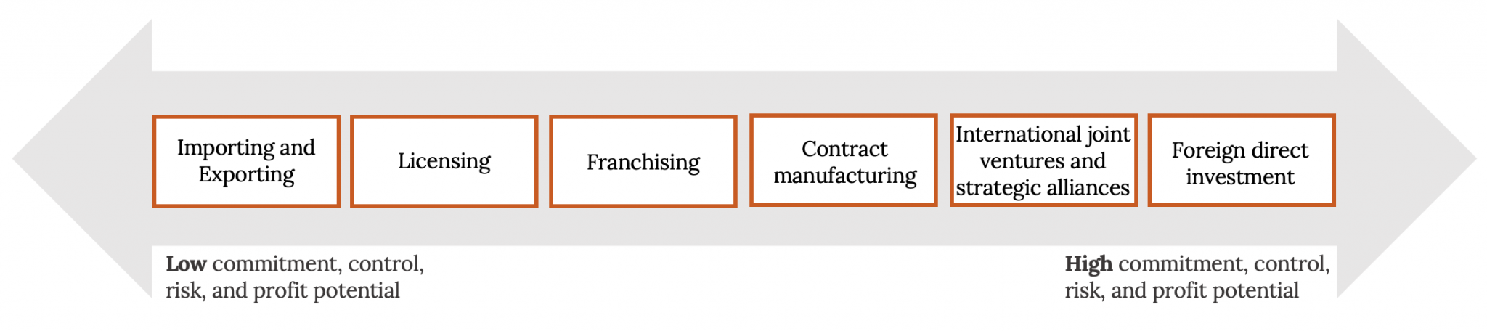
International Strategy Questions to Ask: How?
Modes of Foreign-Market Entry along the Investment and Control Continuum
Kindred Grey (2020). "Modes of Foreign-Market Entry along the Investment and Control Continuum." CC BY SA 4.0. Retrieved from https://commons.wikimedia.org/wiki/File:Modes_of_Foreign-Market_Entry_along_the_Investment_and_Control_Continuum.png .
http://hdl.handle.net/10919/102735
Notes:
Disney did a JV with the French government, and licensed when they went into Tokyo.

