Slide 1
Food Waster
Michael Liu, Andrew Chuba, Divya Sengar, James Wong, Alan Kai
CS 4624: Multimedia, Hypertext, and Information Access
Virginia Tech, Blacksburg, VA 24061
Instructor: Dr. Fox
Client: Susan Chen

Slide 2
Topics
Video Production
Front End
Back End
Database
Web Server
Demonstration
Questions and Answers

Slide 3
Video Deliverables
Two public service announcement videos:
Food Waste at home (1:34)
Food Waste Statistics (0:27)

Slide 4
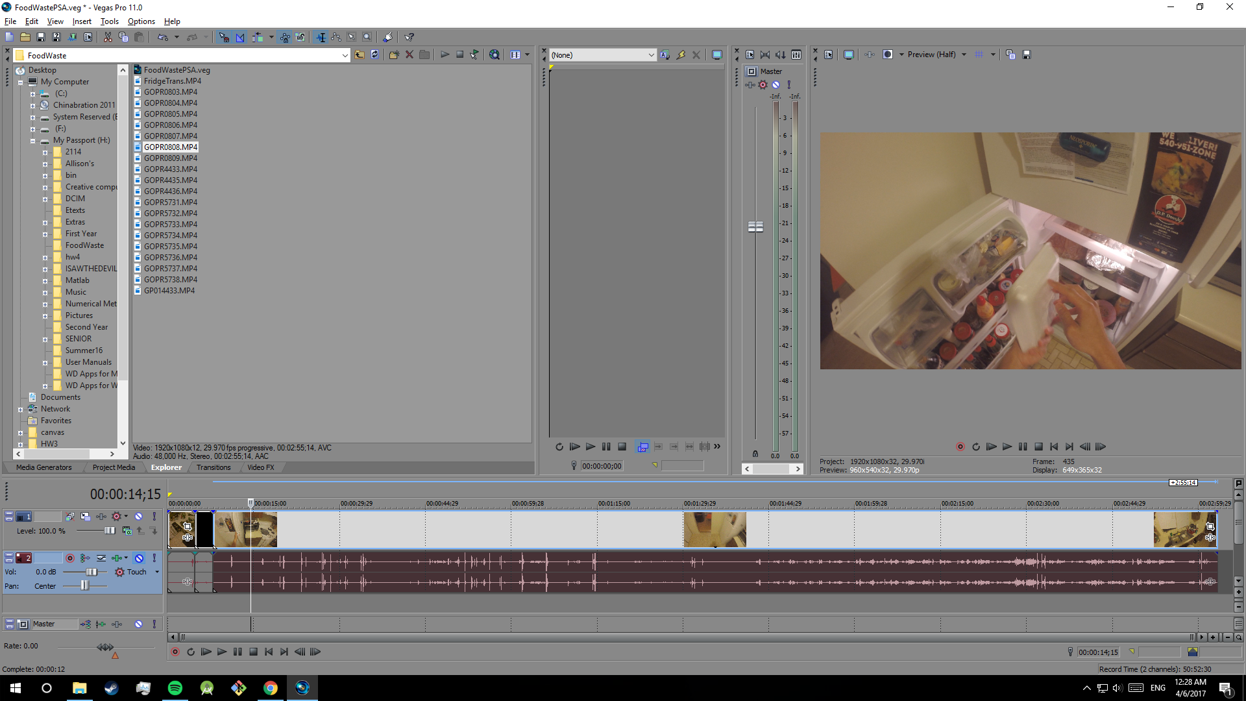
Production
Sony Vegas Pro
Go Pro (3, 3+, 4)

Slide 5
Considerations for the Frontend
Very user friendly
A lot of images for selecting food
Not user based
Able to show statistics
Can show money wasted after entering information

Slide 6
Frontend Implementation
The frontend of this website was implemented with
HTML
CSS
JQuery/ JavaScript
Bootstrap
D3

Slide 7
Frontpage history
Original Idea as an autocomplete search entry bar and a submit button
Client suggested that there be images that go along with your searching
A “grid-based” image system was implemented with the autocomplete bar
Styles were added, making it presentable
The need for entering in more than one food group arises
Support for multiple food groups being entered is implemented
Support for clickable images for autocompletion is implemented

Slide 8
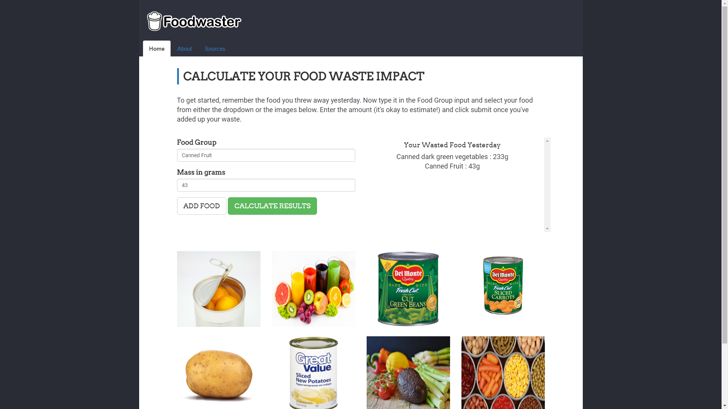
Frontpage design

Slide 9
Statistics Page
Used d3 and CSS to create visualizations of food waste
Built to be robust against unusual inputs
Chose to show a variety of different statistics (Money, Food amount, Humanitarian etc.)

Slide 10
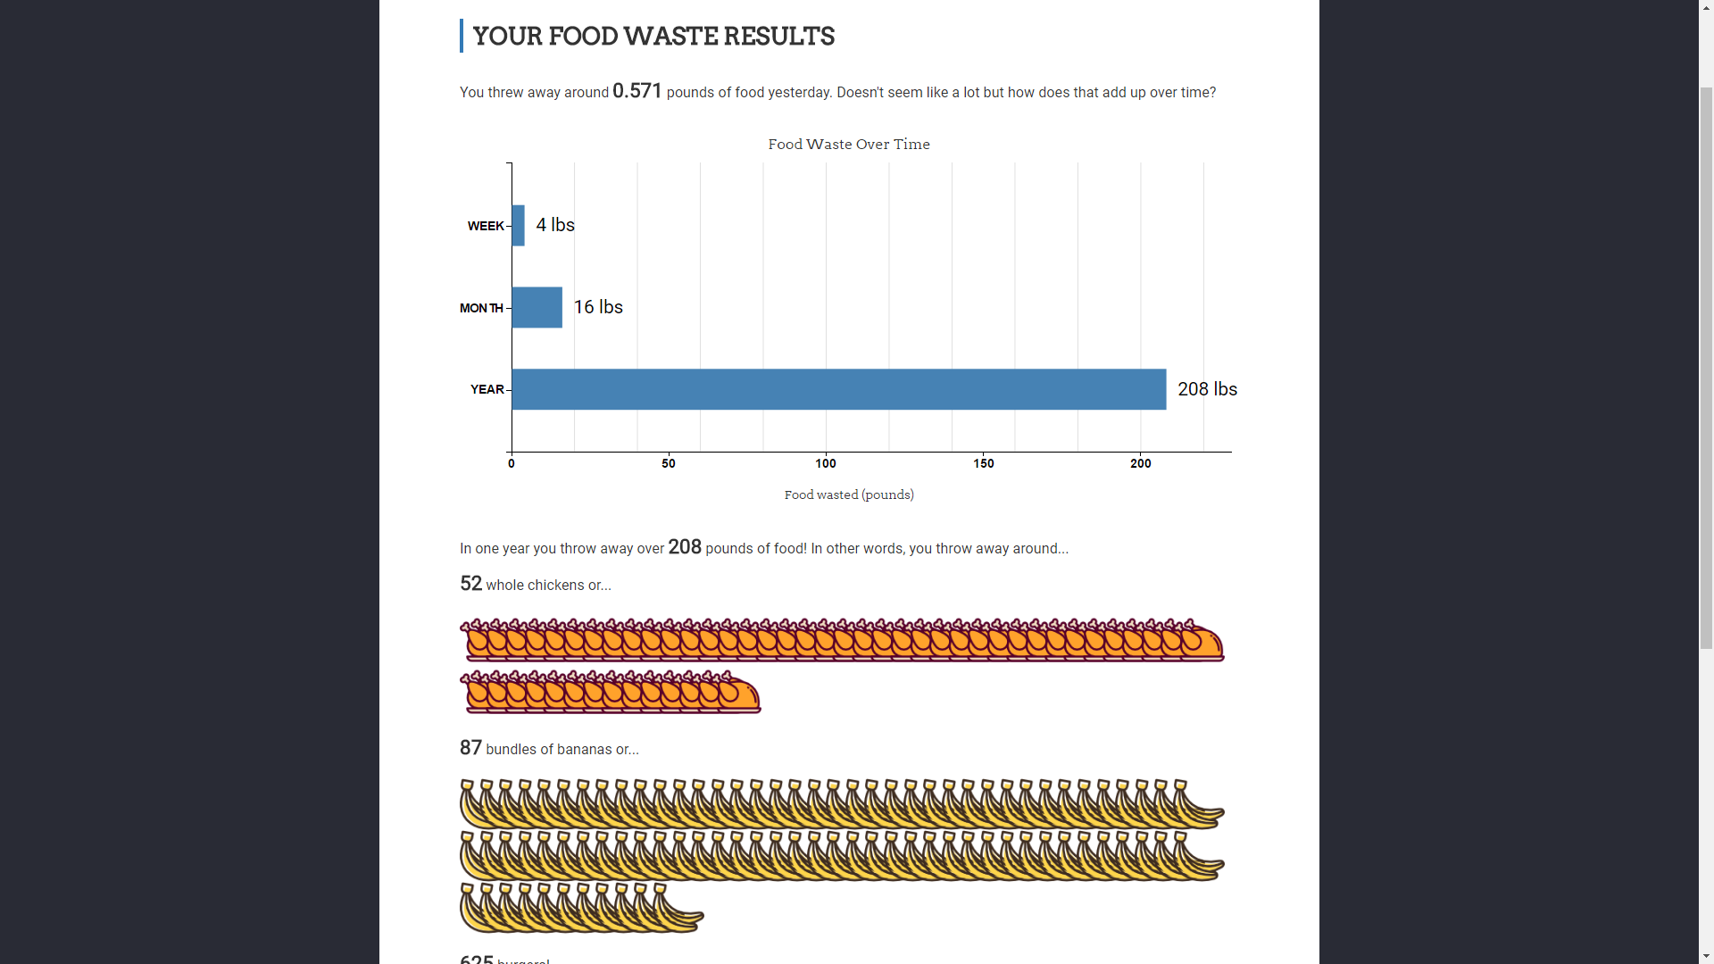

Slide 11
Database - Overview
MySQL
Multiple sources for data
USDA National Nutrient Database for Standard Reference
USDA Agricultural Research Service
Quarterly Food-at-Home Price Database
USDA Economic Research Service
Required functionality
Input: Some type of food
Output: The price for that food type

Slide 12
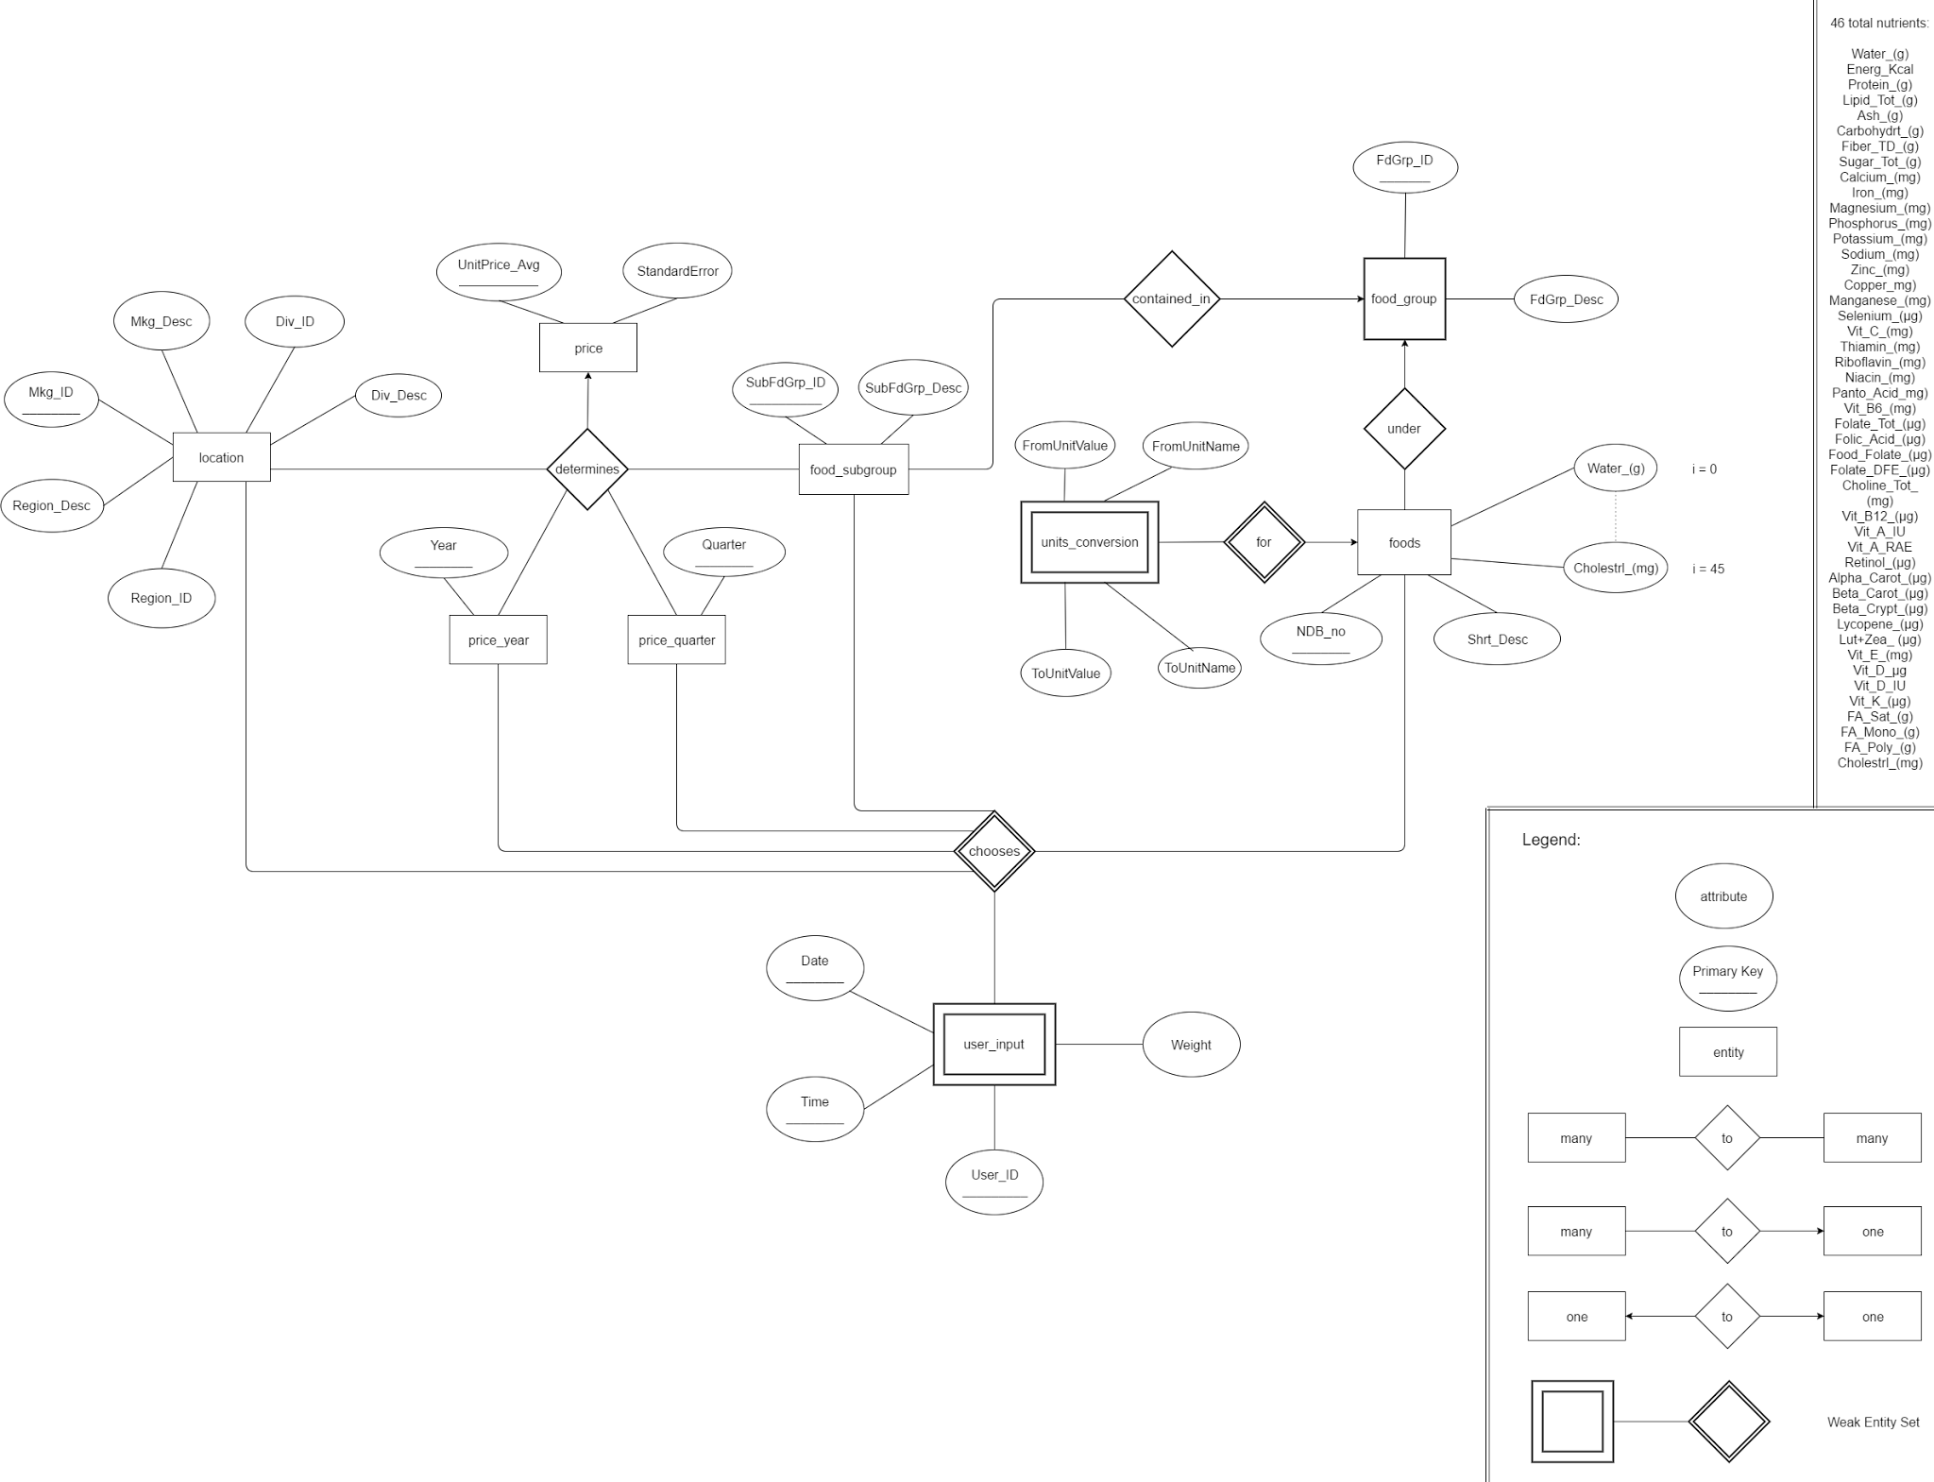
Database - Design

Slide 13
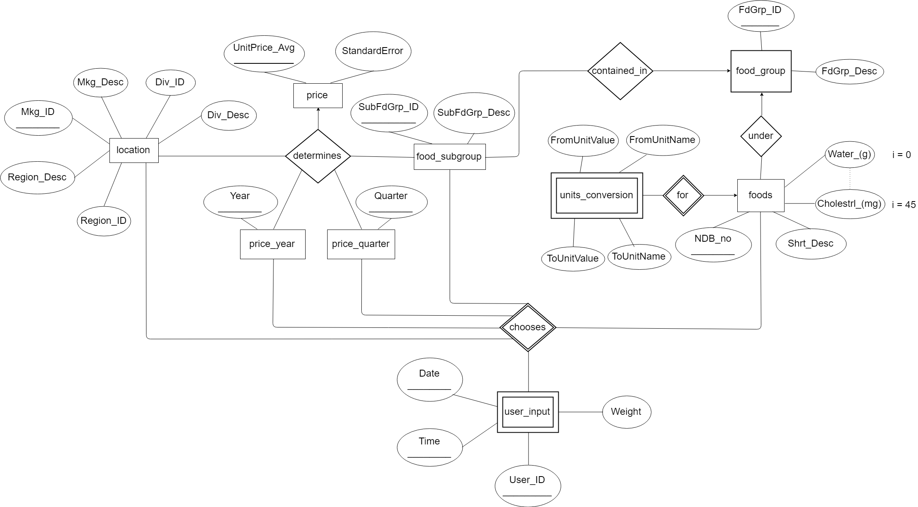
Database - Initial Design

Slide 14
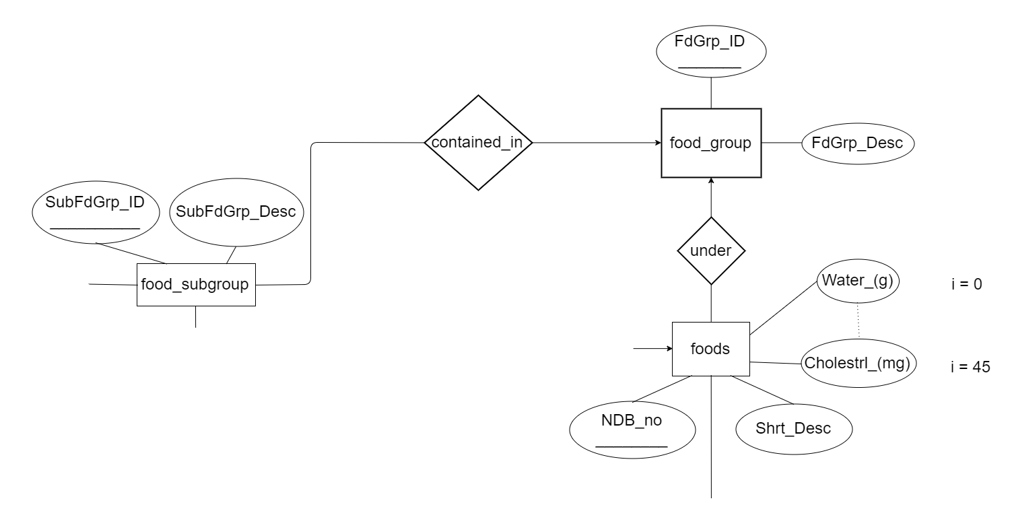
Database - Challenges and Lessons
Unused tables
Extraneous datasets
Dataset for future applications
Multiple data sources
Two independent studies
Different classifications of data

Slide 15
Database - Future Tasks
Tracking and logging
User identifying information
Better integration of the datasets
Directly associate specific foods with food sub-groups
Confirm associations with expert(s)

Slide 16
The Webserver - How and Why
Running on Nodejs webserver
Conventional Webserver vs. Nodejs
Why Nodejs
Handles large number of requests
Event based
Non-blocking

Slide 17
Web Server - Future Considerations
More secure
Handle exceptions better
Redesign to take advantage of Nodejs event based nature

