Slide 1
Lincoln in Our Time
Online Museum Exhibition Website
04/30/2015
CS 4624
Department of Computer Science
Virginia Tech, Blacksburg, VA 24060, United States
Cate Bissell
Grant Foster
K. K.
Bryce Langlotz

Slide 2
Client Information
Kimberly Kutz
The Virginia Center for Civil War Studies
Department of History
Virginia Tech
kkutz@vt.edu

Slide 3
Project Goal
Create a dynamic website with images and videos of Lincoln artifacts

Slide 4


Technologies
WordPress
JavaScript
HTML5
CSS3
Server

Slide 5

WordPress Site
Mural theme
Responsive design
Search

Slide 6
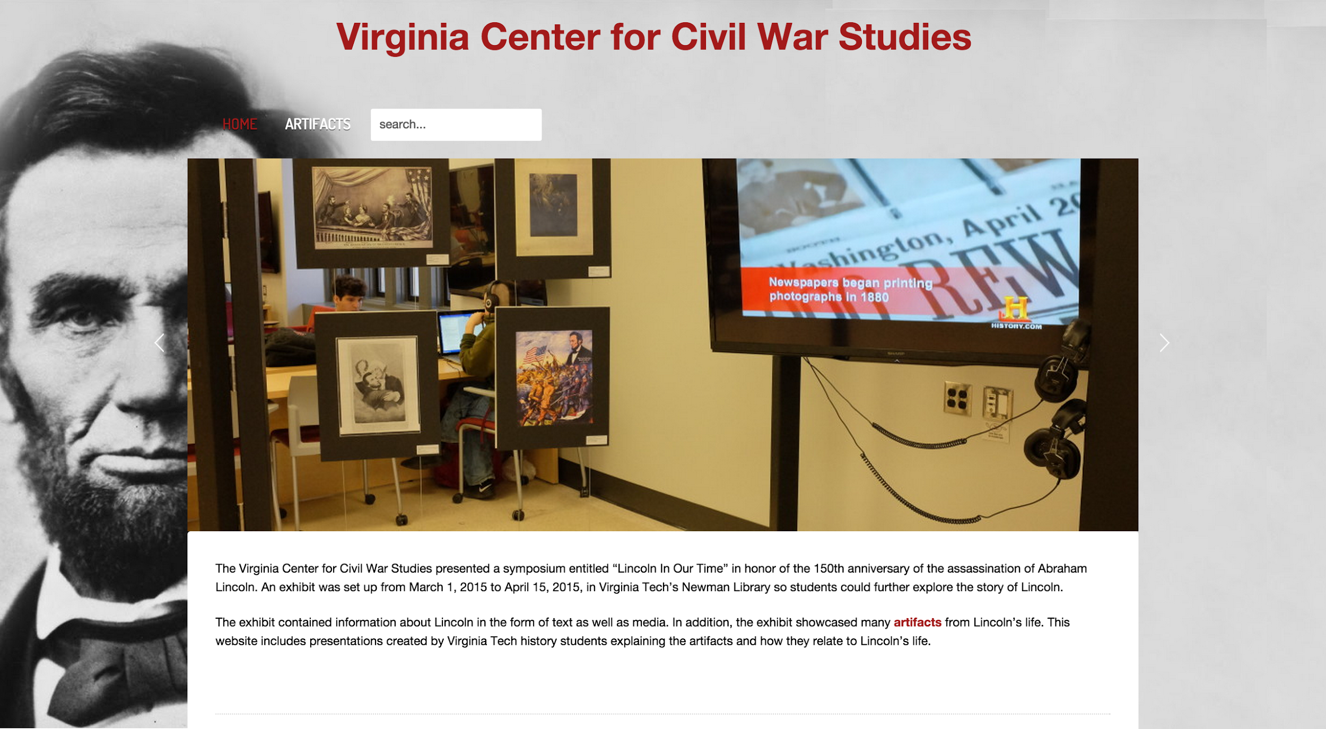

Slide 7
Home Page
Image slider with controls
Link to artifacts page
Search bar

Slide 8
Artifacts Page
Dynamic tiles
Title and description on hover
Link to content on click
Lightbox view of image/video

Slide 9
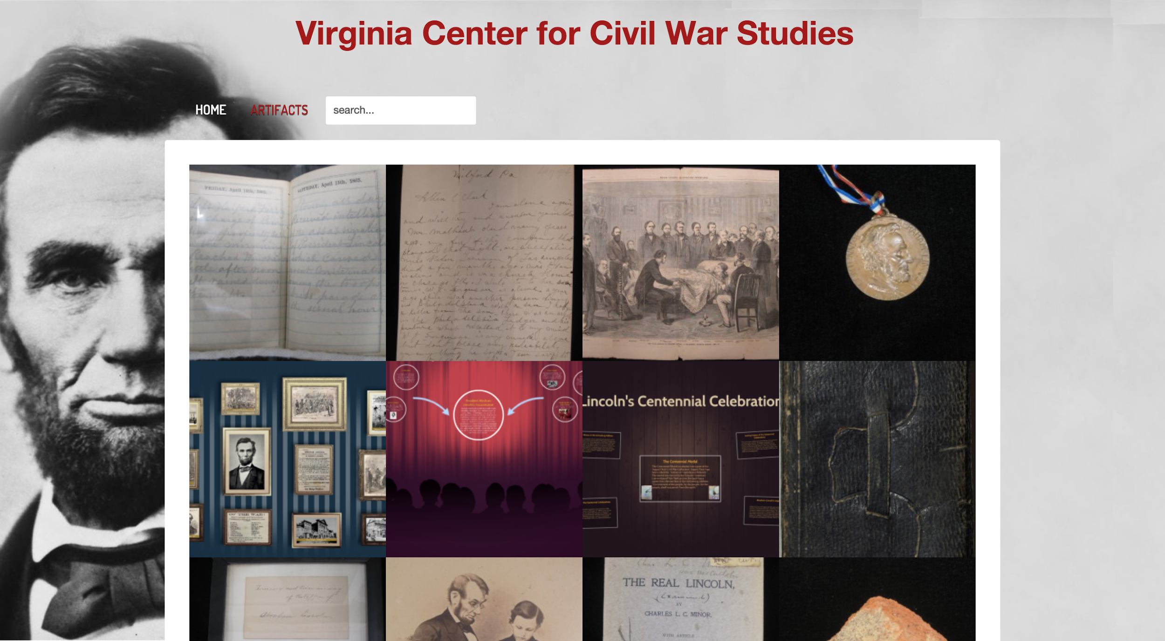

Slide 10
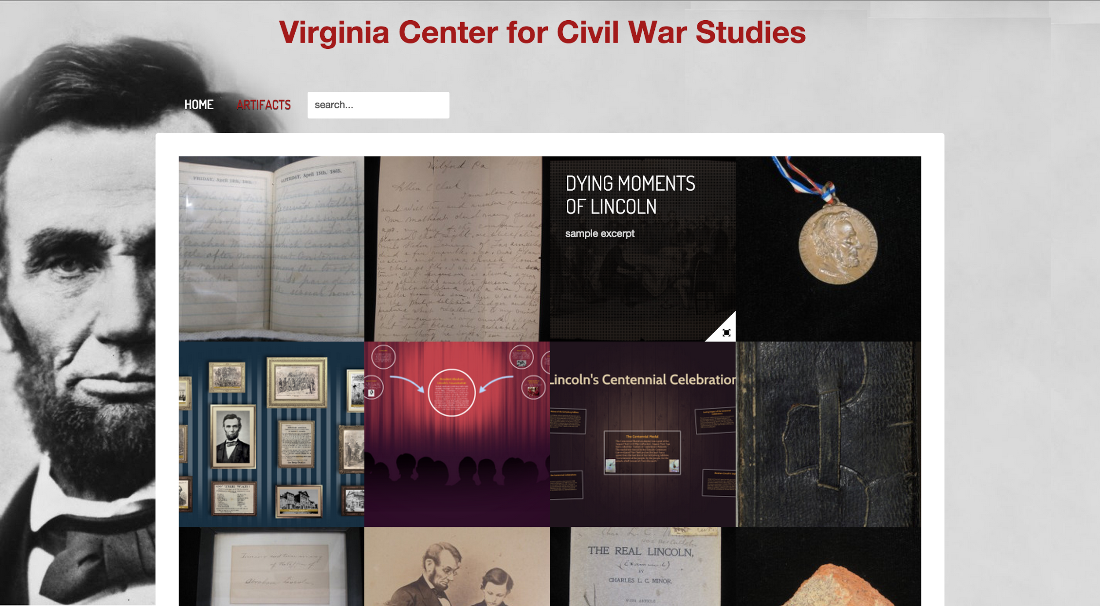

Slide 11
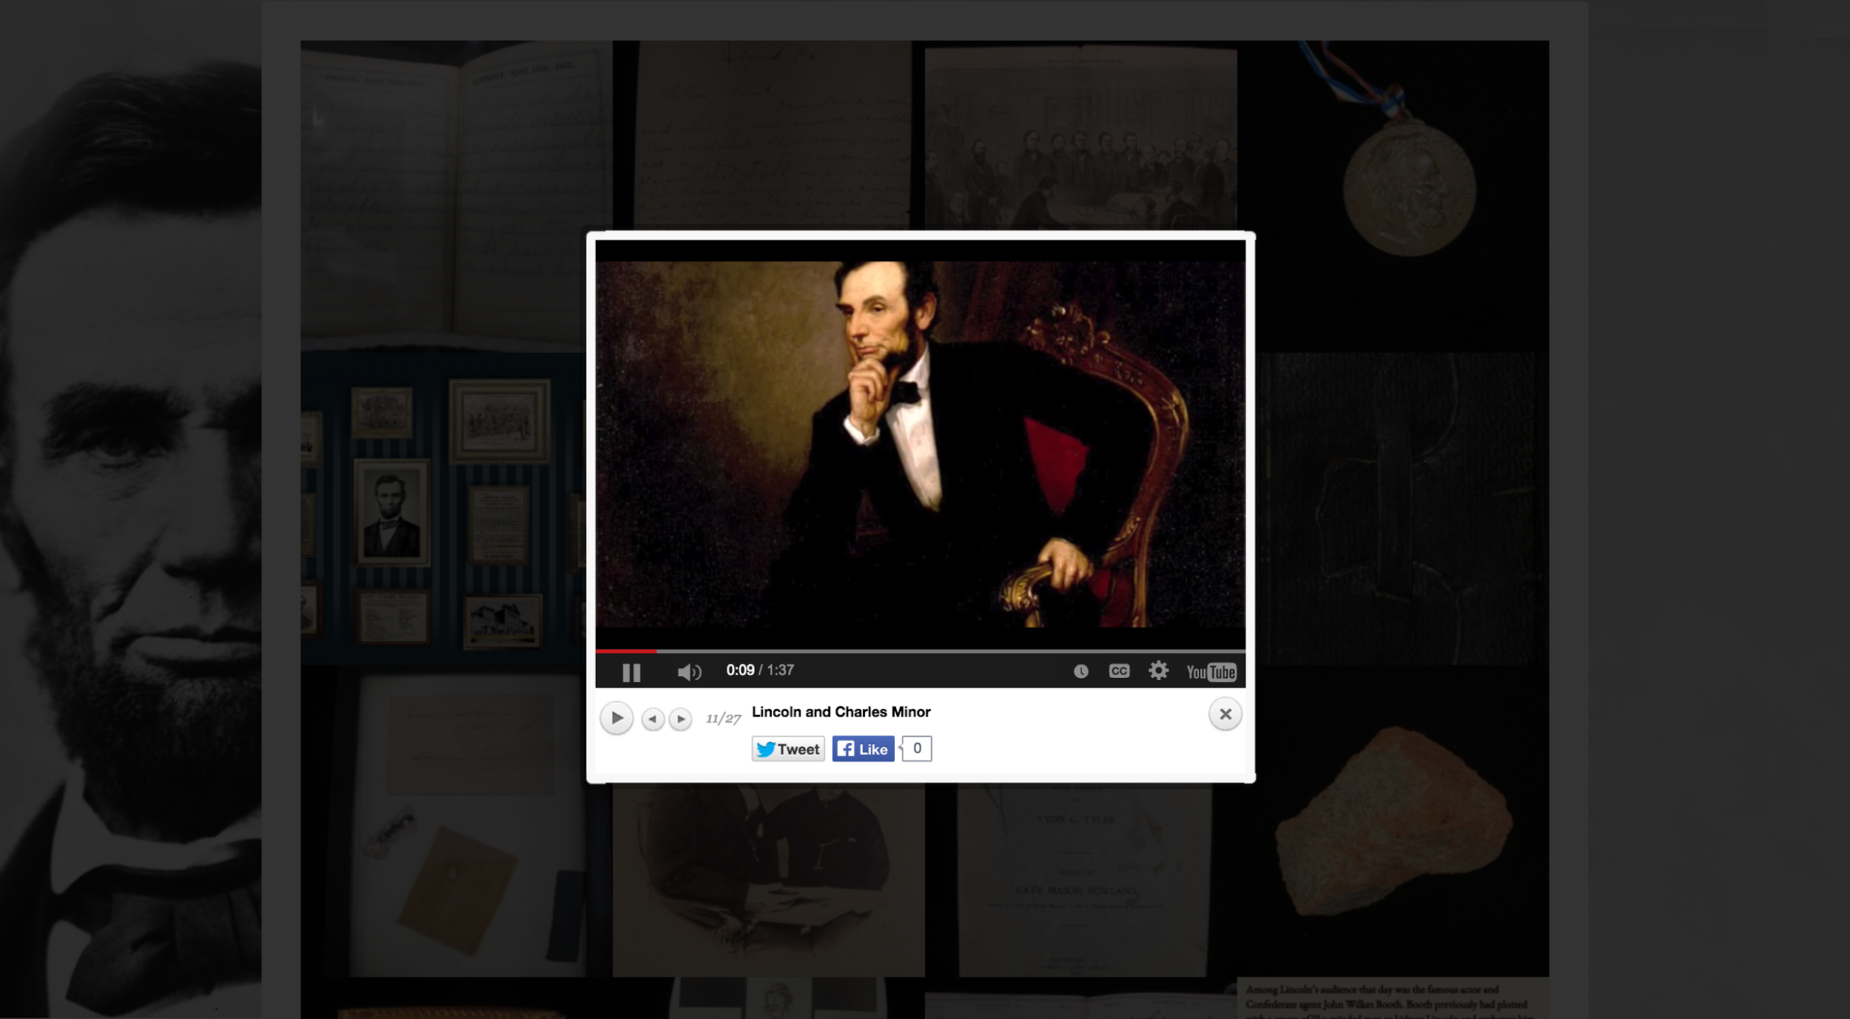

Slide 12
Artifacts
Social media integration
Twitter
Facebook
Google+
Embedded media
YouTube videos
Prezis

Slide 13
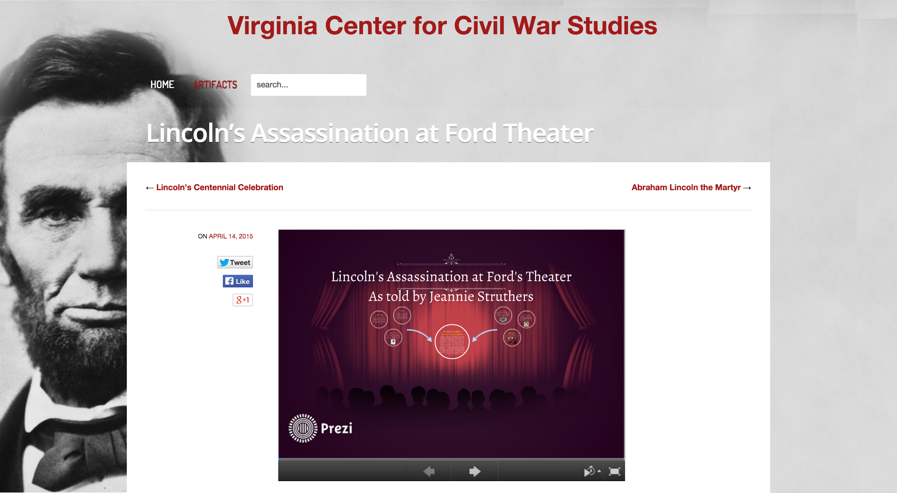

Slide 14
Acknowledgements
Kimberly Kutz - images, videos, presentations, and text for all artifacts

Slide 15
Questions

