Slide 1
CS 5604 - Final Presentation
CINETGraphCrawl
Rushi Kaw
Hemanth Makkapati
Rajesh Subbiah
Client:
Network Dynamics & Simulation Science Laboratory (NDSSL)
CINET is supported by the NSF under Grant No. 1032677
6 December 2012

Slide 2
Overview
Motivation
Objectives
Methodology
Implementation
Challenges
Milestones
Future Work

Slide 3
Motivation
Social systems all around us
  Urban transportation systems
  Communication networks
  Epidemics
  Energy systems, etc.
Social systems as graphs
  Identify critical elements
  Understand inherent phenomenon
  Predict evolving trends
  Intervene with countermeasures, etc.

Slide 4
Objectives
Enable (semi-)automated graph construction from blogs
  Support social media analysis research at NDSSL
    Rumor spread & opinion formation
    Especially over political blogs
  Enhance CINET graph repository
    CINET - A Cyber-Infrastructure for Network Science

Slide 5
Methodology
Blog 1
Blog 2
Blog 3
Blog 4
. . . .
Meta
Model
Crawlers
Blog Models
Graph Constructor
Graph(s)
User Input

Slide 6
Metamodel
Blog
has post
has user
affiliated with
Post
posted by
User
Affiliation
has
reputation
commented by
has reputation
tagged as
has comment
Reputation
Tag
Comment
has reputation
tagged as
has comment

Slide 7
Methodology (..contd)
Start with a seed
Extract URLs
Download pages
Extract content
Dump content into database
  As per the metamodel
Query database
Construct graphs

Slide 8
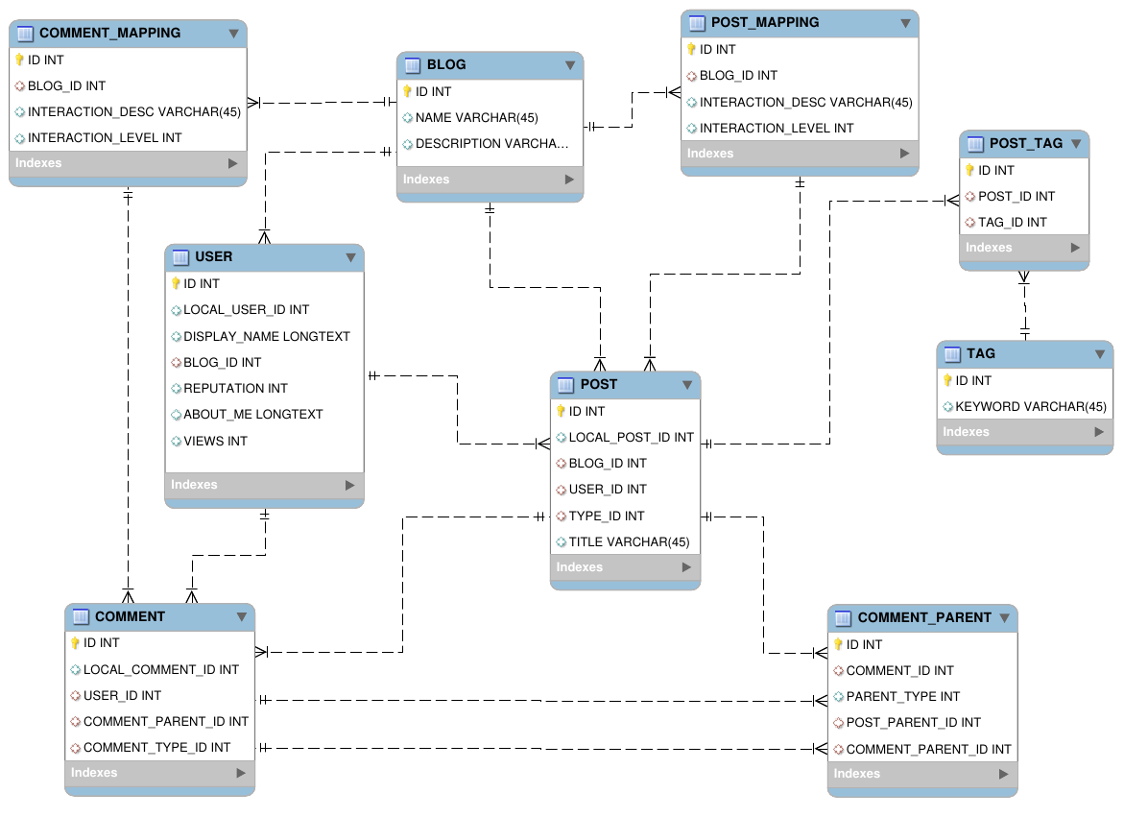
Data Model

Slide 9
Implementation
Data sets
Stack Overflow
  Most used forum of Stack Exchange family
  Discusses software programming
  3.3M questions
  6.6M answers
  13M comments
  30K tags
CNN Political Ticker
  Discusses politics
  Comments are spread across multiple HTML pages
Development setup
CPU
  Intel(R) Core(TM) i5-2400 CPU @ 3.10GHz
Physical Memory
  8GB
Disk
  320 GB
  RPM = 7200
  Buffer size = 16MB

Slide 10
Graphs Constructed
User-user interaction graphs
  1st degree interactions
    Stackoverflow: post-comment, post-answer and answer-comment
    CNN political ticker: post-comment
  2nd degree interactions
    CNN political ticker: comment-post-comment
Hierarchical representation of blog posts and comments

Slide 11
Graph Construction: Pseudo Code
For each blog B_{i}, retrieve all users
For each user U_{ij}, retrieve all posts written by U_{ij}
For each post P_{ik-j}, retrieve all comments
For each comment C_{it-k}, get its owner U_{id}
Construct an edge between U_{ij} & U_{id}
For each comment C_{is} written by U_{ij}, get its parent post P_{k'}
Construct an edge between U_{ij} & owner of P_{ik'}
Dump the U_{ij} edge list in a file (adjacency matrix)

Slide 12
Stackoverflow

Slide 13
Stack Overflow Approach
Post
Question
Comment
Comment
Comment
Answer
Comment
Comment

Slide 14
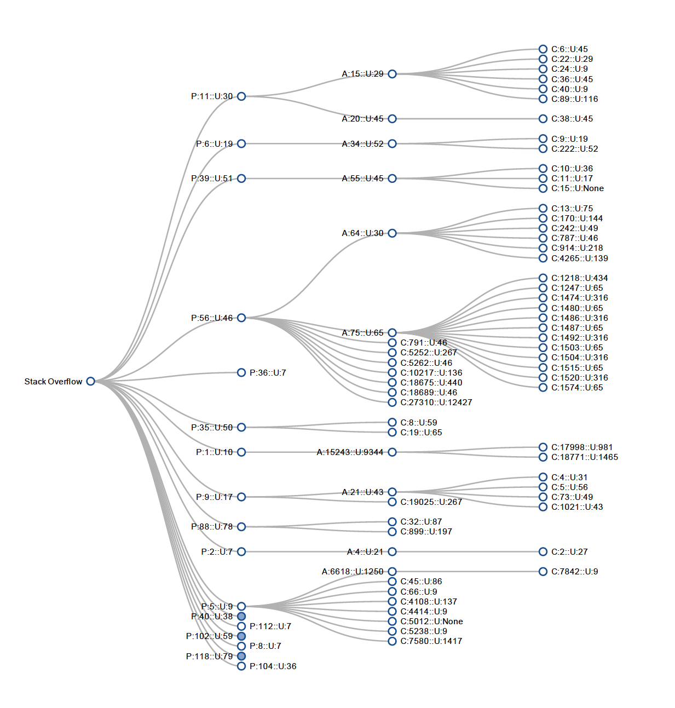
Hierarchical Representation

Slide 15
Stackoverflow Graphs
Complete user-user interaction graph
Nodes = 805652
Edges = 9.3 million
Max. deg. = 21869
Avg. deg. = 23.118
Runtime
Graph construction
  Tg = 2104 seconds (incl. dumping into file) [7 threads]
Reduced user-user interaction graph
Nodes = 34265
Edges = 1 million
Max. deg. = 5601
Avg. deg. = 59.5053
Runtime
Graph construction
  Tg = 1803 seconds (incl. dumping into file) [1 thread]

Slide 16
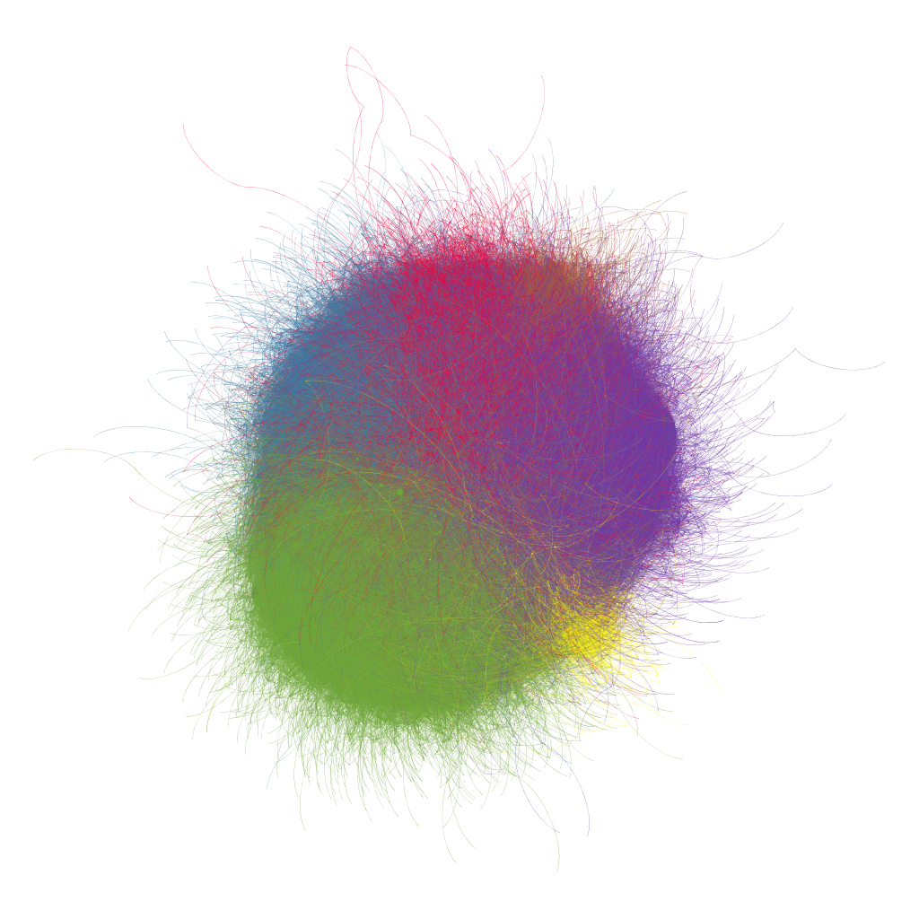
Stack Overflow Graph (~35K nodes)
Nodes = 34265
Edges = 1 million
Min. degree = 1
Max.degree = 5601
Avg. degree = 59.5
Colors represent modularity classes

Slide 17
CNN Political Ticker

Slide 18
CNN Political Ticker Approach
Post
Post
Comment
Comment

Slide 19
CNN Constructed Graphs
1st degree interaction graph
Post-comments
270 posts
  Jan. - Feb. 2012
Nodes = 2945
Edges = 5117
Max. deg. = 943
Avg. deg. = 3.47
Runtime
Extraction time
  Te = 3120 seconds (incl. data download)
Graph construction
  Tg = 2 seconds (incl. dumping into file)
2nd degree interaction graph
Post-comment and
comment-post-comment
270 posts
  Jan. 1 - Feb. 2, 2012
Nodes = 2945
Edges = 433630
Max. deg. =2120
Avg. deg. = 294.48
Runtime
Extraction time:
  Te = 3120 seconds (incl. data download)
Graph construction
  Tg = 6 seconds (incl. dumping into file)

Slide 20
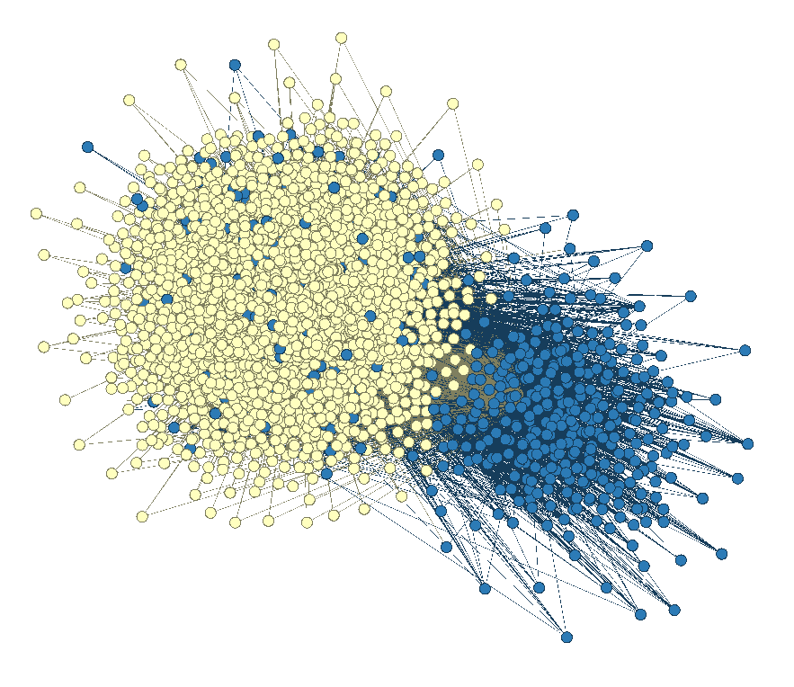
CNN - First Degree Interaction
Nodes = 2945
Edges = 5117
Min. degree = 1
Max.degree = 943
Avg. degree = 3.5
Colors represent modularity classes
Layout used: OpenOrd

Slide 21
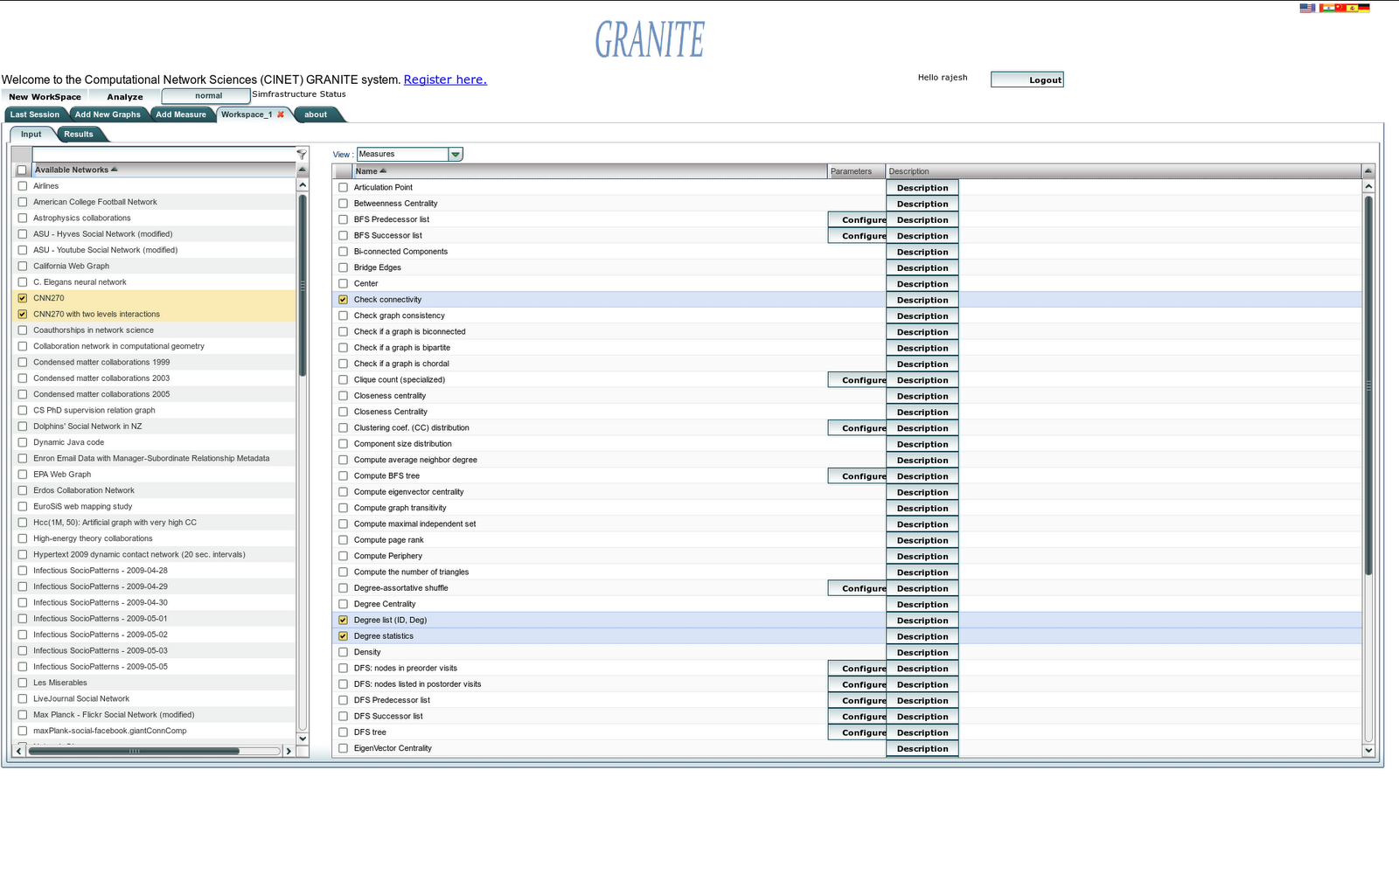
CINET Snapshots with
Extracted Graphs

Slide 22
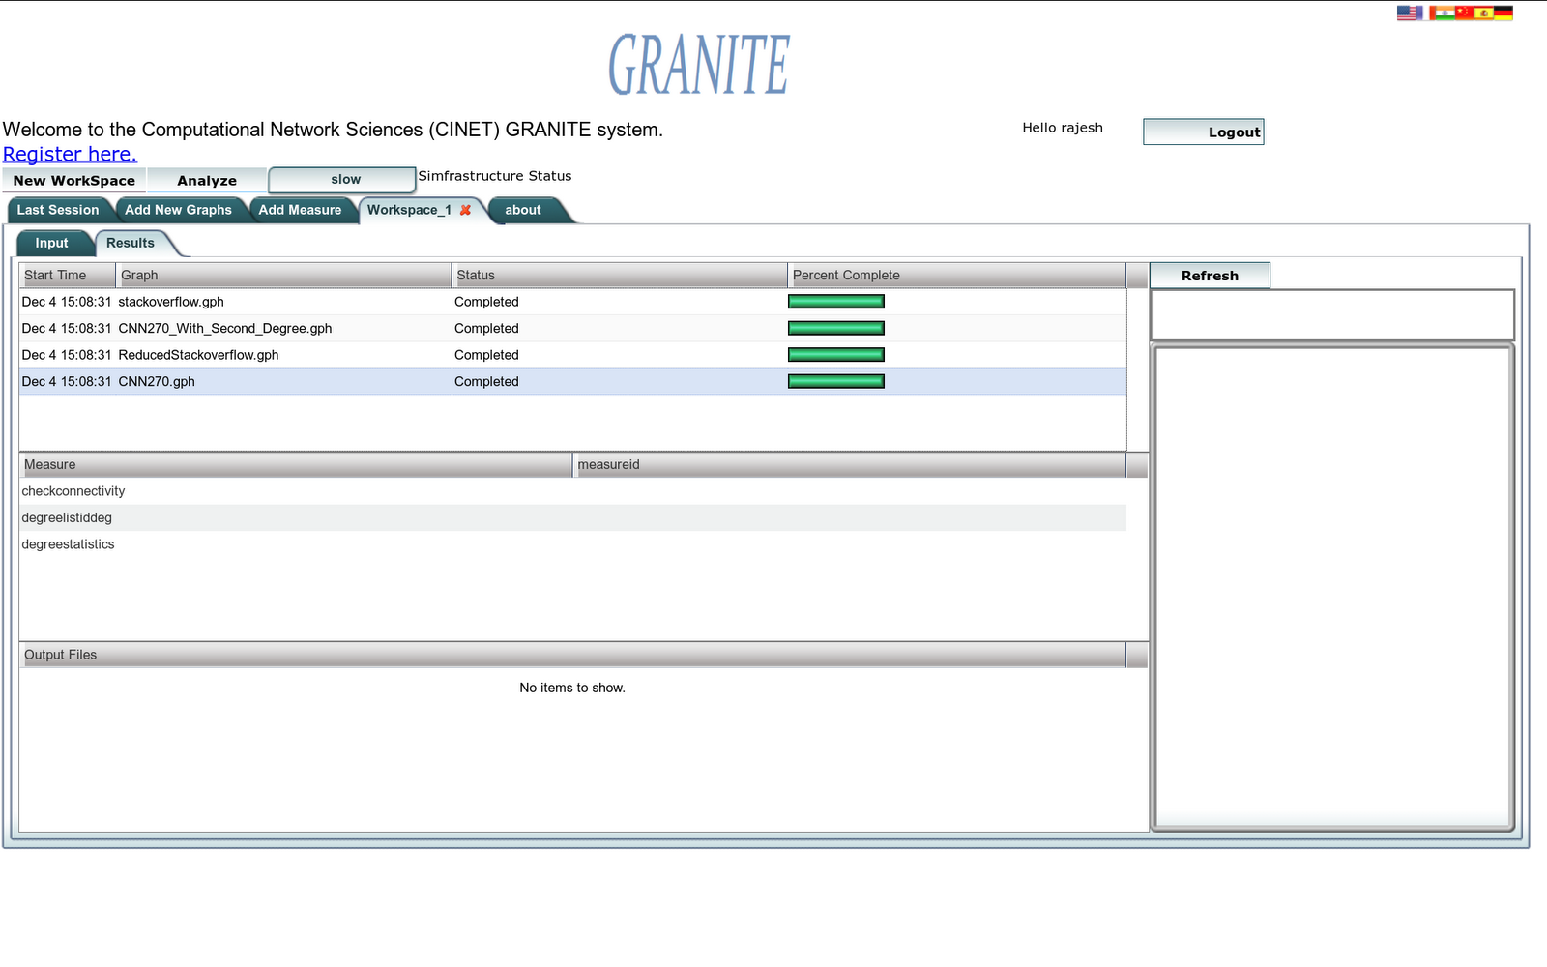

Slide 23
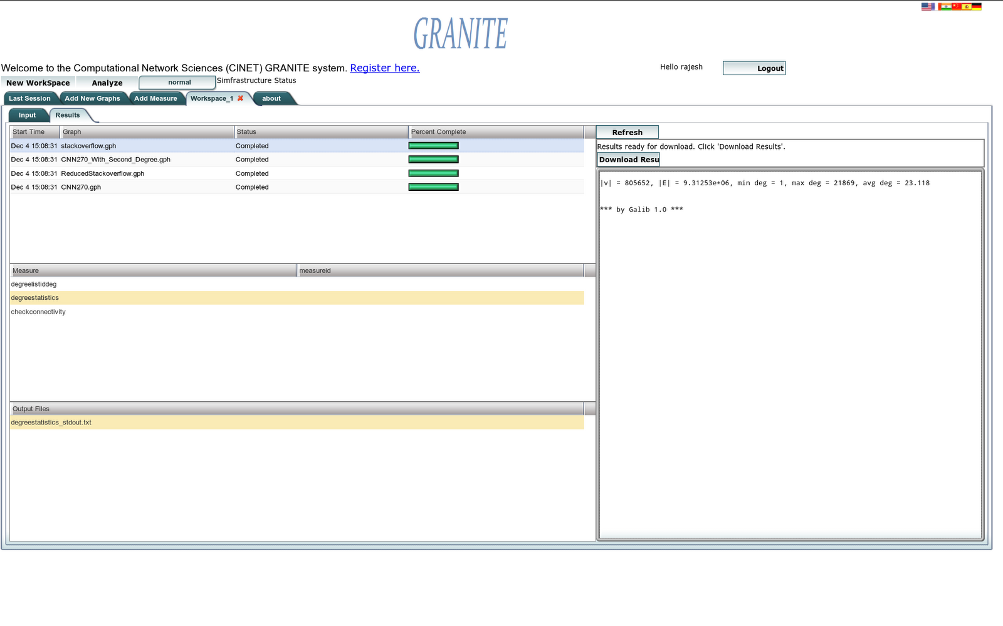

Slide 24
Challenges
Extracting content from blogs
  No standardized structure
    Custom crawlers & metamodel based extraction
  Comments are incorporated in different forms
    Only available if signed-in
    Embedded Ajax scripts
    Embedded in the same page
    Focus on embedded comments
Input flexibility
  Many different ways to specify input
  1st and 2nd degree interactions to start off with
Duplicate and anonymous names
  Represented all the anonymous users as one user

Slide 25
Milestones
Literature Survey - All - 09/25
Meta Model Creation - HM - 10/03
Custom Crawlers - HM - 10/31
Graph Construction - RK - 11/05
Visualization - RS - 11/20
Integration & Testing - All - 11/23
First Demo to Client - All - 11/26
Fixes & Improvements - All - 12/06
Final Demo to Client - All - 12/07
Report Writing - All - 12/10
HM: Hemanth Makkapati
RK: Rushi Kaw
RS: Rajesh Subbiah

Slide 26
Future work
More blogs
  different topics
  different structures
Generic content extraction
Richer graph representation

Slide 27
Acknowledgments
Prof. Fox
  Help with methodology
Spencer Lee
  Graph upload to CINET
Team CINETGraphViz
  Graph visualizations
Keith Bisset
  Suggestions on data sets

Slide 28
References
[1] L. A. Adamic and N. Glance. The political blogosphere and the 2004 U.S. election: divided they blog. In Proceedings of the 3rd international workshop on Link discovery, LinkKDD ’05, pages 36–43, New York, NY, USA, 2005. ACM.
[2] A. Apolloni, K. Channakeshava, L. Durbeck, M. Khan, C. Kuhlman, B. Lewis, and S. Swarup. A study of information diffusion over a realistic social network model. In Proceedings of the 2009 International Conference on Computational Science and Engineering - Volume 04,CSE ’09, pages 675–682, Washington, DC, USA, 2009. IEEE Computer Society.
[3] D. Gruhl, R. Guha, D. Liben-Nowell, and A. Tomkins. Information diffusion through blogspace. In Proceedings of the 13th international conference on World Wide Web, WWW ’04, pages 491–501, New York, NY, USA, 2004. ACM.
[4] C. Kohlschtter. Boilerplate: Removal and Fulltext Extraction from HTML pages. URL: http://code.google.com/p/boilerpipe/.
[5] Python Library. Beautiful soup. URL: http://www.crummy.com/software/BeautifulSoup/ (2012).
[6] Python Library. Urllib. URL: http://docs.python.org/library/urllib.html (2012).
[7] D3 Javascript Visualization Library. URL: http://d3js.org/ (2012).

Slide 29
Thank you!

