Slide 1

OER Update
Anita Walz, Open Education, Copyright & Scholarly Communication Librarian
Virginia Scholarly Communication Interest Group
Lynchburg, VA June 29, 2018 @arwalz
Excluding 3rd party materials,
© Anita Walz. Licensed with a Creative Commons Attribution 4.0 International License. Best practices for
Attribution of CC materials.

Slide 2
A crowded
OER Update in context
Anita Walz, Open Education, Copyright & Scholarly Communication Librarian
Virginia Scholarly Communication Interest Group
Lynchburg, VA June 29, 2018 @arwalz
Excluding 3rd party materials,
© Anita Walz. Licensed with a Creative Commons Attribution 4.0 International License. Best practices for
Attribution of CC materials.

Slide 3

Open Education Is:
a movement
a philosophy
a broad, expanding set of value-driven practices.
© Luis Prado “Jumping Hurdle” CC BY
Excluding 3rd party materials,
© Anita Walz. Licensed with a Creative Commons Attribution 4.0 International License. Best practices for
Attribution of CC materials.

Slide 4
Open Education values:
SHARING
GIVING & RECEIVING FEEDBACK
NEW IDEAS in TEACHING & LEARNING
OPEN LICENSES
GIVING CREDIT
STUDENTS at the CENTER
© Luis Prado “Jumping Hurdle” CC BY
Adapted from: McKernan, R., Skirko, T., & West, Q. (2015) Librarians as open education advocates: Readings on being an open advocate. Retrieved from https://openedadvocates.pressbooks.com/chapter/definition-of-open-education

Slide 5


SHARING
Public domain images. Source: Pixabay

Slide 6

GIVING & RECEIVING FEEDBACK
Public domain images. Source: Pixabay

Slide 7

NEW IDEAS IN
TEACHING & LEARNING
Public domain images. Source: Pixabay

Slide 8


OPEN LICENSES
5 R Permissions
Can anyone . . .
Retain it?
Reuse it?
Revise it?
Remix it?
Redistribute
Source:
http://opencontent.org/definition

Slide 9
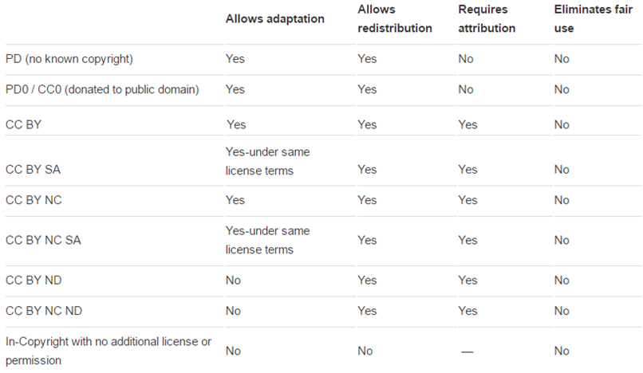
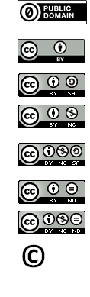
Most open
Not OER
Excluding 3rd party materials,
© Anita Walz. Licensed with a Creative Commons Attribution 4.0 International License. Best practices for
Attribution of CC materials.
Least open

Slide 10
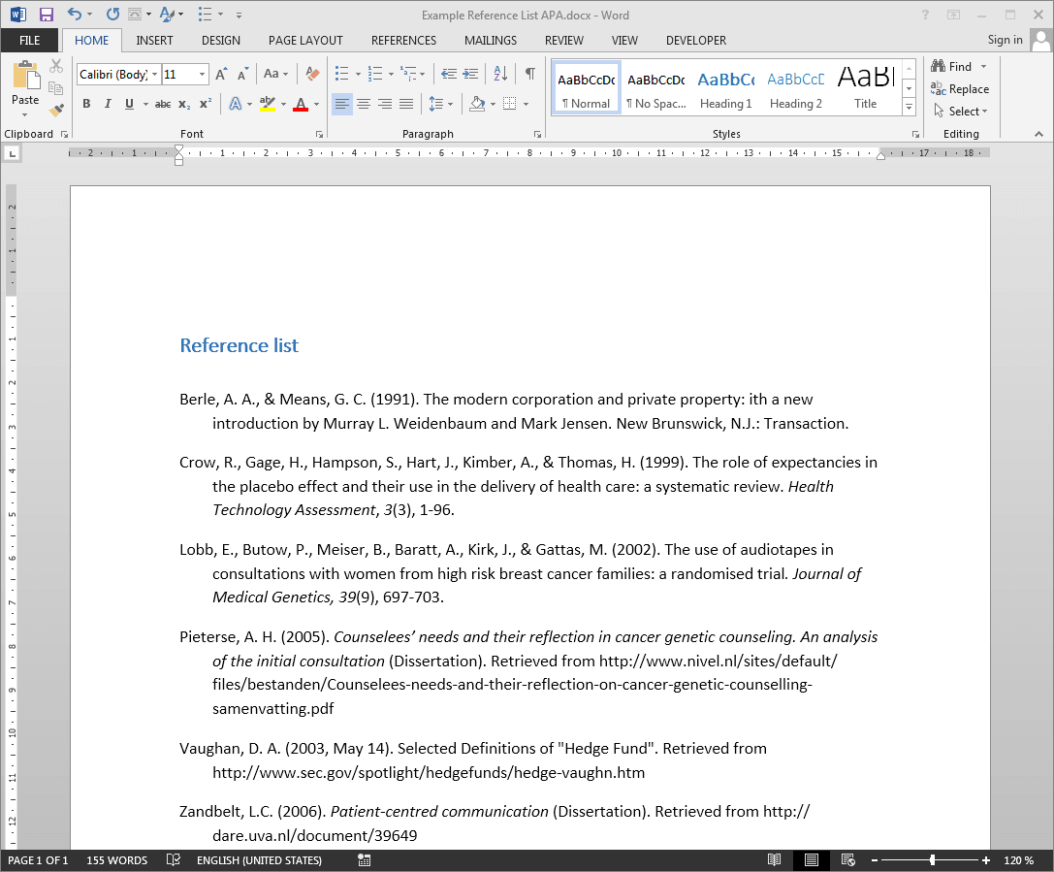


GIVING CREDIT
Best practices for attribution: https://wiki.creativecommons.org/wiki/Best_practices_for_attribution
Public domain images. Source: Pixabay

Slide 11
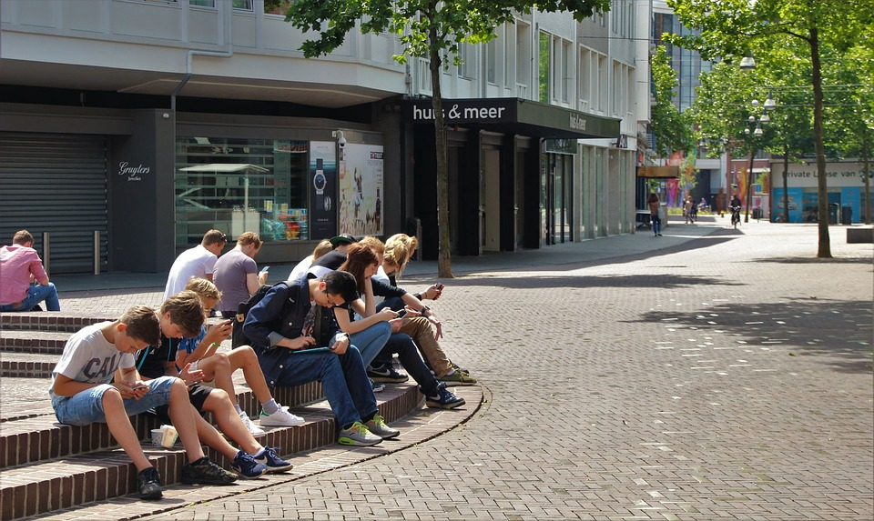
STUDENTS at the CENTER
Public domain images. Source: Pixabay

Slide 12
A kind of crowded update on OER

Slide 13
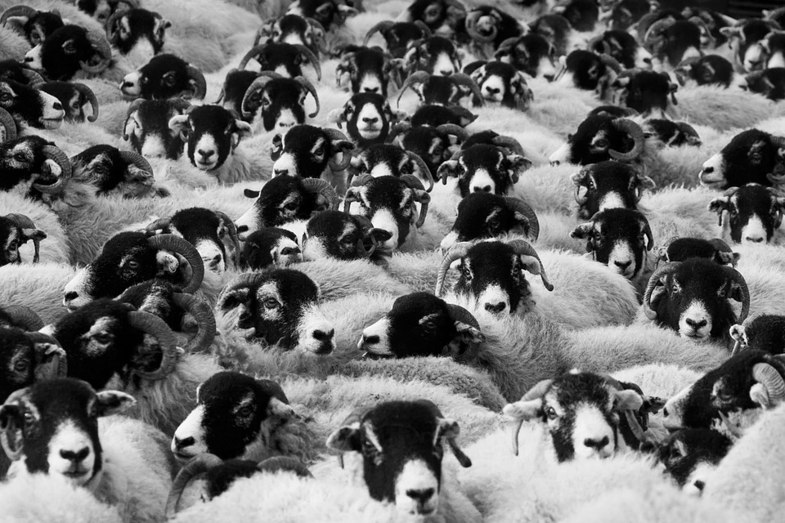
Public domain images. Source: Pixabay

Slide 14
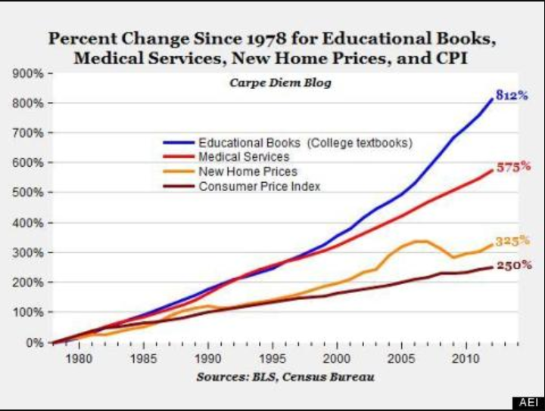
http://www.aei.org/publication/the-college-textbook-bubble-and-how-the-open-educational-resources-movement-is-going-up-against-the-textbook-cartel

Slide 15
Incentives and the changing behaviors of . . .
Students
Publishers
Authors / faculty
Open advocates
Affordability advocates
. . . and everything in between

Slide 16
Incentives and the changing behaviors of . . .
Students
Publishers
Authors / faculty
Open advocates
Affordability advocates
. . . and everything in between
Pass the class, GRADES, FOOD, and reduced debt
Produce a quality product, SHAREHOLDER REVENUES
RECOGNITION, rewards, student learning, easy to use
resources that FIT
Build faculty CAPACITY to create & control their own course materials. Save students $$.
Save students $$.
© Anita Walz. Licensed with a Creative Commons Attribution 4.0 International License.

Slide 17
Student reported methods for obtaining a required textbook
Borrow or make the $$ to buy the book
  Scrimp on necessities
Buy the book (if you have $$)
Rent/share the book
Buy an older edition
Illegally download the book
Wait until you know you really need the book
Why even bother? Go without

Slide 18
In your academic career, has the cost of required textbooks caused you to:
66.5% | Not purchase the required textbook
47.6% | Take fewer courses
45.5% | Not register for a specific course
37.6% | Earn a poor grade
26.1% | Drop a course
19.8% | Fail a course
https://florida.theorangegrove.org/og/file/3a65c507-2510-42d7-814c-ffdefd394b6c/1/2016%20Student%20Textbook%20Survey%20Draft%205.pdf

Slide 19

2015

Slide 20

2016
Critiques of homework software access codes

Slide 21
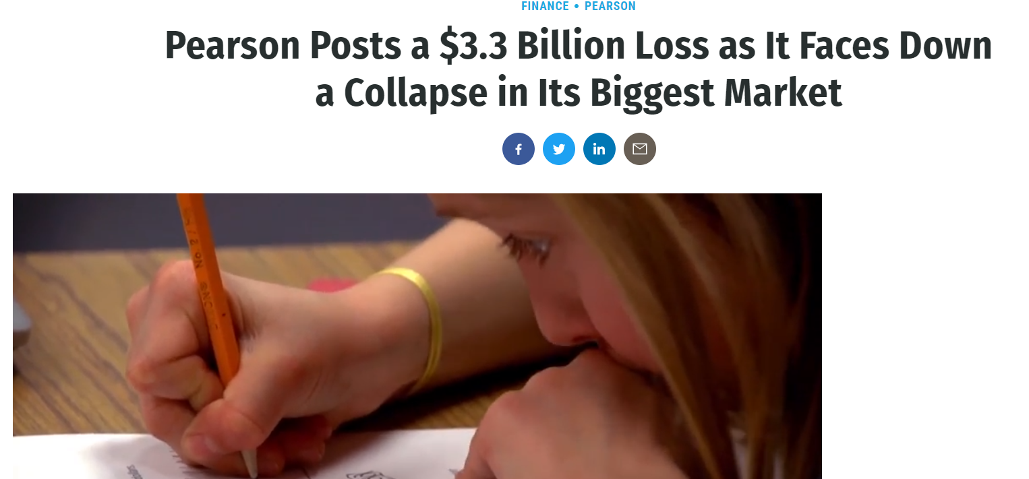
2017

Slide 22
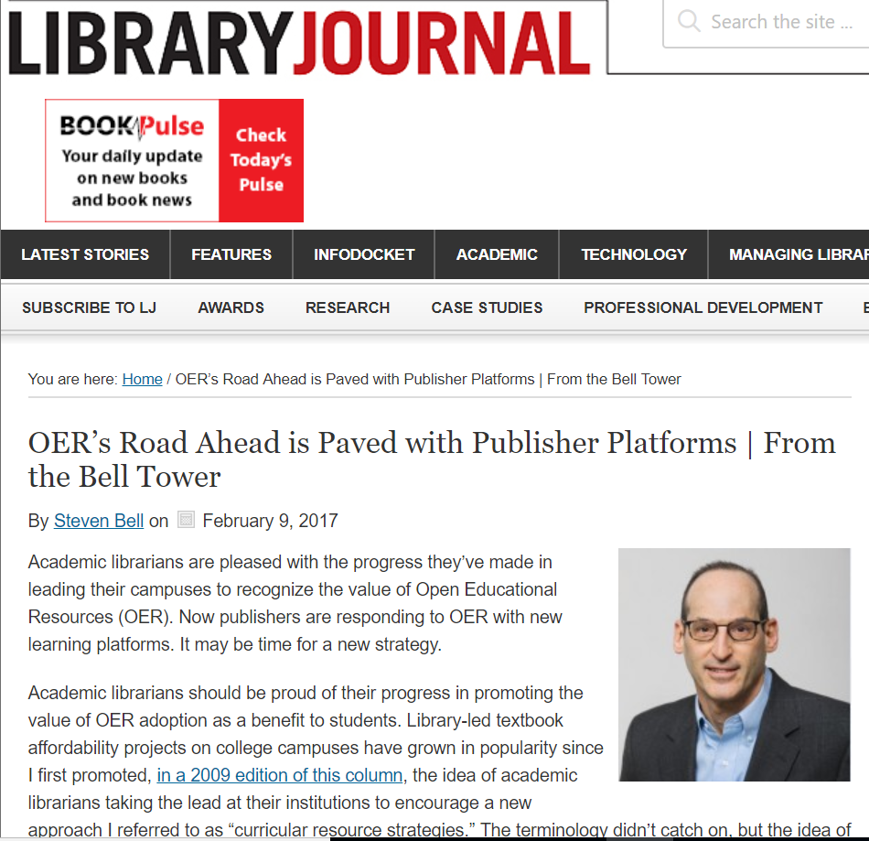
2017

Slide 23
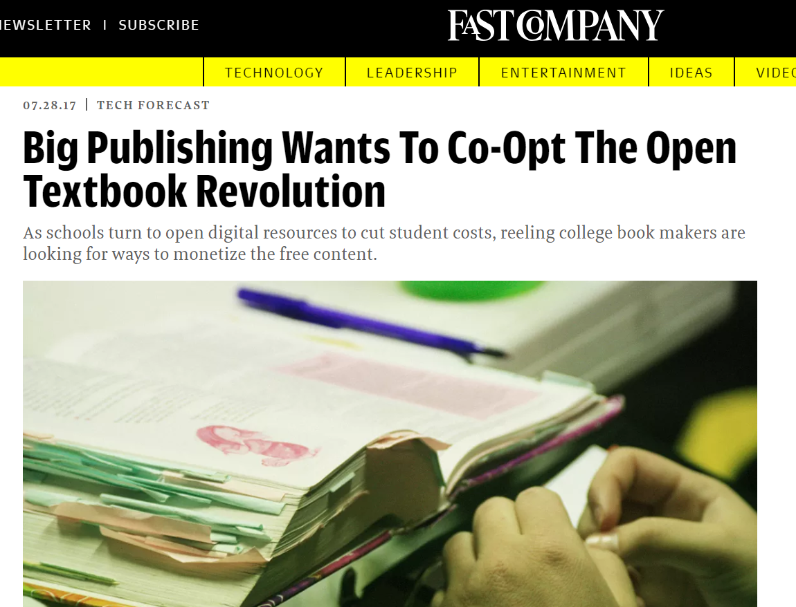
2017

Slide 24
“Inclusive access”
5 Rs evaluation
Retain
Reuse
Revise
Remix
Redistribute
Temporary access
Direct-billed via bursar’s office
Cannot be resold
Digital access only. May prevent printing
VENDOR LOCK IN

Slide 25

2018

Slide 26

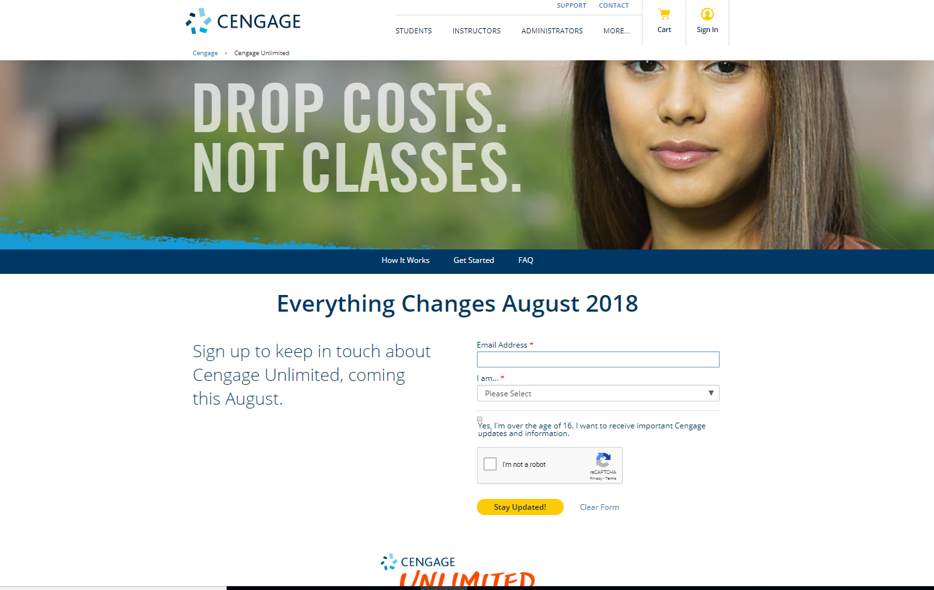
2018

Slide 27
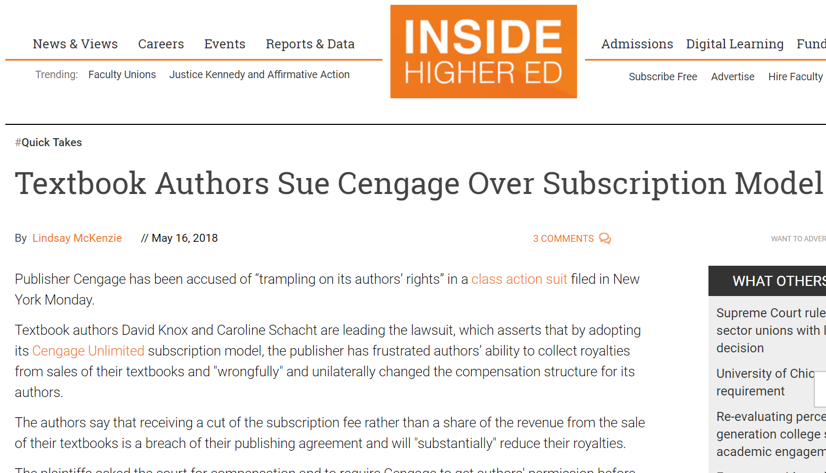
2018

Slide 28
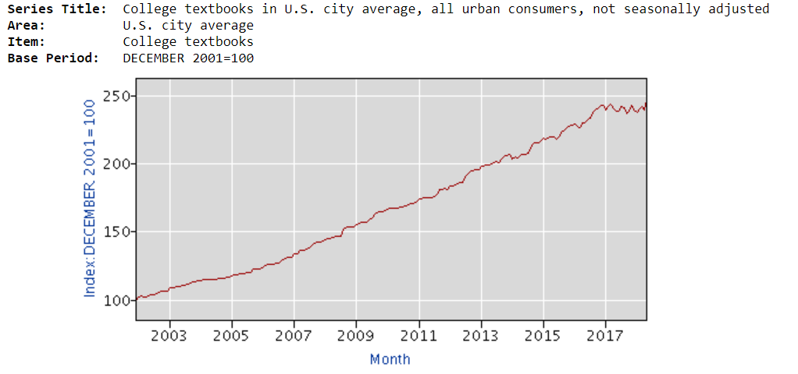
https://data.bls.gov/pdq/SurveyOutputServlet
2018

Slide 29
Themes & Values (other than cost)

Slide 30
Discovery
See George Mason University’s OER Metafinder
Need to make better progress with metadata, tagging or getting created-OER into locations where they can be found.

Slide 31
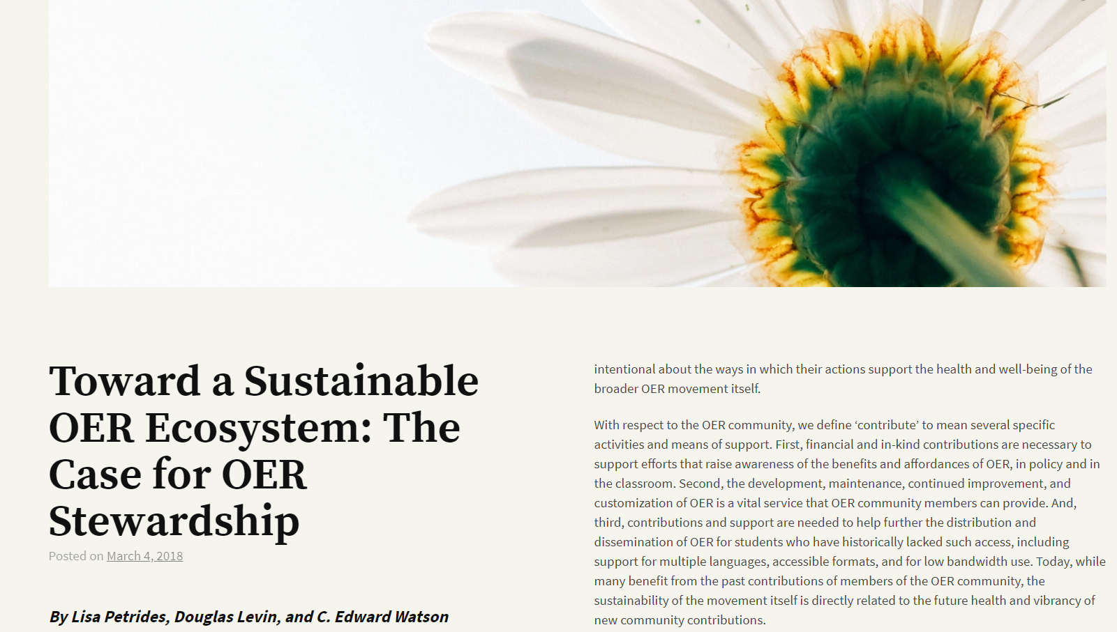
Sustainability
https://careframework.org

Slide 32
Contribute
Attribute
Release
Empower
https://careframework.org

Slide 33
Contribute: OER stewards actively contribute to efforts, whether financially or via in-kind contributions, to advance the awareness, improvement, and distribution of OER; and
Attribute: OER stewards practice conspicuous attribution, ensuring that all who create or remix OER are properly and clearly credited for their contributions; and
Release: OER stewards ensure OER can be released and used beyond the course and platform in which it was created or delivered; and
Empower: OER stewards are inclusive and strive to meet the diverse needs of all learners, including by supporting the participation of new and non-traditional voices in OER creation and adoption.
https://careframework.org

Slide 34
Contribute
Attribute
Release
Empower
https://careframework.org

Slide 35
Other prominent themes in open education

Slide 36
Software and processes for production & remix
Legally editable and technically open
Open source

Slide 37
Labor & fairness -- Do we support/reward people who create OER?
Or, do we expect “free labor?”
Do we disregard credit for promotion/tenure?
Do adjuncts have capacity to contribute?

Slide 38
Investments in open

Slide 39
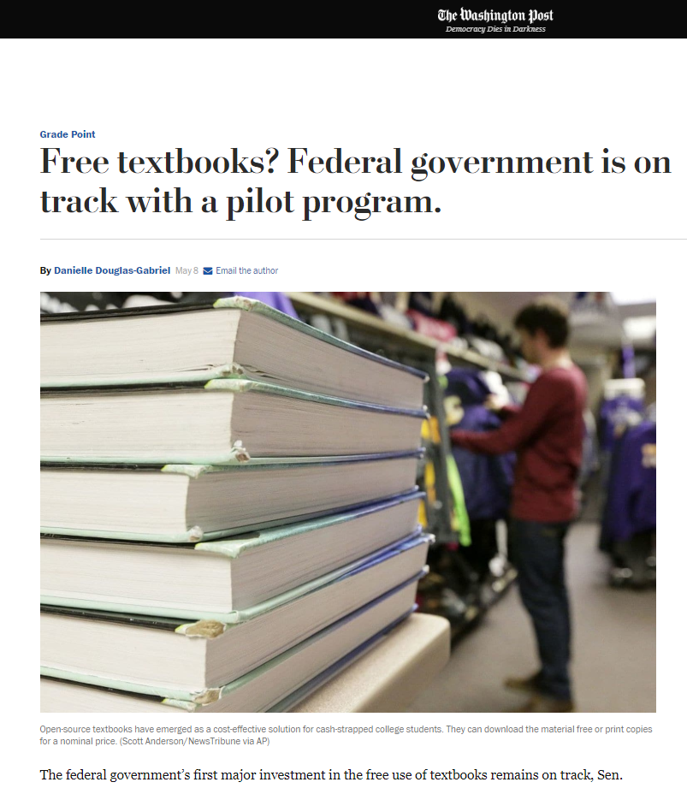
U.S. Omnibus Budget
$5 Million OER Adoption/Creation Pilot (2018)
Request for proposals to be released
in “early summer.”
Will be managed by U.S. Department of Education
https://www.washingtonpost.com/news/grade-point/wp/2018/05/08/education-dept-sets-course-for-open-textbook-pilot-program
“. . . creation or expansion of open-educational resources: peer-reviewed academic material released under an intellectual property license that permits free use.”

Slide 40
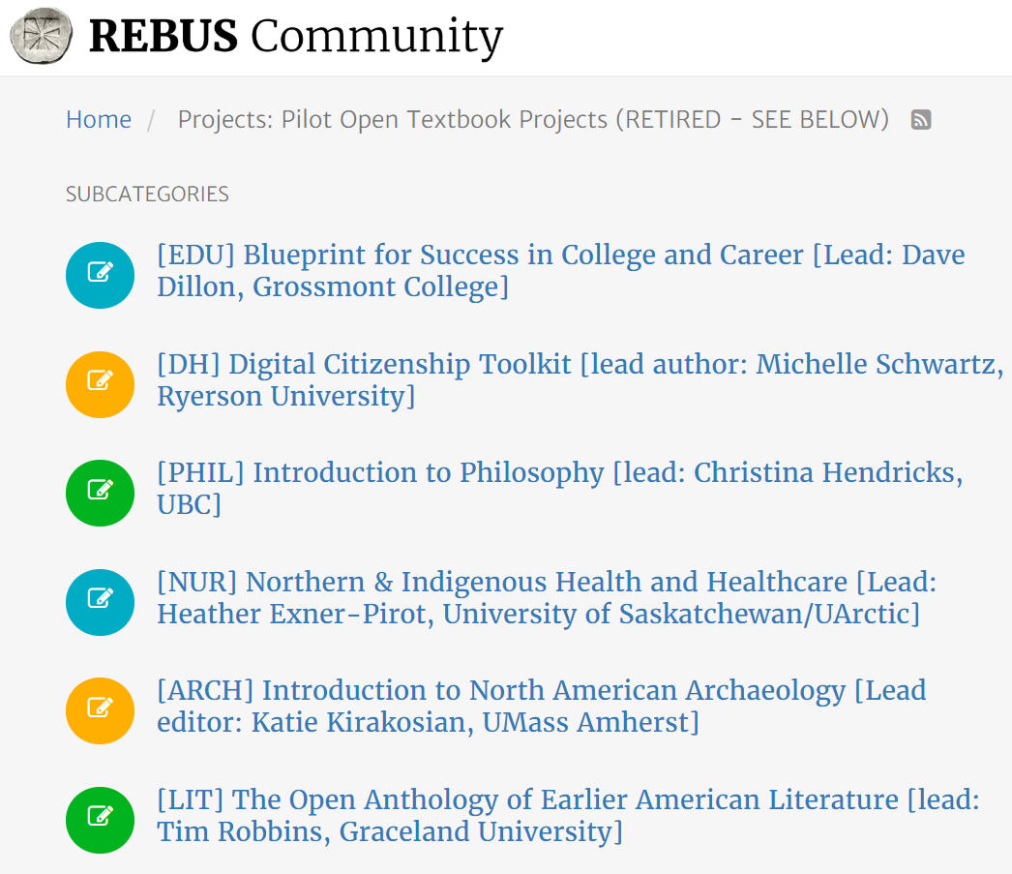
https://forum.rebus.community

Slide 41
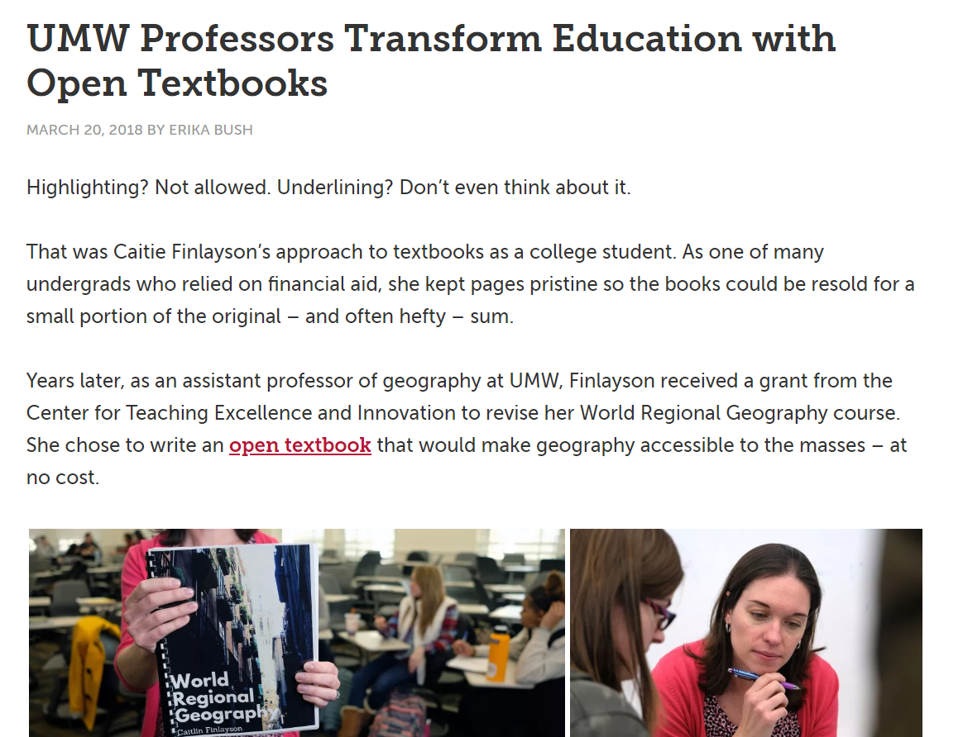

Slide 42
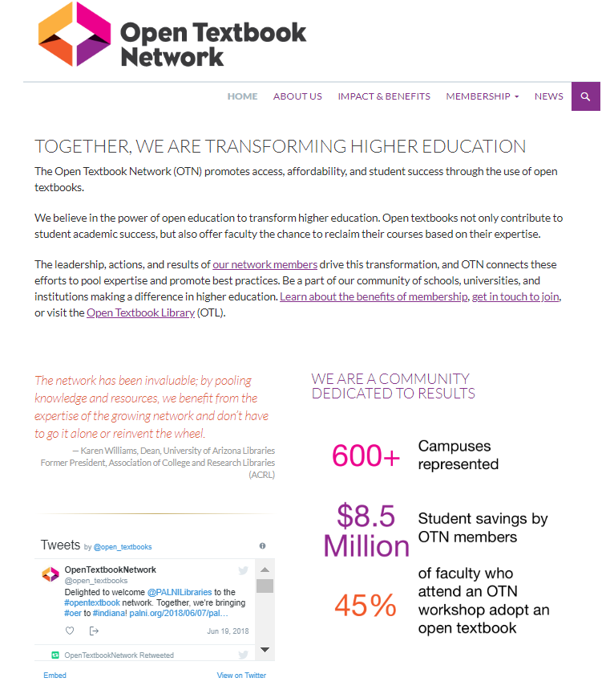
https://research.cehd.umn.edu/otn

Slide 43
IMLS Programs & Projects
https://www.imls.gov/grants/awarded/lg-72-17-0051-17
North Carolina State University Libraries in collaboration with the American Psychological Association, the University of North Carolina Press, the Student Public Interest Research Groups, the Open Textbook Network, and the new preprint service PsyArxiv, will explore the development of a strategy to use open educational resources (OERs) in psychology classrooms. Specifically, the project will gather information about the practices and needs of psychology instructors who may consider adopting or creating OERs. Project findings, recommendations, and a scalable "toolkit" will assist a broad range of scholars, instructors, librarians, and publishers to better understand how to support subject matter experts in the creation and adoption of OERs.

Slide 44


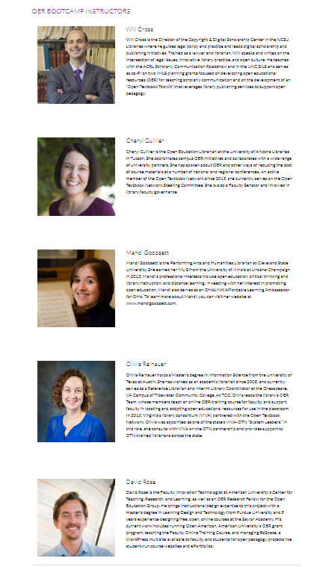
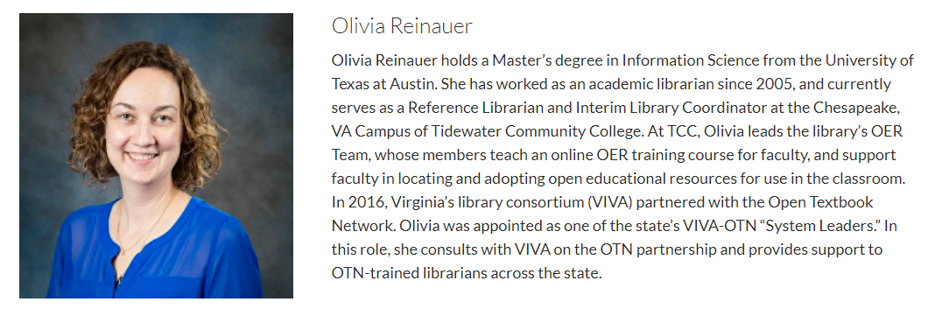
Training opportunities
OER Bootcamp (Open Textbook Network at ACRL 2019)
Bootcamp leaders

Slide 45
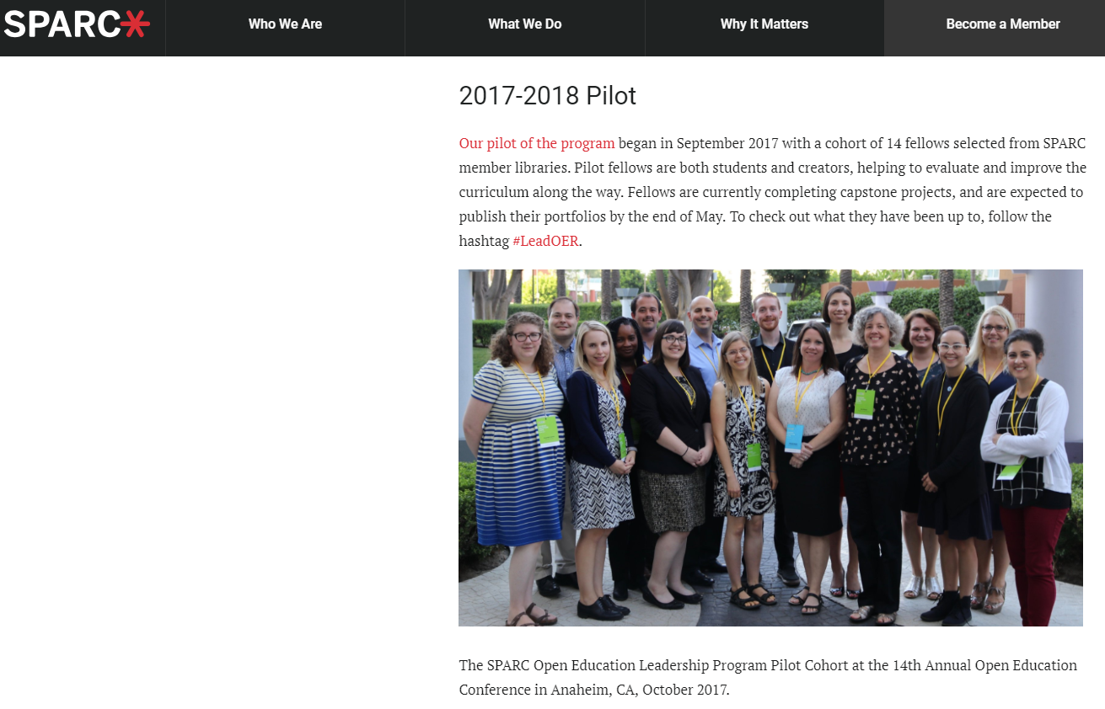
Training opportunities
https://sparcopen.org/our-work/open-education-leadership-program

Slide 46
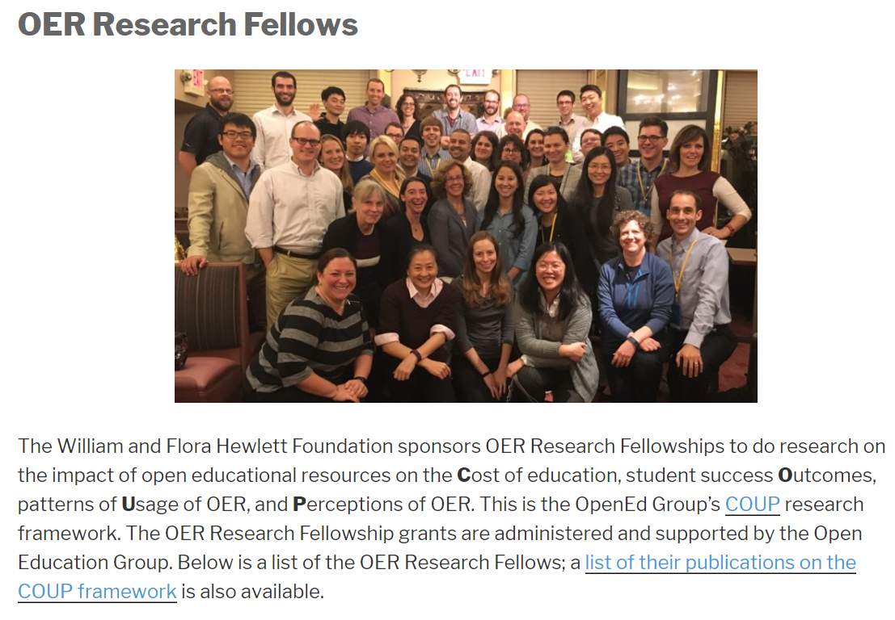
Training opportunities
http://openedgroup.org/fellowship

Slide 47

Training opportunities
https://www.insidehighered.com/digital-learning/deals/2018/06/27/openstax-announces-9-institutions-2018-19-partnerships
http://news.rice.edu/2016/07/06/11-schools-selected-for-national-openstax-partnership-program

Slide 48

https://librarypublishing.org/wp-content/uploads/2017/09/LPF18_OTNCoopPilot.pdf

Slide 49
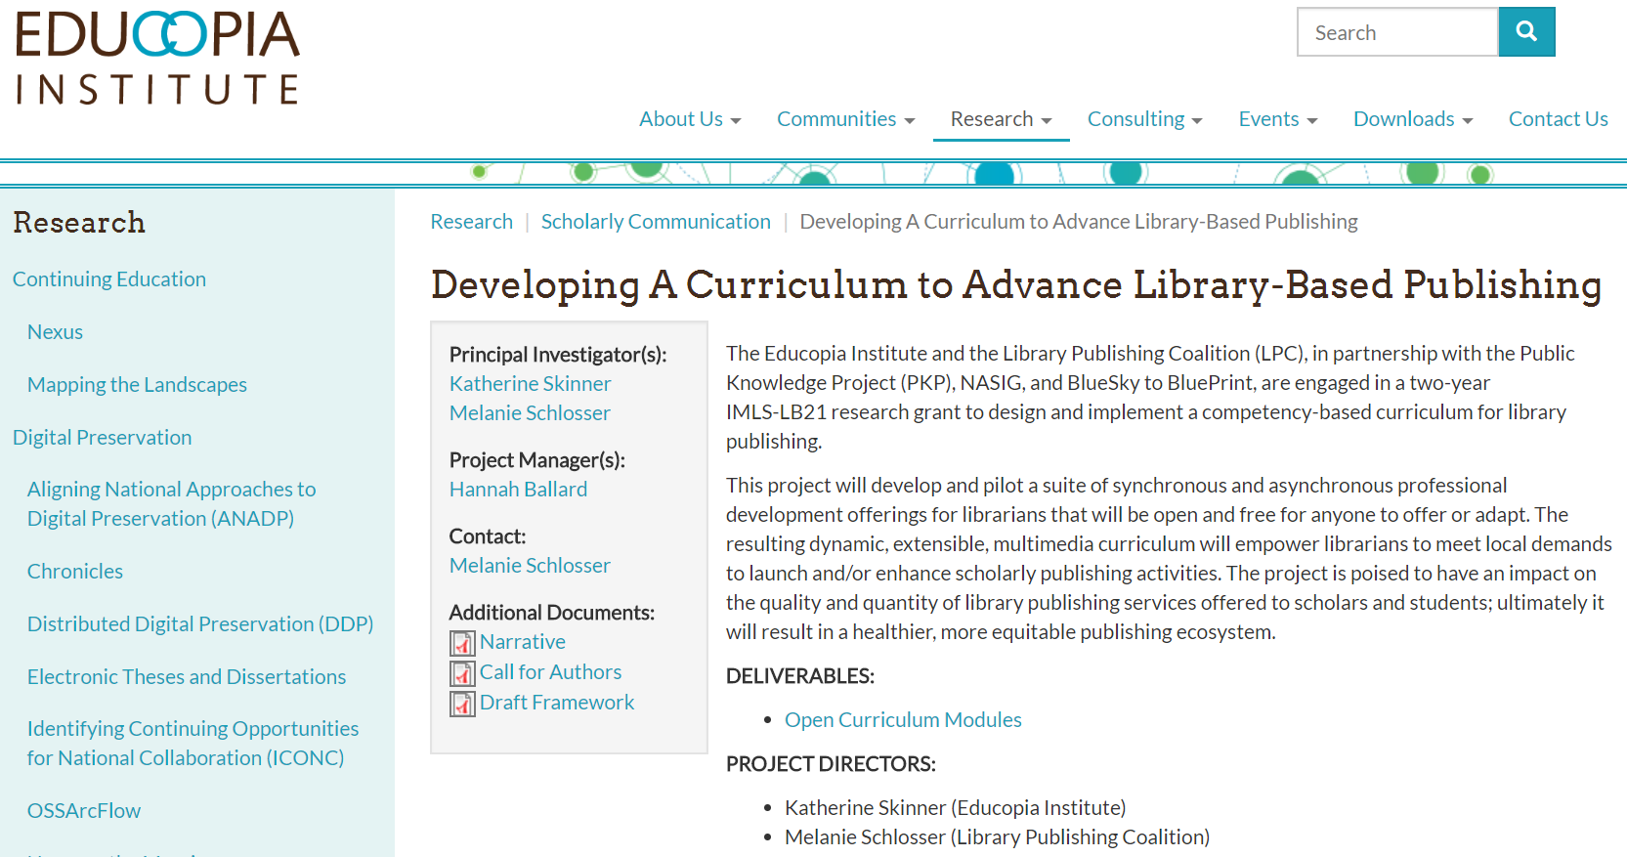
IMLS Programs & Projects
https://educopia.org/research/libpubcurriculum

Slide 50
Is open education just about content?

Slide 51
Open Education values:
SHARING
GIVING & RECEIVING FEEDBACK
NEW IDEAS in TEACHING & LEARNING
OPEN LICENSES
GIVING CREDIT
STUDENTS at the CENTER
© Luis Prado “Jumping Hurdle” CC BY
Adapted from: McKernan, R., Skirko, T., & West, Q. (2015) Librarians as open education advocates: Readings on being an open advocate. Retrieved from https://openedadvocates.pressbooks.com/chapter/definition-of-open-education

Slide 52
Open Pedagogy is . . .
Students with agency as contributors
Collaboration, connection, diversity, democracy, critical assessments of educational tools and environments
Teaching & learning in public
Avoiding disposable assignments

Slide 53
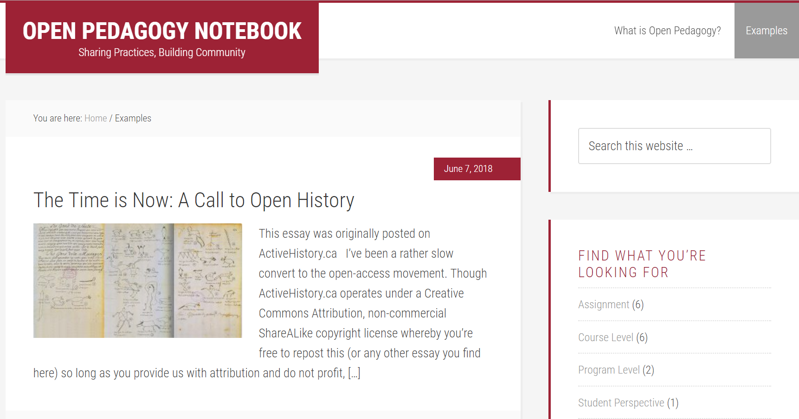
http://openpedagogy.org

Slide 54
Public domain images. Source: Pixabay

Slide 55
THREE Developments in Virginia
Will a P20 consortium (preK-Higher Edu) form?
State Assembly - law amended
VIVA - continued and new programs

Slide 56
Will a P-20 Consortium form in Virginia?
SCHEV LAC (Higher Ed libraries)
#GoOpen (K12)
SCHEV-OVAC (Higher Ed)
VA Department of Education (K12)
School media librarians & educators
- December 2017 meeting in Norfolk, VA

Slide 57
VIVA Open & Affordable Course Content Program
Two years of funding guaranteed
  Continuation of VIVA’s OTN program
  Course redesign grant program
  Purchase of © eBook for courses
  Portal to locate eBooks & open textbooks
  Increased staffing

Slide 58
4/4/2018 added to §23.1-1308 Code of Virginia
“The governing board of each public institution of higher education shall implement guidelines for the adoption and use of low-cost and no-cost open educational resources in courses offered at such institution. Such guidelines may include provisions for low-cost commercially published materials.”

Slide 59

SCHEV’s Open Virginia Advisory Council (OVAC)
→ Creating model guidelines

Slide 60

Virginia Tech
On-campus research
Education, outreach, including course modules
Building partnerships/collaborations/champions on campus
Create/adapt OER
  Open textbooks
  Virtual & augmented reality
Operate, evaluate & improve grant program to adapt/create OER
Notes:
on-campus research, education/outreach/public dissemination/communications, building parnerships/champions/collaborators, and on creating OER and evaluating/improving the open education grants program.
campus outreach,
developing partnerships with individuals and groups that have overlapping concerns,
and supporting faculty who want to find, adopt, adapt, or create open educational
resources.

Slide 61
Discussion
Federal
Priorities of different actors in this space
Values in open education
Various priorities (addressing costs, 5Rs, better teaching & learning)
CARE Framework
Investments in reaching goals – short and long term
State / Virginia
Other burning questions

Slide 62
Discussion
In a context where there is not OER for all topics and with various pressures in higher education (especially the rise of adjunct faculty) what are some ways to continue to invest in a future we want to see?

Slide 63
Thank you!
Anita Walz
arwalz@vt.edu
@arwalz

