Slide 1
Global Event Detector
Final Project Presentation
Multimedia, Hypertext, and Information Access
4/27/2017
Blacksburg, VA 24061
Emma Manchester, Alec Masterson, Ravi Srinivasan, Harrison Grinnan, Sean Patrick Crenshaw

Slide 2
Project Systems
Data Acquisition
Data Analysis
Data Visualization
Notes:
Different Title

Slide 3
Project Systems
Data Acquisition
Polling
Databases
Parsing
Data Analysis
Data Visualization
Notes:
Different Title

Slide 4
Polling
Collects data from Reddit WorldNews Subreddit
Driver script runs every 12 hours
Processes news articles
Stores articles in database
Notes:
PRAW API obtains Subreddit instances to get data from
Updates the database tables especially Cluster table for viz
Poller.py: collects and parses content; establishes connection with raw DB table
ProcessNews.py: stems content, clusters articles, and gathers SNER data

Slide 5
Databases
Stores data into raw, processed, cluster, and clusterPast tables
Retrieving articles more than once
Data used for visualizations
Notes:
Raw - stores data from Subreddit instance: RedditId, URL, title, content, datePosted, dateAccessed
Processed - stores filtered content and article seeds from SNER
Cluster - stores articles that are clustered together and the size of clusters
ClusterPast - stores all clustered data
Updates time accessed when articles are accessed more than once
Clustering array in DB stores all articles in the cluster

Slide 6
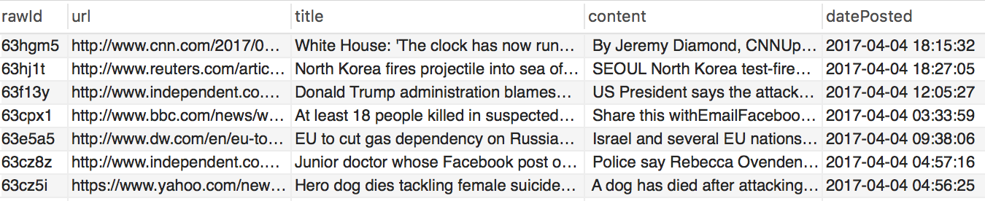
Raw Database Table
Notes:
Raw - stores rawId, url, title, content, datePosted, dateAccessed, numComments, numVotes, domainName
Processed - stores processId, processedDate, processedTitle, seeds, articleScore
Cluster and Past - clusterId, clusterArr, clusterSize, url, articleTitle, dateAccessed

Slide 7
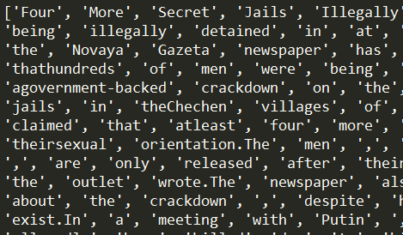
Parsing - BeautifulSoup
Notes:
parse by all p tags
keep everything within p tags
limit to 1000 words
eliminates anything (like javascript) that’s not in p-tags

Slide 8
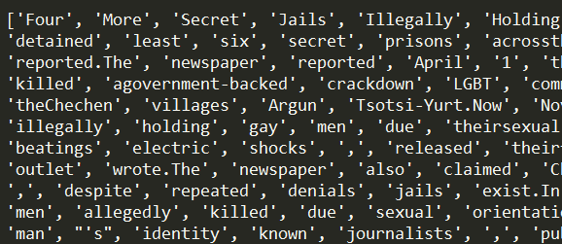
Parsing - Removing Stopwords
Notes:
get rid of words like “the” and “and”
helps to normalize articles (can be heavy on “the” and considered similar, but about another topic)

Slide 9
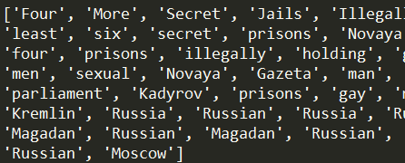
Parsing - Filtering Content
Notes:
remove words that are irrelevant to the text
compare words in text to words in title and already kept words
keep words that are similar enough to title

Slide 10
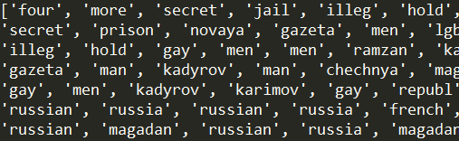
Parsing - Stemming Content
Notes:
get rid of endings to keep the same stem word
use porter stemmer
words with the same roots (and meaning) but with different endings are effectively the same
make everything lowercase

Slide 11
Project Systems
Data Acquisition
Data Analysis
Seed
Clustering
Data Visualization
Notes:
Different Title

Slide 12

Stanford Named Entity Recognizer
3 Class Models used
Location
Person
Organization
SNER demo
[1]

Slide 13
Seed Extraction
Seed - a series of entities
Attached to article object
Inserted into Database
Notes:
Explain seed or change title

Slide 14
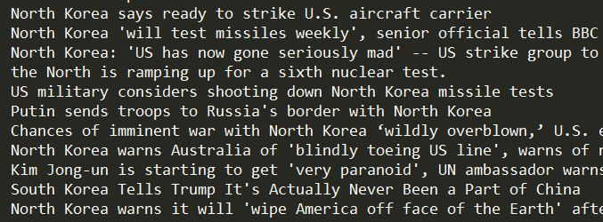
Clustering
Notes:
create a tfdif matrix of all the documents
represent similarities with a graph – nodes are articles, edges connect nodes that are similar
compare each article to every other article
if they are > 15% similar, draw an edge
find maximum cliques – maximally connected components in a graph
these are clusters
for each cluster – pick a representative article at random, the reddit id is how to identify the cluster
lesson learned – ask client for help

Slide 15
Project Systems
Data Acquisition
Data Analysis
Data Visualization
PHP
Bubbles
Carousel
Notes:
Different Title

Slide 16
Data Visualization
A PHP-based single-page Web-Application
Used to display Cluster Data
Bubble
Cluster
Database
Front End
PHP
JSON
Article
Carousel

Slide 17
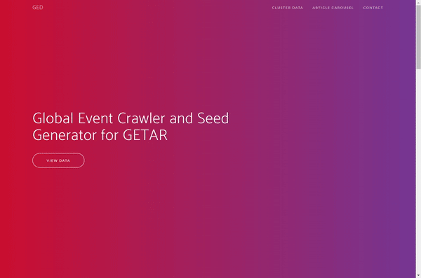
Navigation

Slide 18
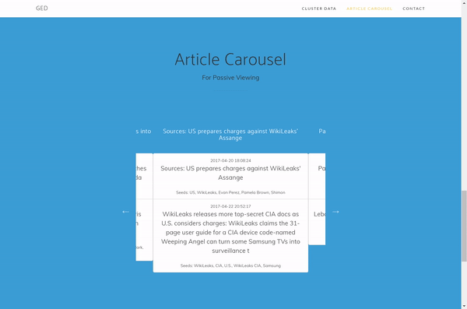
Article Carousel

Slide 19
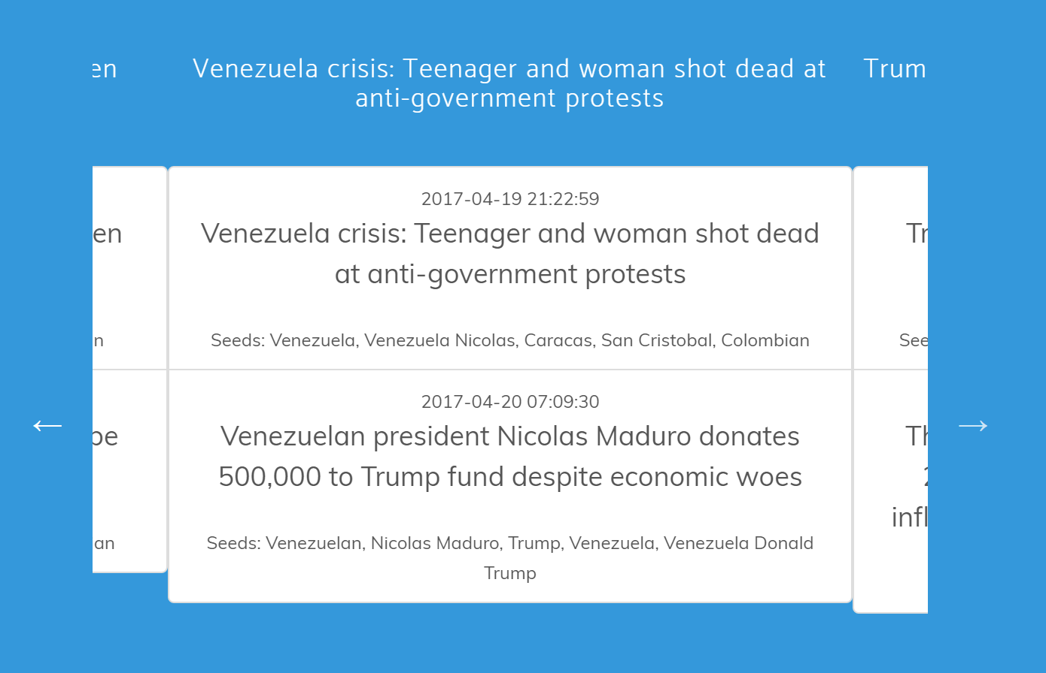
[1]
[2]
[3]
[4]

Slide 20
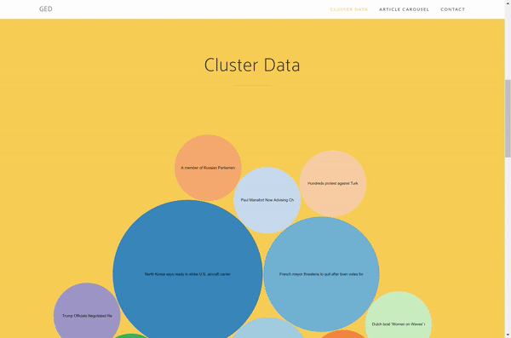
Notes:
Now, the moment that we have all been waiting for: the interactive bubble display.
Used SQL queries in PHP to pull specific data from MySQL database and parse data into JSON
I had to use a regex expression to filter out special characters that break JSON because some titles include very interesting characters
Once the JSON is processed, we use D3.js to iterate through each cluster of JSON data
We then create a bubble for each cluster of the appropriate size that contains the relevant articles within the cluster
This visualization is interactive because if you click on any bubble, you will get a list of the articles in that cluster with some details and a link for each article

Slide 21
Deliverables
Effective Clustering of Articles from Reddit
Storage of Entities in Database
Website
Visualization of Clusters
Article Carousel
Notes:
Quantitative
Average of size of clusters
Biggest and smallest cluster sizes
Total number of articles we processed
Qualitative
Any interesting cluster topic we found

Slide 22
Lessons Learned
Ask for help early
Project specifications change over time
Most things have a built-in Python library - save time!
Frequent, regularly scheduled meetings keep things moving

Slide 23
Questions?

Slide 24
References
Stanford University at Twitter. Retrieved April 24, 2017, from https://twitter.com/stanford
Collaborative Research: Global Event and Trend Archive Research (GETAR) (NSF Grant No. 1619028). URL: http://www.eventsarchive.org/sites/default/files/GETARsummaryWeb.pdf
Stop Words with NLTK. (2016). Retrieved March 16, 2017, from https://pythonprogramming.net/stop-words-nltk-tutorial/
Natural Language Toolkit. (2017, January 02). Retrieved March 16, 2017, from http://www.nltk.org/
Using word2vec with NLTK. (2014, December 29). Retrieved March 16, 2017, from http://streamhacker.com/2014/12/29/word2vec-nltk/
Rehurek, R. (2017, January 11). Gensim: topic modelling for humans. Retrieved February 17, 2017, from https://radimrehurek.com/gensim/
Stanford Named Entity Recognizer (NER). (2016, October 31). Retrieved March 16, 2017, from http://nlp.stanford.edu/software/CRF-NER.shtml
Jhlau/doc2vec. (2016, September 19). Retrieved March 16, 2017, from https://github.com/jhlau/doc2vec
Python Software Foundation. "20.5. urllib — Open arbitrary resources by URL." 20.5. urllib - Open arbitrary resources by URL — Python 2.7.13 documentation. 27 Mar. 2017. Web. 28 Mar. 2017.

Slide 25
References
Rehurek, R. (2017, March 8). Models.doc2vec – Deep learning with paragraph2vec. Retrieved March 16, 2017, from https://radimrehurek.com/gensim/models/doc2vec.html
Richardson, L. (2015). Beautiful Soup Documentation. Retrieved March 16, 2017, from https://www.crummy.com/software/BeautifulSoup/bs4/doc/
Boe, B. (2016). PRAW: The Python Reddit API Wrapper. Retrieved March 16, 2017, from http://praw.readthedocs.io/en/latest/
Bostock, M. Data-Driven Documents. Retrieved March 17, 2017, from https://d3js.org/
Jenny Rose Finkel, Trond Grenager, and Christopher Manning. 2005. Incorporating Non-local Information into Information Extraction Systems by Gibbs Sampling. Proceedings of the 43nd Annual Meeting of the Association for Computational Linguistics (ACL 2005), pp. 363-370. http://nlp.stanford.edu/~manning/papers/gibbscrf3.pdf
Mikolov, T. GoogleNews-vectors-negative300.bin.gz. Retrieved March 16, 2017, from https://drive.google.com/file/d/0B7XkCwpI5KDYNlNUTTlSS21pQmM/edit
Schmidt, T. (2016, December 7). Named Entity Recognition with Regular Expression: NLTK. Retrieved March 16, 2017, from http://stackoverflow.com/questions/24398536/named-entity-recognition-with-regular-expression-nltk
Project, NLTK. "Nltk.stem package." Nltk.stem package — NLTK 3.0 documentation. 2015. Web. 16 Mar. 2017.

