Slide 1
March 06, 2014
Presentation # 8
CINET Registry
Aditya Agashe,
Harshal Ganpatrao Hayatnagarkar and
Sarang Joshi
Mentored by
Dr. Keith Bisset (NDSSL)
CS 6604 – Digital Libraries Virginia Tech, Blacksburg

Slide 2
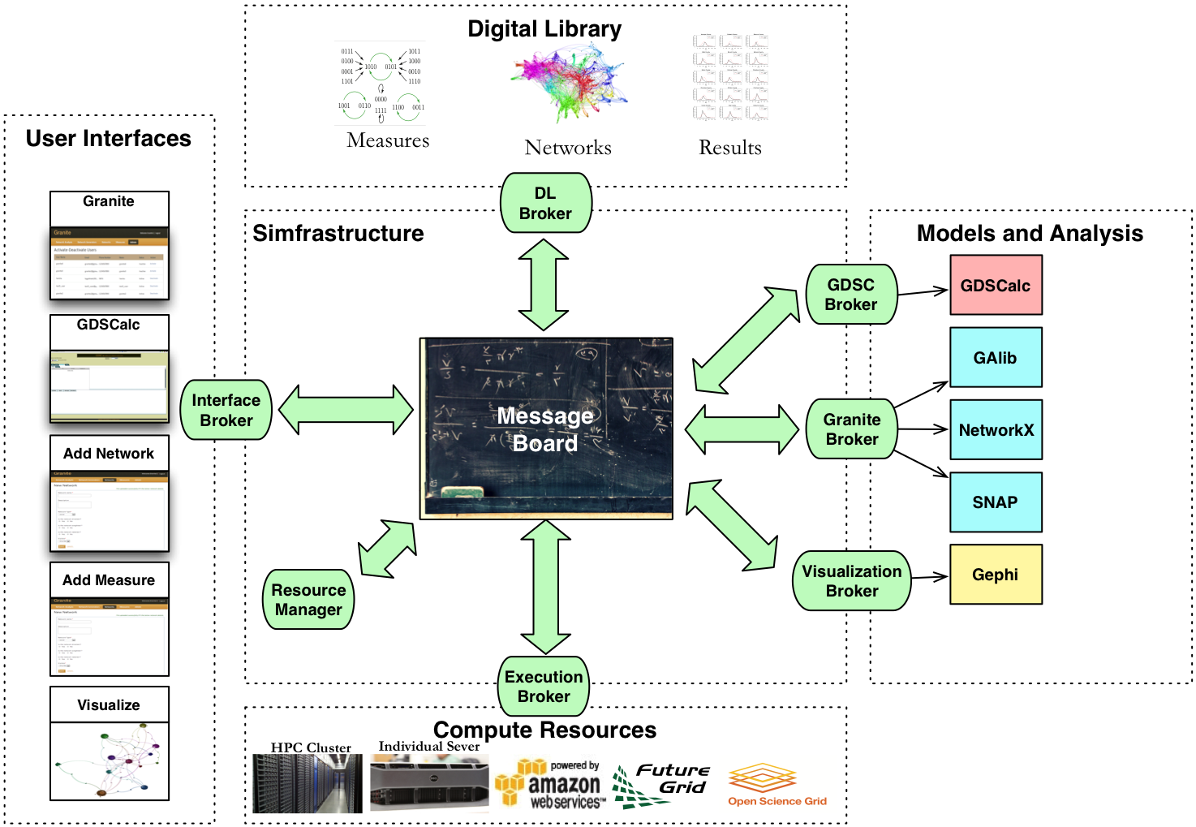
CINET Architecture

Slide 3
Workflow and entities
Input Network dataset
  Formats
  Metadata
  Properties
Select network
Select measure
Define analysis jobs
Schedule analysis jobs
Collect output
Output Network/Image/Dataset
  Format
  Metadata
  Properties
Measures
  Parameters
  Platform
  Formats
  Complexity
DL
Analysis job
  Network
  Measure
  Resource
  Metadata: Duration, user…
Resource
  Type
  Availability
  Supported measures

Slide 4
Motivation
From RDBMS to digital object repository
  Common minimum subset of metadata
  Creation of one table per kind of dataset to capture metadata
Unified data model
  Domain-specific metadata
  Multiple dataset in data streams and respective metadata in single complex digital object.

Slide 5
Challenges
Complex digital object for datasets
  Multiple format files as embedded data streams.
  Domain-specific metadata
  Format conversion
    Loss of info
    Automatic conversion
Analysis configuration specification
  Entire analysis as complex digital object
  Refers: Input, output, algorithms, user and so on.
‘Concept’: Plug-in based metadata element
  For example, ‘Person’ entity can be plugged with disease specific metadata for different diseases.

Slide 6
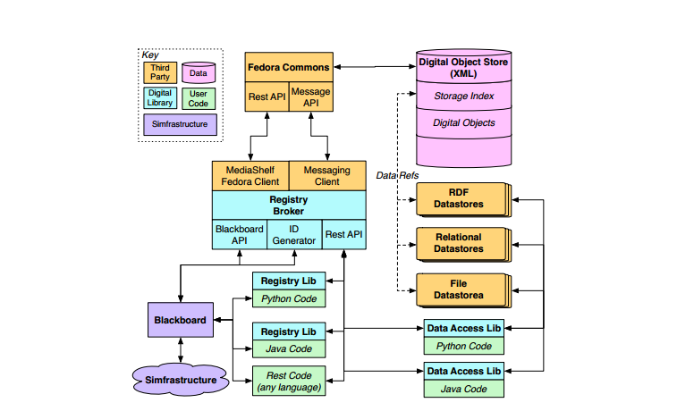
Proposed Solution Architecture

Slide 7
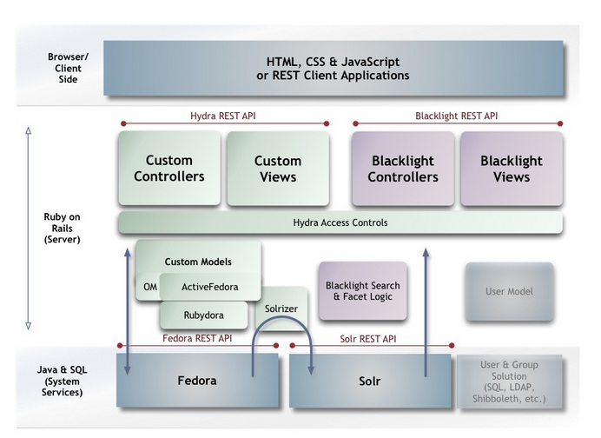
Technology stack

