Slide 1

Crisis Event Template Generation
Nicholas Hess, Gibbs Gresge, Alex Ryu, Jackson Small, Aneesh Tummeti
Group 15
4624 Multimedia/Hypertext | Mohamed Farag Virginia Tech, Blacksburg VA 24061
Notes:
Jackson

Slide 2
Table of Contents
Demo
1
2
3
4
Project Overview
Tech Stack
Problems & Solutions
Future plans
Notes:
Jackson

Slide 3
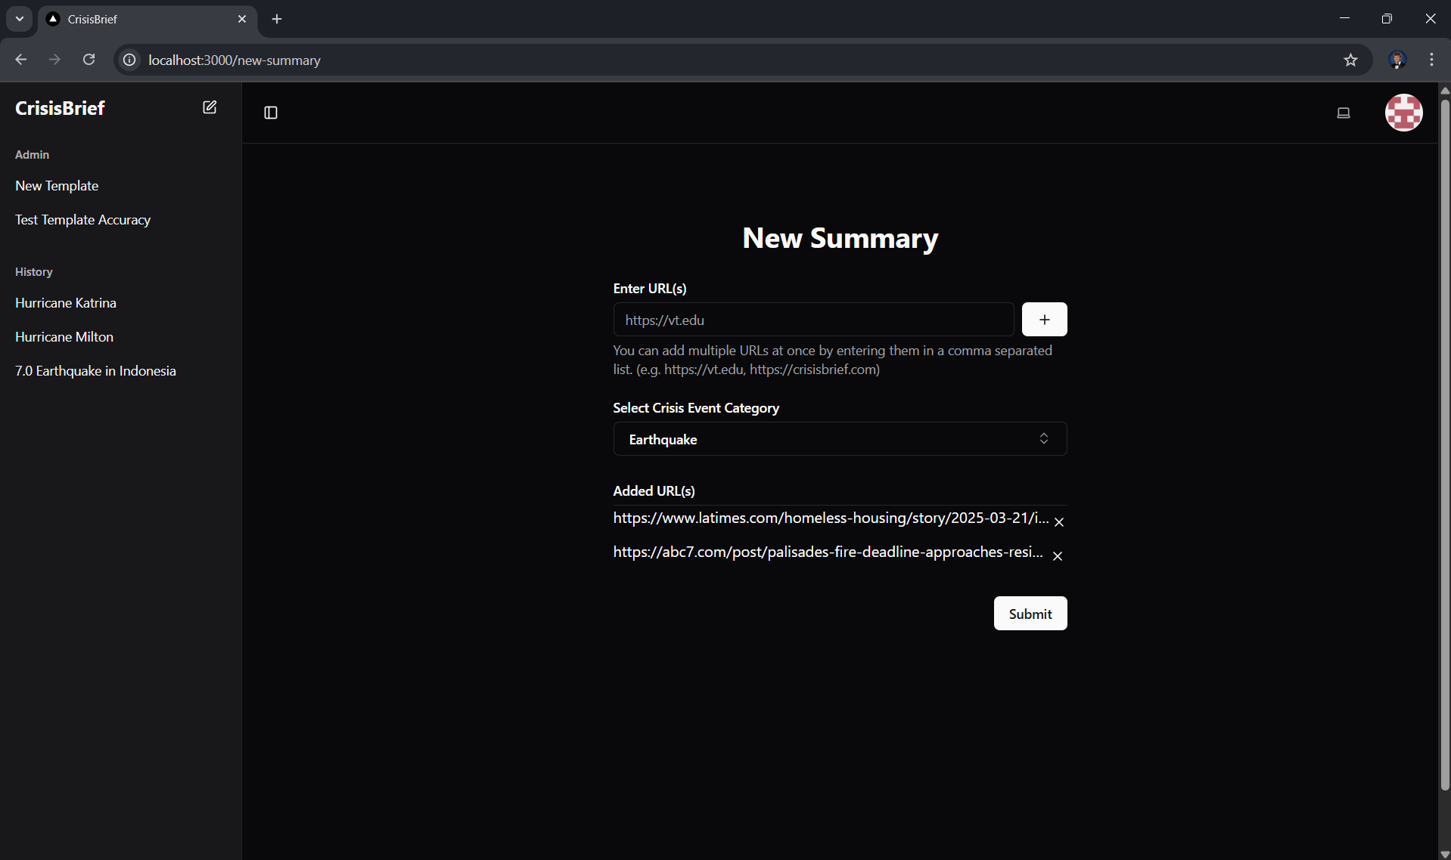
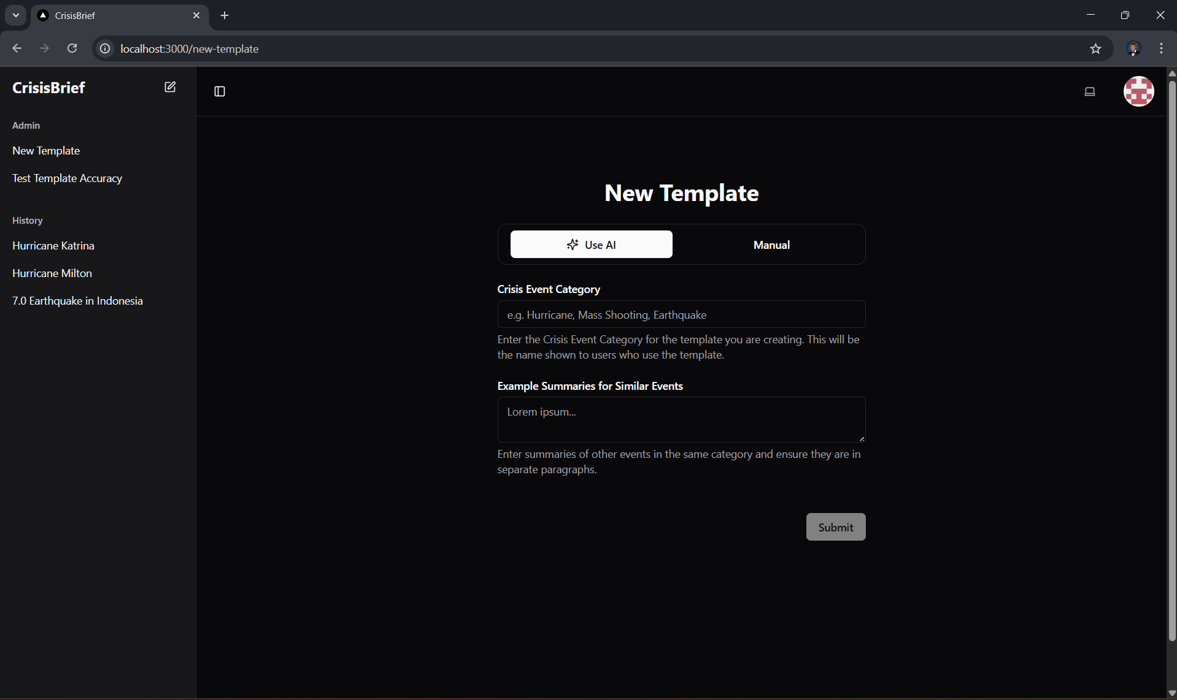
What does our project do?
1. Generate templates for Crisis Event Categories
Hurricanes, shootings, earthquakes, etc.
Summarize events and find similarities and key attributes
2. Allow users to generate filled out templates for a given Crisis Event
User can select from Crisis Event Categories
User chooses URLs related to a Crisis Event and generates the filled out template
Notes:
Jackson

Slide 4

LLM use
CapyBaraHermes-2.5-Mistral-7B-GGUF
Used for template generation and website summarization
LangChain for modularity
Notes:
Alex

Slide 5

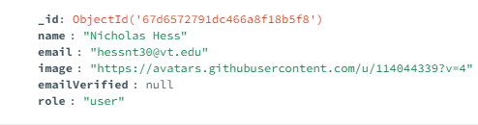
Database
MongoDB
It is easy to amend the documents
Great and lightweight noSQL database
Notes:
Gibbs

Slide 6

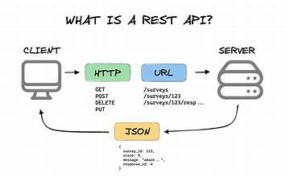
Backend with Flask
Two endpoints
  one that scrapes URLs for text for generating summaries
  one that accepts raw text input to generate templates
BeautifulSoup to parse HTML to scrape URLs
Hugging Face’s transformers pipeline for text generation.
LangChain for LLM use
Parse generated text using regular expression and find key attributes
Both endpoints accept and respond with JSON, returning a dictionary mapping each placeholder to its corresponding text.
Notes:
Alex

Slide 7


Frontend
Server Actions
NextAuth.js
TanStack Query
(React Query)
Server-side functions for handling actions that don’t deal with LLM (auth, database management)
Open source authentication library that integrates seamlessly with MongoDB
Optimizes data fetched from API calls by caching and updating data in real time
Server-Side Rendering
GitHub OAuth
Role-Based Access
Pages are pre-rendered on the server before being delivered to the client
Authentication provider used for authentication implementation
Using roles to conditionally show information/pages to users or admin.
Notes:
Nick

Slide 8
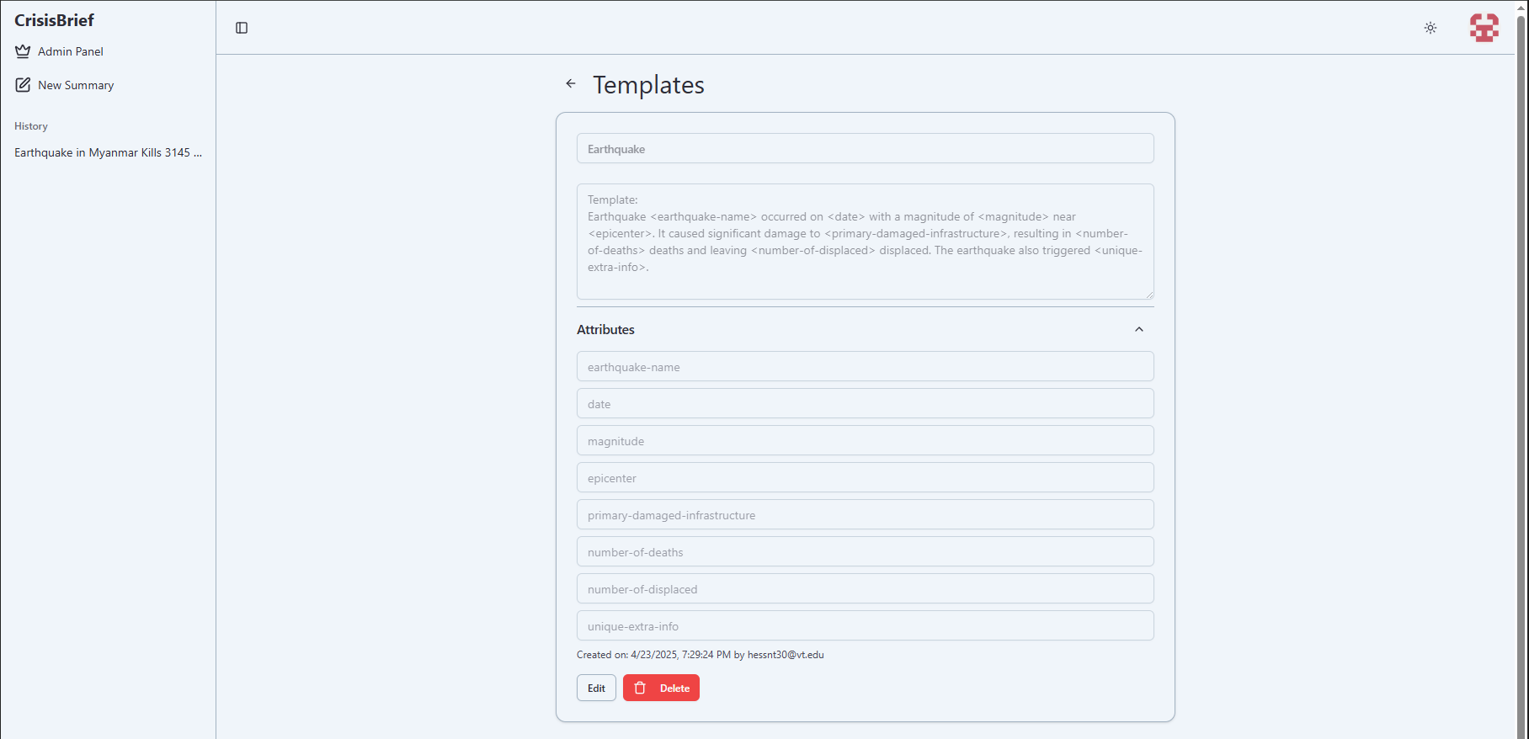
Earthquake Template
Notes:
Nick

Slide 9
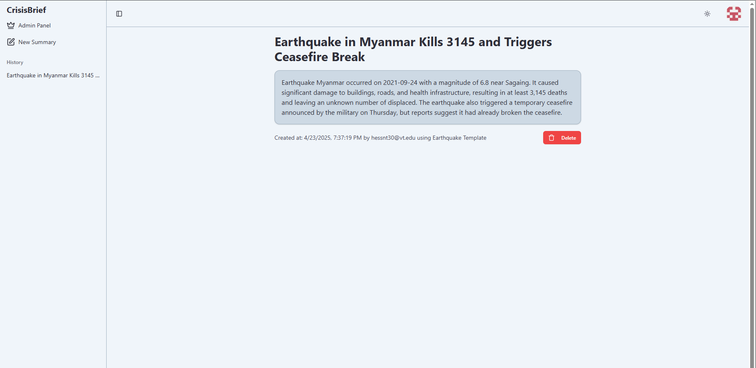
Earthquake Summary
Notes:
Nick

Slide 10
Problems along the way
And how we fixed them
Notes:
Gibbs

Slide 11
Issues
LLM was too large
Long time to create prompts & templates
Poor LLM outputs
How we fixed it
How we fixed it
How we fixed it
Research to find a new model, and pivoted to use LangChain to make use of distilled models from Hugging Face
Built an email service to notify the user when the templates and summaries are complete.
Iterated over multiple prompts, more on this…
Notes:
Gibbs

Slide 12
Template Generation
Prompt Engineering
First Prompt
Final Prompt
You are a professional news reporter whose job is to create a summary template for {disaster_type}. You should pick up on key attributes found across all the given paragraphs.
Each context paragraph is a separate instance of a {disaster_type} event that has happened.
Your goal is to return ONE 5 sentence summary template that has key attributes left as tags in this format <example-attribute>.
The template should end with a tag specifically for unique/extra info about a specific {disaster_type}.
Only use the provided summaries of crisis events
For example, the template for a hurricane would look like this:
<hurricane-name> made landfall as a <category> hurricane, impacting
<primary-location> with <primary-impact>. The storm caused <death-toll> deaths and resulted in <damage-cost> in damages. <secondary-impact> displaced thousands and left widespread destruction. The response and recovery efforts were <response-evaluation>.
<unique-extra-info>.
RETURN ONLY THE TEMPLATE IN THE DESCRIBED FORMAT, NO OTHER TEXT.
ONLY RETURN ONE TEMPLATE THAT COULD BE USED FOR THE DISASTER TYPE
MAKE SURE THE ATTRIBUTES/TEMPLATE ARE SPECIFIC TO THAT DISASTER TYPE AND ARE SURROUNDED BY THE <>.
You are a professional news reporter. Your task is to generate a generalized summary template for {disaster_type}, ensuring that it applies to any event of this type.
Each input paragraph describes a past {disaster_type} event. Identify common key attributes across all examples and structure them into a standardized template.
Instructions:
The template must be fully generalized for {disaster_type}s—DO NOT insert specific details from the given context.
Use descriptive placeholder tags in this format: <attribute-name>.
DO NOT add extra commentary or change the output structure.
The template must remain neutral and applicable to all {disaster_type} events.
The template must end with a <unique-extra-info> tag for unique info about a specific {disaster_type}.
Here are some examples of summaries that were used to create a template for a Hurricane disaster.
Context of Hurricanes:
Hurricane Katrina made landfall on August 29, 2005, as a Category 3 hurricane along the Gulf Coast, primarily affecting Louisiana and Mississippi… (omitted for space on slide)
Generated Template:
Hurricane <hurricane-name> was a Category <category> hurricane that affected <primary-affected-location> and caused <primary-effect> on <hurricane-date>. The hurricane had winds up to <max-wind-speed>. Hurricane <hurricane-name> also affected <secondary-affected-area>. <unique-extra-info>.
Here are some examples of summaries that were used to create a template for a Wildfire disaster.
… (omitted for space on slide)
Now given the follow context, create a template for {disaster_type}s like the examples above:
{disaster_context}
Return ONLY the structured template above without explanations or additional text.
Ensuring the template is general to any event within the crisis type
Explicit instructions helped immensely with formatting output
Examples of summary to template transformation
Notes:
Nick

Slide 13
Demo
Notes:
Nick

Slide 14
Future Work
What the next team can do.
Notes:
Gibbs

Slide 15

When Better AI models come up update the prompt
Find a more efficient backend
Notes:
Gibbs

Slide 16
Team and Acknowledgements
Notes:
Gibbs

Slide 17
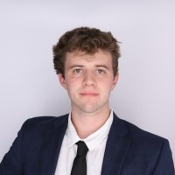
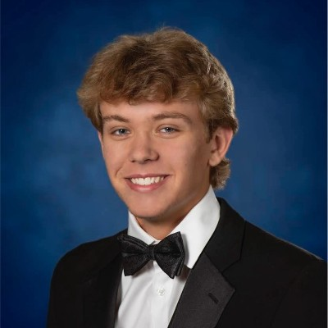



Meet the Team
Gibbs Gresge
Nicholas
Hess
Jackson Small
Alex Ryu
Aneesh Tummeti
Backend
Fullstack
Frontend
Backend
Frontend
Notes:
Gibbs

Slide 18

Dr. Farag
Professor for CS4624
Research associate in the Center for Sustainable Mobility (CSM)
Notes:
Gibbs

