Slide 1

Chapter 2
The Foundations of Business
(c) Virginia Tech, Department of Management, Pamplin College of Business. CC BY NC SA 4.0.
Available from: http://hdl.handle.net/10919/105157
Photo from Unsplash

Slide 2
Objectives
Describe the concept of stakeholders and identify the stakeholder groups relevant to an organization
Discuss and be able to apply the PESTEL macro-business-environment model to an industry or emerging technology
Explain other key terms related to this chapter including entrepreneur; profit; revenue

Slide 3

Why is Apple Successful?
“Steve Jobs.” (2011). Flickr. CC BY 2.0. Retrieved from: https://www.flickr.com/photos/8010717@N02/6216457030

Slide 4
Dynamic Business Environment
What is the purpose of a business?
Business: Any activity that seeks to provide goods and services to others while operating at a profit.
Goods: Tangible products
Services: Intangible products
Entrepreneur: A person who risks time and money to start and manage a business.

Slide 5
Revenue vs. Profit
Revenue represents the funds an enterprise receives in exchange for its goods or services.
Profit is what’s left (hopefully) after all the bills are paid or the COST of doing business.

Slide 6
Types of Businesses
Goods
Apple produces and sells goods
Mac
iPhone
iPod
iPad
Apple Watch
Services
Many businesses provide services
Hotels
Airlines
Law Firms
Movie Theaters
Hospitals
Goods and Services
Car Dealership
Sells Goods (Cars)
Provides Services
(Automobile Repairs)
Not-for-Profit (Nonprofit)
United Way of America
Habitat for Humanity
The Boys and Girls Clubs
American Red Cross
Colleges and Universities

Slide 7
Nonprofit Organizations
Nonprofit Organization --An organization whose goals are for the betterment of the community, not financial gain

Slide 8
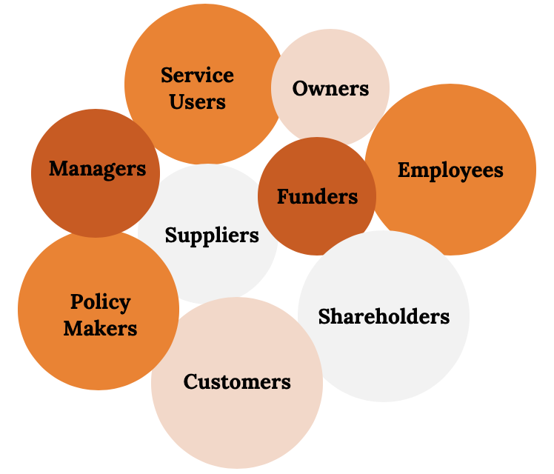
Stakeholders
Stakeholders --All the people who stand to gain or lose by the policies and activities of a business and whose concerns the businesses need to add
Who are Stakeholders?
- Customers
- Employees
- Shareholders
- Suppliers
- Dealers
- Community Members
- Banks
- Media
- Elected Officials
- Environmentalist

Slide 9
Goals: Explore the World of Business
Introduction to the various activities in which businesspeople engage.
Functional Areas
    Accounting
    Finance Information
    Business Technology
    Management
    Marketing
    Operations
Understand the roles that these activities play in an organization and show you how they work together.
Reviewing the interactions of these functional areas will help you decide whether business is right for you and, if so, what areas of business you’d like to study further

Slide 10
Functional Areas of Business
Management
Managers are responsible for the work performance of other people.
Management involves:
Planning for,
Organizing,
Leading, and
Controlling a company’s resources so that it can achieve its goals.
Management Examples
Purchasing, Human Resources, Engineering, Administration

Slide 11
Functional Areas of Business
Operations
The person who designs and oversees the transformation of resources into goods or services is called an operations manager.
Career Examples
Operations, Manufacturing, Quality, Project Manager

Slide 12
Functional Areas of Business
Marketing
Marketing consists of everything that a company does to identify customers’ needs (i.e. market research) and design products to meet those needs. They manage relationships with customers and make them aware of the organization’s desire and ability to satisfy their needs.
Marketing establishes the Four P’s:
Price
Product
Promotion
Place
Career Examples
Brand, Digital, Product, Research, Communications, Channel, Sales

Slide 13
Functional Areas of Business
Accounting
Managers need accurate, relevant and timely financial information, which is provided by accountants.
Accountants measure, summarize, and communicate financial and managerial information and advice other managers on financial matters.
Financial accountants prepare financial statements to help users, both inside and outside the organization, assess the financial strength of the company.
Managerial accountants prepare information, such as reports on the cost of materials used in the production process, for internal use only

Slide 14
Functional Areas of Business
Finance
Finance involves
Planning for,
Obtaining, and
Managing a company’s funds.
Financial managers address such questions as the following:
How much money does the company need?
How and where will it get the necessary money?
How and when will it pay the money back?
What investments should be made in plant and equipment?
How much should be spent on research and development
Career examples: Audit, Planning, Analyst, Budget, Consultant

Slide 15
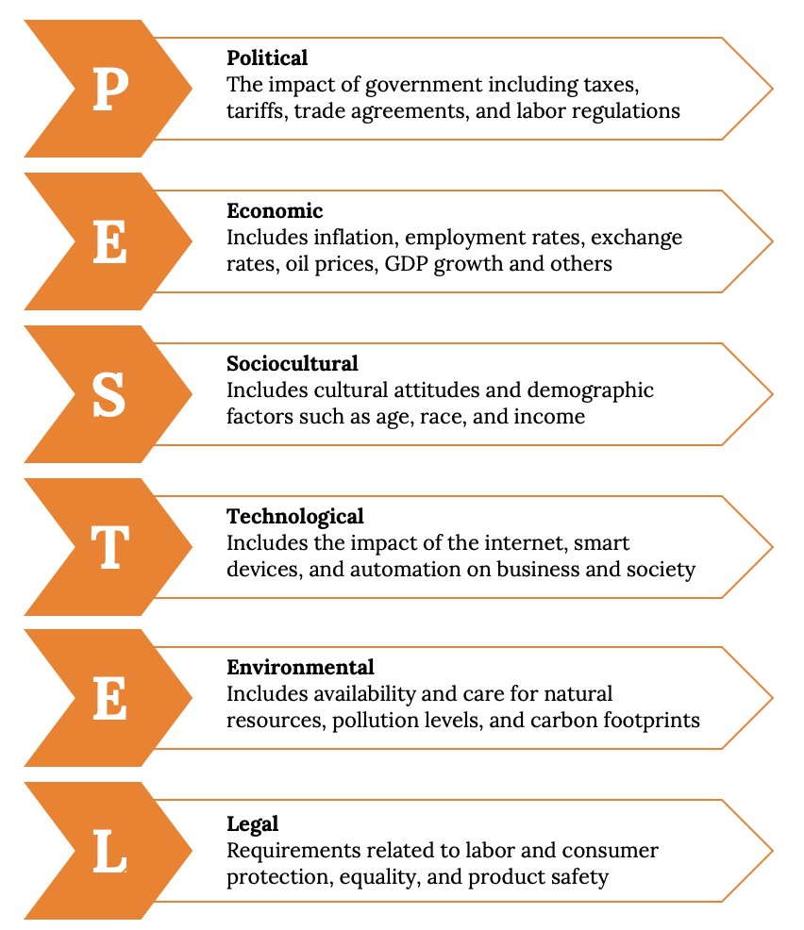
PESTEL

Slide 16
Takeaways
The main participants in a business are its owners, employees, and customers.
Every business must consider its stakeholders, and their sometimes-conflicting interests, when making decisions.
The activities needed to run a business can be divided into functional. The business functions correspond closely to many majors found within a typical college of business.
Businesses are influenced by such external factors as the economy, government, and other forces external to the business. The PESTEL model is a useful tool for analyzing these forces.

Slide 17
Q & A
(c) Virginia Tech, Department of Management, Pamplin College of Business. CC BY NC SA 4.0.
Available from: http://hdl.handle.net/10919/105157

