Slide 1
Discovery Portal for CS4624 Projects
Team Members: Henry Arze, Logan Natysin, Matthew Titi, Patrick Underwood
CS4624: Multimedia, Hypertext, and Information Access
Instructor: Mohamed Farag
Blacksburg, VA, 24061
12/3/2024

Slide 2
Outline
Project Overview
Final Design (User Roles / System Architecture)
Backend Features + Database Schema
Frontend Features
Live Demo
Future Work
Roles
Acknowledgements + References

Slide 3
Project Overview
Problem: Create a website to facilitate and store all past and future CS4624 projects
Motivation: A separate website will make it easier for…
Clients to create projects for the class
Students to search for and sign up for projects
Instructor to organize and manage the projects for the semester
Deliverables:
Source code and documentation
Docker image of system
Deployed web application

Slide 4
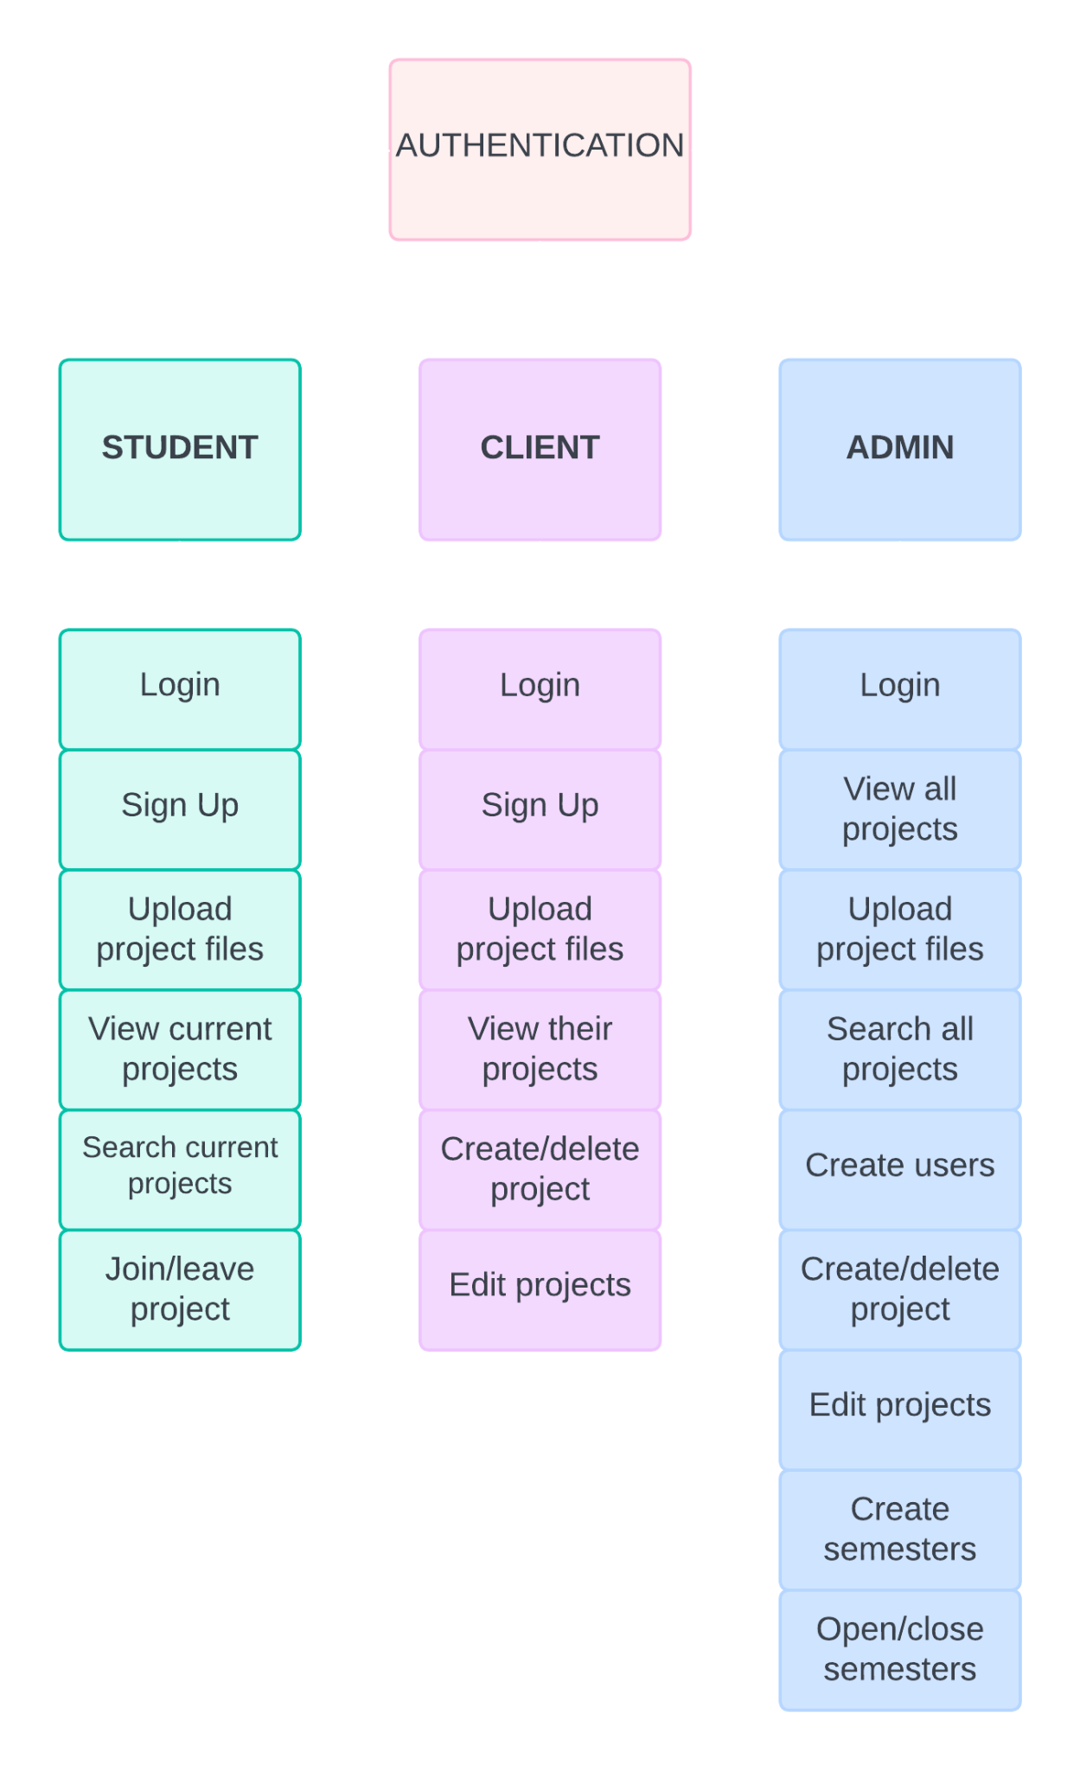
Design Flow: User Roles

Slide 5



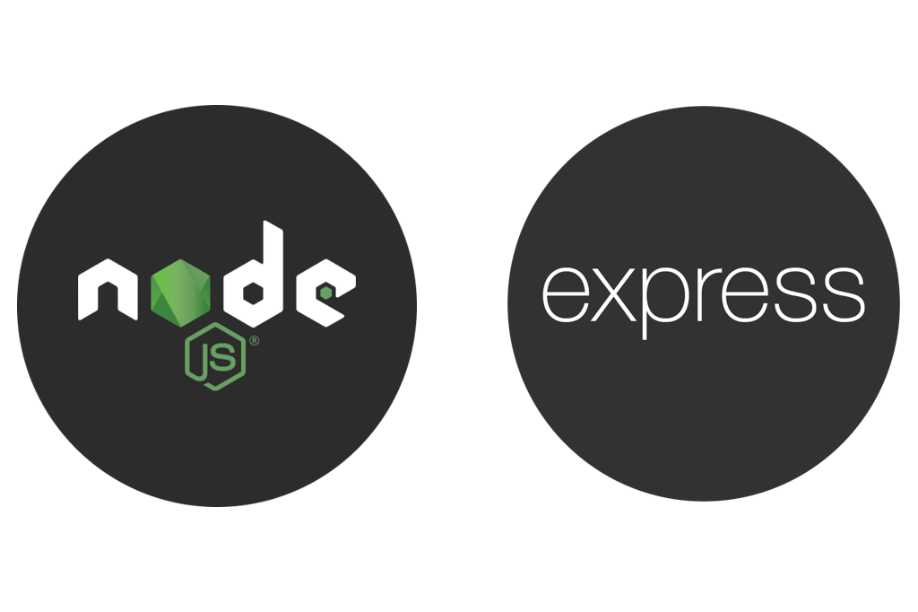


Final System Design
Design
Protected pages
Distinct user roles
Web scraped VTechWorks for project files
Stack
MongoDB to MySQL (kept same data)
Node and Express to Python and Flask
Regular CSS to Tailwind and shadcn components

Slide 6

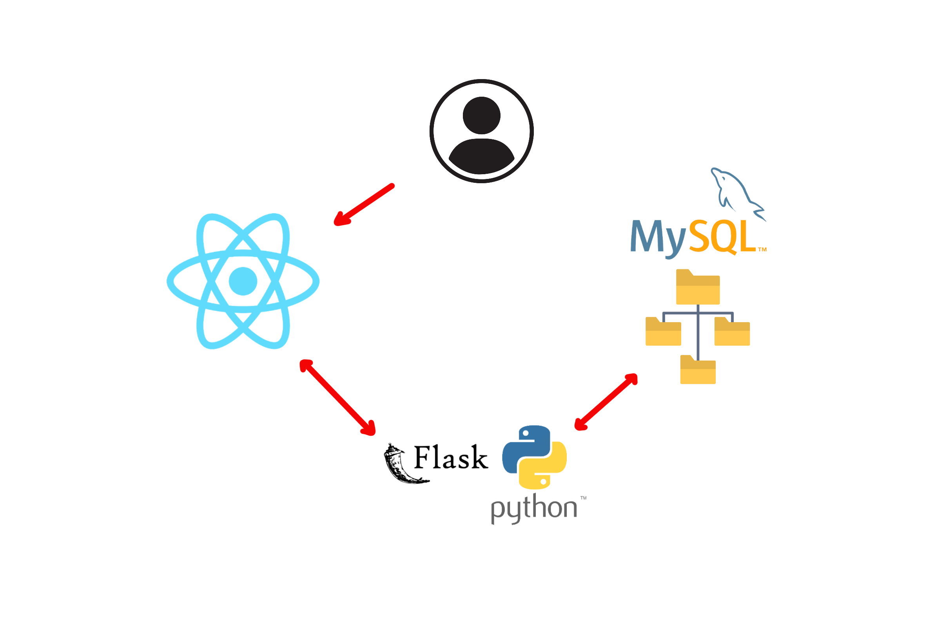
System Architecture
User can create, see, join, and delete projects (based on role) on website
Database stores project files and information on the system
React frontend interacts with Python Flask backend
Backend server for data retrieval
Notes:
React: http request to Flask
Flaks: interacts with DB accordingly, sends JSON to React
React: receives response and updates the UI
Docker: Creates container for our application and allows for portability and simplicity

Slide 7
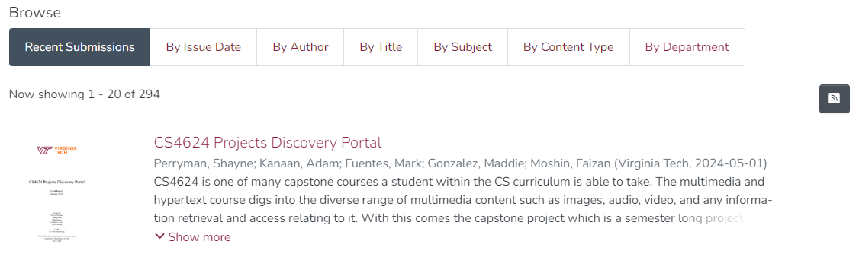
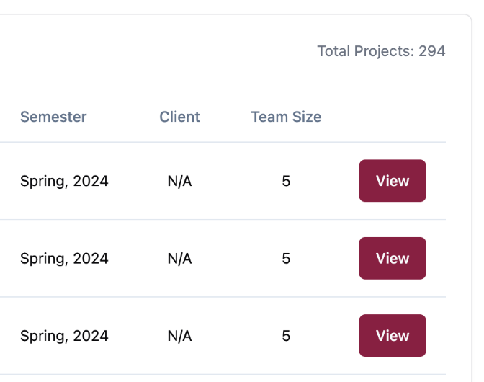
VTechWorks Repository:
Backend Summary
Our system:
Login/Sign-up functionality
Functionality for Admin, Client, and Student
Uploaded all existing CS4624 projects to DB
Project metadata
Project files (presentation, report, source code)
Fully linked backend to frontend

Slide 8
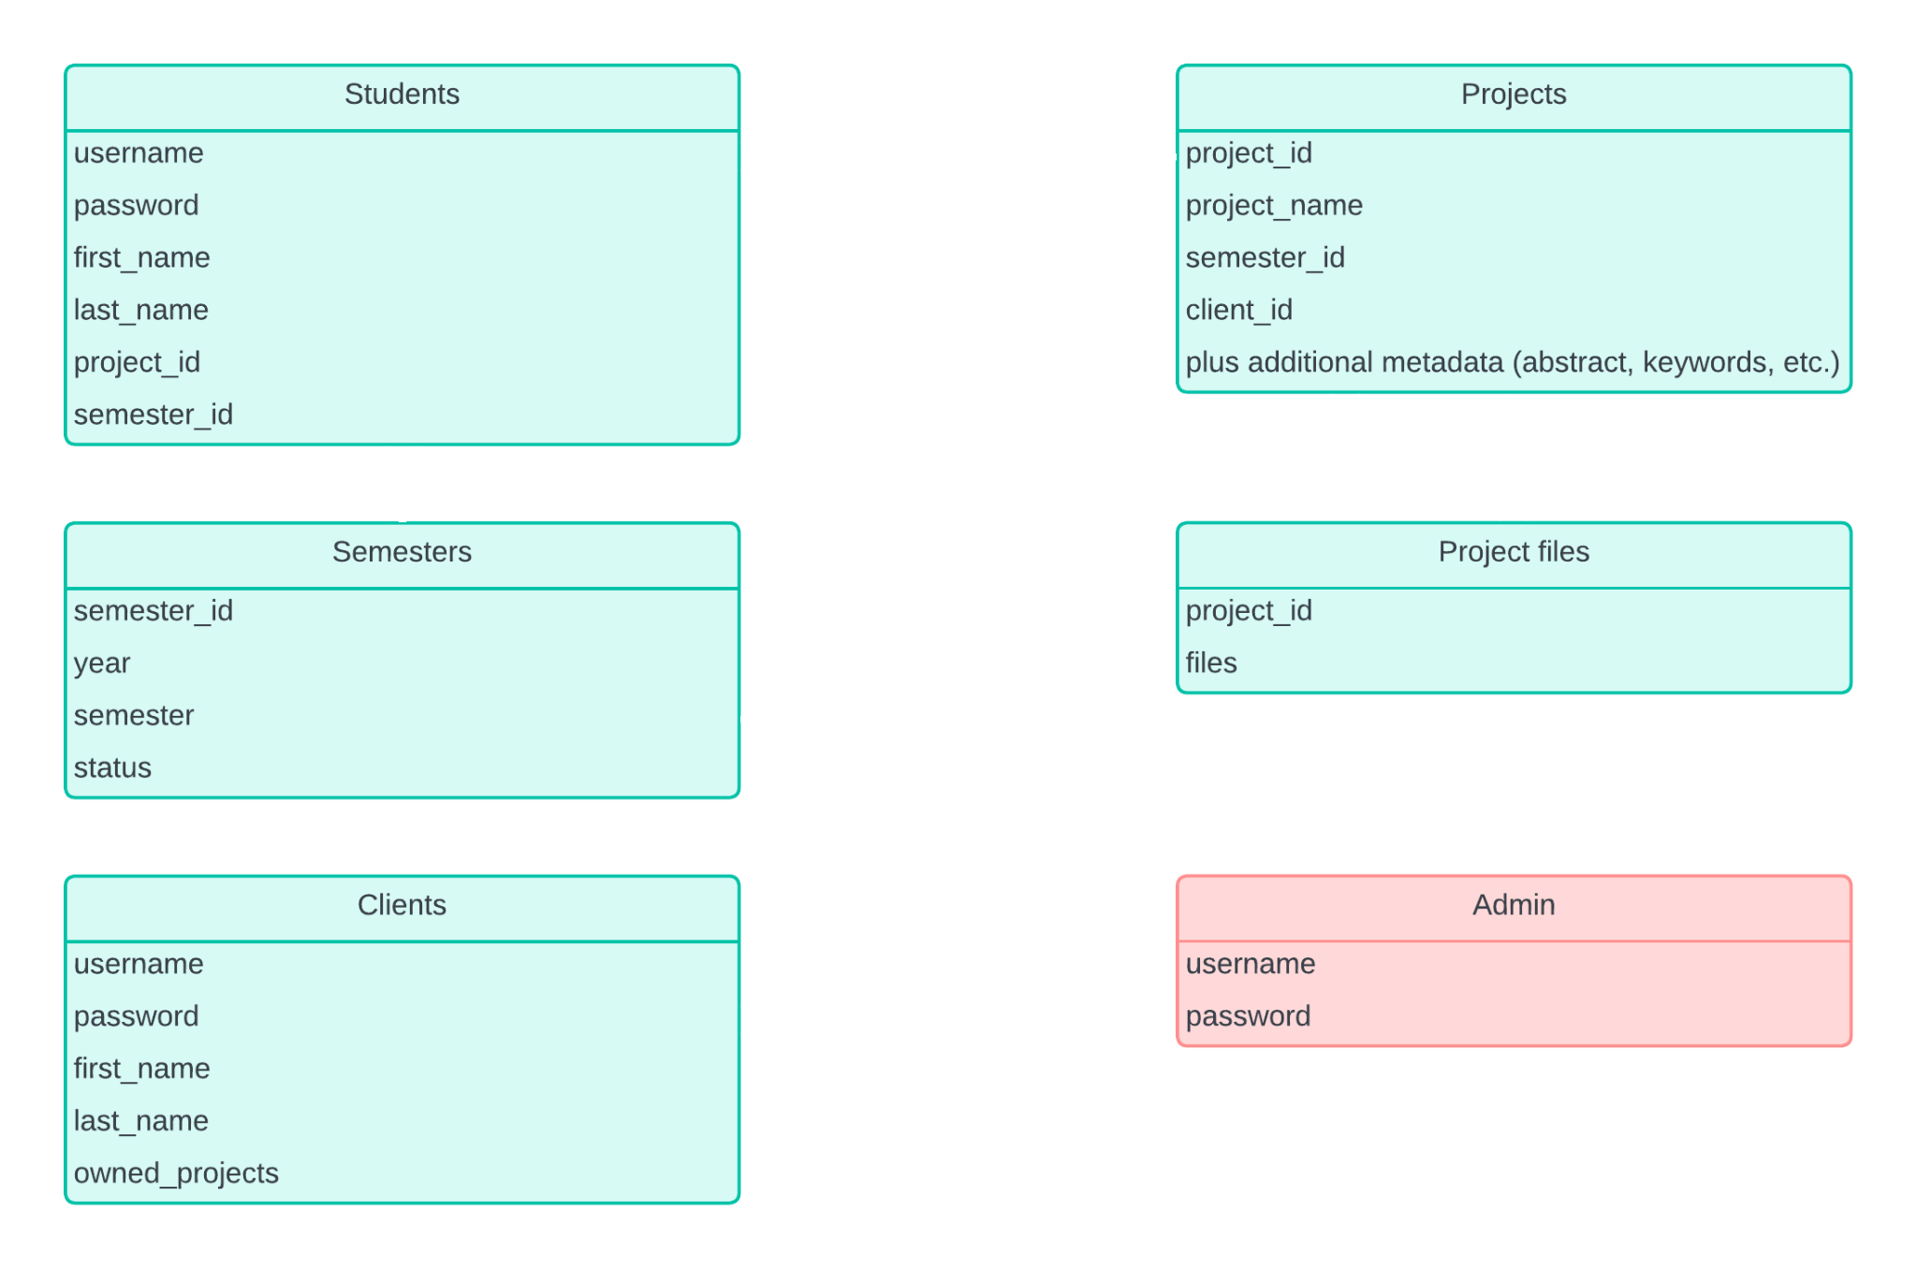
Database
Schema

Slide 9

Frontend Summary
Created reusable Collections Page for all user roles
Created new login and registration forms
Created new project details page
Linked backend functionality (student, admin, client)

Slide 10
Features
Sign in/Sign up (admin, client, student)
Join/leave project (student)
View and search open projects (student)
Create/edit/delete project (admin, client)
Upload/download files (admin, client, student)
Create user (admin)
Create semester (admin)
Open/close semester (admin)
Search all projects (admin)

Slide 11
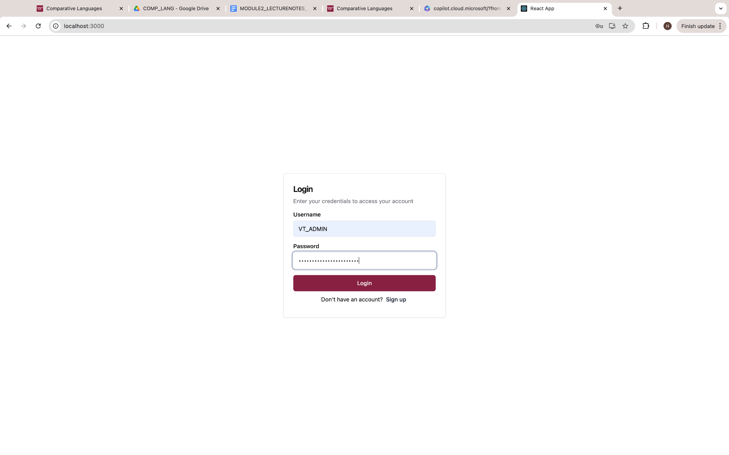
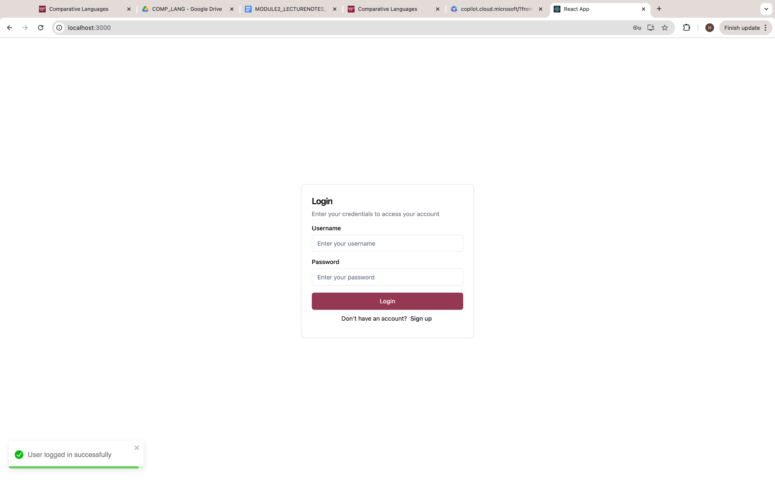
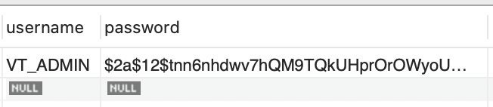
User Authentication ↔ Admin Table (or Student, Client Table)
Notes:
# Hash the password before saving the user
hashed_password = bcrypt.hashpw(data['password'].encode('utf-8'), bcrypt.gensalt())
data['password'] = hashed_password.decode('utf-8')

Slide 12
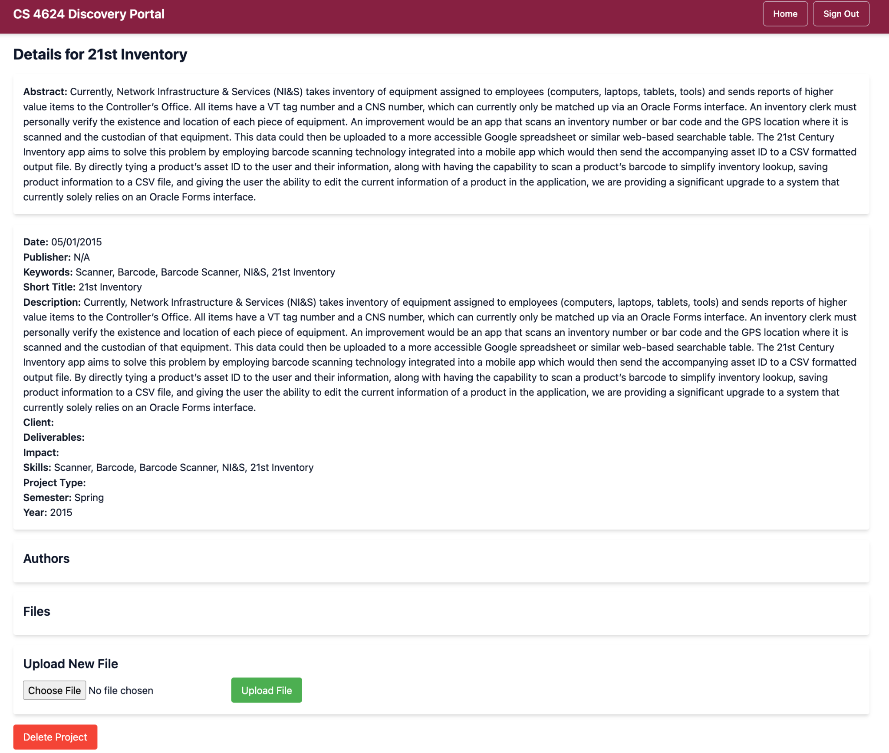
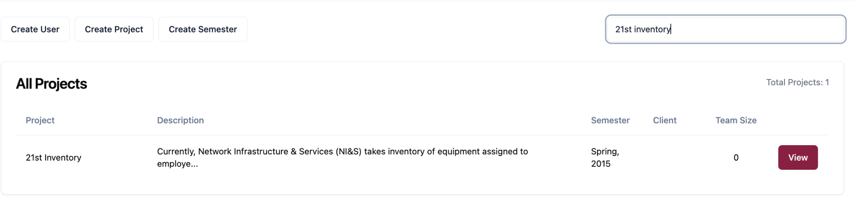
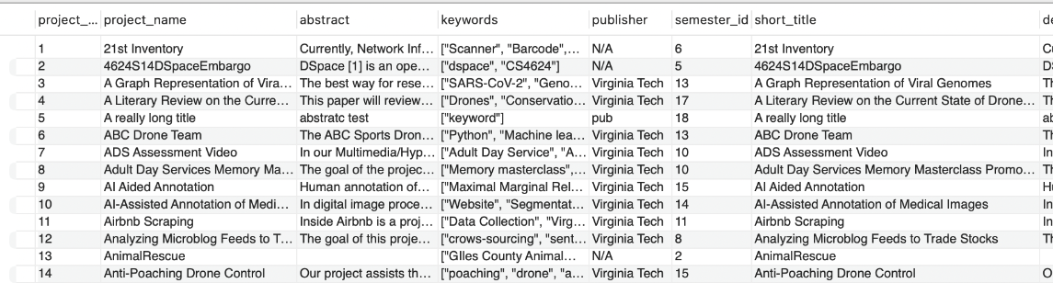
Collections Page ↔ Projects Table

Slide 13
Live Demo

Slide 14
Future Work
Deployment for CS4624 course usage
Bug fixes and further testing
Feedback collection and iterative improvement
Scalability and maintenance

Slide 15
Roles
Matthew:
Frontend Lead
Henry:
Frontend Support
Logan:
Backend Lead
Patrick:
Backend Support

Slide 16

Acknowledgements
Client:
Dr. Mohamed Farag
Previous Authors:
Mark Fuentes
Maddie Gonzalez
Adam Kanaan
Faizen Moshin
Shayne Perryman

Slide 17
References
https://vtechworks.lib.vt.edu/server/api/core/bitstreams/335c4bd1-788f-445e-968a-c450ab3a9fe6/content

