Slide 1
Crisis Events Information Extraction
Sully Gregory, Brianna Brown, Will Spies, Nishesh Saikrishna, Eitsaam Rabbani
CS 4624 Multimedia and Hypertext, Instructor: Mohamed Farag, Virginia Tech, Blacksburg VA 24061
04/22/2024

Slide 2
Outline
Client & Problem
Approach
Architecture
Implementation
Features
Demo
Final Plans

Slide 3

Client
Problem
Crisis event news articles can be time-consuming to read and wordy, distracting from the key information.
A straightforward way to extract key details from multiple crisis events articles is needed.
Dr. Mohamed Farag

Slide 4
Approach
Design a web application to summarize crisis events with a specific who, what, when, where, and how
Who, What, When, Where, & How (WWWWH)
Save Usage History in DB
Named Entity Recognition
Frequency Analysis
Accept user input of crisis event webpages (URL/HTML/txt)
Extract summary data from user input
Require user login to save input/output collections
Display collection history for a user, recounting all past input/output collections they have created

Slide 5








System Architecture
Node.JS
Front-end
Backend
Database

Slide 6
Front-end Implementation
Display extracted information in table format
Extractions can be expanded to show relevant sentences
MUI component library for consistent design language

Slide 7
Back-end Implementation
Node.JS
Front-end talks exclusively to Node.js / Express server
Node.js handles authentication natively and calls all NLP via Flask using API requests
Flask / SpaCy handles all information extraction and NLP and uploads results to MongoDB
Login
Extraction & History

Slide 8
Database Design
Database: CrisisEventInfoExtraction
Collection: users
Collection: collections
User 1
Collection 1
User 2
Collection 2
User 3
Collection 3
...
...
User N
Collection N

Slide 9
Users Schema
_id: ObjectId
username: String
password: String
The _id field will be used to connect collections to the users who created them.
The password field is hashed with bcrypt for added database security.

Slide 10
Collections Schema
userId: ObjectId
fileName: String
collectionName: String
inputData: {
links: [String]
}
outputData: {
how: [String]
what: [String]
when: [String]
where: [String]
who: [String]
howSentences: Object
whatSentences: Object
whenSentences: Object
whereSentences: Object
whoSentences: Object
}
userId – id of user who created the collection
how/what/etc - top K responses for that category
K value is set in code for client access
__Sentences – object with 1 field for each of the K responses in WWWWH
Each field's value is an array of the sentences that the given response was extracted from

Slide 11
Project Features
User Authentication
2. Create a new collection
- File Upload
- WWWWH Extraction
3. Collection History Table
- Delete a collection
- Details pop-up
- Sentences display

Slide 12
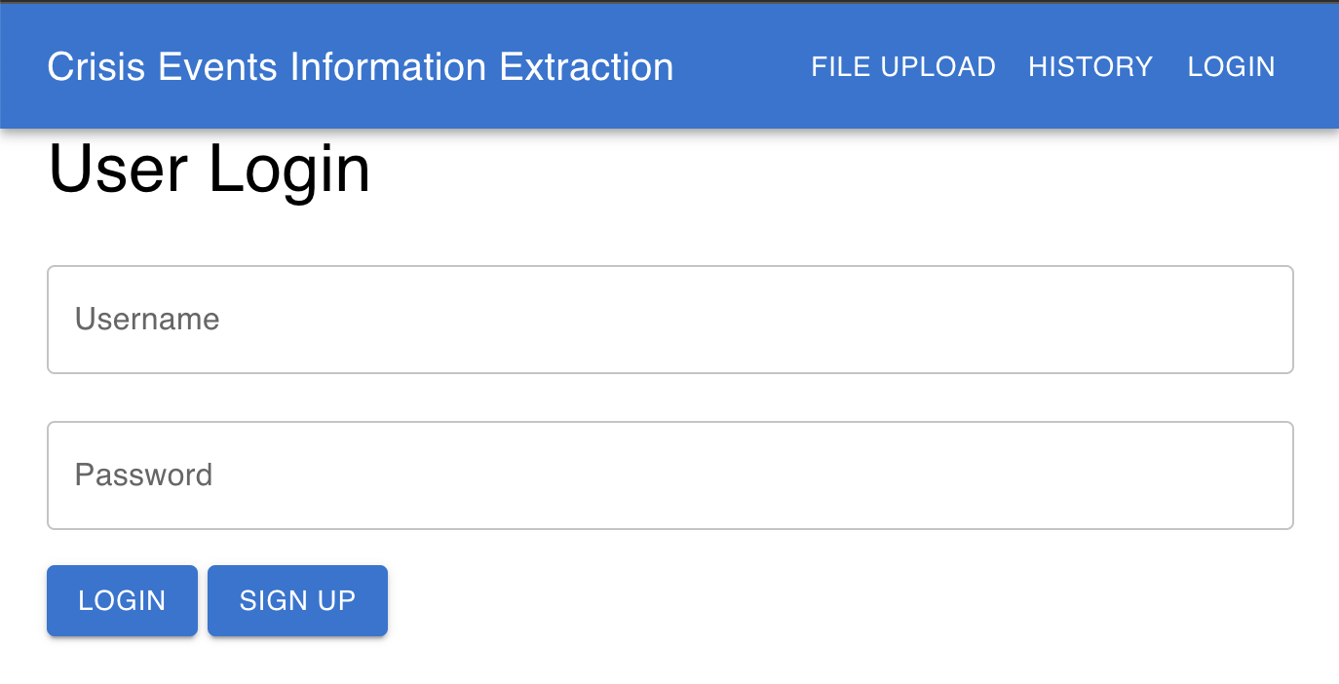
User Authentication
Login

Slide 13
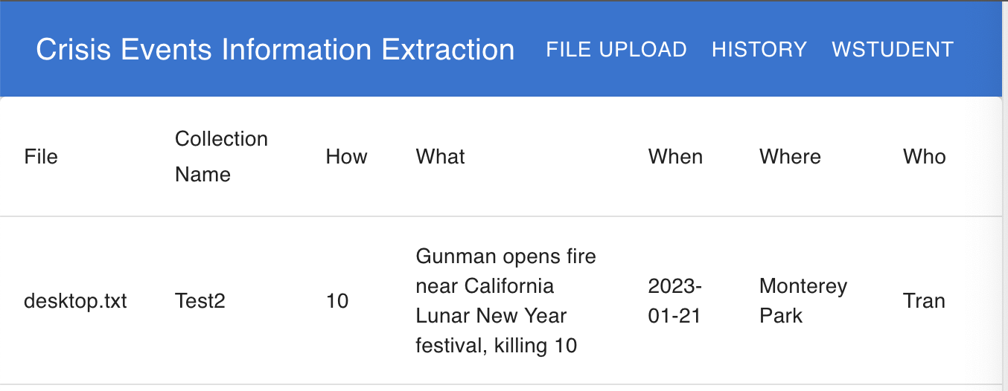
User Authentication
Login Success
On a successful login, you are redirected to the collection history page and username is displayed

Slide 14
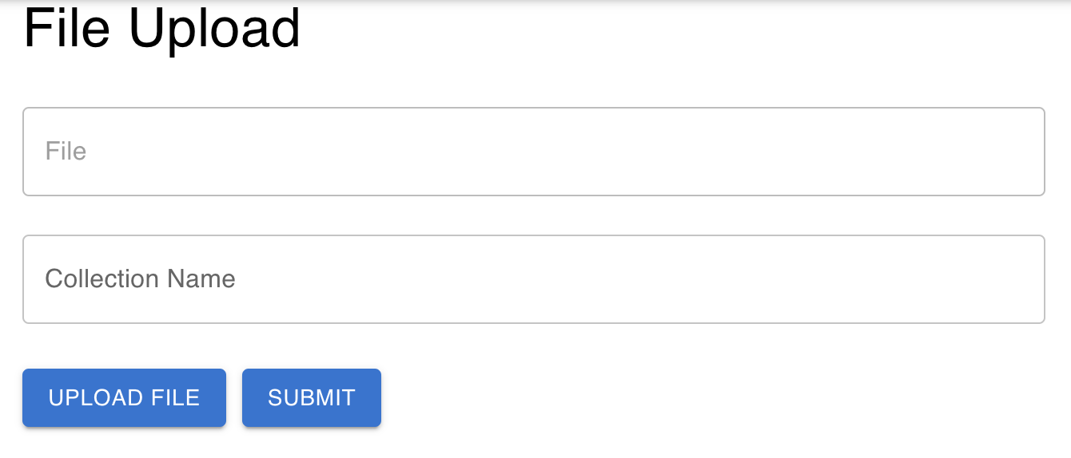
New Collection
File Upload
Home page displayed to user, user has the option to upload file and add a collection name. Pressing the submit button will run the extraction.

Slide 15
Text Processing & Extraction
3
Date Formatting
Article date and entities used to find event date
1
Preprocess User Input
Scrape and format text
2
Entity Extraction
Labels are recorded
5
Frequency Analysis
Most frequent entities are kept for output
6
Sentence Selection
Relevant sentences are saved
4
Entity Categorization
Entities split by category

Slide 16
PERSON
Individual People
GPE
countries, cities, states
WHERE
LOC
Mountains, bodies of water
ORG
Organizations
WHO
NORP
Nationalities, religious, political groups
DATE
WHEN
TIME
CARDINAL
Cardinal Numbers
EVENT
ORDINAL
Ordinal numbers
WORK OF ART
Ex: Books, Songs
WHAT
PERCENT
Percent numbers
PRODUCT
Commercial Products
HOW
MONEY
Financial Amounts
LAW
Legal Documents / Laws
QUANTITY
Measurable Amounts

Slide 17
WHO
WHAT
WHEN
HOW
WHERE
ORG
EVENT
DATE
CARDINAL
PERSON
GPE
TIME
ORDINAL
NORP
United States Presidential Election of 2016, American presidential election held on November 8, 2016, in which Republican Donald Trump
lost the popular vote to Democrat Hillary Clinton by more than 2.8 million votes but won 30 states and the decisive electoral college with 304 electoral votes to Clinton’s 227 and thus became the 45th president of the United States.
The tumultuous, abrasive 2016 campaign defied established political norms. Clinton’s campaign featured superior organization and
fund-raising—and almost every election-eve poll pointed to a comfortable victory for her—but Trump’s anti-Washington appeal to white
working-class voters outside major cities in pivotal manufacturing states proved to be the key factor in what several publications
called “the most stunning upset in American history.” The election of an outsider with no political job experience represented a major
repudiation of business as usual by both parties in Washington, D.C.

Slide 18

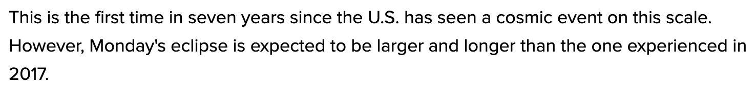
Date Formatting
Get publishing date
2. Identify date and time entities
3. Calculate crisis event date

Slide 19
Frequency Analysis – What
Solar Eclipse Example
Join all frequency dictionaries
Where: { Norfolk: 6, Virginia: 4, Earth: 2, VA: 2 }
When: { 2024-04-08: 9 }
Select x top entities (ex: x=3)
Top Entities: { 2024-04-08: 9, Norfolk: 6, Virginia: 4 }
3. Get article titles containing the most top entities (weighted)
Title 1: Eclipse visible from Norfolk, Virginia – Score = 10
Title 2: Eclipse seen in Virginia on April 8th – Score = 13

Slide 20
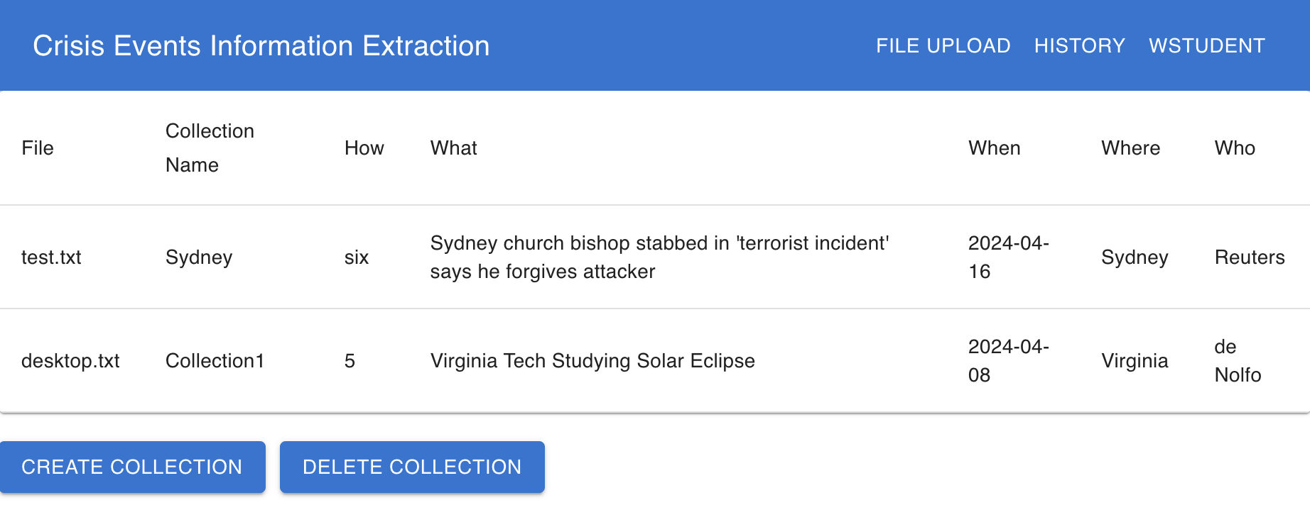
Collection History
Display Table

Slide 21
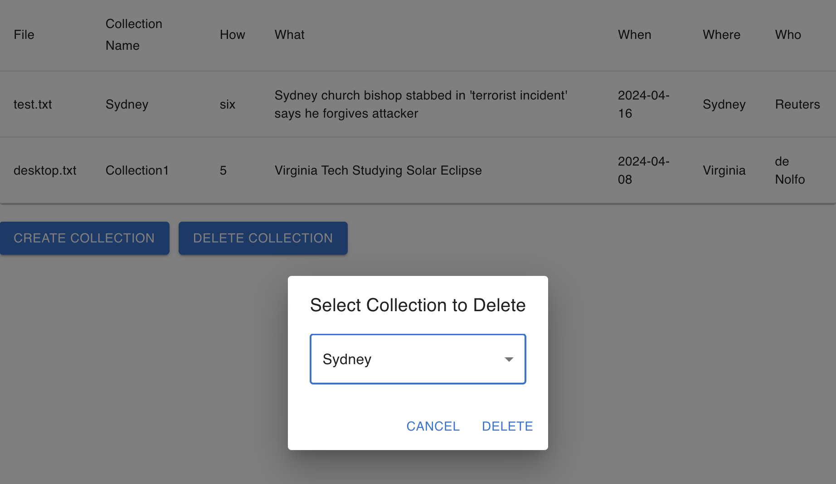
Collection History
Delete a Collection
The delete collection button displays a pop-up with a drop-down to select which collection to delete based on the collection name.

Slide 22
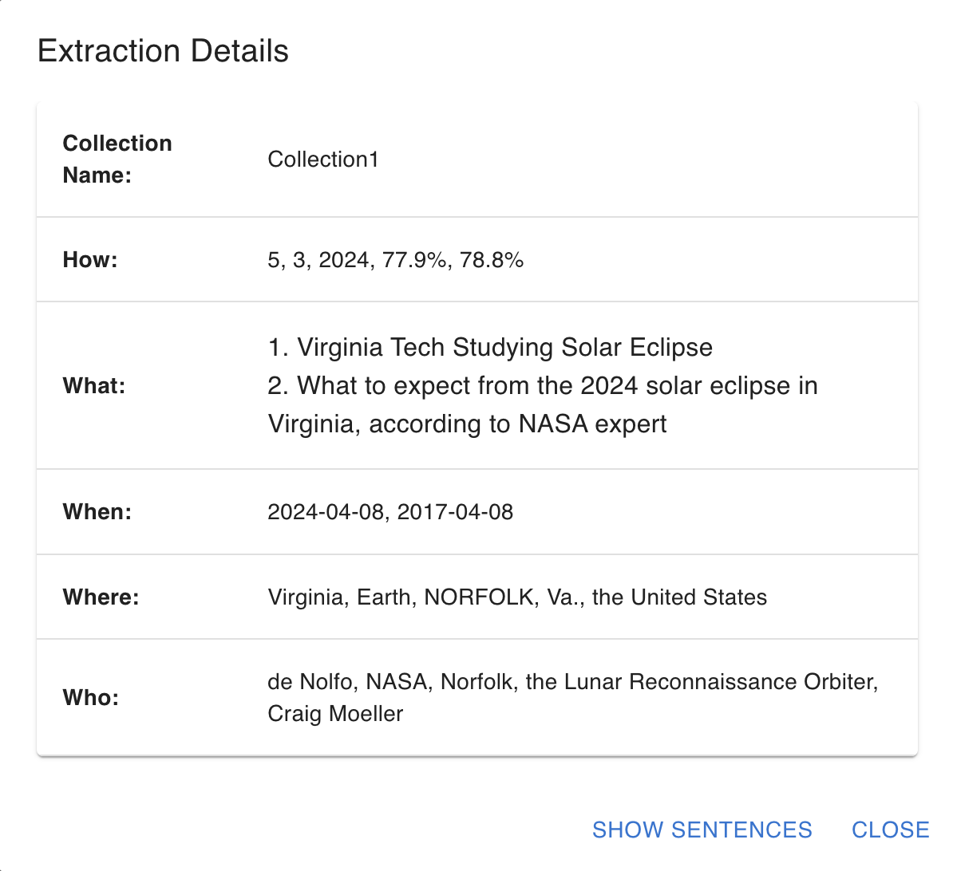
Collection History
Details Pop-up
Clicking a collection will display a pop-up with at most the top K results for each category. The K value can be set in the code by the client.

Slide 23
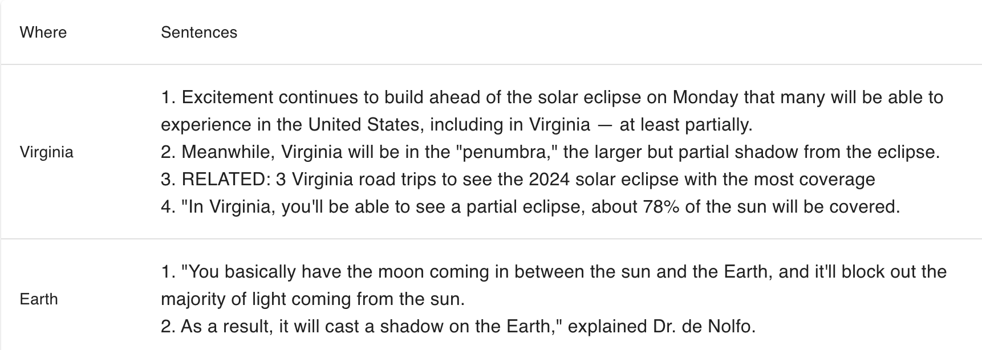
Collection History
Sentences Display
The sentences display shows the top K results for each category and what sentences they were extracted from.

Slide 24
Final Plans
Improve “how” extraction
Improve modularity – extract each WWWWH category separately with minimal added TC
Testing failures and edge cases

Slide 25
Acknowledgements
Dr. Mohamed Farag
Professor & Client

Slide 26
Resources
Slide Template:
https://slidesgo.com/theme/multimedia-software-pitch-deck#search-Computer&position-10&results-486

