Slide 1
Assessment
How electronic assessment can help you!
Carolyn Meier, Instruction Services Librarian
Jennifer Nardine, Instruction & Outreach Librarian

Slide 2
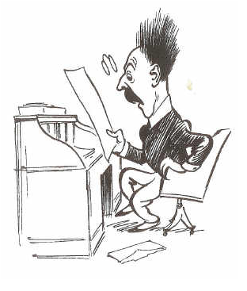

Why is assessment important?
Notes:
Allows instructor to see if they are effective
Monitor and adjust lessons, focus, etc
If done quickly, can adjust before end of semester or even in class

Slide 3
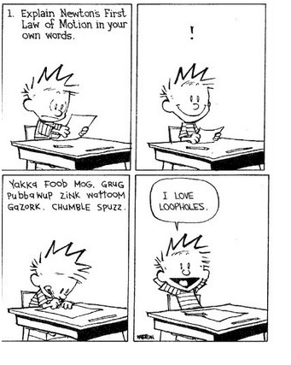
Why is assessment important?
Notes:
Forces students to think about what they have just covered
Gives students a chance to focus and put their learning into their own terms
“review, rephrase, retain”

Slide 4
VT Library Class Offerings
Tour
“One shot” – 50 or 75 minutes
Class series
Online for-credit class

Slide 5
Types of Classes
1961 were ENGL 1106 or COMM 1016
217 from content area classes
Notes:
Vast majority 1st year classes: English Comp & Intro Comm, several 1st year programs
One shots – all same basic info
First introduction to library, may or may not have toured
Spring of 2009
2178 responses

Slide 6
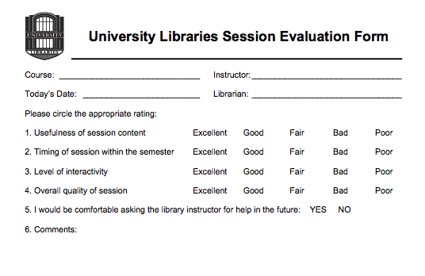
In the beginning…… Lickert Scale
Notes:
This was assessment in 2006 – classroom aides did the tabulating
Easy to tabulate
Didn’t assess what students learned
Evaluated the presenter
Too easy to select a row
Popularity issue

Slide 7
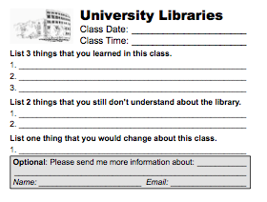
In the beginning… 3-2-1 cards
Notes:
+Had the advantage of students thinking about what they learned and let librarians know what was still fuzzy
-Extremely labor intensive
-Too many ticky marks
+Switched from personality to content analysis
+Provided built in end of class review for students to solidify their learning

Slide 8
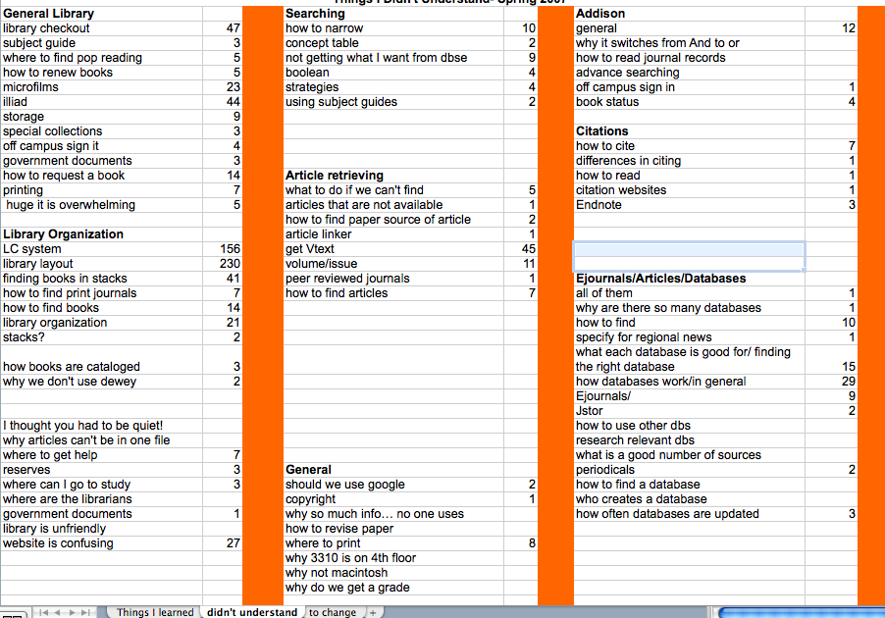
Notes:
Got some good data but on the whole time consuming and tedious

Slide 9

Move to Electronic
SURVEY.VT.EDU
Notes:
Moved to electronic Fall of 2008 - Trend to all things electronic vs paper-based
Choice of survey
Survey monkey – universal, flexible (included images), but costs money
Survey.vt.edu – no images, local to vt (homegrown), free

Slide 10
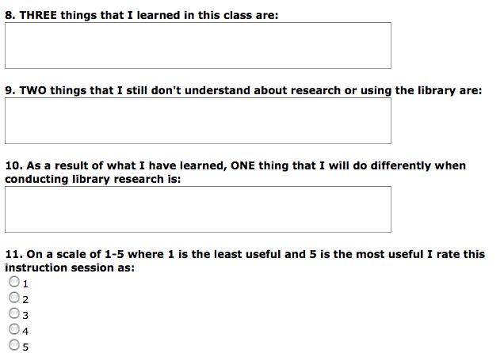
Electronic Interface
Notes:
On every desktop in both classrooms
Can sent url to librarians who wish to use it in other buildings
Reluctant because I didn’t want it to be just liker
Added the 3 things to get qualitative data & give students review time

Slide 11
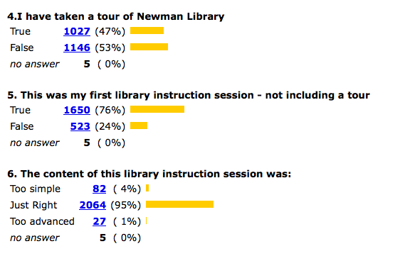
Survey Results
Notes:
Very east to get an overview
This is for everything – all levels
Advantage quick tabulations of quantitative information
Easy for percentages

Slide 12
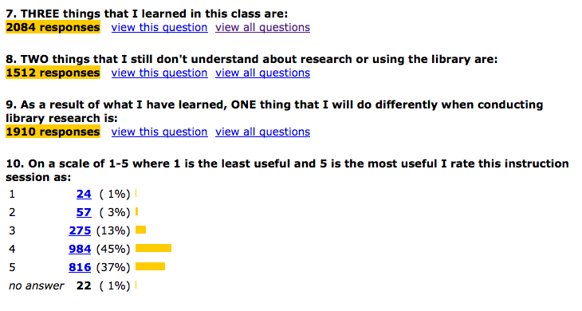
Survey Results
Notes:
Allows for quick assessment – percents etc.
But also shows the number of assessments received – almost 2100
Can also export the qualitative data

Slide 13
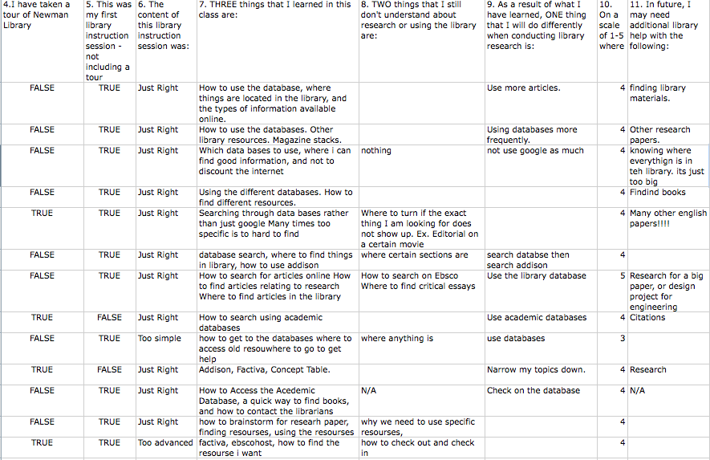
Notes:
Can do some analysis on qualitative data

Slide 14
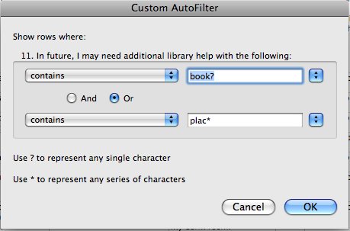
Filter and sort

Slide 15
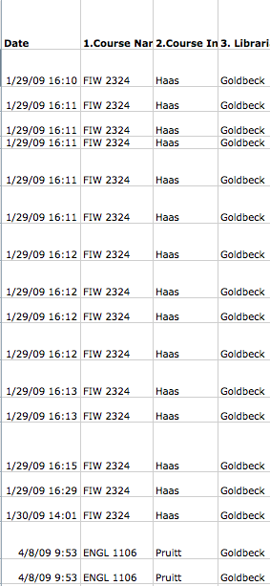
Notes:
Allows to sort by librarian or by course or by instructor
I was able to sort all of the results by librarian and then send them their own results
I stabilized the names and the course numbers
We are able to see if it is the professor is the library user or the if it course driven

Slide 16
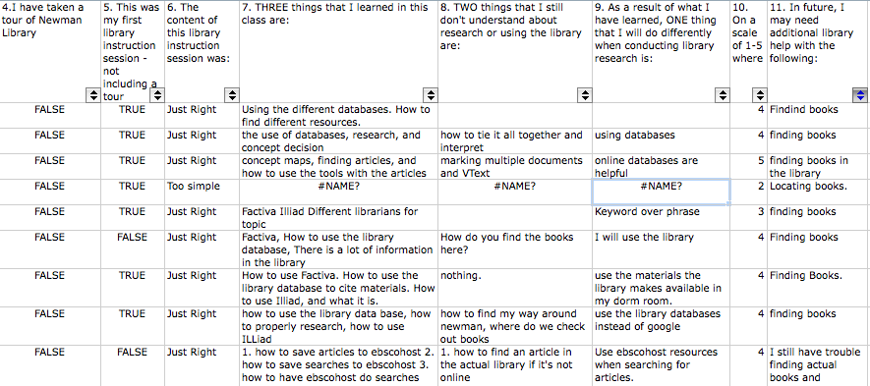
Filter and sort

Slide 17
Things I will do differently
Notes:
Easier to display data graphically to show trends, even when dropping some qualitative because of misspellings, etc.

Slide 18
What they learned
Notes:
683 no mention of database
1487 mentions database or database by title
Hard to measure our goals because we only see them one time but 2 goals – to make them aware of the library and to be aware of the databases – they at least remembered for 10 minutes

Slide 19
The professor tie-in
Going electronic allows us to survey professors after class
Allows professors to easily review student surveys
Assess value of library session
Assess student retention of points professor values most
Assess possible future student needs
Notes:
Easy to send to professors

Slide 20
Why do we use electronic vs paper
Ease of access leads to higher response
Ease of collating and disseminating
Held in central location, accessible from any computer
Fast turn around has improved instruction mid-semester

Slide 21
Challenges and work-arounds
Spotty response from classes taught outside of Newman
Sometimes taught in rooms without computers
None of the remote labs have the survey link on the desktops
Solutions
Create a tiny URL – easy to hand out
Ask professor to post survey URL on Blackboard/Scholar

Slide 22
Where to go next?
Further Analysis - Can export data into a spreadsheet and from there you can export it into a database
Filemaker Pro or Access or other professional software
Increase correlation between professor’s and librarian’s expectations
Continually change the form to reflect new needs

Slide 23
Survey Options
Moodle www.moodle.org
Open source, targets universities & schools
Survey Monkey www.surveymonkey.com
Free trial, $20/month or $200/year
Zoomerang www.zoomerang.com/
$350/year for non-profits
LimeSurvey www.limesurvey.org
Open source, but self-hosted and supported
Key Survey www.keysurvey.com
Most robust, biggest price tag $1950 to $5950 for single user subscriptions

Slide 24
Contact Information
Carolyn Meier, Instruction Services Coordinator
cmeier@vt.edu
540-231-9861
Jennifer Nardine, Instruction and Outreach Librarian
jnardine@vt.edu
540-231-4073
University Libraries, Virginia Tech
P.O. Box 90001
Blacksburg, VA 24062-9001

Slide 25
Questions?

