Slide 1
Conversation Facts
Nathan Miller, Christian Kang, Jon Marks
CS 4624 - Multimedia, Hypertext & Information Access - Dr. Fox
Virginia Tech - Blacksburg 24061 - 4/25/2019

Slide 2
Outline
Project Overview
Implementation
  Parsing
  Preprocessing
  Building KGs
  Matching
Results
Challenges
Deliverables
Acknowledgements

Slide 3
Project Overview
Project Goal - Matching summary sentences to their origin in a conversation
Dataset - Argumentative Dialogue Summary Corpus: Version 1.
S1:1- Another problem with the study is that most ( or at least more ).....
S2:1- S1 you don't know how they conducted the study. You don't know….
……….
D0: S1 argues that most people in the country might identify as Chr……...

Slide 4
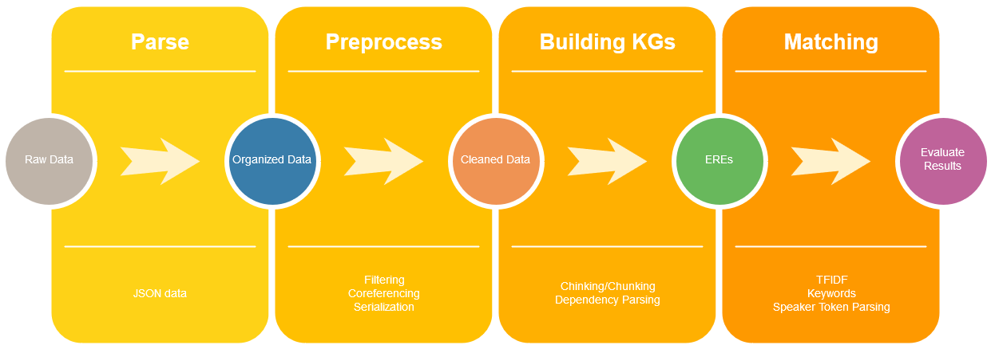
Implementation

Slide 5
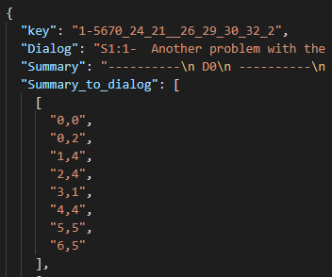
Parsing
Unique ID key
Dialog string split with “S#:#” tags
Summary string split with newlines/”D#” labels
Summary to dialog annotations
  Group made mapping of summary sentences to their relevant dialog

Slide 6
Preprocessing
Rule Based filtering
  Remove text between parentheses
  Remove sentences under a given length
  Replace words to increase comprehension eg “you’re” -> “you are”
Special Text Filtering
  Remove special characters, extraneous punctuation, emoticons etc.
Coreferencing
  Resolving ambiguous pronouns (Next Slide)
Serializing preprocessed object
  ~20x speedup by not rerunning expensive operations eg spaCy

Slide 7
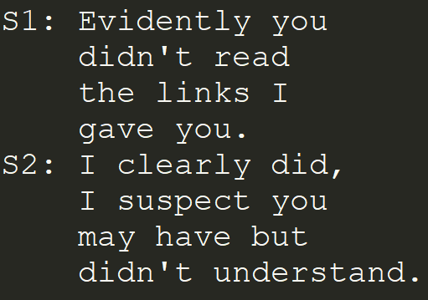
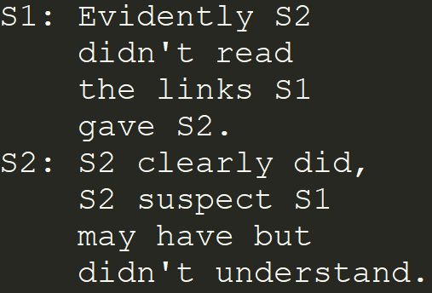
Preprocessing - Coreferencing

Slide 8
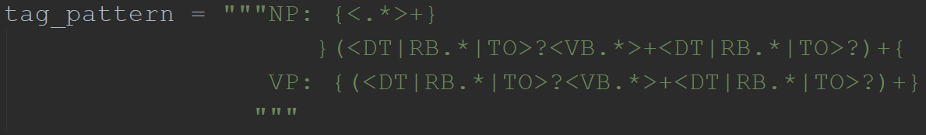
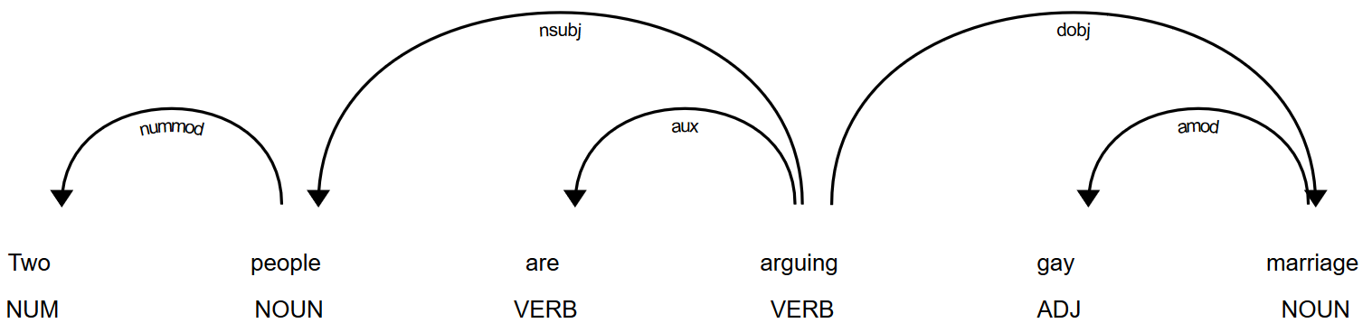
Building ERE triples KGs
Chinking/Chunking
Dependency Parsing
  spaCy

Slide 9
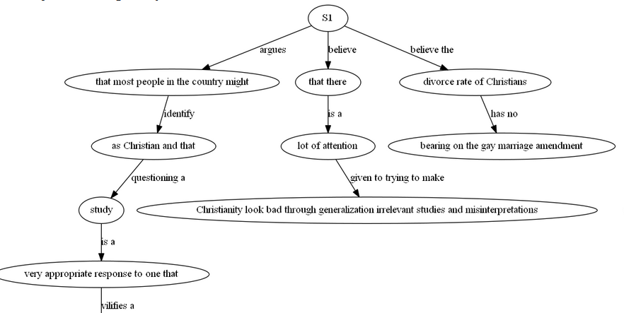
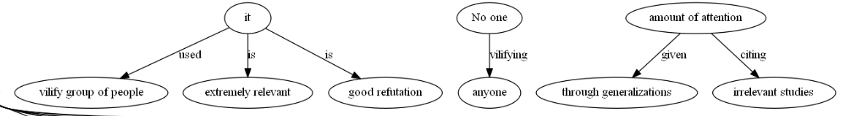
Example KG

Slide 10
Matching Summaries and Dialogs
Cosine Similarity
  Use TFIDF to compare summary EREs and dialog
Key/Rarewords
  Check summary EREs for important specific words in dialog
S1/S2 token parsing
  Use order and count of S1/S2 strings in summaries
  “S1 argues that…..”

Slide 11
Results
Check correctness against manually annotated dataset
 | Random | spaCy | Our Method
% Correct | 16.96% | 24.87% | 33.18%
% Relative change over random | 0% | 46.63% | 95.63%

Slide 12

Challenges and Lessons Learned
Dataset
  Short conversations are more difficult to match.
  Conversations lack starting posts/links/quotes and posters handles.
  Grammar, spelling, formatting, and general relevance are not priorities to forum posters.
Off the shelf libraries don’t necessarily work for all use cases
  Neural coref, AllenNLP
  SNAP.py
  spaCy dependency parsing, similarities

Slide 13
Deliverables
Final Report
  Document detailing project
Code
  Github Repo (link in final report)
Docker
  Publicly accessible container (link in final report)

Slide 14
Acknowledgements
Client - Saurabh Chakravarty saurabc@vt.edu
Resources -
Stanford NLP Dependency Manual https://nlp.stanford.edu/software/dependencies_manual.pdf
Christopher Manning Lectures https://www.youtube.com/watch?v=OQQ-W_63UgQ&list=PL3FW7Lu3i5Jsnh1rnUwq_TcylNr7EkRe6
Amita Misra, Pranav Anand, Jean E. Fox Tree, Marilyn Walker. "Using Summarization to Discover Argument Facets in Online Idealogical Dialog", In The North American Chapter of the Association for Computational Linguistics (NAACL), Denver, Colorado, 2015.

