Slide 1



A Testbank Sprint for
Fundamentals of Business
Anita Walz
Associate Professor, Open Education, Copyright & Scholarly Communication Librarian, University Libraries, Virginia Tech
June 28, 2019
Virginia Scholarly Communication Interest Group, University of Richmond, Richmond, VA
© Runner by Emily L. CC BY 3.0 https://thenounproject.com/term/runner/64045

Slide 2

17 chapters
440+ pages (2016)
372 pages (2018)
Free online
(2016) http://hdl.handle.net/10919/70961
(2018) http://hdl.handle.net/10919/84848
Editable (CC BY NC SA)
Print options
Credits for cover images: “Hong Kong Skyscrapers” by Estial, cropped and modified by Trevor Finney CC BY-SA 4.0. “Paris vue d’ensemble tour Eiffel” by Taxiarchos228, cropped and modified by Poke2001 and Trevor Finney CC BY 3.0 “London Bridge” by Skitterphoto, cropped and modified by Trevor Finney. Public Domain. “New York” by Mscamilaalmeida, cropped and modified by Trevor Finney. Public Domain

Slide 3
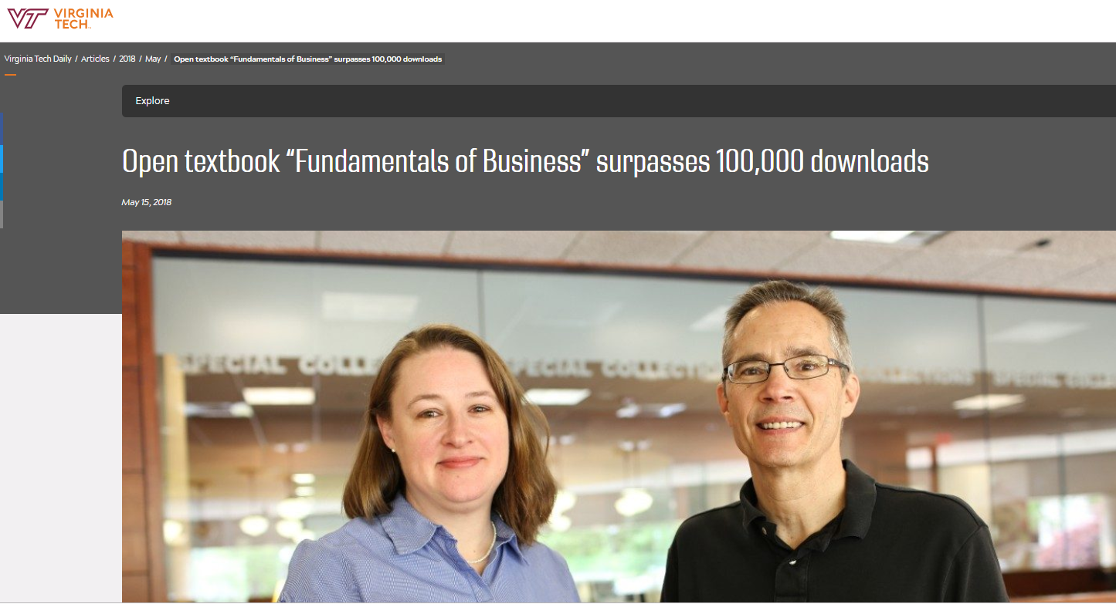
May 2018

Slide 4
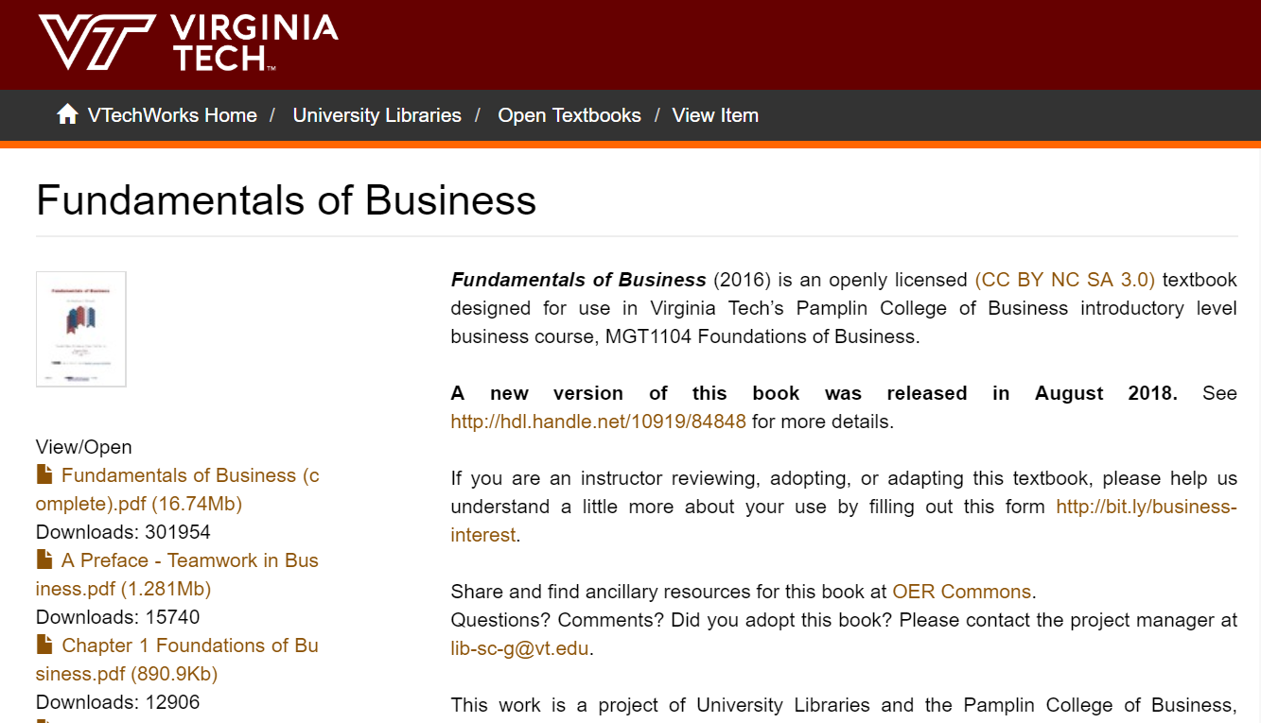

As of June 27, 2019
1st edition (2016)

Slide 5


June 27, 2019
2nd edition (2018)

Slide 6
LOTS O’ EMAILS

Slide 7
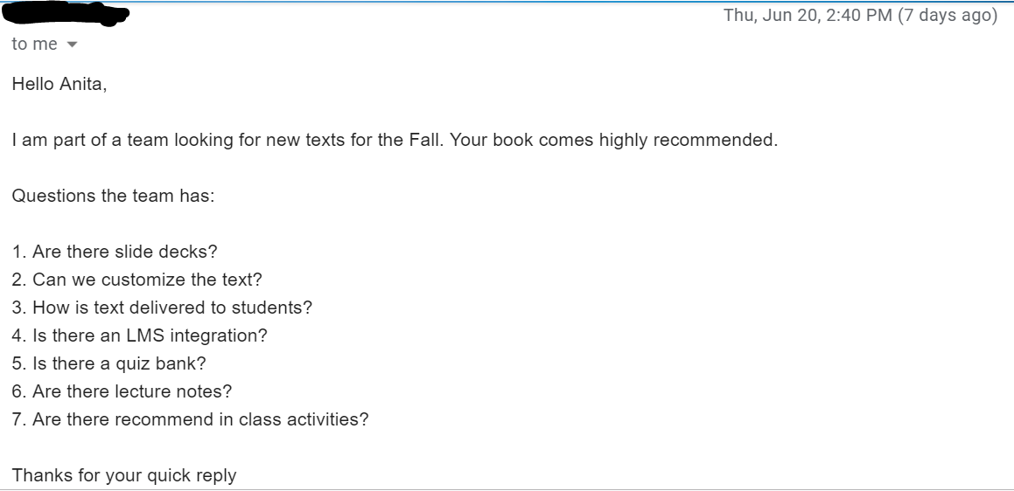

Slide 8

CC BY SA https://thatpsychprof.com/the-great-psychology-testbank-sprint/

Slide 9
GOALS:
Develop a 500 question testbank
Learn how to do this
Help others learn to do this
Have fun

Slide 10
What’s required?
Ingredients: 500-question test bank

Slide 11
2 grants
9 business faculty
3 guest speakers
4 librarians
1.5 days
a lot of food and logistics
1 robot and 1 cat
editorial work afterwards
Ingredients: 400-question test bank

Slide 12

Incentive funding from the Inn at Virginia Tech
$$ used for event support, travel, lodging, food & honoraria

Slide 13
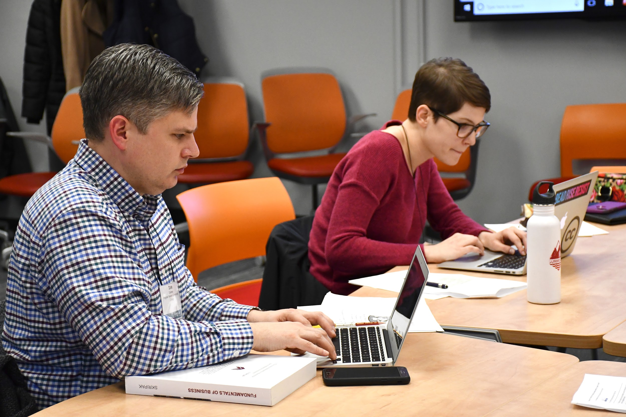

Slide 14
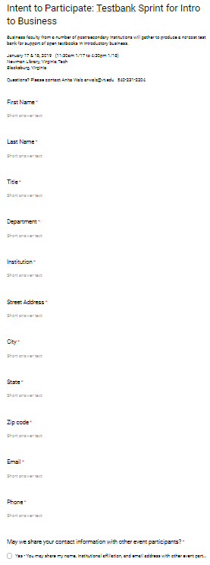
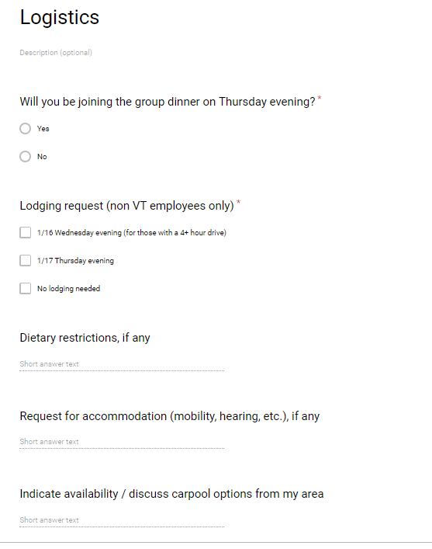
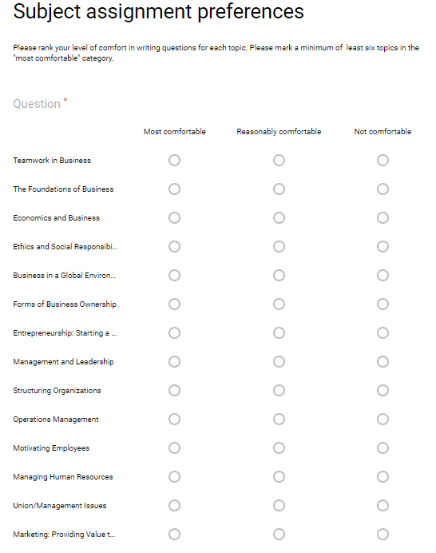
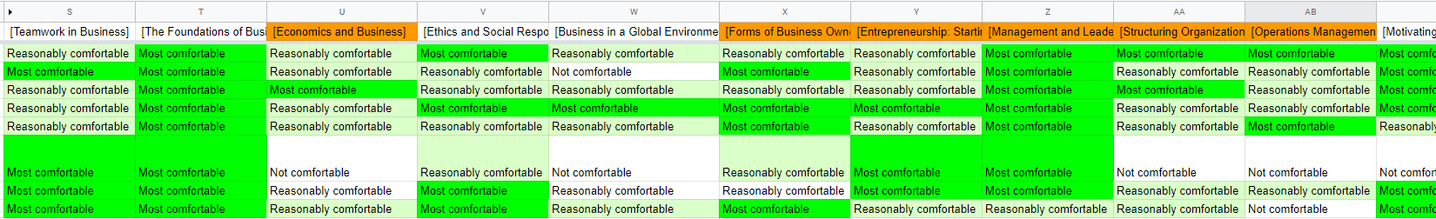
PLANNING

Slide 15
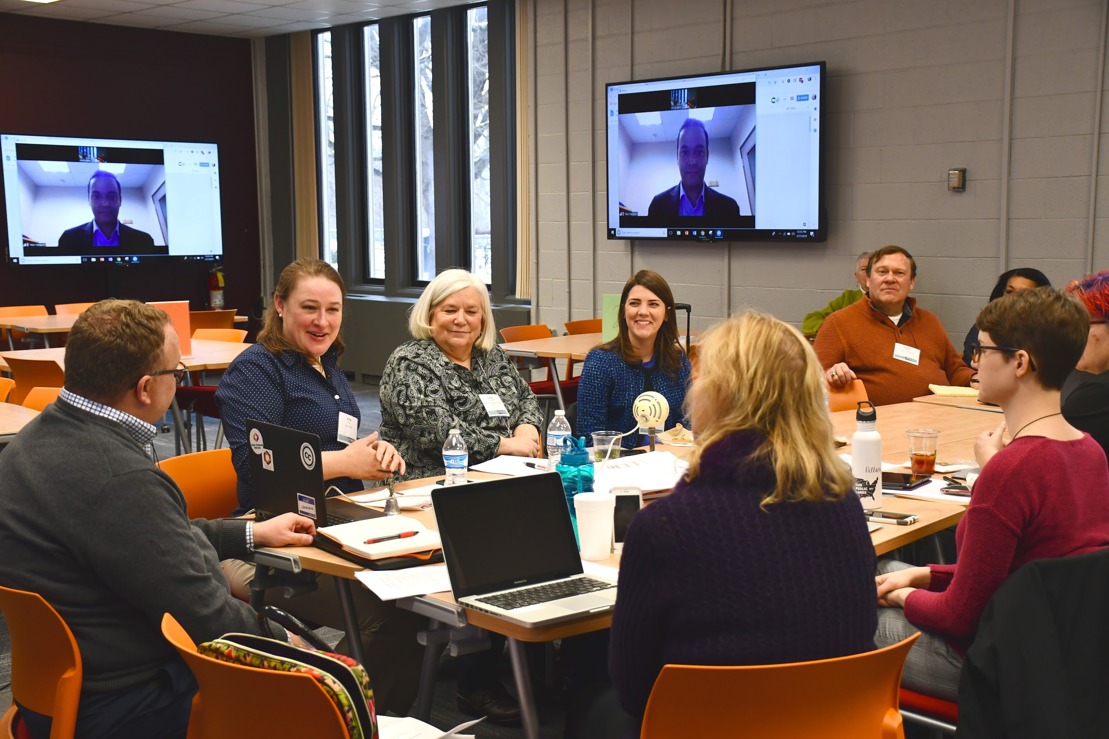

Slide 16
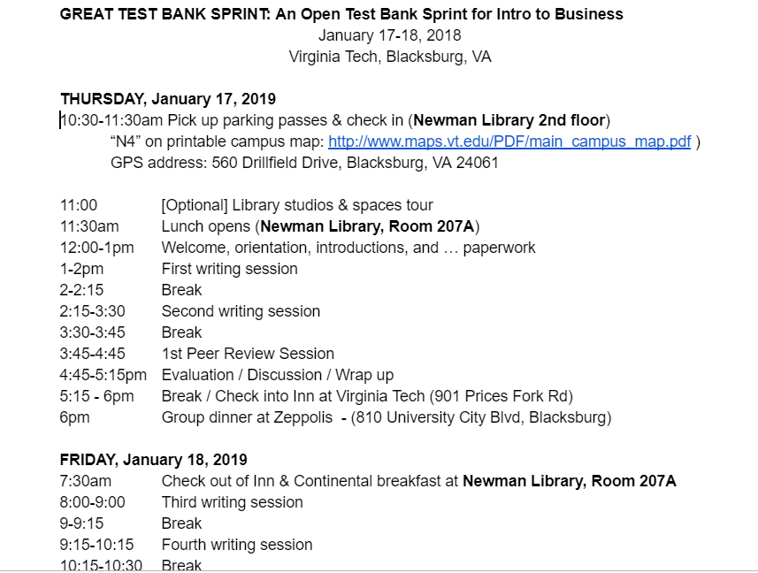

Slide 17
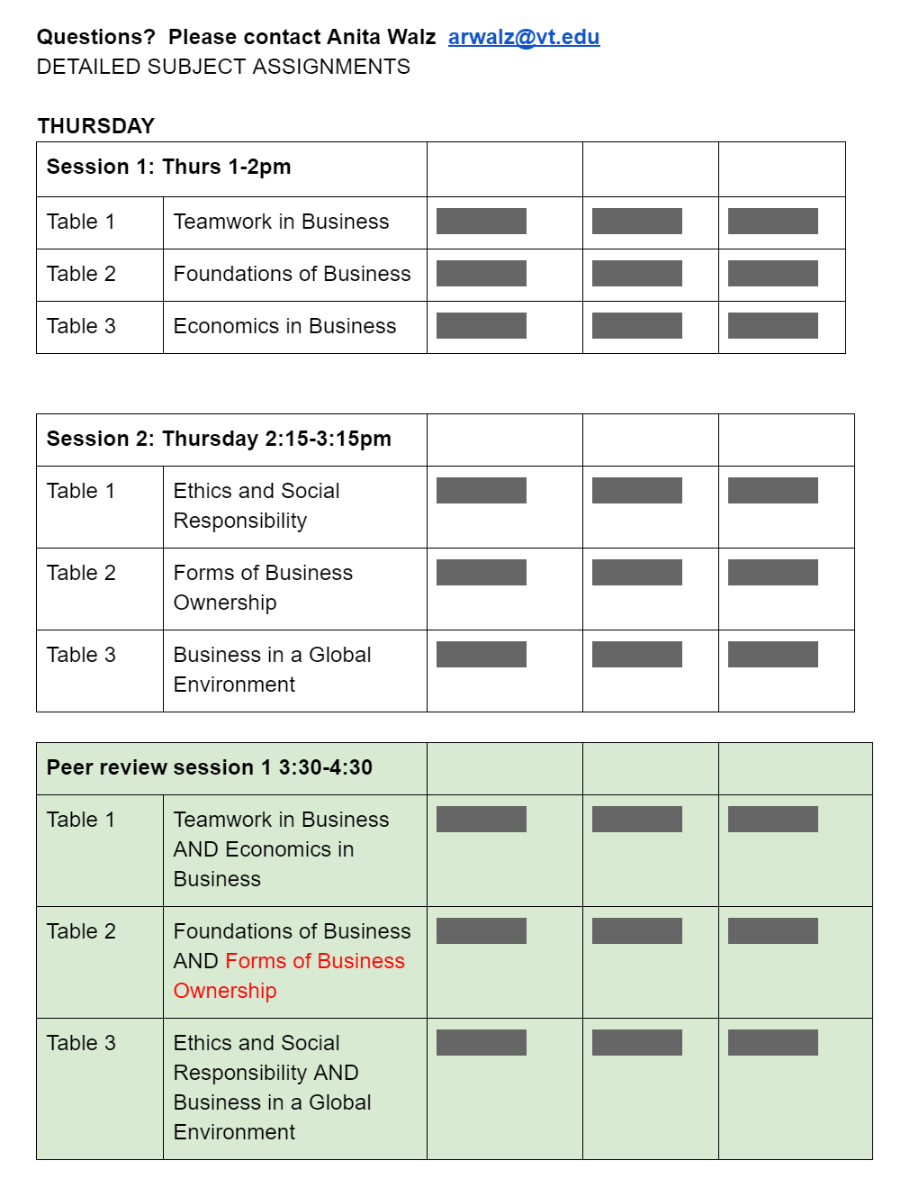
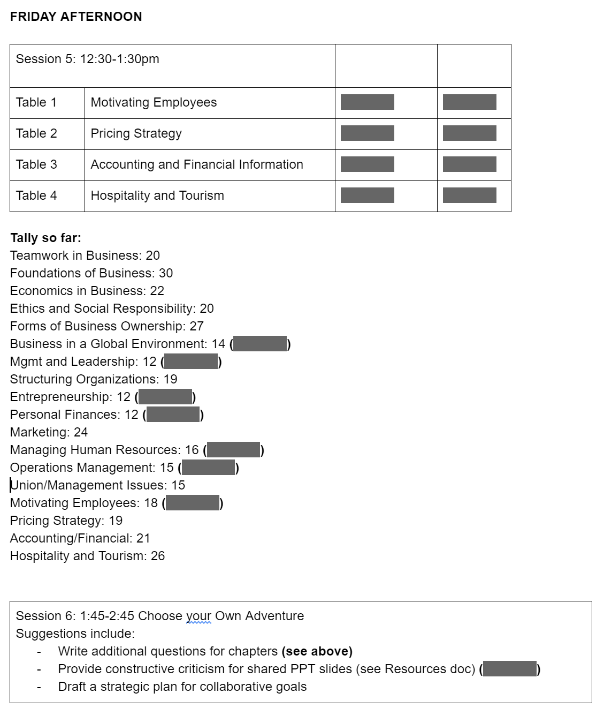
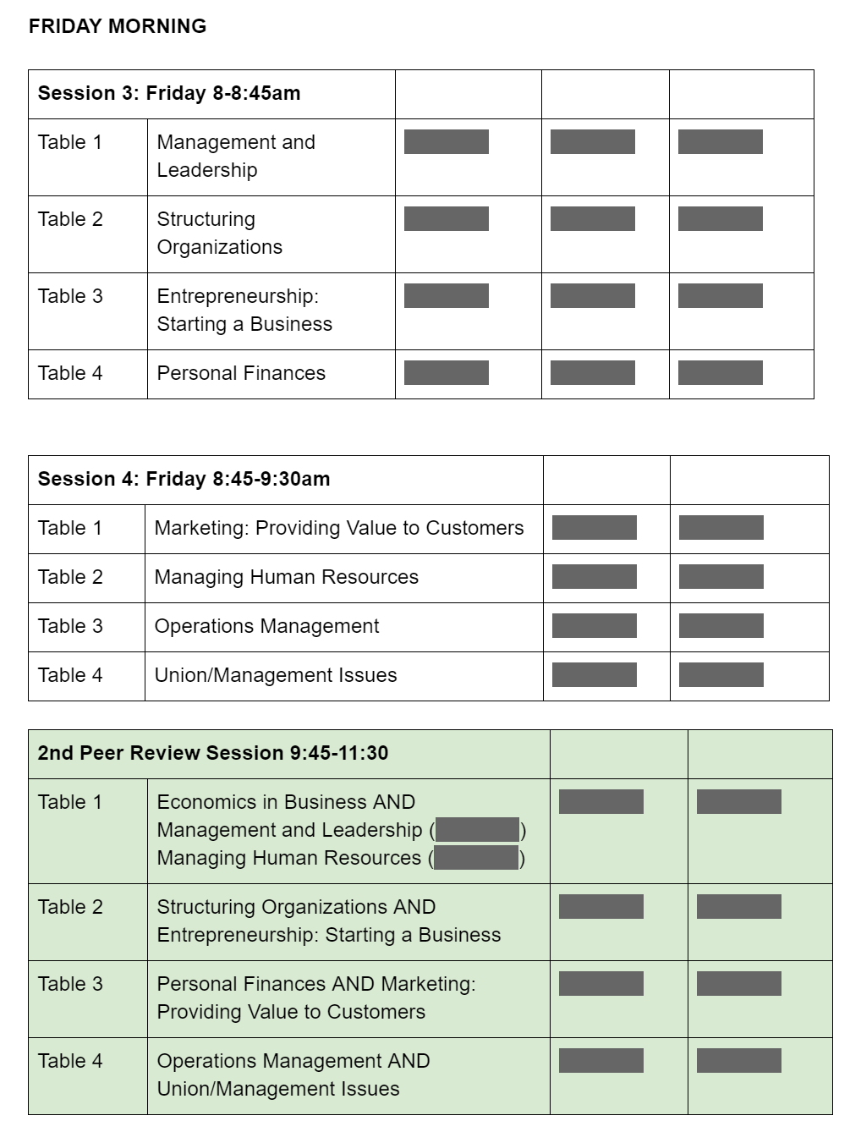
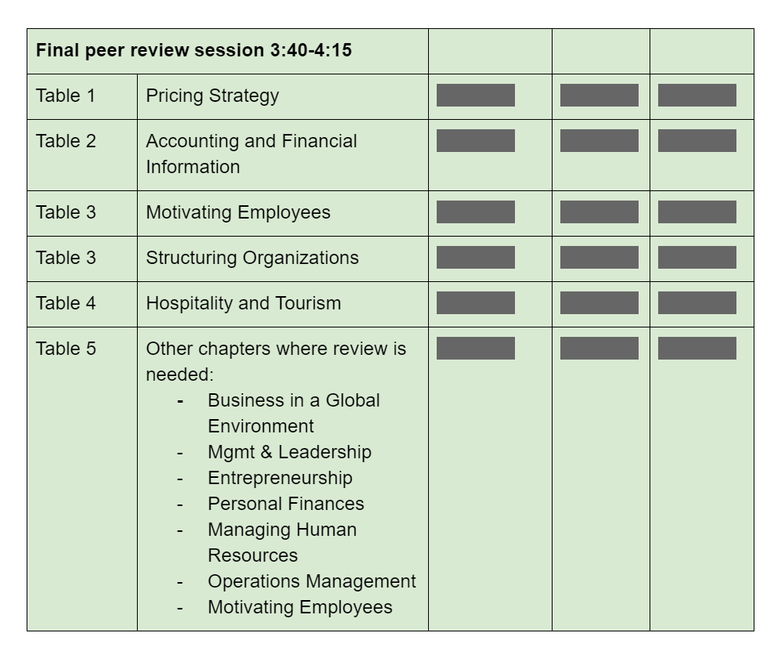

Slide 18
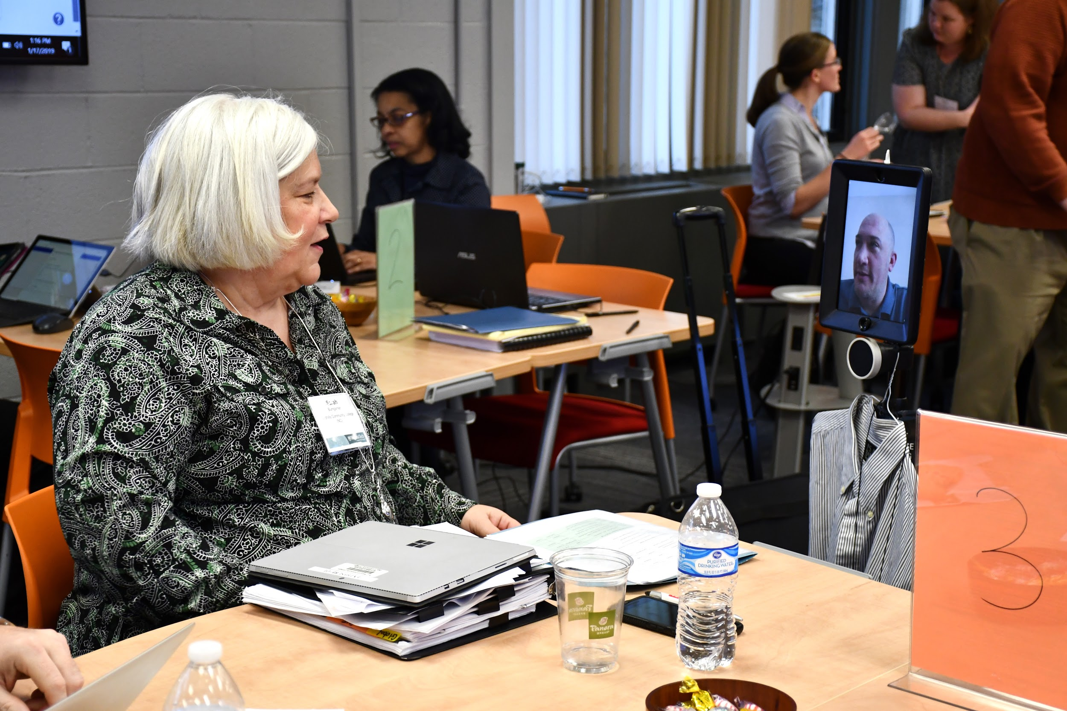

Slide 19
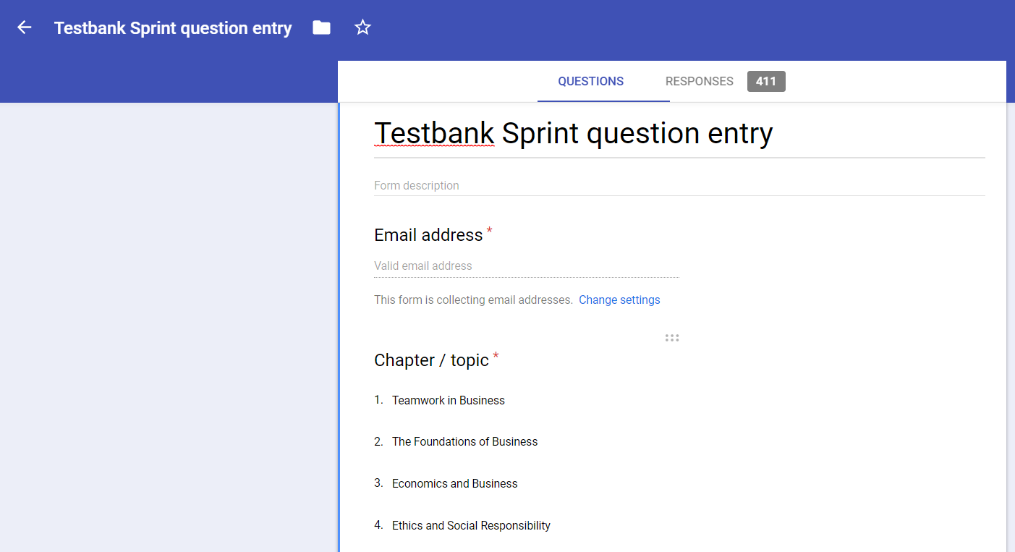

Slide 20
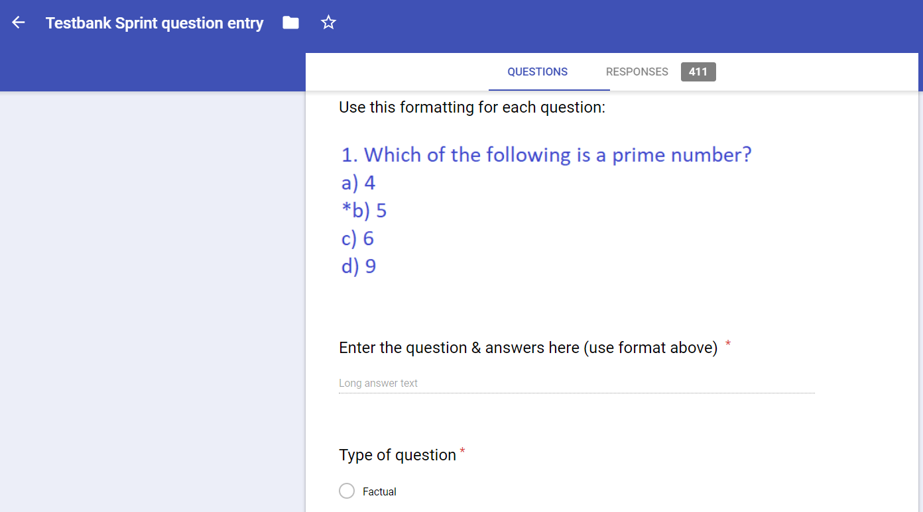

Slide 21
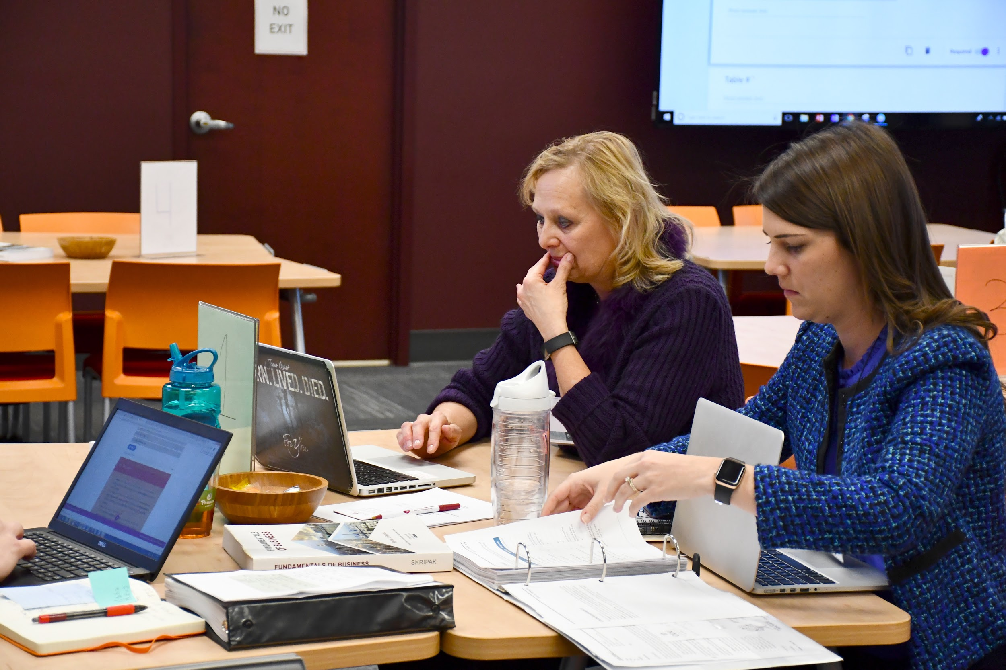

Slide 22
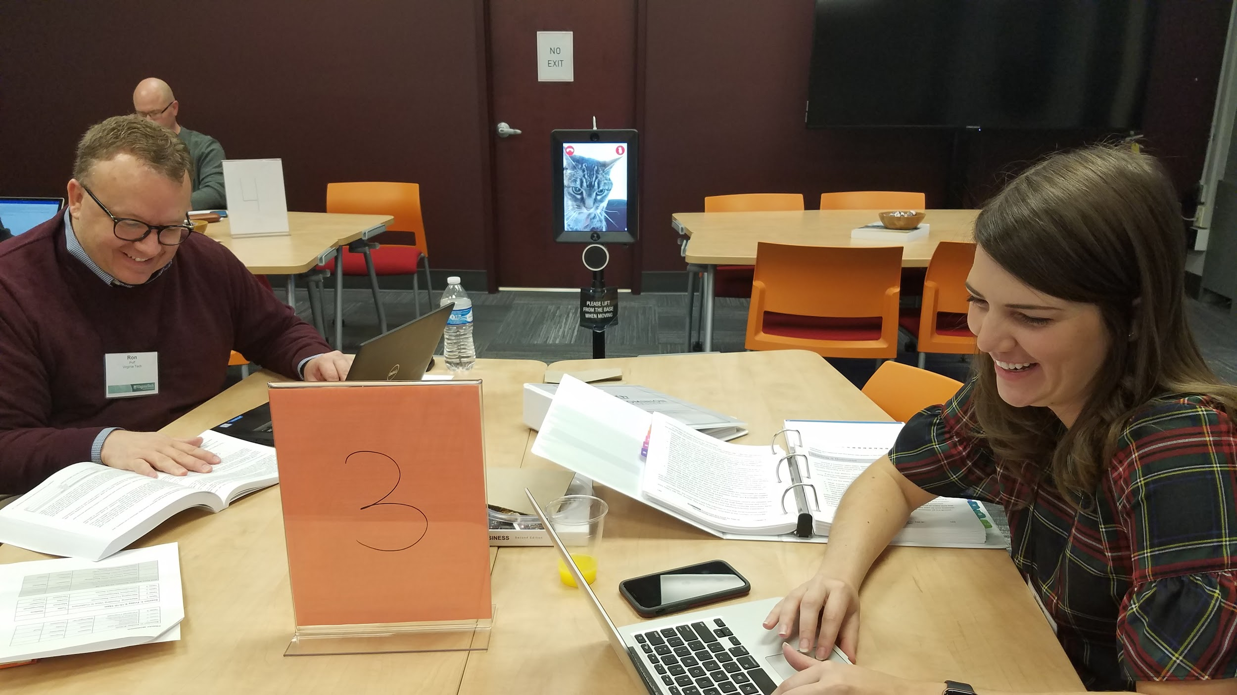

Slide 24
Giant spreadsheet!

Slide 25
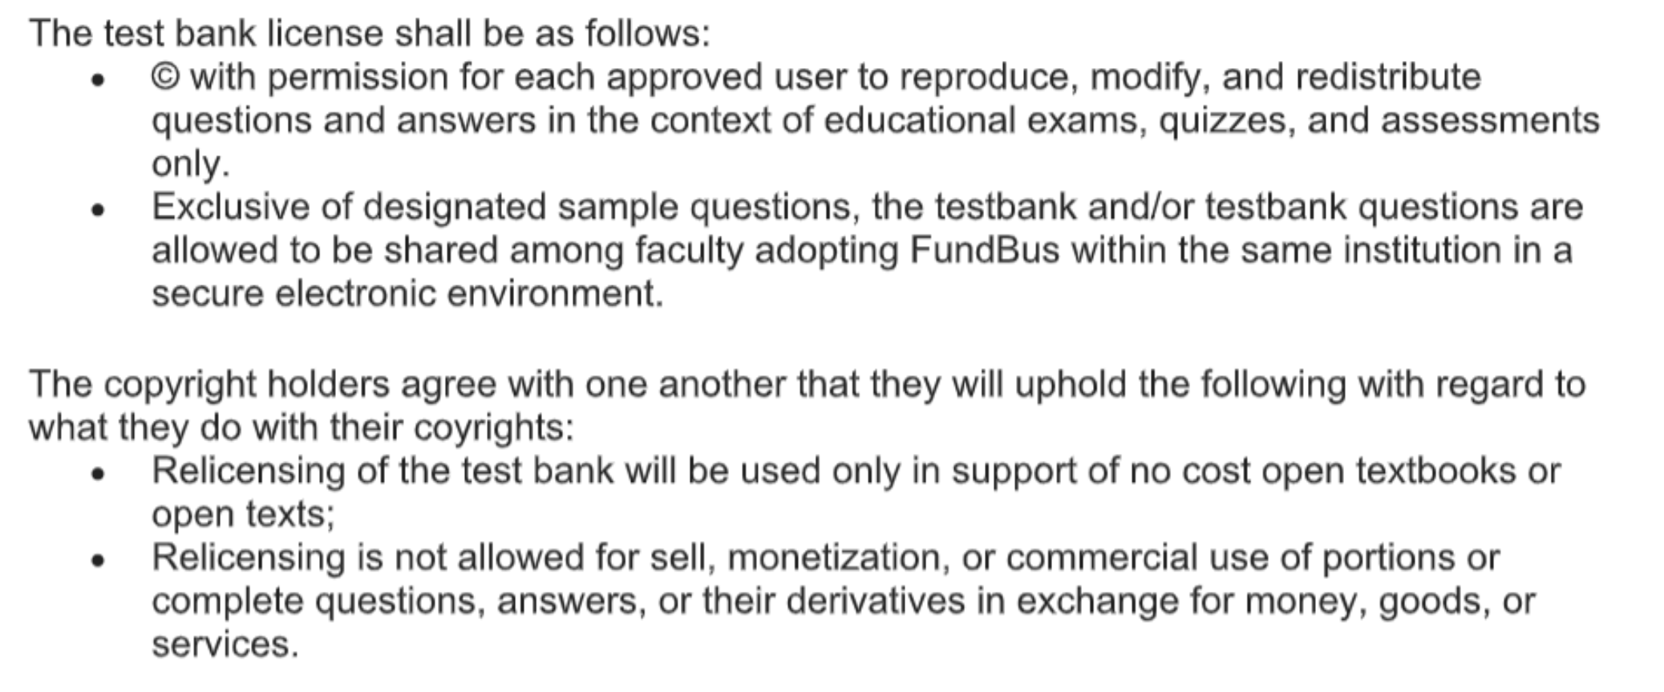
License & approved uses

Slide 26


Slide 27

Restricted file in DSpace repository
OR via a request form
manual authentication
Distribution (to instructors -- not students)

Slide 28
Looking forward to future sprints!

Slide 29
Thanks!
Questions?
Anita Walz @arwalz

