Slide 1
Bio-Inspired Trailing Edge Noise Control
Ian Clark, Nathan Alexander, and William Devenport, Virginia Tech
Stewart Glegg, Florida Atlantic University, Justin Jaworski, Lehigh University
Nigel Peake and Conor Daly, Cambridge University
Work supported by ONR under grants N00014-13-1-0244, N00014-14-1-0242, N62909-12-1-7116 (NICOP)

Slide 2
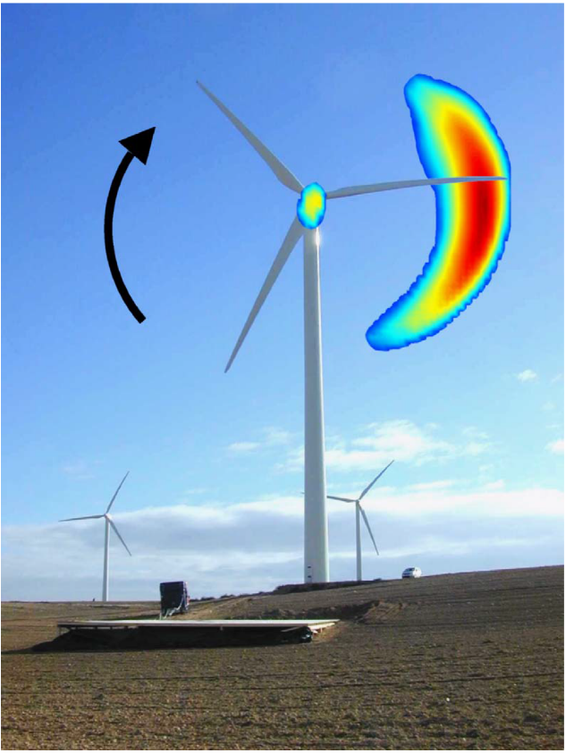
Motivation
Wind turbines are regulated for noise which limits their size, location, and operation.
A significant percentage of wind turbines are de-rated to comply with these regulations.
This results in a loss of Annual Energy Production for each decibel of noise reduction required.
We seek to reduce or eliminate the dominant noise source of wind turbines, which is trailing edge noise at the outer portion of the blades (where the most power is produced).
Credit: Oerlemans, S., et al. (2007). "Location and quantification of noise sources on a wind turbine." Journal of Sound and Vibration 299(4-5): 869-883.

Slide 3
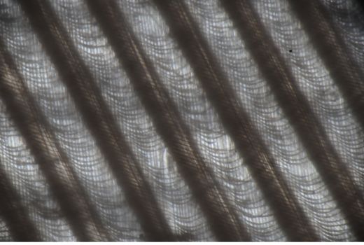
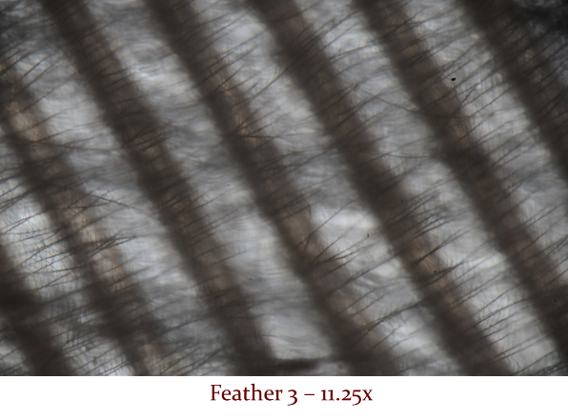
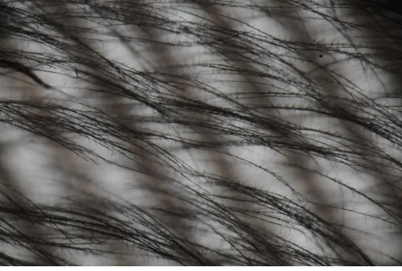
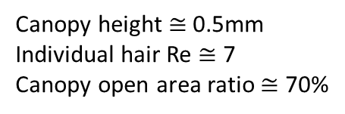
Inspiration
Certain species of owl that fly silently above 1.5kHz have down-like hairs on their feathers.
These hairs tend to form a canopy suspended over the surface of the feather.
A similar structure has been shown to attenuate pressure fluctuations at the underlying surface.
Middle Layer
Base Layer
Canopy Layer
Canopy height $≅$ 0.5mm
Individual hair Re $≅$ 7
Canopy open area ratio $≅$ 70%

Slide 4
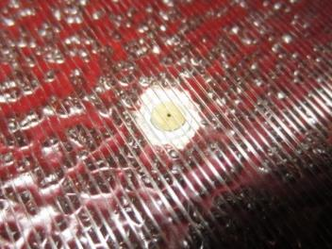




Unidirectional Fabric Canopy
Flow
129°
Flow
Increasing U_{j}
Increasing U_{j}
$$Φ_{pp} (SPL)$$
$$G_{pp} (SPL)$$
U_{j} = …
60 m/s
50 m/s
40 m/s
30 m/s
20 m/s
Solid – Roughness
Dotted – Roughness with Canopy
$$Freq. (Hz)$$
$$Freq. (Hz)$$
4

Slide 5
The Idea
The canopy can greatly suppress surface pressure fluctuations. Would it therefore not also suppress trailing edge noise?
How could a canopy be applied to an airfoil?
Could the hoped-for beneficial effects be achieved without significant adverse effects on the aerodynamics?

Slide 6
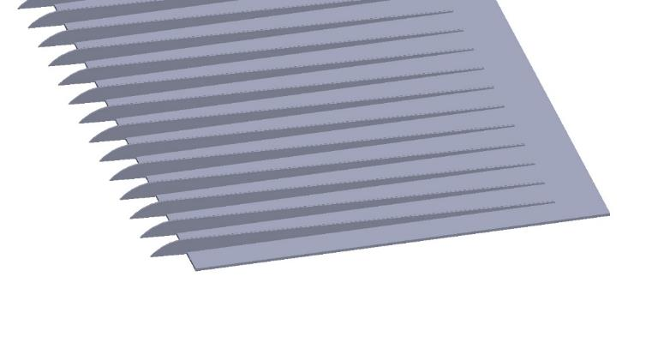
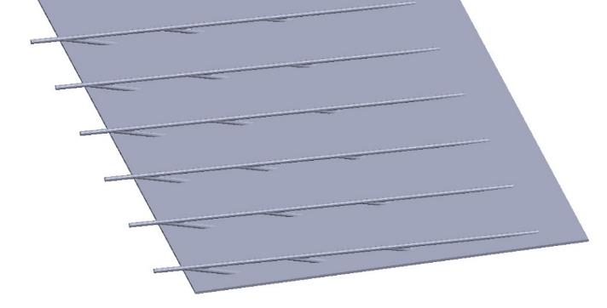
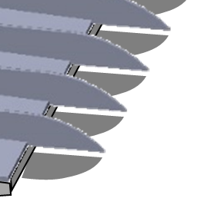
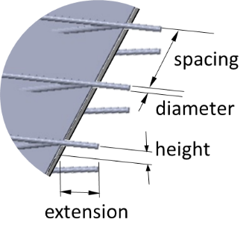
Two Practical Concepts
Flow-aligned elements on top and bottom surfaces manipulate boundary layers ahead of the trailing edge.
Flow
Flow
Trailing edge region
Trailing edge region
Finlets
Rails
height
spacing
thickness
extension

Slide 7
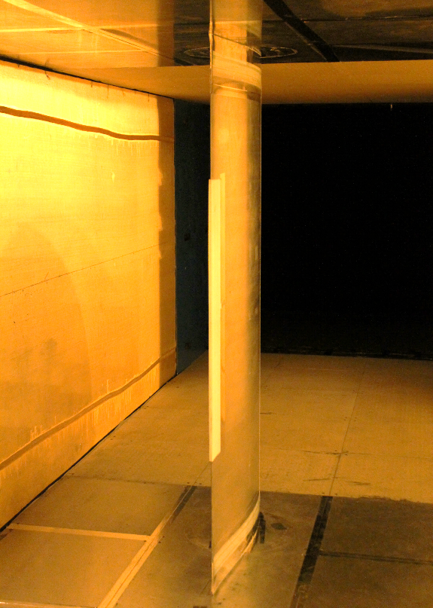
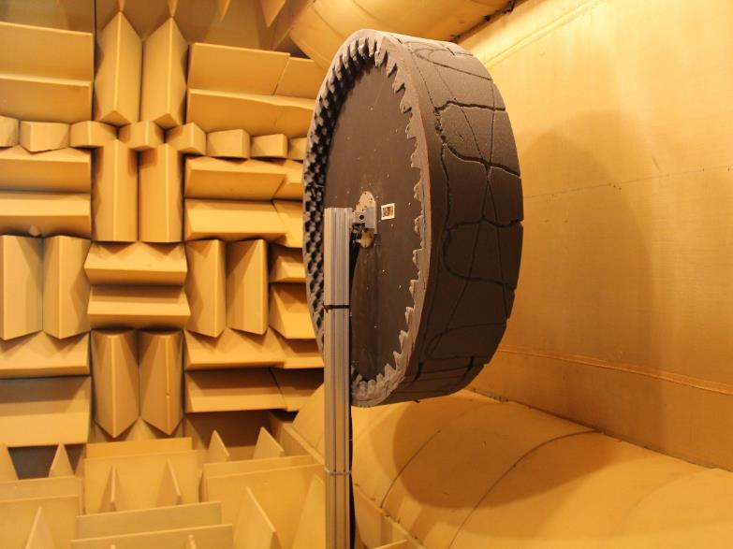
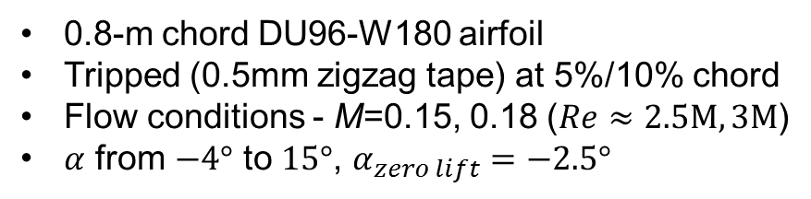
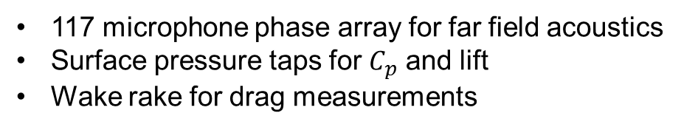
The Experiment
117 microphone phase array for far field acoustics
Surface pressure taps for $C_{p}$ and lift
Wake rake for drag measurements
0.8-m chord DU96-W180 airfoil
Tripped (0.5mm zigzag tape) at 5%/10% chord
Flow conditions - M=0.15, 0.18 ($Re≈2.5M, 3M$)
$α$ from $−4°$ to $15°$, $α_{zero lift}=−2.5°$

Slide 8
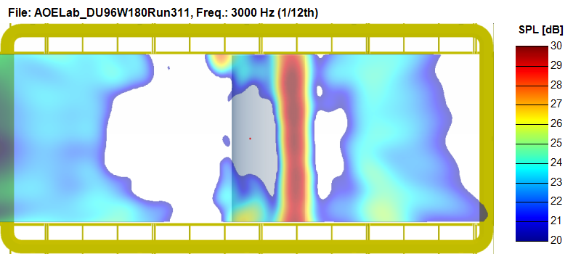
Clean Airfoil
Re = 3M, Tripped, 3000 Hz
Airfoil
TE
Integration Region
Test Section
-0.5°

Slide 9
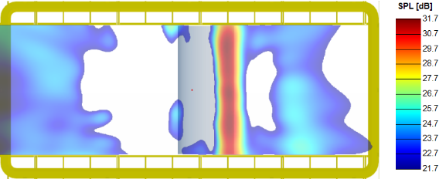
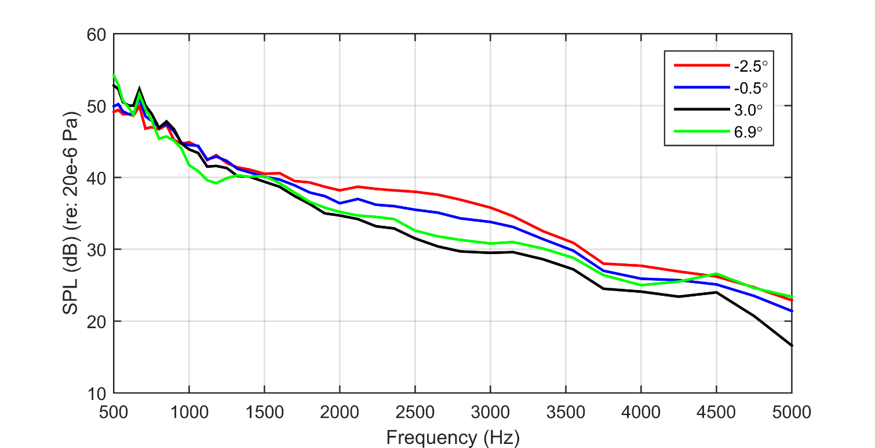
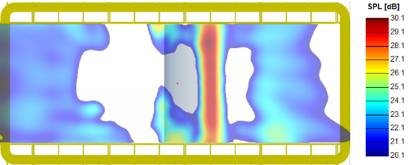
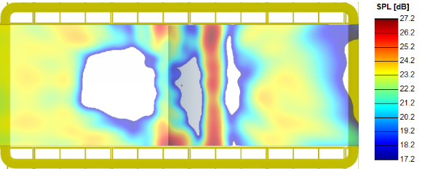
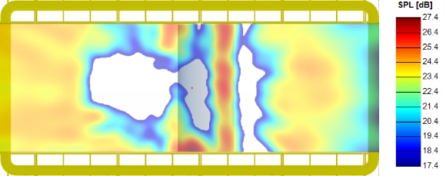
Clean Airfoil
3000 Hz
Integrated Spectra
-2.5°
-0.5°
3.0°
6.9°

Slide 10
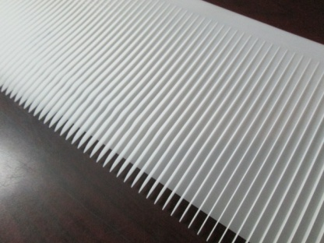
Finlets – Configuration 5
4
4
0.5
Thickness – 0.5mm
Spacing – 4mm
Height – 4mm
10mm Extension
10

Slide 11
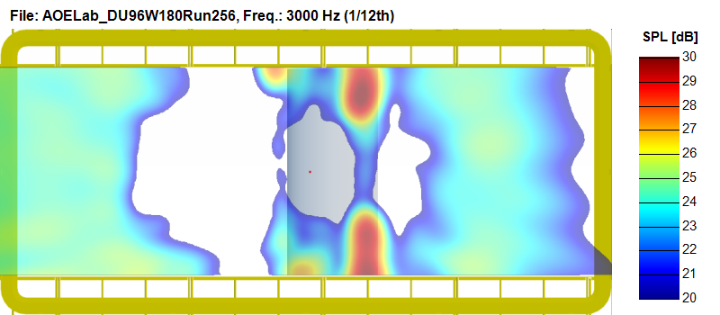
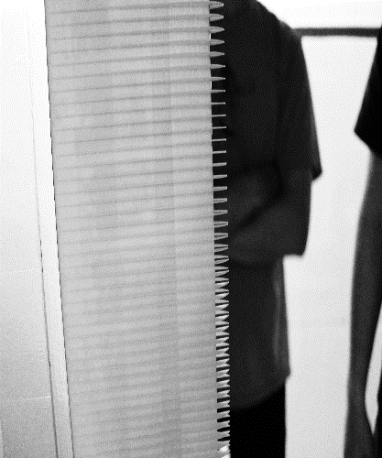
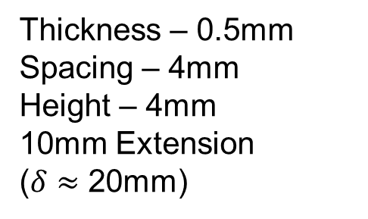
Finlets – Configuration 5
4
4
0.5
Re = 3M, Tripped, 3000 Hz
10
Thickness – 0.5mm
Spacing – 4mm
Height – 4mm
10mm Extension
($δ≈$ 20mm)
Treatment Location
Airfoil
TE
Test Section
-0.5°

Slide 12
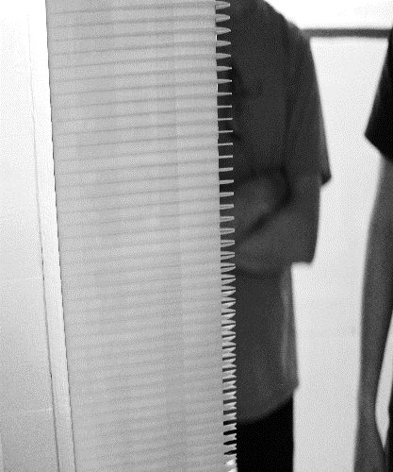
Finlets – Configuration 5
4
4
0.5
Re = 3M, Tripped, 3000 Hz
10
Thickness – 0.5mm
Spacing – 4mm
Height – 4mm
10mm Extension
($δ≈$ 20mm)
Airfoil
TE
Integration Region
Test Section
-0.5°

Slide 13
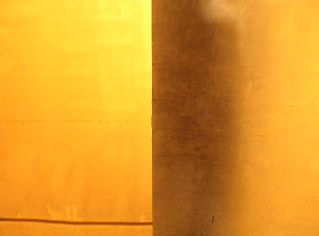

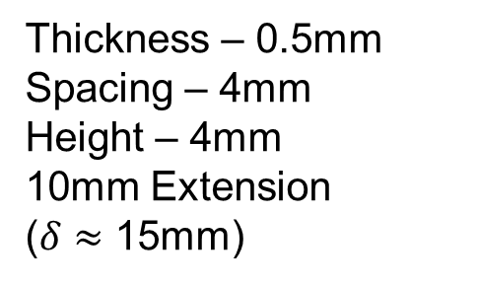
Effect of Configuration 5 Finlet
4
4
0.5
Integrated Spectra
10
Thickness – 0.5mm
Spacing – 4mm
Height – 4mm
10mm Extension
($δ≈$ 15mm)
-0.5°

Slide 14
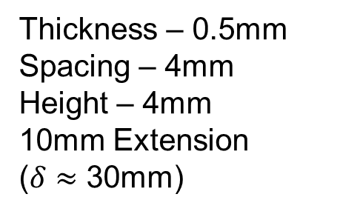
Effect of Configuration 5 Finlet
4
4
0.5
Integrated Spectra
10
Thickness – 0.5mm
Spacing – 4mm
Height – 4mm
10mm Extension
($δ≈$ 30mm)
3.0°

Slide 15
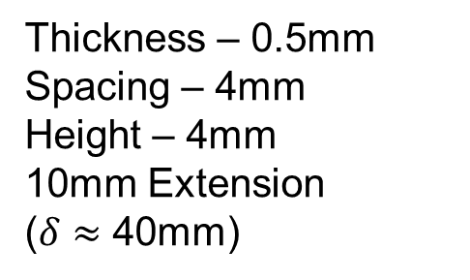
Effect of Configuration 5 Finlet
4
4
0.5
Integrated Spectra
10
Thickness – 0.5mm
Spacing – 4mm
Height – 4mm
10mm Extension
($δ≈$ 40mm)
6.9°

Slide 16
Effects of Finlet Geometry
Spacing
  In general, smaller finlet spacing improves performance
  However, very small spacings cause vortex shedding
Height
  Increased height improves performance, particularly at high angle of attack
Trailing Edge Extension
  Removing the trailing edge extension improves performance, particularly at high angle of attack
-0.5°

Slide 17
Effects of Finlet Geometry
-0.5°
Spacing
  In general, smaller finlet spacing improves performance
  However, very small spacings cause vortex shedding
Height
  Increased height improves performance, particularly at high angle of attack
Trailing Edge Extension
  Removing the trailing edge extension improves performance, particularly at high angle of attack
6.9°

Slide 18
Effects of Finlet Geometry
-0.5°
Spacing
  In general, smaller finlet spacing improves performance
  However, very small spacings cause vortex shedding
Height
  Increased height improves performance, particularly at high angle of attack
Trailing Edge Extension
  Removing the trailing edge extension improves performance, particularly at high angle of attack
6.9°

Slide 19

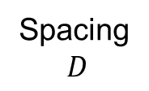

What physical mechanisms are we exploiting?
Spacing
$D$
Break up of the boundary layer eddies?
Displacing those structures away from the surface/edge?
Shear sheltering of the edge?
Suppression of trailing edge shedding?
Span $S$
Correlation lengthscale $L$
cylinder with defined porosity

Slide 20
Conclusions
A new, bio-inspired surface treatment for the suppression of trailing edge noise has been demonstrated.
The treatment could be combined with existing trailing edge modifications (serrations, etc.) to maximize noise control.
The treatment is effective throughout a wide parameter range and is not highly dependent on a particular geometry, but there appears to be strong potential for optimization.
The treatment has been shown to be effective over an angle of attack range that extends over 8 degrees from zero lift.
Drag data suggests that the impact of finlets is limited to an increase in skin friction from the additional wetted area.

Slide 21
Extras

Slide 22
Configurations - Finlets
114.3
101.6
substrate
Config# | Runs | Type | Height | Spacing | Thickness | TE extension | Substrate | Suction only | Cp/lift | Drag | Acoustics |  | Comment
0 | All | - | - | - | - | - | - | - | Y | Y | Y |  | Control cases
2 | 133-154 | Blank | - | - | - | - | 0.5 | - | Y | Y | Y
10 | 683-704 | Blank | - | - | - | - | 0.75 | - | Y | - | Y
3 | 463-484 | Fin | 4 | 1 | 0.5 | 10 | 0.5 | - | Y | - | Y |  | Fin anchor case
1 | 419-440 | Fin | 4 | 1 | 0.5 | 0 | 0.5 | - | Y | - | Y |  | Effect of extension w. C3
5 | 243-264 | Fin | 4 | 4 | 0.5 | 10 | 0.5 | - | Y | - | Y |  | Effects of fin spacing w. C3
13 | 804-825 | Fin | 4 | 6 | 0.5 | 10 | 0.75 | - | Y | - | Y
7 | 331-352 | Fin | 4 | 10 | 0.5 | 10 | 0.5 | - | Y | - | Y
11 | 727-748 | Fin | 2 | 1 | 0.5 | 10 | 0.75 | - | Y | - | Y |  | Effects of height w. C3
6 | 287-308 | Fin | 4 | 1 | 0.5 | 10 | 0.5 | - | Y | - | Y |  | Effect of fractal length w. C3
12 | 760-781 | Fin | 4 | 1 | 0.5 | 10 | 0.75 | - | Y | - | Y |  | Effect of fractal length/height w. C3
8 | 375-396 | Fin | 8 | 4 | 0.5 | 10 | 0.5 | - | Y | Y | Y |  | Effect of fin height, w. C5
9 | 639-660 | Fin | 4 | 4 | 2 | 10 | 0.75 | - | Y | - | Y |  | Effect of fin thickness w. C5
1S | 507-528 | Fin | 4 | 1 | 0.5 | 0 | 0.5 | Y | Y | - | Y |  | Effect of no pressure side treatment w. C1
3S | 551-572 | Fin | 4 | 1 | 0.5 | 10 | 0.5 | Y | Y | - | Y |  | Effect of no pressure side treatment w. C3
8S | 980-1001 | Fin | 8 | 4 | 0.5 | 10 | 0.5 | Y | Y | - | Y |  | Effect of no pressure side treatment w. C8
26s | 1112-1122, 1134-1144 | Fin | 16 | 4 | 0.5 | 0 | 0.5 | Y | Y | - | Y |  | High suction-side treatment
height
spacing
thickness
extension

Slide 23
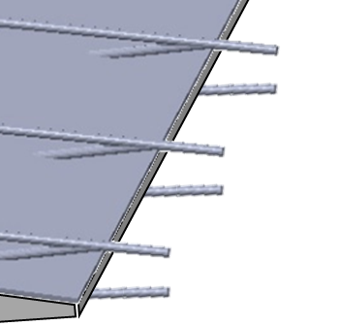
Configurations - Rails
114.3
101.6
substrate
Config# | Runs | Type | Height | Spacing | Diameter | TE extension | Substrate | Suction only | Cp/lift | Drag | Acoustics |  | Comment
14 | 848-869 | Rail | 4 | 2.5 | 1.25 | 10 | 0.75 |  | Y | - | Y |  | Rod anchor case
15 | 936-957 | Rail | 4 | 2.5 | 1.25 | 0 | 0.75 | - | Y | - | Y |  | Effect of extension w. C14
17 | 1024-1045 | Rail | 8 | 2.5 | 1.25 | 10 | 0.75 | - | Y | - | Y |  | Effect of height w. C14
18 | 1068-1089 | Rail | 4 | 5 | 2.5 | 10 | 0.75 | - | Y | - | Y |  | Effect of dia. & spacing w. C14
20 | 1211-1232 | Rail | 8 | 10 | 1.25 | 10 | 0.75 | - | Y | - | Y |  | Effect of spacing w. C17
19 | 1167-1188 | Rail | 4 | 2.5 | 1.25 | 10 | 0.75 | - | Y | - | Y |  | Effect of fractal length w. C14
Velvet | 892-913 | Velvet | n/a | n/a | n/a | n/a | n/a | - | Y | - | Y
Velcro | 23-44 | Velcro | n/a | n/a | n/a | n/a | n/a | - | Y | - | Y
spacing
diameter
height
extension

Slide 24
BL Thickness
Separation

Slide 25

Effect of Configuration 5 Finlet
4
4
0.5
Integrated Spectra
10
Thickness – 0.5mm
Spacing – 4mm
Height – 4mm
10mm Extension
($δ≈$ 15mm)
7
14
20
27
34
40
47
54
60
67
$$\frac{fc}{U}$$
-0.5°

Slide 26
Finlets – Effect of Spacing
4
1,4, 6, 10
0.5
Integrated Spectra
10
Thickness – 0.5mm
Spacing – 1,4, 6, 10mm
Height – 4mm
10mm Extension
-0.5°

Slide 27
Finlets – Effect of Height
4,8
4
0.5
Integrated Spectra
10
Thickness – 0.5mm
Spacing – 4mm
Height – 4, 8mm
10mm Extension
-0.5°

Slide 28
Finlets – Effect of Height
4,8
4
0.5
Integrated Spectra
10
Thickness – 0.5mm
Spacing – 4mm
Height – 4, 8mm
10mm Extension
6.9°

Slide 29
Finlets – Effect of Extension
4
1
0.5
Integrated Spectra
0,10
Thickness – 0.5mm
Spacing – 1mm
Height – 4mm
0, 10mm Extension
-0.5°

Slide 30
Finlets – Effect of Extension
4
1
0.5
Integrated Spectra
0,10
Thickness – 0.5mm
Spacing – 1mm
Height – 4mm
0, 10mm Extension
6.9°

Slide 31
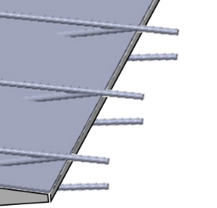
Rails vs Finlets
2.5
1.25
Integrated Spectra
4
4
10
1, 4
0.5
10
-0.5°

