Slide 1

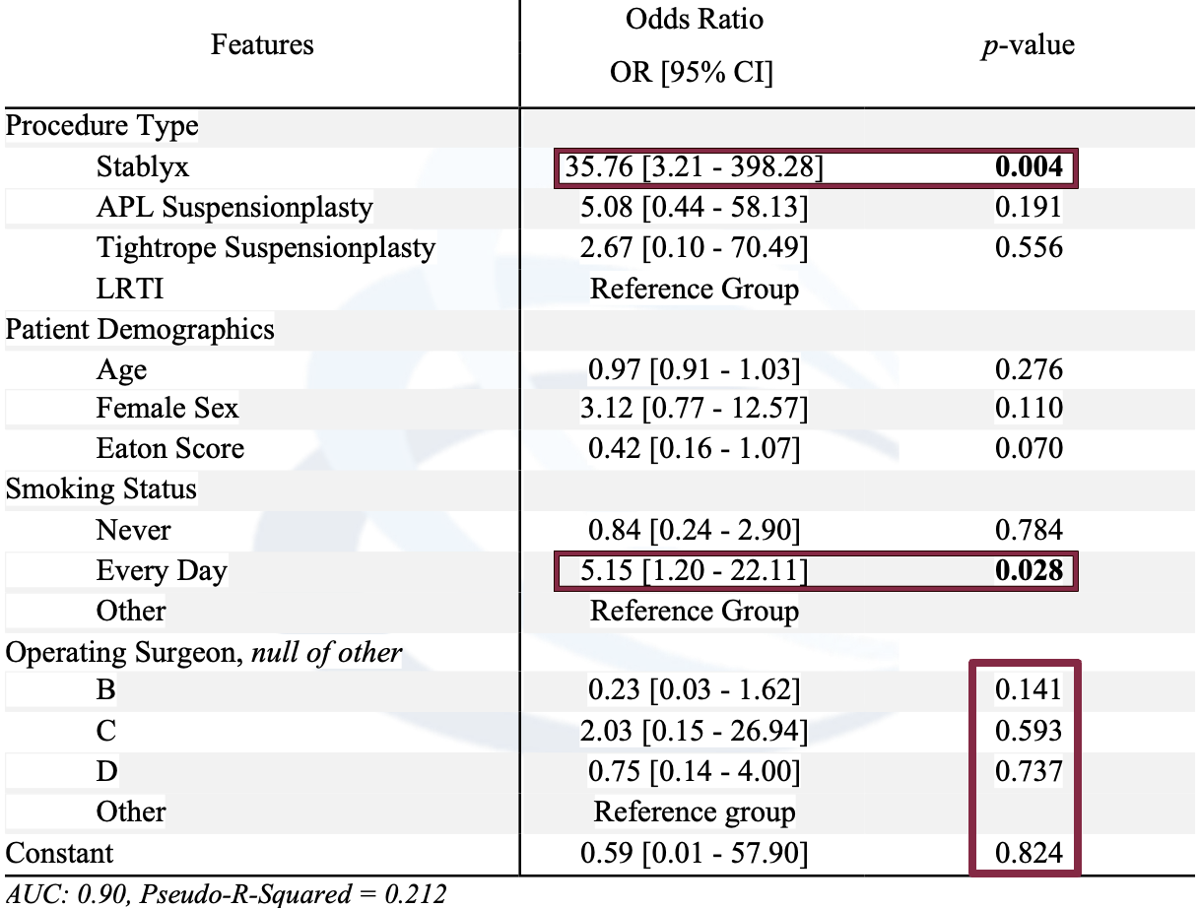
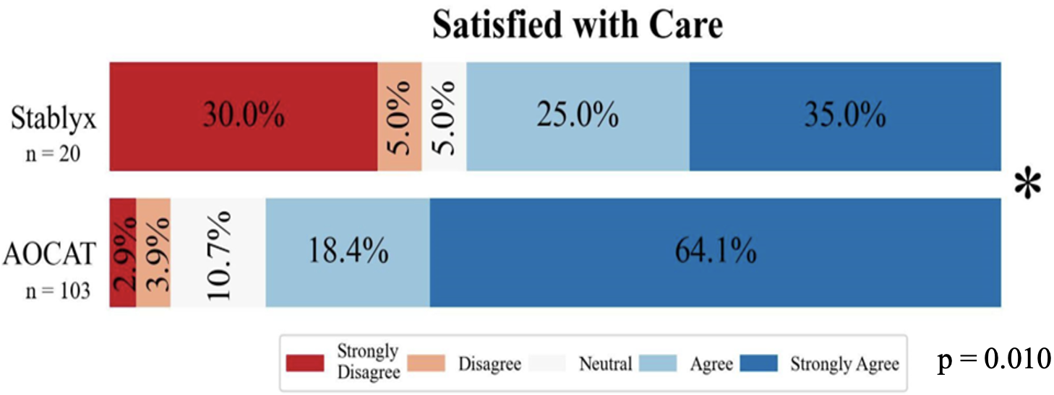
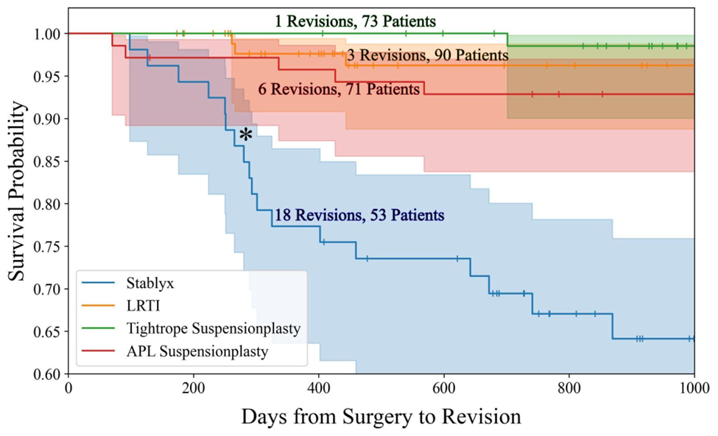
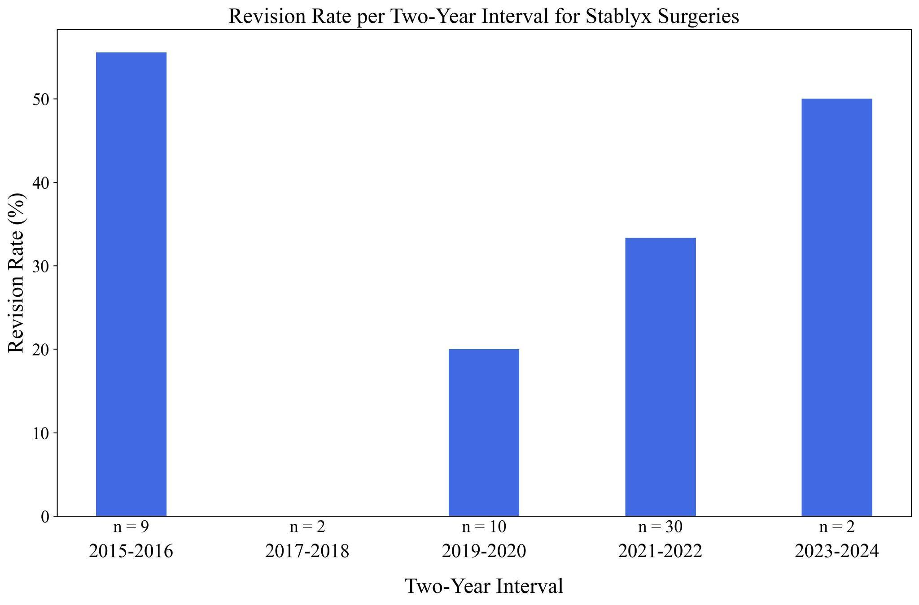
Stablyx Hemiarthroplasty Implant Survivorship in Thumb Carpometacarpal Arthritis
Kelsey M. Gray MD, Camden Novikova BS, Nick Peterman MD, Micheala McCarthy MD, Peter Apel MD PhD,
Anthony E. Capito MD FACS
Virginia Tech Carilion Clinic, Roanoke, VA
INTRODUCTION
RESULTS
RESULTS (CONT.)
Estimated 40,000 CMC joint arthroplasties performed each year¹
Numerous CMC arthroplasty implant designs have been utilized, with none demonstrating clear superiority²
Limited data regarding Stablyx® hemiarthroplasty implant survivorship and patient satisfaction³
Study goal: Non-revision survival of CMC arthroplasty performed at our institution with special attention to the Stablyx implant®
Primary Outcome: Survival
Secondary Outcome:
QuickDASH
No difference between cohorts with a mean of 28.41 ± 22.84 for the Stablyx® cohort and 22.23 ± 21.17 for the AOCAT (All other CMC arthroplasty techniques) cohort
Satisfaction
MATERIALS & METHODS
All patients who underwent a CMC arthroplasty (CPT 25447) over 10 years by 8 hand surgeons
4 Cohorts:
Stablyx® implant arthroplasty (n=53)
APL suspensionplasty (n=71)
Tightrope suspensionplasty (CMC Mini TightRope® Fixation System, Arthrex) (n=73)
LRTI (n=90)
Minimum 6-month follow-up period
Contacted (email and phone) and sent surveys
Satisfaction via 5-point Likert scale
QuickDASH
Chart review: demographics, revision surgeries, Eaton score, smoking status
Total responses = 287 patients
Primary outcome: revision-free surgical/implant survivorship
Secondary outcomes: final QuickDASH score and overall satisfaction
Stablyx cohort 35% were strongly dissatisfied or dissatisfied vs 6.8% AOCAT cohort
Stabylx cohort 60% were strongly satisfied or satisfied vs. 82.5% AOCAT cohort
CONCLUSION
Stablyx® implant had an OR of 35x for revision compared to all other surgery types
Lower Satisfaction
Similar QuickDASH
Smoking status had an OR of 5x revision of all arthroplasty techniques
Daily smokers
No surgeon effect
High revision rate and low satisfaction with Stablyx®
Implant not recommended
More well established CMC arthroplasty techniques are preferred
Survival rate at 1 year: LRTI (98%), APL suspensionplasty (96%), Tightrope suspensionplasty (100.0%), Stablyx (77%)
REFERENCES
No significant difference was observed between revision rates per 2 year intervals
Yoon AP, Hutton DW, Chung KC. Cost-effectiveness of surgical treatment of thumb carpometacarpal joint arthritis: a value of information study. Cost Eff Resour Alloc. 2023;21(1):28. doi:10.1186/s12962-023-00438-8
Raj S, Clay R, Ramji S, et al. Trapeziectomy versus joint replacement for first carpometacarpal (CMC 1) joint osteoarthritis: a systematic review and meta-analysis. Eur J Orthop Surg Traumatol. 2022;32(6):1001-1021. doi:10.1007/s00590-021-03070-5
Florez GB, Rubio F. Carpometacarpal Hemiarthroplasty. Oper Tech Orthop. 2018;28(1):43-48. doi:10.1053/J.OTO.2017.12.010

