Slide 1
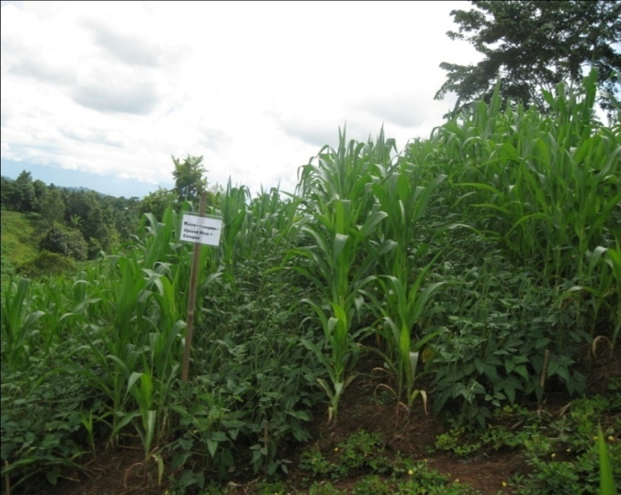


Developing Conservation Agriculture in the Philippines
Agustin R. Mercado, Jr., ICRAF
Manuel Reyes, NCAT
Vic Ella, UPLB

Slide 2
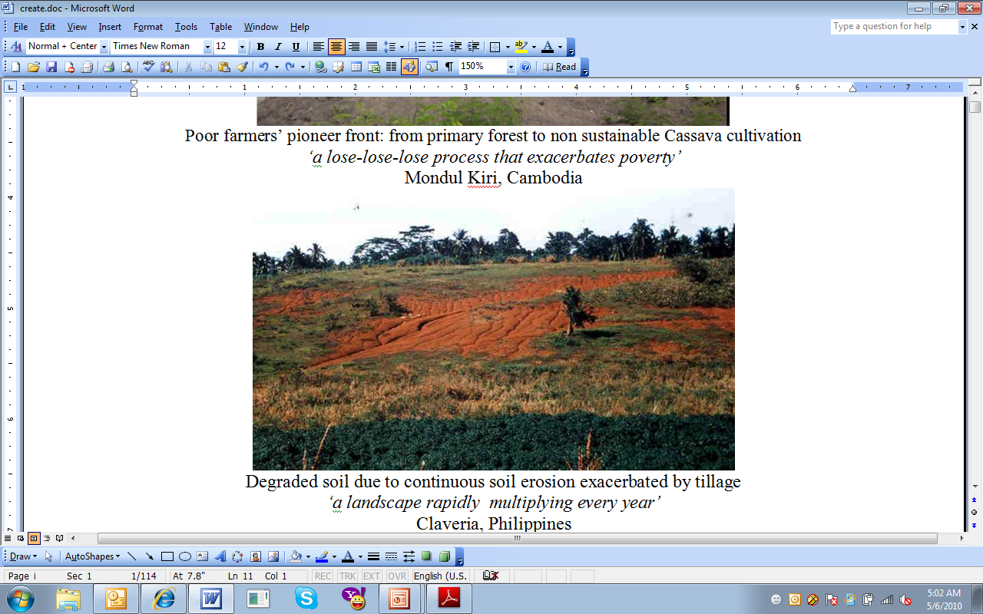
Conservation Agriculture for Food Security in Cambodia and the Philippines
Philippines site: a landscape rapidly multiplying every year

Slide 3
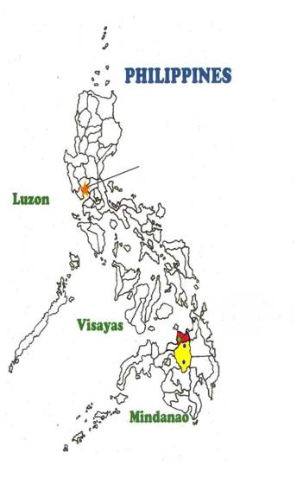
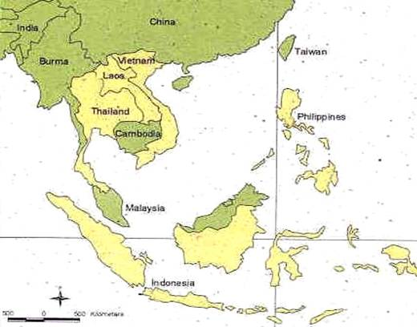
Context: Upland areas and smallholders
Philippines
More than 7,000 islands
Population is 92 M people
Land area is 30 M has
10 M has sloping acid upland soils
5 M has less productive upland areas due to degradation
Manila
Claveria

Slide 4
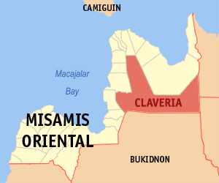
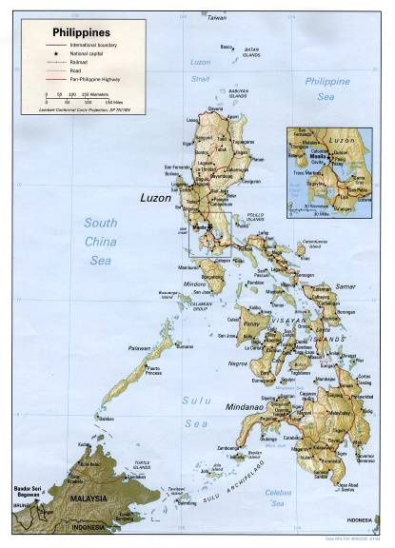
Philippines SANREM site

Slide 5
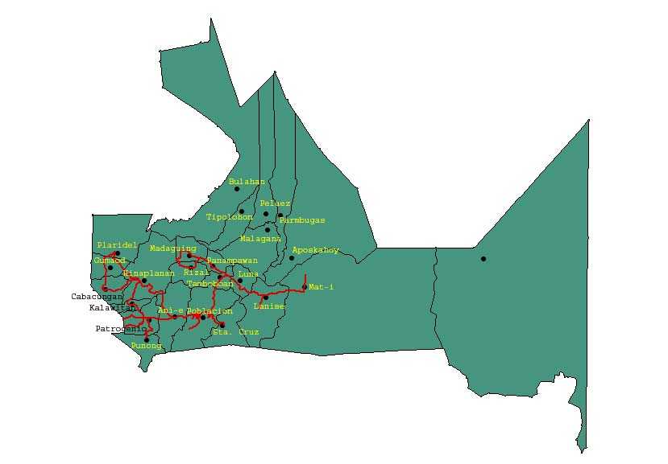
Claveria, Misamis Oriental
Elevation ranges from 450 to 1200 meters above sea level
Maize, cassava and upland rice cropping dominate the lower elevation (<600masl), while vegetable and maize in rotation dominate the upper elevation.
Landscape is derived from pyroclastic materials. Soils are deep, fine mixed isohyperthermic Ultic Haplorthox
Soils are acidic with pH ranges from 4.2 to 5.2.
Rainfall is 2500 mm well distributed throughout the year.
Average farm size is 2.0 hectares
Represents 10 M has in the Philippines; 181 has in Southeast Asia

Slide 6
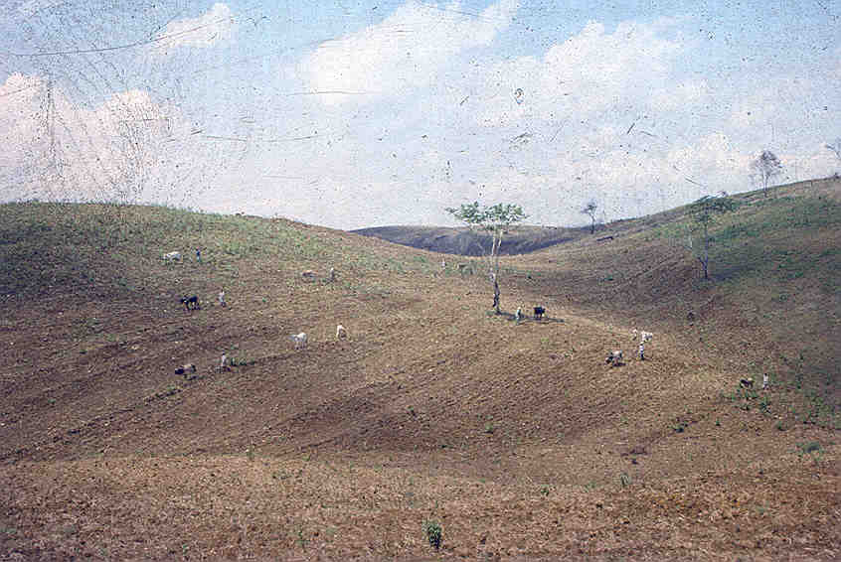
Upland farmers traditionally cultivate their fields up and down the slope

Slide 7
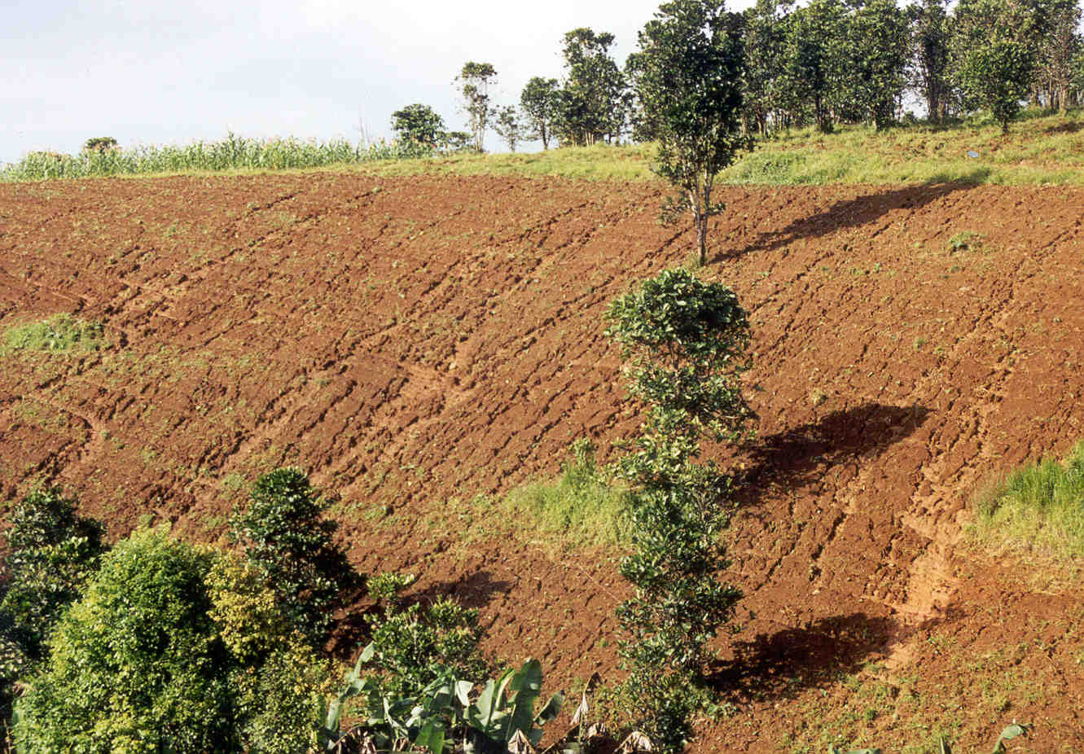
The estimated annual replacement cost of eroded nutrients (Claveria) is P37,000 per hectare per year.

Slide 8
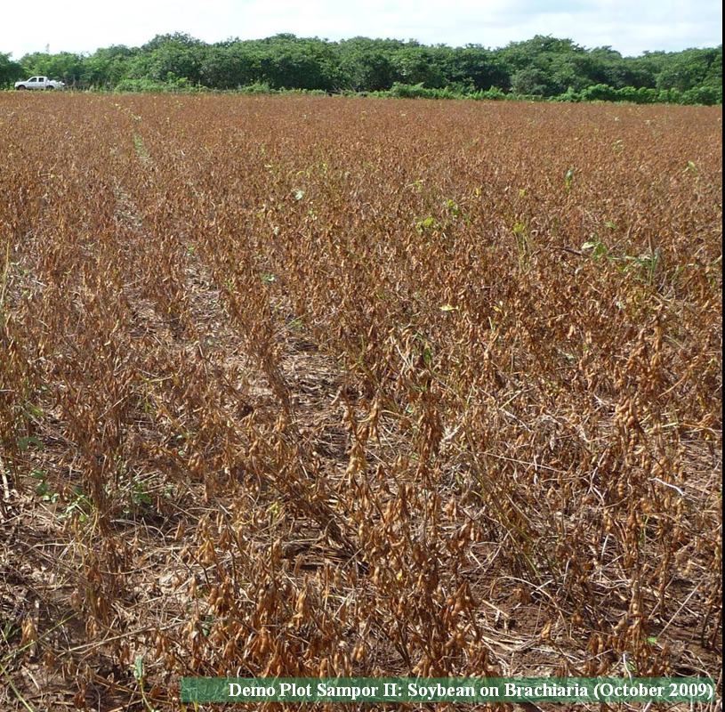
Project Goal (Philippines)
To promote Conservation Agriculture as a
technologically-feasible, economically-viable, environmentally-sustainable and gender-responsive production system for food security of small farm communities in the Philippines.

Slide 9
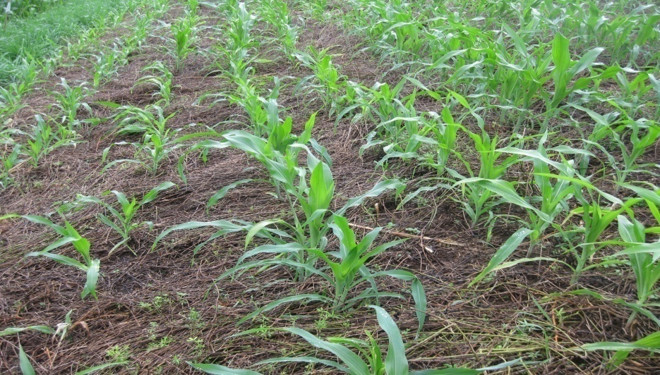
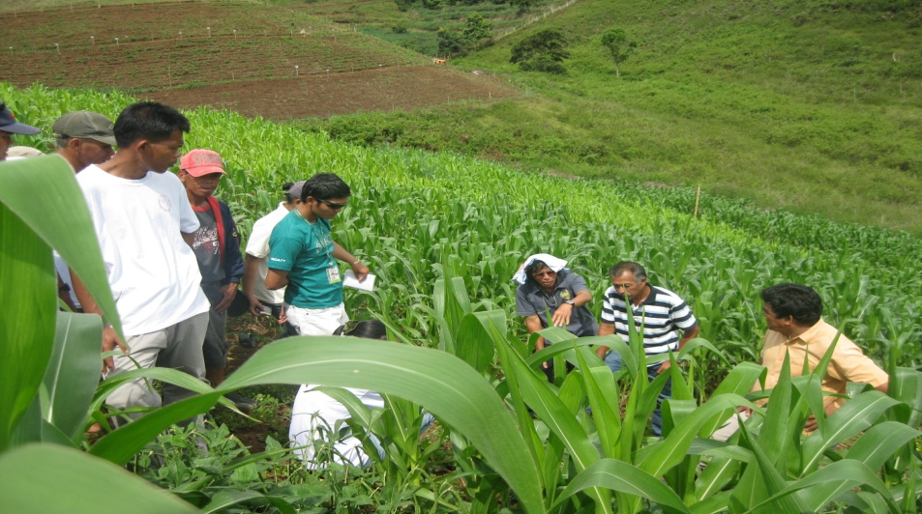
Objective
Assess agronomic performance and soil quality from conservation agriculture production systems (CAPS) and compare them with conventional plow-based system in the Philippines

Slide 10
The researcher managed trial (RMT): Treatments
T1 - Maize + Arachis pintoi (AP) - Maize + AP
T2 - Maize + Sytlosanthes guinanensis (SG)- Fallow
T3 - Maize + Cowpea (CP)- Upland rice + CP
T4 - Maize + Rice beans (RB) - Maize + RB
T5 - Cassava + Stylo
T6 . Farmer’s practice
Two fertility levels:
0-30-0 N P₂O₅K₂O (Low fertility); 120-60-60 P₂O₅K₂O (new modification )
60-30-30 N P₂O₅K₂O (Moderate fertility)

Slide 11
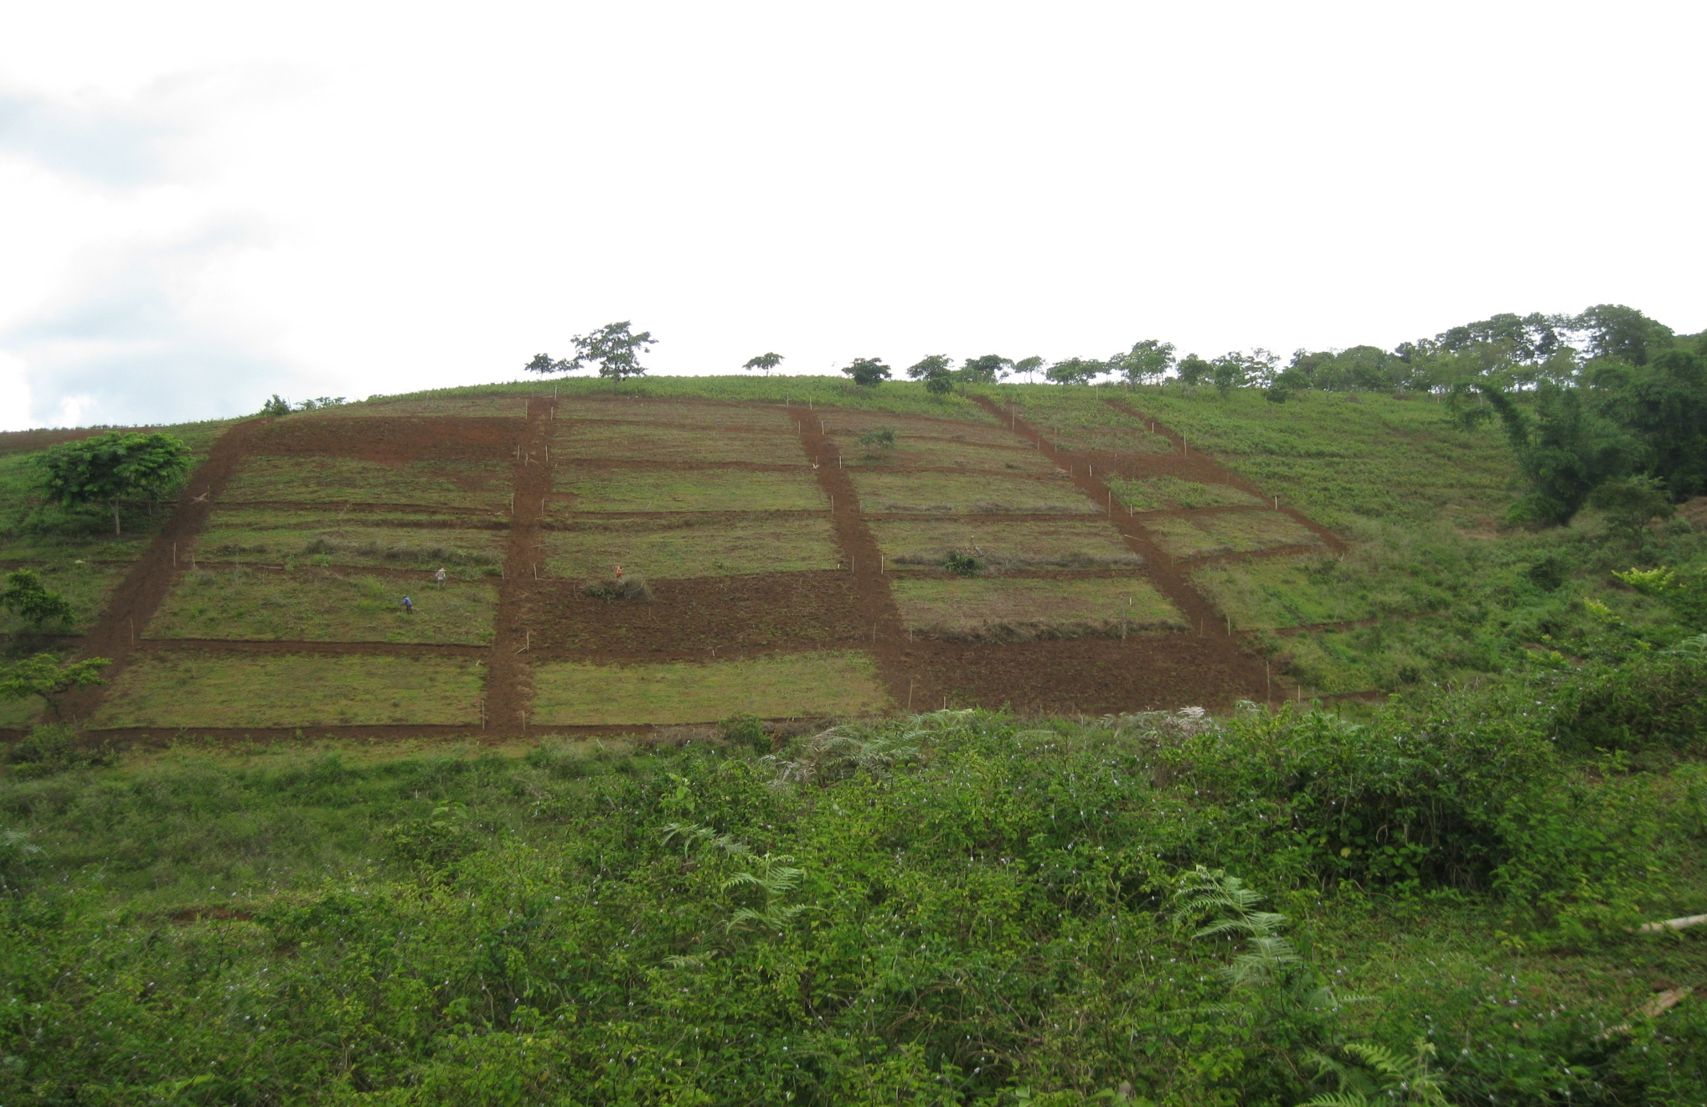
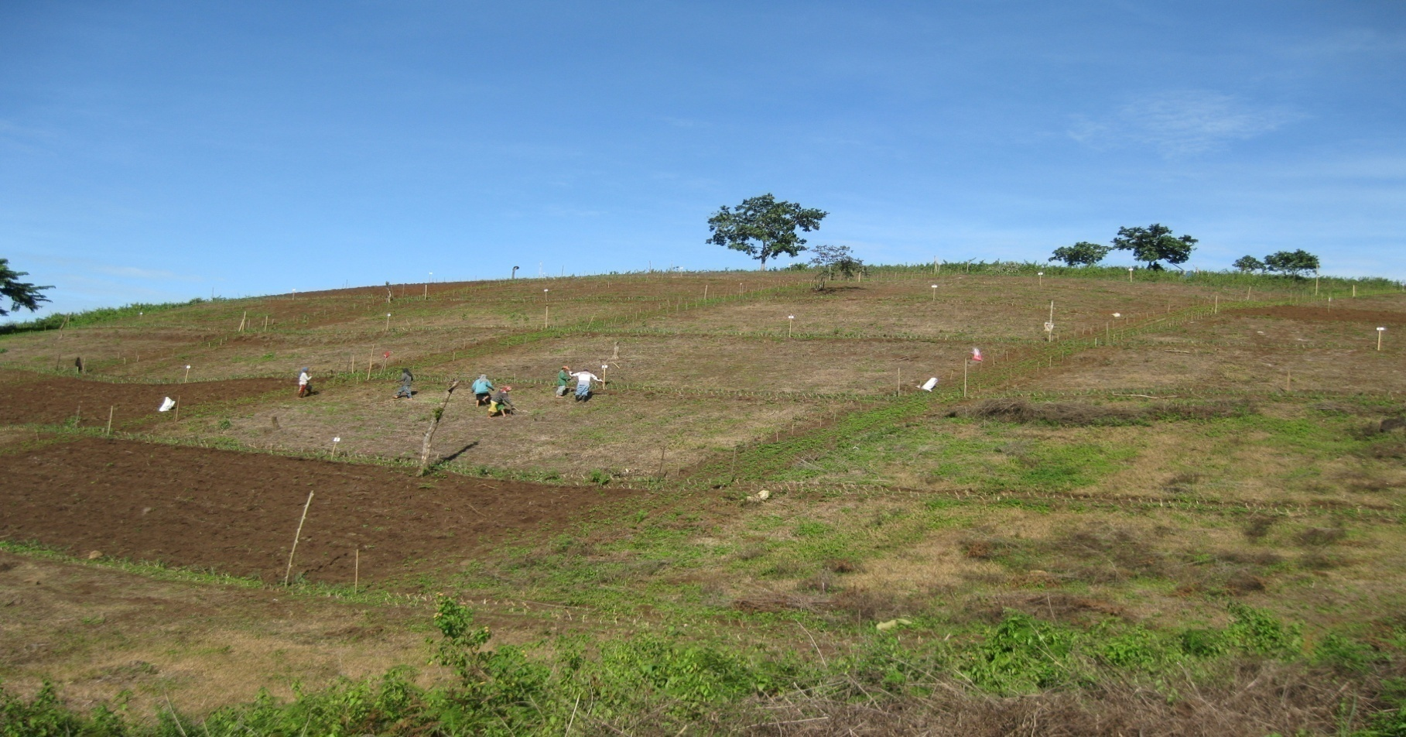
Field layout

Slide 12
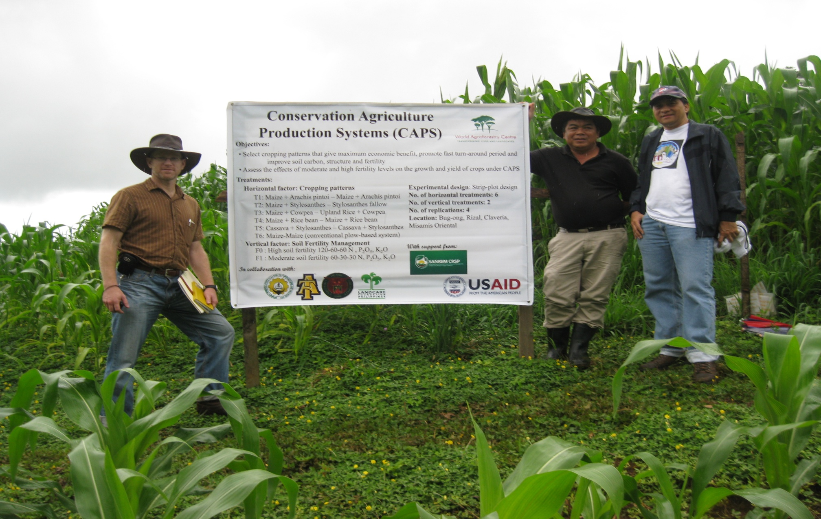
Researcher-managed CAPS experiment

Slide 13
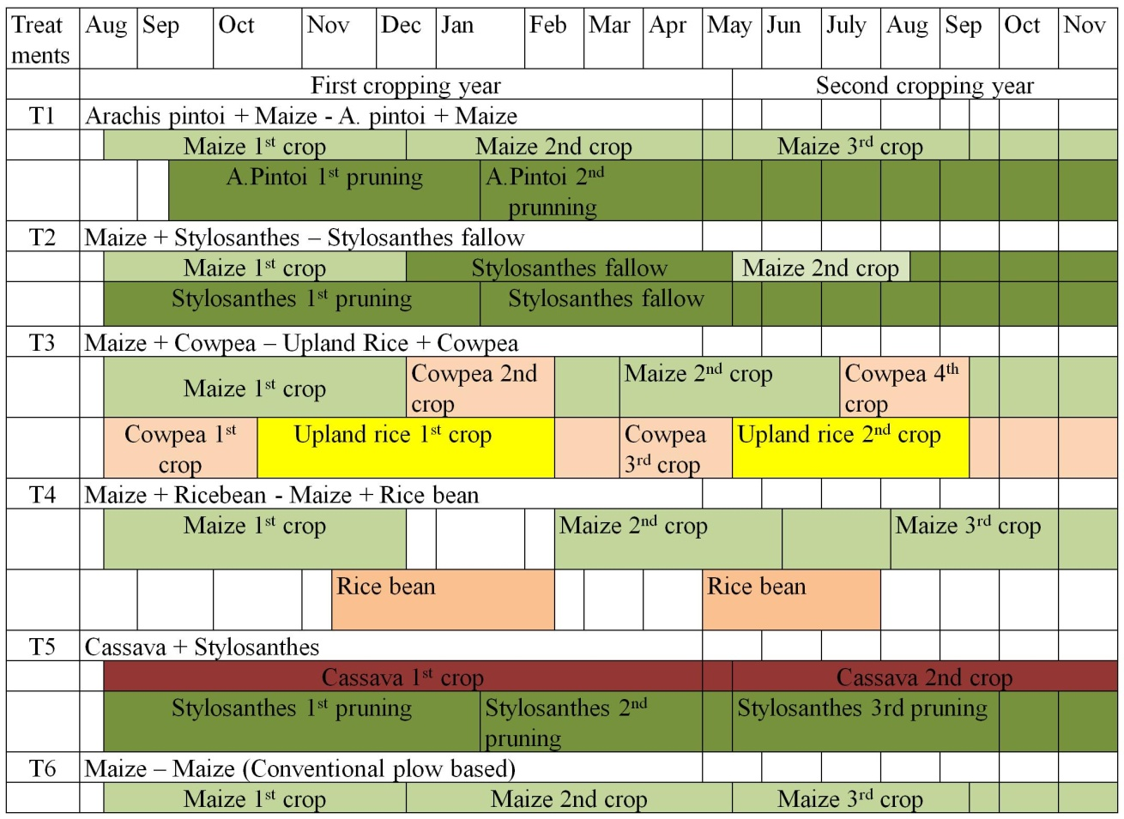
System phenology of conservation agriculture production systems. Claveria, Misamis Oriental, Philippines

Slide 14
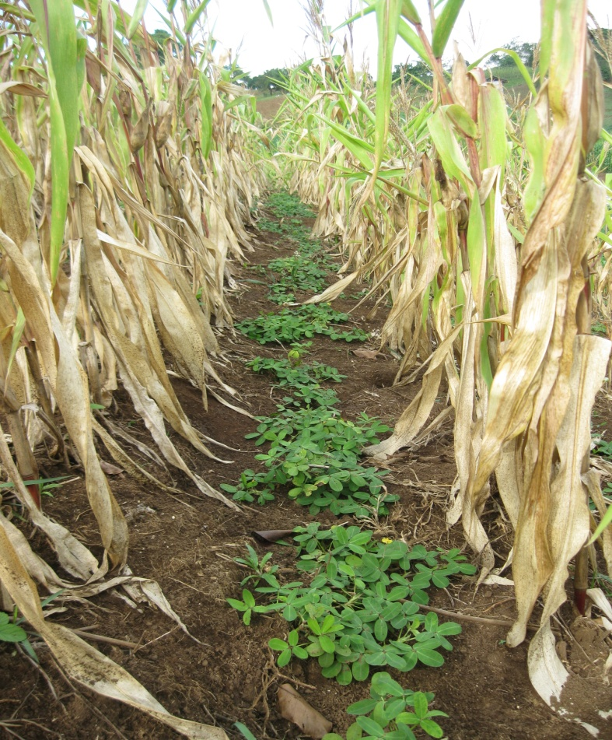
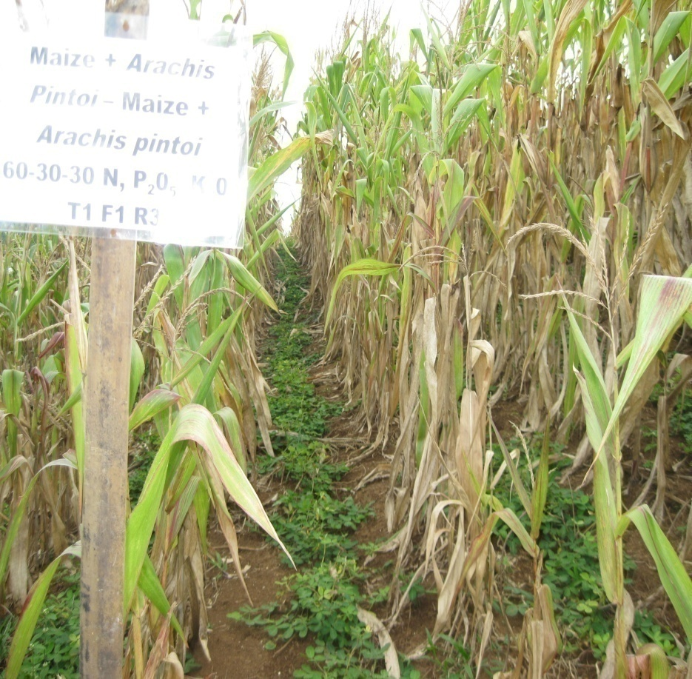
Maize + Arachis pintoi

Slide 15
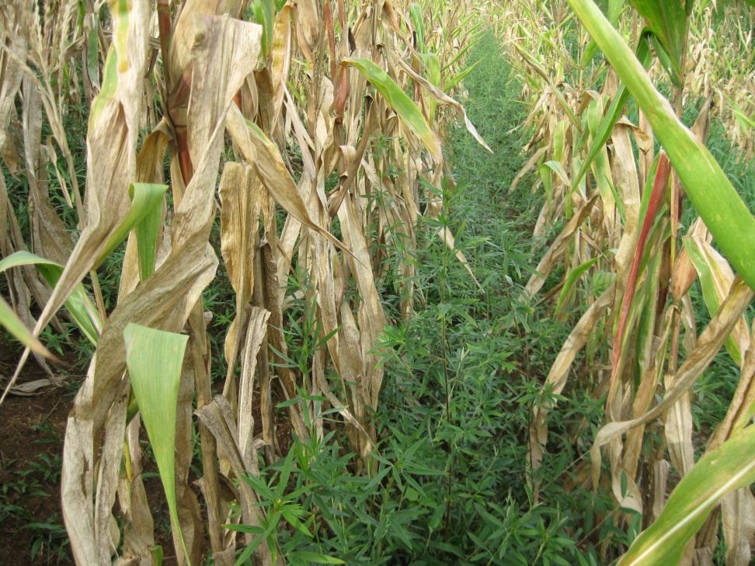
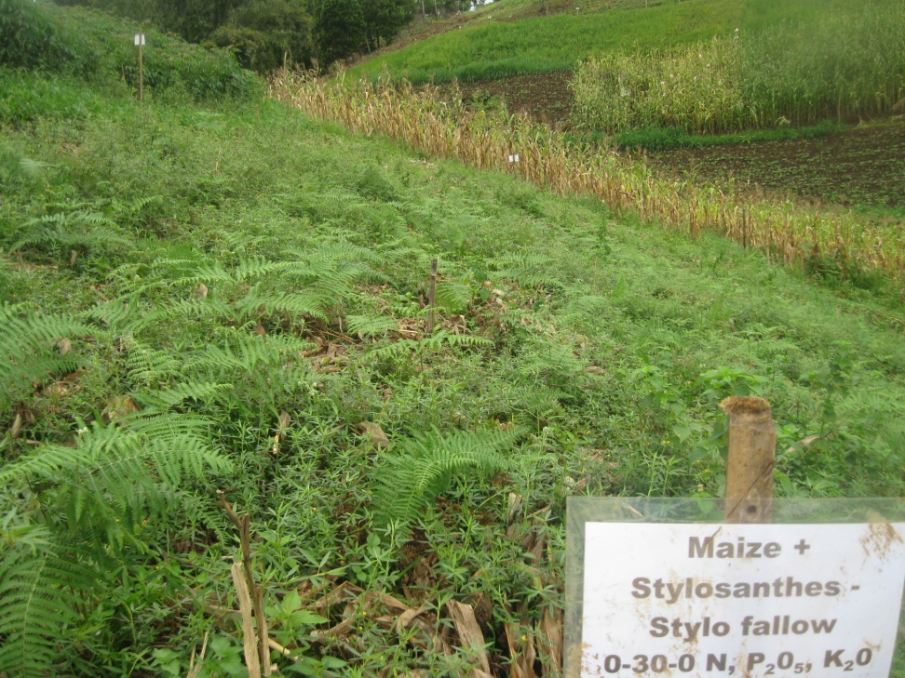
Maize + Stylo – Fallow

Slide 16
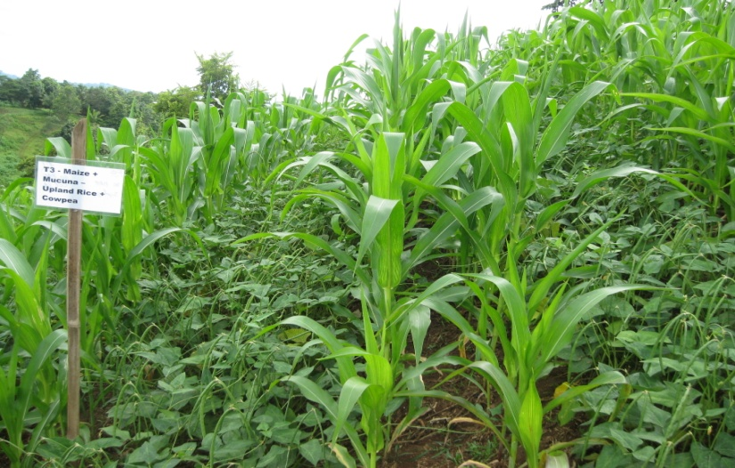
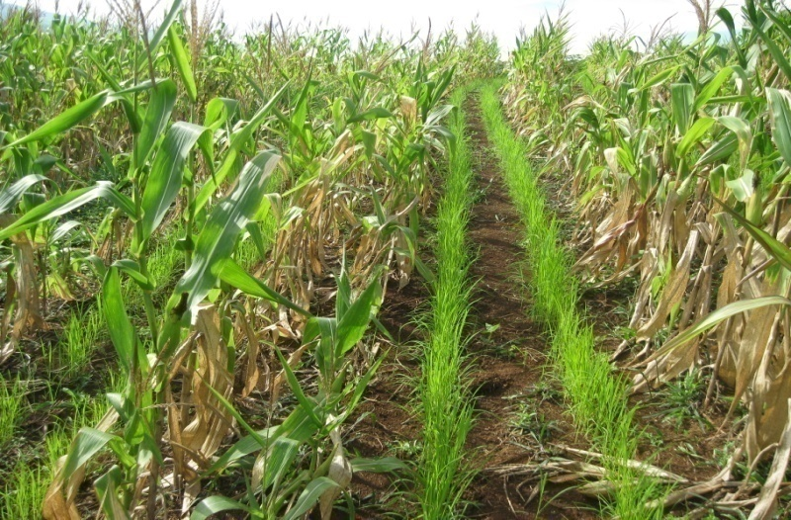
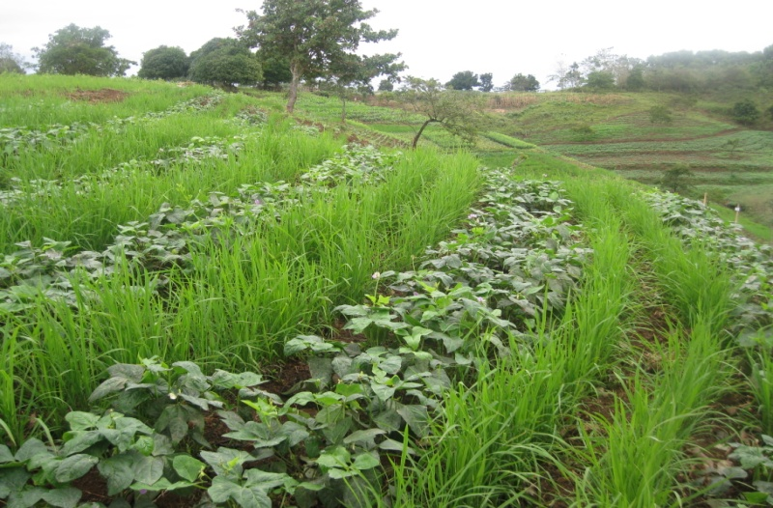
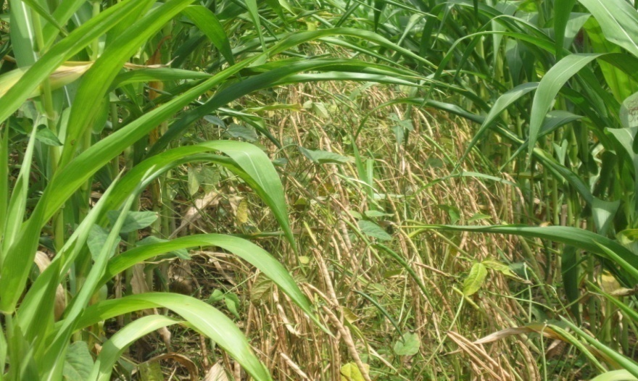
Maize + cowpea – Upland rice + cowpea

Slide 17
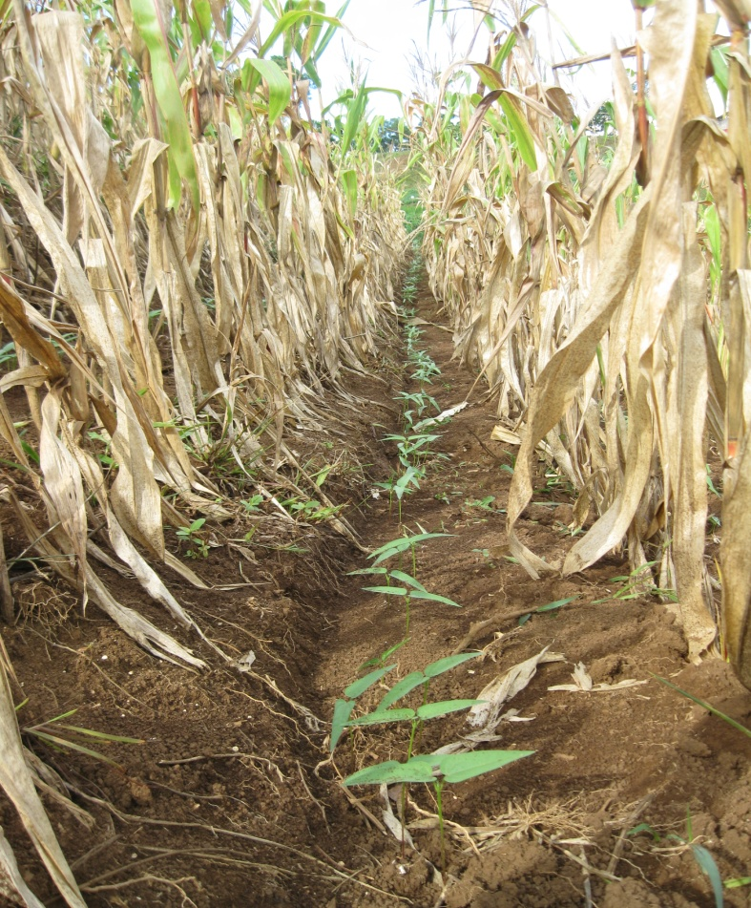
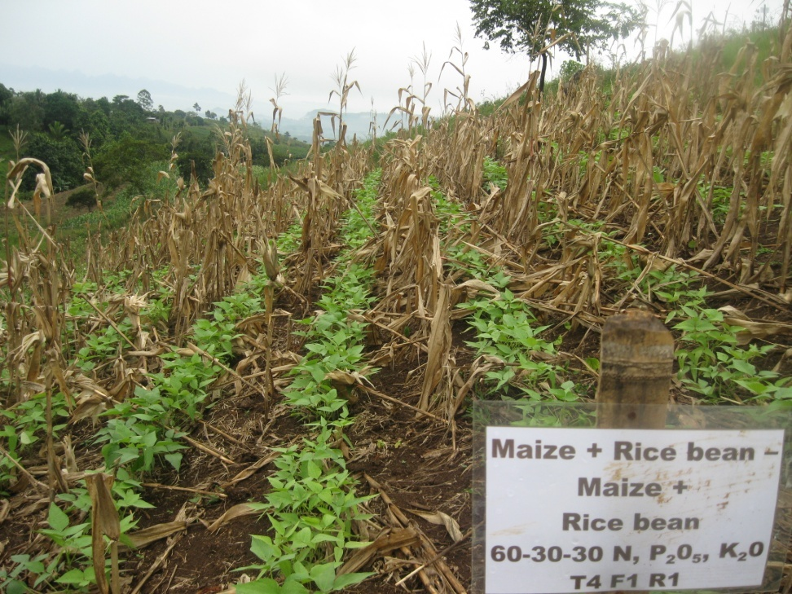
Maize + Rice bean

Slide 18
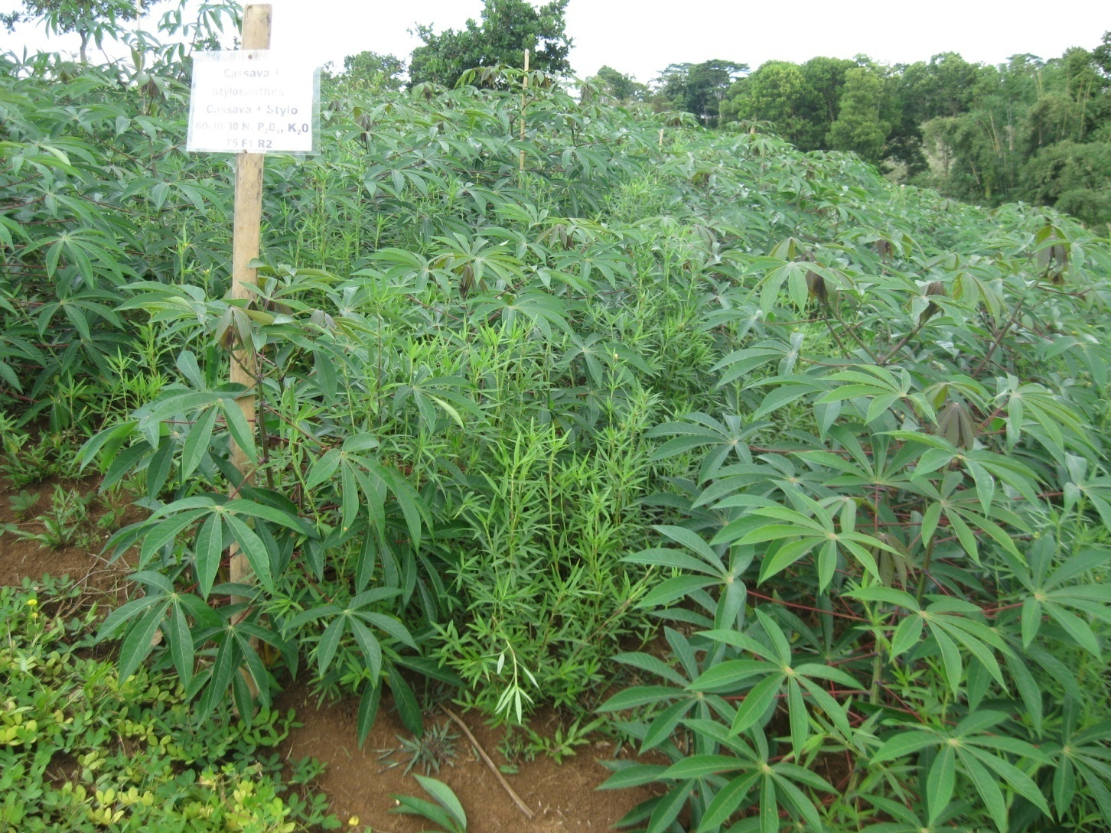
Cassava + Stylosanthes

Slide 19
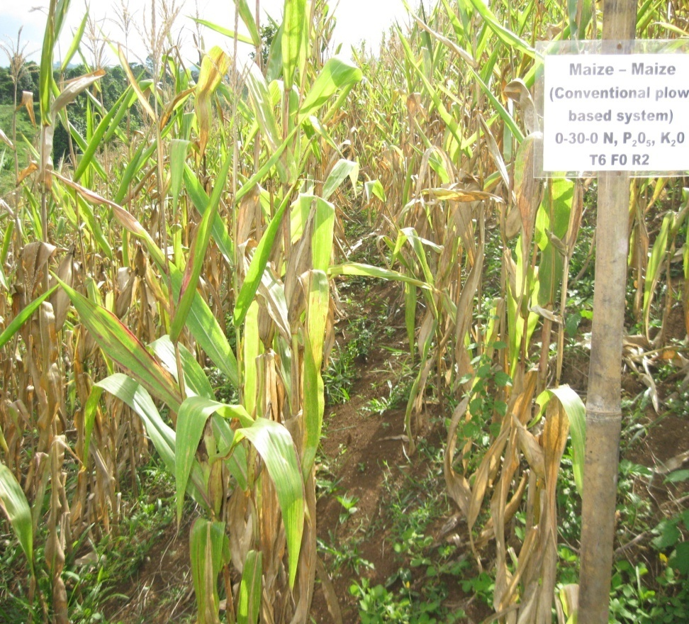
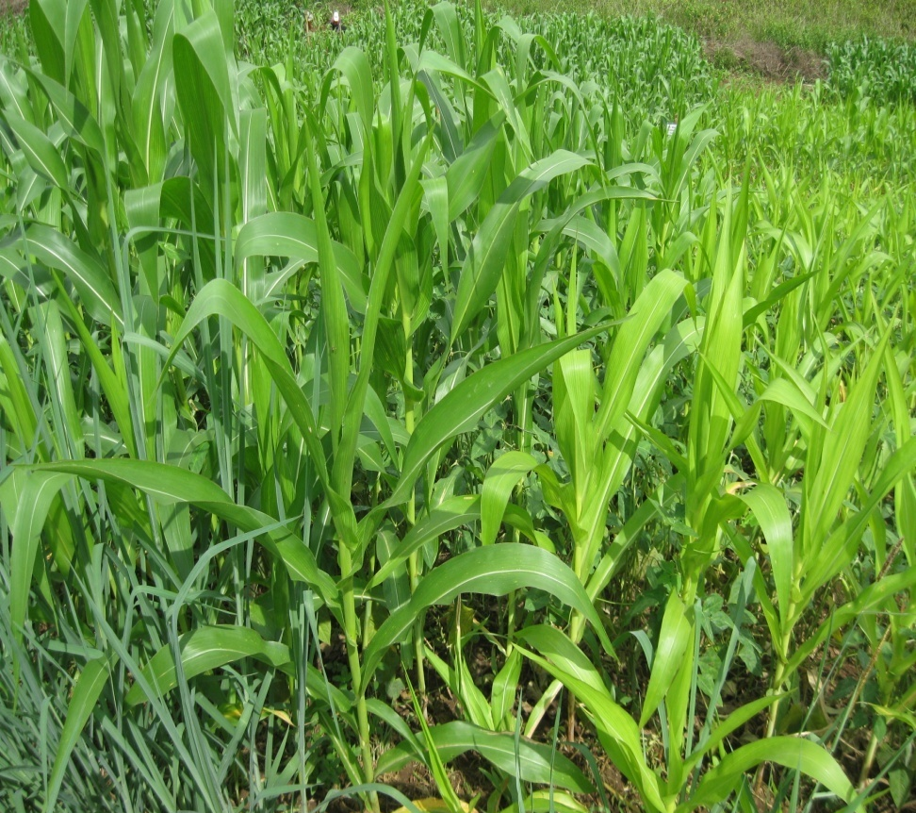
Maize - Maize

Slide 20
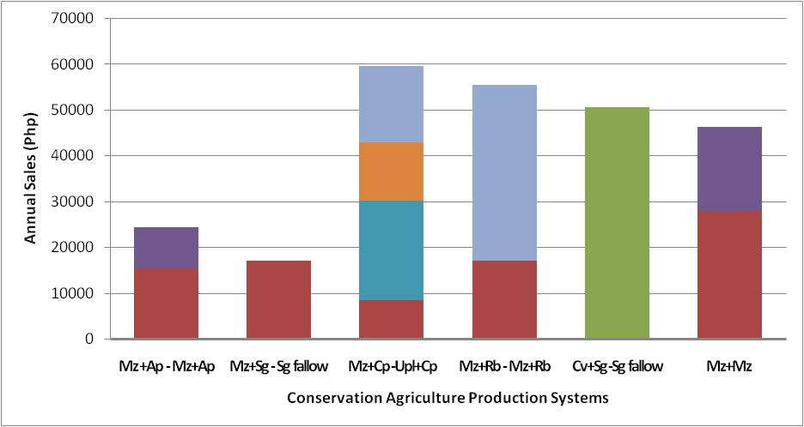
Annual total system biomass production of different CAPS. Claveria, Misamis Oriental, Philippines

Slide 21
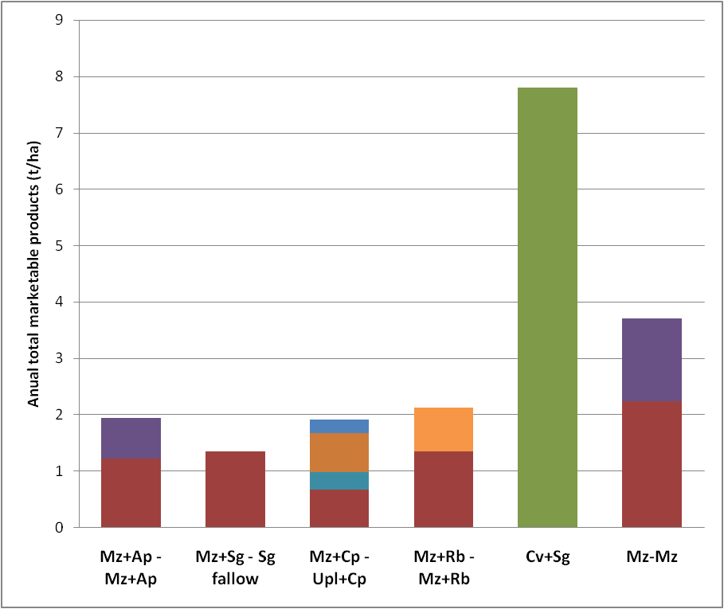
Annual total marketable produce from different CAPS. Claveria, Misamis Oriental, Philippines

Slide 22
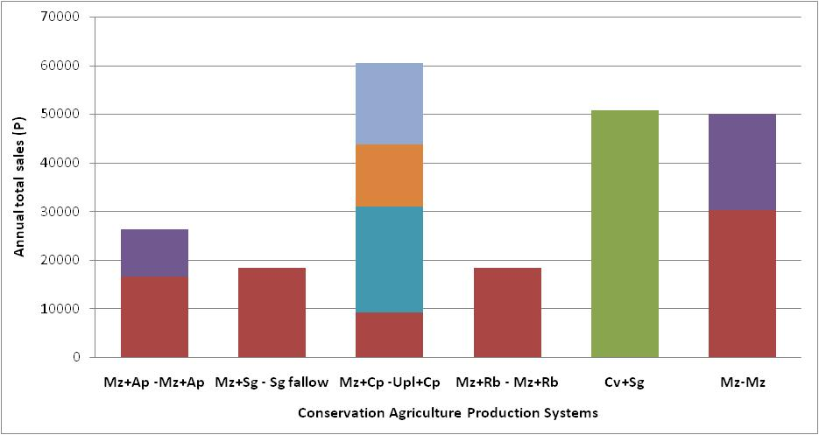
Annual total sales of CAPS marketable produce. Claveria, Misamis Oriental, Philippines
$1 = P43.5

Slide 23
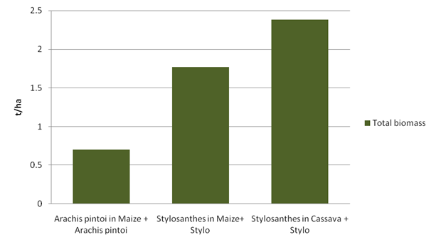
Aboveground biomass of different forage legumes as interplant at different cropping patterns 6 months after planting
a
ab
b

Slide 24
Farmer-managed trials (FMT)
8 Treatments x 3 replications
1. Maize (Mz) - Baguio beans (BB) - Mz - BB - Crotalaria (Cr) fallow
2. Maize + Stylosanthes guianensis (Sg) – Sg fallow
3. Maize (Mz) + Cowpea (Cp) – Mz+CP- Sorghum (Sgh) fallow
4. Maize (Mz) +Peanut (Pnt)/Cassava (Cv)
5. Sweet Corn (SwC) + Peanut (Pnt) - SwC + Pnt
6. Baguio bean (Bb) + Mz – Mz – Sorghum fallow
7. Maize (Mz) + Stylosanthes guianensis (Sg) – Mz + Cv
8. SwC + Pechay (Pc) – SwC + Pc

Slide 25
Field layout:
CAPS replicated 3 times by farm
Farmer’s conventional practice
1000 m2 CAPS with chosen cropping pattern (no tillage)

Slide 26
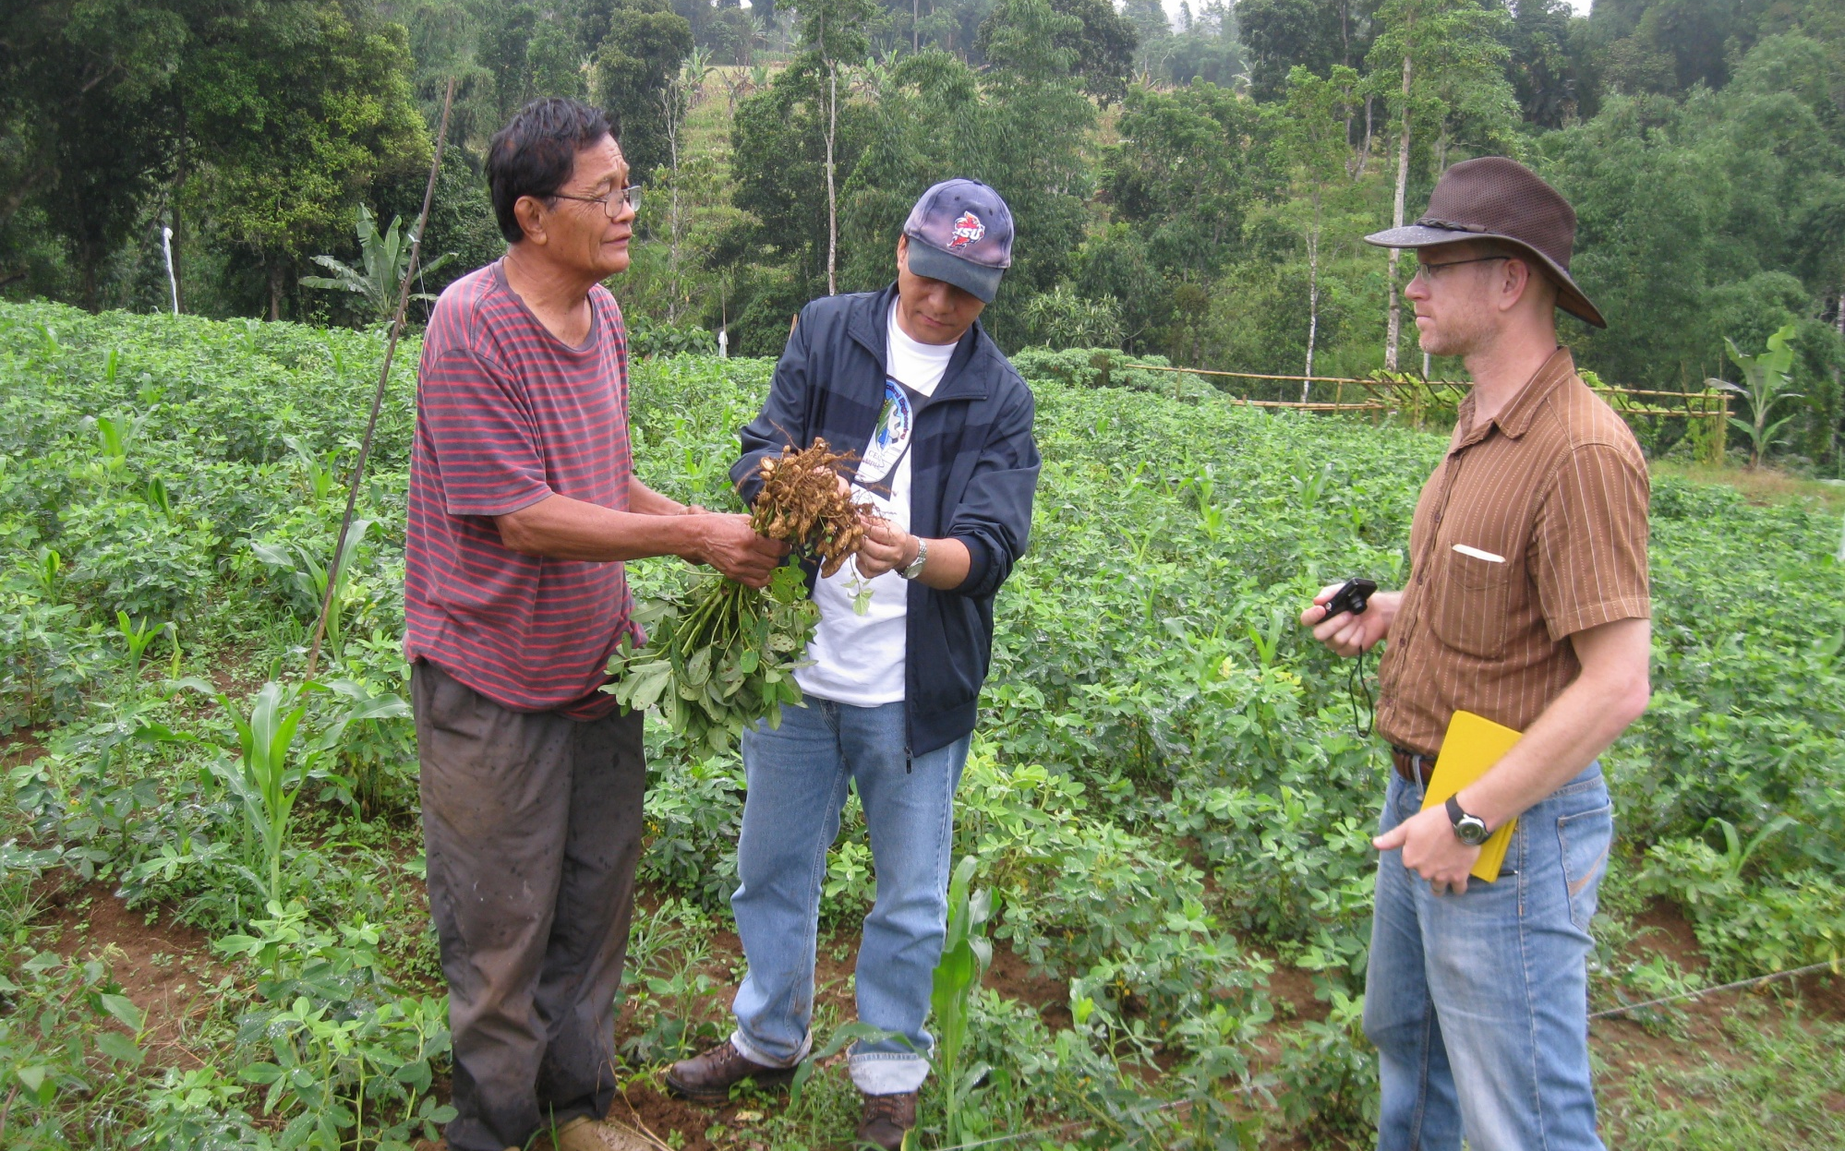
Farmer-cooperator

Slide 27
Component research (“kitchen experiments”) Crop varieties evaluation year 1:
Key parameters
Evaluation of crop varieties that are best for conservation agriculture production systems that produce high biomass and economic yield which includes forage grasses, sorghum, cassava, upland rice, sweet potato, cowpea and open pollinated maize
Economic yield
Biomass yield

Slide 28
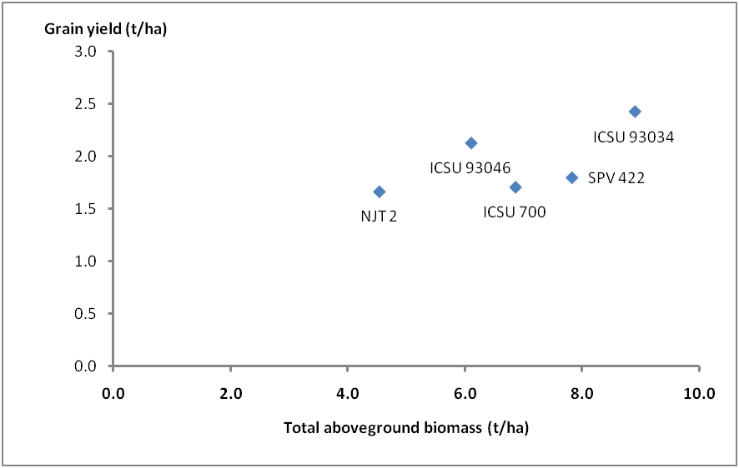
Promising sorghum cultivars for CAPS
Claveria, Misamis Oriental, Philippines

Slide 29
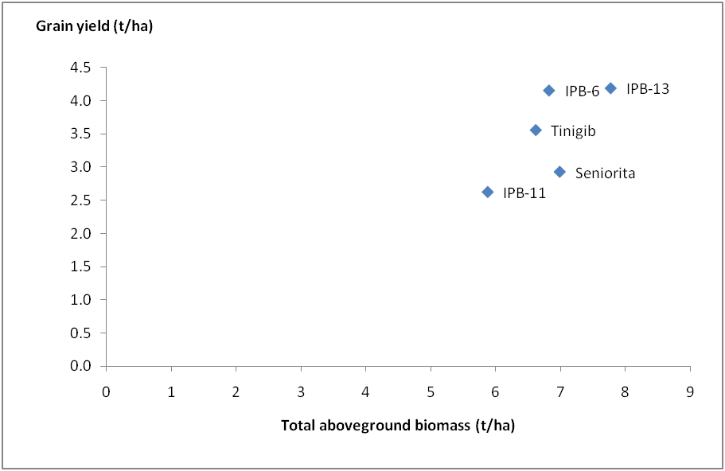
Promising open pollinated maize for CAPS
Claveria, Misamis Oriental, Philippines

Slide 31
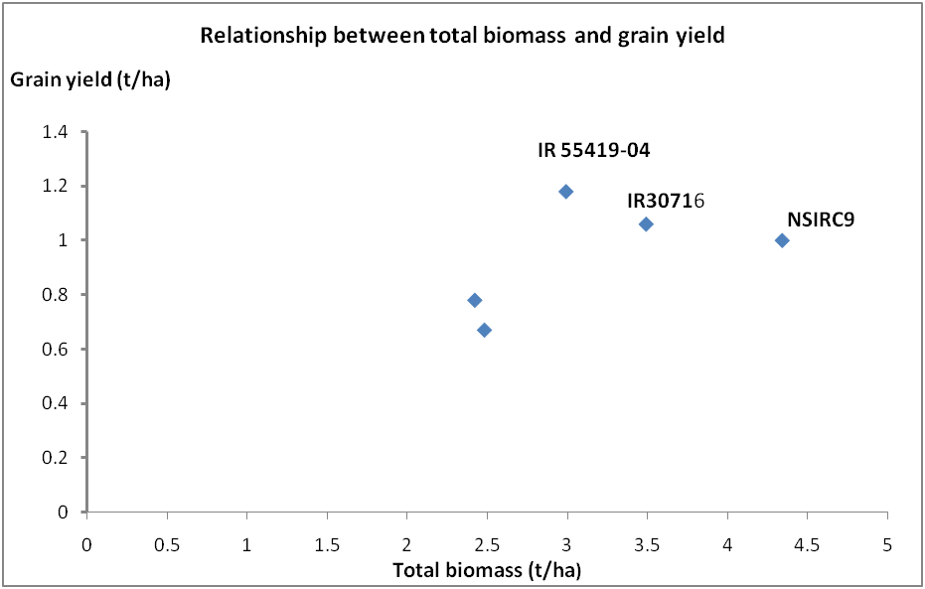
Promising upland rice cultivars for CAPS. Claveria, Misamis Oriental, Philippines

Slide 32
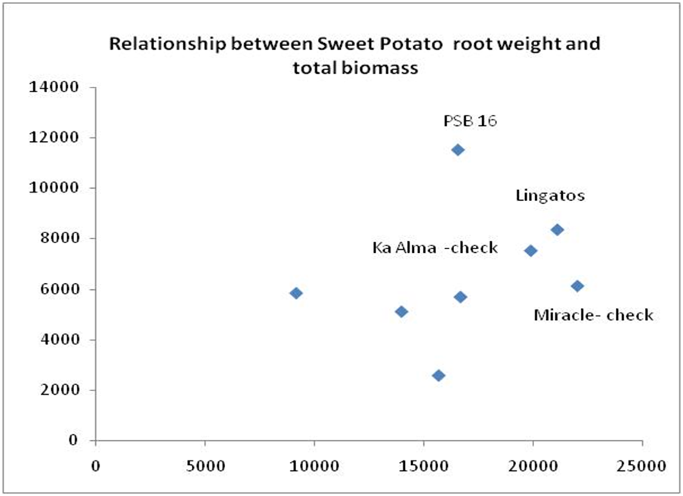
Promising Sweet Potato cultivars for CAPS. Claveria, Misamis Oriental, Philippines
Kg/ha
Kg/ha

Slide 34
Grain yield of maize as influenced by different fertility levels and spacing. Claveria, Misamis Oriental.
Grain yield of maize as influenced by different fertility levels and spacing. Claveria, Misamis Oriental. Dry Season 2010-2011.
Fertility levels (N P₂O₅ K₂O) | Spacing |  | Mean
 | 60 cm (t/ha) | 75 cm (t/ha)
60-30-30 | 1.31^{bc} | 1.35^{b} | 1.33^{ns}
200-120-120 | 2.99ª | 2.46ª | 2.72^{ns}
0-120-120 | 0.99^{c} | 0.78^{c} | 0.88^{ns}
200-0-120 | 1.23^{bc} | 1.23^{b} | 1.23^{ns}
200-120-0 | 2.38ª | 1.70^{ab} | 2.04^{ns}
Mean | 1.78 | 1.50
LSD | 0.84 | 0.84
Nutrient deficiency = N (67%) > P (59%) > K (21%)
Fertilizer rates study to establish nutrient response curve: N = 0, 30, 60, 90, 120, 200 kg/ha;
P2O5 = 0, 15, 30, 45, 60, 120 kg/ha; K2O = 0, 15, 30, 45, 60, 120 kg/ha

Slide 35
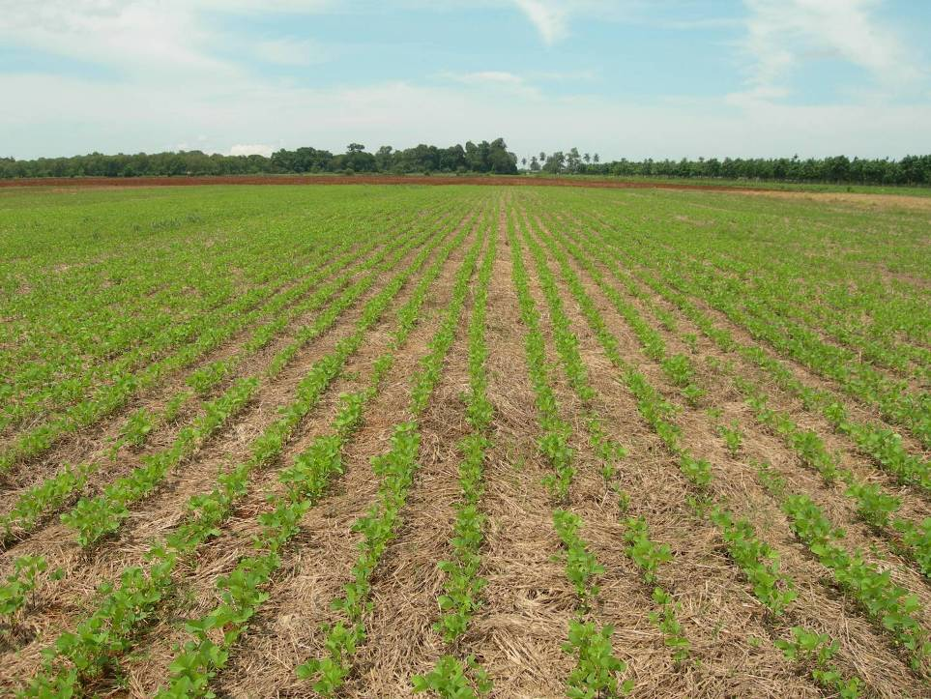
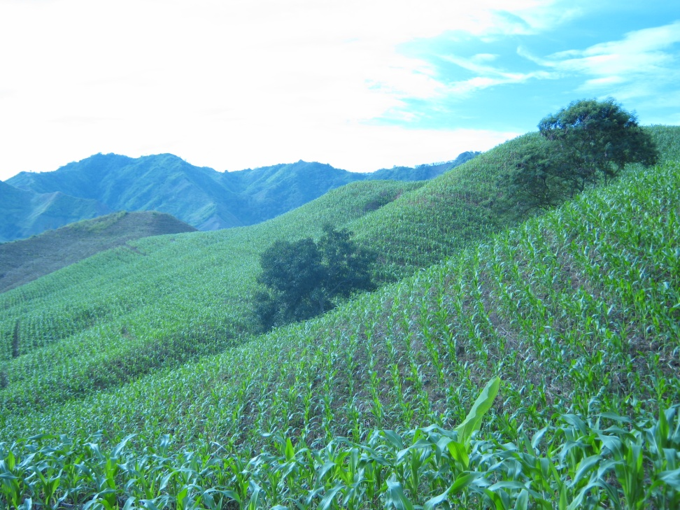
Context
Cambodia and other places
Philippines (10 M ha)

Slide 36
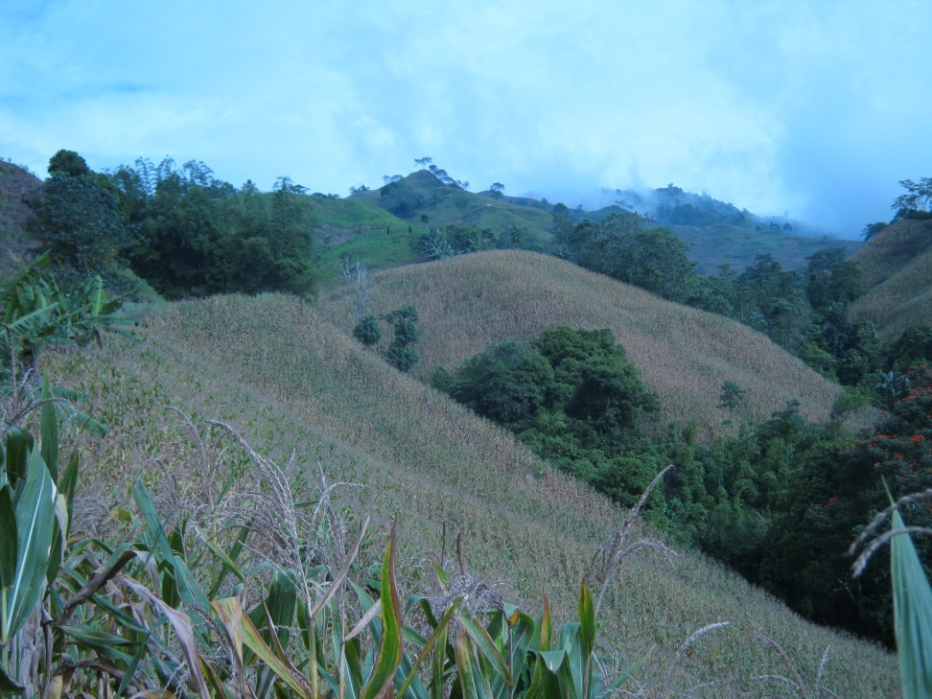
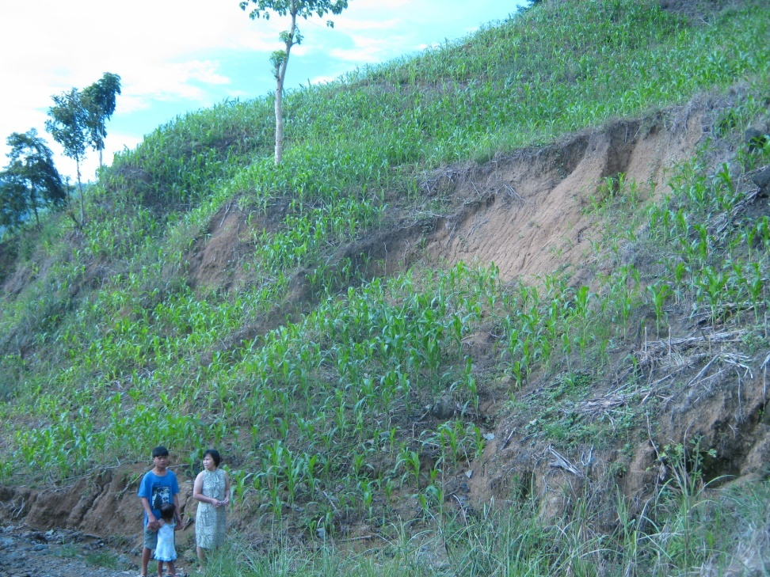
In the context of sloping lands, there’s a need for deliberate integration of trees .....

Slide 37
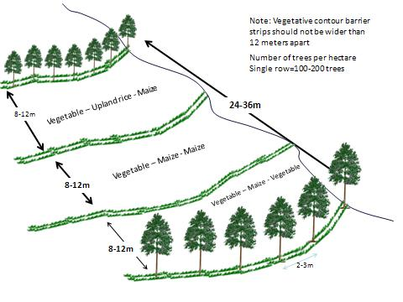
Schematic diagram of single tree-line agroforestry system
CAPS
CAPS
CAPS
Notes:
This is an schematic diagram of single tree-line hedgerow system or agroforestry system that maximizes the complementarity effect by having wider tree spacing from 24-36 meters between tree lines. Our earlier studies indicated that for effective soil erosion control, grass strips or tree lines should not be wider than 12 meters apart, otherwise soil erosion is greater than the tolerable soil loss of 12 tons per hectare per year. This means that in-between widely spaced tree lines, grass strips like NVS should be established at 8-12 meters apart.

Slide 38
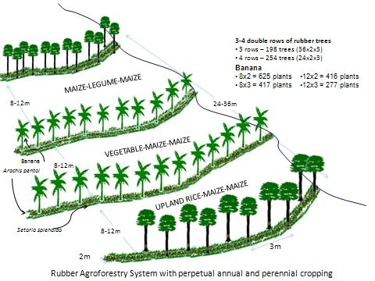
Schematic diagram of double -tree line agroforestry system
CAPS
CAPS
CAPS
Notes:
This is another example with double-tree line system. This is to increase the total number of trees per hectare without compromising the productivity of companion annual crops.

Slide 39
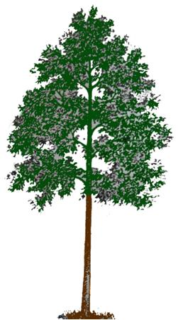
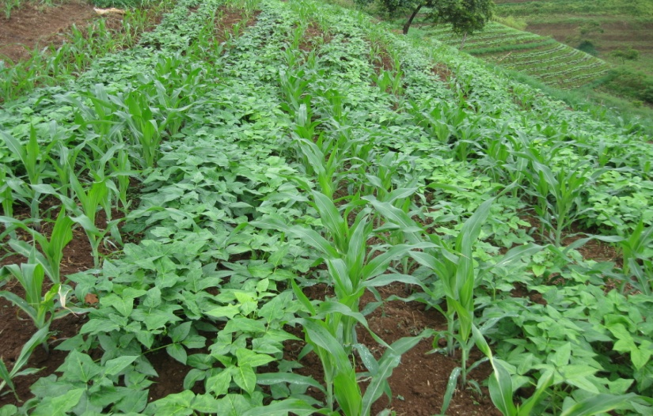
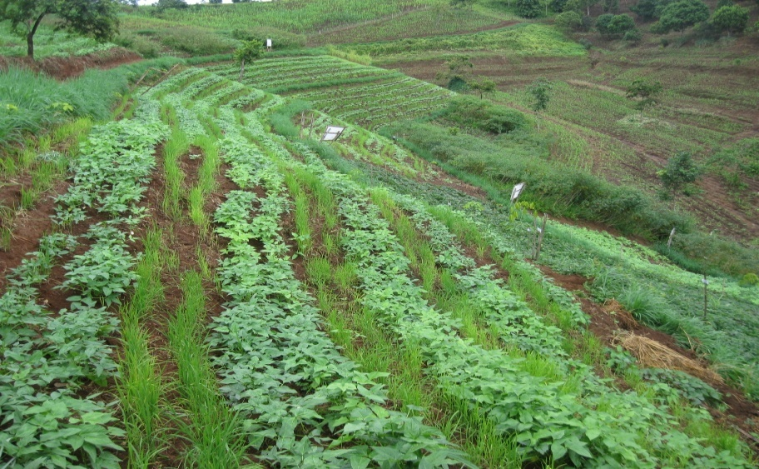
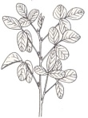
Conservation Agriculture Production System with Trees (CAwT)
20-30m
Maize + Cowpea - Upland rice + Cowpea Cropping Pattern

Slide 40
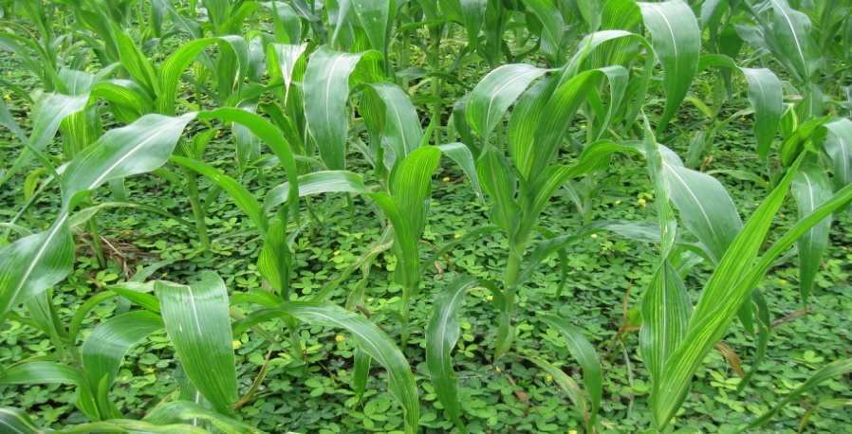
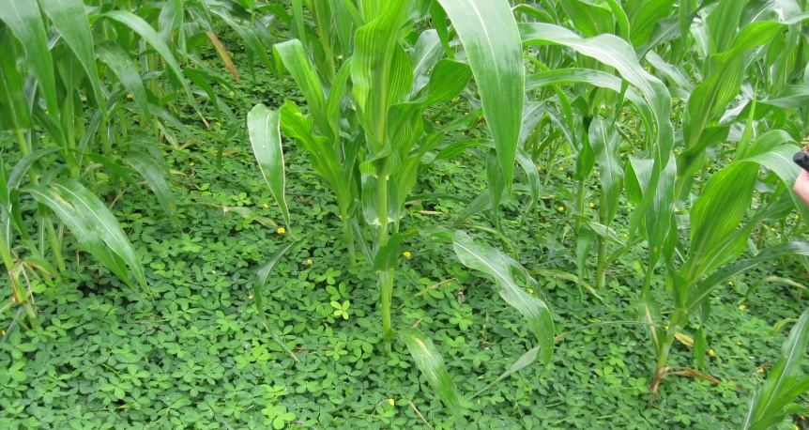
Conservation Agriculture Production System with Trees
20-30m
Maize+ Arachis pintoi
Maize+ Arachis pintoi

Slide 41



Conservation Agriculture Production System with Trees (CAwT)
20-30m
Maize+Stylo
Stylo fallow
Maize+Stylo

Slide 42



Conservation Agriculture Production System with Trees (CAwT)
20-30m
Cassava +Stylo
Stylo fallow
Cassava +Stylo

Slide 43
Summary
In making a dent in the promotion of conservation agriculture in the Philippines requires improved cropping patterns/crop sequences, improved and adapted crop cultivars, improved component crops fertility management, and adapted and affordable machineries in the context of acid sloping lands and smallholders environment.
Current works identified promising conservation agriculture production systems (CAPS) including promising varieties of crops, forages and herbaceous legumes that require further evaluation
Integration of trees is important component in CAPS as they protect the sloping lands from soil erosion and potential landslides as well as providing additional economic to the farmers and environmental and ecological benefits.
Implementation of farmer -managed experiments on CAPS require proactive information and education for them to be able to actively participate in the research processes
Machineries appropriate to sloping lands in the context of smallholders are important in the development of conservation agriculture in the Philippines

Slide 44





Thank you!!!!

