Slide 1


Family Nutrition Program
Healthier Foods-Fast
Peninsula Health District
December 13, 2017
Kimberly hoffman
Snap-ed agent

Slide 2


What is Virginia Cooperative Extension?
Virginia Cooperative Extension (VCE) is the educational outreach of Virginia’s land grant universities.
Virginia Tech
Blacksburg
Virginia State University
Petersburg

Slide 3


Virginia’s Family Nutrition Program is funded by:
SNAP-ED
EFNEP
Supplemental Nutrition Assistance –Education (Food Stamp Education)
Expanded Food and Nutrition Education Program

Slide 4
Mission of FNP
To teach limited-resource families and youth to make healthier food choices and become better managers of available food resources for optimal health and growth.

Slide 5


What Exactly is Fast Food?
For this lesson fast food will be considered drive thru meals, restaurant take-out, frozen meals, and already-prepared meals.

Slide 6
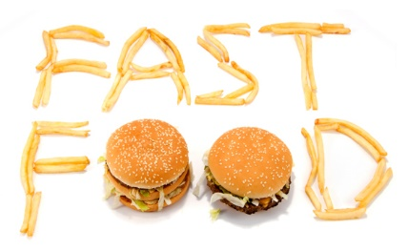
WHY DO YOU CHOOSE TO EAT FAST FOOD?

Slide 7
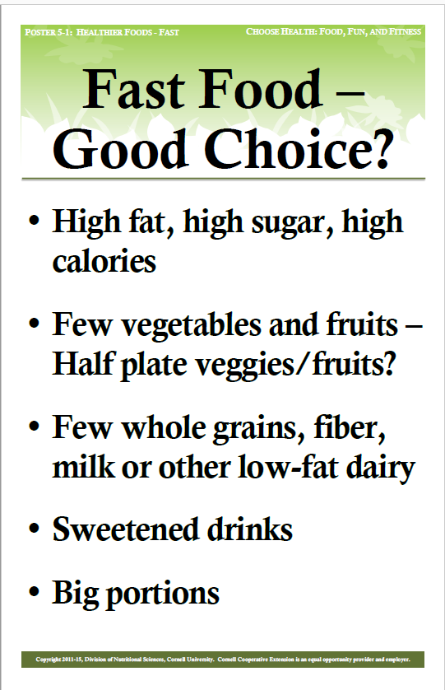

Slide 8
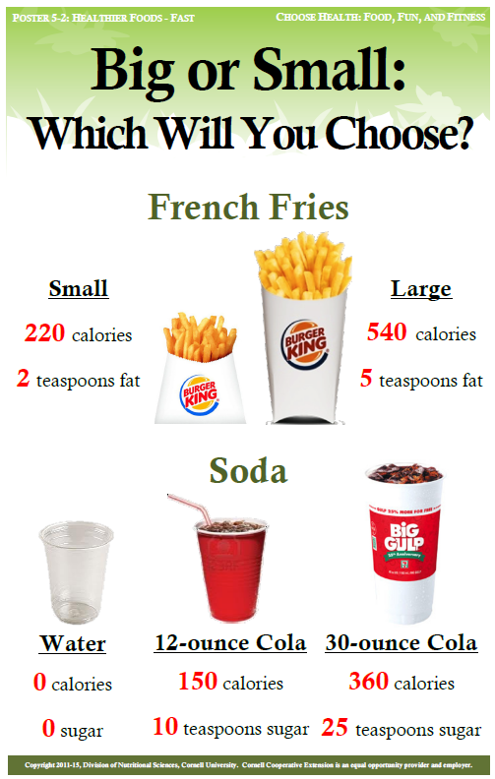
Portion Size: Which will you choose?

Slide 9
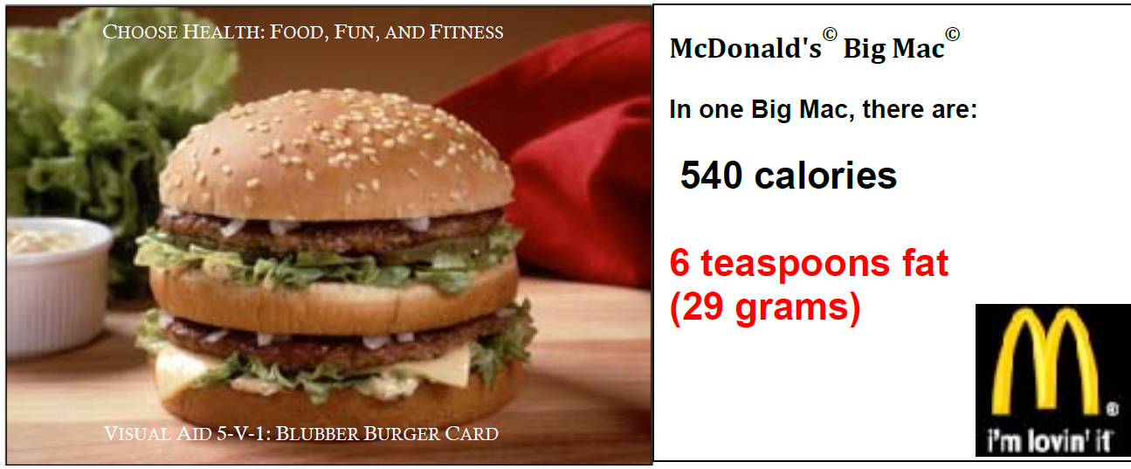

Slide 10
A Big Mac, Large Fries, & Large Coke
Total Fat: 52 grams or 11.5 teaspoons
Total Sugar: 86 grams or 21.5 teaspoons
Total Sodium: 2,600 mg
the recommended amount daily is 2,400 mg
Calories: 1340
*Information was retrieved by the McDonalds Nutrition Calculator

Slide 11
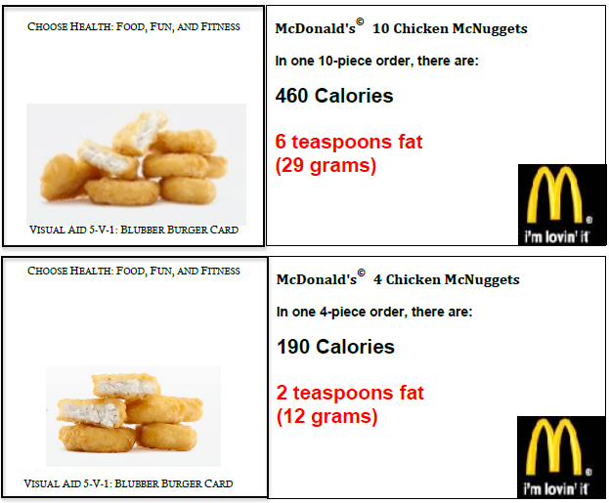

Slide 12
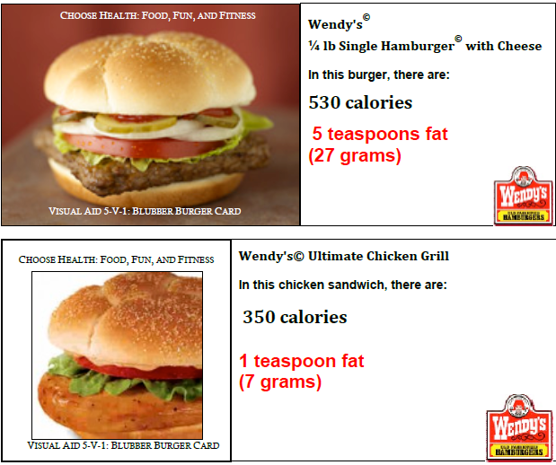

Slide 13
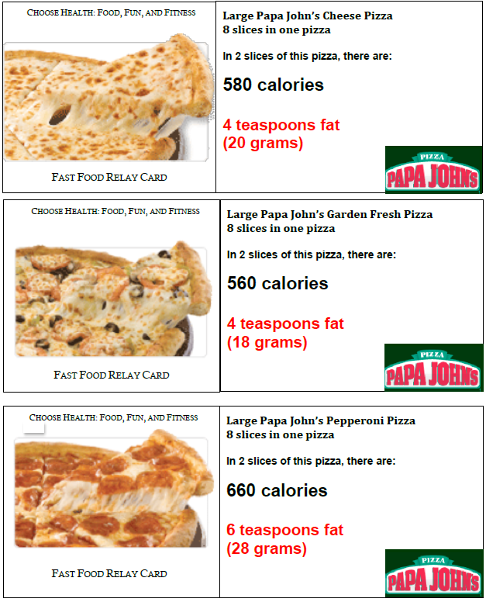

Slide 14
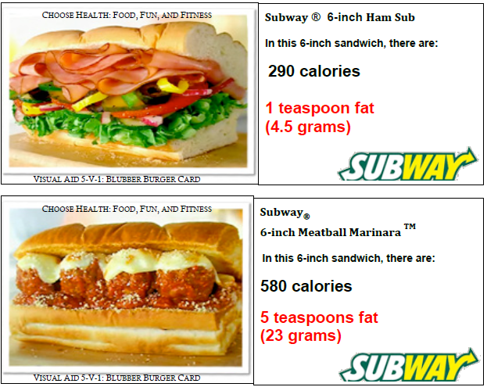

Slide 15
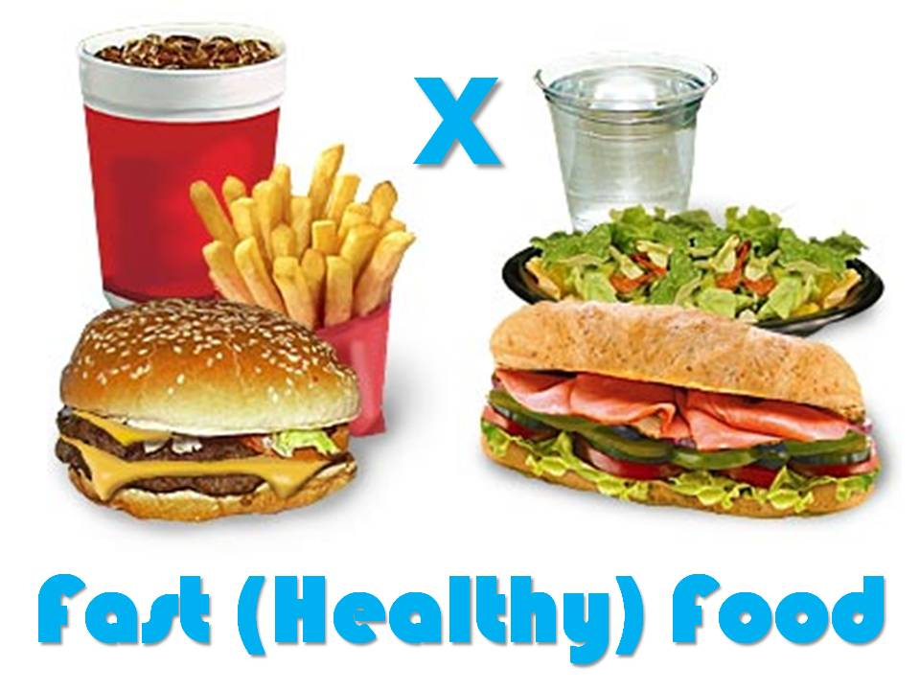
HOW CAN WE EAT HEALTHIER FAST FOOD?

Slide 16
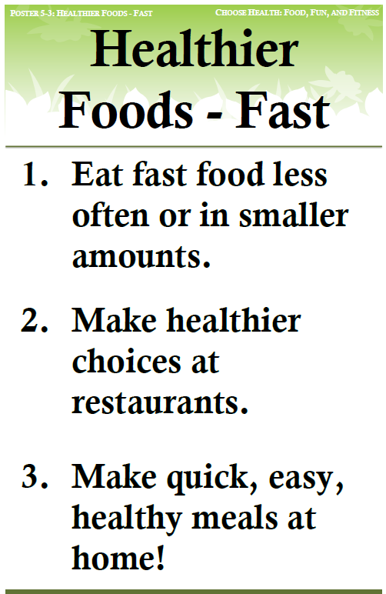

Slide 17
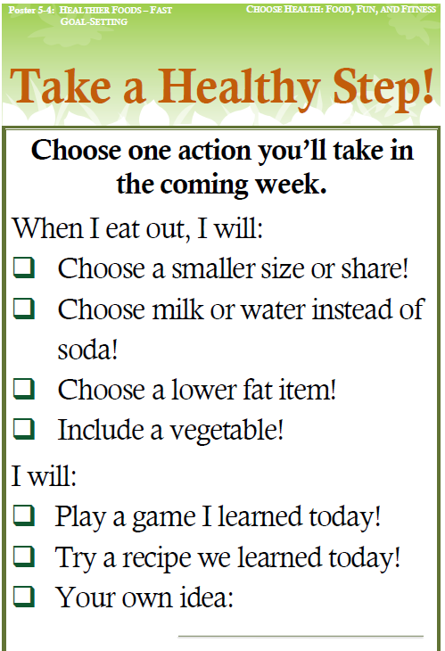

Slide 18



Questions?
Kimberly Hoffman
FCS SNAP-Ed Extension Agent
Virginia Cooperative Extension
Isle of Wight County Office
17100 Monument Circle, STE B
Isle of Wight, VA 23397
Office: 757-365-6257
Fax: 757-357-9610
kimh822@vt.edu

Slide 19

Thank you!
Family Nutrition Program’s ability
to teach our communities healthy choices
depends on caring individuals like
YOU!

Slide 20


The U.S. Department of Agriculture (USDA) is an equal opportunity provider and employer. This material is funded by USDA’s Supplemental Nutrition Assistance Program – SNAP which provides nutrition assistance to people with low income. It can help you buy nutritious foods for a better diet. To find out more, contact your county or city Department of Social Services or to locate your county office call toll-free: 1-800-552-3431 (M-F 8:15-5:00, except holidays). By calling your local DSS office, you can get other useful information about services.
Virginia Cooperative Extension programs and employment are open to all, regardless of age, color, disability, gender, gender identity, gender expression, national origin, political affiliation, race, religion, sexual orientation, genetic information, veteran status, or any other basis protected by law. An equal opportunity/affirmative action employer. Issued in furtherance of Cooperative Extension work, Virginia Polytechnic Institute and State University, Virginia State University, and the U.S. Department of Agriculture cooperating. Edwin J. Jones, Director, Virginia Cooperative Extension, Virginia Tech, Blacksburg; M. Ray McKinnie, Interim Administrator, 1890 Extension Program, Virginia State University, Petersburg.

