Slide 1


Gendered Implications for Agricultural Labor in the Mid-hills of Nepal with the Introduction of Conservation Agriculture Practices
Jacqueline Halbrendt
Department of Natural Resources & Environmental Management
University of Hawaii

Slide 2
Introduction
Women represent half the population in subsistence farming communities, however, there is a lack of research measuring the labor effects of agricultural interventions on gender
Household labor capacity can be a limiting factor for changes to agriculture in subsistence communities
Inability to increase agricultural labor hours can contribute to failure to adopt practices despite potential to increase food security, improve soil, and maintain livelihoods
Rural women take on a disproportionate workload for both agricultural and household duties
Labor division is highly localized and contextual, and may depend on culture, education, income, or environmental conditions

Slide 3
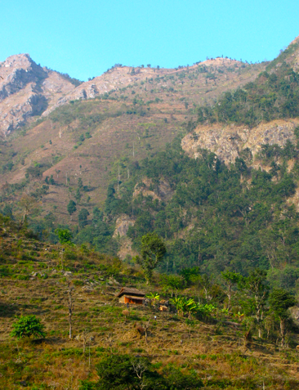
Objectives
To identify the gendered distribution of agricultural labor in three Chepang tribal villages of central Nepal
To estimate the changes in gender labor required by conservation agriculture interventions
To assess the implications of labor shifts with respect to the potential for adoption of conservation agriculture practices.

Slide 4
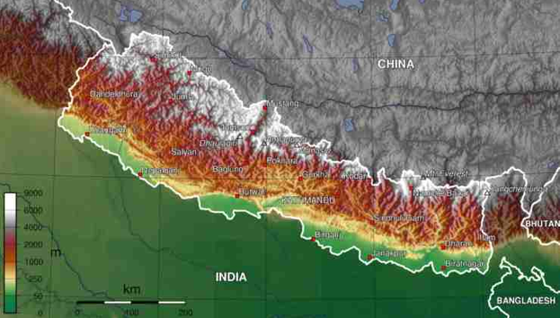
Study Area: Central Mid-hills, Nepal
Agriculture in the central mid-hills supports 44% of the population of Nepal; A region of high importance for improving and maintaining food security
Three villages in the central mid-hills were studied with village size ranging from 25 to 42 households
Communities were selected due to high risk for food insecurity, marginal agricultural lands, and small landholdings
Agriculture in this area is characterized by subsistence farming, less than 2 ha of arable land and limited opportunities for income generation
Farmers use continuous cultivation, terracing, and mono-cropping in a rice and maize-based agricultural system

Slide 5
Methodology
June 2012, individual households were surveyed in three Chepang tribal communities in the central mid-hills of Nepal to conduct an activities analysis by gender
Male and female heads for each household were surveyed separately in face-to-face interviews to assess gender participation in various agricultural activities
The survey analysis measured the labor hours required for the farmer’s cultivation approach, representing a complete cropping season: (T1) maize followed by legumes
CA plots on 8 representative farmer fields in each village
Labor activities recorded by gender for two treatments: (T2) maize followed by intercropping with millet and cowpea, and (T3) minimum tillage with maize followed by intercropping with millet and cowpea

Slide 6
Results: Labor distribution (%) with Conventional and Conservation Practices
Women perform over 53-55% of total labor hours for both farmer’s practice and conservation agriculture

Slide 7
Results: Changes in (%) Gender Labor by Activity

Slide 8
Results: Comparison of Systems
Increases in land preparation, sowing, harvesting with CA
Overall decreases were observed in fertilizer application, weeding
Drivers for the shift in labor are increased harvesting for women, with some increases in land preparation

Slide 9
Conclusions & Implications
The introduced CA practices have been shown to increase agricultural labor for women
Increased demands for harvesting are the driving force for this shift in labor
Indicates potential for greater food security and income generation
Greater demands for processing and marketing will be required
However, limited household labor availability and seasonal demands may be prohibitive for the adoption of these CA practices
Reduced demands for fertilizer application and weeding may allow for diversification of agricultural or off-farm activities

Slide 10
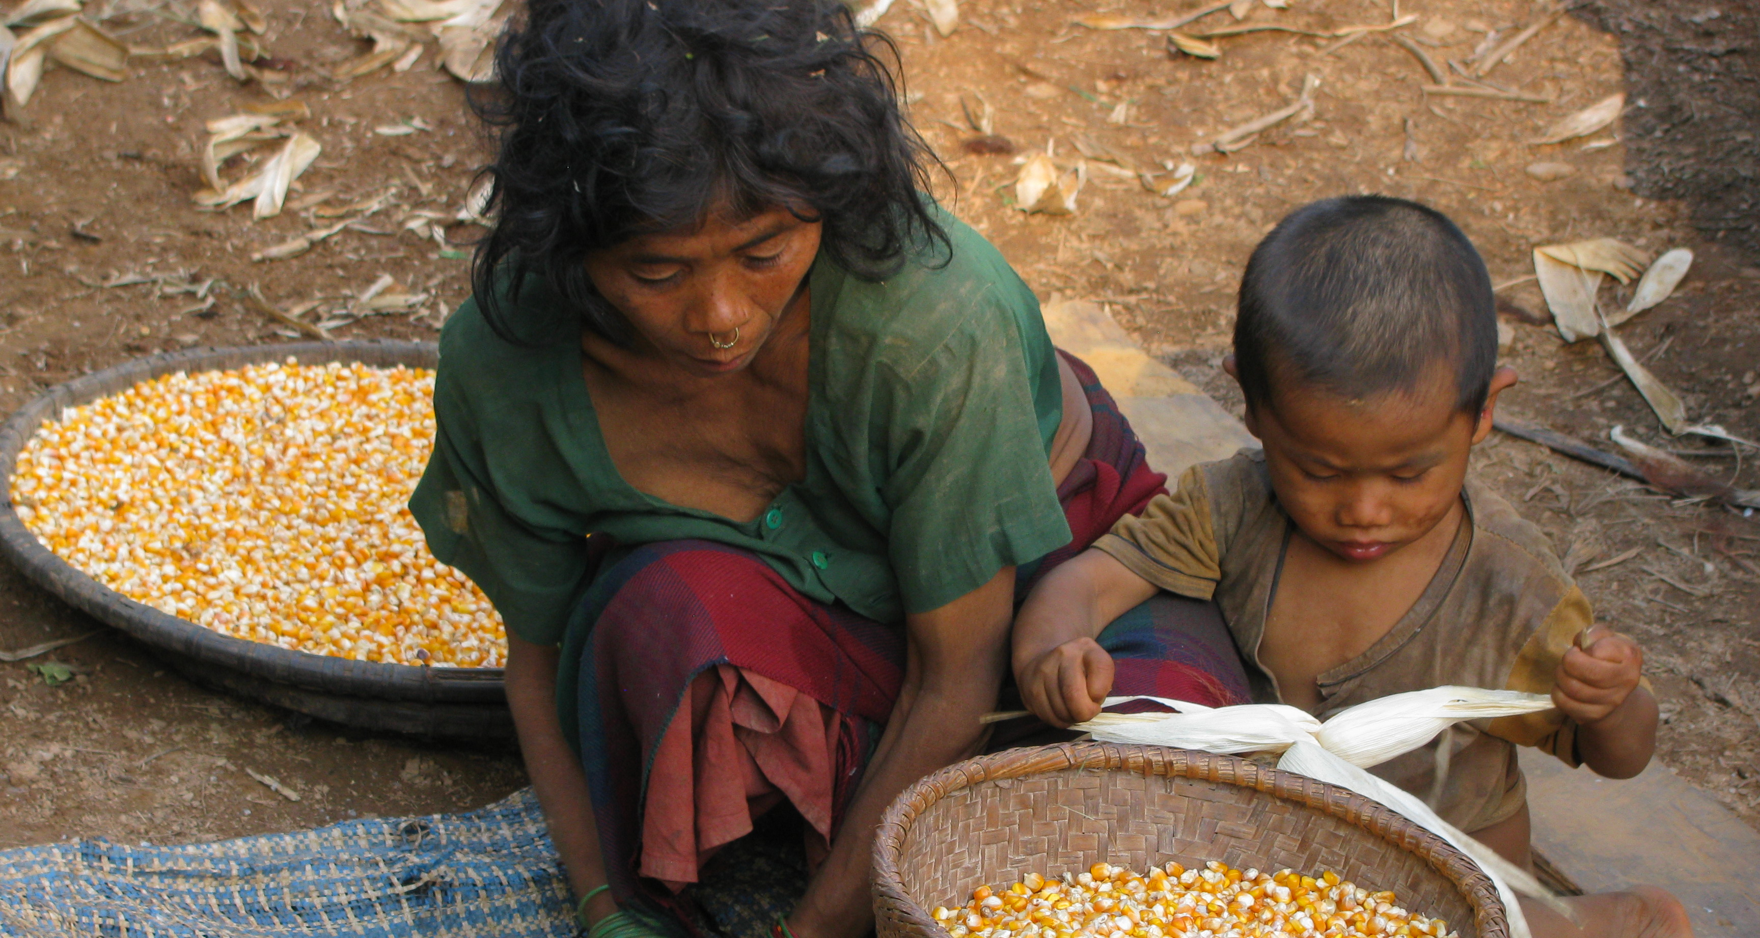
Future Research
Conduct further research to explore the driving forces behind the gender-based labor shifts and decision-making
Determine the opportunity costs of increased agricultural labor as compared with other wage earning, community, or education opportunities
Assess the agricultural labor demands within the scope of total household and community time commitments labor and seasonal time demands

Slide 11
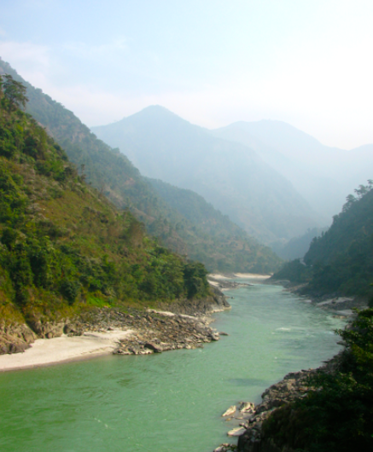
Thank You!
Acknowledgements:
USAID/FtF Food Security Innovation Lab: Collaborative Research on Sustainable Agriculture and Natural Resource Management
University of Hawaii
Local Initiatives for Biodiversity Research and Development (Li-Bird)
Institute for Agriculture and Animal Science, Tribhuvan University

