Slide 1
Solr Team
CS5604: Cloudera Search in IDEAL
Nikhil Komawar, Ananya Choudhury, Rich Gruss
Tuesday May 5, 2015
Department of Computer Science
Virginia Tech, Blacksburg

Slide 2
Outline
Schema design
Indexing
Custom Search

Slide 3
System Overview
CPU
  Intel i5 Haswell Quad core 3.3 Ghz Xeon
RAM
  660 GB in total
  32 GB in each of the 19 Hadoop nodes
  4 GB in the manager node
  16 GB in the tweet DB nodes
  16 GB in the HDFS backup node
Storage
  60 TB across Hadoop, manager, and tweet DB nodes
  11.3 TB for backup
Number of nodes
  19 Hadoop nodes
  1 Manager node
  2 Tweet DB nodes
  1 HDFS backup node

Slide 4
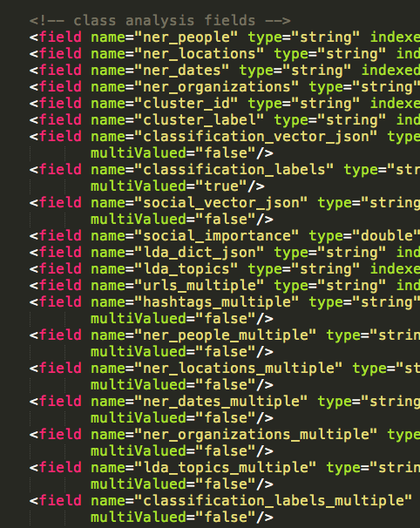
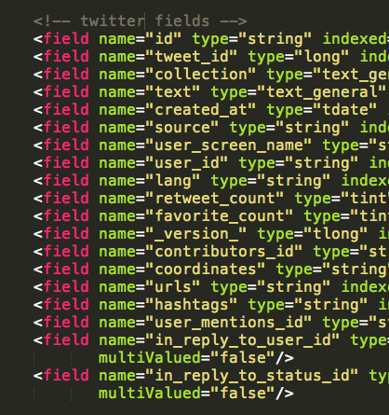
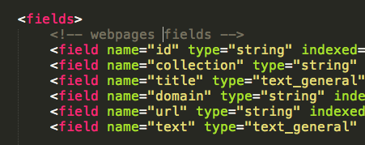
Solr Schema: Design

Slide 5
Solr Schema: Effect
Solr idx size depends on:
Number of fields
Stored vs. not stored
Type of field
  example: string vs. text
Index issues:
  Recommended to add H/W
  Alternatively, design schema and tune Java/Solr configurations

Slide 6
Solr Schema: Future
Fewer stored fields
NRT indexer
  Consider using facet.method=fcs, helps during first request
Index size lowering
  D x S + U
    D is the document count
    S is the the size of the data type
    ints - 4bytes, 8 bytes for doubles, U cumulative size of the unique field values
Notes:
enum Enumerates all terms in a field, calculating the set intersection of documents that match the term with documents that match the query. This was the default (and only) method for faceting multi-valued fields prior to Solr 1.4.
fc (stands for Field Cache) The facet counts are calculated by iterating over documents that match the query and summing the terms that appear in each document. This was the default method for single valued fields prior to Solr 1.4.
fcs (stands for Field Cache per Segment) works the same as fc except the underlying cache data structure is built for each segment of the index individually

Slide 7
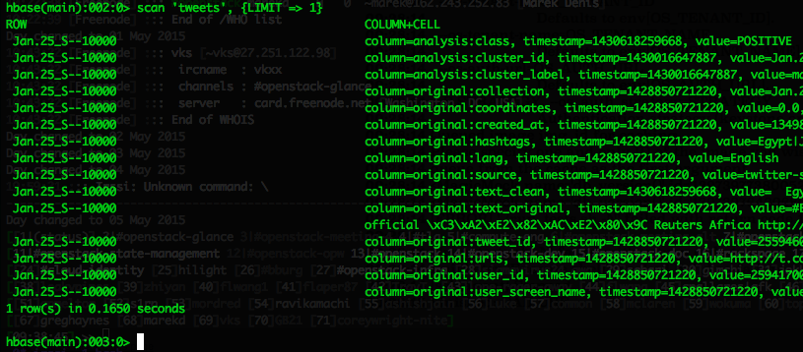
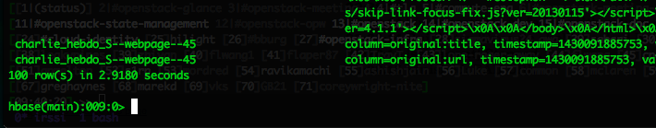
Document ID: Design
Syntax: Collection_name--Counter_value
Use: Noise, Reduction, HBase, Solr/Lucene

Slide 8
Document ID: Effect
Affects Lucene indexing
Does not affect Solr index size
Fastest: Zero padded sequential
Slowest: Random UUID generated using some languages (UUID v4)
Our current design
  Performance tradeoffs
  Somewhere in the middle

Slide 9
ID generation in pipeline
ID addition
RAW
NR
HBase
Solr
Lucene

Slide 10
Document ID: Future
Preprocessing
Current:
  Concurrency
  `test_and_set`
  Batch processing
Recommendation:
  Binary encoded UUID
  Parallel
  CPU hit
Querying
Current:
  Faster fetching
  Lower disk I/O
Recommendation:
  Sequentially assigned value or unhashed timestamp
  Batch processing vs. asynchronous processing

Slide 11
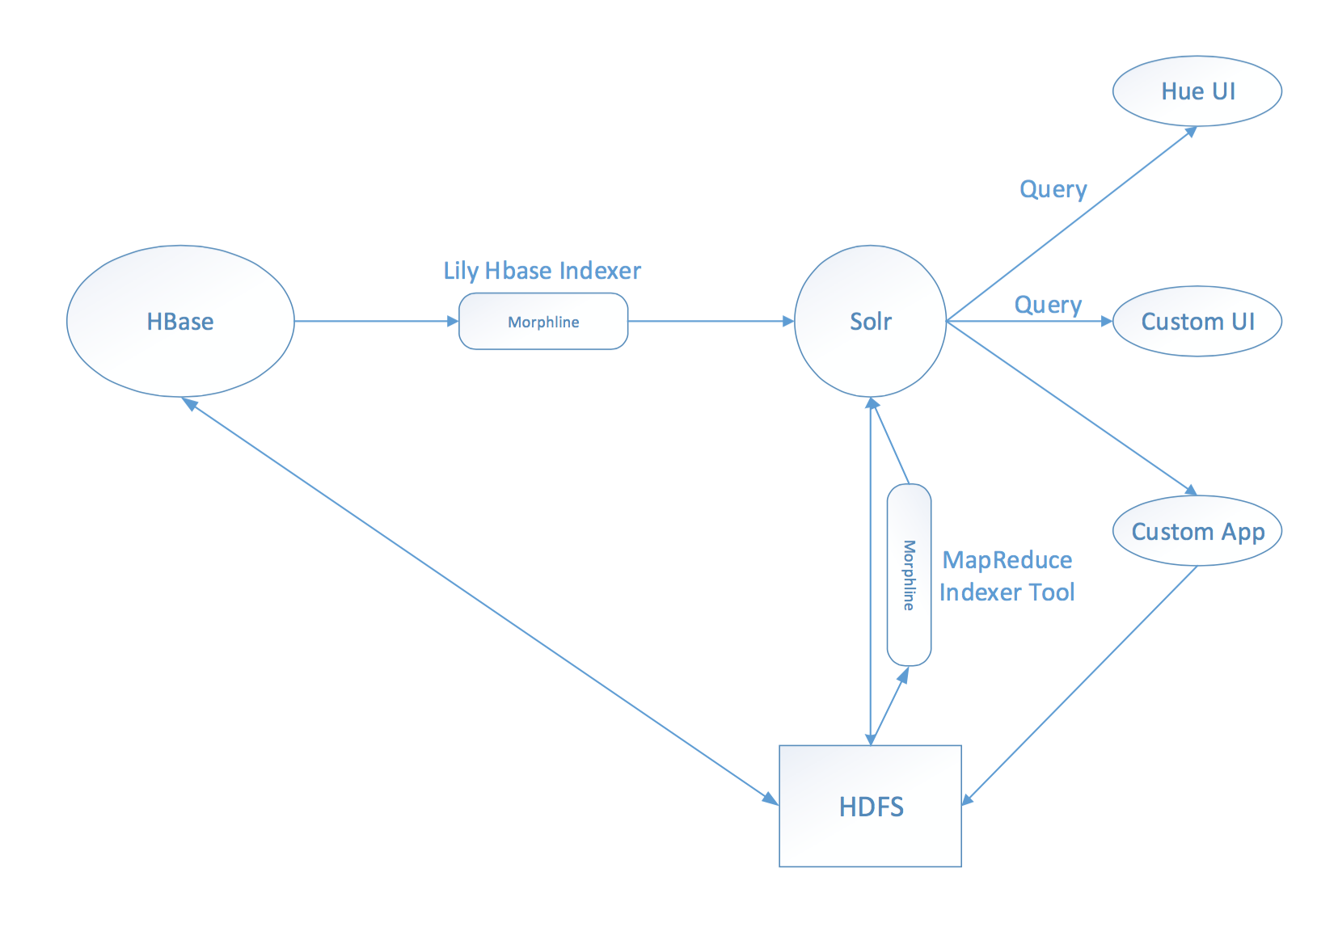
Indexing

Slide 12
Hbase Indexer - Morphline
morphlines: [
{
commands: [
{
extractHBaseCells {
mappings: [{
inputColumn: "original:text_clean"
outputField: "text"
type: string
source: value
}
{
inputColumn: "analysis:ner_people"
outputField: "ner_people_multiple"
type: string
source: value
}
] } }
{
split {
inputField: "ner_people_multiple"
outputField: "ner_people"
separator: "|"
}
}
maps to HBase column family and column qualifier
defined in schema.xml

Slide 13
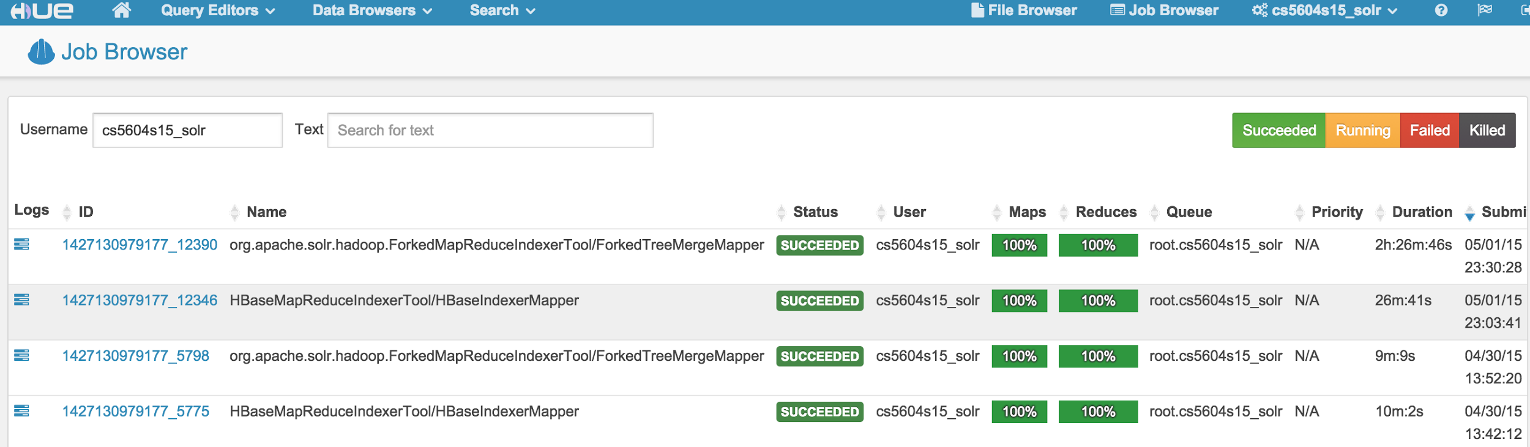
Indexing - Jobs

Slide 14
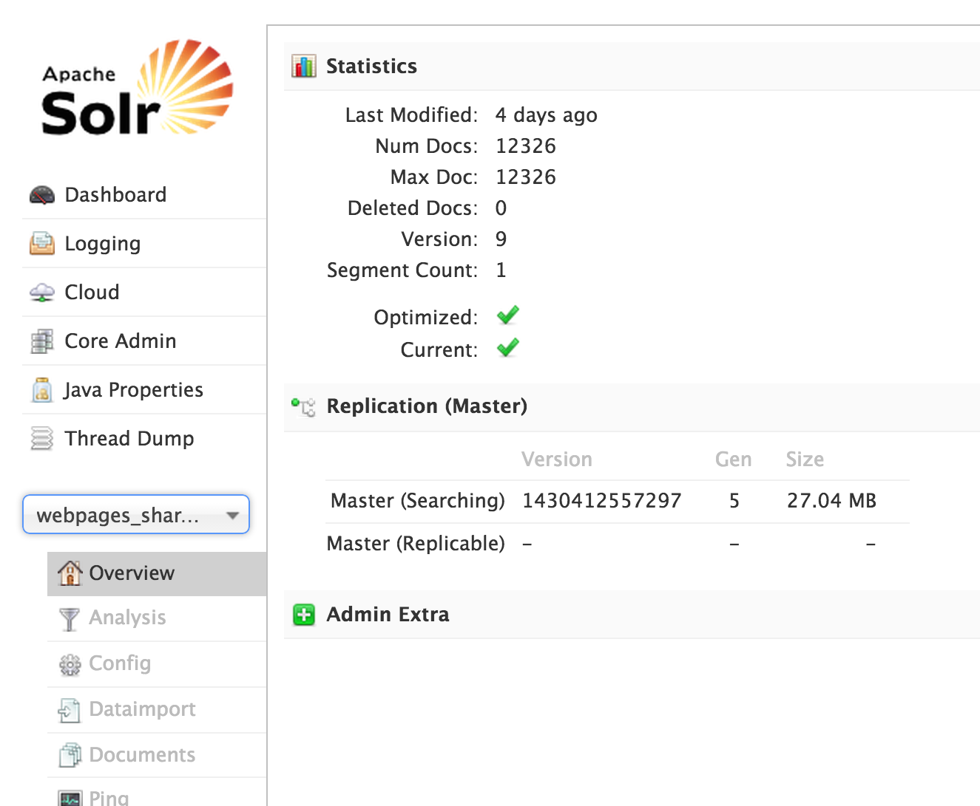
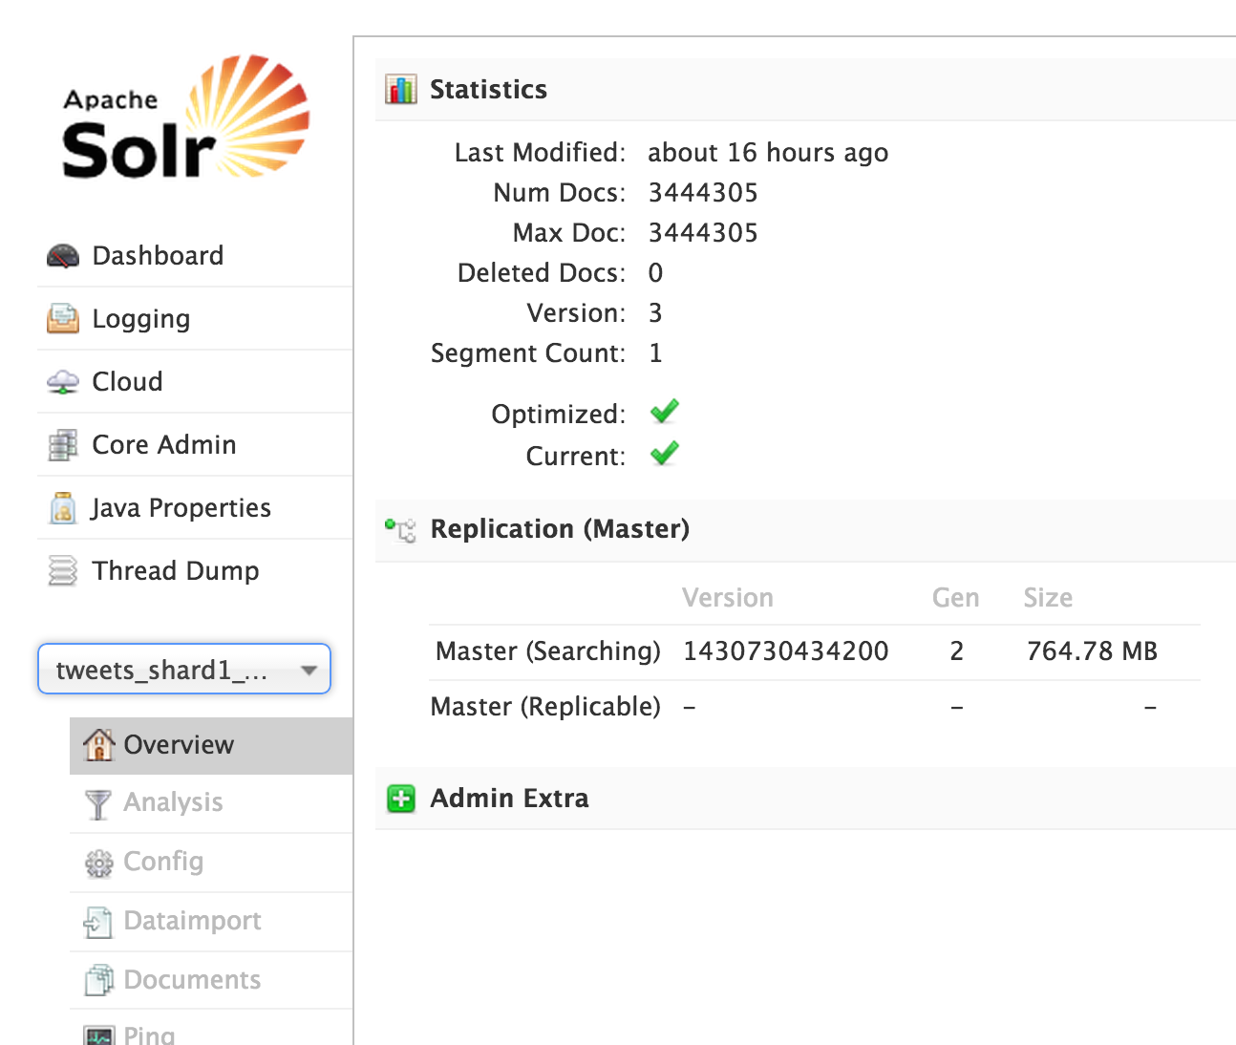
Results
Webpages
Tweets

Slide 15
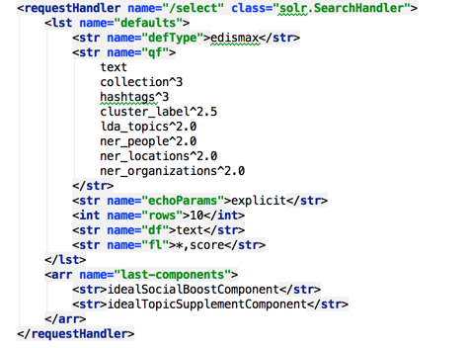
Search
1: Adjust boost levels in Query Parser (solrconfig.xml)
These numbers are conjectural. A more disciplined approach:
Relevance = f(q,d)
For each of 100 queries, induce a logistic regression model. Find average contribution of each field to relevance.

Slide 16
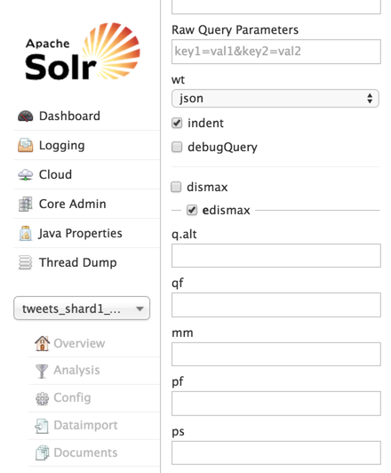
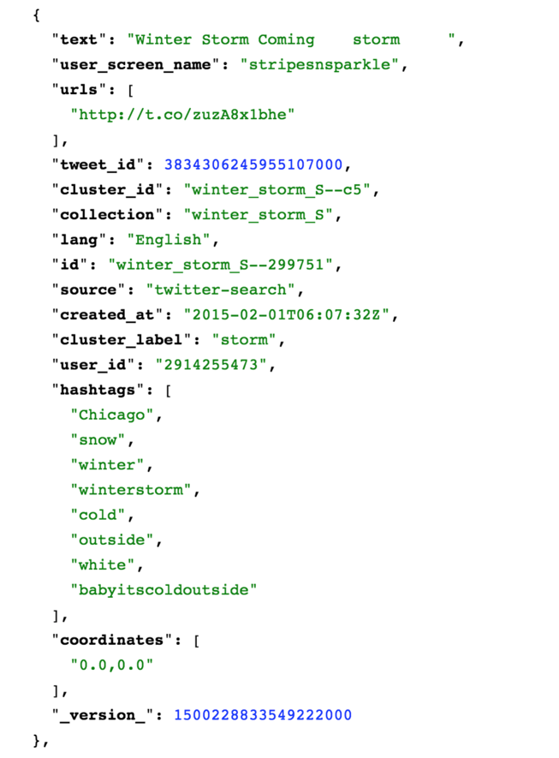

Search

Slide 17
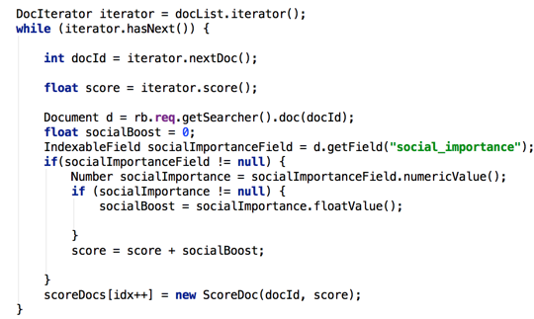


Search
2: Reorder documents on the basis of Social Importance Score.
edu.vt.dlib.ideal.solr.SocialBoostComponent
solr.SearchHandler
...

Slide 18
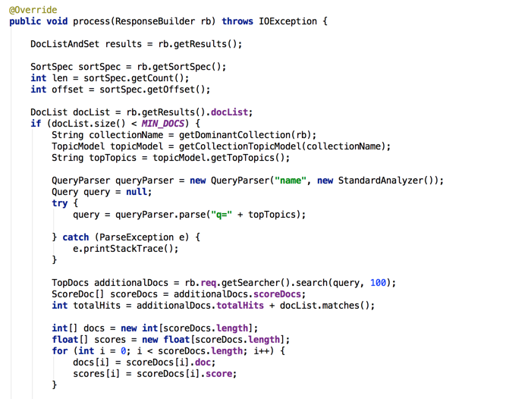
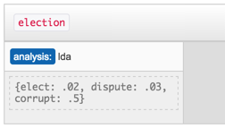
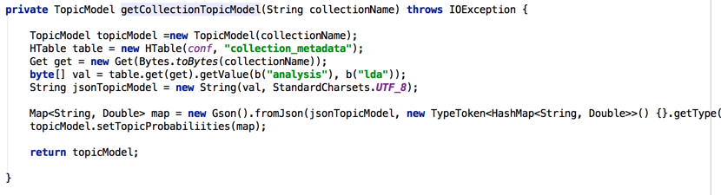
Search
3: Supplement result list, if necessary, by retrieving documents from collections that include topics related to the search. Get topic list straight from HBase.

Slide 19
Search Results
(first 1000 results)
{'query': 'election', 'num_results': 637498, 'precision': 0.998, 'time': 0.05295705795288086}
{'query': 'elect', 'num_results': 3247, 'precision': 0.978, 'time': 0.04558682441711426}
{'query': 'revolution', 'num_results': 13048, 'precision': 0.95, 'time': 0.04502081871032715}
{'query': 'uprising', 'num_results': 1769, 'precision': 0.851, 'time': 0.04298877716064453}
{'query': 'storm', 'num_results': 429329, 'precision': 0.999, 'time': 0.04975700378417969}
{'query': 'winter', 'num_results': 409987, 'precision': 0.999, 'time': 0.04920697212219238}
{'query': 'ebola', 'num_results': 306827, 'precision': 1.0, 'time': 0.04514813423156738}
{'query': 'disease', 'num_results': 6802, 'precision': 0.993, 'time': 0.041940927505493164}
{'query': 'bomb', 'num_results': 33924, 'precision': 0.857, 'time': 0.040463924407958984}
{'query': 'explosion', 'num_results': 1224, 'precision': 0.284, 'time': 0.04803609848022461}
{'query': 'crash', 'num_results': 274014, 'precision': 0.995, 'time': 0.04688715934753418}
{'query': 'plane crash', 'num_results': 193046, 'precision': 1.0, 'time': 0.056591033935546875}
{'query': 'shooting', 'num_results': 5366, 'precision': 0.744, 'time': 0.04262495040893555}
{'query': 'paris shooting', 'num_results': 446, 'precision': 0.446, 'time': 0.20793604850769043}
{'query': 'terrorist attack', 'num_results': 1143, 'precision': 0.768, 'time': 0.042675018310546875}

Slide 20
Future Work
Relevance feedback to derive logistic regression, evaluate with F1 score.
More Solr nodes -> more index shards.
Boost by length
Innovative inputs (social graph)
More sophisticated traversal of hierarchical classification

Slide 21
Acknowledgement
We are especially thankful to
The NSF grant IIS - 1319578, III: Small: Integrated Digital Event Archiving and Library (IDEAL) for the funding that supported the infrastructure and the data used in the project.
Dr. Edward A. Fox for being the guide on the side for us and for coordinating efforts of all the teams to help us make it a successful class project.
The GTA (Sunshin), the GRA (Mohamed) and other students of the class who supported us with ideas as well as efforts during the semester.
The authors and the contributors of open source projects, blogs and wiki pages from where we borrowed some ideas and solutions.

Slide 22
Thank you!
Q & A

