Slide 1


Strategic Management
International Strategy
Case: Levendary Cafe
Unless otherwise noted, this slide deck is (c) Virginia Polytechnic Institute and State University. It is released under a Creative Commons Attribution NonCommercial ShareAlike 3.0 license (CC BY NC-SA 3.0)
Instructor Name | Name of Institution
http://hdl.handle.net/10919/102735
Photo by Jon Sailer on Unsplash

Slide 2
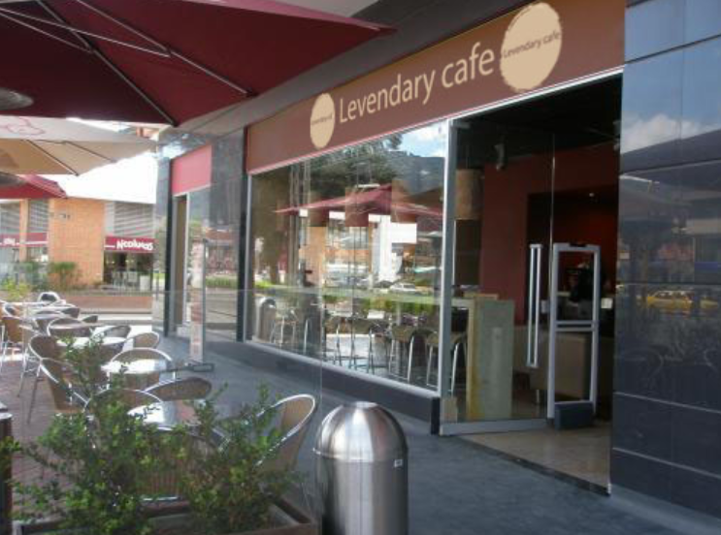
Focus Questions: Levendary Café
1. Business Level/Competitive Strategy
Differentiation: Focused or Broad?
Broad
Key resources & capabilities?
Customer service
High quality, healthy food options
Corporate Level Strategy
What kind of diversification?
Geographic diversification
Linkages?
Customer service
High-end menu options
Economies of Scale?
More café units to spread fixed costs across
Economies of Scope?
Support activities from headquarters
Photo used under Fair Use. Source: https://www.coroflot.com/patorivera/Levendary-Caf%C3%A9
http://hdl.handle.net/10919/102735

Slide 3

Focus Questions: Levendary Café
2. International expansion to China
Resources & capabilities? Assistance with expansion?
Expertise from HQ
Franchising experience
Low-cost input factors?
Yes, food and labor costs are lower in China
New competencies?
New supply and menu items, but these don’t translate well to the U.S.
How to conform to local / international markets
Disadvantages / Risks?
Liability of foreignness? Mitigated using Chen
Loss of reputation? Yes, could hurt U.S. reputation
By Dezalb. Pixabay license. Retrieved from https://pixabay.com/photos/china-shanghai-old-town-1115532

Slide 4
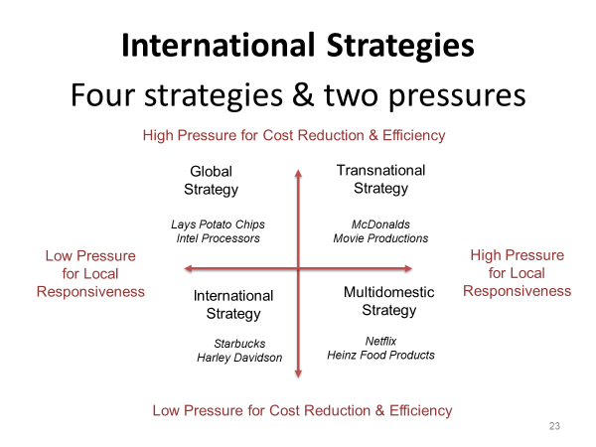
Focus Questions: Levendary Café
3. Integration-Responsive Framework
Which international strategy is HQ pursuing?
  International
Which strategy is Mr. Chen pursuing?
  Multi-domestic
Hence the conflict!!!
  Let’s look at the financial situation for Levendary in China.
http://hdl.handle.net/10919/102735

Slide 5
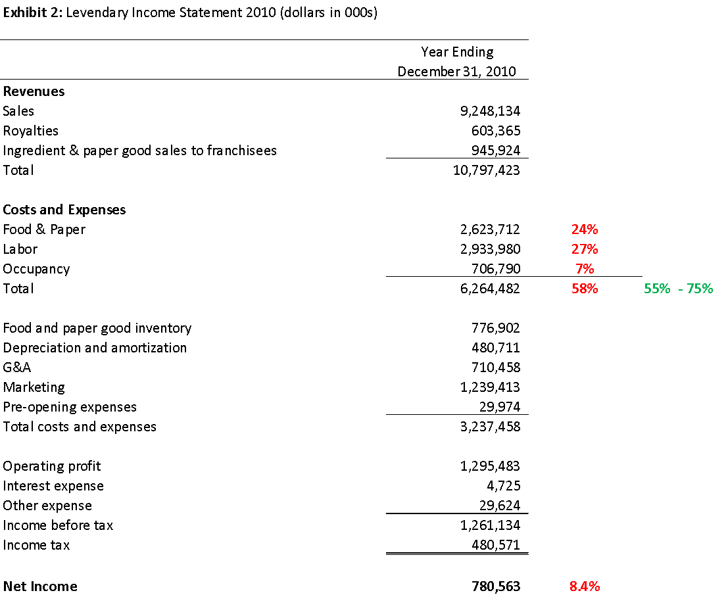
Levendary U.S. Operations
Case says these costs should run between 55% – 75% of revenues.
58% = Very Good!
http://hdl.handle.net/10919/102735

Slide 6
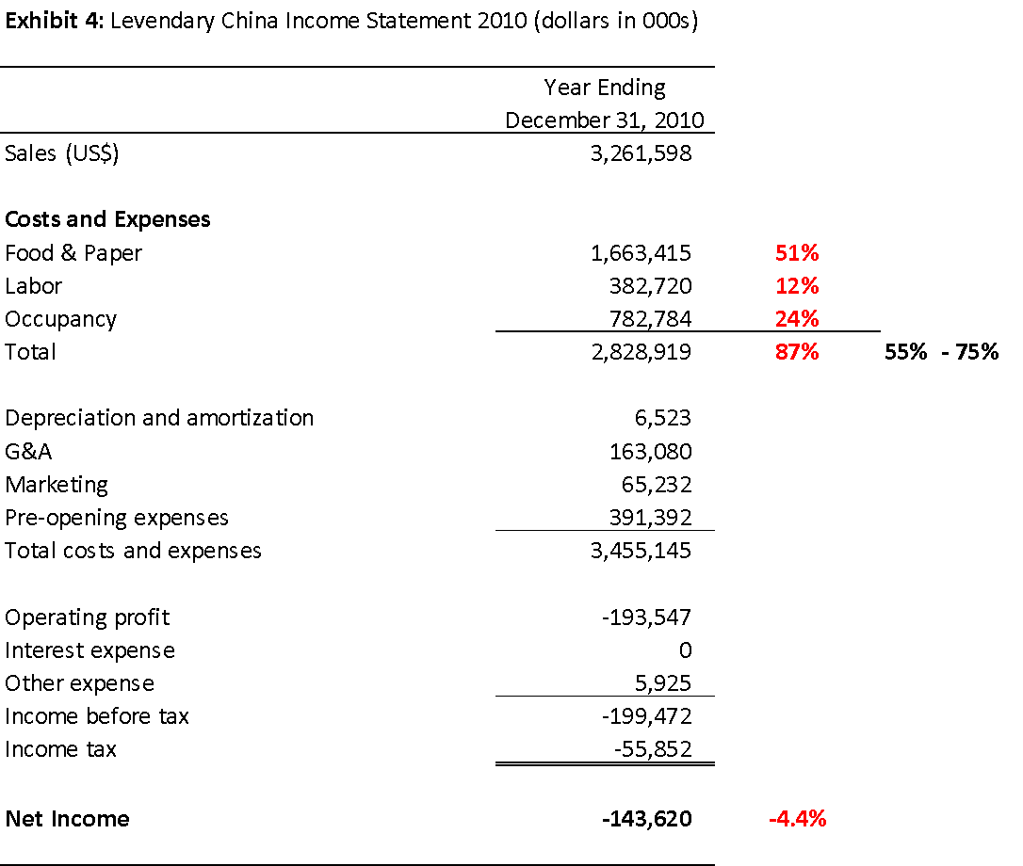
Levendary China Operations
Ooops! China running at 87%, and these costs were supposed to be less than US!
Running at a loss!
Time for a chat with Mr. Chen!!
http://hdl.handle.net/10919/102735

Slide 7
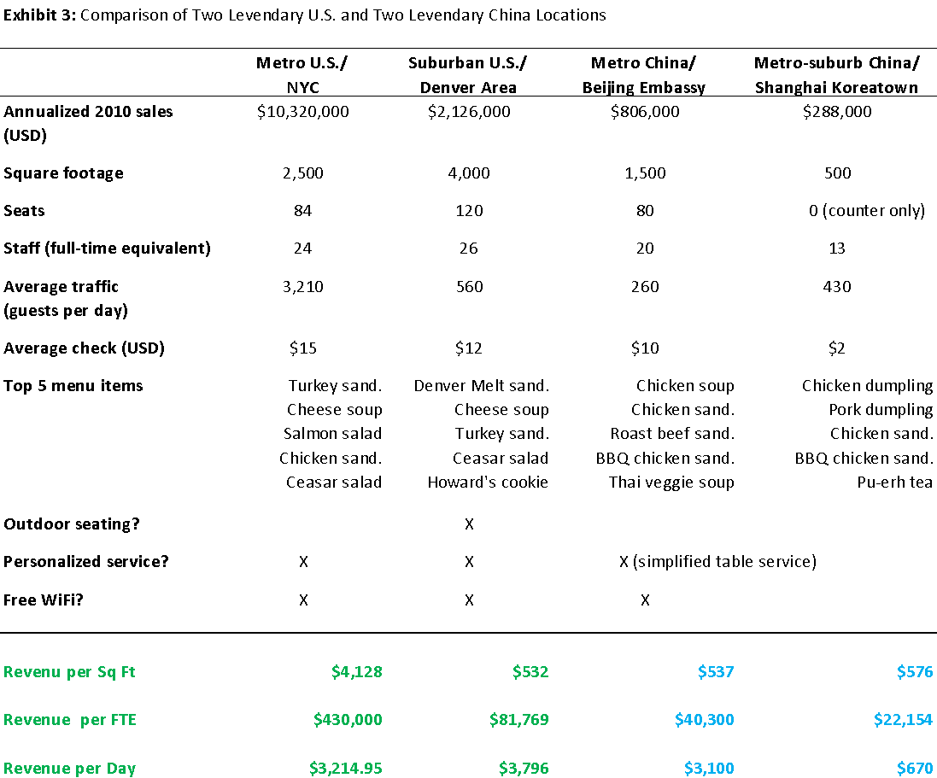
Levendary China Operations
Let’s run some ratios
See Notes below
http://hdl.handle.net/10919/102735
Notes:
NYC is an outlier. Beijing and Shanghai compare well with Denver on Revenue per Sq. Ft, but much worse on Revenue per FTE and per Day. Need another learning moment with Mr. Chen!

Slide 8
Focus Questions: Levendary Cafe
4. Expanding to China… Good Idea?
Photo used under Fair Use. Source: https://www.coroflot.com/patorivera/Levendary-Caf%C3%A9
By Dezalb. Pixabay license. Retrieved from https://pixabay.com/photos/china-shanghai-old-town-1115532
Let’s use some tools to do an assessment.

Slide 9
Porter’s Diamond Framework
National Competitive Advantage
Factor Conditions
Related & Supporting Industries
Demand Conditions
Strategy, Structure & Rivalry
http://hdl.handle.net/10919/102735

Slide 10
Focus Questions: Levendary Café (Cont.)
4. Porter’s Diamond
Does Levendary’s home country, restaurant industry have strong Porter’s Diamond factors?
Factor Conditions? Yes
Related and Supporting Industries? Yes
Demand Conditions? Yes
Strategy, Structure and Rivalry Yes
Conclusion: From Porter’s Diamond, Levendary has good chances of success abroad.
http://hdl.handle.net/10919/102735

Slide 11

Focus Questions: Levendary Café (Cont.)
4. What about the risks?
Political Risk?
Strong
Economic Risk?
Moderate
Cultural Risk?
Strong
Conclusion?
Need help, a Chinese partner, to lower risks
By priyampatel4. Pixabay license. Retrieved from https://pixabay.com/vectors/america-china-war-usa-discussion-5129061/
http://hdl.handle.net/10919/102735

Slide 12
International Strategies: The Integration-Responsiveness Framework
Four Strategies & Two Pressures
High Pressure for Cost Reduction & Efficiency
Global Strategy
Transnational Strategy
Lays Potato Chips
Intel Processors
McDonalds
Movie Productions
Low Pressure for Local Responsiveness
High Pressure for Local Responsiveness
International
Strategy
Multidomestic
Strategy
Starbucks
Harley Davidson
Netflix
Heinz Food Products
Low Pressure for Cost Reduction & Efficiency

Slide 13
Recap & Look Ahead
Today
Next Class: See Schedule
  Resource-based view of the firm
  Framework for analyzing resources and capabilities
  Examples
  Topics:
    Resource-based view Application
  Readings:
    Samsung Electronics Case
    Prepare your answers to the Focus Questions and upload on time
http://hdl.handle.net/10919/102735

