Slide 1



Utilizing Docker and Kafka for Highly Scalable Bulk Processing of Electronic Theses and Dissertations (ETDs)
ECE 5904: Project and Report
By Dhanush Dinesh
Chair: Dr. Edward Fox
Committee Members:
Dr. Creed Jones
Dr. Nektaria Tryfona
Dr. Prashant Chandrasekar
May 9, 2023 Virginia Tech MEng Defense
Blacksburg, VA 24061

Slide 2
Introduction
Introduction to Electronic Thesis and Dissertation (ETD) data
Cloud computing and Container as a Service (CaaS)
Advantages of containerization and platform-agnostic software
Challenges in managing large infrastructure with numerous interconnected Docker containers [ 1 ]
Overview of previous system architecture[ 2, 3 ]
Challenges in processing bulk ETD data

Slide 3
Introduction
Introduction to Kafka
Advantages of Kafka
High performance
Low latency
High availability
Role of Zookeeper
Tracking the status of Kafka nodes
Elects a leader of a specific partition and topic

Slide 4
Previous pipeline architecture
Airflow
Kubernetes managed by
Rancher
Goals
Segmentation
Text extraction
Classification
Clear Up
ETD ID
Upload API
Upload API
Upload API

Slide 5
Developing a Pipeline for ETD Data Processing
Overview of previous pipeline and limitations
Large set up time (6- 8 min)
Serial processing of ETD
Processing one ETD at a time
Need for a pipeline to process bulk ETD data
Utilizing Kafka as an intermediary between services to enable parallel processing

Slide 6

Current pipeline architecture
Zookeeper
Kubernetes managed by
Rancher
Segmentation
Segmentation
Kafka Broker
Segmentation Q
Parse and clean
Kafka Producer
Text Extraction Q
Summarize Q
Summarization
Classification Q
Classification

Slide 7
Live Demo - Propagation of ETD Data through the Pipeline
cloud.cs.vt.edu

Slide 8
Advantages of current system
Fast deployment and scalability
Faster migrations
Achieving parallel processing
Significantly reducing processing times (one set up time)
Bulk processing
Decoupling of services

Slide 9
Conclusion
Utilized Docker and Kafka for a high-performance and scalable bulk processing of ETD data pipeline
Future scope for further improvements and optimization of the pipeline
Pipeline
CI/CD
User Interfaces

Slide 10
Questions ?

Slide 11
Thank You

Slide 12
References
Mitesh Soni. End to end automation on cloud with build pipeline: The case for DevOps in insurance industry, continuous integration, continuous testing, and continuous delivery. In 2015 IEEE International Conference on Cloud Computing in Emerging Markets (CCEM), pages 85–89, 2015. doi:10.1109/CCEM.2015.29.
Harish Babu, Manogaran Pallavi Sisodiya, Yuze Li, Aaron Travasso, Anmol Shukla. 2022. Team 5 final submission CS 5604: Information storage and retrieval. URL: http://hdl.handle.net/10919/114078
Suraj Gupta, Xingyu Long, Yash Mahajan, Mohit Thazhath, Hsinhan Hsieh, Alex Hicks, Cherie Poland. 2020. INT team final submission CS5604: Information storage and retrieval. URL: http://hdl.handle.net/10919/101544

Slide 13
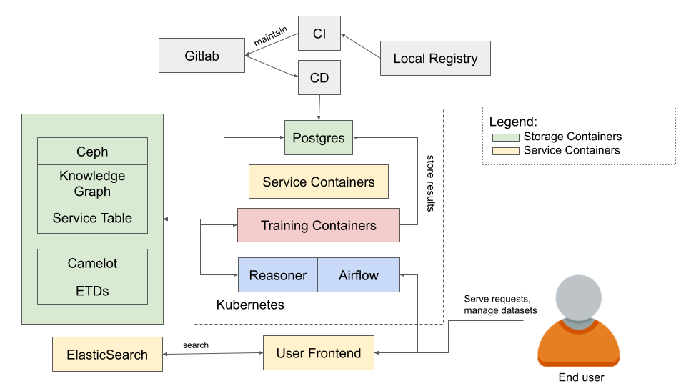
2022 teams system architecture
Fig: System Architecture 2022 [2]

Slide 14
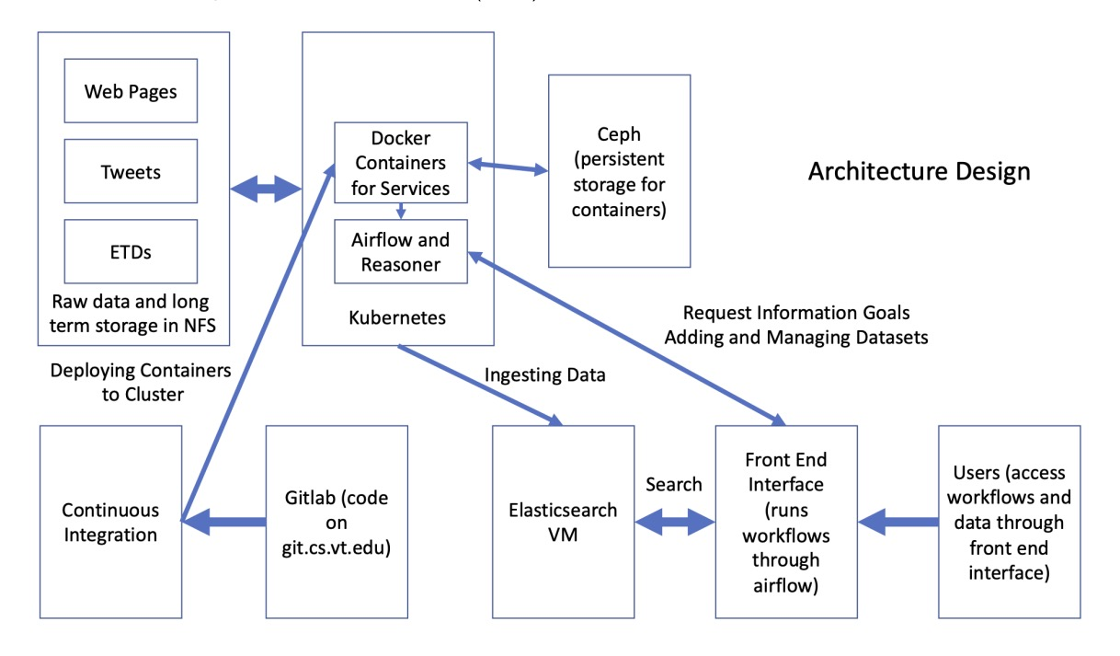
2020 teams system architecture
Fig: System diagram for information retrieval and analysis system 2020 [3]

Slide 15
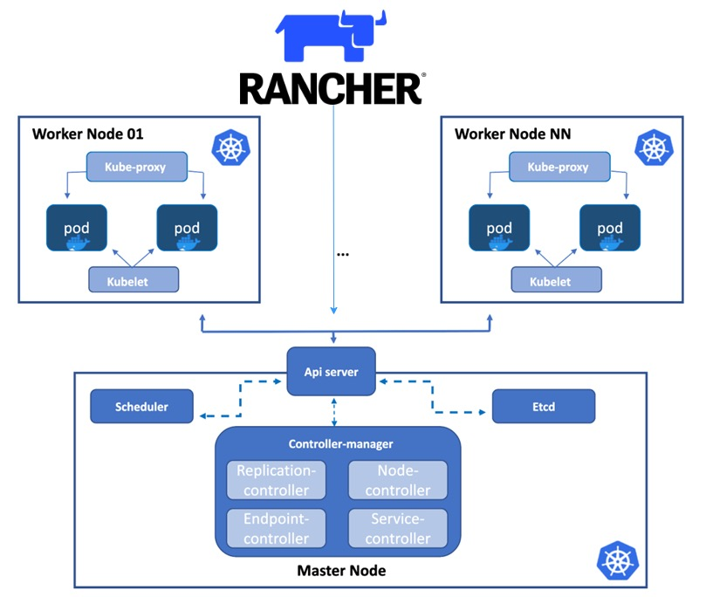
Discovery cluster - Rancher
Fig: Rancher architecture as used in discovery cluster

