Slide 1
Computer Science Seminar Recordings
May 14, 2013
Virginia Tech
Multimedia/Hypertext
Clients: Manuel Perez-Quinonez, Ryan Chase, Nathan Hall
Glen Tona, Sivani Parbadia, Derek Ong, Kyle Gibb

Slide 2
Roles
Sivani: recording seminars
Glen: interviews & assisting with shooting
Kyle: video editing
Derek: website

Slide 3
Seminar Recordings
Cloud Computing and People with Disabilities
Speaker: Clayton Lewis
University of Colorado
Location: 2150 Torgersen
Date: Friday February 8th, 2013
Time: 11:15am-12:30pm
More details: http://people.cs.vt.edu/~mperezqu/CSSeminar/2013-02-08-clayton-lewis.html
Design-Driven Software Development: A Programming Language-Inspired Approach
Distinguished Lecture: Dr. Charles Consel
Inria / University of Bordeaux
Location: 2150 Torgersen
Date: Friday February 22nd, 2013
Time: 11:15am-12:30pm
More details: https://www.cs.vt.edu/DistinguishedLectures/consel
An Ecosystem for the New HPC: Heterogeneous Parallel Computing
Speaker: Wu Feng
Location: 2150 Torgersen
Date: Friday February 15th, 2013
Time: 11:15am-12:30pm
More details: http://people.cs.vt.edu/~mperezqu/CSSeminar/2013-02-15-wu-feng.html
Scaling Secure Computation
Speaker: David Evans, University of Virginia
Location: 2150 Torgersen
Date: Friday February 1st, 2013
Time: 11:15am-12:30pm
More details: http://people.cs.vt.edu/~mperezqu/CSSeminar/2013-02-01-david-evans.html

Slide 4
Seminar Recordings
Semantic Interaction for Visual Analytics: Inferring Analytical
Speaker: Alex Endert
Location: 2150 Torgersen
Date: Friday April 26, 2013
Time: 11:15am-12:30pm
On the Complexity of Robust Source-to-Source
Speaker: Paul Sathre
Location: 2150 Torgersen
Date: Friday April 26, 2013
Time: 11:15am-12:30pm
Data Models of Confidentiality
Speaker: Denis Kafura
Location: 2150 Torgersen
Date: Friday May 3, 2013
Time: 11:15am-12:30pm
Science at Extreme Scale: Challenges in Data Management, Analysis, and Visualization
Speaker: Lucy Nowell
Location: 2150 Torgersen
Date: Friday April 12, 2013
Time: 11:15am-12:30pm
Using Process Definition and Analysis Techniques to Reduce Errors and Improve Efficiency in the Delivery of Health Care
Speaker: Lori A. Clarke, Leon J. Osterweil
Location: 2150 Torgersen
Date: Friday April 19, 2013
Time: 11:15am-12:30pm

Slide 5
Seminar Recording
DEMO

Slide 6

Interviews
Analyzing Speech
Composing questions
1 on 1 interviews
Topic Discussion with Speaker

Slide 7
Interview Recording
DEMO

Slide 8
Web Development
All videos have been posted
Powerpoints are posted
Abstracts and bios are available
Web URL: http://vtechworks.lib.vt.edu/handle/10919/19036

Slide 9
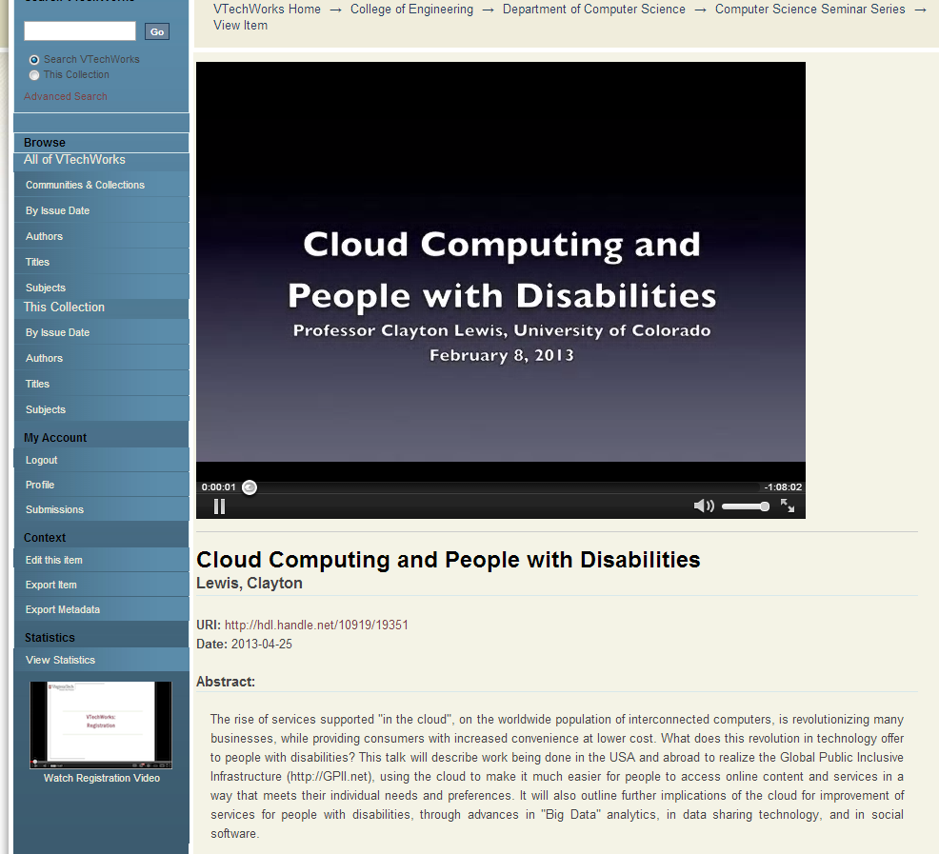
Web Development

Slide 10
Video Editing
Had to cut out some parts
  Captured some footage from before lectures started
iMovie has limited options
  Clients requested specific formats such as WebM
  WebM not natively supported by iMovie
Some videos were unusable
  Poor audio or mic failure- mosty during interviews

Slide 11
Problems We Had
Inexperience with recording hardware
Initial audio issues
Communication problems
Changing format requirements

