Slide 1
Benefits of vertically-staggered wind turbines from theoretical analysis and Large-Eddy Simulations
Cristina L. Archer, Shengbai Xie, Niranjan Ghaisas,
College of Earth, Ocean, and Environment
University of Delaware and
Charles Meneveau
Department of Mechanical Engineering
Johns Hopkins University
North American Wind Energy Academy (NAWEA) 2015 Symposium
Virginia Tech, Blacksburg, VA, 9-11 June 2015

Slide 2
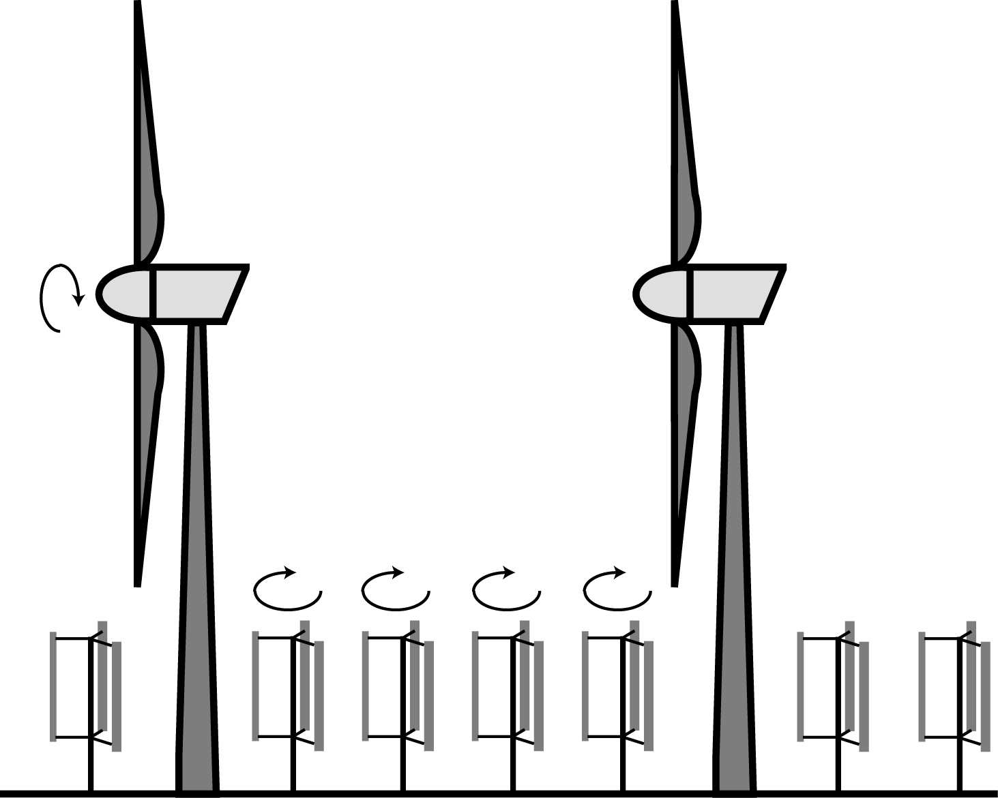
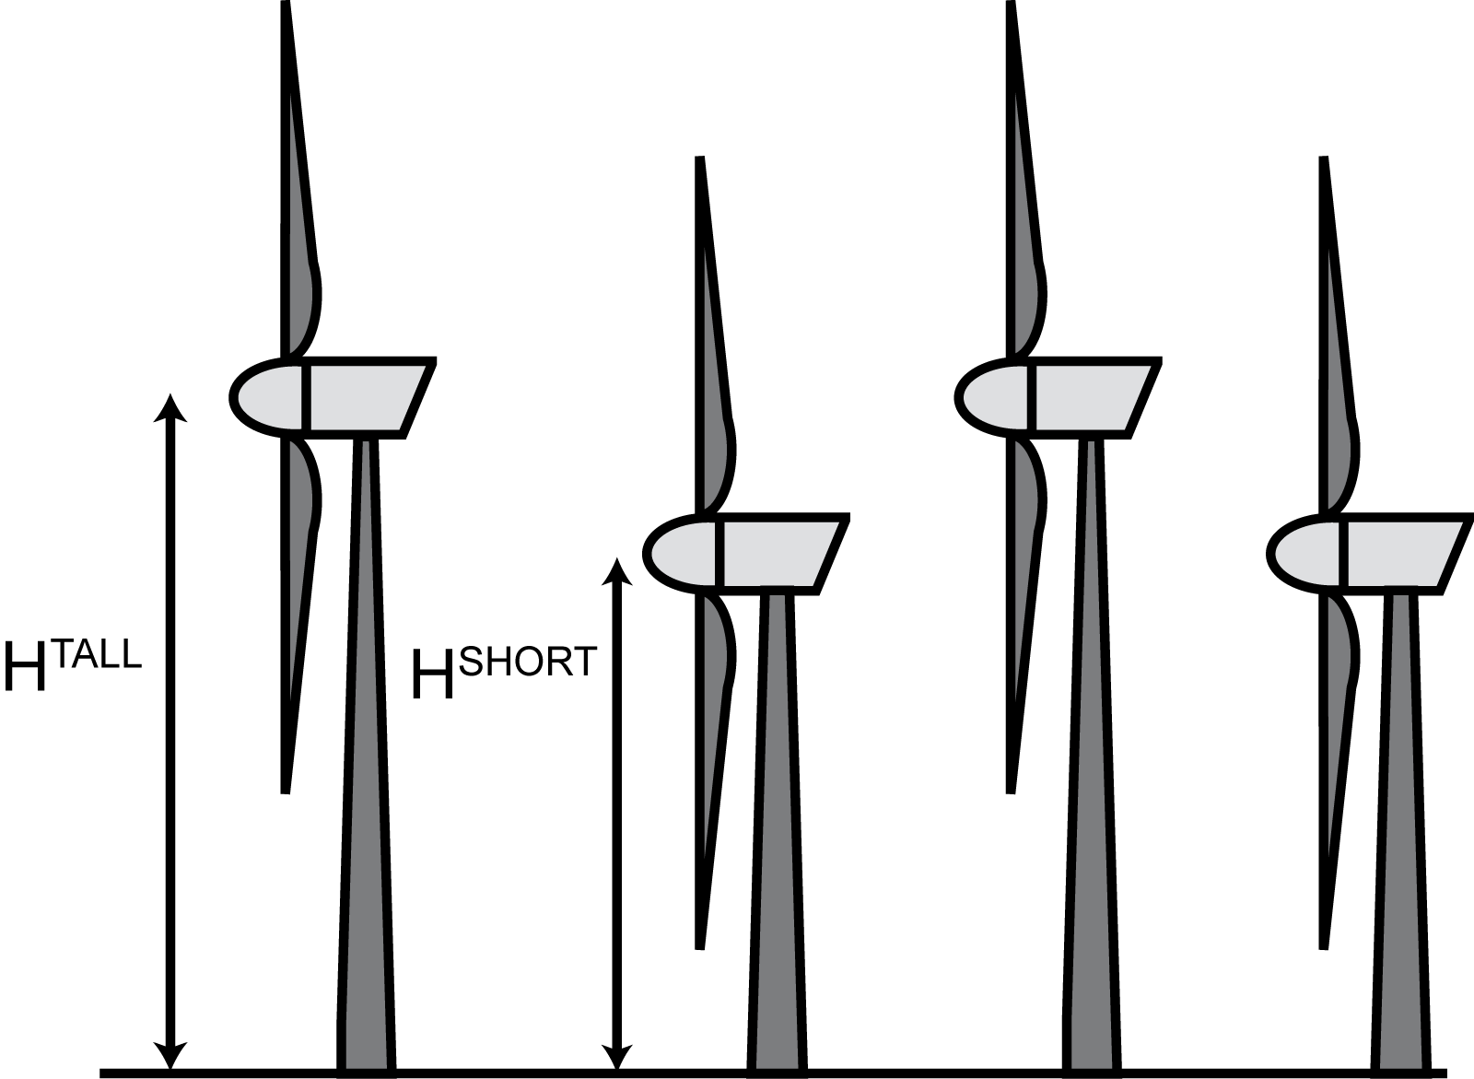
Types of vertical staggering
Benefits of horizontal staggering in a wind farm are relatively well known;
Cannot change horizontal staggering in existing wind farms;
Two types of vertical staggering:
  Multi-type (VSMT):
  add smaller, vertical-axis wind turbines (VAWTs) between larger, horizontal-axis wind turbines (HAWTs).
  Multi-height (VSMH):
  reduce/increase the height of selected rows of HAWTs inside a wind farm.

Slide 3
Methods
Multi-type (VSMT):
  LES with the Wind Turbine and Turbulence Simulator (WiTTS), UDelaware, Fortran, finite-differences, MPI, actuator lines and disks, all stabilities, non-periodic BCs;
  Analytical analysis based on alternating log layers and enhanced-ν layers;
Multi-height (VSMH):
  LES with the Software for Offshore/onshore Wind Farm Applications (SOWFA), NREL, C++, OpenFOAM based, finite-volume, actuator lines, all stabilities, non-periodic BCs.

Slide 4
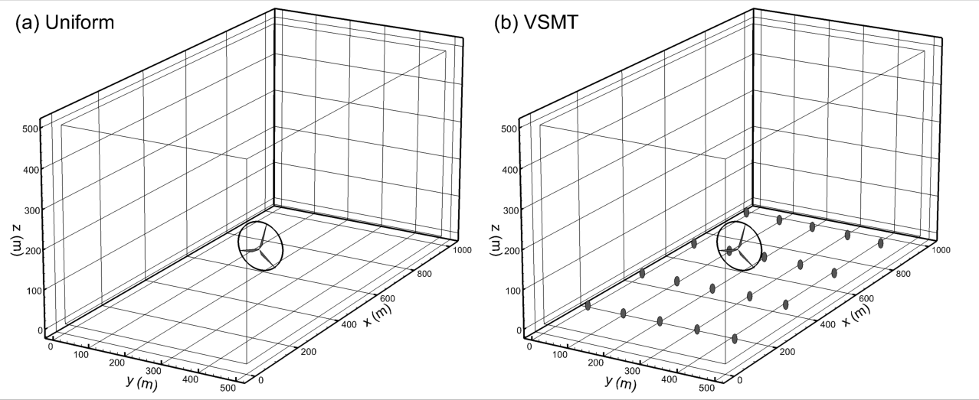
WiTTS setup for the VSMT farm
Control
Control case:
  HAWT: REPower 5 MW, D = 126 m, H_{h} = 87.6 m, tip speed ratio = 5.3, actuator lines;
VSMT case:
  Add 20 VAWTs: w = 10 m, h = 20 m, H_{h} = 15 m, C_{T} = 0.25, actuator disks;
Setup:
  Pseudo-spectral, LASD;
  1000 m x 500 m x 500 m;
  3.9 m resolution;
  Neutral ABL with U_{g} = 16 m/s at top and z₀=2x10⁻⁴ m;
  6-hr spin-up and 30-min averaging time.

Slide 5
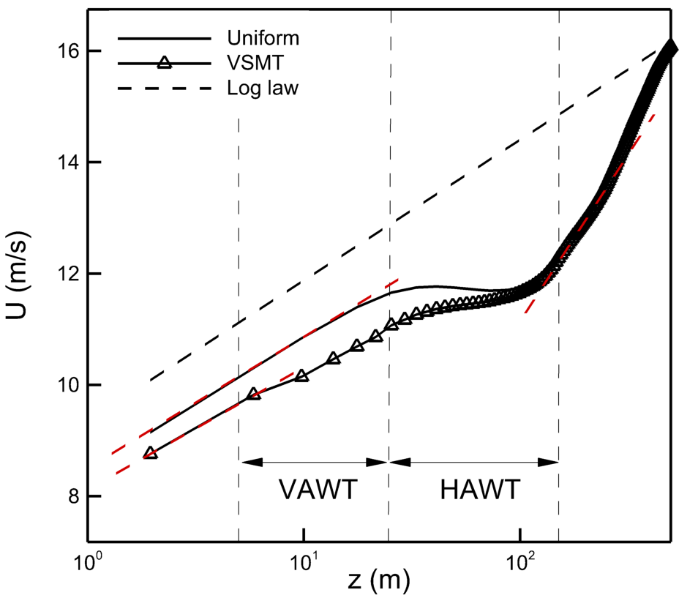
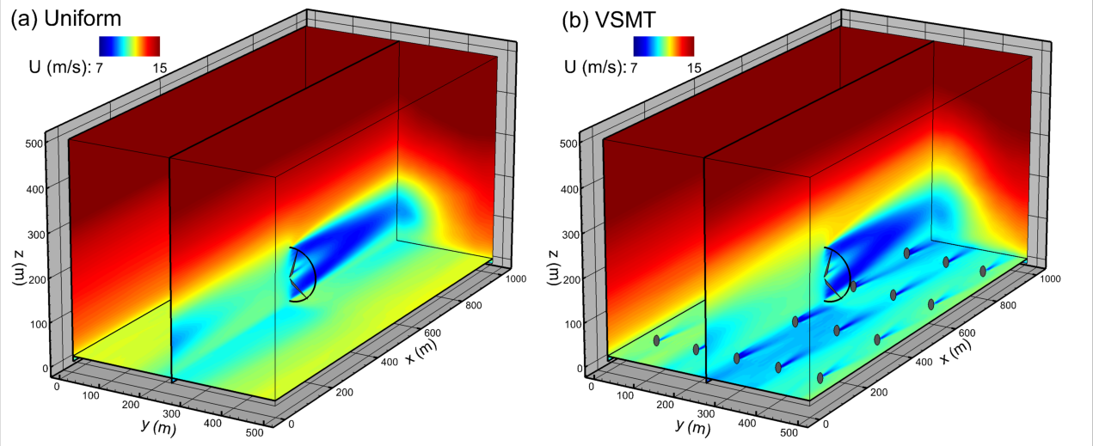
Mean wind speed
Multi-log layers are observed in the mean wind speed profiles;
The mean wind speed is reduced in the lower part of the VSMT and unaffected above HAWT;
The HAWT in VSMT has shorter wake (faster wake recovery).
Notes:
Time and horizontally averaged wind speed in figure

Slide 6
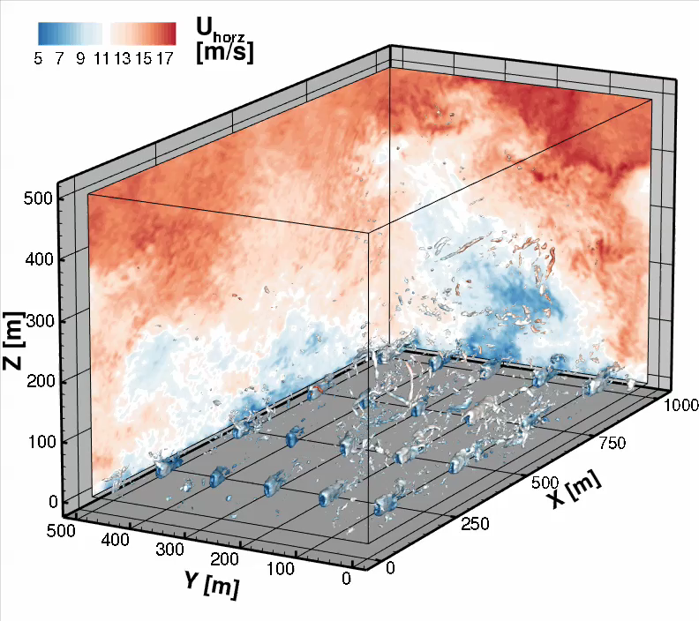
Wind speed and vorticity

Slide 7
Net effect on HAWT is negligible
Two competing effects:
Reduced wind speed above HAWT (due to higher roughness), less entrainment, less power;
Faster wake recovery, more power.

Slide 8
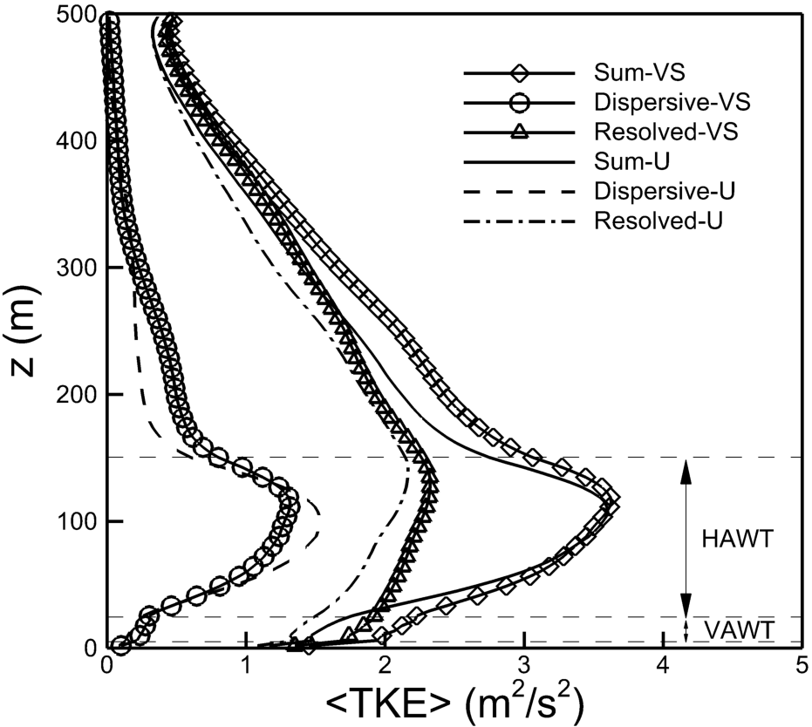
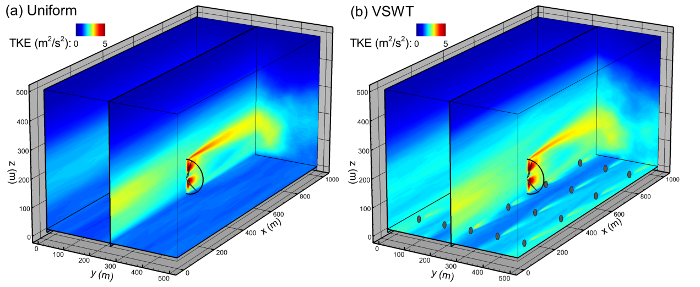
Turbulent kinetic energy
Control
VSMT
VSMT
Dispersive part: due to spatial inhomogeneity;
VSMT has larger TKE, especially the resolved part, throughout the ABL;
Stronger turbulence induces faster wake recovery.

Slide 9
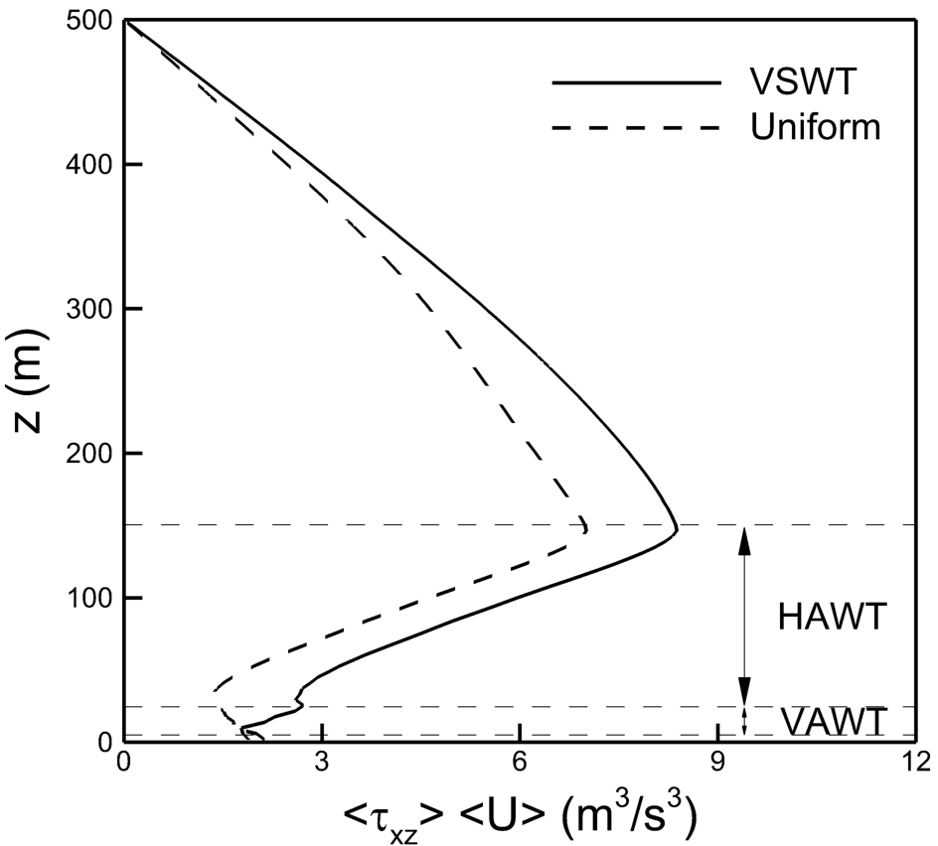
Power extraction
VSMT
Control
Power extracted: U_{d}×T;
Total power extracted: VSMT is 20% larger;
STD is slightly reduced.
Flux of kinetic energy is proportional to energy extraction (Calaf et al. 2010);
Flux of kinetic energy: VSMT is 17% larger.
Notes:
Time and horizontally averaged flux of kinetic energy.
Ud is the resolved streamwise velocity averaged over the turbine rotor region and T is the thrust force exerted by the turbine

Slide 10
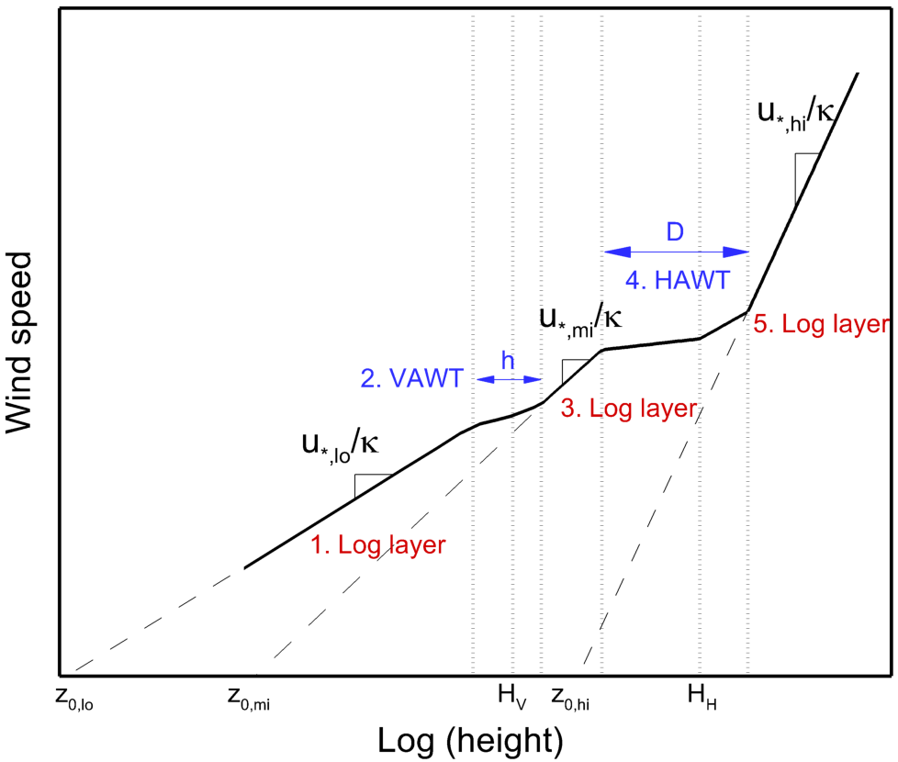
An theoretical top-down model
,
Five layers:
Lower log layer:
Wake layer of VAWT:
Middle log layer:
Wake layer of HAWT
Upper log layer:
Infinite, fully developed wind farm;
No overlap between VAWT and HAWT layers;
Neutral ABL.
Calaf et al., Phys. Fluids 22, 015110 (2010)
Meneveau, J. Turbulence 13, 1–12 (2012)

Slide 11
After some tedious algebra…
,

Slide 12
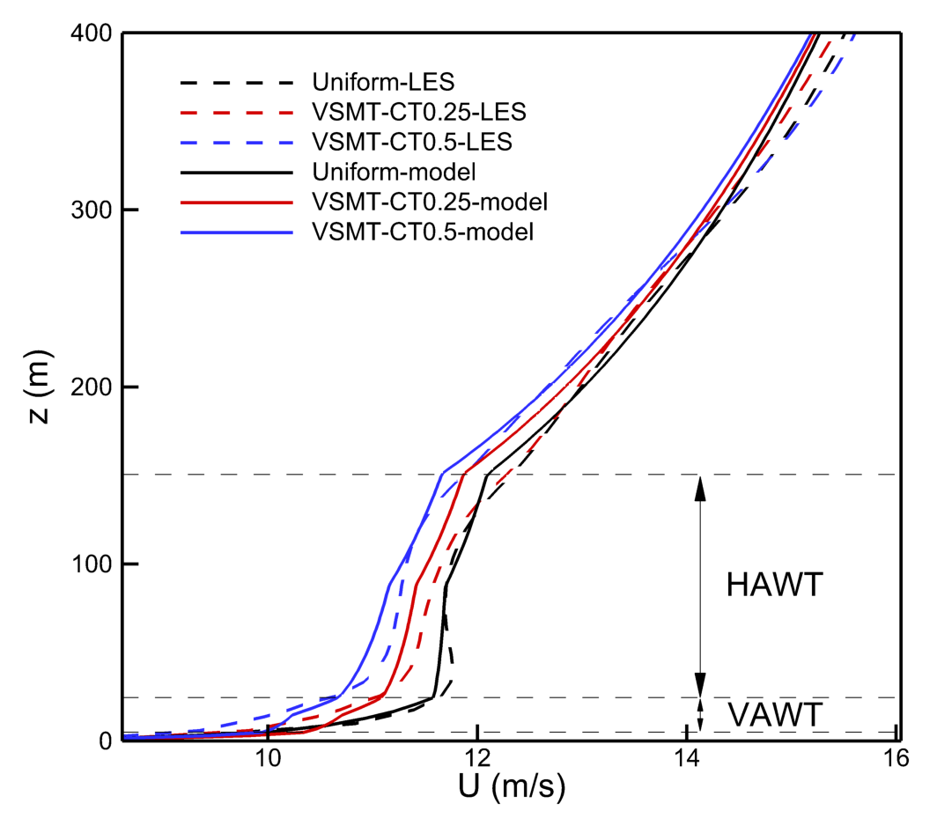
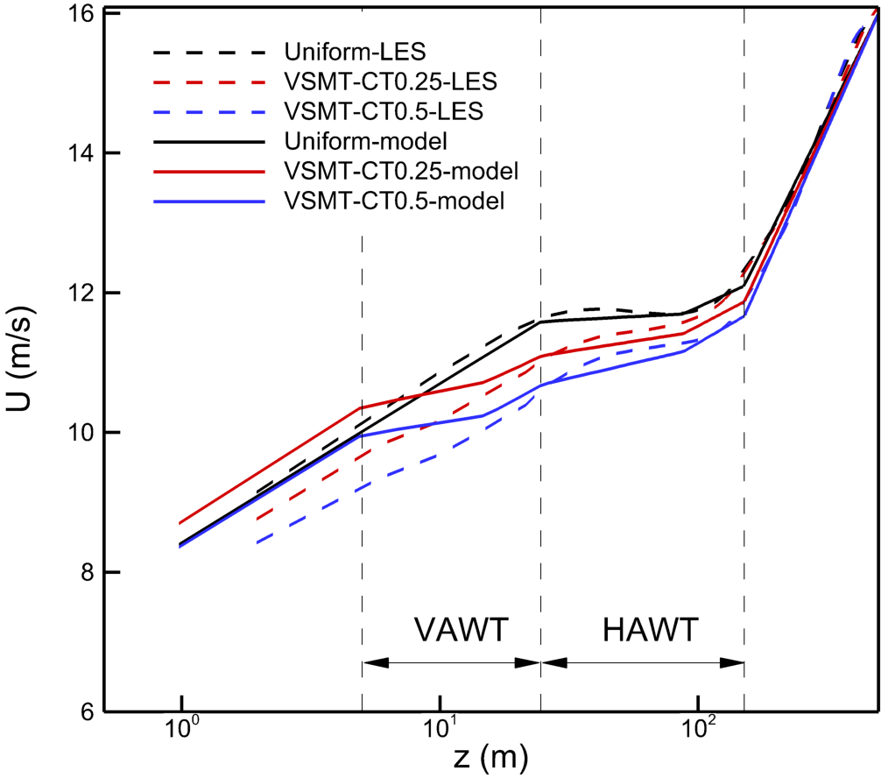
Validation: mean velocity profiles
,
In general, model matches well with LES;
Profile shifts left with increase of thrust coefficient of VAWTs;
The model overestimates wind speed below VAWTs.

Slide 13
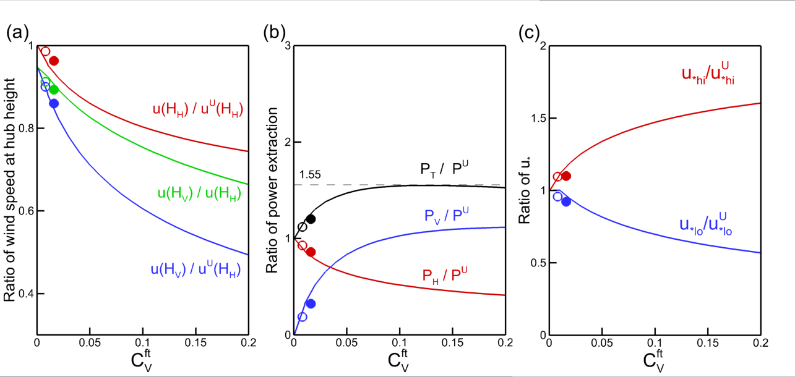
What if we increase the capacity of the VAWT?
,
Solid lines: model predictions;
Open circles: LES with C_{T}=0.25;
Filled circles: LES with C_{T}=0.5;
Superscript U: uniform wind farm,
Subscript ‘V’: ‘VAWT’, ‘H’: ‘HAWT’, ‘T’: ‘total’
Hub height velocity: decrease for both VAWT and HAWT;
Power: increase for VAWT, decrease for HAWT; A maximum, about 155%, exists;
The total momentum defect keeps decreasing.
Notes:
Here we increase the capacity by increasing C_ft, which means that we either increase the thrust coefficient or decrease the spacing

Slide 14
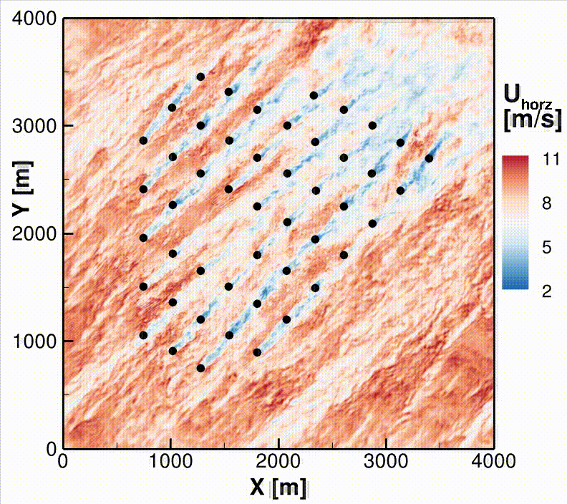
SOWFA setup for the VSMH farm
Control case:
  Lillgrund wind farm;
  48 2.3-MW Siemens turbines, D = 93 m, H = 63.4 m, actuator lines;
VSMH case:
  Even rows (in blue) with H^{SHORT}= 48.4 m (15 m shorter);
Setup:
  SGS model: Smagorinsky;
  4000 m x 4000 m x 1000 m;
  3.5 - 7 m resolution;
  Neutral ABL with U = 9 m/s at 90 m and z₀=0.016 m;
  3-hr spin-up and 30-min averaging time.

Slide 15
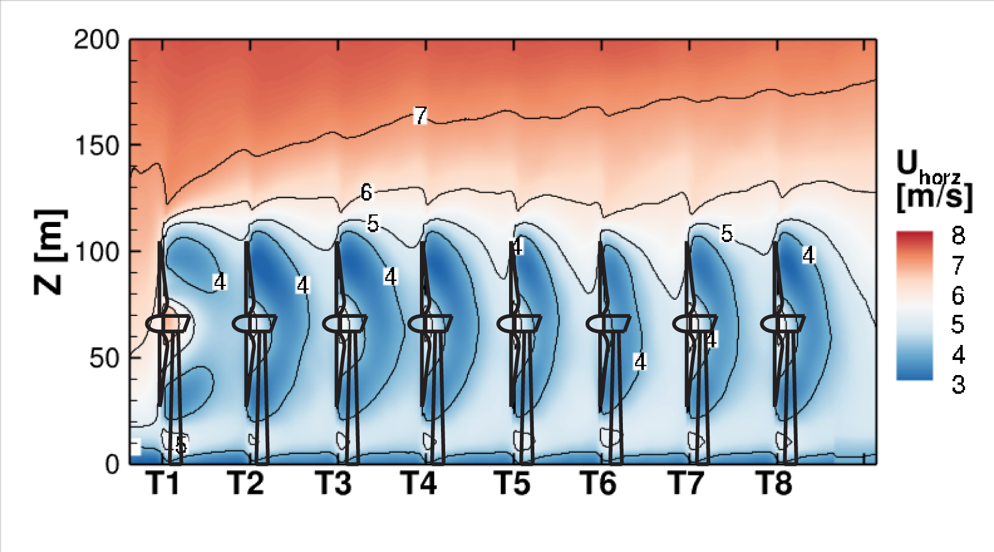
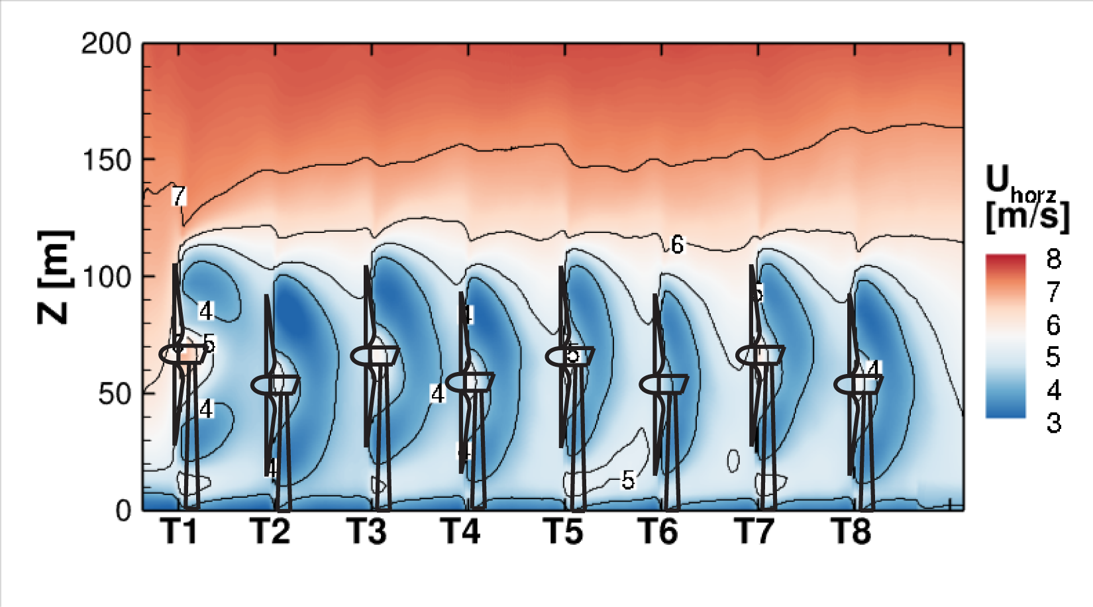
Velocity contours

Slide 16
Wind power by column
Column B
Total power:
Control: 33.4 MW (1.6 MW)
VSMH: 33.6 MW (1.6 MW)
Column C

Slide 17
Conclusions
Vertically staggering a wind farm is a promising method to increase wind farm efficiency;
VSMT:
  Power generated by the HAWT ~unaffected by the smaller VAWTs;
  Power generated by VAWTs adds on ~linearly to the power from the HAWT;
  Top-down analytical model: linearity of benefits ends eventually and a maximum/optimal exists;
VSMH:
  Power generated is ~same as in control case;
  Installation and maintenance costs are lower;
Future work includes: compensating effects of various wind directions; atmospheric stability; optimal layout using both vertical and horizontal staggering/spacing.

