Slide 1


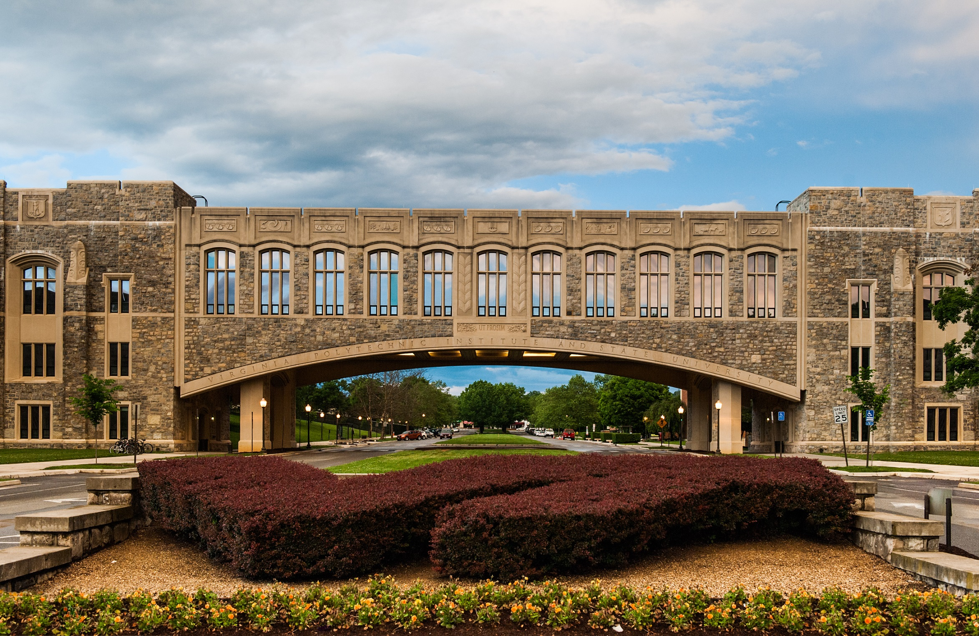

Becoming a Good Neighbor:
Befriending Instructional Designers and Campus Distance Learning Folks
Anita R. Walz, Open Education, Copyright, & Scholarly Communication Librarian Stefanie Metko, Associate Director of Learning Services , Virginia Tech
17th Distance Library Services Conference, Pittsburgh, PA April 21, 2016
Becoming colleagues
The iterative process of building trust
Ideas / Exploring the Landscape / Iterative
THE APPROACH
Library liaison to educational technology units
Relationships matter! “Tell me what you do”
Learning to work within each others’ frameworks
Needs assessment (formal and informal)
Discussing systems we both care about
Connecting colleagues
THE ACTIONS
Taking an advocacy role for each other
Working together on campus-wide initiatives
Exploration of collaborative LMS customization
Default “on” Library Help button in LMS
Piloting collaborative models as a learning experience
Embedding librarians. What worked & what didn’t?
Team teaching:
Using Library Resources for flipped classrooms
Exploring technology applications for deep student learning
Canvas/Creative Commons workshop
Collaborative event planning
Copyright & Creative Commons consulting for OER learning object development
Library-initiated IT improvements
EzProxy integration with campus authentication
Becoming collaborators
New understandings of librarian roles
Technical / Designing / IT Policy-making / Co-teaching
Invitations extended
THE APPROACH
Implementation of LTI (Learning Tools Interoperability)
LMS collaborative customization (Librarian role)
Development of learning modules for course redesign
Library research skills course redesign grant
Collaborative educational programming (faculty & public)
Committee work:
Campus-wide Distance Learning Committee
NextGenLMS Steering Committee
Campus-wide working group for LTI
FERPA compliance & student fees
Co-Teaching (for faculty development)
Building a referral network
FUTURE ACTIONS
Implementation of actions from formal needs assessment
Exploration of platforms for sharing/editing learning objects
Continued involvement in course redesign process
OER Instructional Module
Cohort participation
References
“Torg Bridge” Paul Kurlak https://flic.kr/p/epBEtT CC BY 2.0
Handshake https://pixabay.com/en/handshake-meeting-deal-hand-trade-651818 CC0
“Tea Mug” Creative Stall https://thenounproject.com/term/tea-mug/130325/ CC BY 3.0

