Slide 1
CS6604 Course Project
Fall 2019
Automatic Classification of Arabic ETDs
Eman Abdelrahman and Fatimah Alotaibi
Supervised by: Dr. Edward Fox
December 10th, 2019
Virginia Tech, Blacksburg, 24061

Slide 2
Acknowledgements:
We would like to deeply thank Dr. Fox for his continuous support.
Also, our colleague Palakh Jude for the guidelines and assistance she provided us.
We would also like to thank our colleague Bill Ingram for adding us to his ARC allocation.
Special thanks to Saudi Digital Libraries for giving an account for Fatimah Alotaibi which made this project possible.
Thanks to Institute of Museum and Library Services IMLS LG-37-19-0078-19.

Slide 3
Outline:
Motivation.
NLP in Arabic language.
Related work.
Dataset.
Preprocessing.
Experiment and results.
Insights and future work.

Slide 4
Motivation
ETDs are becoming the new genre.
They need classification for better browsing and accessibility.
Increasing number of universities are requesting their graduate students to deposit an Arabic translated version of their ETD or at least for the title and abstract.
No prior machine learning research has been done on Arabic ETDs due to:
  Data availability.
  Complexity of Arabic Language.

Slide 5
NLP in Arabic Language
According to “Introduction to Arabic Natural Language Processing” book, Nizar Y. Habash, Morgan & Claypool Publishers, 2010:
Vast majority of Arabic words are morphologically complex.
Arabic is high inflectional and derivational language.
Arabic language has rich and complex grammatical structures.
Significant challenges to many Natural Language Processing (NLP) applications.

Slide 6
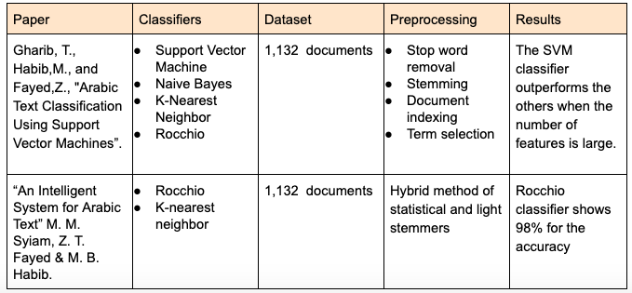
Related Work
Classification models performance comparison:

Slide 7
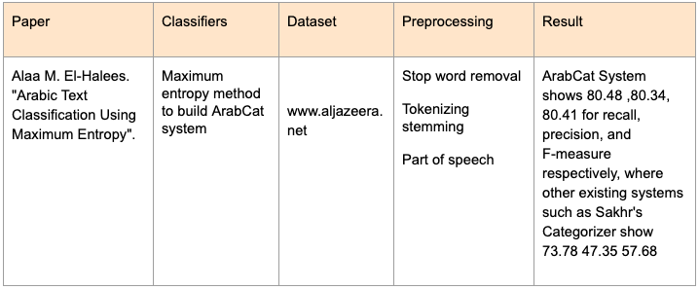
Related Work Cont.
Building new system, comparison with other existing systems

Slide 8
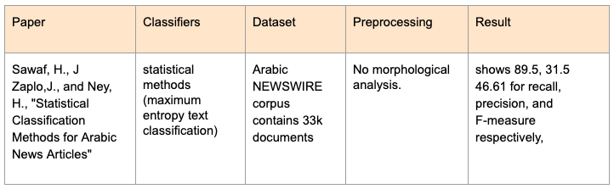
Related Work Cont.
Classification with no preprocessing

Slide 9

Dataset:

Slide 10
Dataset:
United Arab Emirates University “Scholarworks @ UAEU”.

Slide 11
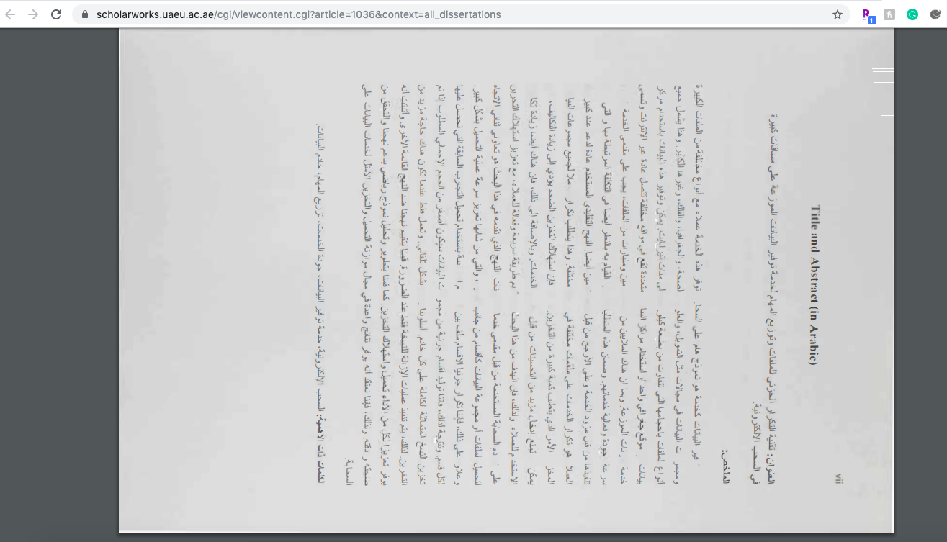
Dataset:
United Arab Emirates University “Scholarworks @ UAEU”.
Challenge:

Slide 12
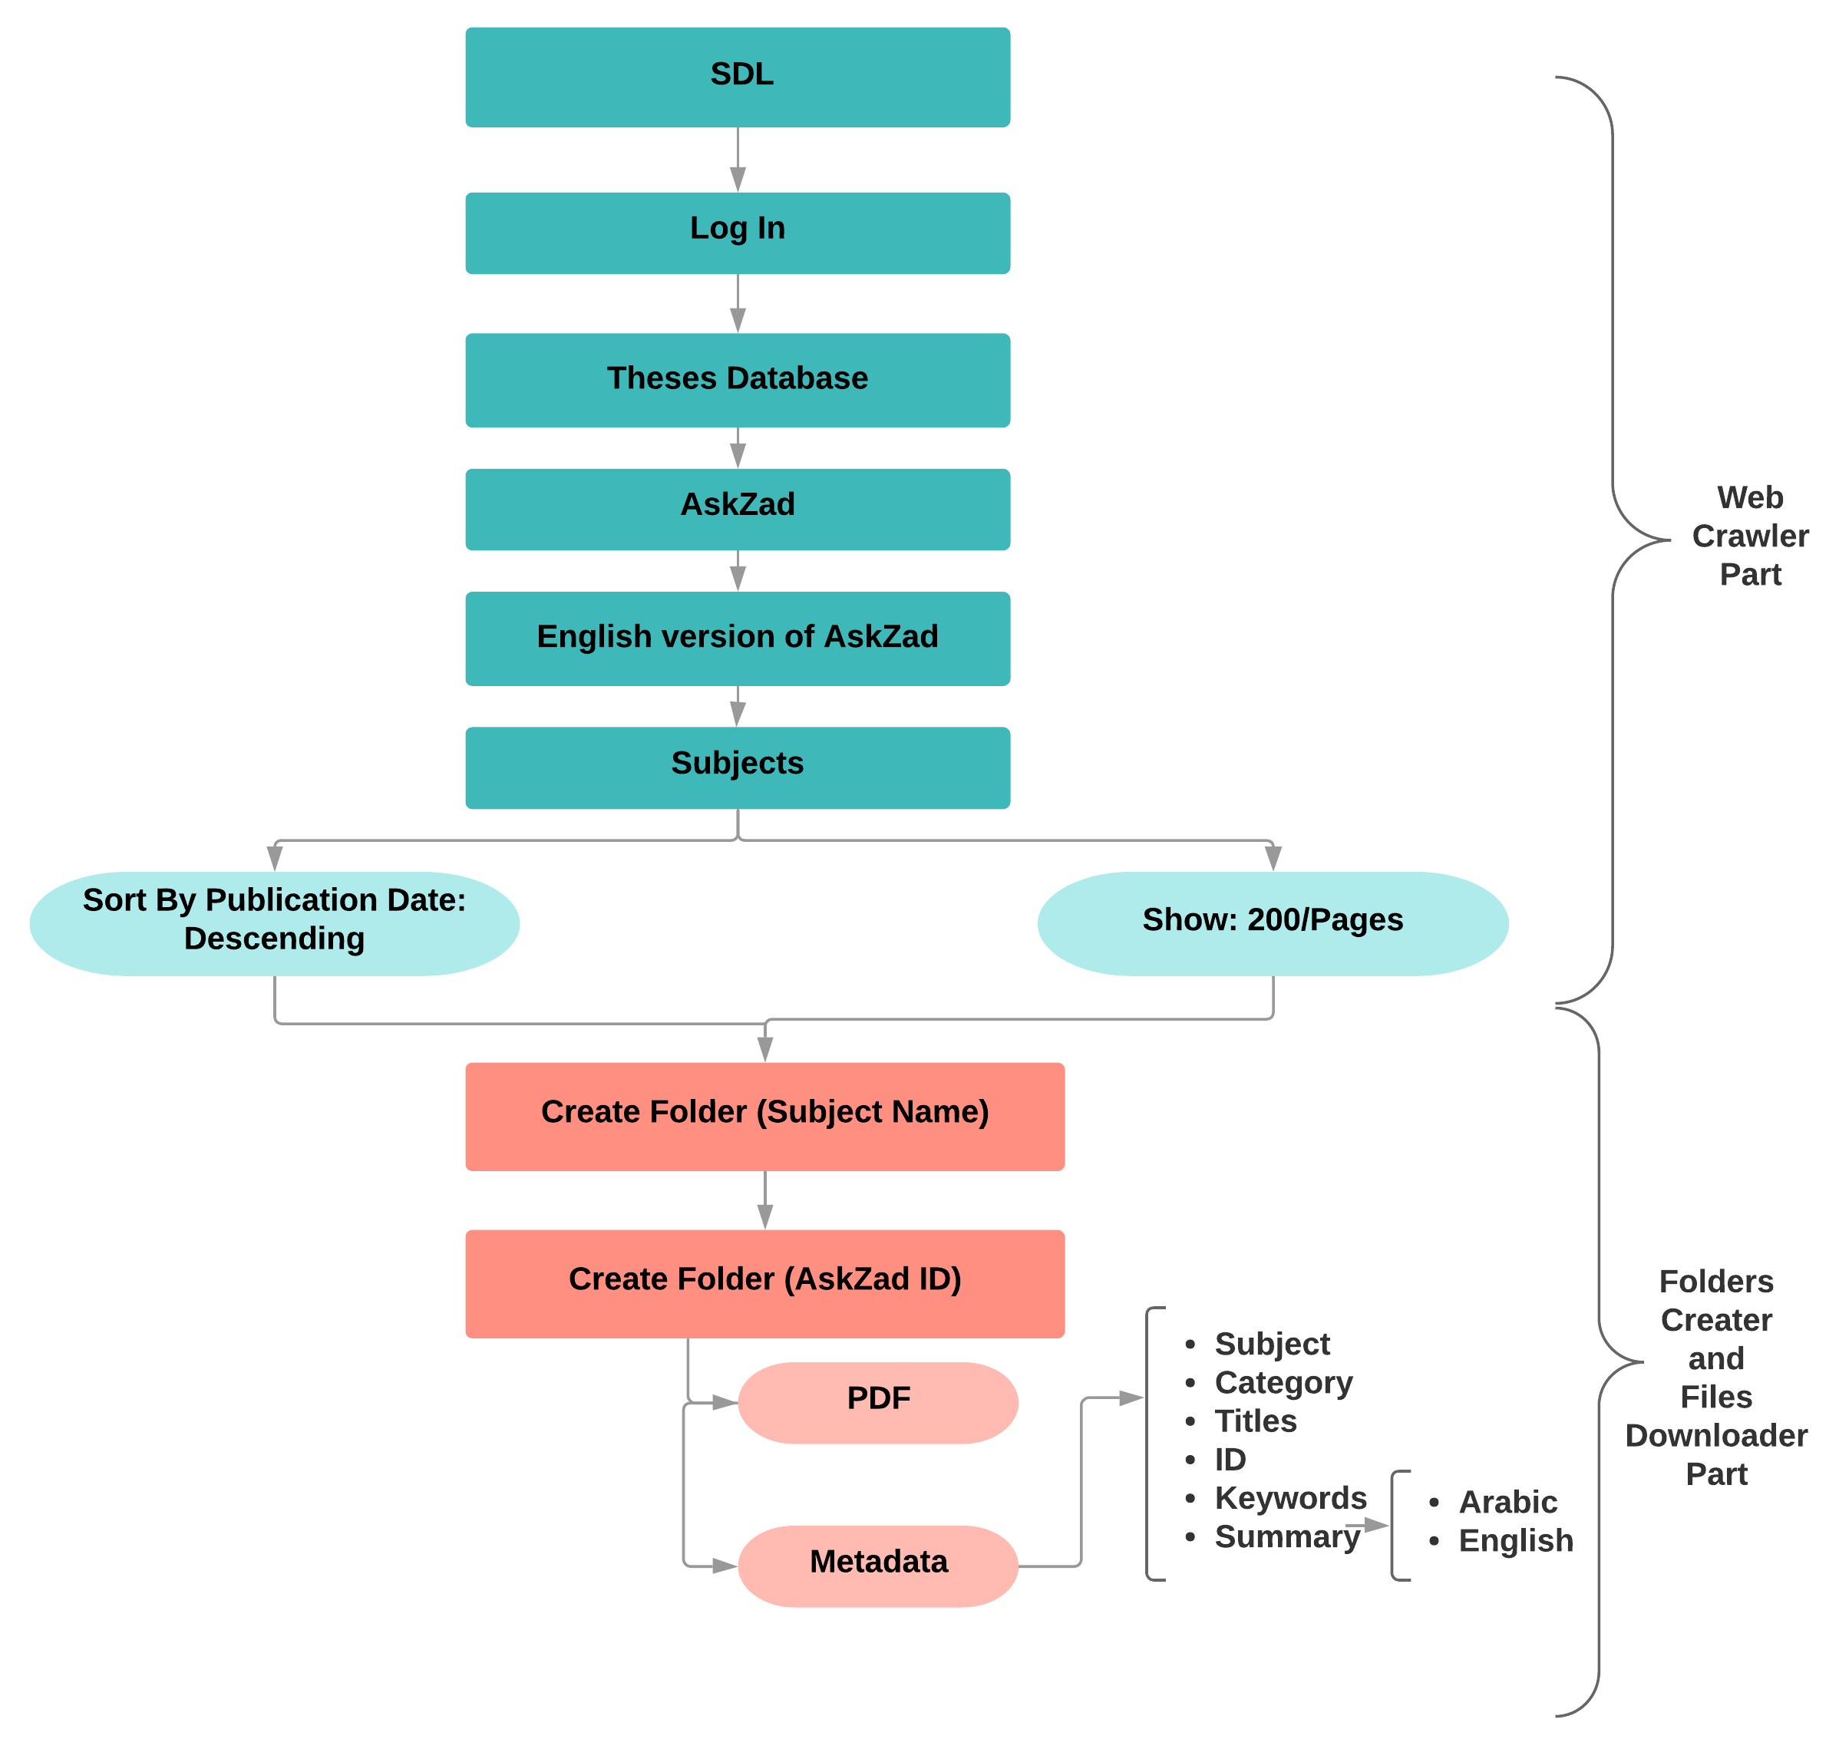
Dataset
Saudi Digital Library
  AskZad Library

Slide 13
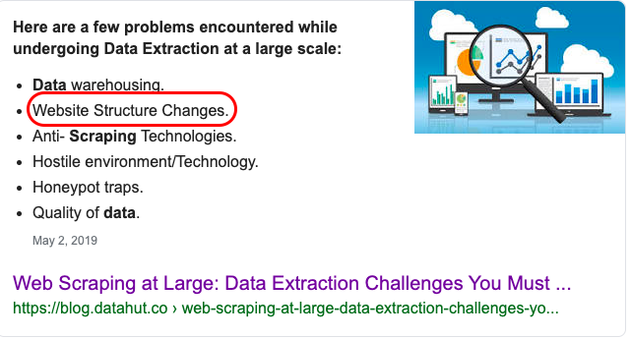
Dataset:
Saudi Digital Library
  AskZad Library
Challenge:

Slide 14
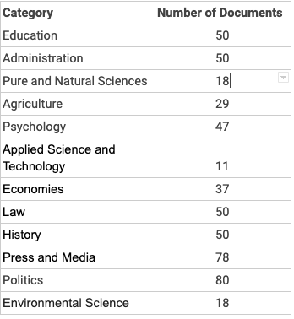
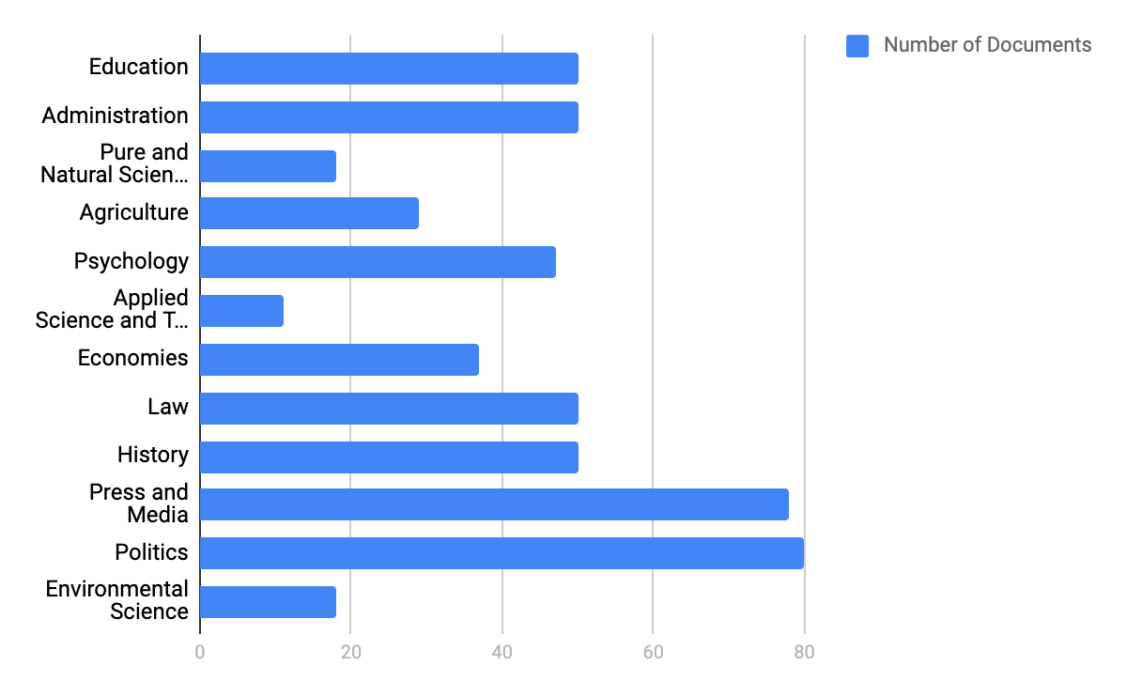
Dataset:
Saudi Digital Libraries
  AskZad Library
  12 categories
    Total 518 documents
    124,320 words

Slide 15
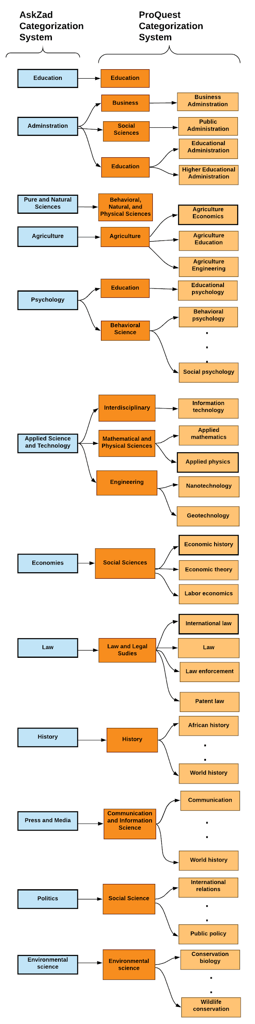
Categories:
Mapping to ProQuest categorization system

Slide 16
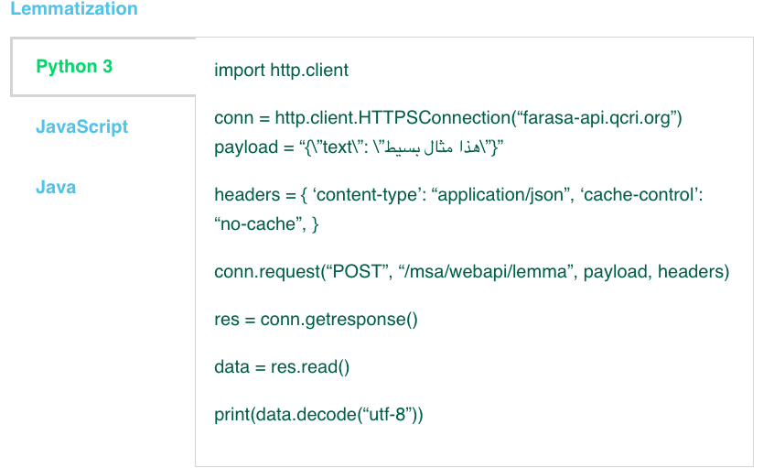
Preprocessing:
Stopwords removal
  NLTK
Lemmatization
  By Farasa API
Lemmatization works better than stemming for the
data mining and information retrieval, especially in Arabic as it is highly inflectional language.

Slide 17
Experiments and Preliminary Results
Multiclass classification performed poorly:
  Average Accuracy ~ 24%
Binary classification performed better:
  Average Accuracy ~ 68% per Category

Slide 18
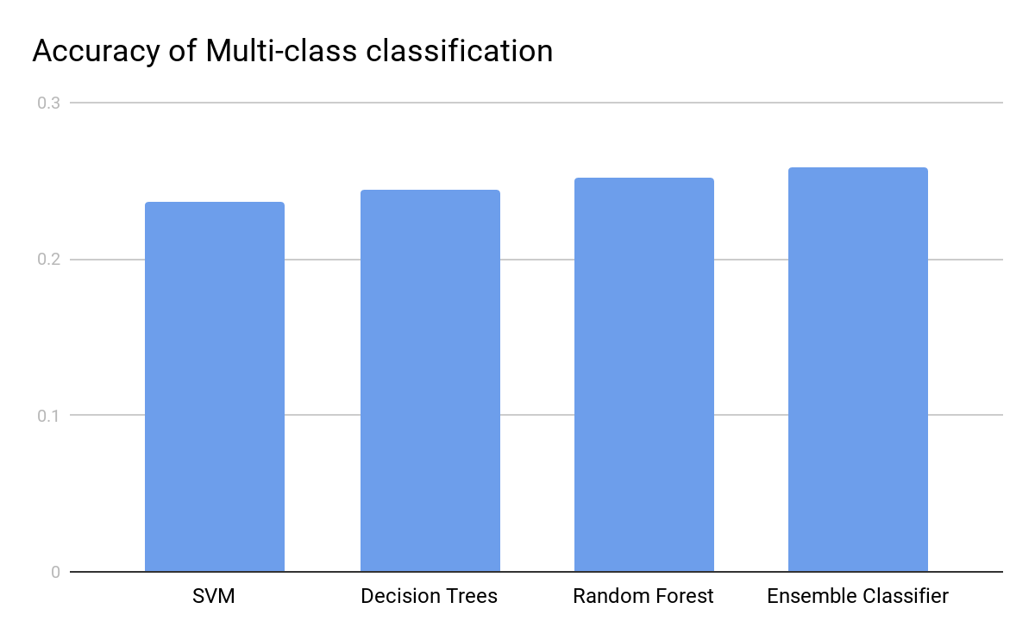
Experiments and Preliminary Results (Contd.):
Multi-class Classification:
Classifier | Accuracy
SVM | 0.237
Decision Trees | 0.244
Random Forest | 0.252
Ensemble Classifier | 0.259

Slide 19
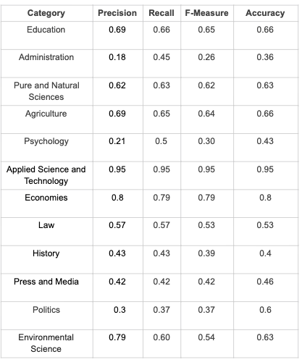
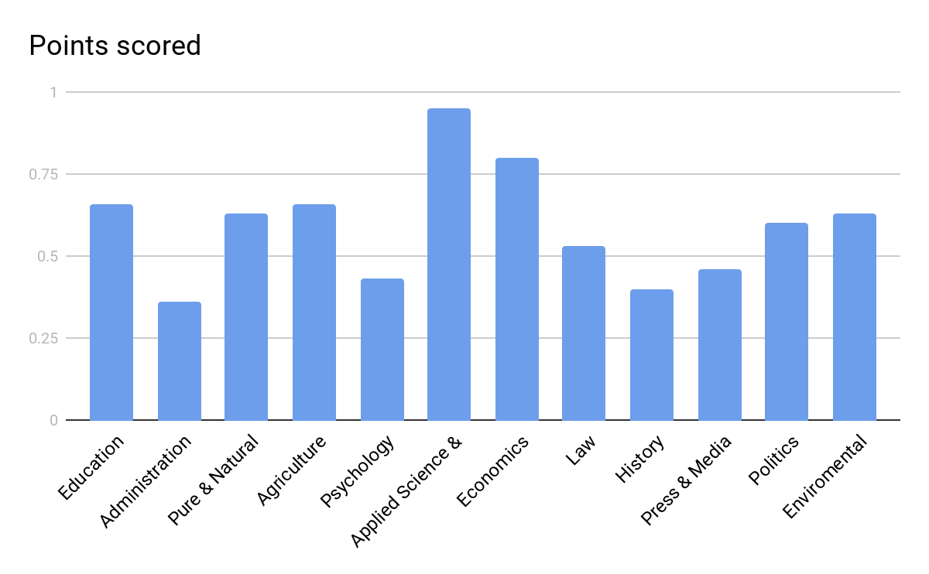
Experiments and Preliminary Results (Contd.):
Binary Classification:
  Random Forest

Slide 20
Experiments and Preliminary Results (Contd.):
Binary Classification:
  Random Forest

Slide 21
Experiments and Preliminary Results (Contd.):
Binary Classification:
  Random Forest

Slide 22
Insights and Future work
Investigate why there exists a big difference between accuracies for different categories in the Binary Classification.

Slide 23
Insights and Future work
Investigate why there exists a big difference between accuracies for different categories in the Binary Classification.
Investigate the low performance of the Multi-class Classification:
  Parameters tuning

Slide 24
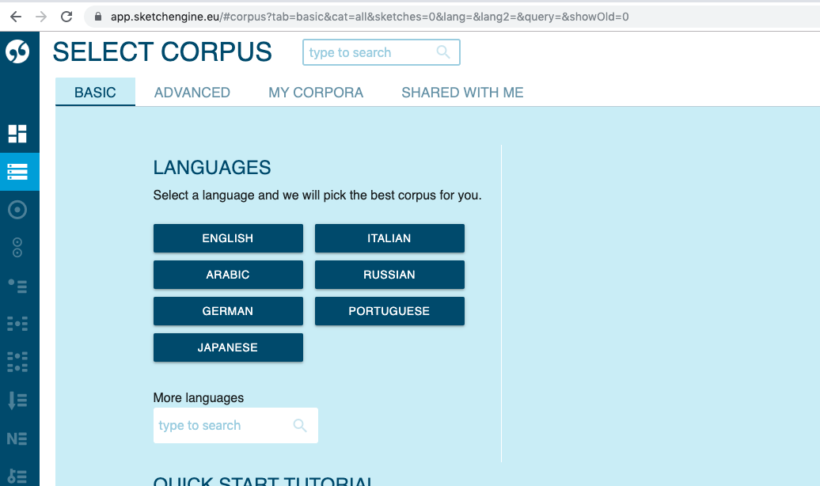
Insights and Future work
Investigate why there exists a big difference between accuracies for different categories in the Binary Classification.
Investigate the low performance of the Multi-class Classification:
  Parameters tuning
Increase the size of the corpus:
  Sketch Engine

Slide 25
Insights and Future work
Investigate why there exists a big difference between accuracies for different categories in the Binary Classification.
Investigate the low performance of the Multi-class Classification:
  Parameters tuning
Increase the size of the corpus .
  Sketch Engine
Run each classifier against both Arabic and English abstracts separately.
Use word embeddings.

Slide 26
Questions

