Slide 1
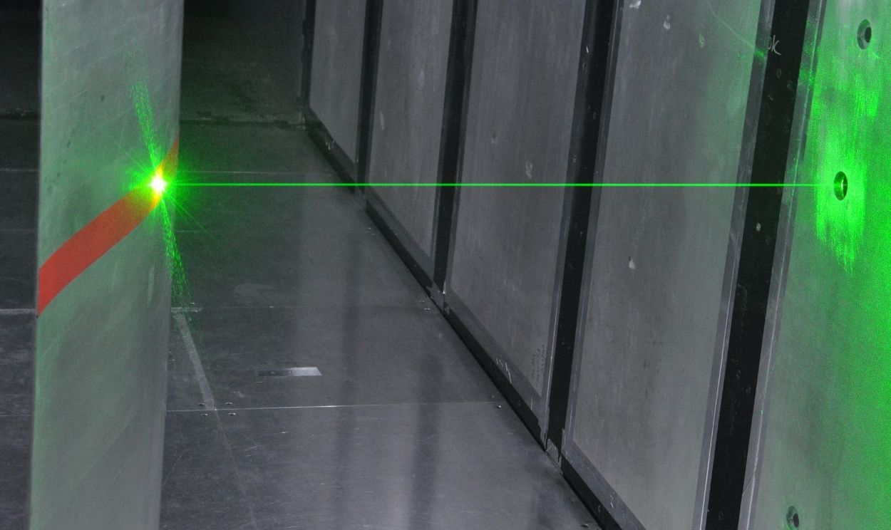
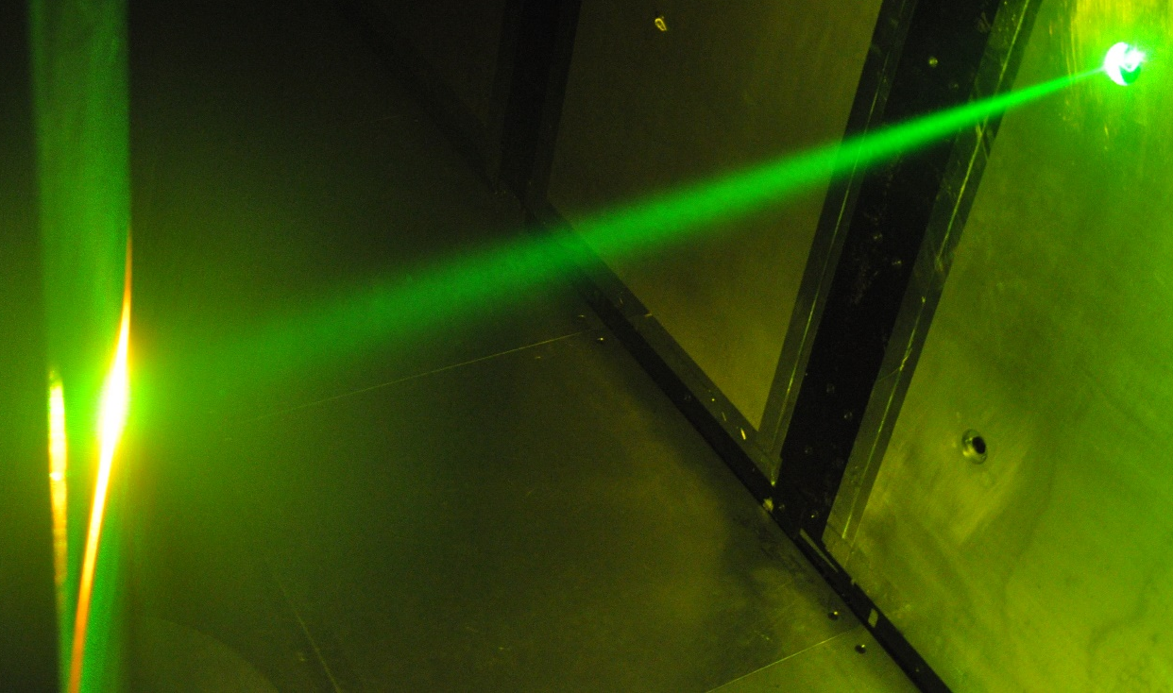

Flare Reduction Technique for Near-Surface Airfoil Boundary Layer Measurements with Laser Diagnostics
Dongyun Shin
Daniel R. Cadel
K. Todd Lowe

Slide 2
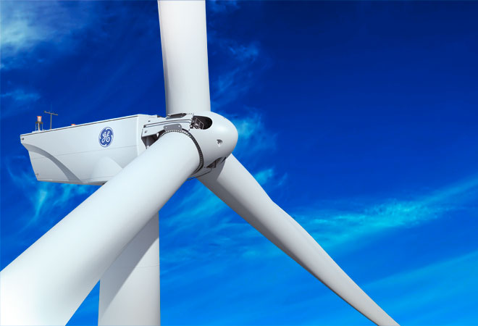
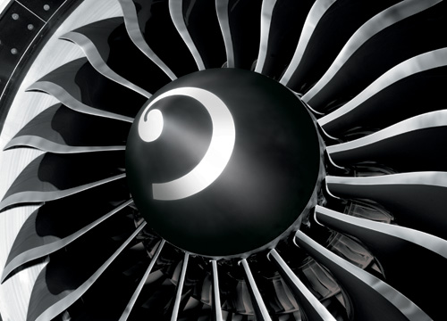
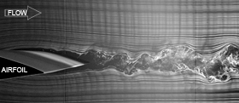
About project
GE Power & Water
Near-wall measurement can lead to more accurate models and design tools for new blade design
http://www.windpowermonthly.com/
http://www.gereports.com/
Boundary layer measurement is difficult but it is valuable
Minimum drag
Higher efficiency
Better performance

Slide 3
Outline
External Illumination background
Literature review
Surface treatment development
Transparent laminate model
PIV results
Summary
Future task

Slide 4
External Illumination background
Objective : To minimize the laser flare from the surface
Laser Flare
Light scattered/reflected off the solid surface of the airfoil saturates corresponding pixels on the camera sensor, as well as surrounding pixels in the boundary layer
Methods
scatter
Fluorescent coating
absorption
Absorb incident light
Specular reflection
Transparent airfoil
transmission
Transmit incident light

Slide 5
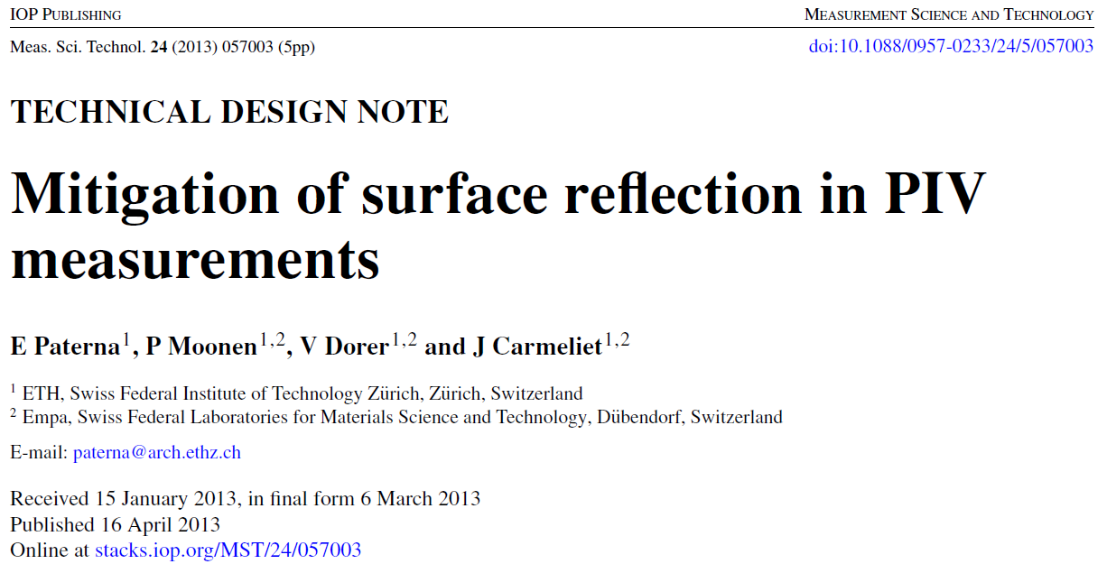
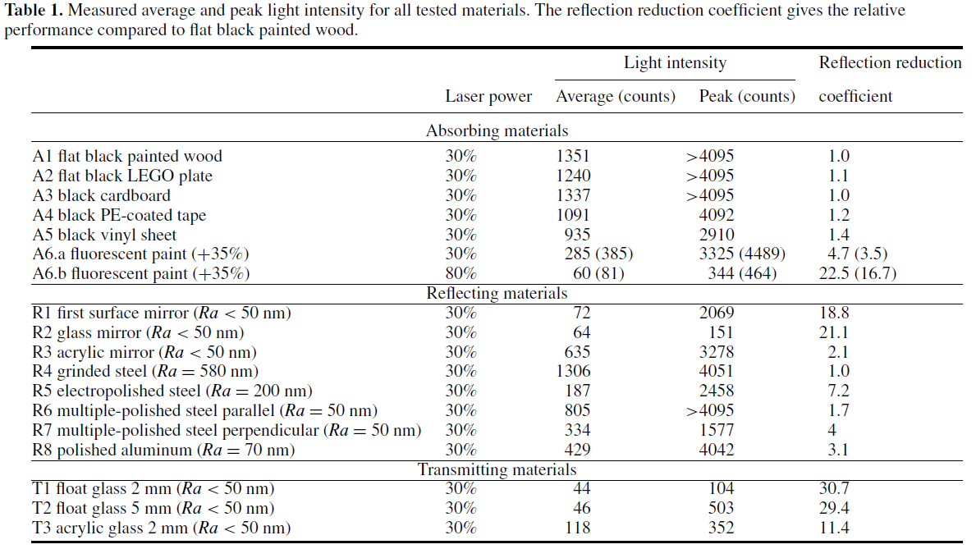
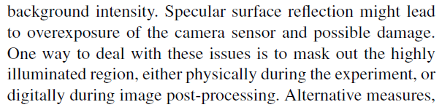
Literature review

Slide 6
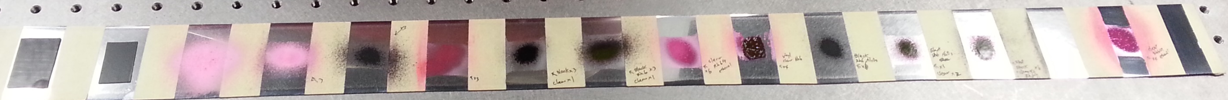
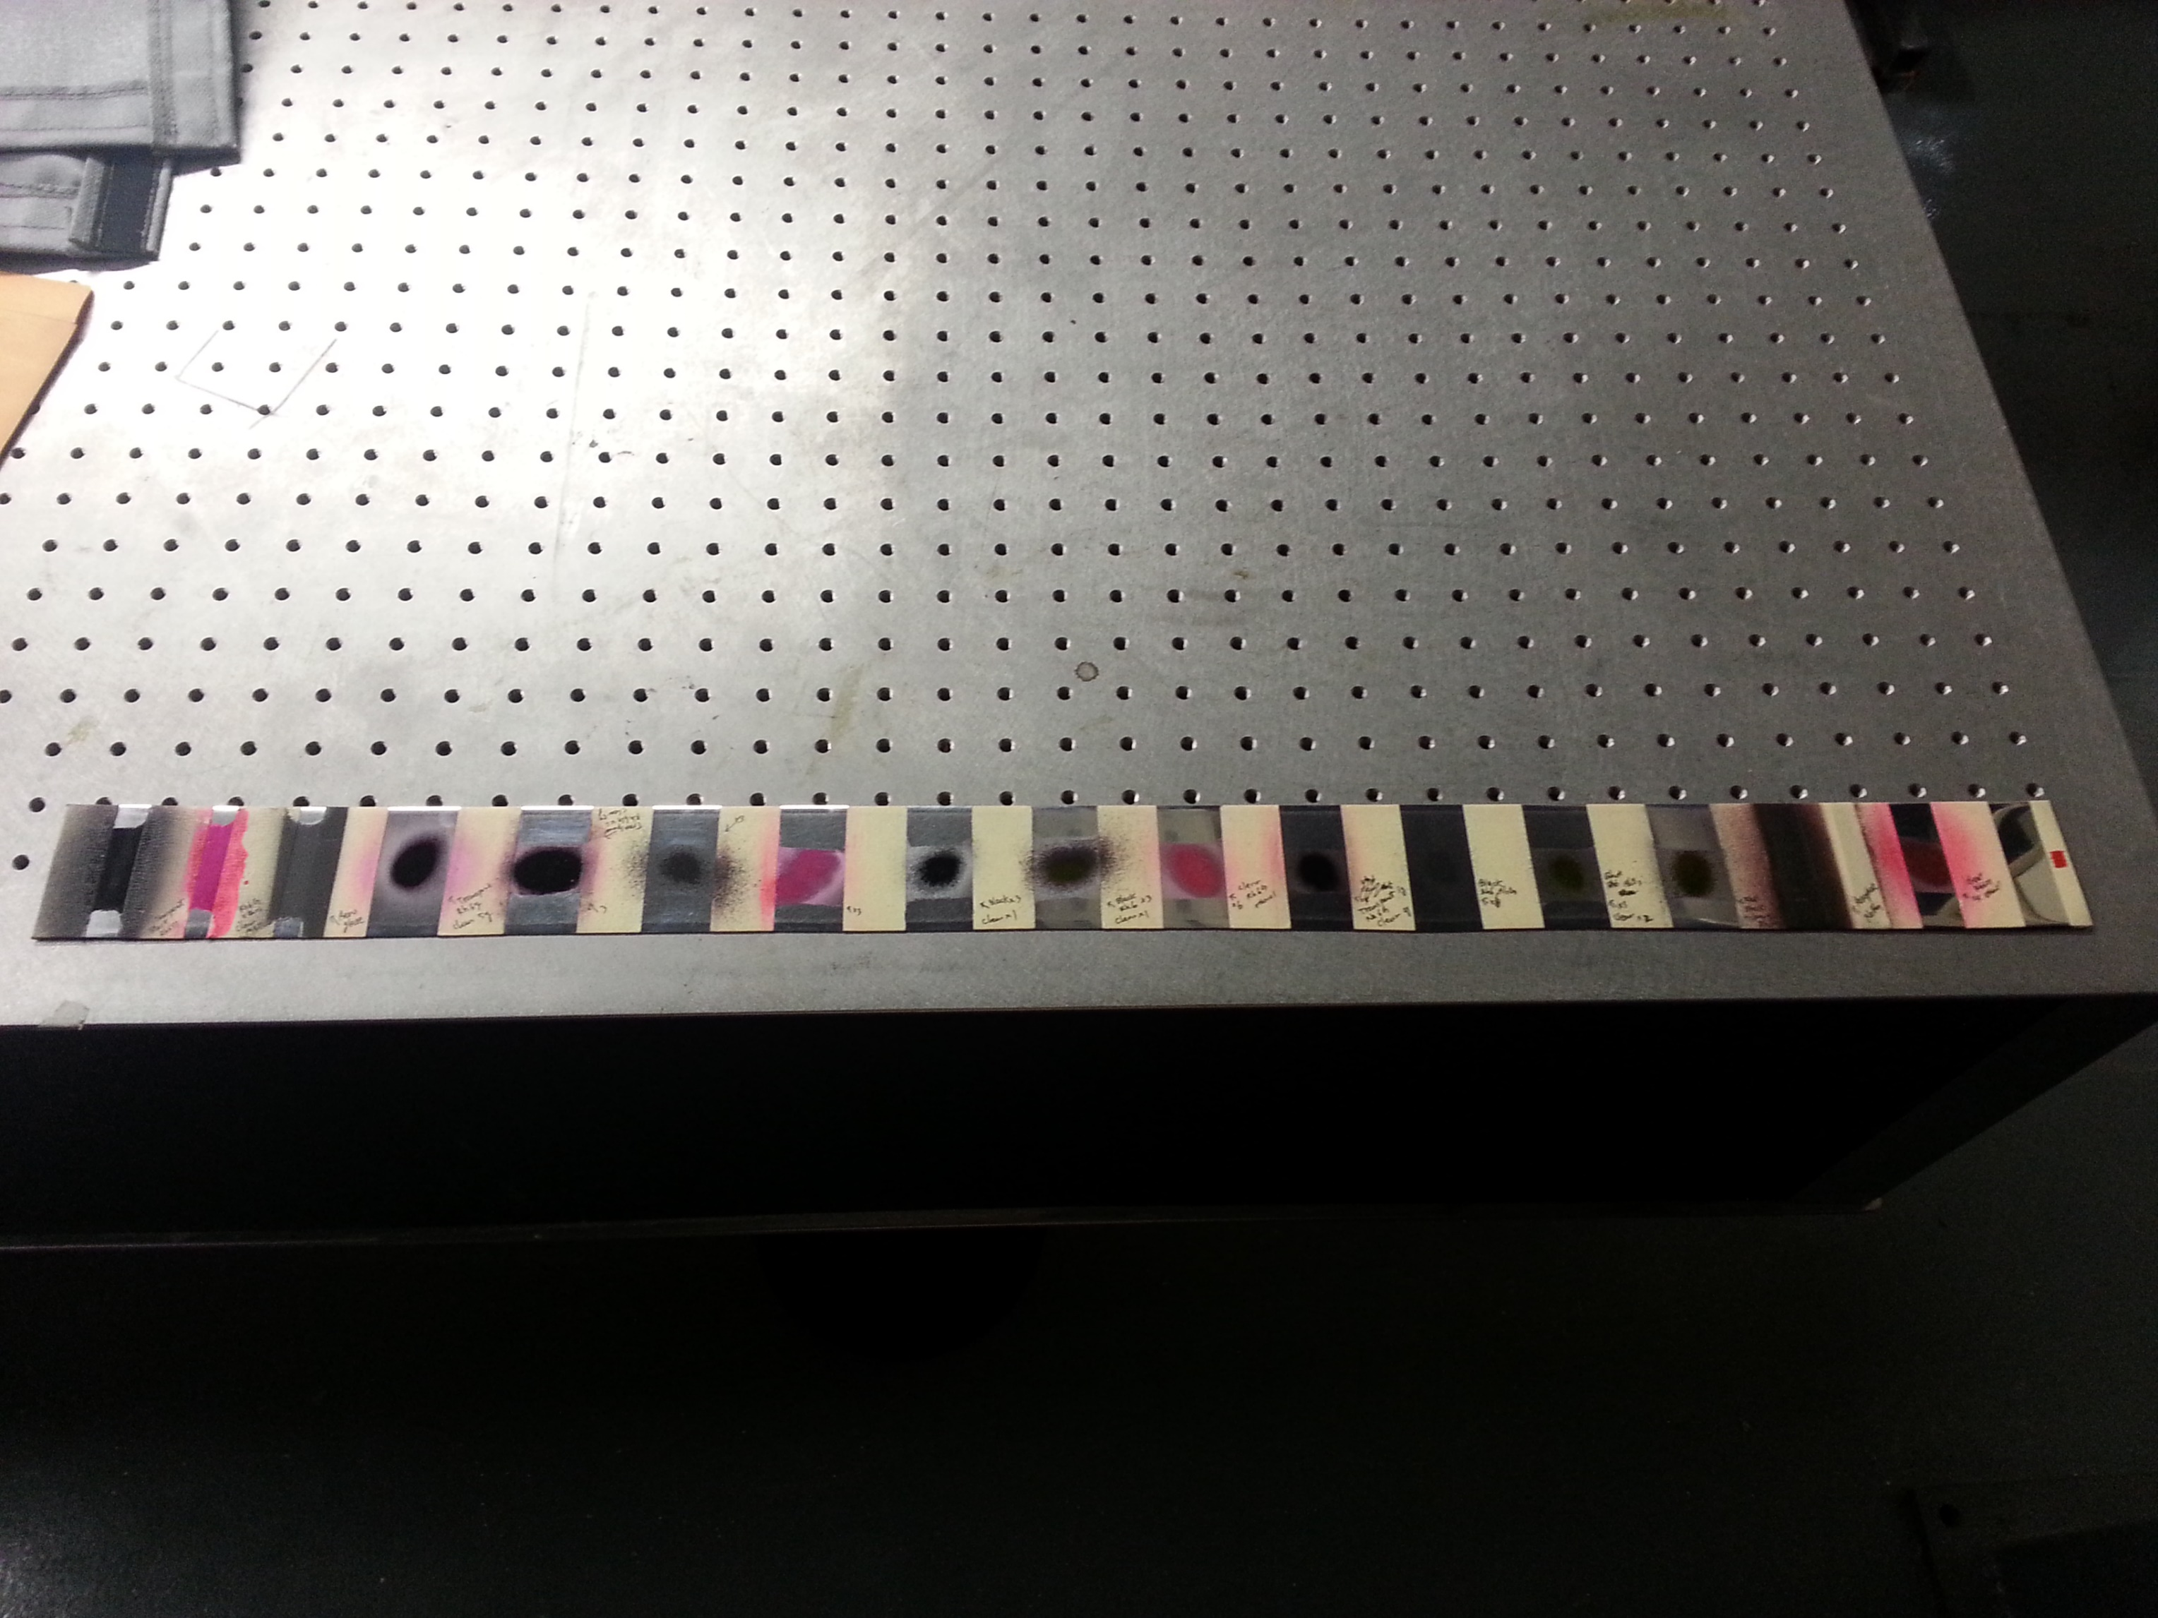
Absorption: Fluorescent Paint
1
2
3
4
5
6
7
8
9
10
11
12
13
14
Silicone
Flat White paint + Rh6G + Al2O3+ ethanol
Flat Black paint + clear paint (x1)
Clear paint + Rh6G + ethanol (6 coat)
Mirror finish
15
16
17
18
19
20
Aeroglaze z306
Transparent Black paint + Rh6G + ethanol + clear paint

Slide 7
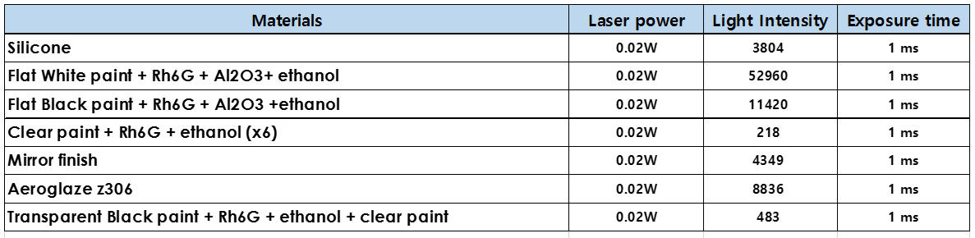
Light intensity results
Note that the dark offset is 100 counts

Slide 8
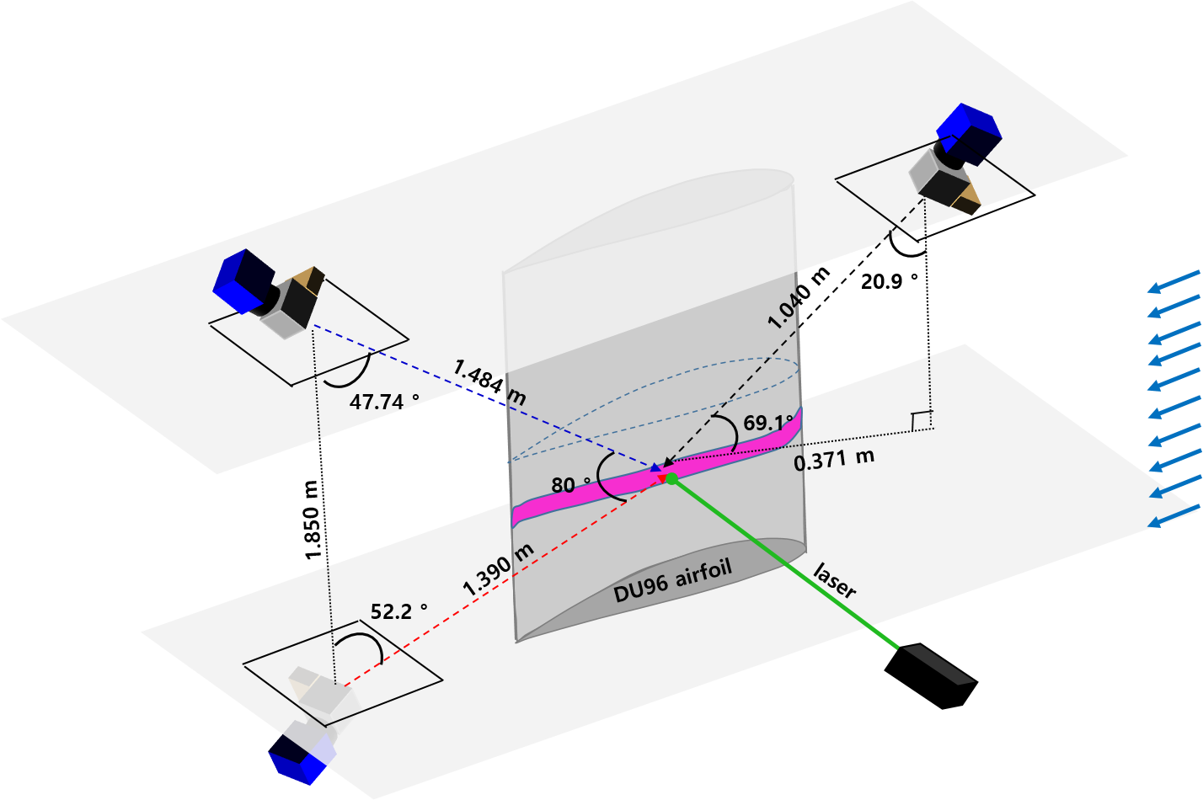
Stability Wind Tunnel Configuration (SWT)
Tested in SWT with Doppler Global Velocimetry
Fluorescent paint mixed and airbrushed onto metal laminate immediately prior to test run
Reynolds number
1.5M
2M
3M
Laser power : 6 W
Exposure time : 2 s
AoA : -15 deg
DU96 airfoil model
Cam 2
Cam 1
Cam 3

Slide 9
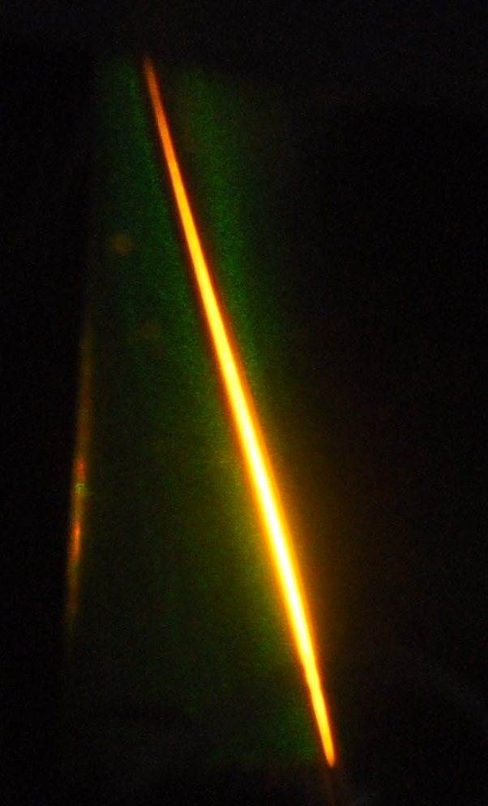
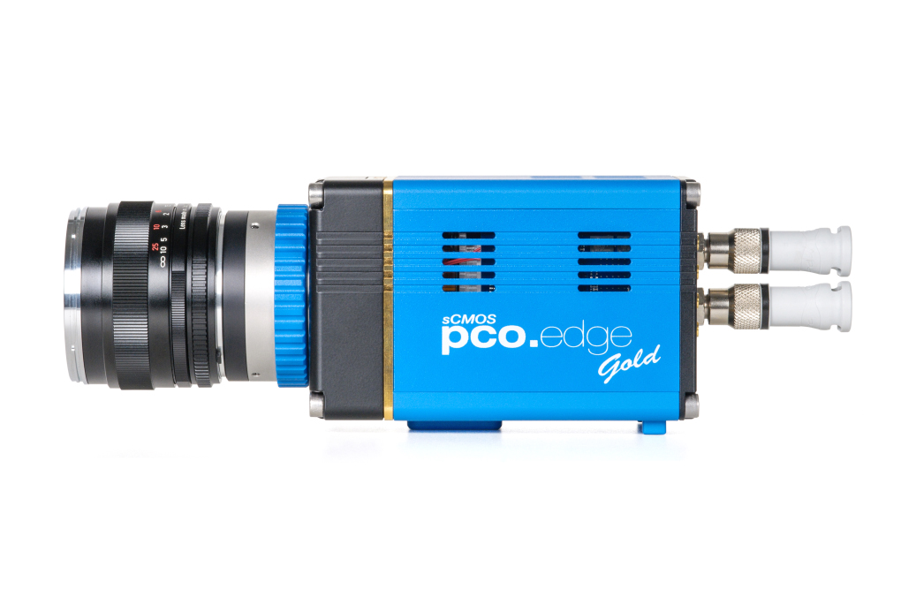
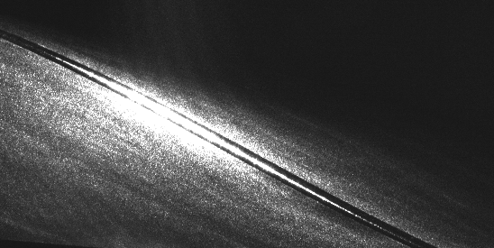
Measurement in SWT (Doppler Global Velocimetry)
Laser
532nm
Frequency to Intensity
532nm filter
camera
532nm
Iodine cell
570nm
(For DGV measurement)
Treated surface
Computer
Data acquisition
Raw image

Slide 10
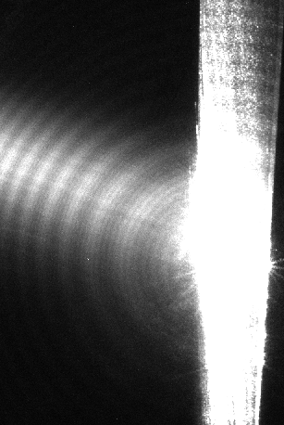
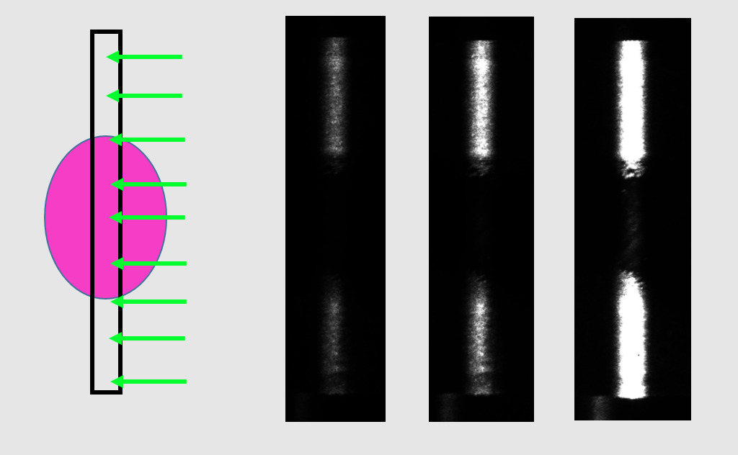
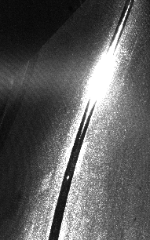
Assessments
Lab development
Stability Wind Tunnel measurements
Laser
Untreated region
Paint
Treated region
Cam1
Cam3
Aluminum plate
Flare appeared several millimeters above surface.
Indicated need for
grazing view angles

Slide 11
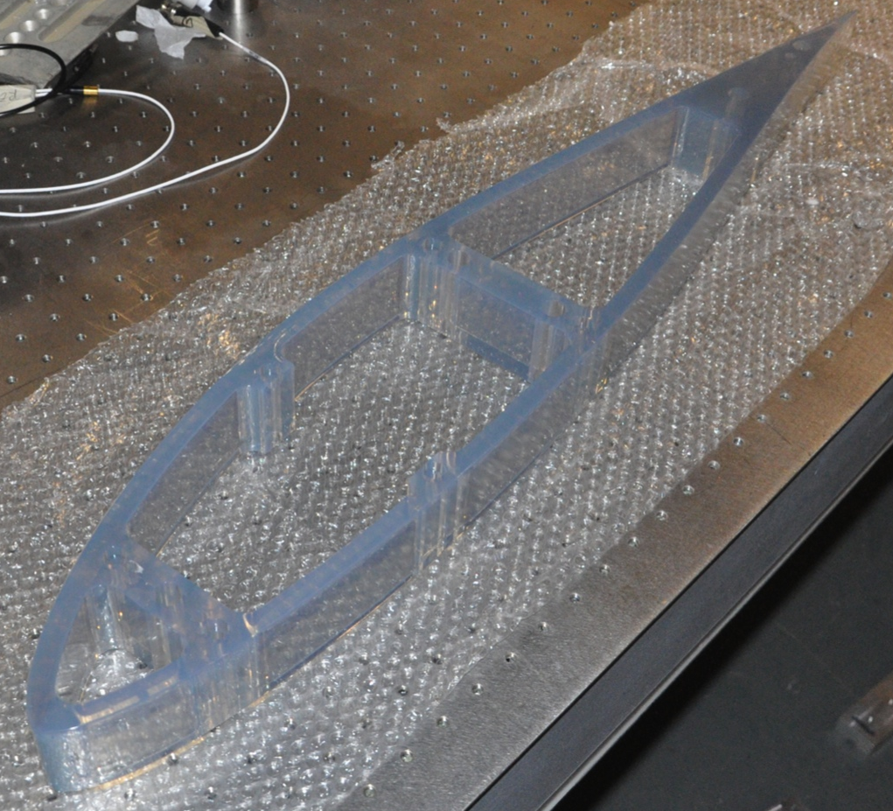
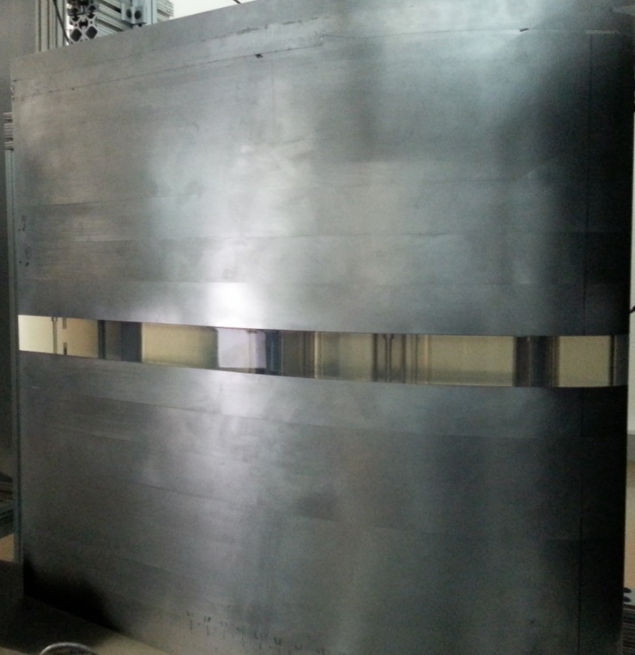
Transmission: Transparent laminate
3D printed airfoil segment, transparent plastic material (Acura 60)
DU 96 airfoil model with transparent segment
Test in Open Jet Wind Tunnel has been done before SWT test

Slide 12
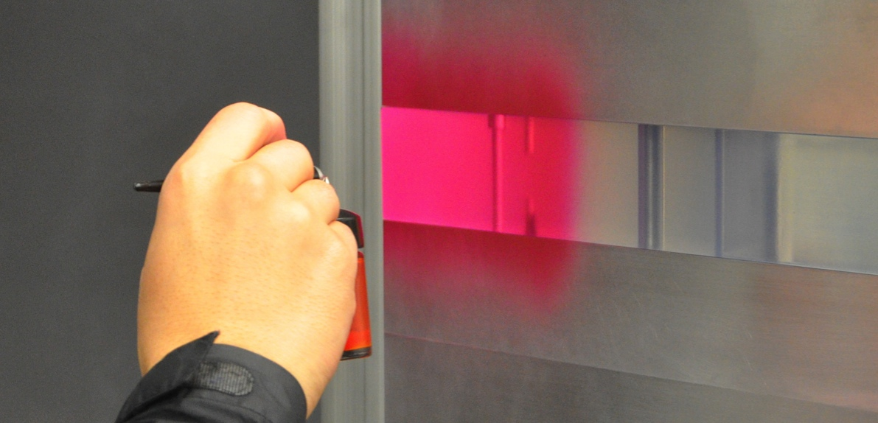
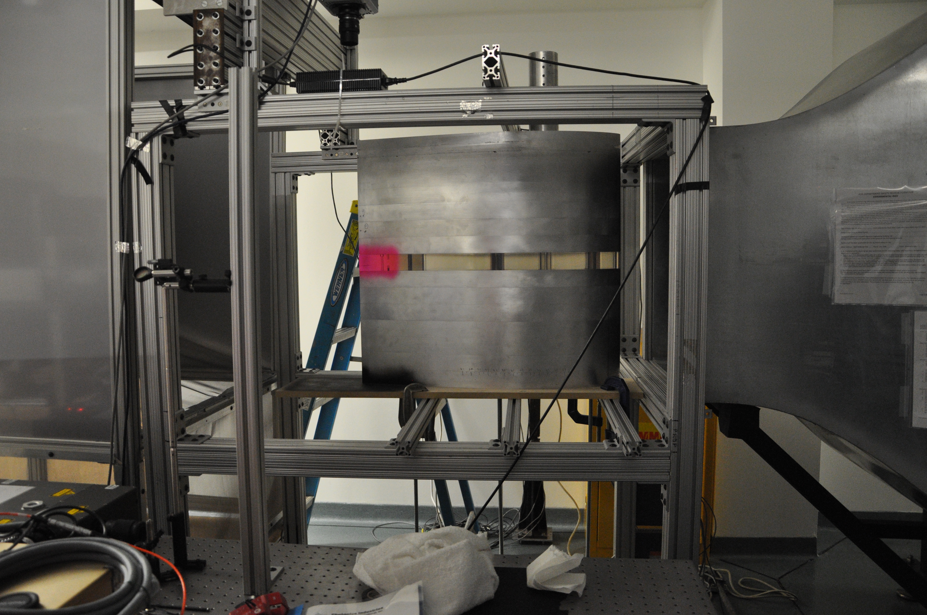
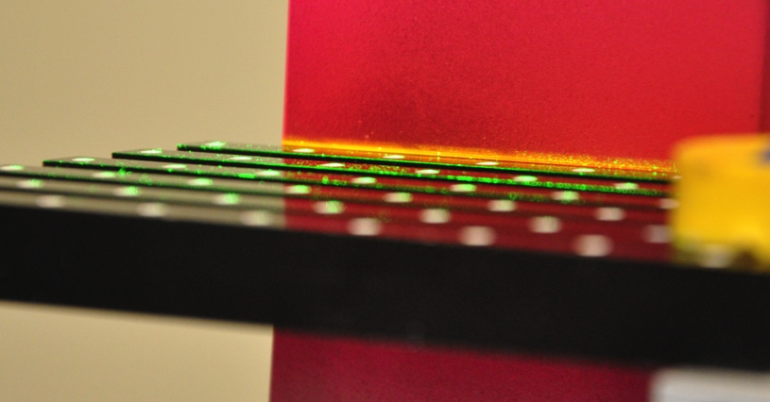
Final Design
Open Jet Wind Tunnel (blower type)
- 0.7m x 0.7m exit area
- Powered by 30hp BC-SW Size 365 Twin City centrifugal fan
- Maximum fan speed of 1180 RPM – flow exits the 5.5:1 contraction at 30m/s
Camera calibration procedure using a LaVision type 31 dual-plane calibration plate.
Application of the Rh6G-based fluorescent paint to the trailing edge of the transparent laminate using a standard airbrush. Paint was applied in situ

Slide 13
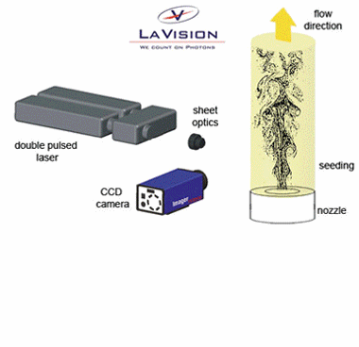
Particle Image Velocimetry (PIV)
- Acquires consecutive images of the flow
- Spatially cross-correlation to determine pixel shift of particles
- Output velocity field with vectors
http://www.lavision.de/en/techniques/piv.php

Slide 14
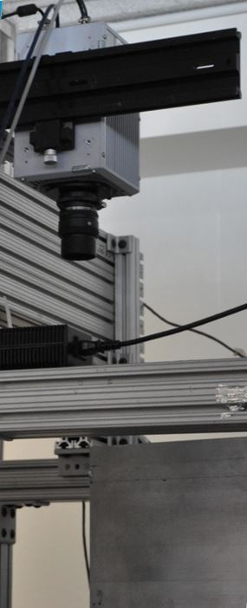
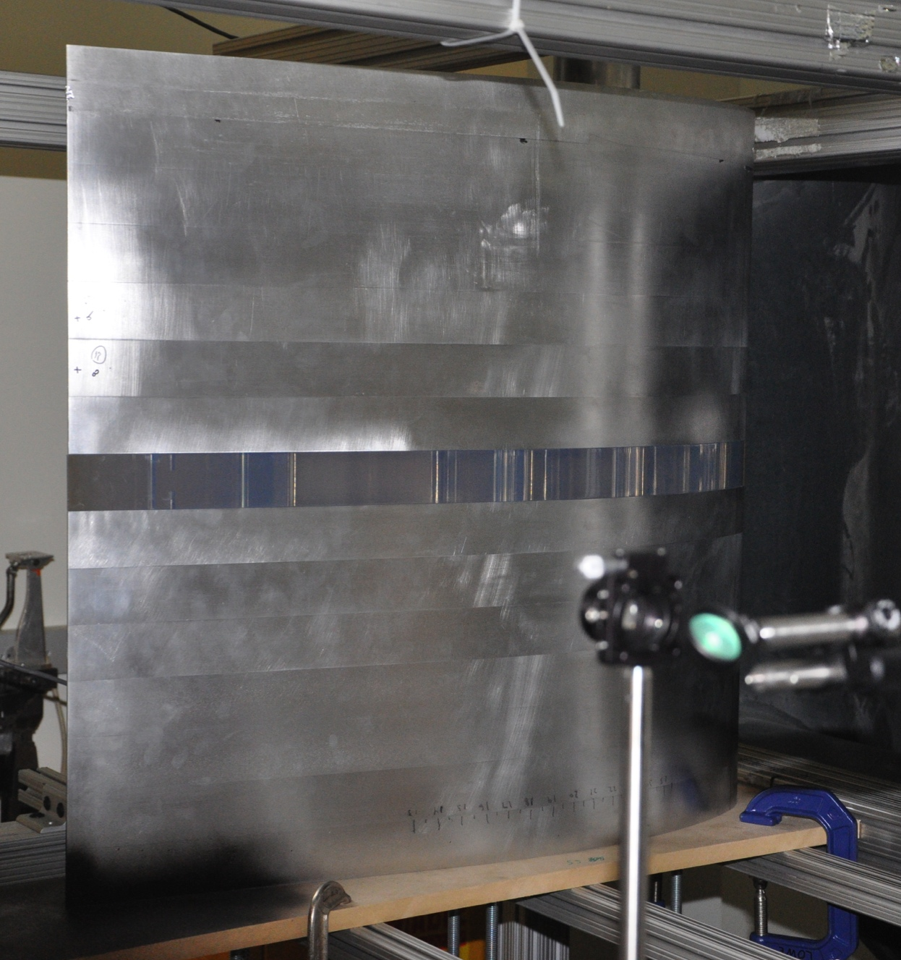
PIV experiment set up
camera
Grazing angle
90 degrees of angle between the camera lens and the plane of the airfoil surface
Transparent segment
U∞
camera
z
Laser pulse
Mirror
x
90°
airfoil
Cylindrical lens
Airfoil surface
C-Clamps
Laser
z
The Photron SA-4 Fastcam is located at a grazing angle directly above the trailing edge of the airfoil
y
x
14

Slide 15
Data processing
5000 images were acquired at a rate of 5 kHz.
Sequential planar PIV processing was performed using a multi-pass interrogation window of 32x32 pixels (first pass) and 24x24 pixels (second pass).
The test matrix of airfoil material and surface treatment combinations
AoA | Re | PIV Type | Laser Current | Laminate | Surface Treatment
0° | 887,000 | Sequential | 39 A | Aluminum | None
0° | 887,000 | Sequential | 39 A | Aluminum | Rh6G paint
0° | 887,000 | Sequential | 39 A | Transparent | None
0° | 887,000 | Sequential | 39 A | Transparent | Rh6G paint

Slide 16
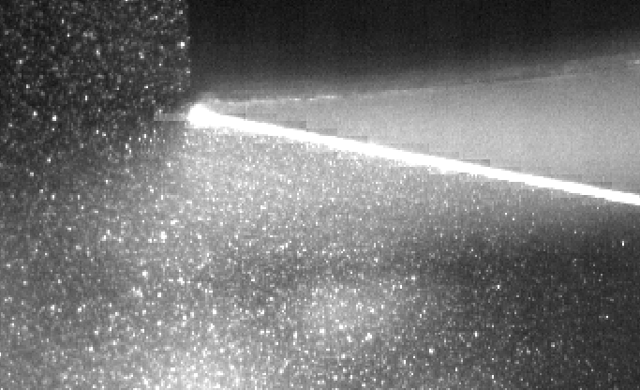
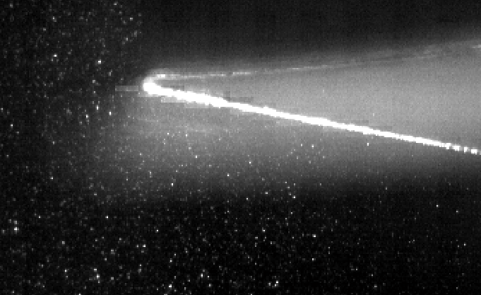
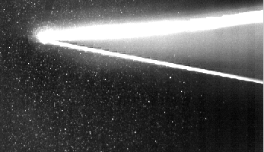
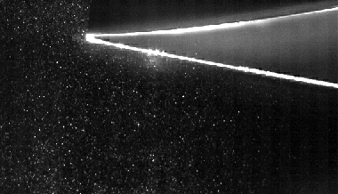
Raw images
Untreated metal laminate
Treated metal laminate
Untreated transparent laminate
Treated transparent laminate

Slide 17
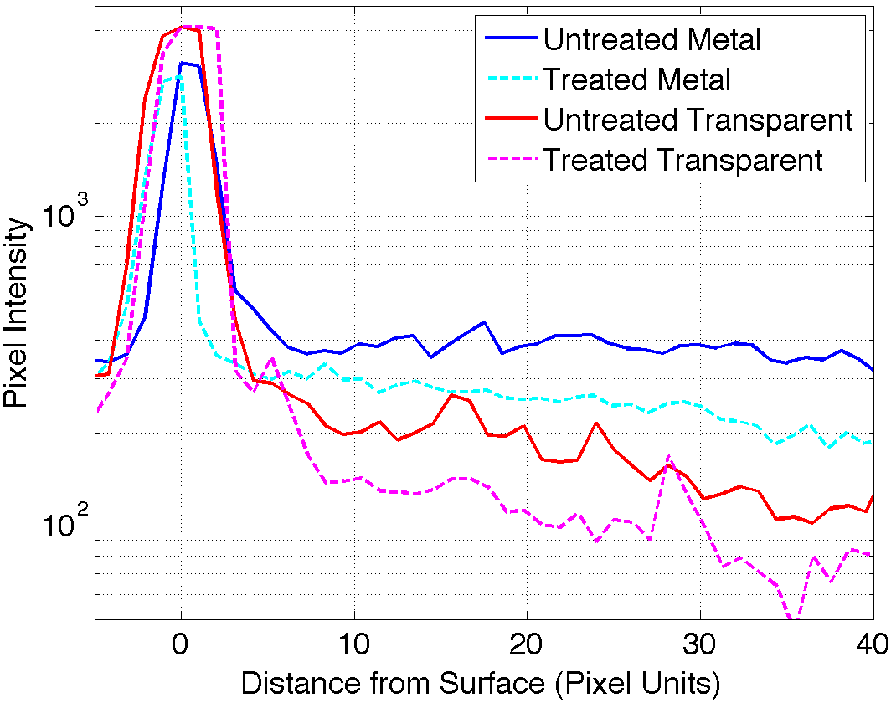
Raw Image Intensity Profiles
12-bit sensor of the Photron camera
4096 counts for saturation
Treated transparent laminate
Rh6G treated transparent laminate provides the best near-wall measurement

Slide 18
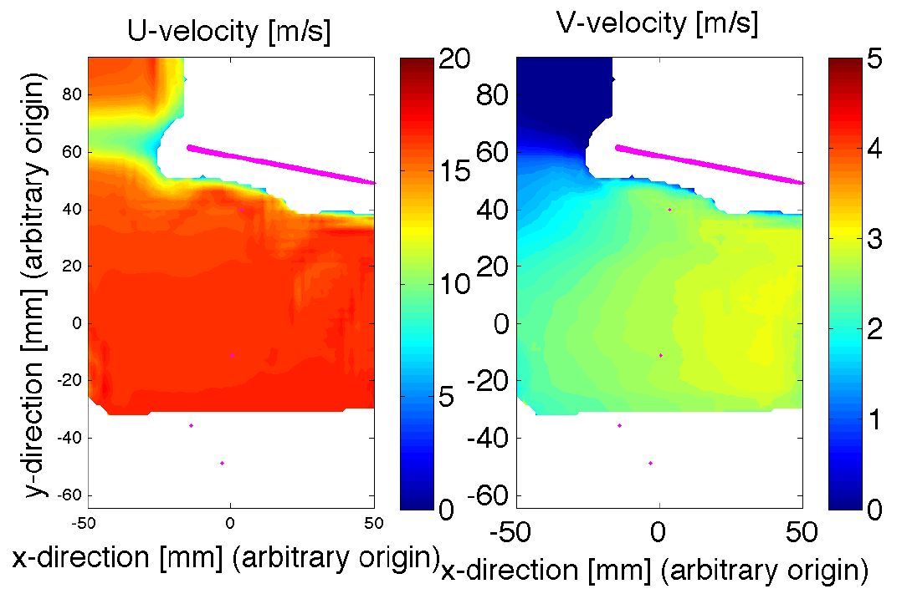
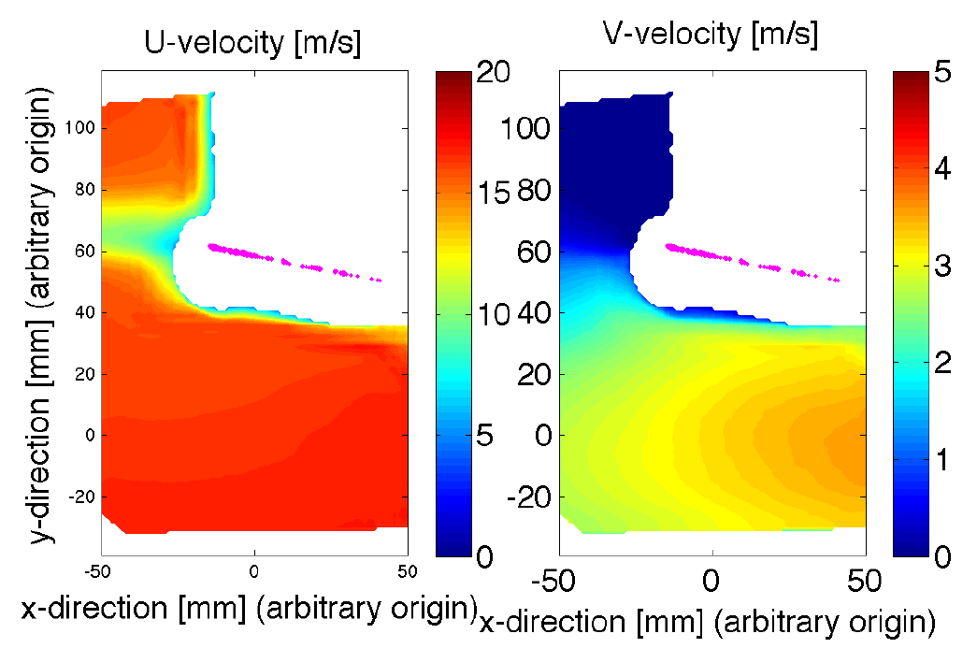
PIV results
Untreated metal laminate
Treated metal laminate
White regions → no valid data
Cross correlation algorithm
Validate a zero velocity when interferences exist
Low flow velocity near the surface
Masking out the flared pixels

Slide 19
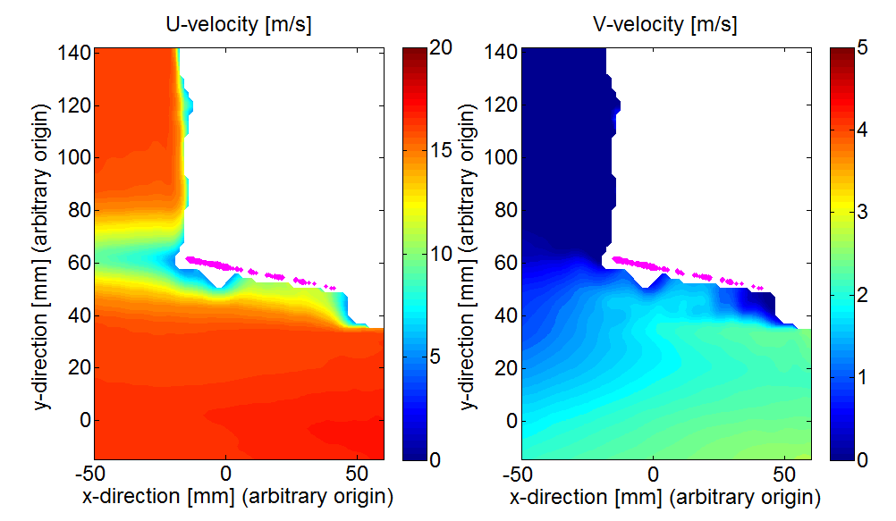
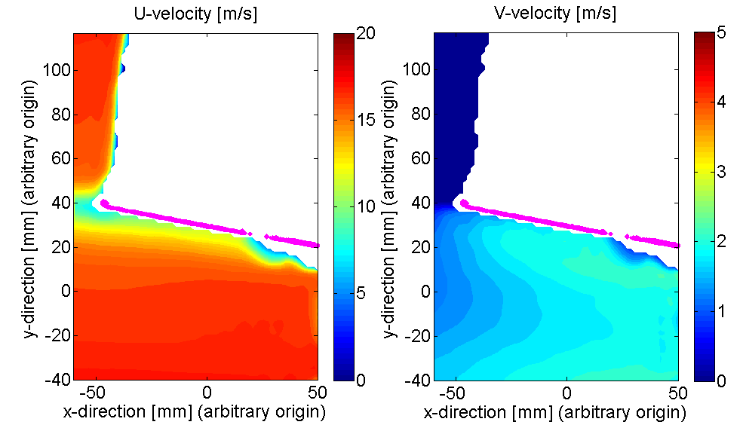
Velocity contour
Treated metal laminate
Treated transparent laminate
Masking-out applied
- Only 500 images were used for processing at 5kHz.
- Burning was observed as the paint heated up. Flare expanded over time.

Slide 20
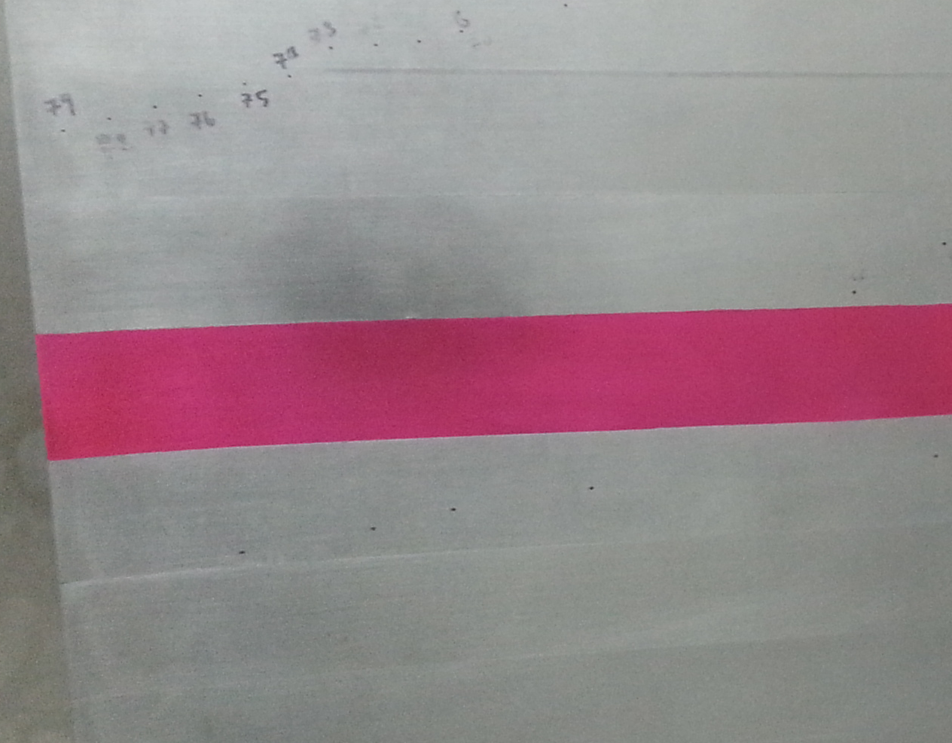
Summary
Key lessons from development
Rhodamine 6G paint mixture provides best fluorescence performance
Grazing angle configuration should always be used when feasible
Masking step during processing removes bias errors from flare
For perfect grazing angles:
Treated Transparent > Untreated Transparent > Treated Metal > Untreated Metal
For realistic camera angles (not perfect grazing angles):
Treated Transparent > Treated Metal > Untreated Transparent > Untreated Metal
Airfoil TE
Treated Metal
Treated transparent
Grazing angle view
Future Task
Scale-up to Stability Wind Tunnel
Need to measure the surface roughness of the paint

Slide 21
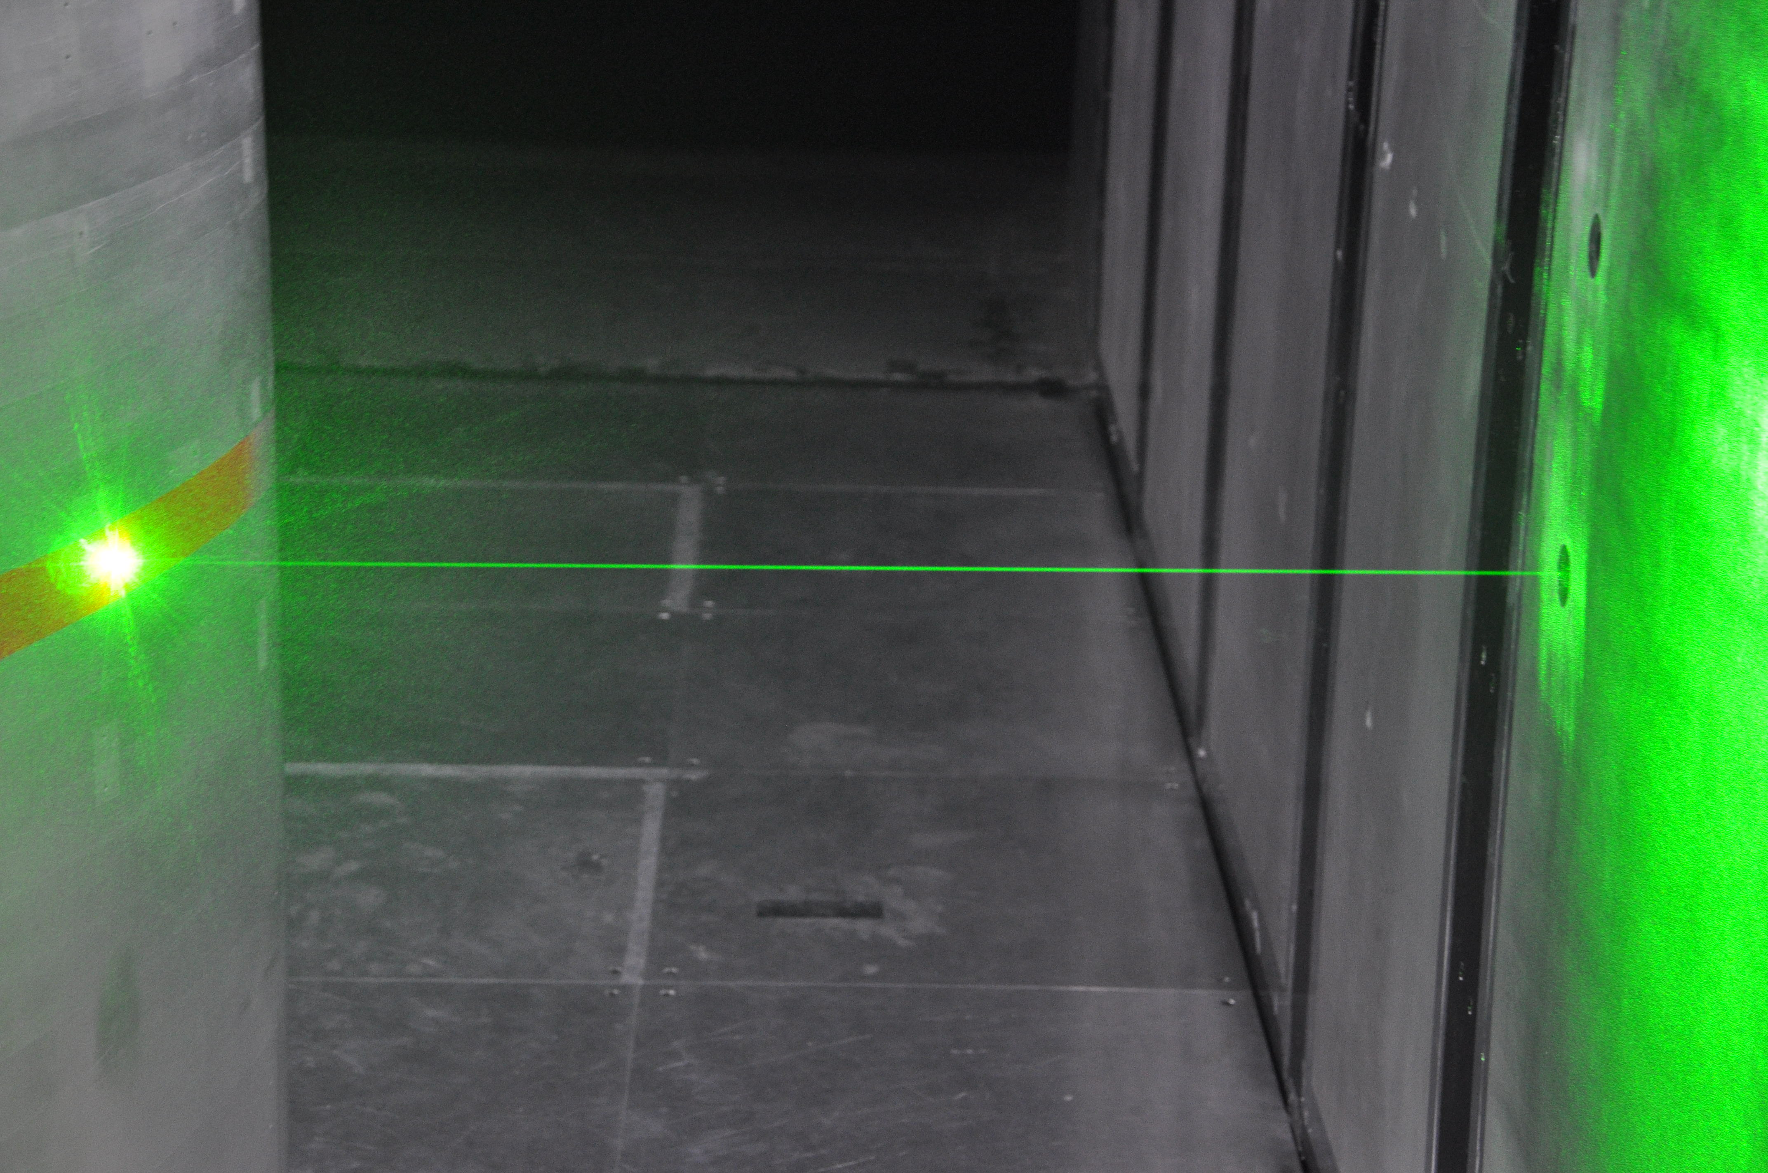
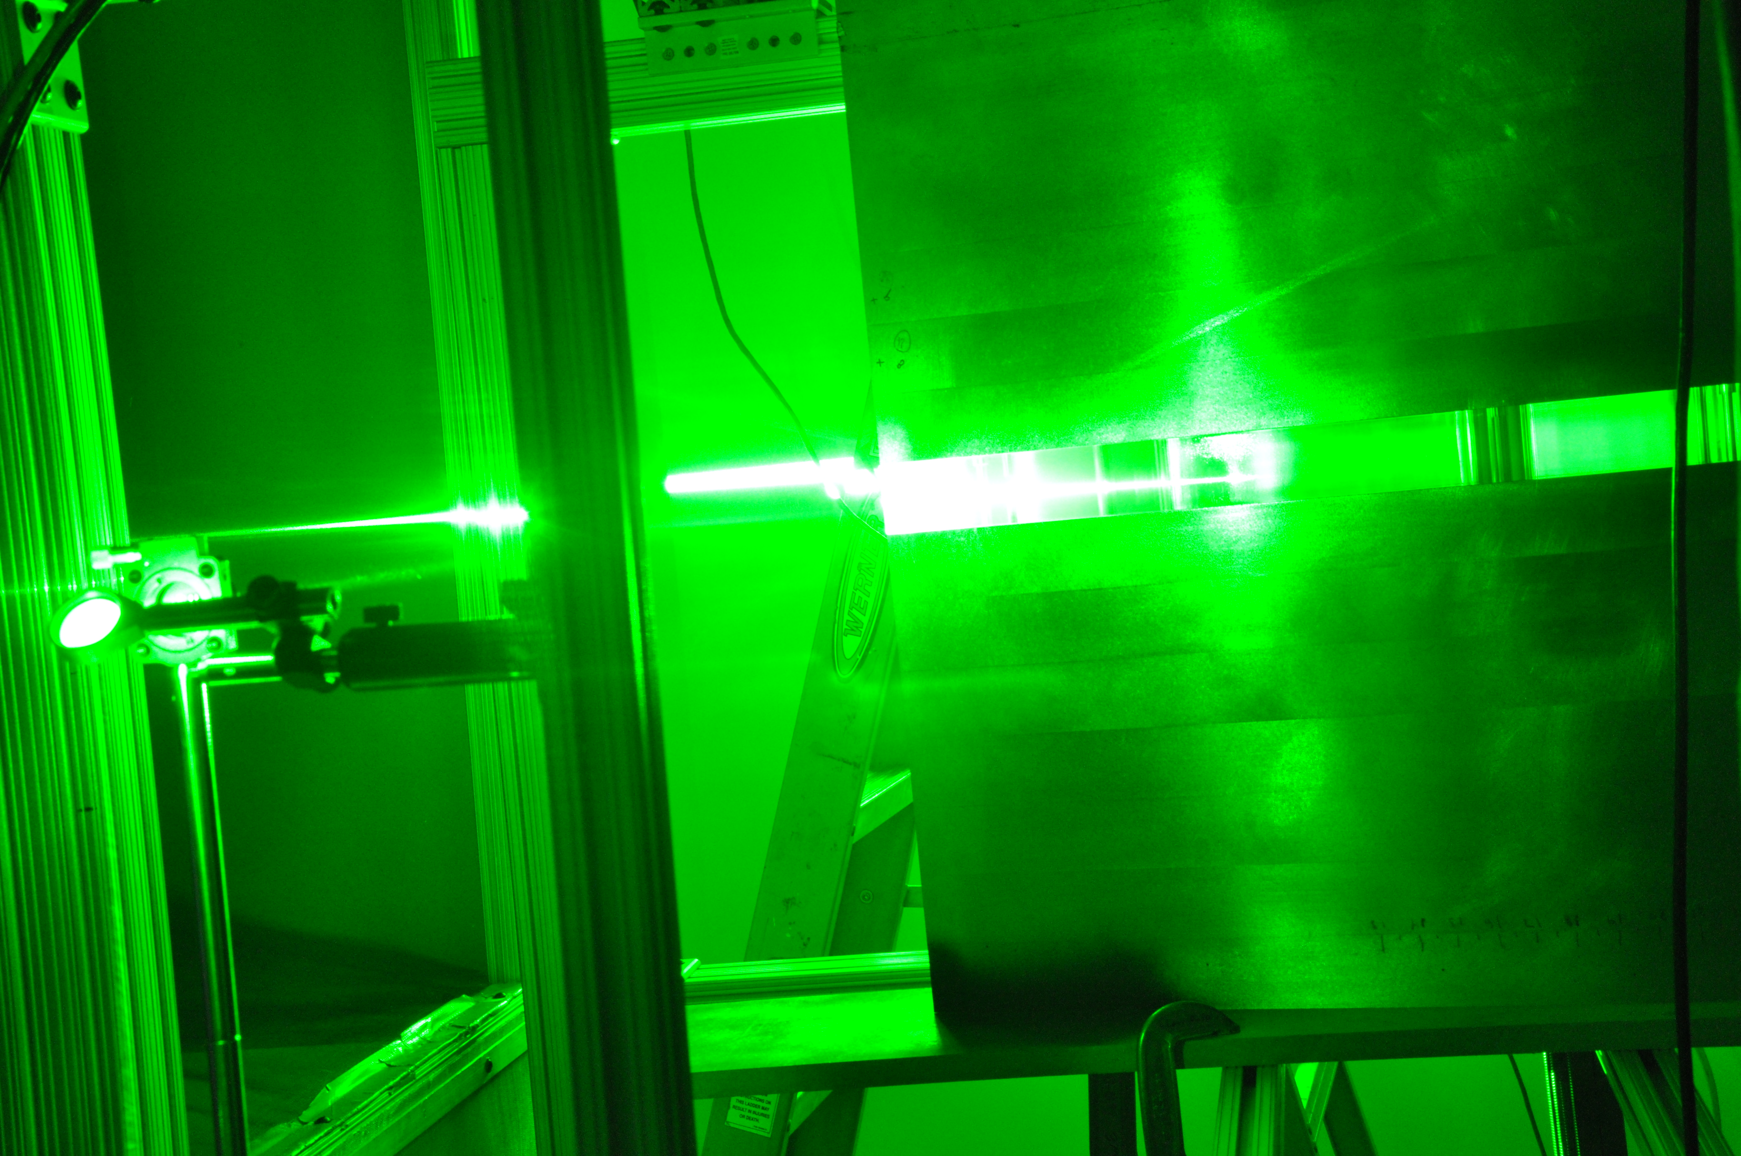
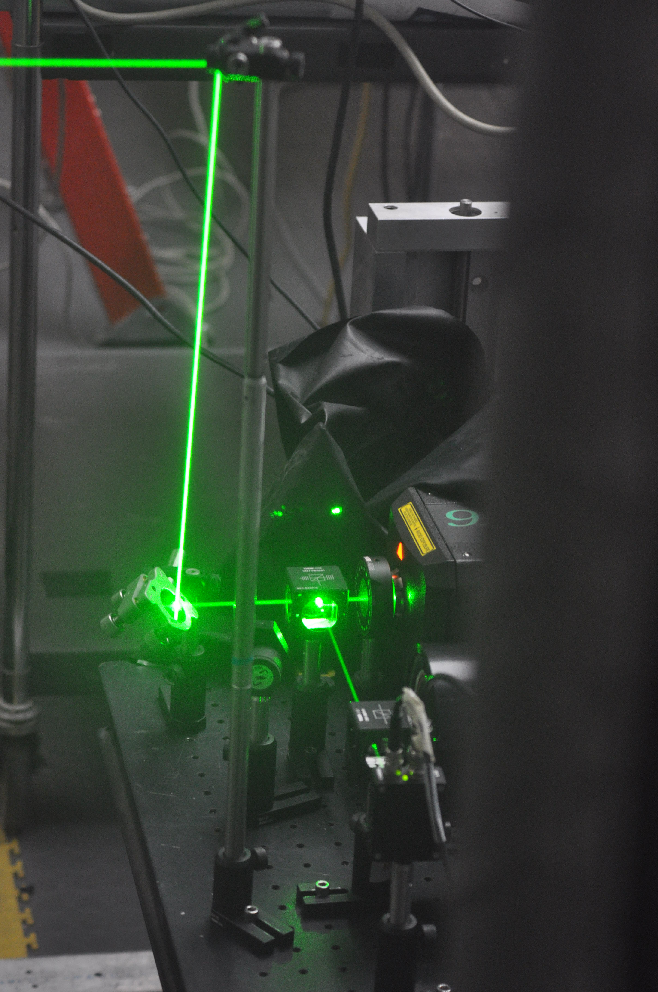
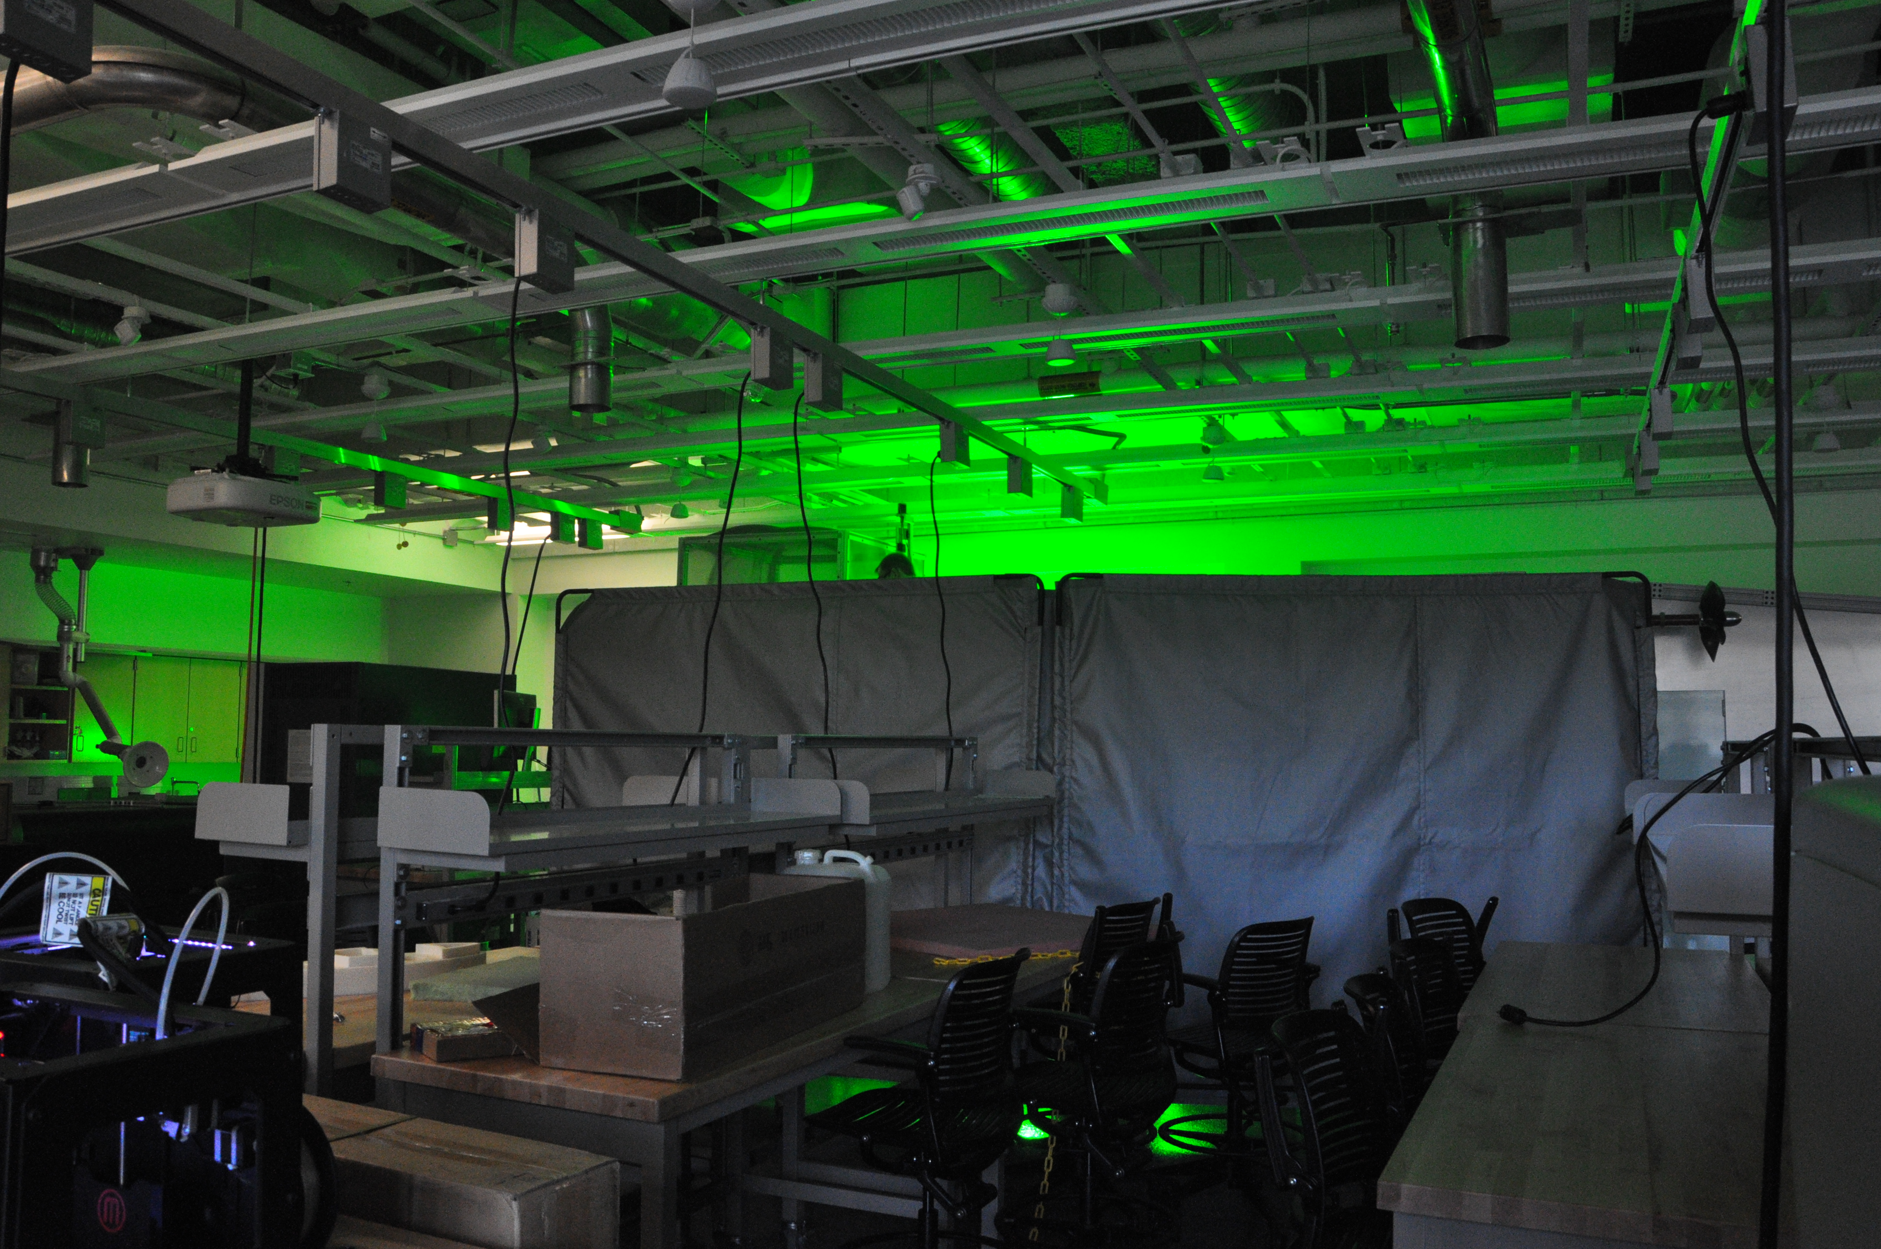
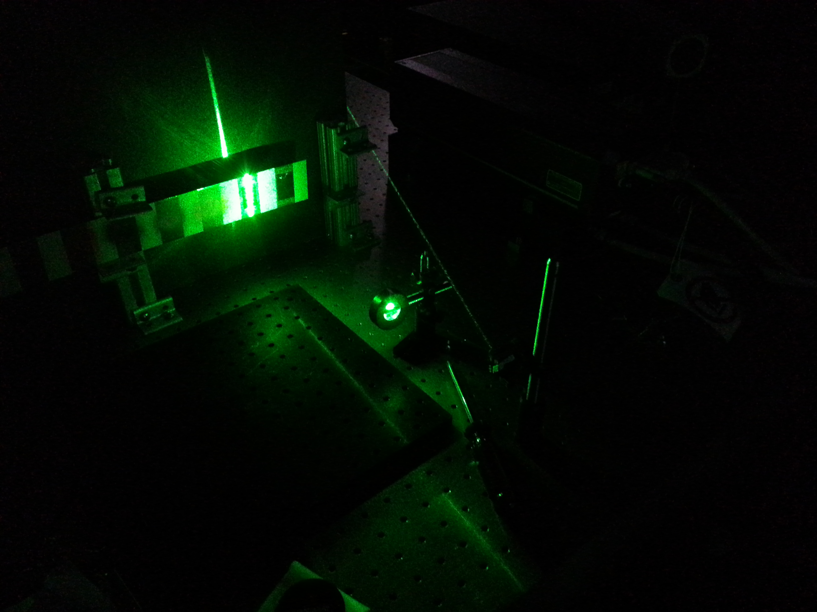
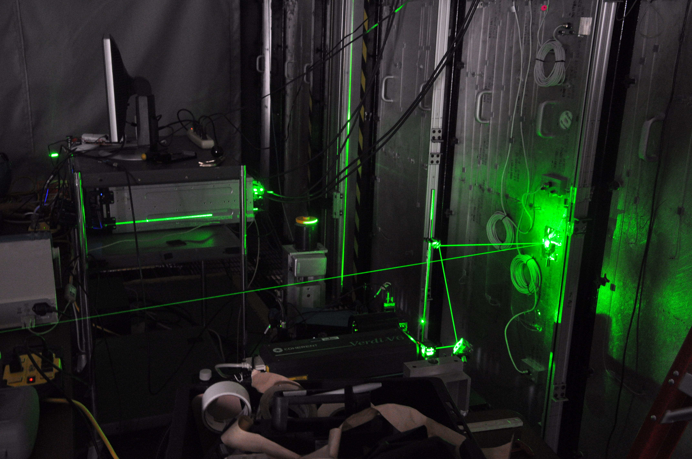

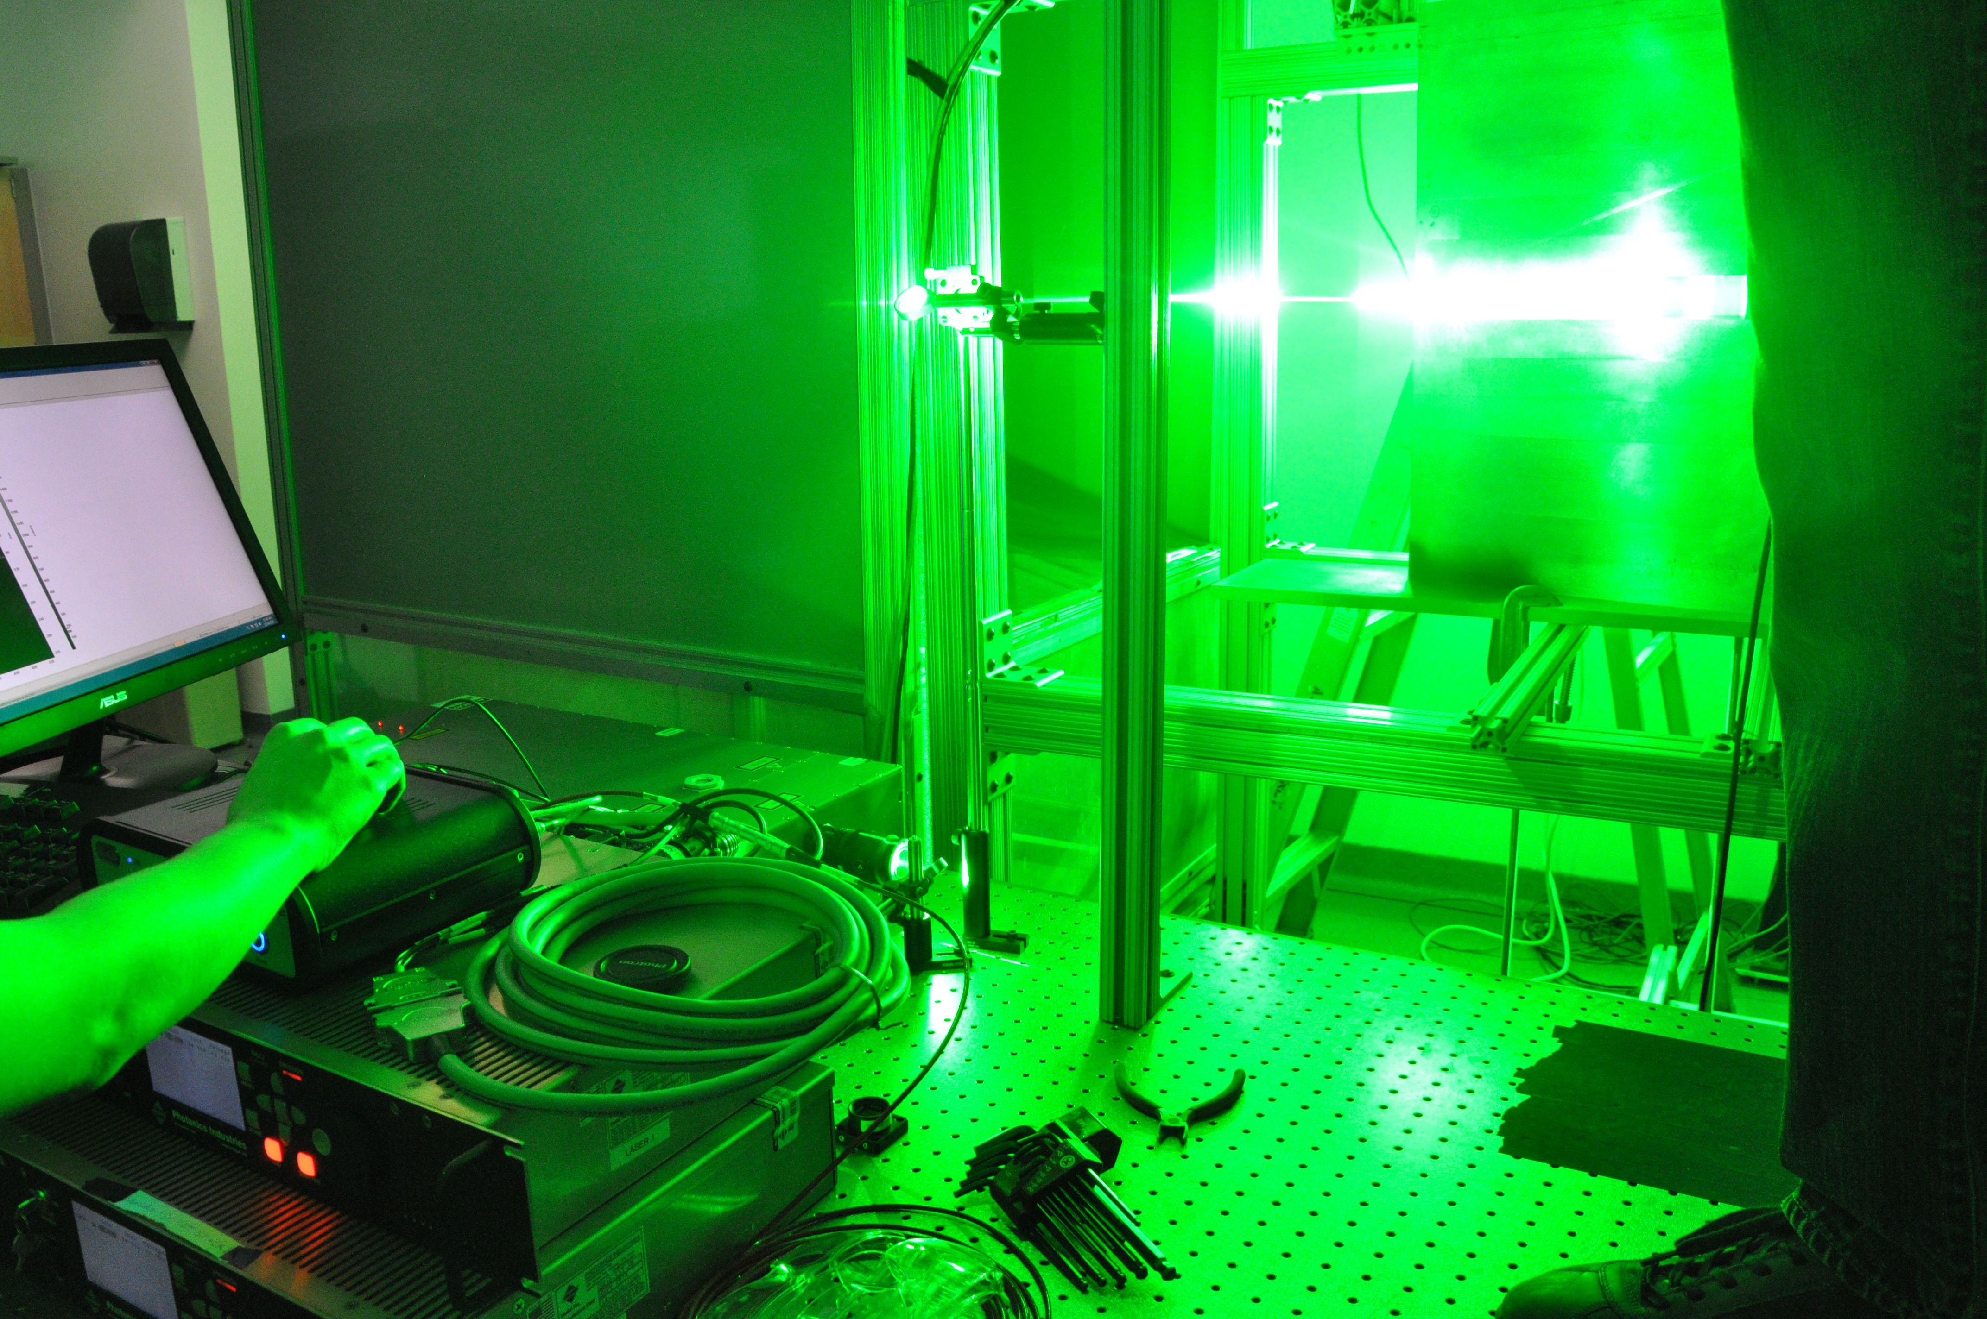
Question ?

Slide 22
Supplemental Slides

Slide 23
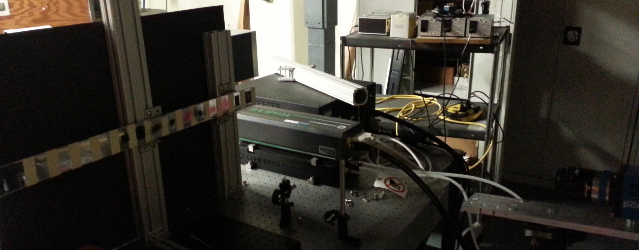
Lab experiment set up
Black board
Painted surface
Nd:YVO4 laser
Pco.egde

Slide 24
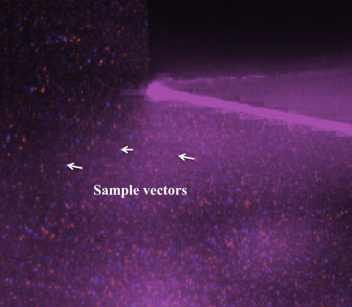
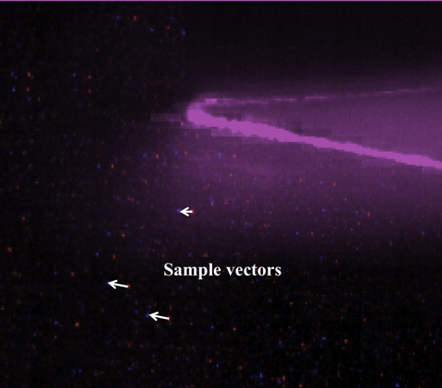
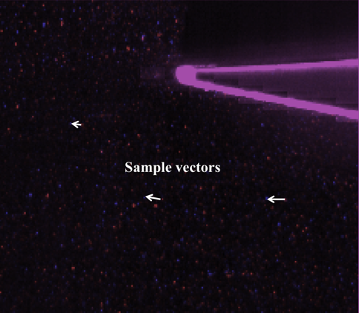
Model Surface Options
Optimal performance with transparent laminate and fluorescent treatment
With metal laminate and fluorescent treatment, still significant benefit
Measurements within ~3mm of the surface
Untreated metal
Treated metal
Treated transparent

Slide 25
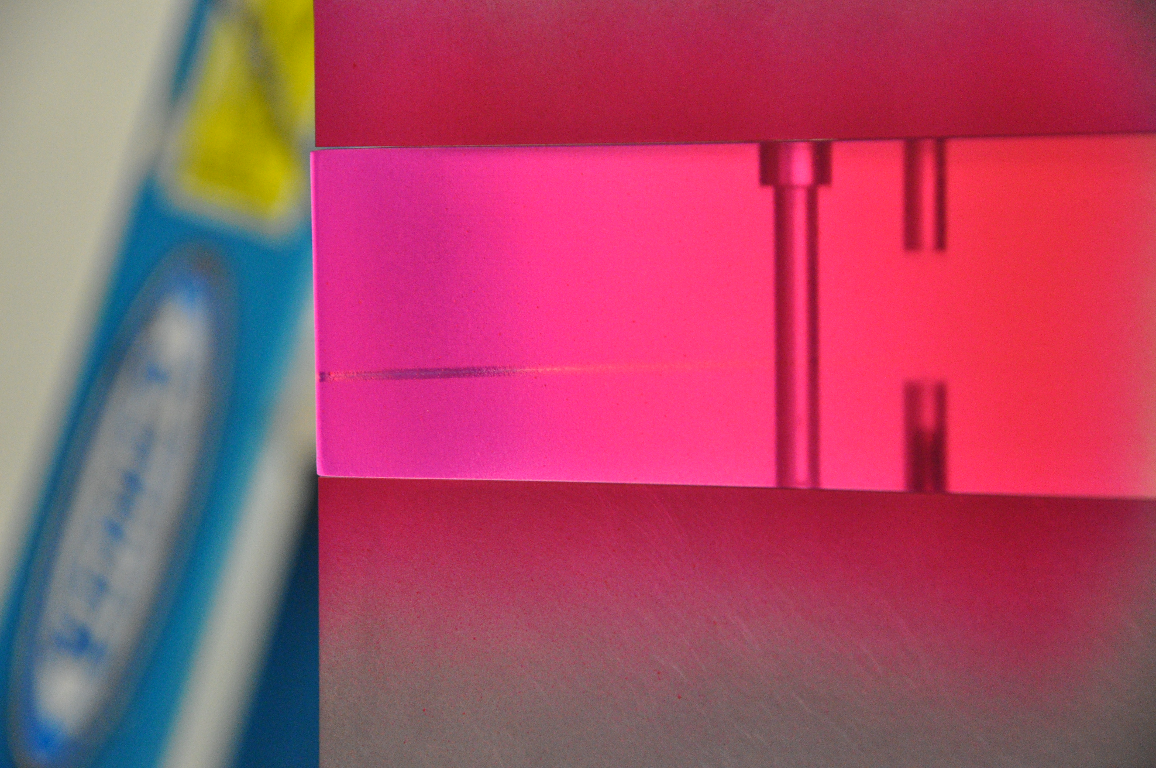
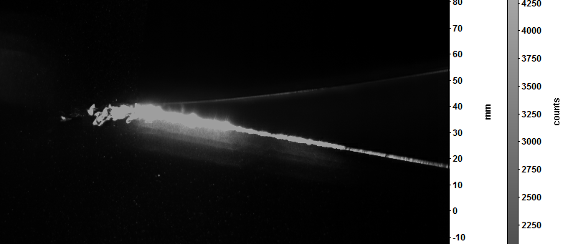
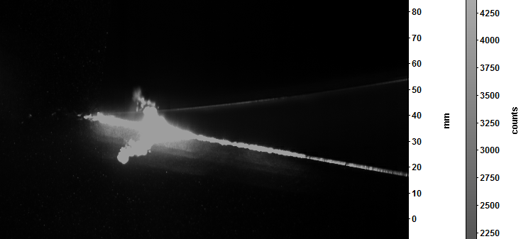
Burning issue
Treated transparent TE
Images of the paint burning
Possible solution : High temperature paint

Slide 26

Absorption: Fluorescent Paint
1
2
3
4
5
6
7
8
9
10
11
12
13
14
Silicone
Black Electric Tape
Flat White paint + Rh6G + Al2O3+ ethanol
Flat Black paint + Rh6G + Al2O3 +ethanol
Clear paint + Rh6G + Al2O3+ ethanol
Flat Black paint + clear paint (x1)
Flat Black paint + Rh6G + ethanol + clear paint (x1)
Clear paint + Rh6G + ethanol (x6)
Clear paint + Rh6G + ethanol (x4) + Black vinyl
Flat Black paint + Rh6G + ethanol (x6)
Flat Black paint + Rh6G + ethanol + clear paint (x2)
Flat Black paint + Rh6G + ethanol (x6) + clear paint (x2)
Clear paint + Rh6G + ethanol (x4) + Mirror finish
Mirror finish
Transparent Black paint + Rh6G + ethanol
Clear paint + Rh6G (x2) + ethanol
Aeroglaze z306
Transparent Black paint + Rh6G + ethanol + clear paint
Transparent Black paint + Rh6G (x2) + ethanol + clear paint
Aeroglaze + Rh6G + ethanol
15
16
17
18
19
20
A
B
Flat White paint + Rh6G + Al2O3
A → Without Ethanol
B→ With Ethanol
Rh6G is dissolved completely with ethanol

Slide 27
Light intensity results
Note that the dark offset is 100 counts

Slide 28


Treated transparent laminate
No Masking applied
Masking applied

Slide 29


Boundary layer profiles

Slide 30


Boundary layer profiles

Slide 31


Literature review (camera angle)

Slide 32

Laser model
DM30-527-DH

