Slide 1
Copyright, Fair Use and Your ETD
Know Your Rights & Responsibilities
Notes:
I AM NOT A LAWYER and I don’t give legal advice. I want you to have good information so that you can make good decisions about exercising your copyright and when you use someone else’s copyrighted work.
I have >30 years experience with digital scholarly communication: online news, ETDs, ImageBase, digital imaging and preservation, etc

Slide 2
Gail McMillan gailmac@vt.edu
Director, Scholarly Communication
Professor, Virginia Tech Libraries
Feb. 27, 2020
Copyright, Fair Use and Your ETD

Slide 3
Let’s talk about
What does copyright mean?
  What can’t be copyrighted?
  Who owns the copyright?
  Copyright licenses
  Public domain
What is fair use?
ETDs

Slide 4
U.S. Constitution
Article I. Sect. 8 Clause 8
[The Congress shall have power] "To promote the progress of science and useful arts, by securing for limited times to authors and inventors the exclusive right to their respective writings and discoveries.”
US Code Title 17 Sect. 102: “original works of authorship fixed in any tangible medium of expression, now known or later developed, from which they can be communicated”
Notes:
This is truly all it takes to copyright your work. You created it, you own it.
No fees
No forms
No notice
In accordance with the requirements of the Berne Convention, notice is no longer a condition of protection for works published after March 1, 1989… The Berne Convention modified the law making copyright registration a precondition to bringing a lawsuit for infringement. For works originating in the U.S. registration is required prior to filing a law suit. http://www.law.cornell.edu/wex/copyright

Slide 5
What cannot be copyrighted?
Ideas, procedures, and methods
Titles, names, slogans (may be trademarked)
Facts and data, phone numbers, news
Works in the public domain
  http://librarycopyright.net/resources/digitalslider
Unrecorded, unwritten, i.e., un“fixed” works
Notes:
procedures, and methods: think recipes—lists of ingredients
doesn’t include computer programs which can be copyrighted

Slide 6
Who can own the copyright?
Creators of original works
  ETDs: theses and dissertations
Creators' assignees
Employers: works for hire
  Explicit, e.g., job description
  Is the work we do owned by Virginia Tech?
    Policy 13000
Notes:
Works for hire
Explicit, as in a job description
Specifically (contractually) commissioned
Is the work we do, therefore, owned by Virginia Tech?

Slide 7
VT Policy 13000 http://www.policies.vt.edu/13000.pdf
Traditional results of academic scholarship
Contributes to the “university's benefit by its creation and by continued use by the university in teaching, further development, and enhancement of the university's academic stature”
Presumption of ownership is to the author
University’s rights are limited to free (no cost) use in teaching, research, extension, etc. in perpetuity.
Notes:
For purposes of this policy creations are divided into two groups:
The traditional results of academic scholarship, i.e. journal articles, conference proceedings, textbooks, literary works, artistic creations and artifacts.
and the novel results of research which can be commercialized such as products, processes, machines, software, biological technology, etc.
In the second group, as a condition of employment or other involvement in research and/or related activities using University resources, the ownership is to the University (with the originator having a right to share in the benefits derived therefrom in accord with University sharing guidelines).

Slide 8
Copyright holders legally control
Reproduction
Modification
Distribution
Public performance
Public display
With exceptions
Notes:
With Exceptions
Fair use
Public Domain
[TEACH Act]

Slide 9
It is not required, but
Copyright © 2020 by Jane Z. Student
Copyright © 2020 by John Q. Public unless otherwise stated
Chapter 3 © 2008 by American Institute of Architects. All other material © 2020 by Ola Nordmann
And include
Notes:
MYTH: It doesn’t say it’s copyrighted. As of March 1, 1989, the copyright warning does not have to appear for a work to be legally copyrighted.

Slide 10
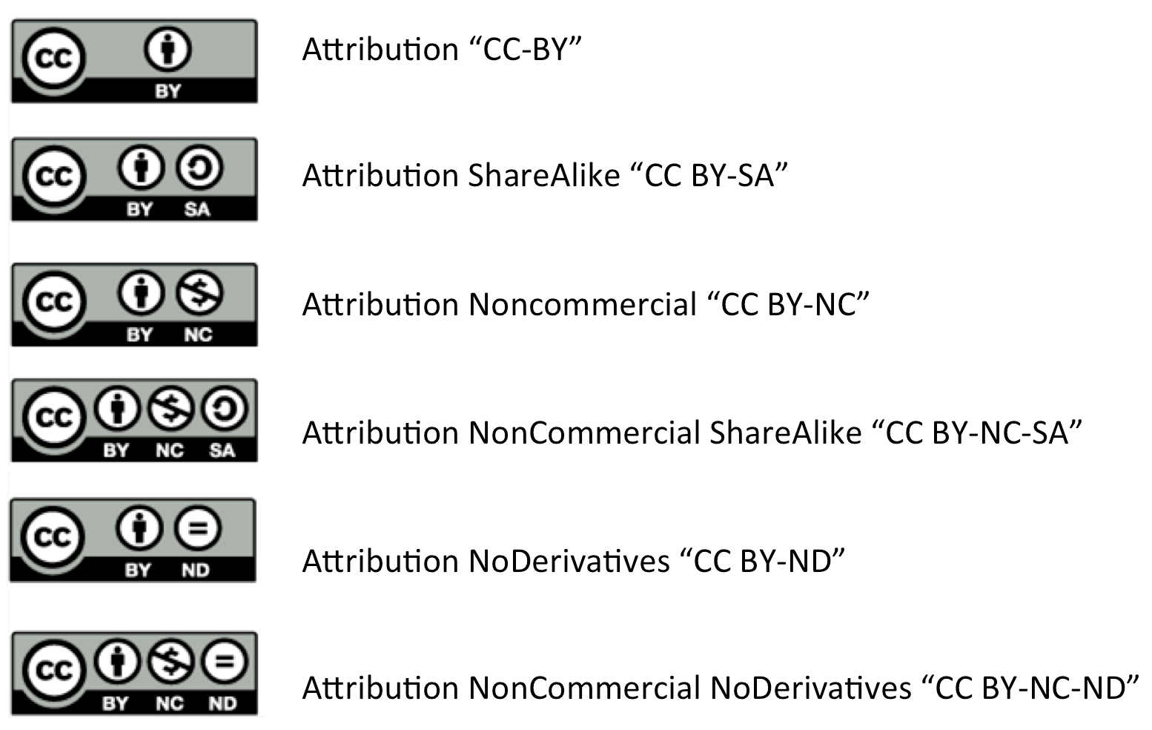
Creative Commons Licenses

Slide 11
Permission or license NOT required
Public domain: Intellectual property is not owned or controlled by anyone
  US government documents
  It’s old
    published before 1923—generally
    70 years after the creator passed on
    95 years after the work-for-hire was published
    120 years after the creation of the work-for-hire
    https://copyright.cornell.edu/publicdomain
  http://librarycopyright.net/resources/digitalslider/
Notes:
Does not mean publicly accessible Internet/Web
PUBLIC DOMAIN
Life of the author plus 70 years (extended from 50 years)
1998 Copyright Term Extension Act
Sonny Bono CTEA: songwriter, Mayor--Palm Springs
Mickey Mouse Act
TEACH Act 2002

Slide 12
Permission or license NOT required
Fair use
  Purpose and character of use
  Nature of the work
  Amount and substantiality
  Effect
            Weigh all 4 factors
Notes:
Consider all four, not just one, fair use factor.
Myth: It’s OK, it’s for educational purposes.
U.S. Copyright Office Fair Use Index: https://www.copyright.gov/fair-use/fair-index.html

Slide 13
1. Purpose and character of use
Commercial or educational use
Profit or not
Criticism, commentary, news reporting, teaching, scholarship, research
Transformative, value added
FAIR USE 1 of 4
Notes:
How transformative is it? Ask 2 questions: (1) adding new expression or meaning?(2) adding value, i.e., creating new information, new aesthetics, new insights, and understandings? Example: Authors’ Guild, Inc, et al. v. HathiTrust, et al. (oct. 2012 decision)
U.S. District Court Southern District of New York Judge Baer [CHE 10/12/12] HathiTrust and its university partners were not violating copyright because their copies are for preservation and full-text searching and indexing. HathiTrust does not make copyrighted material openly available to the public. “The copies serve an entirely different purpose than the original works,” the judge wrote. He noted that HathiTrust‘s search functions “have already given rise to new methods of academic inquiry such as text mining.” “The judge agreed, describing the defendants' mass-digitization work as an "invaluable contribution to the progress of science and cultivation of the arts that at the same time effectuates the ideals espoused by the ADA," the Americans With Disabilities Act.”
(appealed: http://chronicle.com/article/Digital-Librarys-Win-in-Court/135020/)
Judge Harold Baer CHE OA article, 10/22/12 http://chronicle.com/article/Judges-Decision-Could-Clear/135224/
http://copyright.columbia.edu/copyright/2012/10/11/court-rules-on-hathitrust-and-fair-use/ Kenny Crews: HathiTrust is a digital repository of almost 10 million scanned books, most of them created as part of the Google Books project in partnership with leading research libraries. Approximately 76% of the books are still in copyright. At issue in the case are these specific uses: (1) Storing of the scanned book images and text files for preservation; (2) Enabling researchers to conduct word searches of the text files, but the search results only indicate where words appear in the text of books and do not allow viewing of the text; and (3) Facilitating formats of the books to meet the needs of persons who are blind or visually impaired.

Slide 14
2. Nature of the copyrighted work
Worthy of (extensive) protection?
  Not a quality judgment.
  Can it legally be protected by copyright?
Character of the work?
  Fact or fiction
    Published facts weigh in favor of fair use
    Unpublished original expressions weigh in favor of seeking permission
FAIR USE 2 of 4
Notes:
Facts (name, phone number, short phrases, etc.) and ideas cannot be copyrighted but the way that you describe and present them can. (Brad/Myths says: expression and structure. )
Creative works, prose, poetry, correspondence, diary can be copyrighted.
Think of it as a continuum between unprotected ideas and facts and protected expression.
Who owns the copyright to the letter you wrote to your high school sweetheart? Is it his/hers or yours to publish?

Slide 15
3. Amount and Substantiality
Use only what is necessary
In relation to whole work
  Quantity
  Quality
FAIR USE 3 of 4
Notes:
e.g., Ford’s memoirs
If an article has several charts, and you want to include one of them in your dissertation, do you need the copyright holder’s permission or would this fair use factor weigh in your favor?

Slide 16
4. Effect
Will your use reduce the value of the original work?
  Harm to the market
    Real
    Potential
FAIR USE 4 of 4
Notes:
POTENTIAL!!!

Slide 17
Fair Use: weigh all 4 factors
Help is at ALA Fair Use Evaluator (online tool)
If the scales did not tip in favor of fair use
  Modify your use
  Ask for permission
  Assess the risk
Orphan works
  Assume it’s protected by copyright
Notes:
If it’s a 2-2 tie, assess the risk.
SherpaRoMEO
Publishers’ copyright policies
http://www.sherpa.ac.uk/romeo/

Slide 18
Including Copyrighted Works
Graduate School asks for evidence with ETD
Fair use; determination attached
Creative Commons license
Public domain
Used with permission, letter/email attached

Slide 19
Signing Agreements with Publishers
Negotiate after your article is accepted for publication
Keep your copyright
  Use it in your thesis/dissertation
  Link it from your CV/résumé
  Use it for teaching (i.e., distribute to your class)
  Distribute to your colleagues
Give non-exclusive rights to publisher/journal
SPARC author addendum
Notes:
Be sure your copyright agreement allows you to include your article in your ETD and/or reuse the materials for teaching.
As the author you own the copyright and you can negotiate whether to share or relinquish some or all of these rights with a publisher. Before signing a copyright statement when your article/chapter is accepted for publication:
Read the agreement carefully.
Make sure you understand and agree with the terms and conditions.
Make changes as needed, possibly with advice of legal or other counsel.
Make sure the agreement is explicit about what future rights of use you retain.

Slide 20
Manuscript style ETD
Did you keep the copyright to your article?
Include a signed release from the publisher
Link to the publisher’s version
iThenticate plagiarism detection
Notes:
Be sure your copyright agreement allows you to include your article in your ETD and/or reuse the materials for teaching.
If appropriate, cite your ETD in your article/cite your article in your ETD.

Slide 21
Five Questions
Is the work protected by copyright?
Is there a specific exception in copyright law that covers the use?
Is there a license that covers the use?
Is the use covered by fair use?
Is permission needed for the use?
Notes:
Thanks to Anita Walz for this slide.
You may want to REPRODUCE, DISTRIBUTE, PERFORM, DISPLAY OR MODIFY someone else’s work in your ETD. Ask these 5 questions in this order #1. http://librarycopyright.net/resources/digitalslider
#2.
#3. For example: Creative Commons or Public performance license (blbrown@vt.edu)
Adapted from © 2014 Kevin Smith & Lisa Macklin CC BY-SA 4.0 https://d396qusza40orc.cloudfront.net/cfel/Reading%20Docs/A%20Framework%20for%20Analyzing%20any%20Copyright%20Problem.pdf

Slide 22
Copyright Resources at VT Libraries
Copyright
https://scholar.lib.vt.edu/copyright/
Fair Use
https://scholar.lib.vt.edu/copyright/cprtfairuse.html
Copyright and Authors (inc. ETDs)
https://scholar.lib.vt.edu/copyright/cprtetd.html
Request Permission: Sample letter
https://etd.vt.edu/howto/permission.html

Slide 23
Gail McMillan gailmac@vt.edu
Director, Scholarly Communication
Virginia Tech Libraries,
Feb. 27, 2020
Thank you!
Copyright, Fair Use and Your ETD

