Slide 1


Strategic Management
Chapter 5
SWOT and Strategic Issues
Unless otherwise noted, this slide deck is (c) Virginia Polytechnic Institute and State University. It is released under a Creative Commons Attribution NonCommercial ShareAlike 3.0 license (CC BY NC-SA 3.0)
Instructor Name | Name of Institution
http://hdl.handle.net/10919/102735
Photo by Jon Sailer on Unsplash

Slide 2
Learning Objectives
How is the SWOT framework developed and used for determining strategic issues and strategies?
What is a strategic issue and how is it identified and expressed?
http://hdl.handle.net/10919/102735

Slide 3
The Next Step…
So, after the external and internal analysis is completed, what do we do with all this information?????
Consolidate the most important information into a SWOT analysis!!
http://hdl.handle.net/10919/102735

Slide 4

The Purpose of SWOT Analysis
  Purpose – consolidate external and internal analysis to most important factors
Image Source: https://pixabay.com/photos/board-chalk-swot-planning-4874749
http://hdl.handle.net/10919/102735

Slide 5
SWOT Analysis
Strengths and Weaknesses
  Usually internal to the organization
  Resources or capabilities to leverage for a competitive advantage??
  Deficiencies to correct to be a better performing organization??
Opportunities and Threats
  Usually external to the organization
  Positive external or competitive forces to exploit??
  Negative external or competitive forces to mitigate??
http://hdl.handle.net/10919/102735

Slide 6
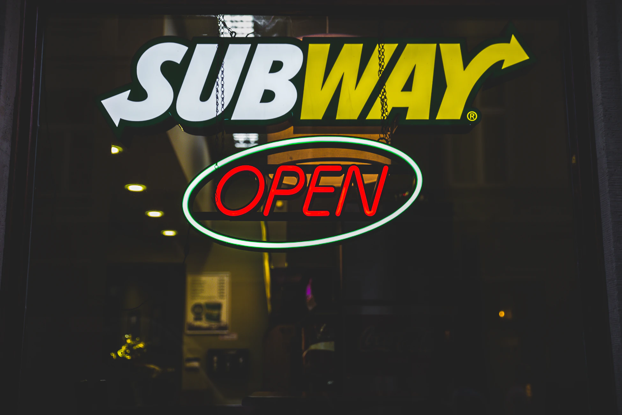
SWOT Analysis Example
Subway
Strengths
  Healthy menu options
  Economical pricing
  Simple business format
Weaknesses
  Limited menu items
  High employee turnover
  No hamburgers or french fries
Image Source: https://unsplash.com/photos/-jv94-xYy-E
http://hdl.handle.net/10919/102735

Slide 7
SWOT Analysis Example (Cont.)
Subway
Opportunities
  Untapped international markets
  Movement to more healthy eating
Threats
  Competitors offering more options
  Long-term economic slow-down due to pandemic
Image Source: https://unsplash.com/photos/-jv94-xYy-E
http://hdl.handle.net/10919/102735

Slide 8
Strategic Issue(s)
Reviewing the SWOT Analysis…
  What is the main strategic issue or issues facing the organization?
  Can be a positive or negative issue
  What do we need to be sure we address in our strategic plan?
  Note that the issue is strategic, not short term.
    A strategic issue is NOT we need to do more marketing, advertise on Facebook
  Write the strategic issue in one sentence, usually in question form.
http://hdl.handle.net/10919/102735

Slide 9
Strategic Issue(s) Examples
Examples
  Southwest Airlines - “How does Southwest Airlines adjust to long-term, lower passenger volumes and remain the preferred, low-cost leader in the industry?”
  Subway - “How does Subway enter untapped international markets?”
http://hdl.handle.net/10919/102735

Slide 10
Strategic Issue(s) Conclusion
In Conclusion
Usually the analysis can be condensed to one strategic issue.
Define the strategic issue concisely, hence in one sentence
Now the next step is to develop strategies to move your organization forward
Be sure at least one strategy addresses the strategic issue
http://hdl.handle.net/10919/102735

