Slide 1
Parking Spaces Occupancy Prediction
Eugene Kwon, Josh Marcelin, Adi Hanumaiah, Antonio Lau, Kevin He
CS4624: Multimedia, Hypertext, and Information Access
Instructor: Mohamed Farag
Virginia Tech, Blacksburg VA 24061, 21 September 2023
Notes:
Kevin

Slide 2
Outline
Problem overview
Deliverables
Features
System Architecture
Timeline
Notes:
Kevin

Slide 3
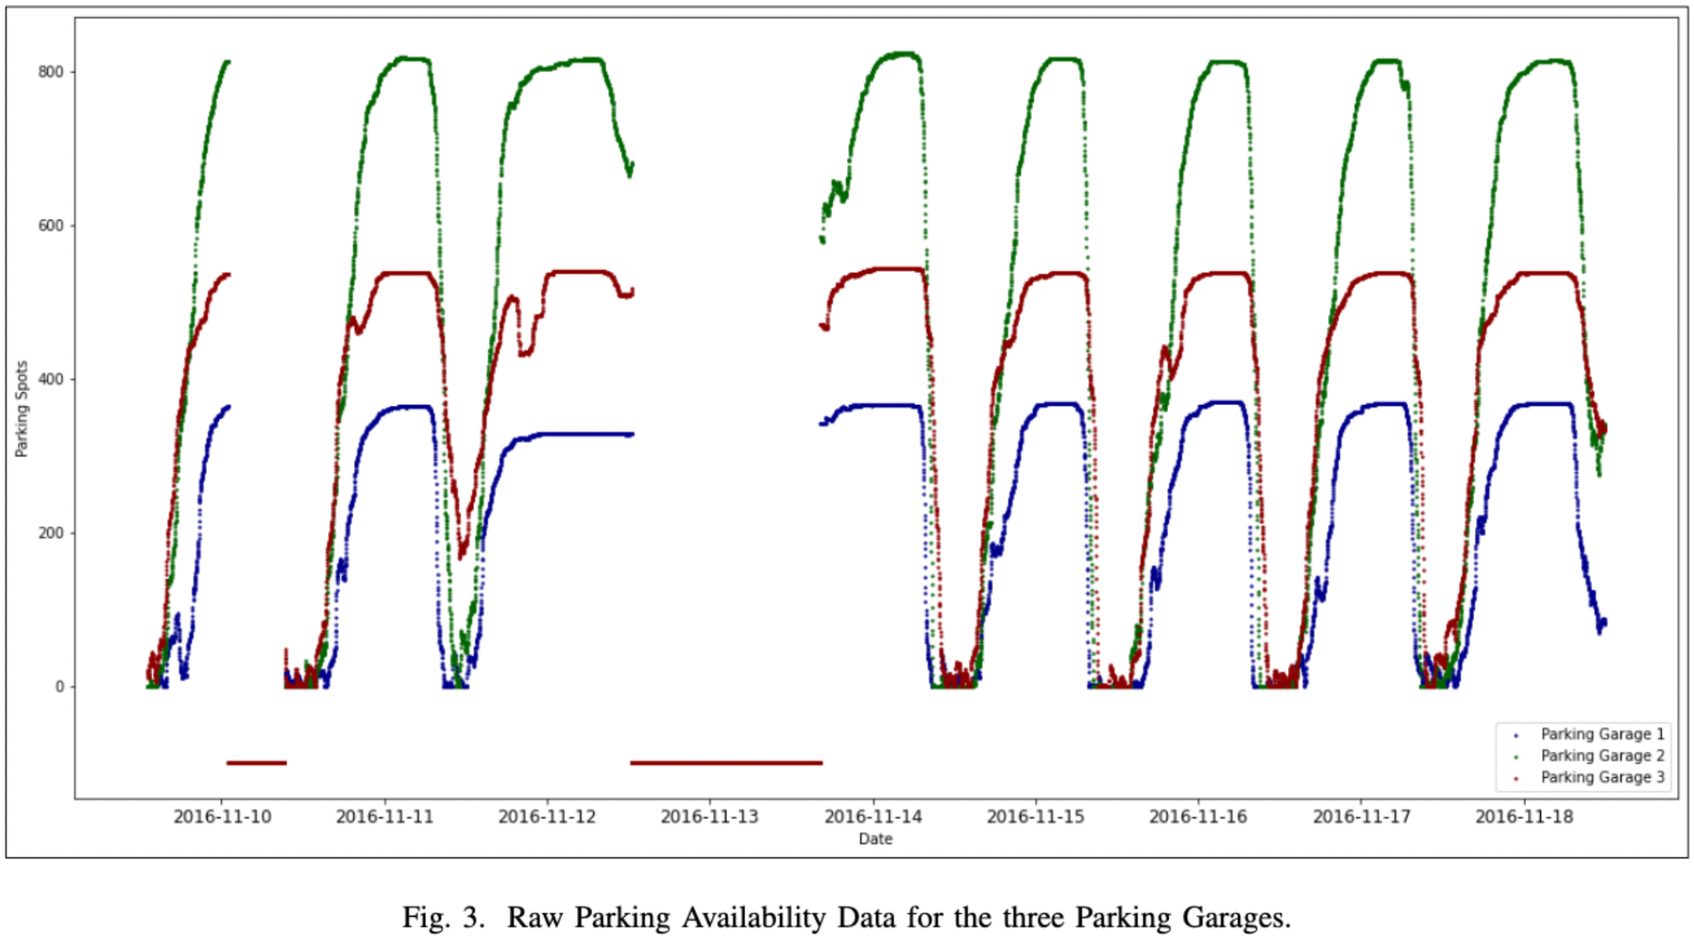
Problem Overview
Finding parking around campus is frustrating for both students and faculty
Leveraging Machine Learning, we can provide parking insights and suggestions to users
We will use real time data to provide a prediction model that informs users of which parking spot to target and how many parking spots are expected to be free
Notes:
Josh

Slide 4
Project Deliverables
User will use web app before they plan to arrive on campus to get parking recommendation
App will calculate time of arrival at each of the garages
Live data and ML model will be used predict number of free spaces at each garage
App will then provide relevant data and recommendation for user
User will be able to manages personal profile with relevant data (i.e Type of Parking Pass)
New parking data will be collected; user session info will be persisted in separate database
Notes:
Josh

Slide 5
Features
Profile management and Authentication
Prediction Model
Interactive Map
Notification System
History and Analytics
Notes:
Adi

Slide 6
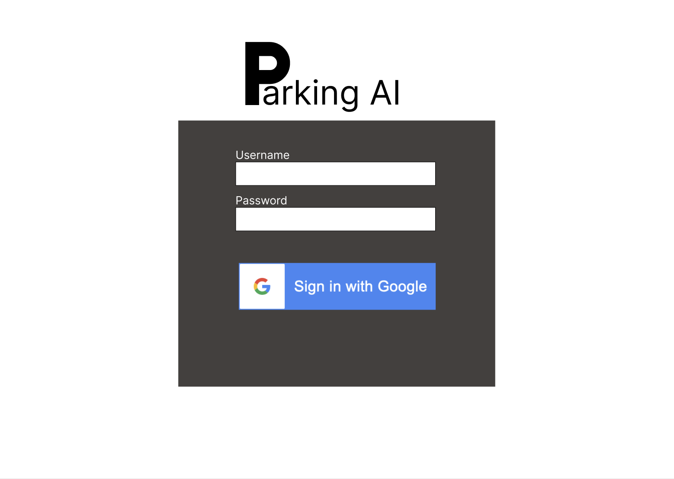
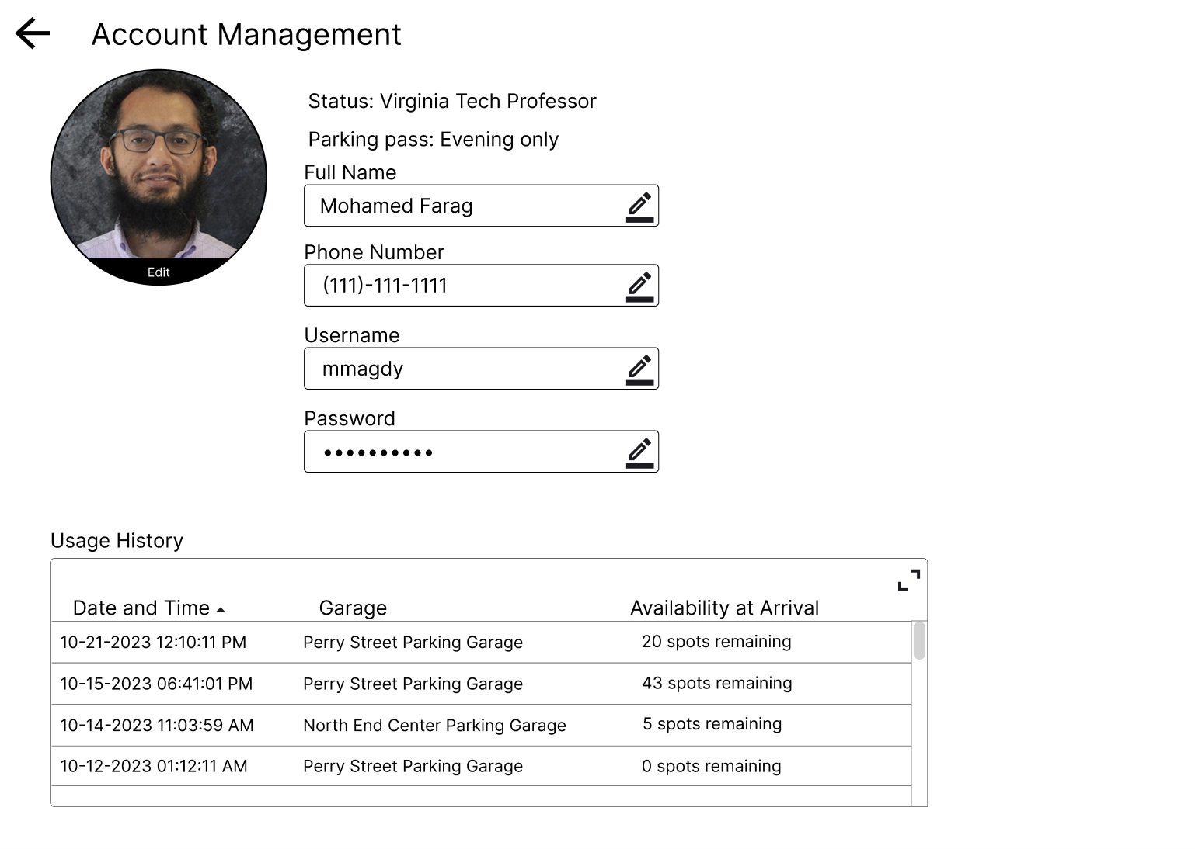
Profile Management
Login/Credentials
Personal Information
Usage History
Notes:
Antonio

Slide 7
Prediction Model Integration
Machine learning model API endpoint
From front-end map, send parking lot distance to the API
Retrieve availability for future times
Time Series Forecasting
…
31
32
33
34
35
36
37
286
338
176
201
—
—
Notes:
Josh

Slide 8
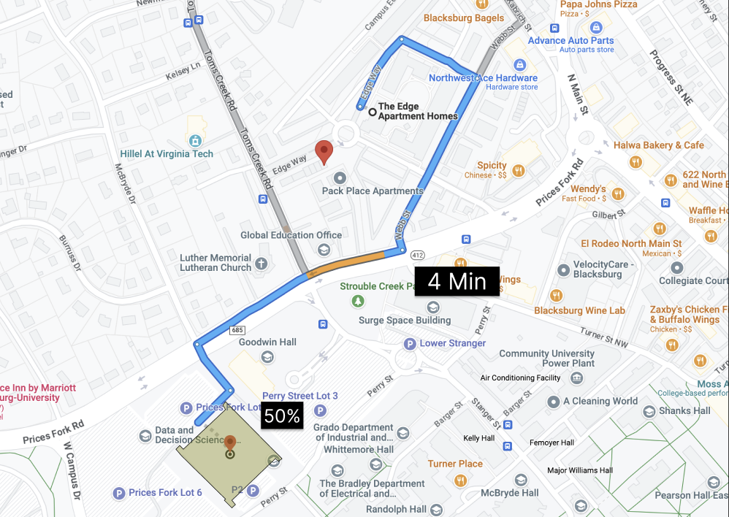
Interactive Map
Live occupancy data
Routing data to each garage
Notes:
Eugene

Slide 9




Notification System
Alerts User to Changes in Recommendation
Alerts user to leave on time in order to arrive on time and find parking
Notes:
Eugene

Slide 10
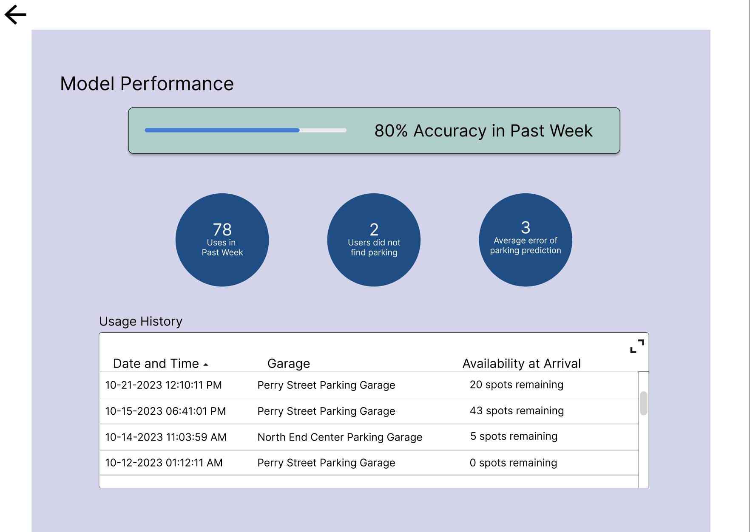
History and Analytics
View past requests and correctness
View user
Notes:
Josh

Slide 11
Data workflow
Data Input
  User Input
    Destination, Particular garage
  Environmental inputs
    User current location, Time of Day, Day of Week, Traffic, Trained ML model
Processing
  Prediction Model
    ML model process the data to predict availability
  Mapping & Visualization
    Calculates distance and ETA to destination
    Correlates spot availability data with map
Data Output
  Display Data
    Interactive Map
    Spot Info
  Spot Availability Forecast
    eg. “Hurry! Spots are filling fast. “, “Spots should open up in the next hour”
Notes:
Adi

Slide 12







Tech Stack
User Interface (Svelte)
Backend
(Node.js)
Machine Learning Model
(Python, Scikit learn)
User Authentication
(Lucia)
Database
(MySql)
Notes:
Adi
Tech Stack:
Frontend: Svelte - utilizing web framework for front-end development, will help us build a responsive and interactive web application.
Backend: Node.js / Express.js - being utilized for backend development, will help with data management, setting up our backend server, and integrating our machine learning model. Hosted on AWS EC2.
Machine Learning: Scikit-learn - python library for machine learning, being used for processing data into the machine learning model, allows us to make real time predictions in the web application.
Database: MySQL - setup the database i.e. tables, columns etc… and query through the data in the database.

Slide 13

Tech Stack
User Interface (Svelte)
Backend
(Node.js)
Machine Learning Model
(Python, Scikit learn)
Database
(MySql)
Map and Routing API (Mapbox)
Notes:
Adi
Tech Stack:
Frontend: Svelte - utilizing web framework for front-end development, will help us build a responsive and interactive web application.
Backend: Node.js / Express.js - being utilized for backend development, will help with data management, setting up our backend server, and integrating our machine learning model. Hosted on AWS EC2.
Machine Learning: Scikit-learn - python library for machine learning, being used for processing data into the machine learning model, allows us to make real time predictions in the web application.
Database: MySQL - setup the database i.e. tables, columns etc… and query through the data in the database.

Slide 14
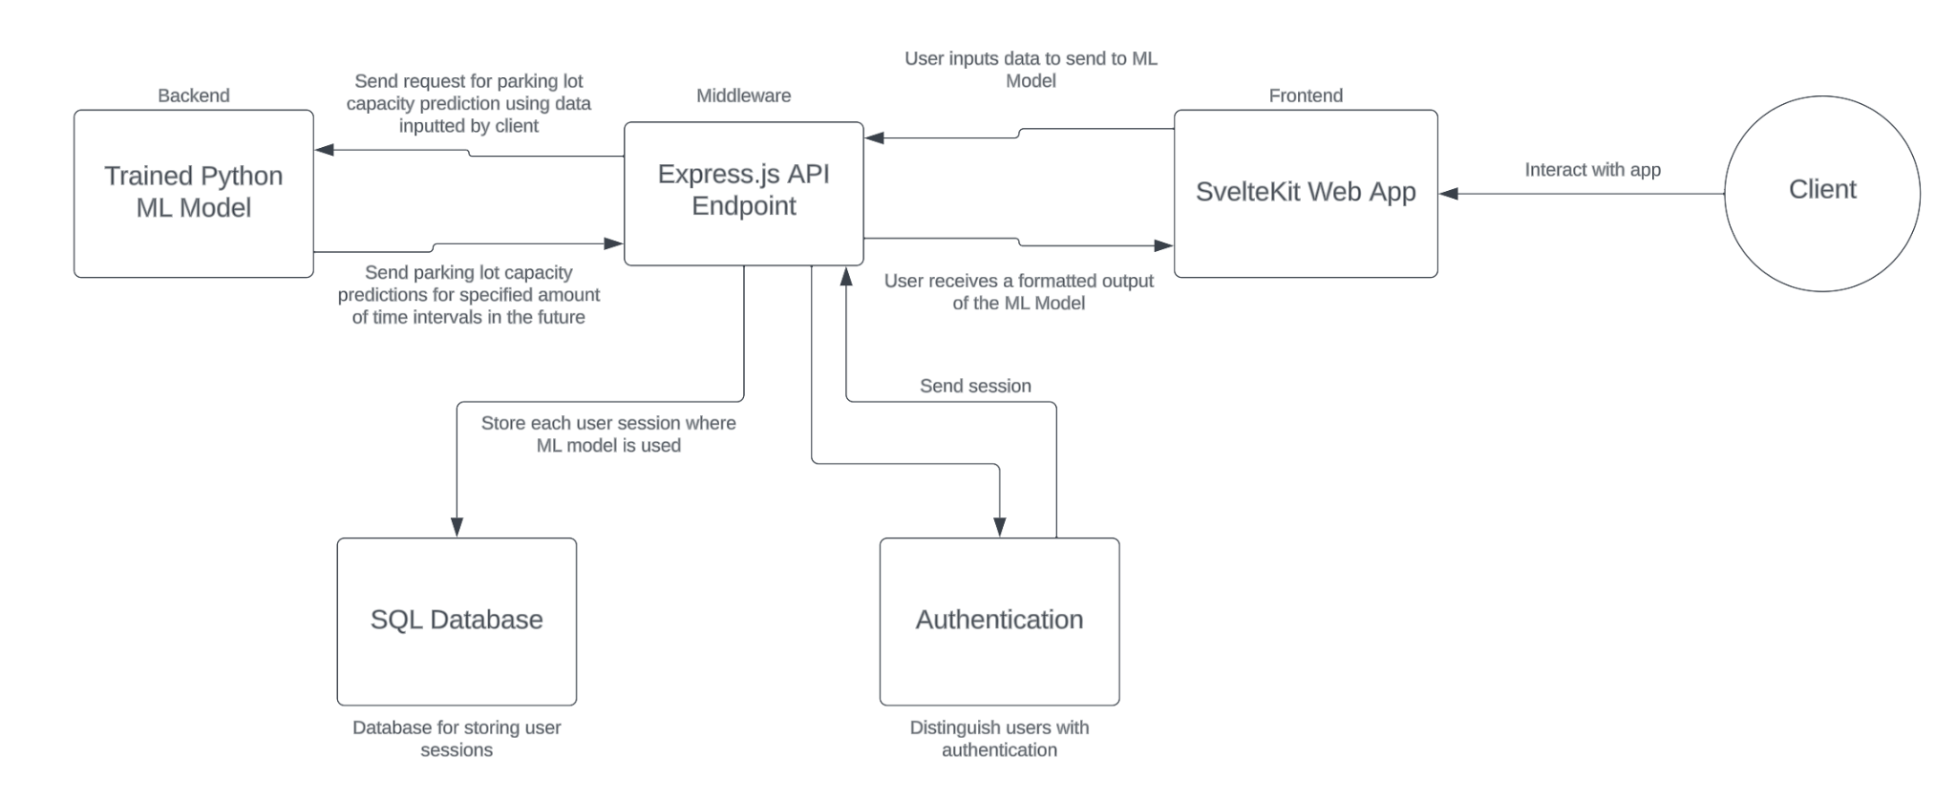
System Architecture
Notes:
Eugene

Slide 15






Project timeline
At-a-glance
MODEL TRAINING
WEB APP & API
INTEGRATION
DATA PREP
TESTING
Preparing the data to train the machine learning model
Training the machine learning model
Testing and refining the model
Development of web application and API
Integrate the frontend and backend; finalizing the project
23 SEP
29 SEP
27 OCT
10 NOV
24 NOV
Notes:
Antonio

Slide 16

Client Info
Dr. Mohamed Farag
  Research associate in the Center for Sustainable Mobility
  His research interests include intelligent transportation systems, connected/automated vehicles, C-V2X, machine learning, large-scale data analysis, large-scale system analysis and design, big data, and information retrieval.
Weekly online meetings to update and approve progress
Provides training data
Notes:
Kevin

Slide 17
Any Questions?

Slide 18
Citations
M. Farag, A. Hilal and S. El-Tawab, "Parking Occupancy Prediction and Traffic Assignment in a University Environment," 2022 10th International Japan-Africa Conference on Electronics, Communications, and Computations (JAC-ECC), Alexandria, Egypt, 2022, pp. 186-190, doi: 10.1109/JAC-ECC56395.2022.10044079.

Slide 19
Images
https://worldvectorlogo.com/
M. Farag, A. Hilal and S. El-Tawab, "Parking Occupancy Prediction and Traffic Assignment in a University Environment," 2022 10th International Japan-Africa Conference on Electronics, Communications, and Computations (JAC-ECC), Alexandria, Egypt, 2022, pp. 186-190, doi: 10.1109/JAC-ECC56395.2022.10044079.

