Slide 1

Social Interactome Breathalyzer “Breathe-EZ”
Virginia Tech - Blacksburg, VA 24061
CS 4624 Spring 2016
Dr. Edward A. Fox
April 25, 2016
Members: Christopher Aska Toda, Colton Walker, Chris Cornett, Ben Robohn
Client: John Crawford, Mikhail Koffarnus

Slide 2
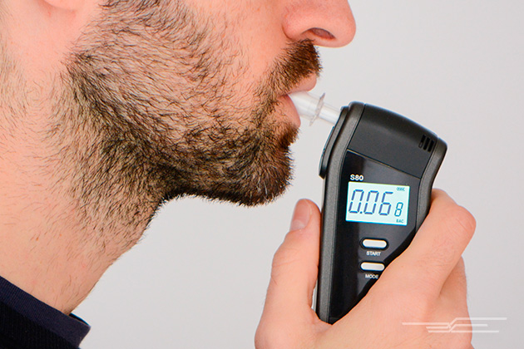
Introduction
Intended to aid users in their road to recovery
Randomly scheduled breathalyzer readings
Monetary rewards for passed measurements
Passing BAC of 0.00
Notes:
Mention that reward increases with successive passed tests

Slide 3

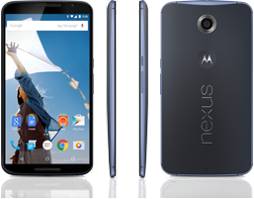
Development Tools
Android Studio
  Java
  XML
Motorola Nexus 6

Slide 4
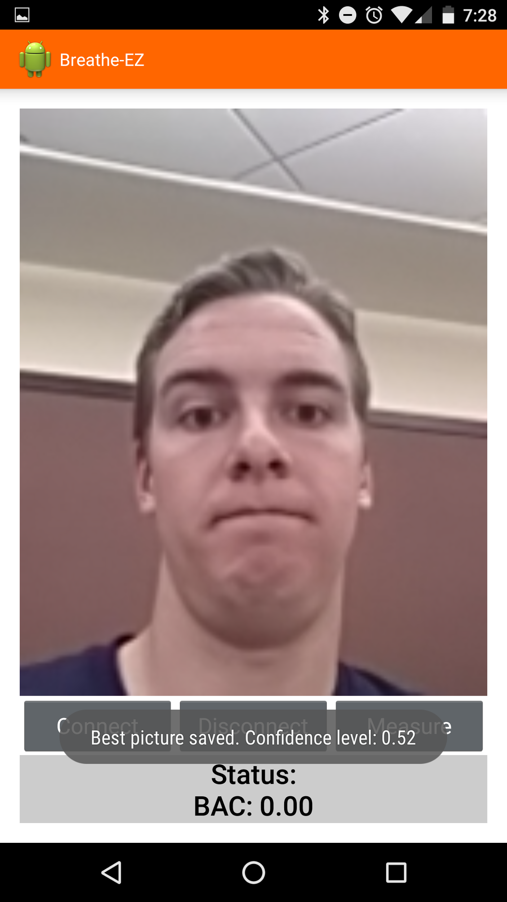
Requirements
Breathe-EZ Application:
  BAC recorded, and will be identified and the ARRC server checks the three photos for facial recongition.
https://github.com/brobohn/Breathe-EZ
Notes:
Interface with BACtrack Breathalyzer to record the user’s Blood Alcohol Content (BAC).
Take three photos of the participant while they are using the device for identification purposes.
Identify the best photo and send it through a server for facial recognition.

Slide 5
Problems/Solutions
Problem | Solution
Camera launches new activity on new screen | Implemented SurfaceView camera preview
Camera preview displayed and saved sideways | Set rotation and display orientation in source code
Android.media.FaceDetector library not compatible with Samsung devices | Study restricted to non-Samsung devices
Unable to find a free and effective Android facial recognition library | The application performs facial detection to select best picture, which the ARRC will use to identify users

Slide 6
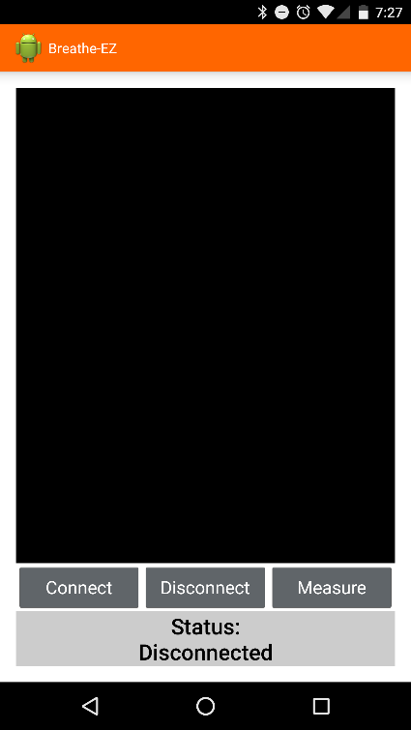
Application Walkthrough
1. Open Application

Slide 7
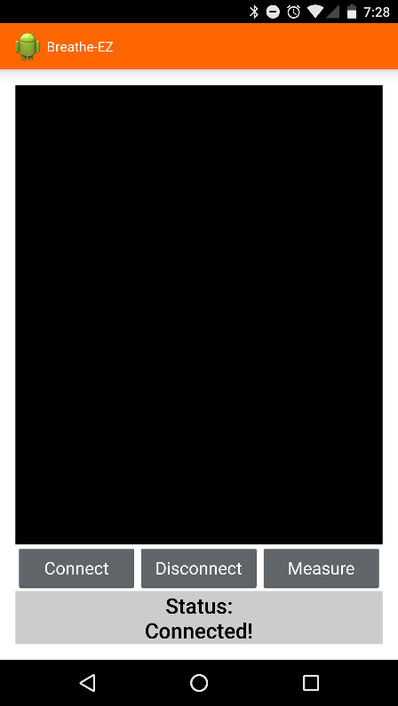
Application Walkthrough
2. Press “Connect” to connect to your BACtrack device

Slide 8
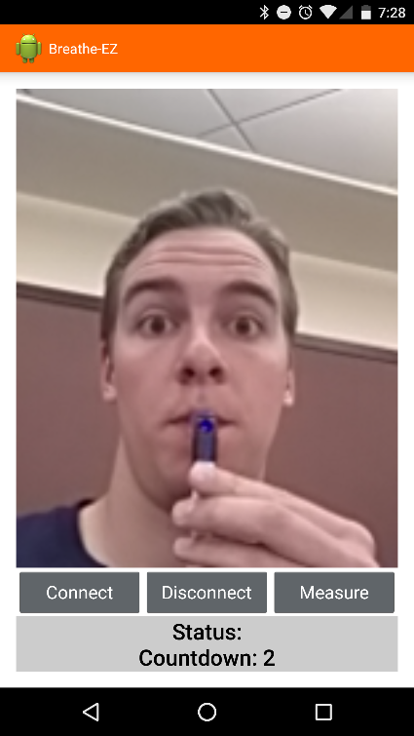
Application Walkthrough
3. Press “Measure” to begin the measurement process

Slide 9
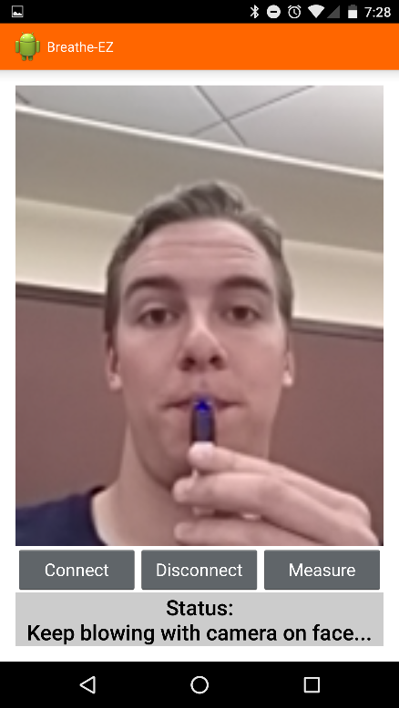
Application Walkthrough
4. After countdown, start blowing and keep your face in the camera preview

Slide 10



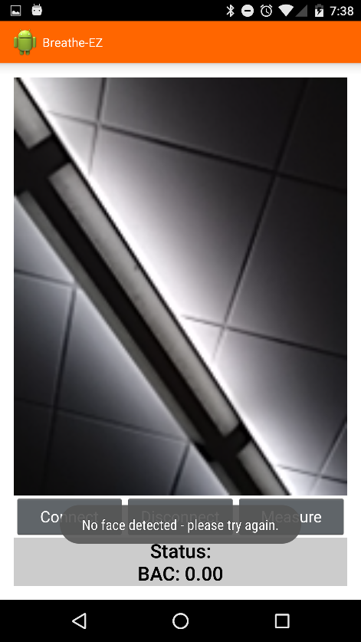
Application Walkthrough
5. Application displays BAC and accepts or rejects pictures

Slide 11

Lessons Learned
Important to meet with the client
Being honest and realistic about one’s abilities when faced with obstacles
Problem with camera for every device but SDK helped
Notes:
Meeting with client is very important, we learned this early on and always scheduled meetings in advance about every two weeks.
It is good to be honest and realistic about your abilities when speaking to your client.
Android is not perfect but has a working solution to most common problems.
We had issues with the camera that we found out were just problems everyone had to deal with but the SDK makes it easy to work around most of them

Slide 12
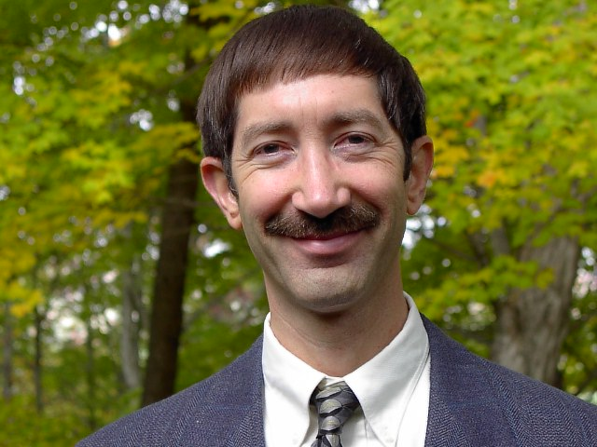
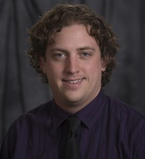
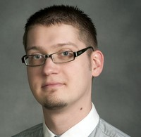
Acknowledgements
Dr. Edward Fox
  Professor, Department of Computer Science
  Virginia Tech
  fox@vt.edu
Mr. John T. Crawford
  Research Programmer
  Virginia Tech Carilion Research Institute - Addiction Recovery Research Center
  jcrwfrd@vtc.vt.edu
Dr. Mikhail Koffarnus
  Research Assistant Professor
  Virginia Tech Carilion Research Institute - Addiction Recovery Research Center
  mickyk@vtc.vt.edu

Slide 13
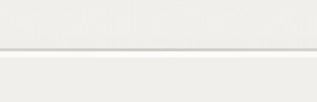

Special Thanks
Sponsor: National Institutes of Health (NIH)
  Granded funding for research
  Grant Title: Remote Alcohol Monitoring to Fascilitate Abstinence Reinforcement
  Project Number: 5R21AA022727-02
  https://projectreporter.nih.gov/project_info_description.cfm?aid=8904569

Slide 14
References
http://research.vtc.vt.edu/people/mikhail-koffarnus
http://research.vtc.vt.edu/people/john-t-crawford
http://thewirecutter.com/wp-content/uploads/2015/12/breathalyzers-testing-630.jpg
http://cdn.shopify.com/s/files/1/0177/6214/products/BuyNow_Mobile_grande_25e68bec-523f-44c6-9b04-a338b2e1b7b1_1024x1024.png?v=1448496556
http://storage.googleapis.com/ix_choosemuse/uploads/2016/02/android-logo.png
http://www.leclairimages.com/new%20web%20images%20links/question_mark_serious_thinker_500_clr_5562.gif

Slide 15

Thank you!

