Slide 1
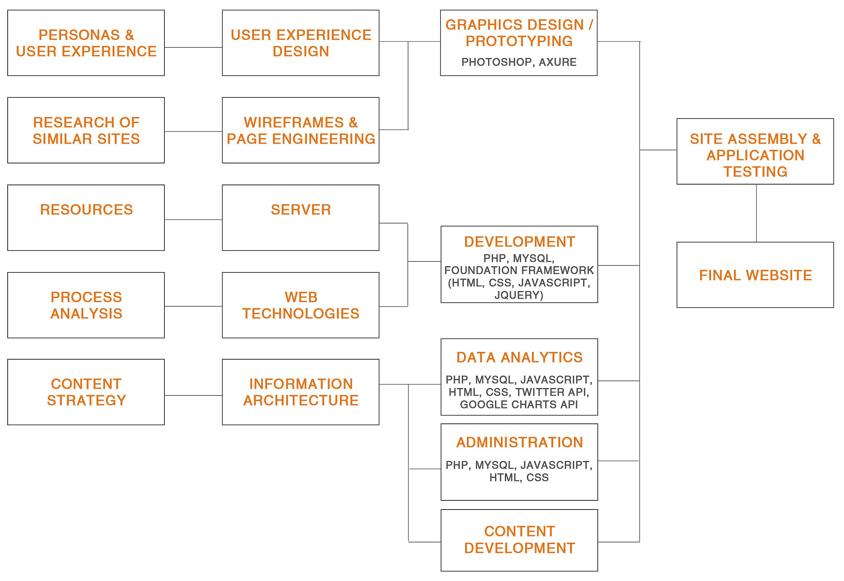
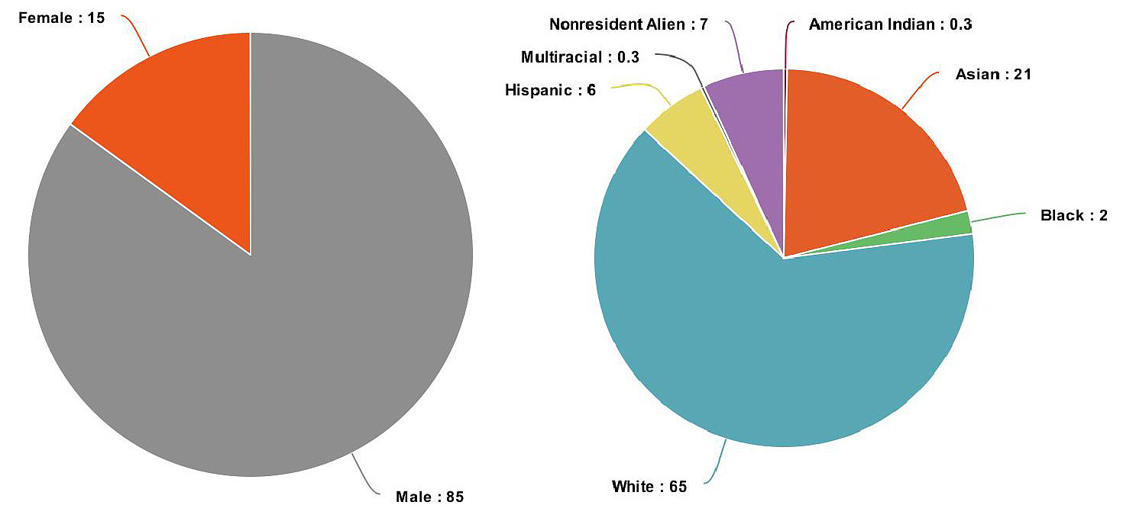

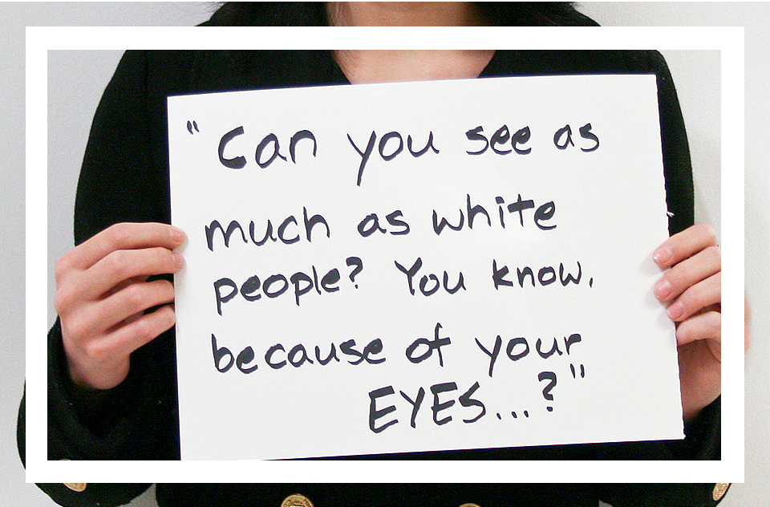
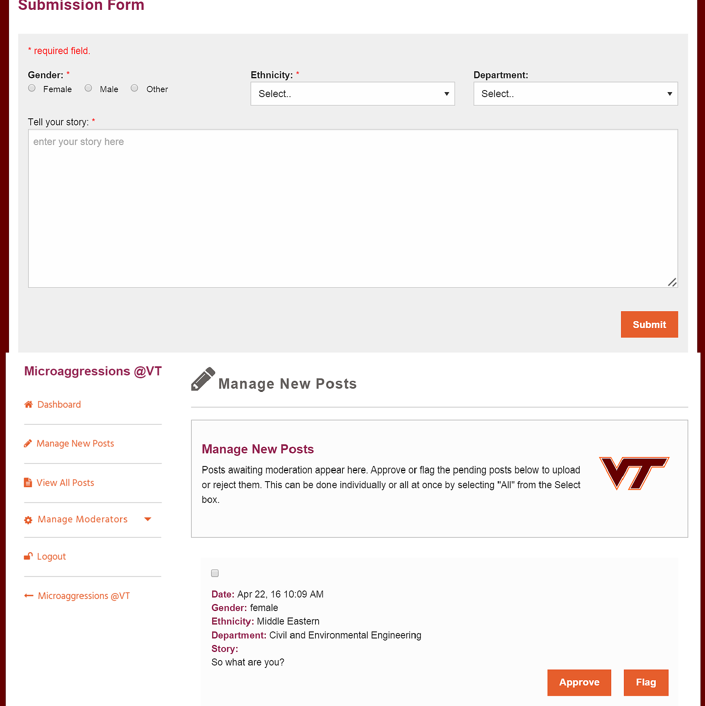
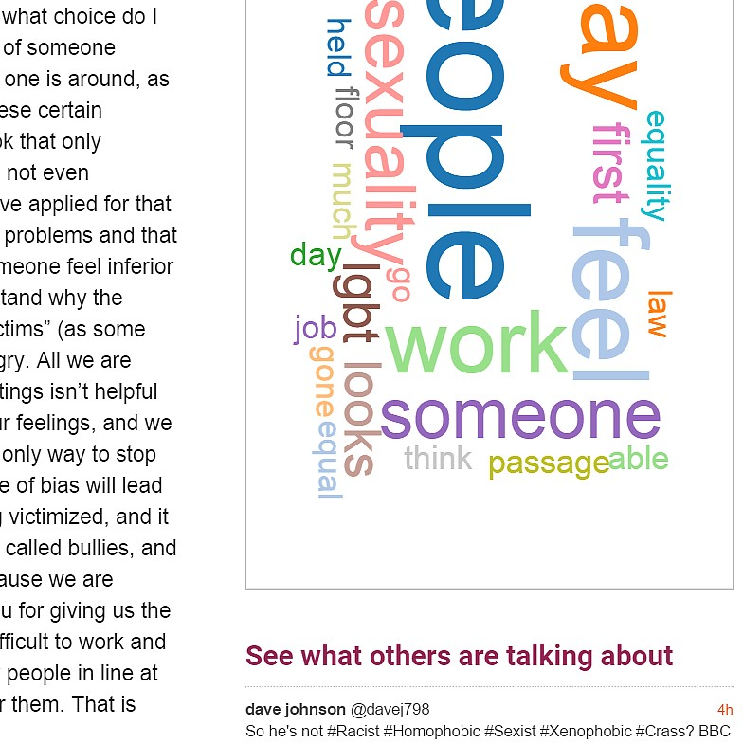
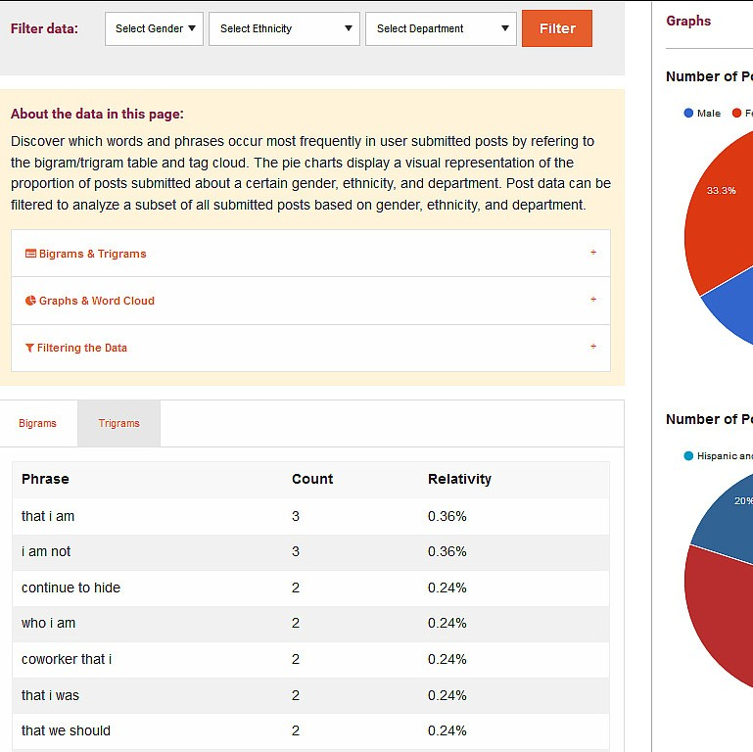
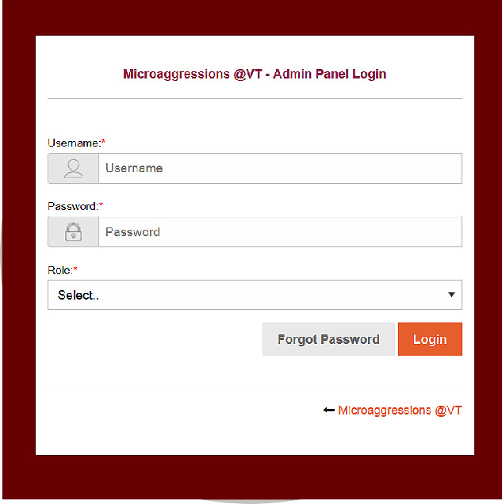

MICROAGGRESSIONS @ VT
Arunima Singh, Brandon Falcone, Cyndy Ejanda, Robert Wenger
CS4624: Multimedia, Hypertext, and Information Access: Capstone Project
www.microaggressions.cs.vt.edu
THE PROBLEM
Microaggressions can negatively impact the cultural climate for Virginia Tech professors.
THE PROCESS
IMPACT
Making faculty feel more included at Virginia Tech is the goal of www.microaggressions.cs.vt.edu
Making anonymous posts about personal experiences with microaggressions allows for the opportunity to bring to the surface the kinds of hurtful comments that repeatedly get dismissed in the work environment.
All faculty will feel more accepted and included at Virginia Tech when the negative impact of microaggressions is more well-known.
Microaggressions are a daily occurrence for some faculty members, which can lead them to feel excluded. This results in a poor work environment at Virginia Tech.
THE TECHNICAL SOLUTIONS
images from: http://i2amubc.tumblr.com/ http://www.ic.edu/Customized/Uploads/ByDate/2015/August_2015/August_10th_2015/081015_diversity­wall­V116184.jpg
[Share stories anonymously]
[Visualize data through a word cloud, N­gram analysis, pie charts, and tweets]
[Control content through a Content Management System]

