Slide 1





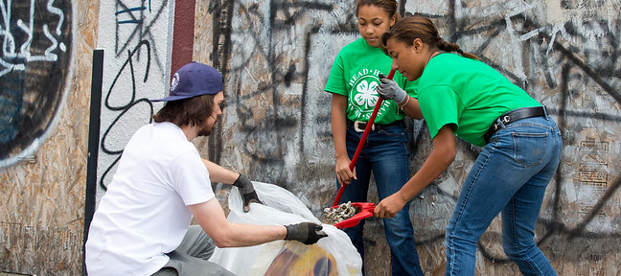

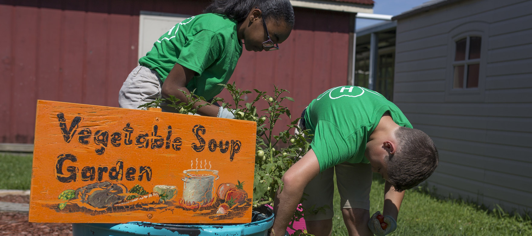

Virginia 4-H
Youth Protection Training
Notes:
Hello, and thank you for your service as a Virginia 4-H volunteer! This training will take you through important information about youth protection including Title IX, Mandated Reporting, Health & Safety, and our Above Suspicion Policy. Training on these topics is required annually for volunteers and employees, and we appreciate you taking the time to become more familiar with these vital topics.

Slide 2
Title IX: Anti-Discrimination, Harassment,
& Violence
By taking this training and applying its lessons you will be contributing to creating a vibrant, equitable and inclusive campus community free of all forms of discrimination, harassment and violence.
This training module will introduce you to Virginia Tech's policies and procedures relating to discrimination, harassment and sex, and gender-based violence. This training module will also teach you the basic skills for being an effective anti-discrimination and anti-harassment ally. Please note that all program supervision personnel and volunteers working with minors in a University sponsored event, program, or activity (including 4-H) are required to complete this training.
We realize that the content of this course could be highly sensitive and even triggering to some. We invite you to contact the Youth Protection Office at (540) 838-1255 if you require any accommodations or if you have any questions, comments, or concerns

Slide 3
Background to Consider
This is a sampling of Federal Civil Rights Laws and Regulations Applicable to Virginia Tech. Simply be aware these issues have been developed over a long period and many people have been working very hard to discourage harassment, discrimination and violence in our society. These laws also determine steps to be taken if any of this is reported to have occurred.
Title VI of the Civil Rights Act of 1964, which prohibits discrimination on the basis of race, color, or national origin.
Federal-Aid Highway Act of 1973, which prohibits discrimination on the basis of sex.
Title IX of the Education Amendments of 1972, as amended, which prohibits discrimination on the basis of sex in education programs or activities.
The Age Discrimination Act of 1975, as amended, which prohibits discrimination on the basis of age.
Section 504 of the Rehabilitation Act of 1973, as amended, which prohibits discrimination on the basis of disability.
Titles II and III of the Americans with Disabilities Act, which prohibit discrimination on the basis of disability in the operation of public entities, public and private transportation systems, places of public accommodation, and certain testing entities

Slide 4
Background to Consider
This is a sampling of Federal Civil Rights Laws and Regulations Applicable to Virginia Tech. Simply be aware these issues have been developed over a long period and many people have been working very hard to discourage harassment, discrimination and violence in our society. These laws also determine steps to be taken if any of this is reported to have occurred.
Executive Order 12898, Federal Actions to Address Environmental Justice in Minority Populations and Low-Income Populations, which prohibits discrimination against minority populations by discouraging programs, policies, and activities with disproportionately high and adverse human health or environmental effects on minority and low-income populations.
Executive Order 13166, Improving Access to Services for Persons with Limited English Proficiency, and resulting guidance, national origin discrimination includes discrimination because of limited English proficiency (LEP).

Slide 5


What is Title IX?
Title IX is a federal law that protects higher education students and employees, including faculty and student workers, from discrimination based on sex or gender stereotyping in federally funded education programs and activities. As a part of Virginia Tech, Virginia 4-H follows all regulations pertaining to Title IX.

Slide 6
Important Title IX Definitions
CONSENT
Knowing, voluntary, and clear permission by word or action to engage in mutually agreed upon sexual activity. Silence does not necessarily constitute consent and coercion, force, or threat of harm if either party invalidates consent. Consent cannot be given where a person is incapacitated due to drugs or alcohol; or where a person has a disability; or is not of legal age to consent as defined by law. Consent to any one form of sexual activity cannot automatically imply consent to any other forms of sexual activity. Consent can be withdrawn at any time. Previous relationships or prior consent cannot imply consent to future sexual acts.

Slide 7
Important Title IX Definitions
SEXUAL HARASSMENT
There are different types of sexual harassment. The behaviors prohibited under Title IX are rape and sexual assault, relationship violence, and stalking.
"Hostile environment" and "quid pro quo" are two other types of sexual harassment that are prohibited under Title IX.

Slide 8
Important Title IX Definitions
HOSTILE ENVIRONMENT
Hostile environment sexual harassment involves verbal or non-verbal conduct. This form of harassment must be so severe, pervasive, and objectively offensive that it effectively denies a person equal access to education in order to violate Title IX.
In other words, if inappropriate behavior makes a reasonable person want to stop participating in an educational opportunity, Title IX has been violated.

Slide 9
Important Title IX Definitions
QUID PRO QUO
Or "this for that", is a type of sexual harassment that occurs when an educational benefit or service is conditional on the student submitting to unwanted sexual conduct.

Slide 10
Important Title IX Definitions
SEXUAL ASSAULT
Any type of sexual contact or behavior initiates without the other person's explicit consent is sexual assault. Minimally this includes any behavior that makes a person feel they will be touched sexually in any way that is not consensual. At the most severe end of the definition, it includes actual unwanted sexual area touching (Sexual Assault), attempted rape and rape.

Slide 11
Important Title IX Definitions
RELATIONSHIP VIOLENCE
Domestic and dating violence is abusive, physical, or sexual behavior that occurs between current or former partners.

Slide 12
Important Title IX Definitions
STALKING
Engaging in a course of conduct directed at a specific person that would cause a reasonable person to: (a) fear for the person’s individual safety or the safety of others, or (b) suffer substantial emotional distress. Stalking may occur in person, but often happens by phone and online.
In short, stalking is making someone fear they may get hurt or sexually assaulted. This can be in person or by electronic means. If repeated, stalking is a crime.

Slide 13
Important Title IX Definitions
RETALIATION
Intimidation, coercion, threatening or discrimination against another person because they reported or participated in an investigation or disciplinary or legal proceeding involving sexual harassment prohibited by Title IX is retaliation.

Slide 14
Building Supportive & Inclusive Programs, Events, & Activities
Notes:
Your Role
These policies and laws are about accepting everyone for who they are and enjoying the time you have to be together. Negativity has no place in the event/program or activity you are working in. Don’t be a part of it and be ready to do something if you see it. Take charge, develop a non-negative culture in your "scope of duty" and if you see something, say something. It may be simply interjecting a reasonable admonishment to quell negativity or it may be to bring something to the attention of the appropriate officials.

Slide 15



The 3 A’s of Bystander Intervention
AWARENESS
Be conscious of what is happening around you and your colleagues in the program, event or activity where you are helping. Assessing and evaluating your environment is the first step to being an active, rather than a passive, bystander.
ATTITUDES
Maintaining a respectful, equitable environment means actively modeling the attitude that discrimination, harassment, and retaliation have no place in a learning environment.
ACTION
You have the power to act whether by intervening directly or by reaching out to others. If you are uncomfortable intervening directly, you can still make a difference by informing someone who is equipped to help address the situation.

Slide 16
Reporting by Employees
Administrators, supervisors, academic advisors, employees with instructional responsibilities and other employees who have significant responsibilities for student or campus activities (including Extension Employees) or for implementing policies relating to employee and student discipline must promptly report all available information to the Office for Equity and Accessibility's (OEA) Title IX Coordinator once they are on notice of any sexual misconduct or gender-based violence.
More information can be obtained at https://oea.vt.edu/.

Slide 17
Reporting Title IX Violations in Virginia 4-H
If volunteers have knowledge or suspicion of a Title IX violation, this should be reported promptly to the local 4-H Extension Agent, and an incident report should be submitted.
Extension Agents should report this information to their District Director, and to the State
4-H Office through submission of the online Accident/Incident Report Form.
The State 4-H Leader, Mr. Jeremy Johnson, serves as the Title IX contact for Virginia 4-H and is responsible for ensuring that all incidents of Title IX violations are reported to the appropriate offices at Virginia Tech.
Remember: If you see something, say something!

Slide 18
Relationship Building
Research shows that healthy relationships both at home and at work enhance well-being, foster greater security and encourage better decision-making. While successful relationships can take many forms, they typically share similar characteristics.

Slide 19
Characteristics of Successful Relationships
RESPECT - Accepting others for who they are, even when you may not agree with what they believe or value.
TRUST - Having confidence in the compassion and reliability of others, so that accountability is always present.
COLLABORATION - Working together toward a common goal.
COMMUNICATION - Exchanging thoughts and ideas in an honest and open manner; speaking up for yourself while respecting the right of others to do the same.
POSITIVITY - Creating an atmosphere that builds an optimistic environment and maintains respect and an equality

Slide 20
Relationship Abuse
Relationship abuse happens when one person coerces or controls the other. It tends to escalate over time and is often part of a larger pattern of dominance.

Slide 21
Characteristics of Relationship Abuse
UNWANTED ISOLATION – Pressuring someone to cut off ties with friends, family, colleagues, and others.
EMOTIONAL ABUSE – Making someone feel bad about themselves or unworthy of being treated well.
FINANCIAL INTERFERENCE – Jeopardizing someone’s job, preventing them from obtaining employment, or withholding financial information in order to keep them financially dependent.
PHYSICAL ABUSE – Threatening assault or acting on those threats in a violent way.
SEXUAL ABUSE – Forcing someone to engage in unwanted sexual activity without their explicit consent.

Slide 22
Mandated Reporting in Virginia
Notes:
Virginia requires that certain suspicions of neglect or abuse be reported to the local social services department. As a Virginia Cooperative Extension representative in Virginia 4-H, you are a Mandated Reporter.

Slide 23
Why am I a Mandated Reporter?
Under the laws of the Commonwealth and the expectations of Virginia Tech, if at any time the neglect or abuse of a minor is known or suspected, it must be reported within 24 hours of discovery or suspicion. This law relates to neglect and/or abuse by a parent, guardian, or anyone having a temporary custodial relationship with a minor (i.e. a camp counselor). This is regardless of whether the neglect or abuse is observed during normal working hours or program activities.
Notes:
Because you have become a person Virginia Tech will entrust minors to, you become a mandated reporter by law. We want to feel comfortable with and act on the phrase "If you see something, say something". Program Administrators and other team members can discuss and determine the best course of action but no one can if nothing is said!
You should be proud of your dedication and desire to be a part of Virginia 4-H's mission to reach as many of the young people in our community with enriching and quality programs, events and activities.

Slide 24
What Do I Report?
Report all known incidents or suspicions of child abuse or neglect
Recognizing a child has been abused or neglected can be a traumatic event. While you are working with a group of minors at camp, you see a bruise that looks like someone gripped too tightly around a youngster’s arm and it wasn't there yesterday. Or a 7-year-old tells you another camp counselor touched him in an inappropriate manner ten minutes ago. You find yourself in a situation that involves reporting the incident, continuing to supervise the others and making sure the victims are safe. It is a difficult situation for anyone to be in.
Nonetheless, Virginia law states that whenever someone is supervising minors, they have an obligation to report these incidents and others to the appropriate people if they think a parent, guardian or custodial official has neglected or abused a minor. A guardian can be anyone in a supervisory role for that minor, including those that are in supervisory roles during activities supported by Virginia Tech.
Notes:
Remember: If you see something, say something! Extension personnel can discuss and determine the best course of action but no one can if nothing is said!

Slide 25
Remember: We Do Not Investigate
Notes:
Please remember, that if there is knowledge or suspicion of child abuse or neglect, our role as mandated reporters is not to investigate. We should only gather the information that is necessary to make the report to Child Protective Services. CPS is the agency charged with investigation – not Virginia 4-H.

Slide 26
Who Do I Report To?
Any suspected abuse or neglect that makes you believe a minor is in danger of severe injury or death can be reported to 911 or local law enforcement.
By law, a report MUST be made to the local Social Services Department (or the state hotline) within 24 hours of any suspected abuse or neglect. Volunteers must notify the local Extension Agent, and it is recommended to make the call together, if possible. But the person knowing or suspecting the abuse or neglect must make the call within 24 hours no matter what!
The local Extension Agent must be notified and will prepare an incident report which will be filed with the State 4-H Office using the online Accident/Incident Report Form. The Extension Agent will also notify the District Director.
It is not enough to just report the incident to the next person in the chain-of-command. Everyone is responsible for ensuring that the report is made to Child Protective Services within 24 hours.
The Virginia CPS Hotline number is 800-552-7096; for hearing impaired it’s 800-828-1120

Slide 27
Information to Have When Making a Report
When making a report to Child Protective Services, it is helpful to have the following information on hand:
Names of youth involved (including any family members)
Ages
Grade levels
Phone numbers
Addresses
Emergency Contact Numbers
Any other known information about the family
Much of this information is available on the Virginia 4-H Health History Form printed from 4-H Online. Volunteers should consult their Extension Agent if there are any questions.

Slide 28
Health & Safety When Working with Minors
Notes:
This information is designed to help know what is expected from employees and volunteers in the event of a health or safety problem. Topics will range from allergies to facing gunfire. The official categories that will be discussed are Medical Issues, Accidental Incidents, Weather, Fire and Acts of Violence.

Slide 29
Communication
In all emergency situations, communication can get confused and chaotic. Many after action evaluations of historically important events include failures in communication being the most difficult issue officials faced. To minimize this, a communication plan is vital.
If you are a volunteer, be sure to check with your Extension Agent to find out what the communication plan is in your locality for any 4-H meetings, events, or activities.

Slide 30
Media Relations
Requests from the media should be directed to the local Extension Agent. Virginia Cooperative Extension policies specify that only certain individuals may speak to the media in case of an accident or incident. Volunteers and agents are expected to follow these policies and should contact the State 4-H Office if there are any questions.
Volunteers should consult with their local Extension Office regarding expectations for social media presence and public relations with clubs or other 4-H events.
The VCE Emergency Procedures card on the Publications website provides updated and useful information for communication in the event of a serious incident or emergency.

Slide 31
Medical Issues
Most medical incidents will be minor. However, there are some potentially serious conditions to be aware of.
All 4-H youth and adults are required to fill out a Health History Form in 4-H Online that includes any medical issues which program officials need to be aware of. This includes allergies and other conditions that may cause emergencies.
The Health History Form, and a Medication Form, should include detailed instructions for how to treat any conditions someone may have including allergies, food sensitivities, diabetes, asthma, etc.

Slide 32
Handling Accidents
Remember to stay calm
If there is a serious or life-threatening emergency, call 911
Know the location of all first aid kits and Automated Exterior Defibrillators (AEDs)
Follow the communication plan provided by the local Extension Office
If someone is hurt, do your best to calm and immobilize the injured until first responders arrive. It is required that all minors are supervised at all times.
Document the incident with an Accident/Incident Report. This may also need to be filed online with the State 4-H Office by the Extension Agent
Notes:
We understand that accidents do happen. Volunteers will be provided more specific training by their Local Extension Office regarding procedures for 4-H clubs, events, camp, etc. In general, we have a few tips to help in case an accident happens at a 4-H function.

Slide 33
Weather & Fire Preparedness
All 4-H Educational Centers have specific plans for dealing with emergencies and will provide training
Follow local training for club meetings, local events, etc.
Remember to always take roll for all youth and adults
We should provide supervision so that we always know where each person (youth and adult) is at all times

Slide 34
Active Violence Events
Hide, Fight, or Run (subject to the immediate deadly threat)
Reaction Zone: Help to Safety or Call for Help
What’s-Going-On-Zone: Lock Down, Shelter-in-Place
Stay as calm as possible
Communicate
Do whatever you can to keep yourself safe
Make reasonable decisions related to the location of the danger
Being “invisible” (lights off, doors locked, blinds closed) may help an active threat move away from your location
Notes:
As we have all come to realize, violence can erupt anywhere at any time. We are vulnerable to this anywhere we go. An active shooter is a prominent example of this concern. Survival is often determined by being able to stay calm and avoid panic during a traumatic event. When working with minors in a supervisory role it is imperative we consider this.
The closer you are to an active violent event the less likely you will utilize any technology and your mind will prompt the fight, flight or hide reaction.
Stay Calm...if you are in the most dangerous spot, any of these options are appropriate. People thrust into this position typically respond with one of three reactions: hide, fight or run. The real key is to not panic. Panic causes most people to do nothing, which is the worst thing. So, if possible and thinking of the assignment in the activity you are in, consider getting yourself and anyone you are responsible for away from the danger. Putting a barrier between you and the threat may be appropriate.
If you are not in the "Hide, Fight or Run Zone" area but close enough to realize what is happening you are in a "Reaction Zone". Most people in this area help pull people to safety and generally are the people calling 911. The quicker someone realizes they are in this area the better they can help those around them.
In the What’s-Going-On-Zone the threat is unknown and awareness will be less as a person's location gets further from "Hide, Fight or Run Zone" and the "Reaction Zone". Someone running from the "Reaction Zone", may give you the first indication something is wrong.

Slide 35
Above Suspicion Policy
Notes:
This policy is designed to help keep all our employees and volunteers safe and above suspicion. Using the "Rule of Three" and knowing who to report certain incidents to gives each adult the ability to protect themselves and those around them during a camp, event, or program.

Slide 36
“Rule of 3”
Virginia Tech Policy 4815 states that all supervisory staff (salaried and volunteers) should avoid placing themselves in situations where they are alone with single unrelated young person. As a result, there will always be three people in any situation involving a minor, preferably another adult.
Any group of two involving a minor should prompt a trained adult to move where a third person is as soon as possible.
Supervising adults should always be within sight and hearing distance to meet the requirements of the Rule of 3.
Parents, the Extension Agent, or another vetted volunteer should always be included if there is electronic communication with a minor.

Slide 37
Avoiding Problematic Situations
Never be alone with a minor
If you find yourself alone with a minor, quickly move to where others are located or summon another adult to where you are
If a minor asks to speak to you, ensure another adult is close enough to see and hear
Alert the Extension Agent immediately if you encounter violations of the Above Suspicion Policy

