Slide 1

CS 5604: Information Storage and Retrieval
Elasticsearch
Soumya Arvind Kumar
Yuan Li
Nicholas Gill
Satvik Chekuri
Tianrui Hu
Instructor: Dr. Edward A. Fox
TA: Ziqian Song
12/10/19
Virginia Tech, Blacksburg, VA, 24060

Slide 2
PROJECT OVERVIEW

Slide 3

Problem Statement
Build an Information and Retrieval System that will act as a search engine to support ranking, searching, browsing and recommendations for two large collections of data:
14M Tobacco Settlement Documents
30K ETDs Electronic Theses and Dissertations

Slide 4
Requirements for Elasticsearch
Ingest data provided by the CME and CMT teams into Elasticsearch in the correct format.
Decide the relevancy and importance of fields related to the ETD and tobacco dataset and provide feedback on the same.
Incorporate additional data from TML team related to text summarisation, name entity recognition, sentiment analysis, and clustering information.
For enhanced search accuracy, perform boosting to assign higher weights to important fields.
Implement nested queries for in-depth search inside each document.
Establish connection with Kibana to support searching, browsing and information visualisation.
Implement automatic ingesting and updating scripts to monitor a designated directory on ceph for new incoming files.

Slide 5
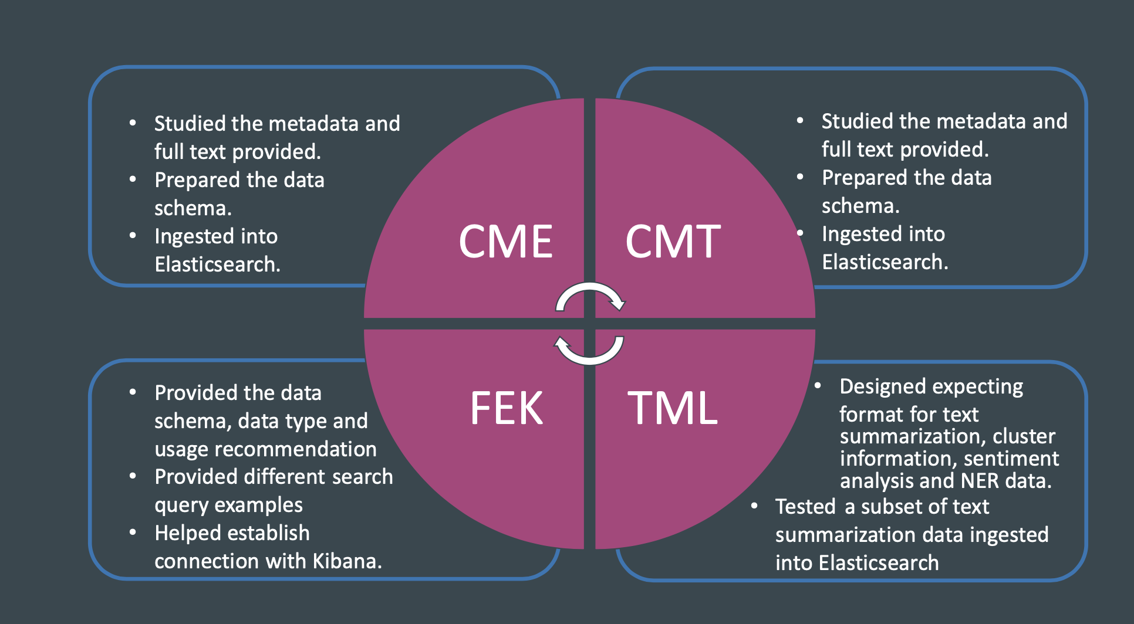

Contribution to Other Teams

Slide 6
Achievements
CME
CMT
TML
99.8%
99.9%
In Progress
30,925 Electronic Thesis Documents ingested including metadata and full text.
5,595,936 Tobacco Settlement Documents metadata ingested (81 failed);
including 100,000 metadata and full text.
Text Summarization,
Sentiment Analysis,
Named-Entity Recognition,
Cluster Data
Fully searchable documents
Can be filtered and sorted.
Prepared automated script for addition of new documents
Fully searchable documents
Can be filtered and sorted.
Prepared automated script for addition of new documents.
Tested the text summarisation format.
Receiving data from TML.
Work in progress.

Slide 7
DESIGN & IMPLEMENTATION

Slide 8
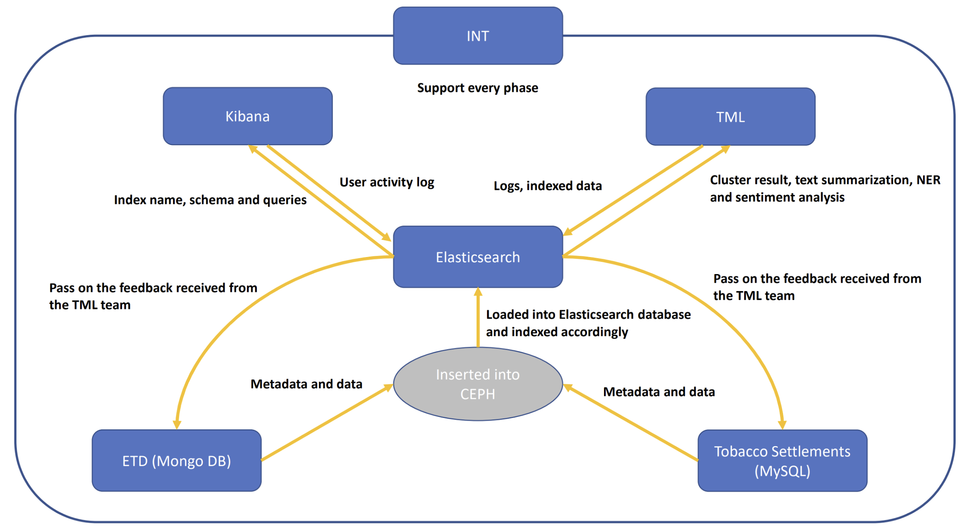
Concept Map for Elasticsearch

Slide 9
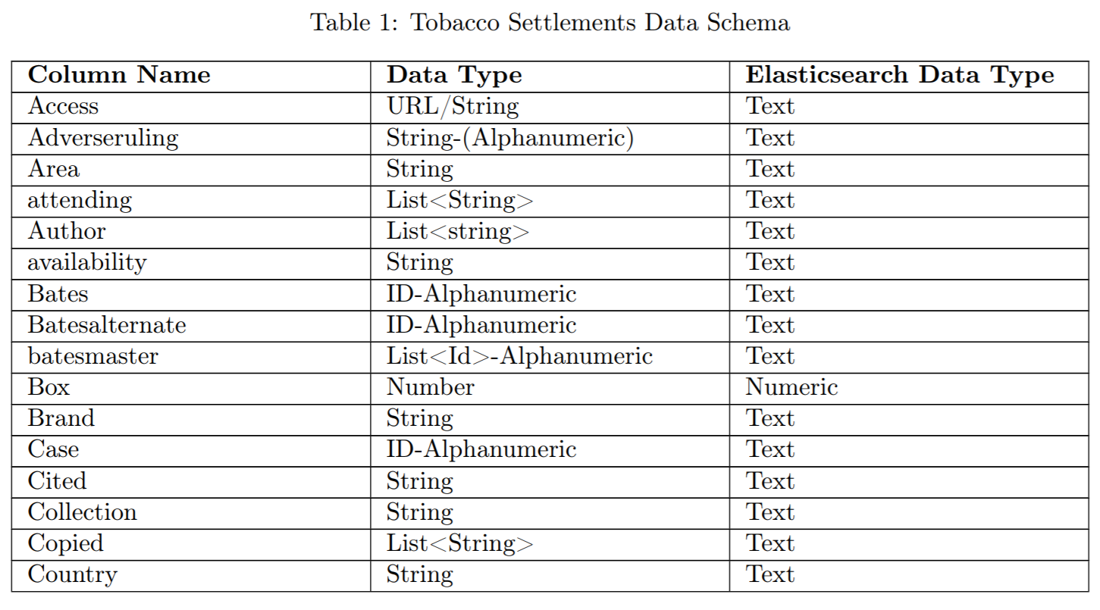
Tobacco Data Schema

Slide 10
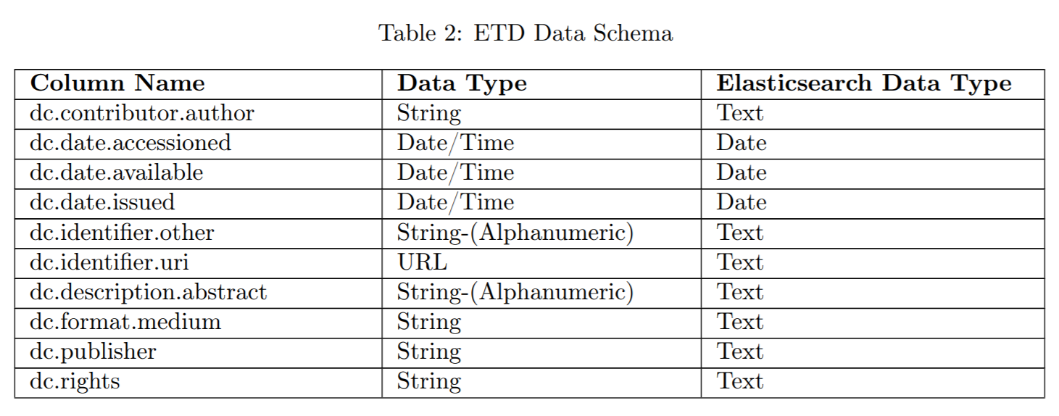
ETD Data Schema

Slide 11
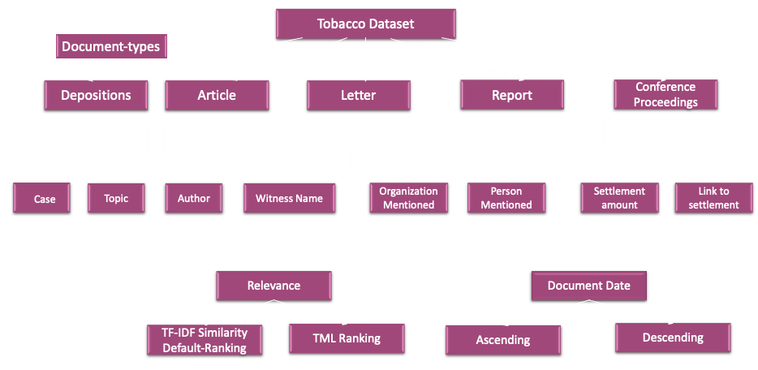
Tobacco Data Structure

Slide 12
Field Name | Field Type | Field Demo
Case | text | Minnesota v. Philip Morris Inc.
Brands | text | Marlboro
Witness_Name | text | "Wyant, Timothy (affiliation: Decipher; expertise: Statistical analysis; job_title:
Topic | text | advertising; health effects
Person_Mentioned | text | Burns, David Michael, M.D
Organization_Mentioned | text | R.J. Reynolds Tobacco Co.
Description | text | "The plaintiffs expert witness, a statistician, was deposed”
Title | text | "Deposition of TIMOTHY S. WYANT, Ph.D., August 19, 1997
Date_Added_UCSF | text | 20 January 2006
Document_Date | text | 19 August 1997
Cluster | text/keyword | 321
page | text/keyword | 5
content | text/keyword | Paper details
Fields for Searching and Filtering:
TOBACCO SETTLEMENT DOCUMENTS
For all field types of ‘Text’, use field_name for searching and field_name.keyword for filtering or sorting

Slide 13
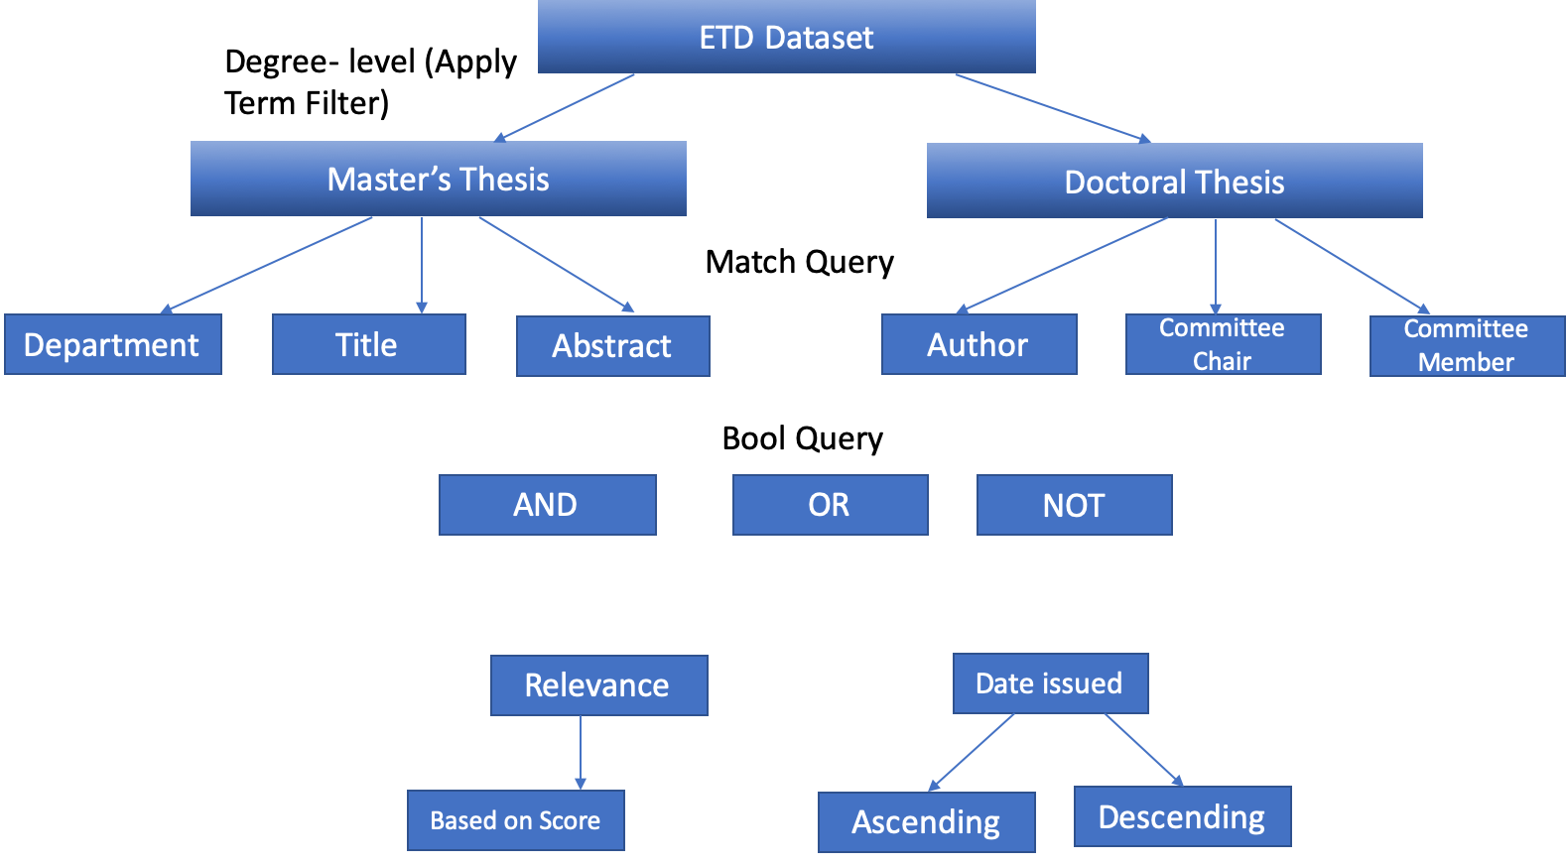
ETD Data Structure
Searching
Degree level (Apply Filter)
Match Query
Bool Query
Sorting
Must
Must
Should
Should not

Slide 14
Fields for Searching and Filtering:
ETDs
For all field types of ‘Text’, use field_name for searching and field_name.keyword for filtering or sorting
Field Name | FIeld Type | Field Demo
degree-level | text | masters
contributor-department | text | Computer science
contributor-author | text | Tony Stark
Contributor-committee chair | text | John wick
Contributor-committee co-chair | text | Chris scott
Contributor-committee member | text | David knight
date-available | date | 2017-01-23
date-issued | date | 2018-02-21
degree-name | text | MS or P.hD
description-abstract | text | This field conveys the abstract of the thesis in 10-15 lines
Author Email | text | tony_s@stark.com
subject-none | text | Soils -- Aluminum content Cations
title-none | text | Hydrolysis of aluminum in synthetic cation exchange
type-none | text | Dissertation

Slide 15
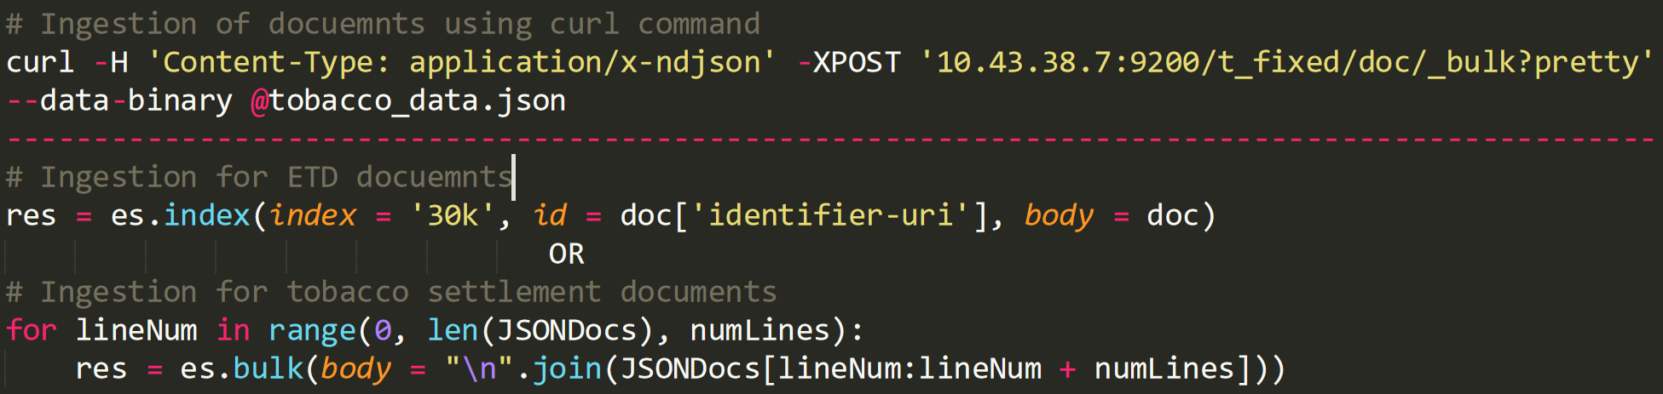
Indexing Methods
Metadata
Data
Generated Data
Stores the records detail that describes and gives information about the source data
Stores the text content of the ETD and tobacco settlement datasets (page-wise)
Data generated by the TML team consists of cluster ID, text summary, sentiment analysis and NER keywords
Executable python script on ceph in els directory

Slide 16
Ingesting by Elasticsearch-Python Client
Parsing files into designed format for ingesting
Assign the ID and the name of index
Logging errors (document ID and error messages)

Slide 17
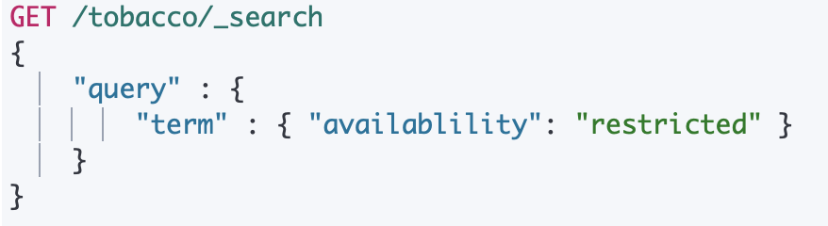
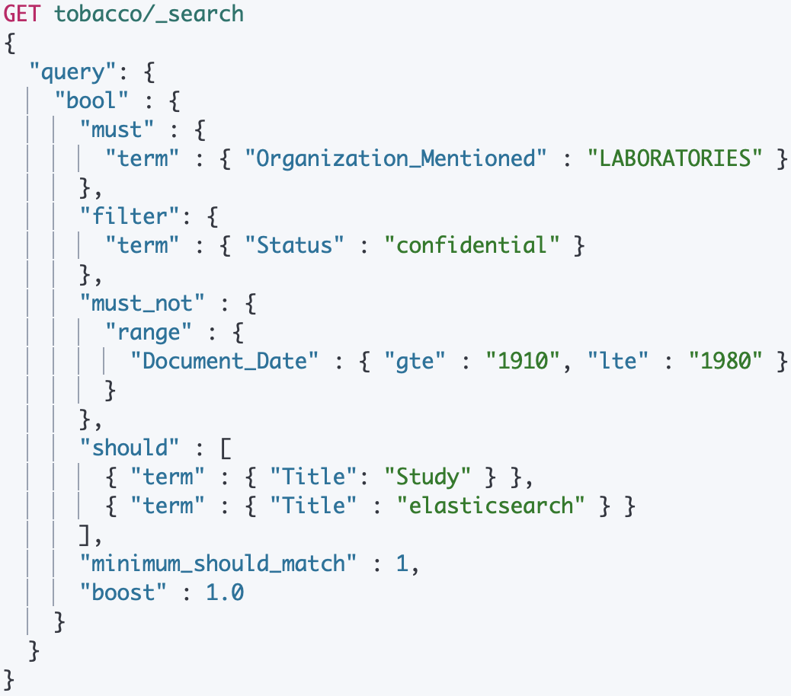
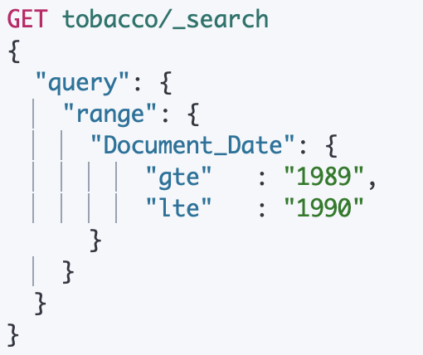
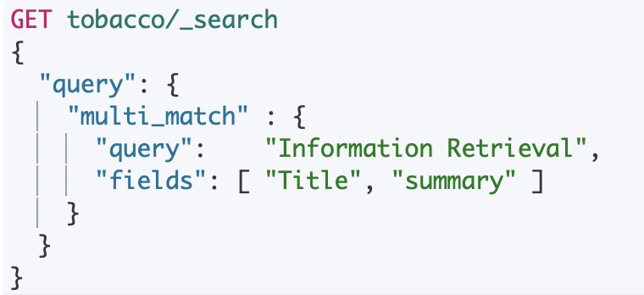
Searching Query
Notes:
After all documents are ingested, let’s talk about how to search in Elasticsearch.
Elasticsearch is designed as a powerful search engine. So it’s capable of many kinds of searching.
For example, the most simple one is directly search for a term in a certain field. It’s able to search in multiple fields.
And query for documents in a date range.
There are also several more complicated logic operation like must, filter, must not, and should
which means a term must appear in matching documents and it will contribute to the score. Filter also means a term must appear in matching documents, but it won’t contribute to the score.

Slide 18
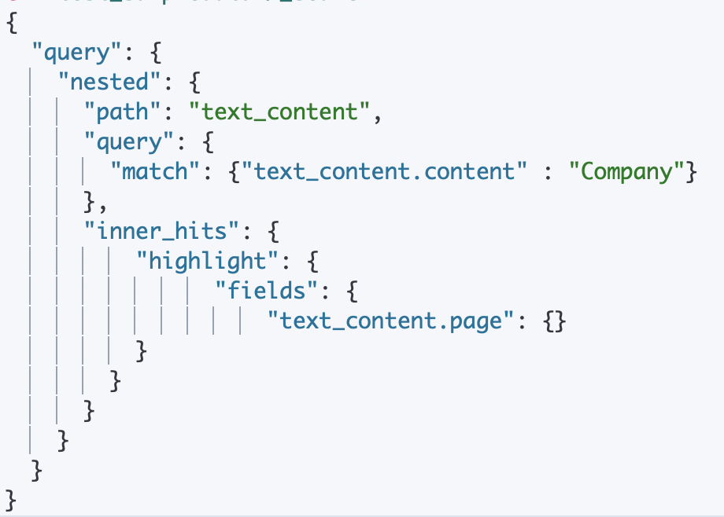
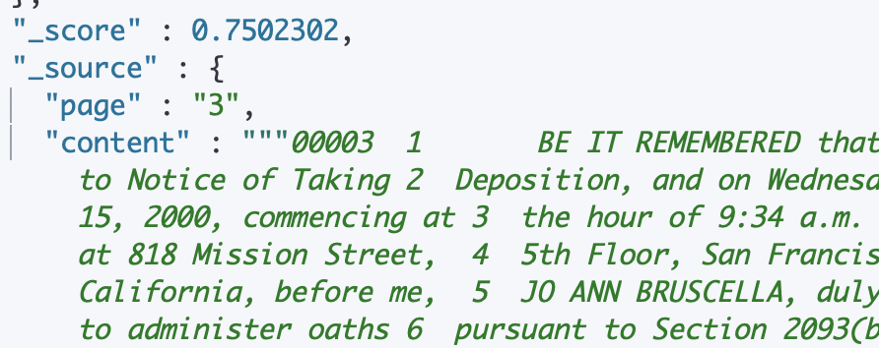
Full Text Search: Nested Query
Tobacco Doc 1:
Full Text content:
Chapter/Page 1
Chapter/Page 1
Chapter/Page 2
Chapter/Page 2
Chapter/Page 3
Chapter/Page 3
Notes:
As mentioned just now, we can search for a term in a field. It means that we are able to implement the full text searching if full texts are put in a certain field. But in this way, users are hard to locate where this term appears in the text, like which page or which chapter. So, we designed a nested data structure to solve the problem. Specifically, we would like the full texts are separated by pages. Then, we will ingest them into a nested structure. So, when we search in the full text field, the number of page which contains the term will be highlighted in the result. Here is an example searching in tobacco dataset. But chapter-wise data is not provided for ETD dataset so right now we don’t have an example for ETD.
nested query is not applicable for the ETD dataset

Slide 19
Search Preference: Boosting
Elasticsearch rank searching results based on a designed score.
The scores are calculated by a similarity model based on Term Frequency (TF) and Inverse Document Frequency (IDF) as well as using the Vector Space Model (VSM) for multi-term queries.
Notes:
Next, let’s talk about boosting.
So what if we’d like to change the score calculation. There are two ways. The first is to modify the calculation function directly. We are able to do that but it will need a careful design.
So, we didn’t implement it in our project.
Another way is to use the boosting. If you want a certain filed to contribute more to the score. Then you can add more boosting weight to it.
The boosting weights can be added to the field directly when ingesting or determined in queries while searching

Slide 20
Search Preference: Boosting
Field 1, with no boost
Field 1
{ETD Doc 1: field_1: A,
field_2: None,
field_3: None}
{ETD Doc 2: field_1: None,
field_2: A,
field_3: None}
{ETD Doc 3: field_1: None,
field_2: None,
field_3: A}
Field 2, with boost weight = 2
Field 2
Field 3, with boost weight = 0.5
Field 3
Score = field_1 + 2 * field_2 + 0.5 * field_3
Searching for A:
score_2 > score_1 > score_3
Notes:
Another way is to use the boosting. If you want a certain filed to contribute more to the score. Then you can add more boosting weight to it.
The boosting weights can be added to the field directly when ingesting or determined in queries while searching

Slide 21
Logging
User Logs:
User-oriented information: username, timestamp, query content, IP, cookie, user-agent, etc.
Recommendation, detecting malicious user behaviors, website data analysis.
Index: .logging-yyyy/mm/dd
Notes:
Regarding logging, the first kind of logging is user logs.
We cannot generate user log but Elasticsearch is able to save the logs. Index can be created for user logs continuously every day, week, or month. It will depend on the number of users and amount of traffic flow of our website. We can decide how long we would like to keep these logs by index Lifecycle. Yuan will talk about what is index lifecycle after.

Slide 22
Logging
{"type": "index_search_slowlog", "timestamp": "2019-12-04T01:09:09,002Z", "level": "WARN", "component": "i.s.s.query", "cluster.name": "elasticsearch", "node.name": "elasticsearch-master-0", "message": "[30k][0]", "took": "930.9ms", "took_millis": "930", "total_hits": "19 hits", "stats": "[]", "search_type": "QUERY_THEN_FETCH", "total_shards": "1", "source": "{\"query\":{\"term\":{\"title-none\":{\"value\":\"data\",\"boost\":1.0}}}}", "cluster.uuid": "M7gJSQVkSYi3THDYCTvIew", "node.id": "nXkX9qONS2y0g5WB8NGezQ" }
{"type": "index_search_slowlog", "timestamp": "2019-12-04T01:17:14,635Z", "level": "WARN", "component": "i.s.s.fetch", "cluster.name": "elasticsearch", "node.name": "elasticsearch-master-1", "message": "[tobacco][0]", "took": "1.5ms", "took_millis": "1", "total_hits": "446 hits", "stats": "[]", "search_type": "QUERY_THEN_FETCH", "total_shards": "1", "source": "{\"query\":{\"term\":{\"Topic\":{\"value\":\"health\",\"boost\":1.0}}}}", "cluster.uuid": "M7gJSQVkSYi3THDYCTvIew", "node.id": "iLagChv6S8OxTzRhY9yLFQ" }
System Logs:
Event/request recording: timestamp, cluster.name, node.name, cluster.uuid, request/event message.
PUT /tobacco/_settings
{
"index.search.slowlog.threshold.query.warn": "1s",
"index.search.slowlog.threshold.query.info": "1s",
"index.search.slowlog.threshold.query.debug": "2s",
"index.search.slowlog.threshold.query.trace": "500ms",
"index.search.slowlog.threshold.fetch.warn": "1s",
"index.search.slowlog.threshold.fetch.info": "800ms",
"index.search.slowlog.threshold.fetch.debug": "500ms",
"index.search.slowlog.threshold.fetch.trace": "200ms",
"index.search.slowlog.level": "info"
}
Notes:
Another log is system logs. It will record events and requests being sent to Elasticsearch. We turn on the logging for both tobacco and ETD. It contains information like

Slide 23
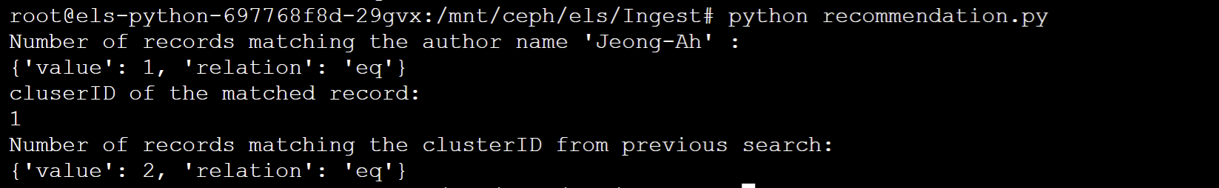
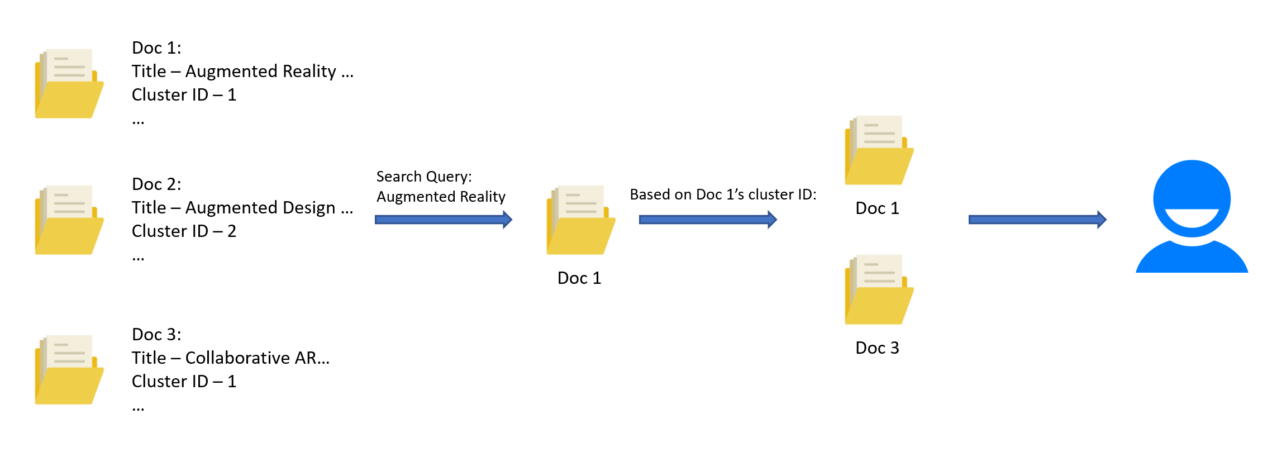
Recommendation in Searching
We discussed various ways of implementing recommendation with the TML team
Based on the anticipated cluster information, we implemented a two-step searching process to recommend related document to the user.

Slide 24
Incorporating TML Data
We are able to modify, update the desired field in an existing index because we pre-configured the following fields in both datasets as plain text fields.
Text Summarization (97,484 for tobacco settlement documents)
Sentiment Analysis (765,530*, for tobacco settlement documents)
Named-Entity Recognition (213,883 for tobacco settlement documents)
Cluster Data (N/A, only for ETDs)
As of 03:14 AM, 12/10/2019
Notes:
Check for empty fiels

Slide 25
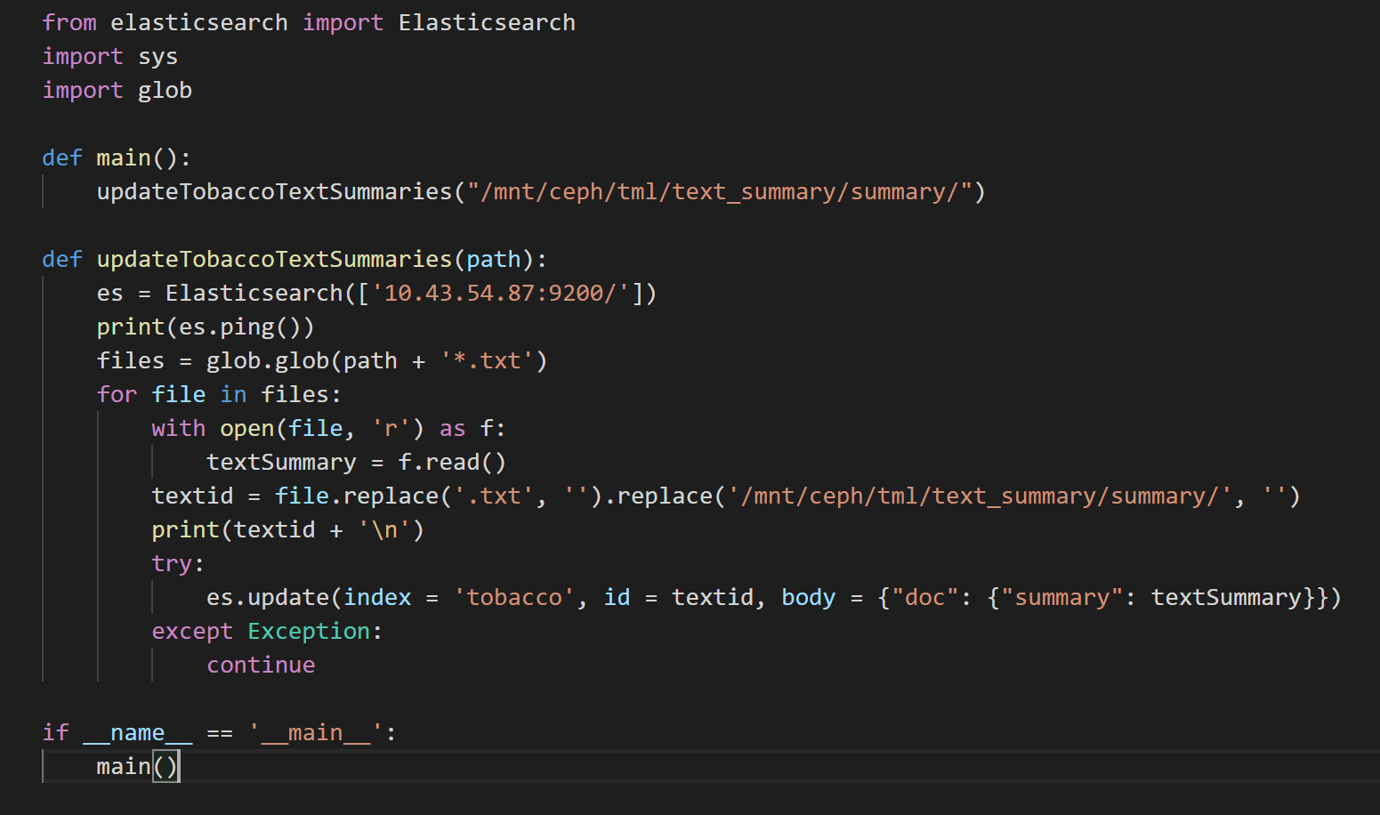
Incorporating TML Data - cont.
The data files can be processed
as:
Plain text file.
Named after document ID
Notes:
The code works on the small sample of text summary data we received.
Files like NER and sentiment analysis arrive too late for us to examine

Slide 26
Index Lifecycle Management
Indices should be properly managed over time.
Different indices should be managed differently given their nature
  Tobacco Settlement Documents: constantly queried, seldom updated
  ETDs: constantly queried, periodically updated
  Logs: periodically queried, extensively updated

Slide 27
Index Lifecycle Management - cont.
Determine appropriate policy for different dataset
  Tobacco Settlement Documents - Stay in warm stage as long as possible and keep in one segment
  ETDs - Stay in warm stage as long as possible and keep in one segment
  Logs - Stay in hot stage, with a limited size of storage and limited life span

Slide 28
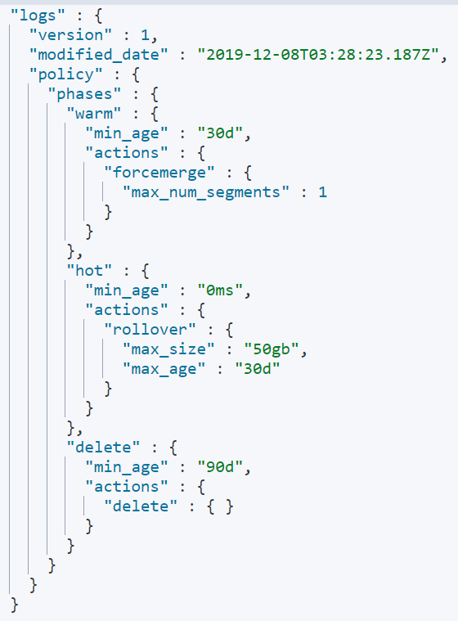
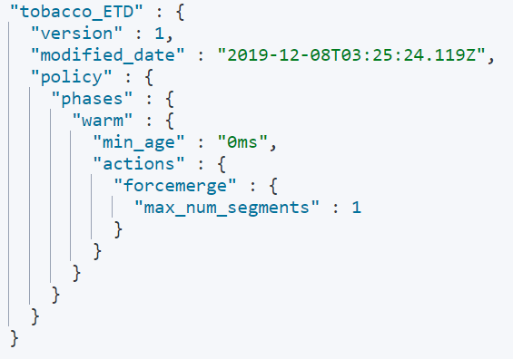
Index Lifecycle Management - cont.

Slide 29
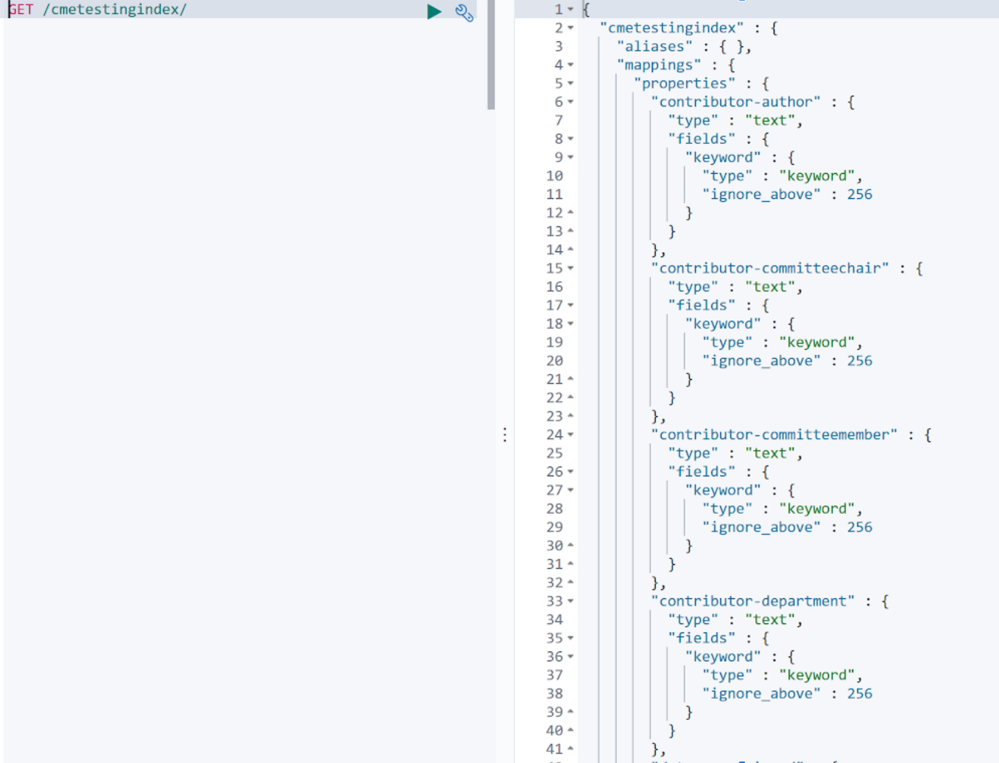
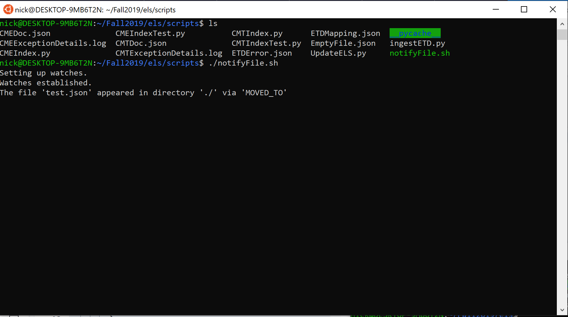
Automatic Script
Notes:
In the future, we will need to ingest new ETD and Tobacco Settlement Documents. And while this could be done manually, one of our goals was to create a procedure that could automatically ingest new documents into Elasticsearch. We have created a shell script for that purpose. The shell script uses a tool called inotify to watch a directory for new files either moved into or created in the directory. First, the CME and CMT teams will parse and format the new documents for us to ingest. They will move the files into specific directories for us. The shell script will call our ingesting script for the correct document type. There will be two directories, one for each of the document types. We can also extend this shell script to an update script for the fields used by the TML team. The TML team will move txt files into another directory to update the documents in elasticsearch. Now, onto the unit tests <Talk about Images?>

Slide 30
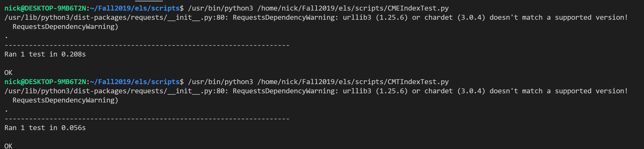
Unit Tests
Notes:
We have also created unit tests for our python scripts that can be used by the INT team to implement Continuous Integration and Continuous Development pipeline. Without going into too much detail, these unit tests will be run on updated code that is pushed to a repository before the code is committed and run on production servers. If the tests pass, the code will be deployed to production servers. If the tests fail, the developer will be notified and the errors will be fixed. The tests are written in python using the unittest python testing framework.

Slide 31
CONCLUSIONS AND FUTURE WORK

Slide 32
Deliverables
Data schema for ETD and tobacco datasets has been provided to the FEK, TML, CMT and CME teams
30k - index for ETD dataset
Tobacco - index for tobacco settlements dataset
Facet names, field types, usage recommendation, and field examples provided to the FEK team for filtering, searching and visualization
Search query format with example
a. Ordinary search (FEK)
b. Nested search with page hit (FEK)
c. Boosting
d. Recommendation script (FEK)
Automated scripts
a. Shell script for monitoring new files
b. Python script for Ingestion and updating
Search log (Slow log) on Kibana
Unit test scripts
Ingesting and indexing data received from the TML team (ClusterID, summary, sentiment, NER)
Notes:
Over the semester, we have collorbated with all of the teams to ingest documents into Elasticsearch. We worked with the CME and CMT teams to develop a streamlined procedure to ingest documents, the TML to improve searching and recommendations for the ingested documents, and the FEK team to search and display the documents for Users.

Slide 33
Future Work
Continue to ingest the rest of the documents into Elasticsearch
  Increase space in Elasticsearch
Improve the recommendations by working with TML team
  Text Summaries
  Sentiment Analysis
  NER
  Clustering
Add support for user logs and recommendations
  User-Specific Logs with FEK team
  Index Logs / Store in CEPH
Notes:
In the future, we plan on focusing a few requirements. One thing we plan to do is fully ingesting the rest of the documents. We have not ingested all of the documents to not go over the storage space in Elasticsearch. We also plan on continuing to improve searching by working with the TML team to add the text summaries, sentiment analysis, and ner to tobacco documents, and cluster ids to etd documents. Lastly, we want to add more support for user log data for user recommendations. By working with the FEK team to create and store user logs in CEPH to improve user recommendations.

Slide 34
ACKNOWLEDGEMENTS

Slide 35
Thank you!

