Slide 1
Automated Exercises
Jacob Mokuvos
Clayton Cunningham
Ted Liu
Mingchi Li
Shuhao Zhao
CS 4624 Multimedia/Hypertext and Information Access, Dr. Fox
Virginia Tech, Blacksburg, VA, 24061
4/25/19

Slide 2
Outline
Overview
Work Completed
Work to Finalize
Issues/challenges

Slide 3
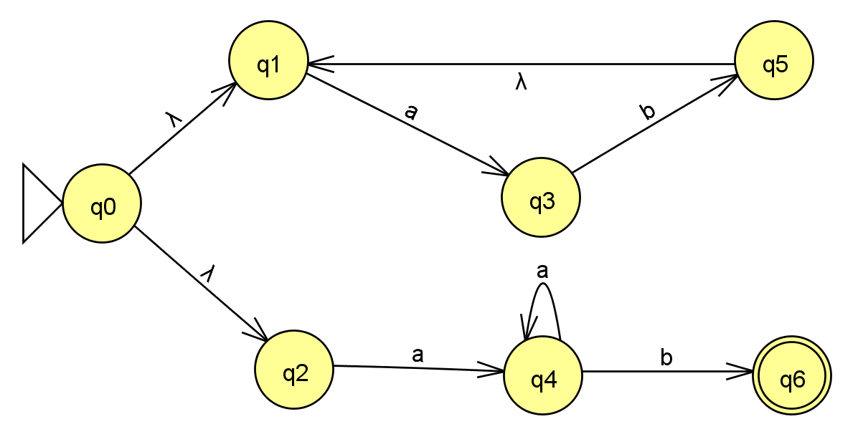


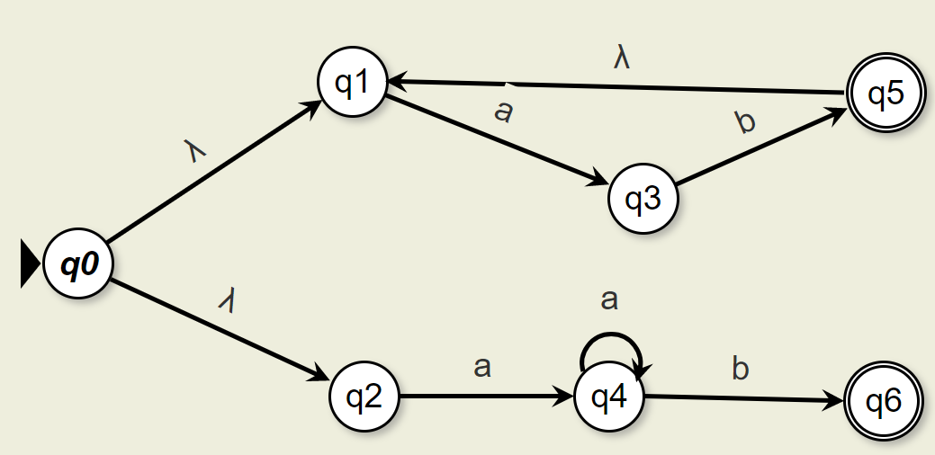


Project Overview
Goal:
Create an interactive OpenDSA module
Help students engage with the Formal Language content.
Method:
Build an automated assessment exercises framework
Allow instructors to build exercises for OpenDSA modules.
Deliverables:
Generate exercises
Auto-grade exercises
Create JSON Submission Log
[{"expression":"(a*b | (ab)*)",
"testCases":[{"aaab":true}],
"graph":{"nodes":[],"edges":[]}}]
https://www.iconfinder.com

Slide 4




Technology in use
JSON
JavaScript
HTML
CSS
GitHub
https://www.iconfinder.com

Slide 5
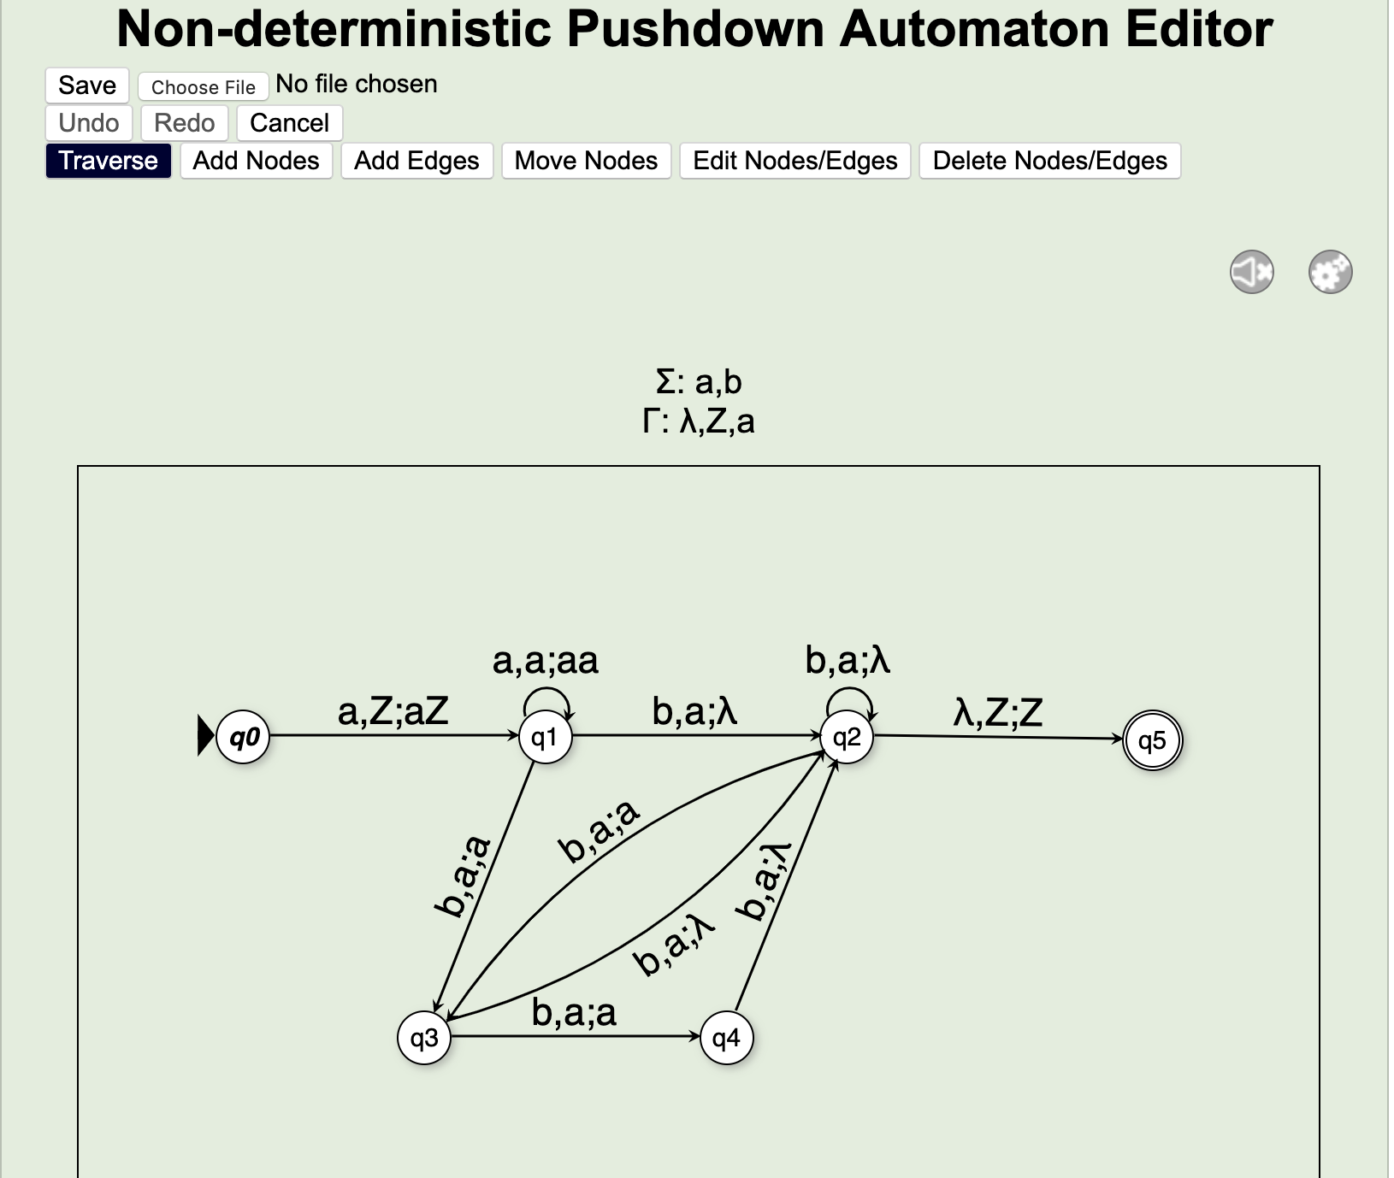
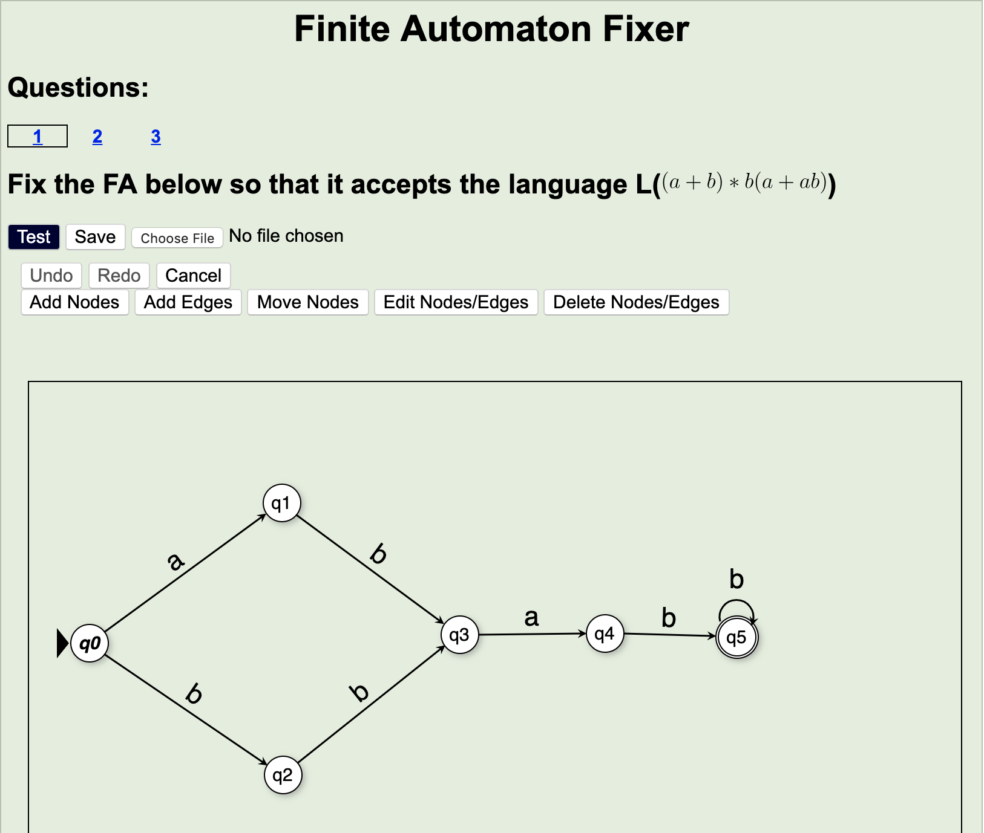
Generation Breakdown
Based on Graph JSON generate HTML
JSON determined by specified machine type
Each exercises has own auto generated HTML
Generation page inputs change based on machine type
Notes:
Screen shots of code and website

Slide 6
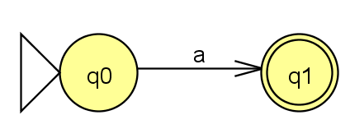
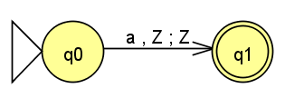
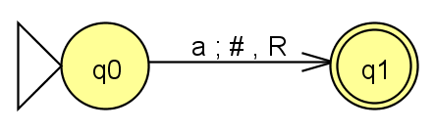
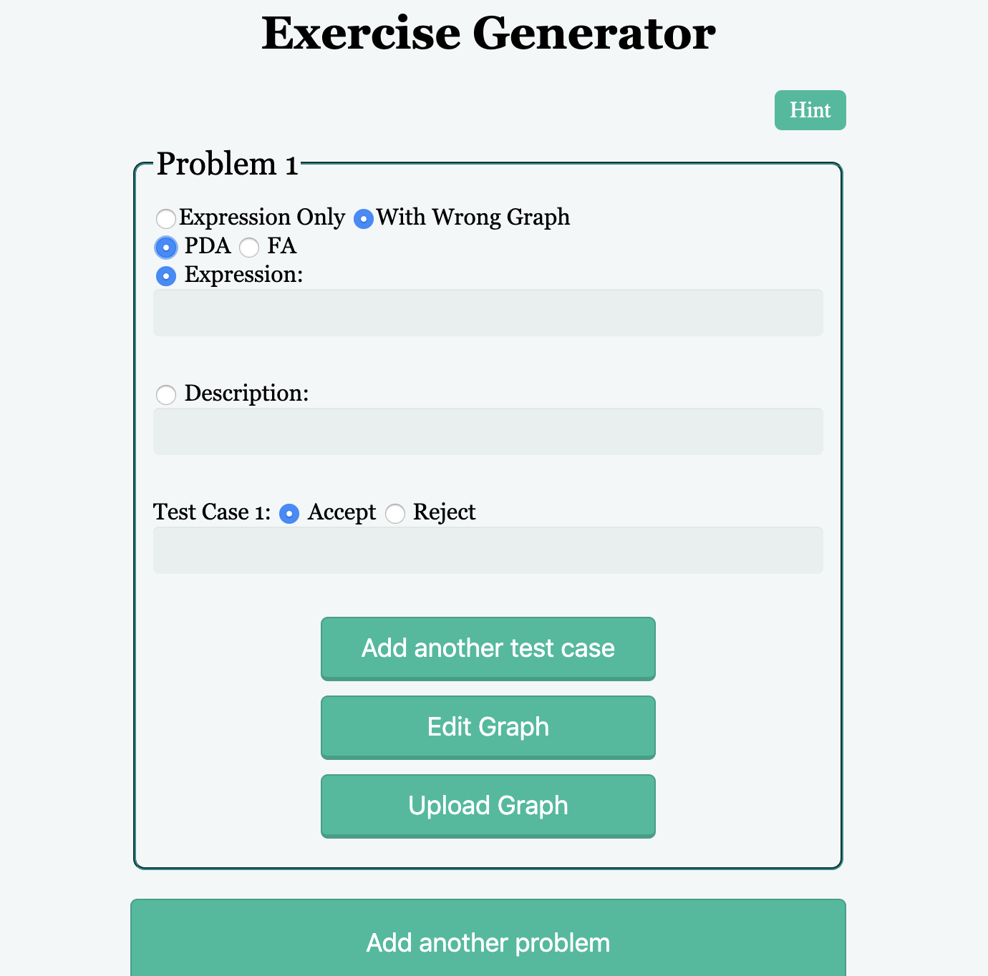
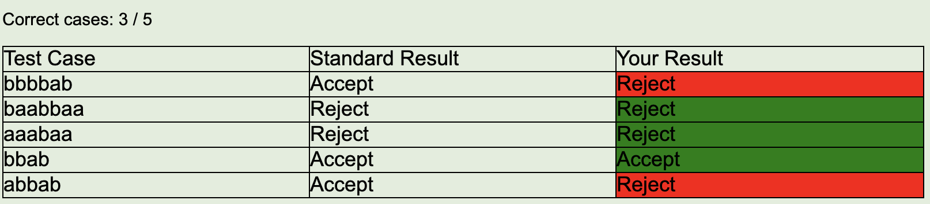
Work Completed
Finished Generation of Exercises
  DFA
  PDA
  Turing Machines
Allow for external file upload
Fixed grading bug
Created Submission Log Format
https://www.iconfinder.com

Slide 7
Project Structure
Exercise Group Type:
FA | PDA | TM
# of problems
Partial Graph ?
Test Cases
Exercise Group:
Editor, Start Graph
Problem Selector
Gader
Test Cases
Grade Log:
Submission
Submission #
Time On Attempt
Test Case Results
Download
Upload
JFLAP
JSON
HTML
https://www.iconfinder.com

Slide 8
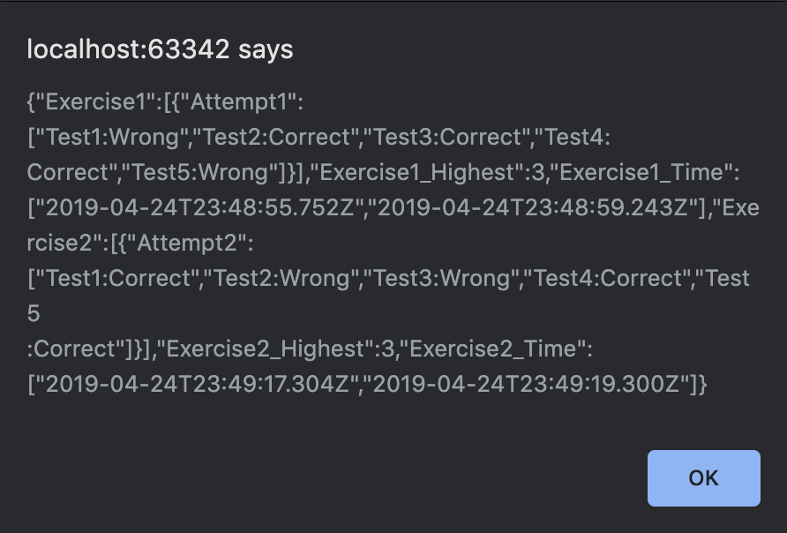


Work to Complete
Generate Logs with JSON
Incorporate updated editors
Private Finish button
Final Report Final Touches
https://www.iconfinder.com

Slide 9
Current Roadmap
2/7 Go over and finalize requirements Set up GitHub All members have access to edit code | 2/28 Add button for JFLAP to JSON conversion Automate a site that accepts input of a DFA/NFA | 3/18 Upload and generate HTML/JSON for exercises Generation for Finite Automata | 3/25 Generation for PDA Fix exercise evaluation display
4/8 Implement Turing machine generation Ensure test cases evaluate correctly | 4/15 Create Submission log format | 5/1 Generate Submission Log for JSON Incorporate updated editors | Bonus Private Finish button

Slide 10




Issues / Lessons Learned
Have universally compatible code
Defining clear information
Collaborating to reach achievable goals
https://www.iconfinder.com
Notes:
Could only work on some people’s computers
Didn’t need a new JSON for DFA’s, NFA’s, PDA’s, Turing Machines
Decided to not use Ruby

Slide 11
Acknowledgments
Client - Professor Mostafa Mohammed
Platform - OpenDSA Interactive Textbook

Slide 12
Questions?

