Slide 1
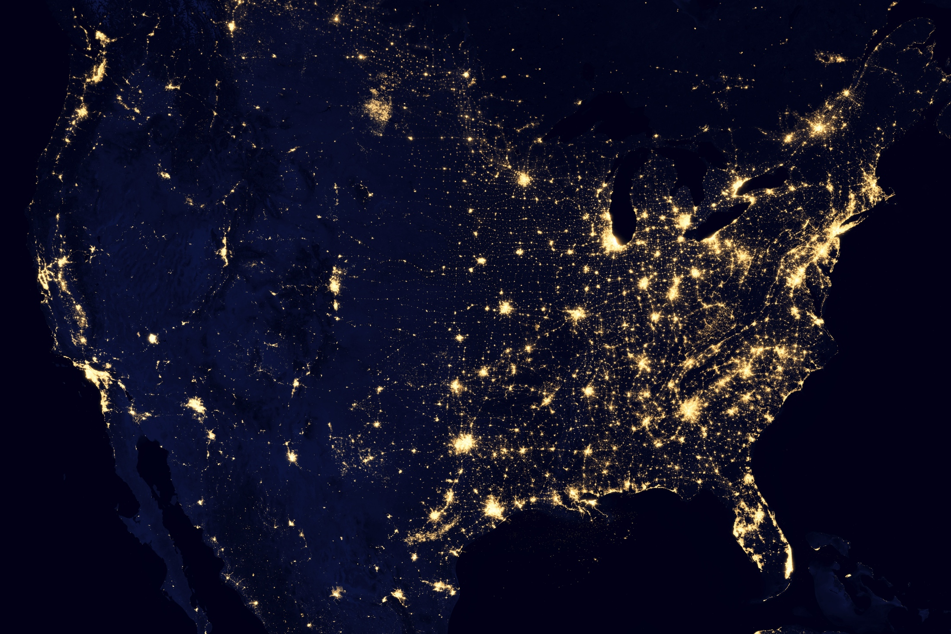
National Energy with Weather System (NEWS) Simulator Results
C.T.M. Clack
A.E. MacDonald
A. Alexander
A.D. Dunbar
Y. Fu
J. Wilczak
NAWEA, Blacksburg VA, June 9th 2015

Slide 2
Post Industrial Carbon Dioxide Rise
When (years ago): 30,000 3M 20 M 40 M
Equilibrium climate: Pleistocene Pliocene Eocene
2 X CO₂
Observations
(278 ppm pre-industrial subtracted)
Exponential Increase:
Doubling Time = 32 years
2 X CO₂ = 2 x 278 ppm = 556 ppm
Year at 556 ppm ~ 2052
Image update and adapted from PNAS paper, Hofmann, et al;
Solomon et al, Irreversible Climate Change, February 2009;
Beerling & Royer, Convergent Cenezoic CO2, Nature Geoscience, July 2011
Notes:
What does doubling mean? More CO2 emitted in doubling year than in all combined previous years…
Pleistocene is characterized as a constant El Nino that never really diminishes until the end of this period…
Pliocene was about 2-3ºC hotter than today, global sea level was 25 m higher…
Eocene saw a swing of ~700 ppm of CO2. This changed the temperature by 6ºC

Slide 3
Take Away Messages
The US can produce up to 80% of its electricity from carbon free sources by 2030 at costs similar to those today.
The US needs a national high-voltage direct-current transmission system and it should be co-optimized with generation.
The US should move away from a localized systems to a large-scale system.
Current technologies without storage can do the job if HVDC is expanded, reducing overall costs of the system.
Other technologies can incorporate into a national electric system.
HVDC improves the efficiency of the electric sector, regardless of generation mix (although the biggest impact is with variable generation).
If a national HVDC system is introduced other sectors can be shifted to electrical energy. For example; water heaters, heat pumps, electric vehicles, power-to-gas, etc.

Slide 4
The Electric Power System in 2012

Slide 5
US Aggregated Electric Demand

Slide 6
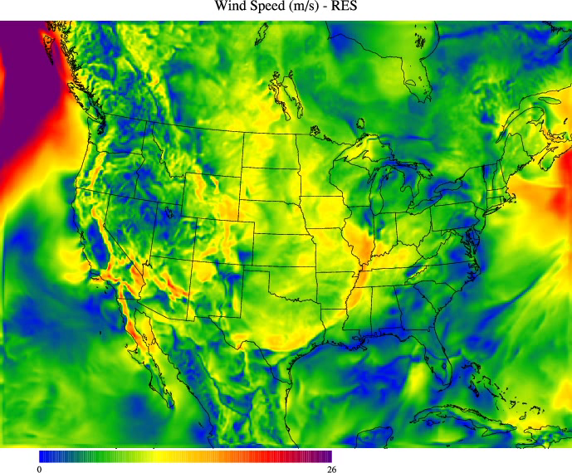
Wind Speed Video (m/s)

Slide 7
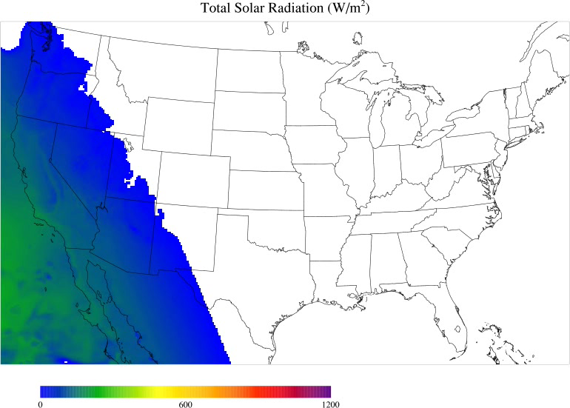
Solar Irradiance Video (W/m²)

Slide 8
Wind Capacity Factor Map

Slide 9
Solar PV Capacity Factor Map
%
%
%
%

Slide 10
Land Use Constraints
Wind
Solar PV
The type and amount of electricity generation installed in each RUC cell is constrained by:
  Spacing between facilities
  Topography of the land
  Land Use (residential, commercial, protected lands, etc…)

Slide 11
HVDC Transmission Overlay

Slide 12

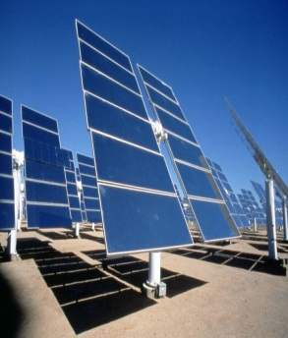
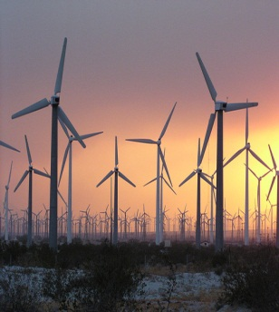
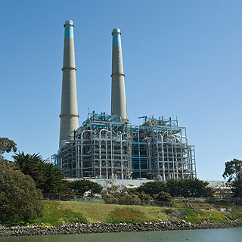

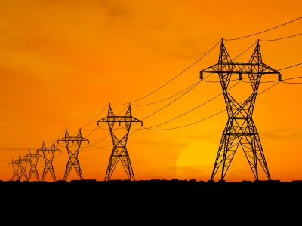


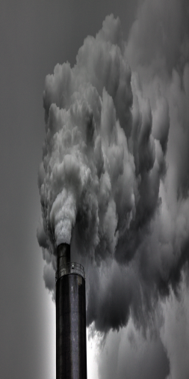



Mathematical Optimization
Minimize:
=
+
+
+
+
Subject to:
+
-
≥
ALL OTHER EQUATIONS CONSTRAIN THE MAGNITUDE OF ANY OF THE TERMS

Slide 13
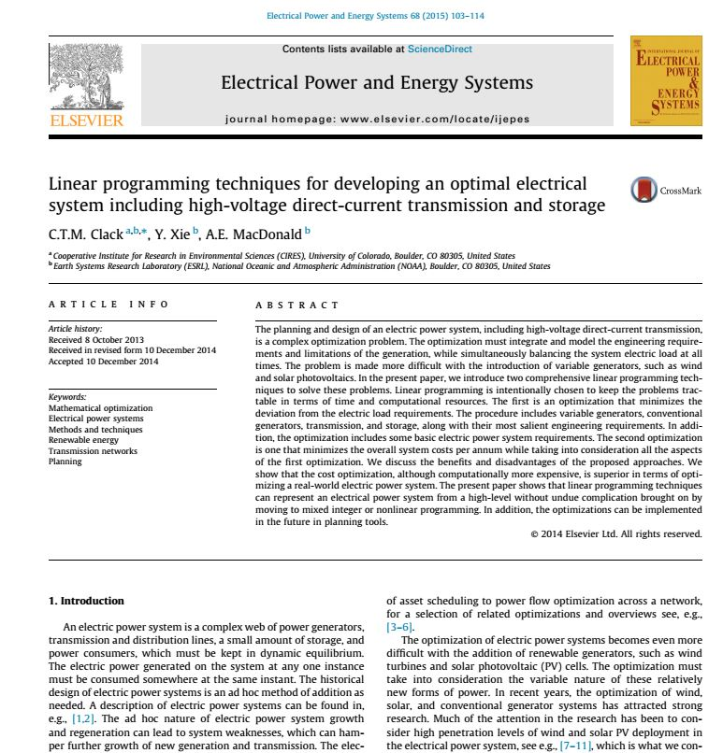
Peer reviewed description of the linear programming optimization techniques used.

Slide 14
NEWS Result: Single US 48 States Electric Power System
(Low Cost Renewables, High Cost Natural Gas)
Capacity
Generation
Uses Low Cost Renewables and High Cost Natural Gas Fuel

Slide 15
NEWS Result: 128 Independent Electric Power Systems
(Low Cost Renewables, High Cost Natural Gas)
Uses Low Cost Renewables and High Cost Natural Gas Fuel

Slide 16
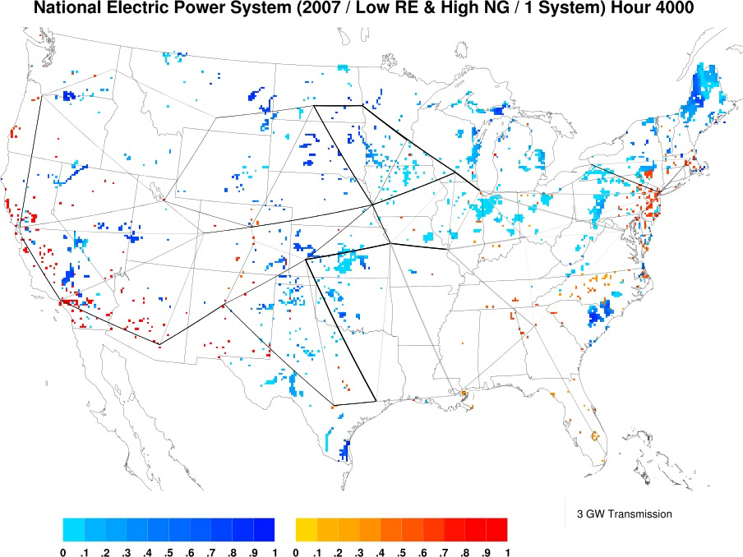
Dispatch of wind and solar PV within the simulation
(Low Cost Renewables, High Cost Natural Gas)

Slide 17
NEWS Result: Geographic Scale and Cost of Technology

Slide 18
NEWS Result: Geographic Scale and Cost of Technology

Slide 19
What can the US achieve and what will it cost?*
* Without storage and with current technologies
Notes:
Without incentives and externalities…

Slide 20
Take Away Messages
The US can produce up to 80% of its electricity from carbon free sources by 2030 at costs similar to those today.
The US needs a national high-voltage direct-current transmission system and it should be co-optimized with generation.
The US should move away from a localized systems to a large-scale system.
Current technologies without storage can do the job if HVDC is expanded, reducing overall costs of the system.
Other technologies can incorporate into a national electric system.
HVDC improves the efficiency of the electric sector, regardless of generation mix (although the biggest impact is with variable generation).
If a national HVDC system is introduced other sectors can be shifted to electrical energy. For example; water heaters, heat pumps, electric vehicles, power-to-gas, etc.

Slide 21
NEWS Result: Back-ups

Slide 22
Distribution of Levelized Cost of Electricity
System uses only ~ 205,000 3MW wind turbines
Approximately 460 km² of land taken out of current use
Wholesale cost of wind power 5.2¢ / kWh
A share of 38.4% of electricity generation
System uses only ~ 18,500 20MW solar PV plants
Approximately 6,110 km² of land taken out of current use
Wholesale cost of solar power 4.6¢ / kWh
A share of 16.7% of electricity generation
Wholesale cost of natural gas power 12.3 ¢ / kWh
Average retail cost of electricity for the entire system 10.7¢ / kWh
Notes:
The wholesale cost of the system is 7.8¢/kWh for the entire system. Transmission is 0.4¢/kWh.

Slide 23
NEWS Result: Sensitivity to Natural Gas

Slide 24
NEWS Result: Sensitivity to Natural Gas

Slide 25
NEWS Result: Sensitivity to Natural Gas

Slide 26
NEWS Result: Sensitivity to Natural Gas

Slide 27
NEWS Result: The Effect of Coal and EPA CAA 111(d)

Slide 28
NEWS Result: The Effect of Coal and EPA CAA 111(d)

