Slide 1
Sentiment and Topic Analysis
Presenters:
Abigail Bartolome, Matthew Bock, Rahul Krishnamurthy, Radha Krishnan Vinayagam
CS 6604 TS: Digital Libraries, Spring 2017
Final Team Term Project Presentation
Virginia Polytechnic Institute and State University
Blacksburg, VA 24061
Professor Edward A. Fox
Presented May 2, 2017

Slide 2
Acknowledgements
Dr. Edward A. Fox
Digital Library Research Laboratory (DLRL)
Integrated Digital Event Archiving and Library (IDEAL) Grant: IIS-1319578
Global Event and Trend Archive Research (GETAR) Grant: IIS-1619028
CS 5604 Topic Analysis Teams of Spring 2016 and Fall 2016

Slide 3
Goal
Extract and Clean Tweets
Latent Dirichlet Allocation
Allow User Interaction
Sentiment Analysis
User Interface
To build an effective tool that will allow linguists and sociologists to find topics of interest within a collection of tweets and explore the sentiments of the tweets relating to each topic

Slide 4
Outline
Workflow
Preprocessing and Latent Dirichlet Allocation
Emoji Labeled Sentiment Classification
Dependency Tree Based Sentiment Classification
Topic Analysis Interface
Future Work

Slide 5
Workflow

Slide 6
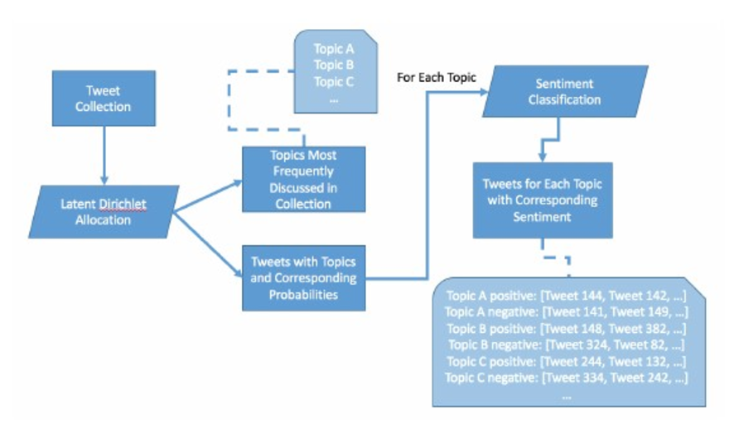
The planned flow for our system’s tools

Slide 7
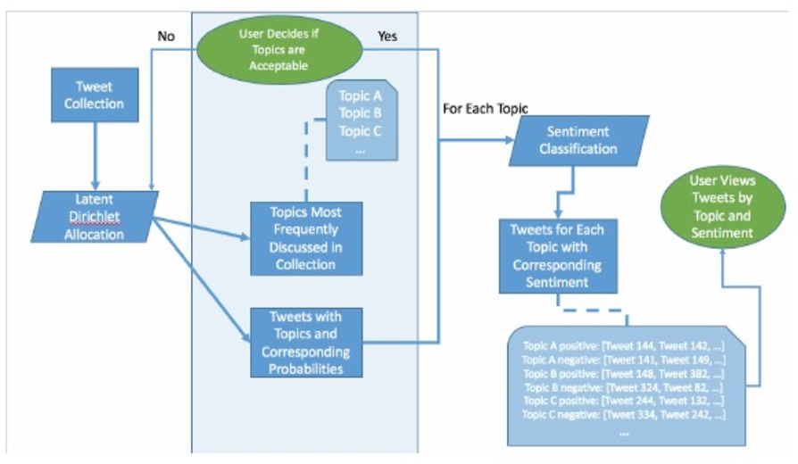
The planned flow of user interaction with our system’s tools

Slide 8
Preprocessing Tweet Collections and Running LDA

Slide 9
Matthew’s Thesis Framework
Preprocesses collections of tweet text
Handles reading data from source files
Processing data into data structures
Runs LDA
Framework provides wrapper for running Spark’s LDA implementation on tweet collections
Automatically returns overall topic results and topic tags for each tweet

Slide 10
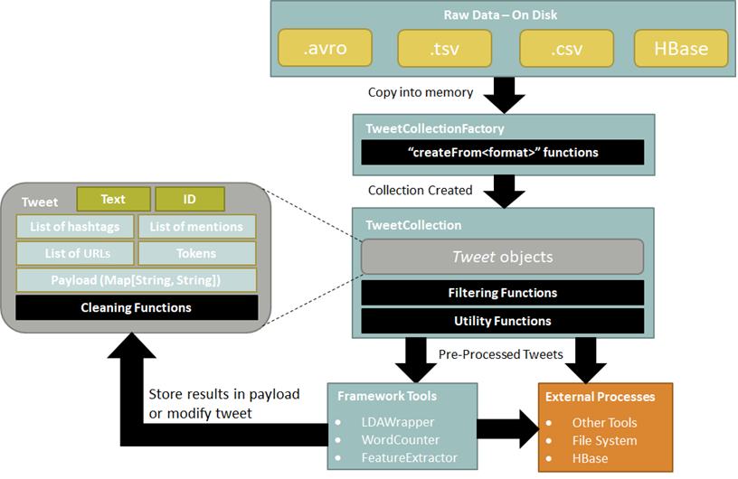
Data flow within framework

Slide 11
Reading Twitter Data
Utilize TweetCollectionFactory
Read data from any supported source
Simplifies development - easy to change data source
Creates a collection of Tweet data structures
Run analysis on TweetCollection data structure
No need to do any raw text processing manually
Use provided functionalities to simplify cleaning and pre-processing

Slide 12
Cleaning Twitter Data
LDA only | Both | Sentiment only
Stopwords | URLs | Mentions
 | lowercase | Hashtags
 | punctuation
 | RT marker
Separate cleaning for LDA and Sentiment Analysis
Stop words hinder LDA results, but are necessary for our Sentiment Analysis
Mentions/hashtags hinder sentiment results, but are common topic-defining terms

Slide 13
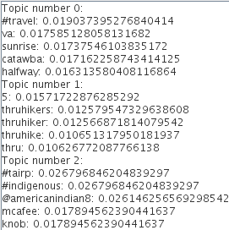
LDAWrapper
Wrapper around Spark’s LDA implementation - works with TweetCollections
Two sets of results: overall topic results and individual tags for each tweet
Overall topic results
Topic tags for each tweet
Result | Example
Probability that this tweet belongs to each topic | [0.851, 0.13, 0.019]
Topic number assigned to this tweet | 0
Topic label assigned to this tweet | “#travel va sunrise catawba halfway”

Slide 14
Emoji-Labeled Sentiment Classification

Slide 15


Emoji Extraction
UTF-8 format containing non-alphanumeric codes
Used a lookup table to identify if emoji was positive or negative
ðŸ˜ | \xF0\x9F\x98\xA0 | Angry | Negative
ðŸ˜„ | \F0\x9F\x98\x84 | Smiling face with open mouth and smiling eyes | Positive

Slide 16
Sentiment Classifier
Binomial logistic regression model
Word2Vec
Not enough labeled data to train classifier
Too many false-negatives

Slide 17
Dependency Tree Based Sentiment Classification

Slide 18
Basics
Lexicon Used:
VADER (Valence Aware Dictionary and sEntiment Reasoner)
General Inquirer (polarity reversal words)
A way to compute overall polarity using Lexicon
Parse Tree created by Syntaxnet
Our Focus: Impact of polarity reversal words and negation in the overall polarity of tweet
Notes:
Polarity reversal words reverses the polarity of connected words

Slide 19
Polarity reversal words with VADER
Tested VADER with tweets that had polarity reversal words.
We focused on very limited words because we were testing the polarity of tweets manually.
We focused on words such as “depression,” “anxiety,” and “stress”
These words have negative sentiment scores.
Then we started looking for tweets which had these negative words along with polarity reversal words like “abate,” “diminish,” “reduce,” and “decrease.”

Slide 20
Polarity reversal words with VADER
The following are subset of tweets that we tested with VADER:
"Study shows a significant decrease in depression after taking psilocybin" Vader score = -.4404
“Escape to nature, even if just for a 30 minute walk.. it will greatly lower your stress levels and reduce risk of depression” Vader score = -.309
"Singing helps reduce feelings of depression and anxiety, increases oxygen to your lungs." Vader score = -.4215
“Listening to music for an hour every day can reduce chronic pain by up to 21% and depression by up to 25%” Vader score = -.7906

Slide 21
Our Observation on VADER
When we have polarity reversal words in tweets with a negative sentiment word, then the output of VADER is different from the expected value.
This list of tweets is not sufficient to draw any concrete conclusion, and hence we cannot make any claims about the accuracy of VADER.
Our objective of such a test was to find a category of tweets for which it is difficult to predict sentiment.
This led to our search for a method that can determine sentiment of tweets with polarity reversal words.

Slide 22

Parse Tree Based Approach (Rule 1)
Voting with Polarity Reversal
Polarities of nodes in a parse tree are reversed if they have odd numbers of reversal phrases in their ancestors.
Add polarities of all nodes
r_{j} =1 if there is a reverse polarity word in Ancestor list
Else rj = 0
Word node in a tree
p = pos, when sum>0
p = neg, when
sum<0
else p=neutral
Set of ancestors

Slide 23
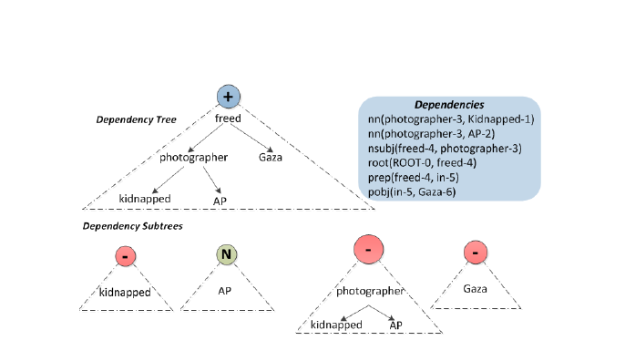
Parse Tree Based Approach (Rule 2)
Reverse polarity of subtrees if head is a polarity reversal word. Add sub trees polarity to get the polarity of overall sentence (Root)

Slide 24
Rule 1 Fails
Both in sentiwordnet and VADER
Score of Negation words in Lexicon is 0. Tweet -> My Anxiety won’t abate
Polarity reversal word
abate VB root
-.17
anxiety NN nsubj
won’t RB neg
Score 0
my PRP poss
Notes:
Use trees to take care of reverse polarity words and negation. Scope of negation now decided by the subtree.

Slide 25
Rule 2 Fails
Tweet - ->Conversations reduce stigma and increase understanding.
Polarity of increase should not be reversed due to word ‘reduce’
And here ‘and’ is connecting two clauses and not two words.
How to detect that in parse tree?
Reduce VBP Root
Pos score
Conversations NNS nsubj
Stigma NN dobj
and CC cc
increase VB conj
understanding NN dobj
Notes:
There are two different clauses

Slide 26
Improvement
Straightforward application of Rules will give wrong results
Approach 1.
Detection of two independent clauses from a Parse tree.
Compute sentiment on each of them separately and add them.
Example :
Conversation reduces stigma
Conversation increases understanding

Slide 27
Improvement Continued
Approach 2
Do a sentential analysis. Find subject, verb, and object.
And decide when to reverse polarity based on the head node.
Our Approach : 1. Do further analysis only if the conjunction is connecting two clauses rather than two words.
2. Do not reverse polarity due to a polarity reversal word in head node, if
The child is a verb and accompanied by a subject in its neighbor
The child has an object as its dependent

Slide 28
Our Approach Continued...
3. Use ‘neg’ part of speech to negate the overall polarity of head node.
Verification of Results:
We compared our results with VADER
Files after Topic Analysis | Tweet Count | Our Approach Accuracy
Topics_0 | 654 | 97.7%
Topics_1 | 552 | 96.3
Topics_2 | 688 | 99.56

Slide 29
Conclusions
We found limitation in state of art tool VADER
Presented limitations in existing parse tree based approaches
Presented a better rule based approach which overcomes problems in previous approaches
Our approach showed good accuracy for general English tweets and not just tweets related to polarity reversal words.

Slide 30
Topic Analysis Interface (demo)

Slide 31
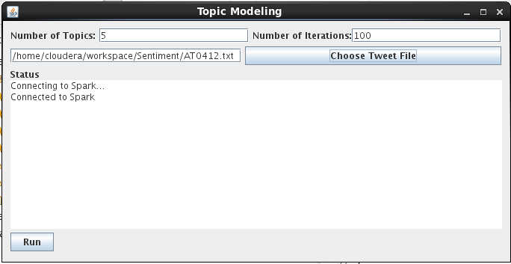
Topic Analysis Start Screen

Slide 32
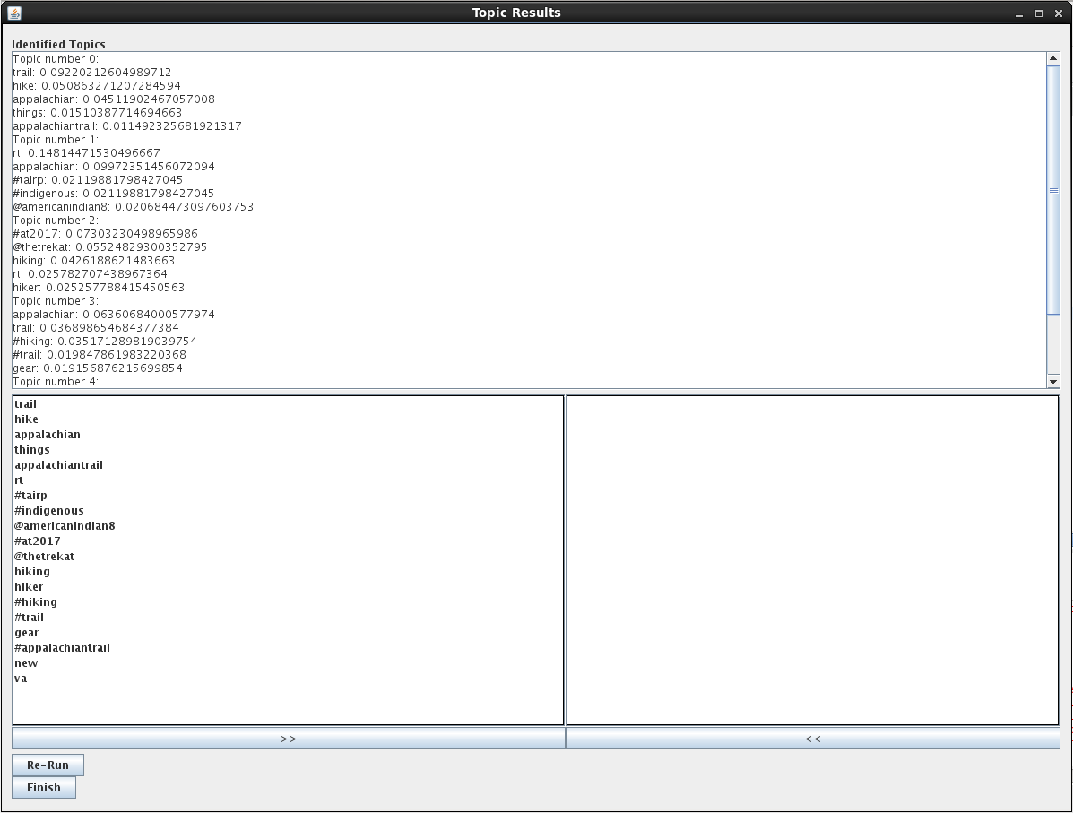
First Pass Results - Reasonable results but not all meaningful

Slide 33
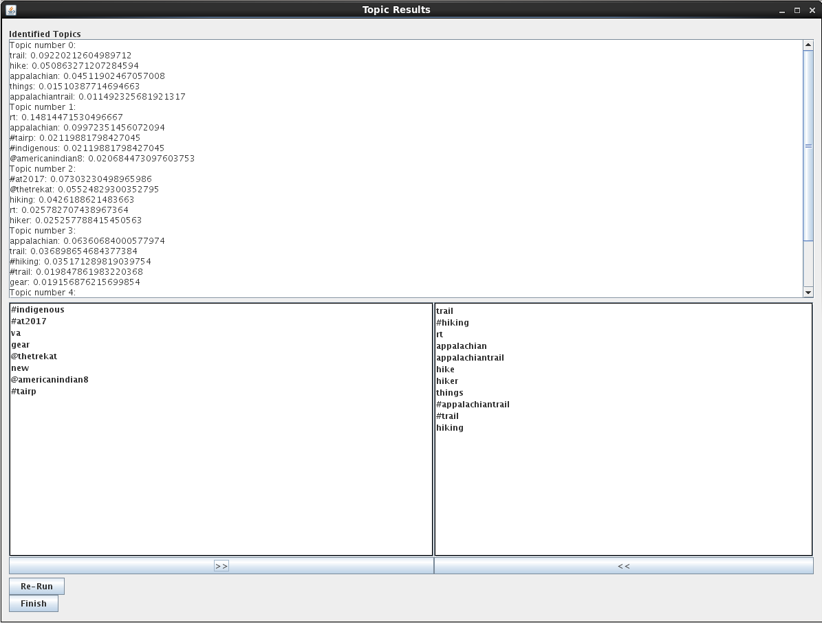
Filtering topic words that don’t contribute meaning

Slide 34
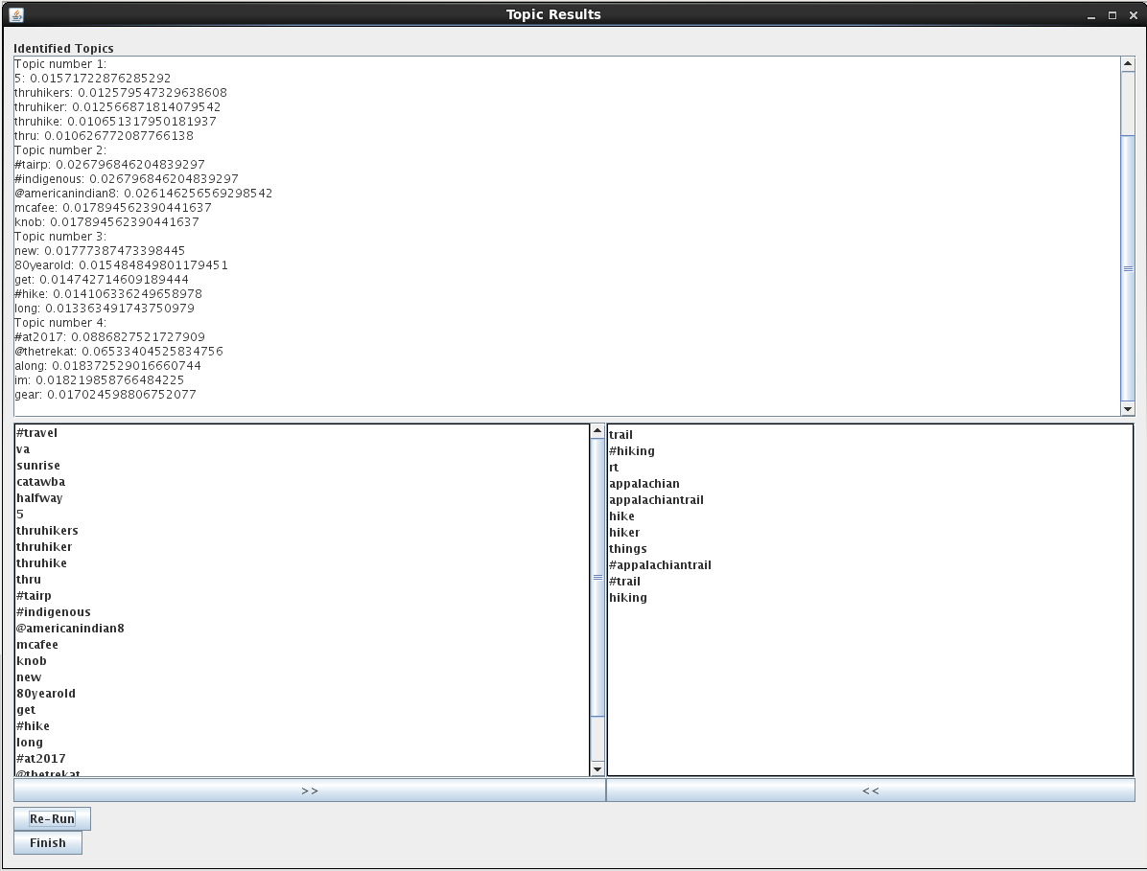
Second Pass Results - Topics start to become more defined

Slide 35
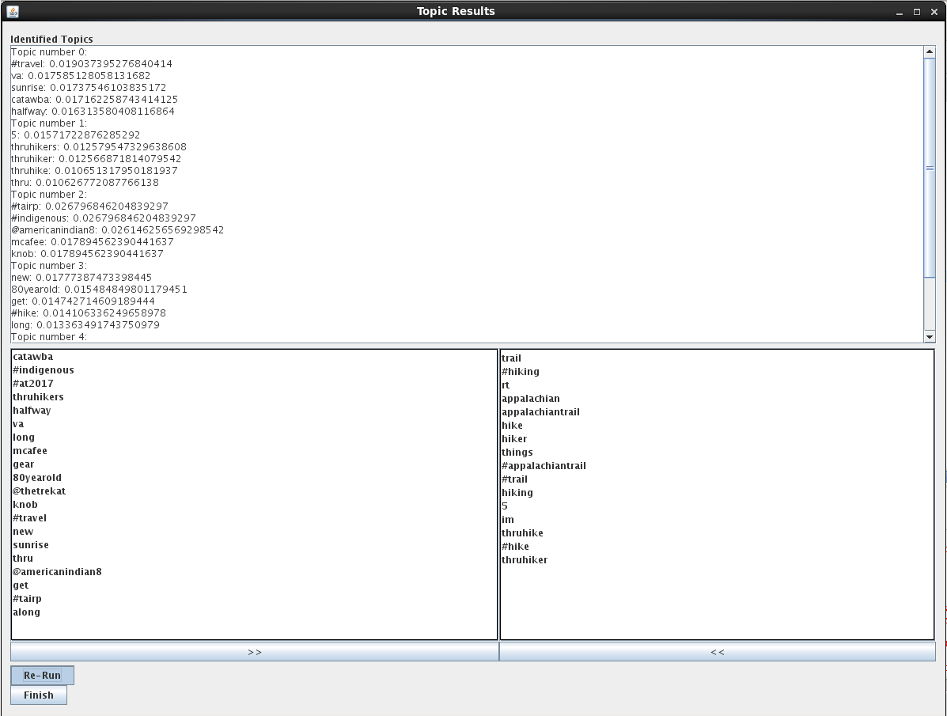
More Filtering

Slide 36
Repeat as Necessary
Process can be repeated any number of times
Continue to remove uninteresting terms until topics become meaningful
Finish button writes result sets to file for sentiment processing

Slide 37
Future Work

Slide 38
Future Work
Lemmatization and stemming for topic analysis
More labeled data
Incorporate specialized hand-labeled data
Use pre-defined dictionary
Combine NER with parse trees technique to get the polarity of entities
Use part of speech tags and apply machine learning techniques to determine sentiment of tweet
Add more granular controls and sentiment analysis to user interface

Slide 39
Questions?

