Slide 1
VTwordpress
Team Members: Scott Mcgee
Ken Pham
Matt Ng
Project Client: Jennifer Sparrow
Blacksburg
3/6/2014
VT CS 4624

Slide 2
Objective
Create WordPress Templates for VT that are developed inline with the Virginia Tech Style Guideline
Prefer at least one template to incorporate the Drag-and-Drop features

Slide 3
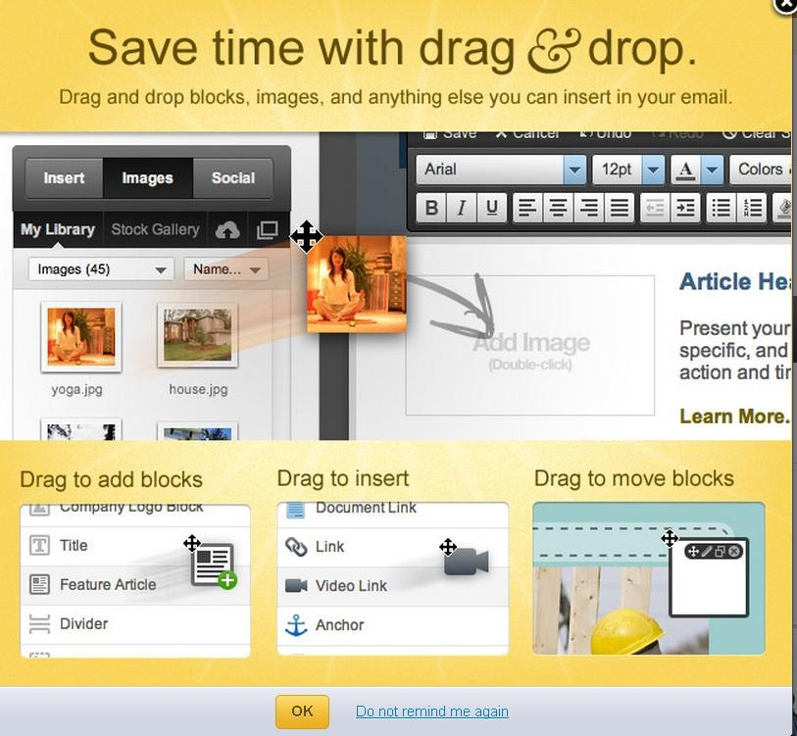
Drag-and-Drop

Slide 4
Why do we need this?
Currently the university-wide blogging platform has over 1600 users and with a high expected growth rate
We hope that we can provide a uniform template for faculty users to use

Slide 5
Tools
BitNami
  https://bitnami.com/
  Eclipse Theme
  NotePad++
  Google Chrome Developer tools
VT Wordpress Blog
  http://blogs.lt.vt.edu/
  Headway Theme

Slide 6
Developer Languages
HTML
  Design of pages
PHP
  Wordpress functionality
    Index, Posts, Images, etc.
CSS
  Style of pages

Slide 7
Child theme Walkthrough

Slide 8
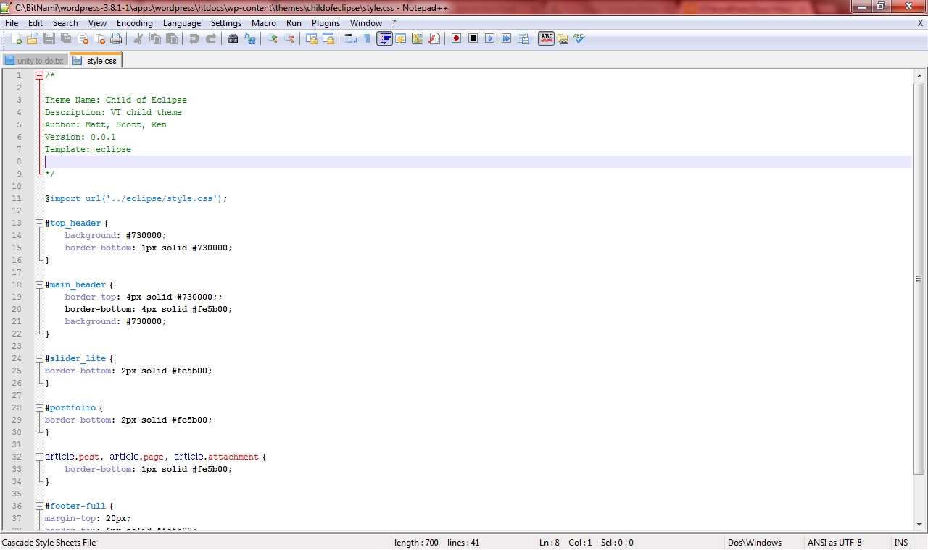

Slide 9
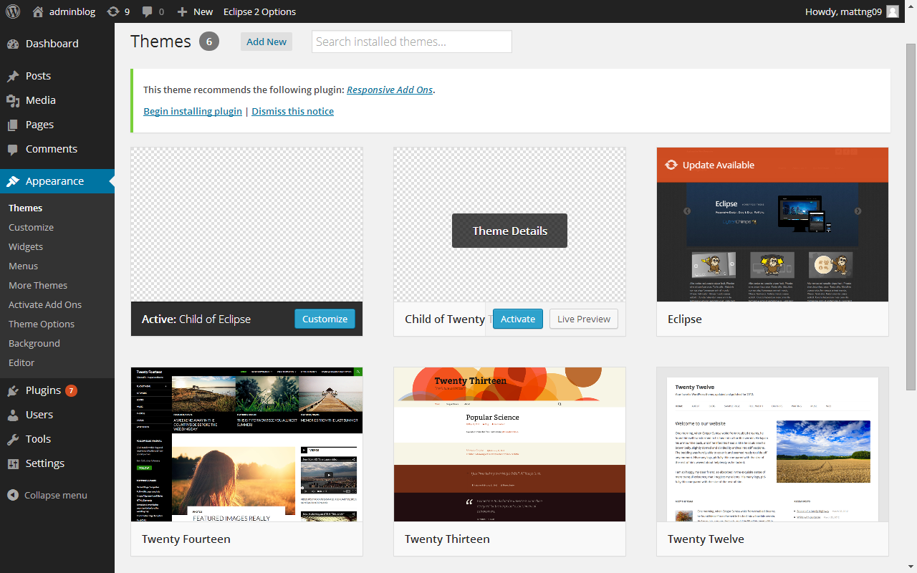

Slide 10
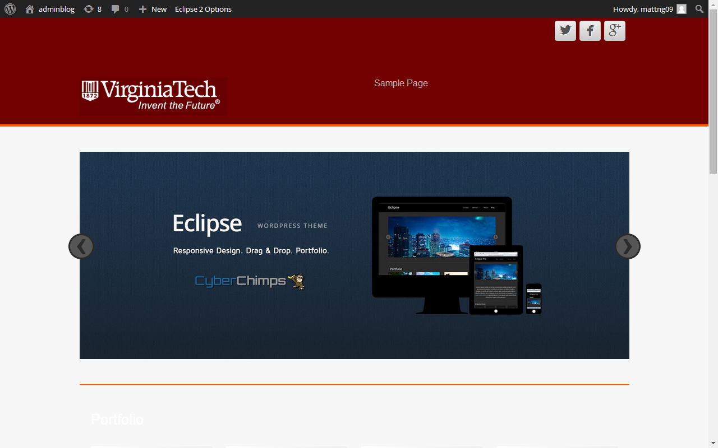

Slide 11
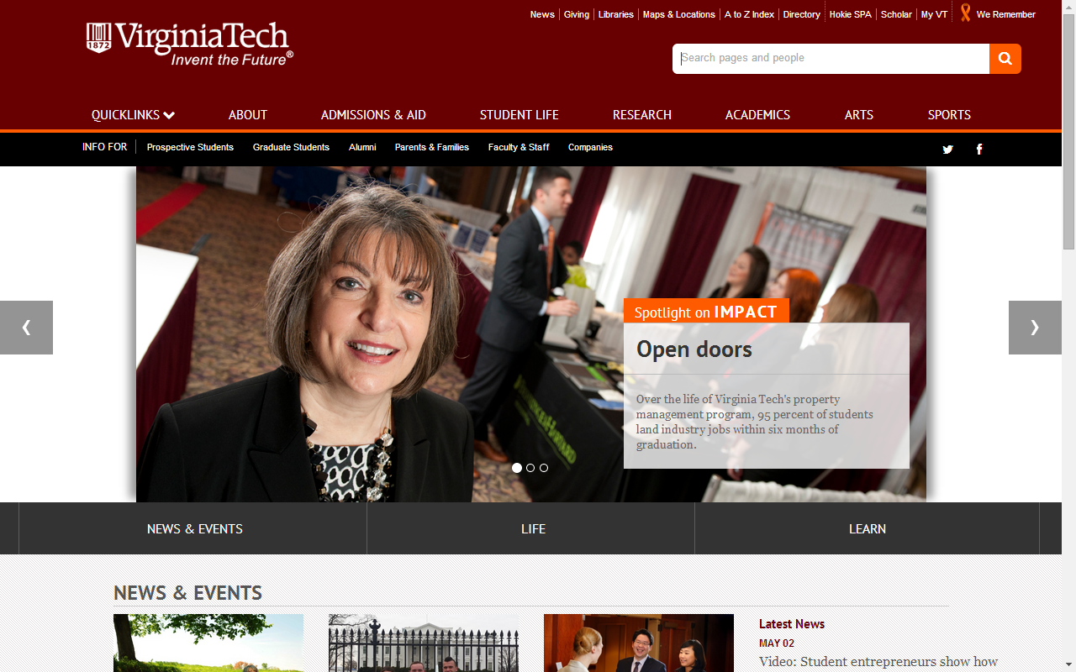

Slide 12
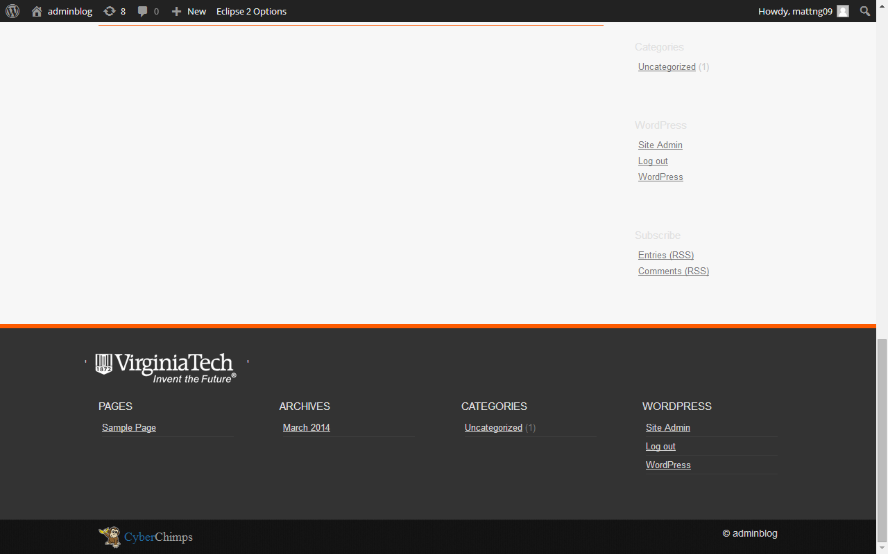

Slide 13
Headway Walkthrough

Slide 14
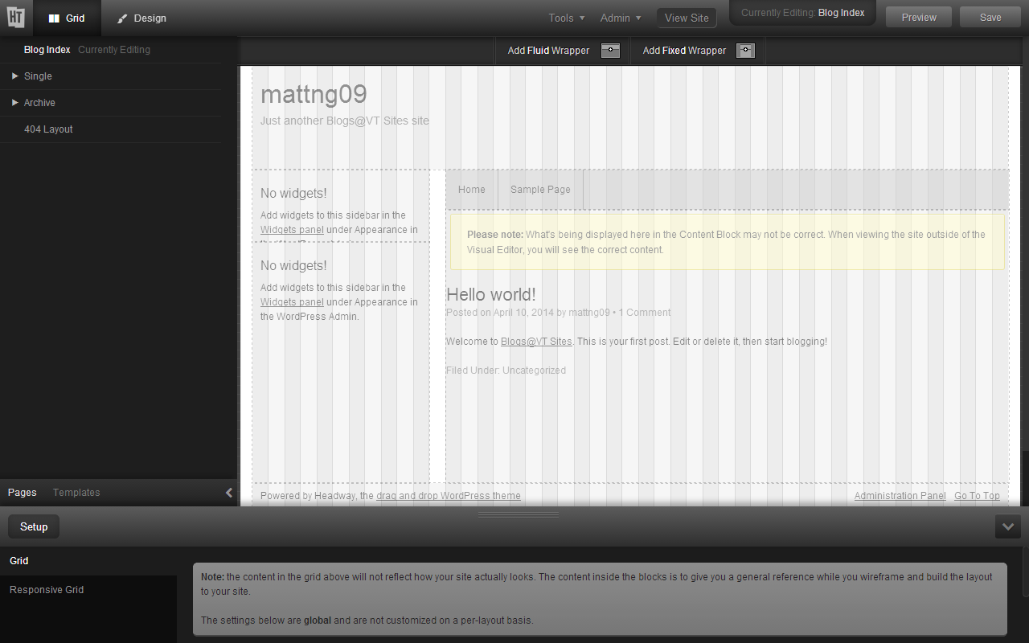

Slide 15


Slide 17
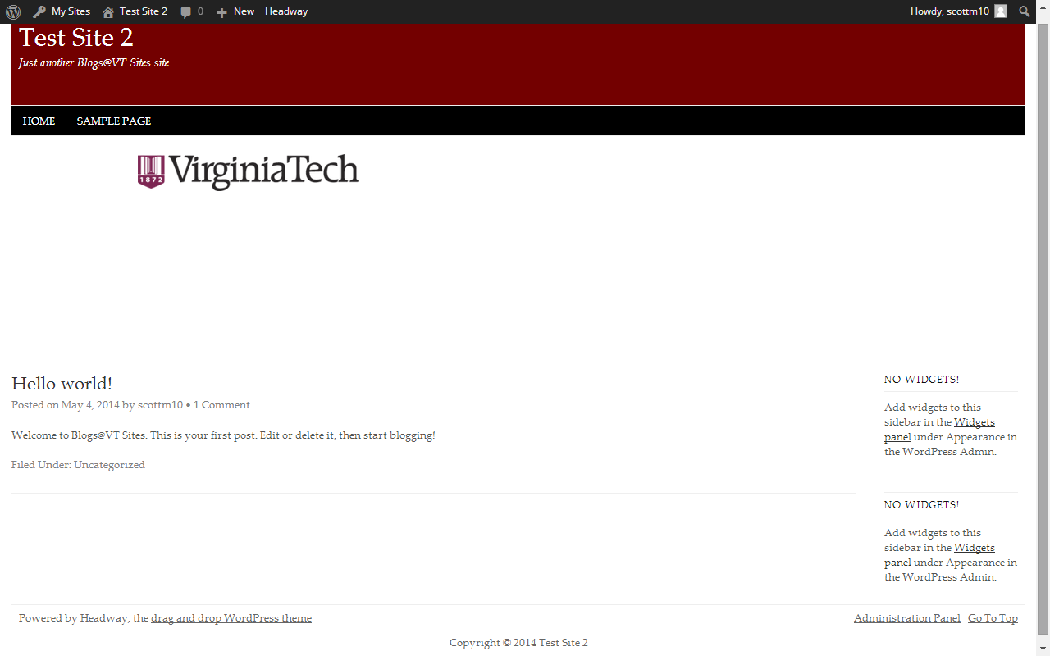

Slide 18
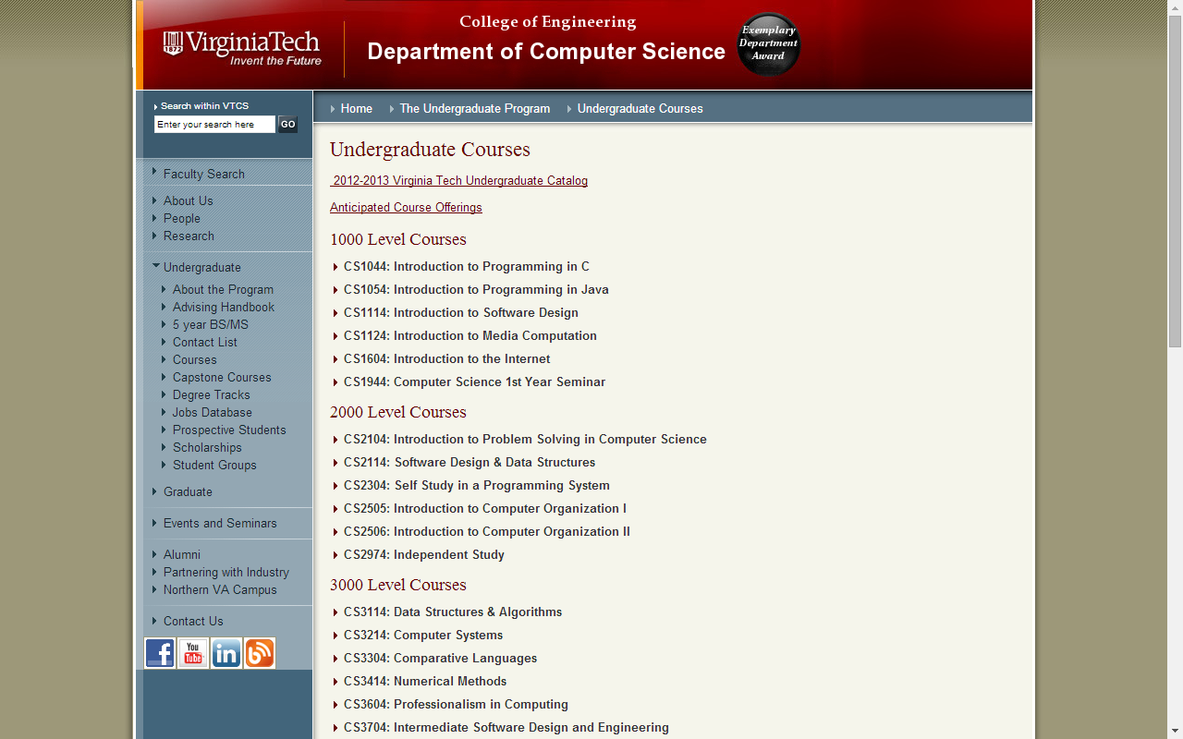

Slide 19
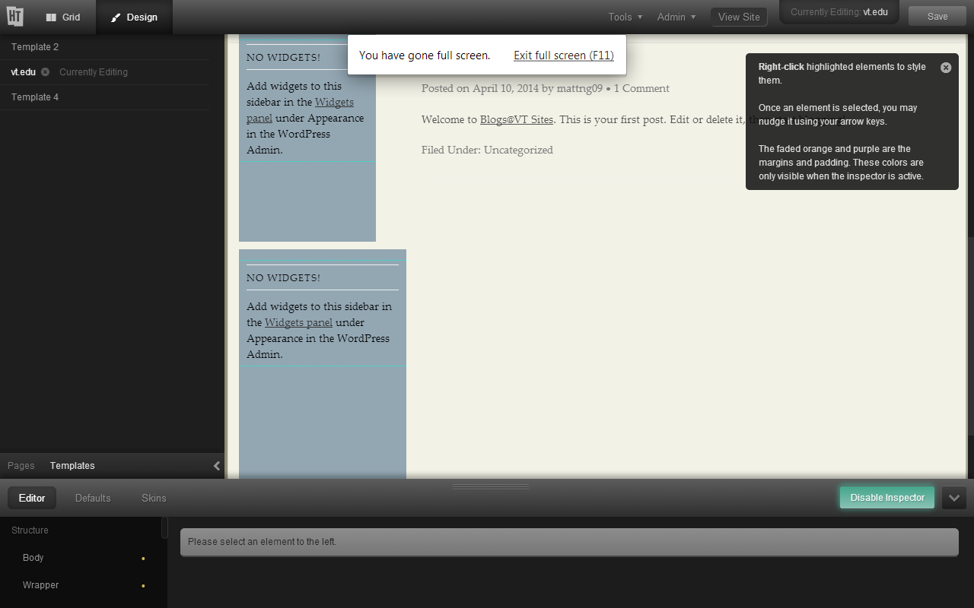

Slide 20
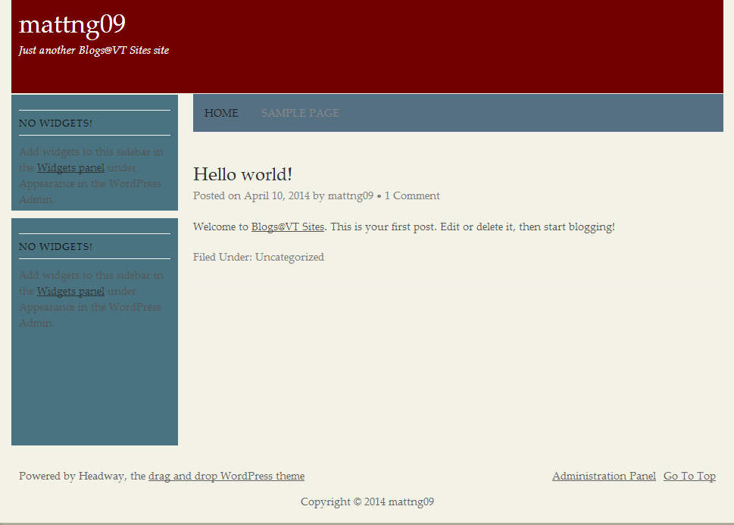

Slide 21
Questions ?

