Slide 1

Social Networks in Great Britain
CS4624 Multimedia, Hypertext, and Information Access
Instructor: Edward A. Fox
Virginia Tech, Blacksburg, VA 24061, 5/4/22
Team Member:
Javan Smith

Slide 2



Agenda
Recap / Problem
Timeline
Deliverables
Challenges

Slide 3

Recap / Problem
CLIENT
MOTIVATION
Professor David Radcliffe
Department of English at VT
Transform 40,000 XML records into indexed and searchable HTML records
Archival purposes: unable to use any 3rd party service

Slide 4
Timeline
Wireframes
Initial work on JavaScript backend
Pivot to all in one Java solution
Combined aspects of previous scrapped projects, but all work from Java
February
March
April
Early May
Finished backend, but required 3rd party service to work: scrapped
Started work on HTML fronted, however needed JavaScript backend: scrapped
Touch up website
Fix network graph

Slide 5
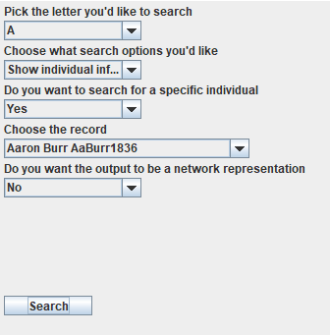
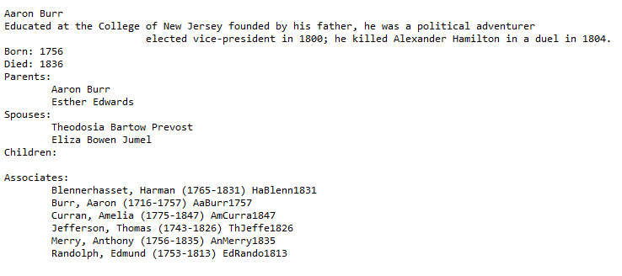
Deliverables

Slide 6
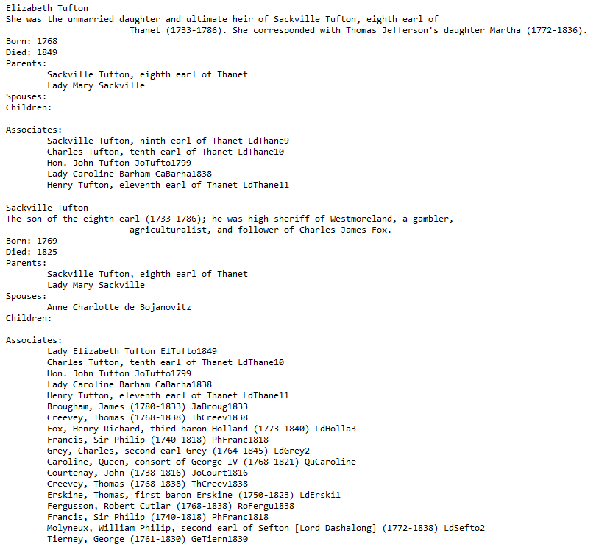
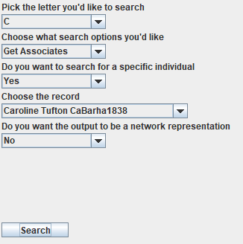
Deliverables

Slide 7
Challenges / Lesson’s Learned
ARCHIVAL RESTRICTIONS
PRIOR RESEARCH
Inability to use anything 3rd party
Stuck with basic Java methods
Forget how useful React, Node.js, Express, MySQL, etc. are
Had scouted out potential Java libraries to use before deciding on switching
Unable to use due to restrictions or them being deprecated:
  Had previously ran a Java website using an Applet in high school
  Deprecated in 2016

Slide 8


Thank You
Acknowledgements
Client: Professor Radcliffe
Instructor: Edward Fox

