Slide 1
VCCWS:
Virginia Center for Civil War Studies
Team:
Kevin Ellis Ben Sechrist
Suhas Avadhuta Richard Howell
5/5/15
Department of Computer Science
Virginia Tech
Blacksburg, VA, 24060, USA

Slide 2
Client
Dr. Paul Quigley
Director of VCCWS
Virginia Tech Department of History
pquigley@vt.edu

Slide 3
Civil War research
Digital Library
“Bookmarks”
Tags
Users
Background
Notes:
Goals of the project, such as collecting digital resources about the civil war.

Slide 4
Original Site
Notes:
Here is what is currently being offered for this service.

Slide 5
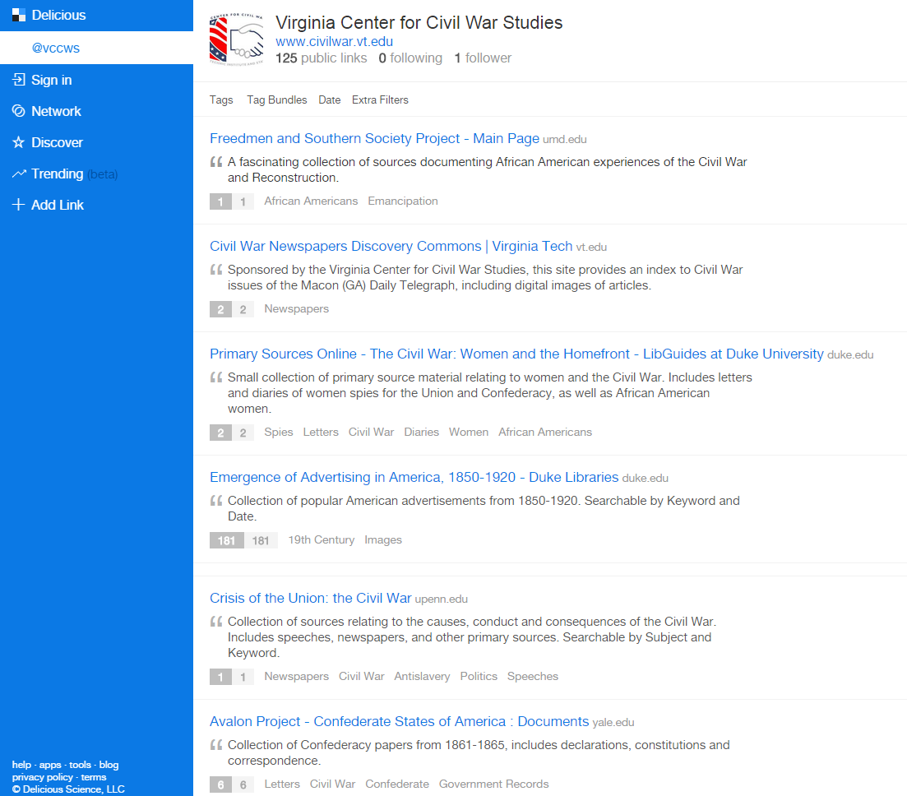

Slide 6
No search
Opens links in outside windows
Hosted by Delicious service
No way to suggest/add new bookmarks
Generic
Issues
Notes:
Discuss what was wrong with the current format. What needed to be solved?
There was administrative managment for our client to use to manage users or bookmarks
There was no descriptions for the bookmarks
There was no previews of the webpages, for quick glancing of webpage contents
The webpage was cluttered and unorganized
It was hard to navigate and its features were hard to discover

Slide 7
NetBeans
AngularJS
MySQL
Bootstrap
Disqus
FatFreeFramework (PHP)
Trello
GitLab
Development Tools
Used

Slide 8
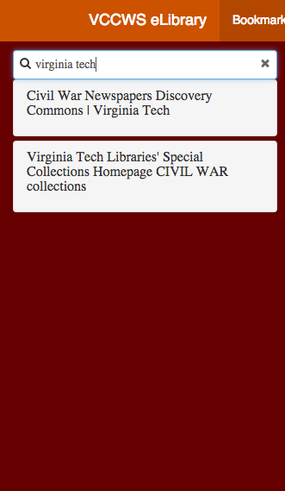
Search
Notes:
[Screenshot of search] Discuss how AngularJS allowed us to implement search easily

Slide 9
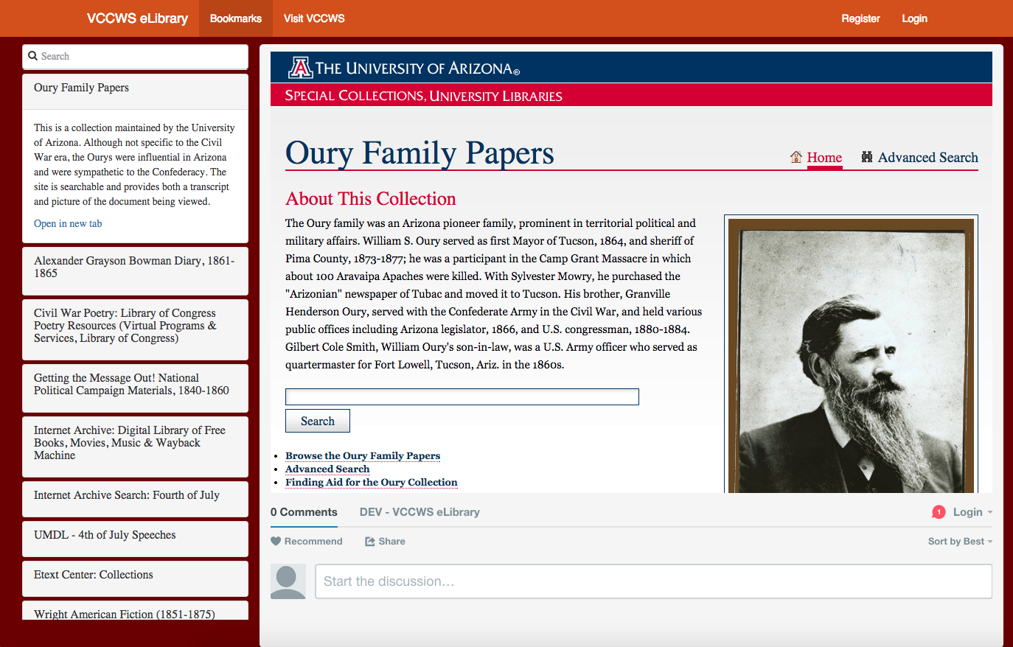
Notes:
[Screenshot of iframed link on same page] The user can easily see the webpage and decide if it contains valuable information relevant to them without leaving the site or opening a new tab.

Slide 10
Overview
Rebuilt using AngularJS/FatFreeFramework (PHP)
Implemented Search
VT Hosting/Style
Suggesting of Bookmarks

Slide 11
Resources
[1] http://fatfreeframework.com/
[2] http://getbootstrap.com/
[3] https://angularjs.org/
[4] https://trello.com/
[5] https://about.gitlab.com/
[6] http://fontawesome.io/
[7] https://disqus.com/
[8] http://www.civilwar.vt.edu/

