Slide 1
Pathways Web
CS4624 Multimedia, Hypertext, and Information Access
Professor Edward A. Fox
Chris Deisher, Chris Rocconi, Erin Gaughan, Jordan White, Louis Michael, Riley Kohl
Virginia Polytechnic Institute and State University
Blacksburg, VA 24061
April 27, 2017
Notes:
Add
name of course
instructor

Slide 2
Background Information
Pathways replaces the CLE system
More meaningful, relevant, and applicable

Slide 3
Project Goals
Help students decide what to take
  Showcase Pilot Courses
    Produce multimedia deliverables for each course:
      Video
      Audio - Faculty Interview, Podcast
      Photos
      Text - Course Summary, Quotes from Students

Slide 4
Brief Explanation of the Effort

Slide 5
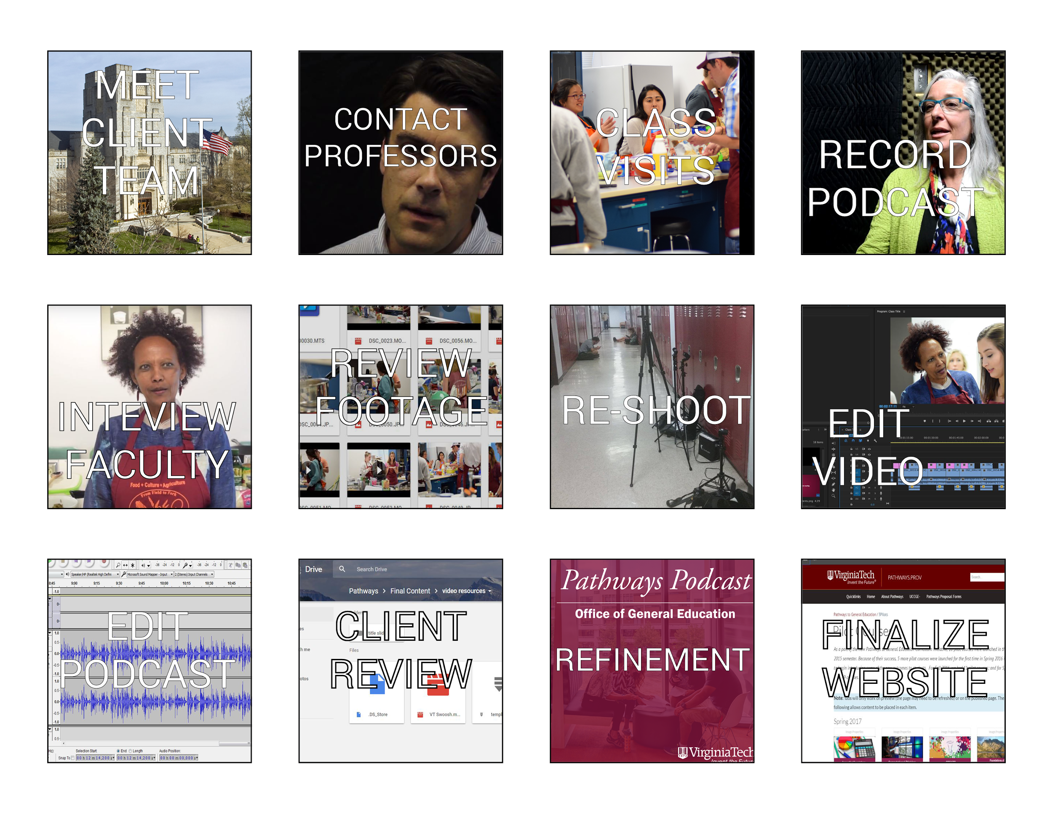

Slide 6
Problems | Solutions
Scheduling | Prioritize Professor Selection
Mediocre early data | Revisiti to Reshoot
Engaging Students | Follow up questions
Problems and Lessons Learned
Notes:
Chris Rocconi
Make this into a table

Slide 7
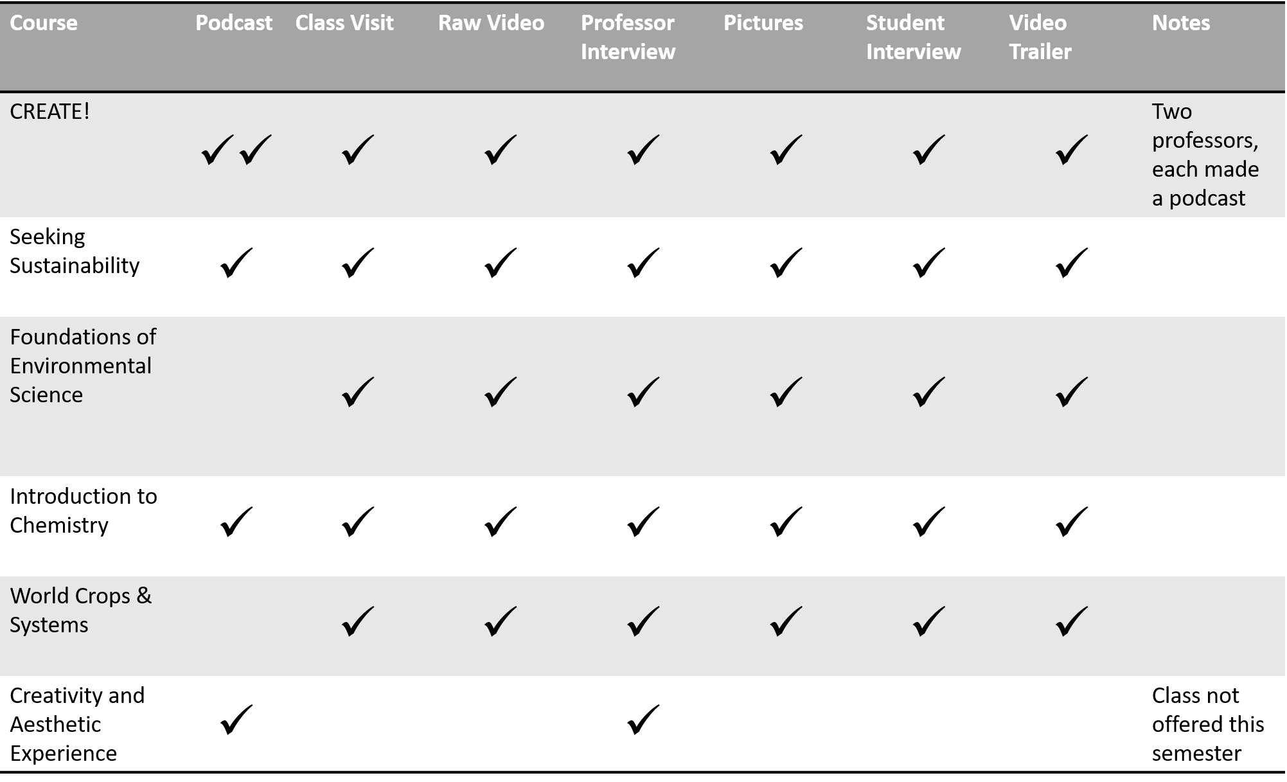
New Content Created

Slide 8
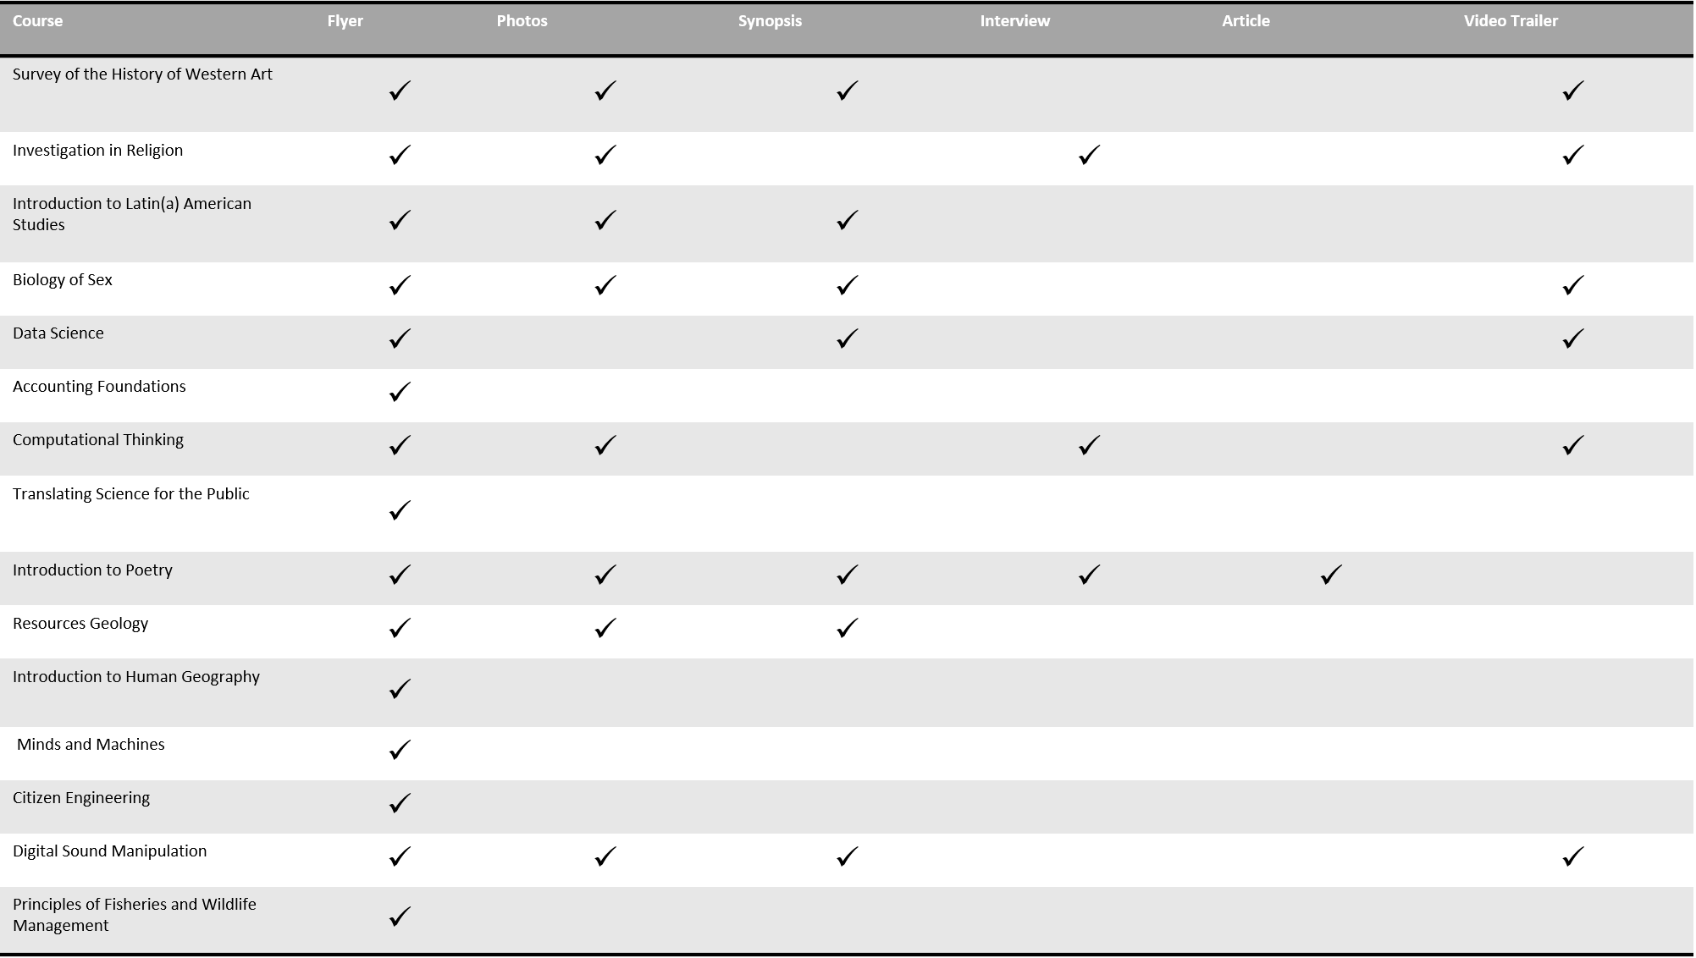
Existing Content for Website

Slide 9
Demo

