Slide 1
Adult Day Services
Promotional Video
Pablo Castillo, Jose Zurita, & Maddie Kulik
CS 4624: Multimedia, Hypertext, and Information Access
Virginia Tech, Blacksburg VA 24061 | 4.24.2019
Final Presentation | Dr. Edward Fox

Slide 2
Outline
ADS + Memory Masterclass Background
ADS
Memory Masterclass
Project Overview
Filming Outdoor Scenes
Details to focus on
Current Progress
Final Video Editing
Details to focus on
Plans for footage
Late feedback from video
Current Progress
3 major milestones completed since Pres. 3
Upcoming Milestones
M4: Final Edits to Video
M5: Receive Feedback
2-week Plan of action
Major Obstacles
Scheduling Conflicts
Amount of Desired Changes
Late Feedback from Video
Acknowledgements

Slide 3
ADS + Memory Masterclass Background
Adult Day Services
Subset of Human Development specializing in:
Personal care
Health monitoring
Meals
Therapeutic activities
Dementia care
Recovery assistance for elders
Patients: adults averaging age 75
Mission:
Maximize patient well-being and functionality
Provide resources and support for caregivers
Memory Masterclass
6-week course for people 55+ who want to maximize brain health
Geared towards participants with Mild Cognitive Impairment
Teach everyday strategies to improve brain function, even with MCI diagnosis
Project Overview
Create a promotional video for the ADS Memory Masterclass program

Slide 4
Filming Outdoor Scenes
Details & Updates
Details to Focus on:
Class participants interacting with one another
Show peaceful exercises that are in the class curriculum
Get active natural footage of participants
Plans for footage
Use in place as stock footage, disperse evenly throughout video
Last big piece of the video – everything else has been recorded/done
Goal: Include an equal amount of active and homey footage to balance aesthetic
Goal: Film comprehensively so we will not have to reshoot anything after this week

Slide 5
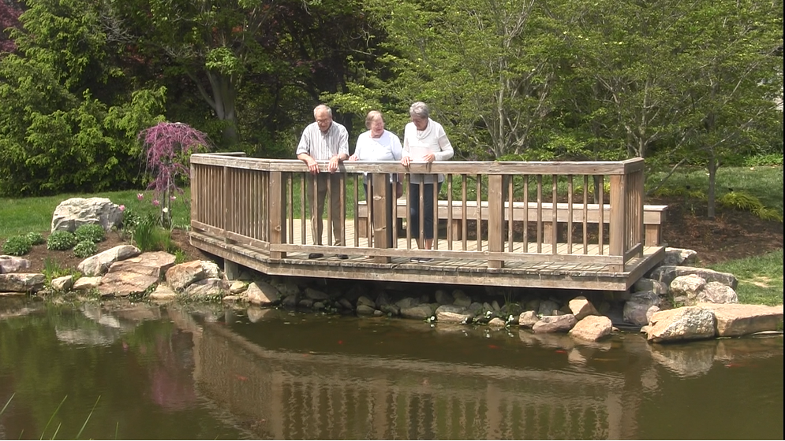
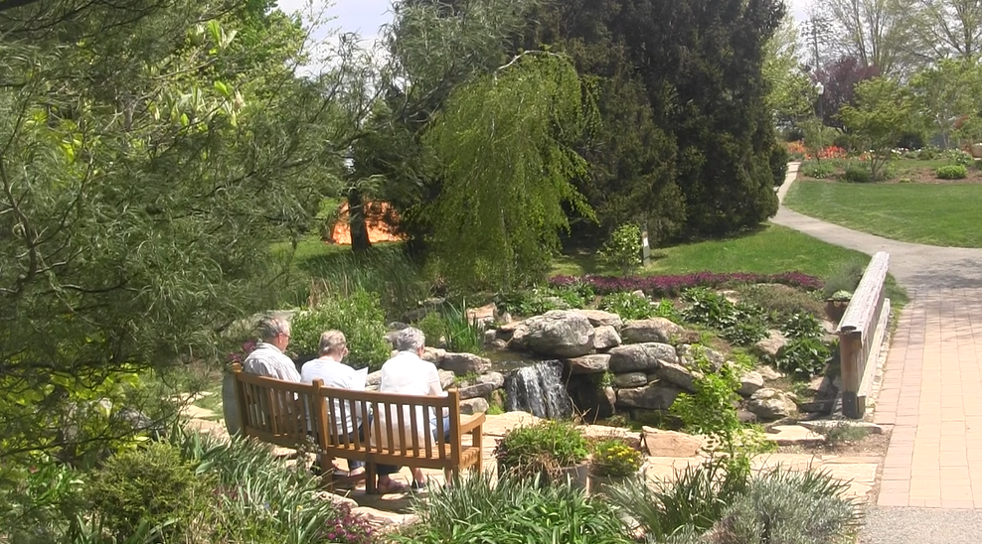
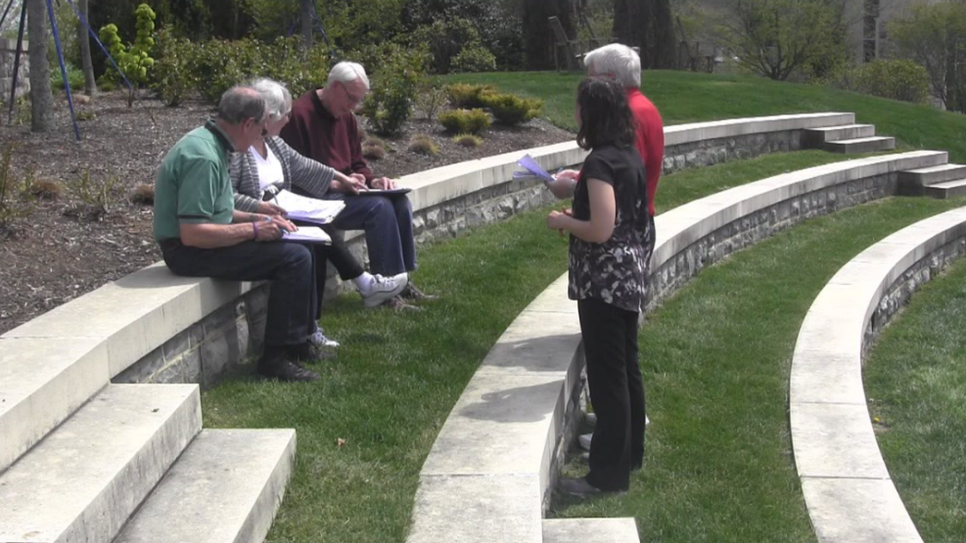
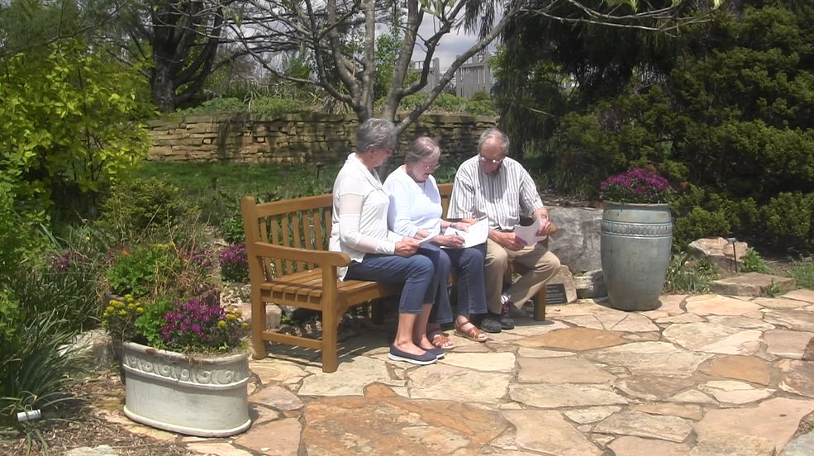
Outdoor Scenes

Slide 6
Final Video Editing
Details & Updates
Details to Focus on:
Substituting Stock Footage
  Classroom footage
  Active/Outdoor footage
  Disperse throughout
Update Sarah’s Footage
Add music + intro/exit
Condense interviews
Current Progress
Have a complete client approved storyboard that we have started piecing together
Clipped videos to clean out irrelevant content
Collected all outdoor footage
Goal: Have the full video complete with all updates by the end of the week
Goal: communicate with Sara for user testing at the beginning of next week

Slide 7
Current Progress
Milestones Achieved Since Presentation 3
Milestone 1: Collected Outdoor Footage
Acquired all outdoor footage that we need in order to replace previous stock footage acquired online.
Milestone 2: Clipped and Cleaned Videos
Split clips up into shorter lengths
Removed unusable clips
Color correction on new clips
Fixed audio on clips
Milestone 3: Updated Storyboard for the Final Video
Incorporated all feedback from client about changes to details
Focus switched from lengthy interviews to voiceovers + stock footage

Slide 8
Current Milestones
Tasks To Be Completed
Milestone 4: Final Edits to Video
Introduce outdoor/active footage
Replace any current stock footage with classroom and active scenes
Timeline: final version done by the end of this week
Milestone 5: Receive Feedback
Client feedback – any small, final changes
User testing – sample group of Memory Masterclass/ADS participants
Timeline: communicate with Sara by end of this week, begin testing early next week

Slide 9
Plan Of Action: Next 2 weeks
Week of 4/22
Film outdoor footage
Review outdoor and indoor footage
Add stock footage into the last draft of the video
Continue tackling the main concerns the client brought up regarding the video
Edit and put together new version of the video
Week of 4/29
Present rough draft to Dr. Fox
Communicate with Sara about group wiling to participate in user testing
Present to client and receive further feedback
Finalize report and make final edits to video

Slide 10
Obstacles
Scheduling Conflicts
Scheduling meetings/shooting times – difficult to all be present due to different schedules
Makes video editing more difficult
Amount of Desired Changes
Many small details that the client wanted changed
Difficult to incorporate absolutely everything they want done
Limit to our videography skills
Late Feedback from Video
Many small details that client wanted changed
Want to avoid any major edits after final version is done
Not much time left in the semester

Slide 11
Acknowledgements
Ila Schepisi: ADS Director
Sara Amos: Memory Masterclass Coordinator
Ben Katz: Professor researching cognitive training
Former & Current Memory Masterclass Participants
VT Adult Day Services
102 Wallace Hall
Blacksburg, VA

