Slide 1
VT OASF Awards
Open Access Subvention Fund
transforming open publishing environments

Slide 2
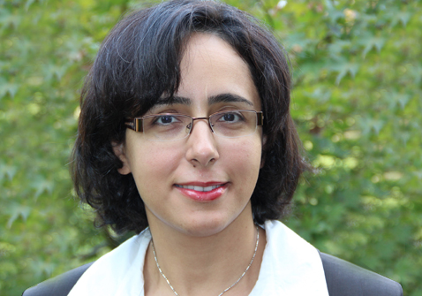

Abedi, Vida;
Yeasin, M.; & Zand, R.
“Empirical Study Using Network of Semantically Related Associations in Bridging the Knowledge Gap”

Slide 3

Burke, Alison K; Guthrie, Leah T.C.; Modise, Thero; Cormier, G.; Jensen, Roderick V.; McCarter, L.; & Stevens, Ann M.
“Series; GSE53639: OpaR Controls a Network of Downstream Transcription Factors in Vibrio Parahaemolyticus BB22OP”

Slide 4
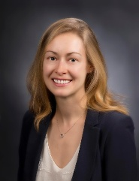
Carey, Cayelan, & Hanson, G.
“Fish and Phytoplankton Exhibit Contrasting Temporal Species Abundance Patterns in a Dynamic North Temperate Lake”

Slide 5


Cheng, Zhiyong; Zou, Peng; Liu, Longhua; Zheng, Louise; Liu, Lu; Stoneman, Rebecca,; Emery, Ashley; Gilbert, Elizabeth R. & Cho, Alicia
“Targeting FoxO1 with AS1842856 Suppresses Adipogenesis”
Landes Bioscience Journals: Cell Cycle

Slide 6
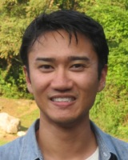
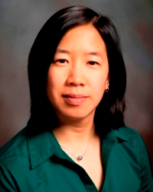
David, Ray, & Marr, Linsey
“Correlation and Causality Analyses of Meteorological Variables Associated with Spore Release of a Plant Pathogen”

Slide 7
Dougherty, Edward; Turner, James; & Vogel, F.
“Multiscale Model and Simulations of Transcranial Direct Current Stimulation to Neuron Electrodynamics: Modeling the Influence of the Transcranial Electric Field on Neuronal Depolarization”

Slide 8
Duncan, Susan; Bianchi, Laurie M.; Webster, Janet B.; Johnson, D.S.; Chang, H.; Marcy, Joseph E.; & O'Keefe, Sean F.
“Protecting Soymilk Flavor and Nutrients from Photodegradation”

Slide 9

Gilbert, Elizabeth R.; Zhang, Shuai; Hulver, Matthew W.; McMillan, Ryan P.; & Cline, Mark A.
“The Pivotal Role of Pyruvate Dehydrogenase
Kinases in Metabolic Flexibility”

Slide 10
VT OASF Awards
Open Access Subvention Fund
transforming open publishing environments

Slide 11

Hill, Jennie L.; You, Wen; & Zoellner, Jammie
“Does Availability of Physical Activity and Food Outlets Differ by Race and Income? Findings from an Enumeration Study in a Health Disparate Region”

Slide 12

Lattimer, Brian; Chen, Yanyun;
Ripe, C.; Allen, B.; Case, Scott &
Mouritz, A.
“Overview of Aluminum Alloy Mechanical Properties
During and After Fires”

Slide 13
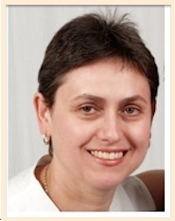

Lazar, Iuliana M.,
& Tenga, Milagros
“Proteomic Study Reveals a Functional Network of Cancer Markers in the G1-Stage of the Breast Cancer Cell Cycle”

Slide 14

Li, Zhiyl; Wu, Xiaowei; He, Bin, &
Zhang, Liging
“Vindel: a Simple Pipeline for Checking Indel Redundancy”

Slide 15
Liu, Dongmin; Luo, Jing; Jia, Z.; Zhen, Wei; Zhou, K.; & Gilbert, Elizabeth.
“Baicalein Prevents Type 2 Diabetes via Promoting Islet ß-Cell”

Slide 16
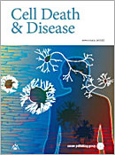
Liu, Longhua; Zhou, Peng; Zheng, Dongxu; Linarelli, Leah E.; Amarell, Sarah; Passaro, Ausin; & Cheng, Zhiyong
“Tamoxifen Reduces Fat Mass by Boosting Reactive Oxygen Species”

Slide 17
Luo, Xin; Ren, Jingling; Liao, Xiaofeng; Wei, C.H.; Ross, C.; Cecere, Thomas; Jortner, Bernard & Ahmed, Ansar
“Paradoxical Effects of All-trans-retinoic Acid on Lupus-like Disease in the MRL/lpr Mouse Model”

Slide 18

McGlothlin, Joel; Chuckalovack, J.P.; Janes, D. E.; Feldman, C.R.; Pfrendere, M. E.; & Brodie, Jr., E. D.
“Parallel Evolution of Tetrodotoxin Resistance in Three Voltage-gated Sodium Channel Genes in the Garter Snake Thamnophis sirtalis”

Slide 19
VT OASF Awards
Open Access Subvention Fund
transforming open publishing environments

Slide 20
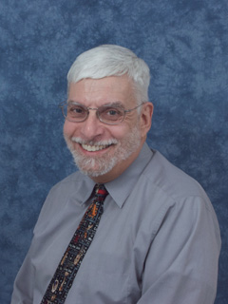
Merola, Joseph. S., & Grieb, A. W.
“Crystal Structure of Chlorido­(η²-phenyl iso­thio­cyanate-κ² C,S)-mer-tris­(tri­methyl­phosphane-κP)iridium(I)”

Slide 21
Merola, Joseph. S., & Grieb, A. W.
“Crystal Structures of Factris (trimethylphosphane)
Trichlororhodium(III) Hydrate and Factris (trimethylphosphane) Trichlororhodium(III) 0.5 Methanolate - rhodium Structures that are Isomorphous with their Iridium Analogs”

Slide 22
Nilsen, Erik T.; Tokuhisa, James; Grene, Ruch; & Freman, J. A
“Rootstock Provides Water Conservation for a Grafted Commercial Tomato (Solanum lycopersicum L.) Line in Response to Mild-Drought Conditions: A Focus on Vegetative Growth and Photosynthetic Parameters”

Slide 23
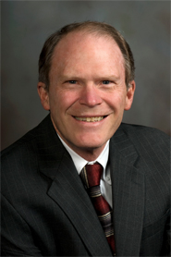

Notter, David,
& Brown, D.
“Effects of Birth-rearing Type on Weaning Weights in Meat Sheep are Systematically Associated with Differences Among Flocks in
Mean Performance”

Slide 24

Obilade, Titilola T.
“A Comparative Study of the Cognitive Function of the Hearing-impaired and the Non-hearing-impaired in Two Primary Schools in Lagos State, Nigeria”

Slide 25
Obilade, Titilola T.
“A Descriptive Study of the Knowledge-Base of Malaria Between the Visually-impaired and the Non-Visually Impaired in Two Primary Schools in Lagos, Nigeria; Implications for Health Education”

Slide 26
Obilade, Titilola T.
“Ebola Virus Disease Stigmatization; The Role of Societal Attributes”

Slide 27
Obilade, Titilola T.
“Exclusive Breastfeeding Among Mothers in Two Semi-Urban Areas Around a Baby Friendly Hospital Initiative Designated Hospital in Lagos State, Nigeria”

Slide 28
VT OASF Awards
Open Access Subvention Fund
transforming open publishing environments

Slide 29
Obilade, Titilola T.
“The Political Economy and Stigmatization of HIV/AIDS in Patients Attending a Clinic in Lagos, Nigeria”

Slide 30
Ray, Parth Pratim; Knowlton,
Katherine F.; Shang, Chao & Xia, Kang
“Development and Validation of a UPLC-MS/MS Method to Monitor Cephapirin Excretion in Dairy Cows Following Intramammary Infusion”

Slide 31
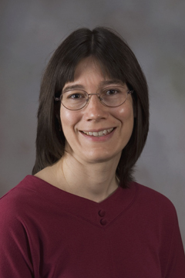
Stevens, Ann M.; Schu, D. J.; Scruggs, J. M.; Geissinger, J. S.; & Michel, K. G.
“Acyl-Homoserine Lactone Recognition and Response Hindering the Quorum-Sensing Regulator EsaR”

Slide 32
Subbiah, Elankumaran; Biswas,
Moanoro; Dhanasekaran, S.; Vignesha, A. R.; Ramya, R.; DhinakarRaj, G.; Raja, A.; Kataria, R. S.; Parida, S.; & Tirumurugaan, K. G.
“Toll-Like Receptor Responses to Peste des Petits Ruminants Virus in Goats and Water Buffalo”

Slide 33

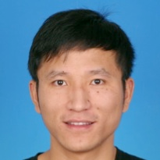
Taylor, John E.,
& Wang, Qi
“Quantifying Human Mobility Perturbation and Resilience in Hurricane Sandy”

Slide 34
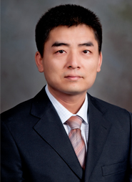
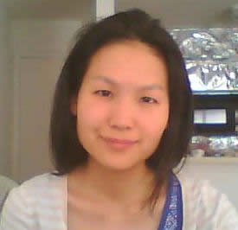
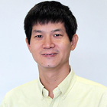

Wu, Xiaowei; Sun, Ming-an; Zhu,
Hongxiao; & Xie, Hehuang
“Nonparametric Bayesian Clustering to Detect Bipolar Methylated Genomic Loci”

Slide 35
Xing, Jianhua; Mondal, D.; Dougherty, Edward; Mukhopadhyay, Abhishek; Carbo, A.; & Yao, G.
“Systematic Reverse Engineering of Network Topologies: A Case Study of Resettable Bistable Cellular Responses”

Slide 36
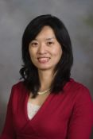
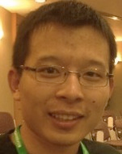
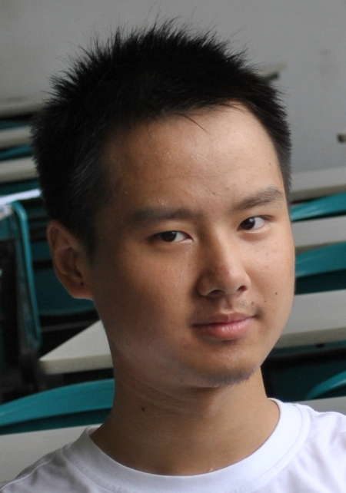
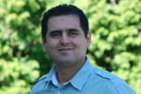
Yao, Danfeng; Liu, Fang; Shu, Xiaokui; & Butt, Ali
“Privacy-Preserving Scanning of Big Content for Sensitive Data Exposure with MapReduce”

