Slide 1
ForWind – Center for Wind Energy Research
Moses Kärn
ForWind / Carl von Ossietzky University of Oldenburg, Germany
  Wind Energy Education @ ForWind
  – Local and European Collaborations
  Part II
NAWEA Symposium 2015, Virginia Tech, Blacksburg, VA
June 10, 2015
Notes:
Thank you very much for inviting to the NAWEA Symposium.
And it is my pleasure to speak to you here at the plenary session
about our educational activities and the wider European perspective in which we are doing them.

Slide 2
Agenda
Revisited: Continuing Education
European Wind Energy Master (EWEM)
Online Certificate Program „Advanced Wind Energy“

Slide 3
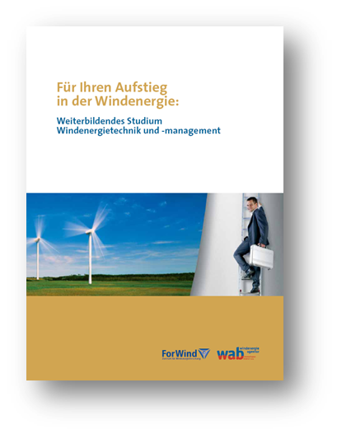

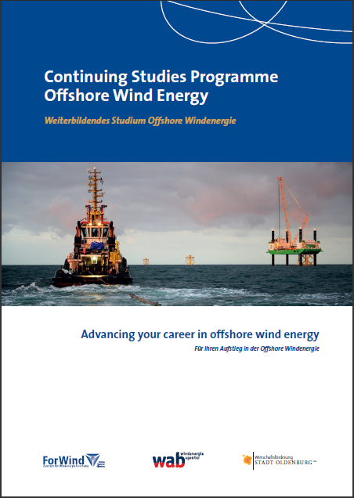
Continuing Education for Professionals in Wind Energy
Onshore 2006
Part 1
Offshore 2012

Slide 4
Recruitment Strategies of the Wind Energy Industry
Hire graduates with degree in traditional science or engineering:
    Mechanical / Civil / Electrical / Aerospace Engineering /…
    Physics / Meteorology / …
… and train them on the job in wind specific applications.
„Pioneer Mentality“ in Germany: „If we tought us everything all by ourselves then the new generations can do that as well.“
Challenge: Experienced staff has to be recruited by headhunters.
Problem: The resulting personnel carousel is not a sustainable HR management.
Solution: Continuing higher education for professionals.

Slide 5















A10 Years of Collaboration of Academia and the Wind Energy Industry -- Onshore and Offshore
energy supplier, grid operator
manufacturer
project developper
finance
+
O & M
research
Wind Energy Agency WAB
Industry and business network since 2003
insurance
service
?
business associations
engineering services

Slide 6
The Concept: Bring together Experts from all Areas of Realisation of Wind Farms
Technology
Management
Multi-disciplinary target group:
    scientists, engineers, project developpers,
    economists, managers, law, finance, insurance,…
Offer systematic know-how about wind energy projects.
Fill individual knowledge gaps.
Develop interdisciplinary competences.
Provide professional development for decision makers.
Build network of experts.
Continuing
Studies
Programme
Wind Energy
Practical
know-how
& project
experience
Scientifically
based

Slide 7
Interdisciplinarity and System Knowledge
Understand and Master the Complexity of
Modern Wind Farm Projects
Science, Technology
Law, Policy, Economy
Planning, Development
Financing, Insurance
Manufacturing, Components
Logistics, Construction
Technical and Commercial Operation
Maritime Technologiies

Slide 8
Participants of the Offshore Program
by Areas of Supply Chain
Public Affairs
Project Development
Naval Officer Installation Vessel
Construction Site Management
Planning
& Consenting
Investment Fund,
Bank
Installation & Commissioning
Ship Building
Engineering, Consulting
Harbour Development
Development, Design
Quality Management
WT Manufacturing
Cable Manufacturing
O&M Manager
Procurement
Substation Engineering
Electrical System & Grid
Energy Supplier
Technical and Commercial Operation
Sales
Electrical Power Systems
Insurance Surveyor / Broker
Service Technician
Offshore Substructure
TSO
Technical Design
Law, Contracting

Slide 9
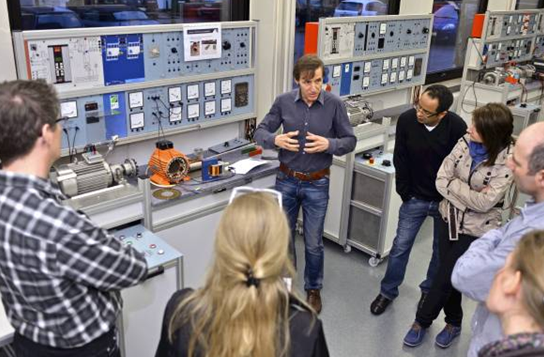
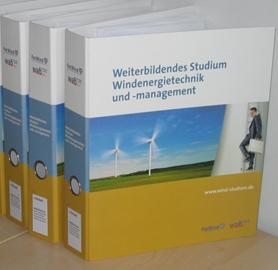
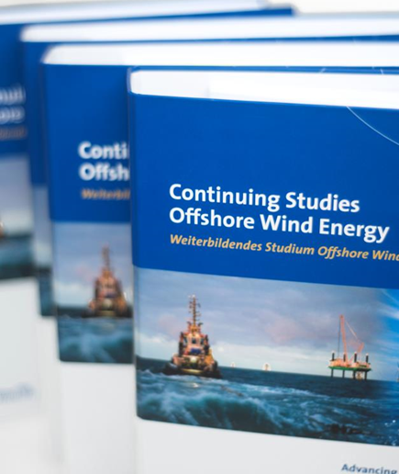
Structure and Organisation
Part-time study program for professionals
    duration: 11 months
    university certificate on Master level (30 ECTS)
    fee: 9200/9800 EUR
Mix of of methods / „blended learning“:
    exclusive reading material (3-4 weeks reading period)
    on-site seminars once a month
    project work (wind farm development)
    Field trips, workshops, …
    online learning platform
  Alumni network with more than 220 alumni and 80 lecturers

Slide 10
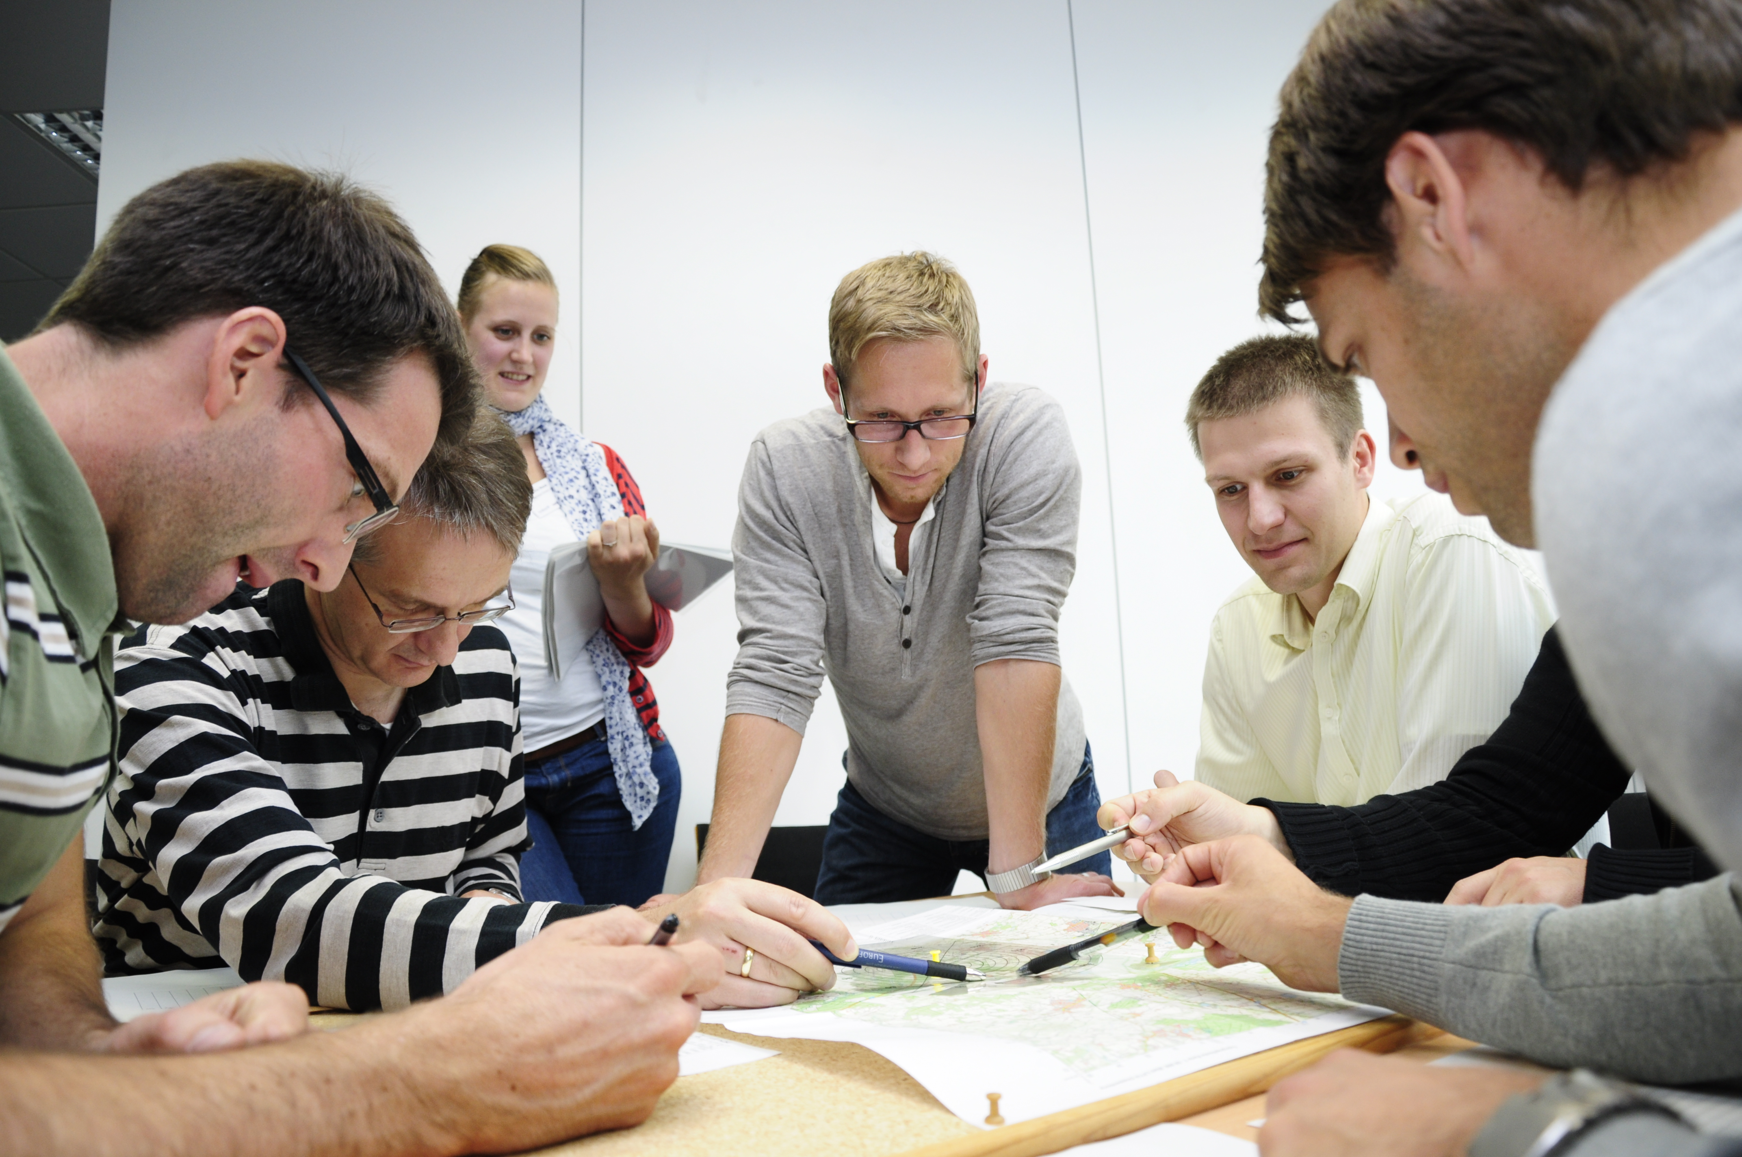
Project work is learning by doing
Task: Wind Farm Development
Interdisciplinary teams form virtual company
Project meetings during on-site lectures
Support through online-platform
Project presentation is main part of final exam
Learning by going:
Experience in project and team management
Intensive training of communication and negotiation skills

Slide 11
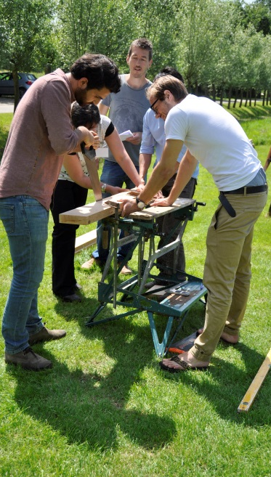
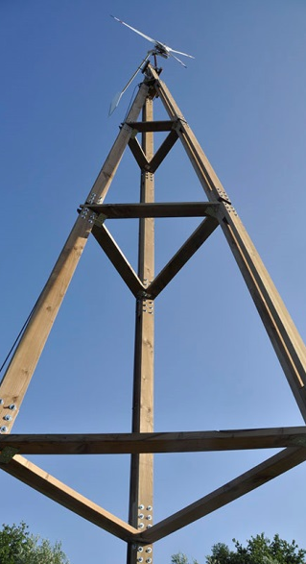
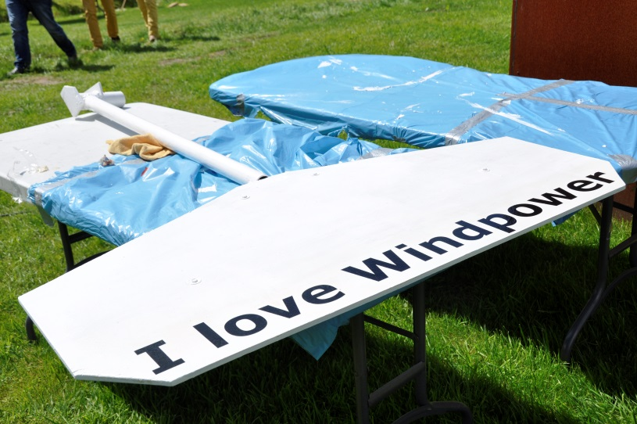
European Wind Energy master (EWEM)
Part 2

Slide 12





European Wind Energy Master (EWEM)
4 world-leading Wind Energy universities join forces
2 year program, 4 tracks, double degree
Building on long-standing cooperation and local master programs
Erasmus Mundus Scholarships for students
Mobility funding for staff and students
Associated partners: major industry, business & associations involved in guest lectures, summer schools, internships or MSc thesis
Aim: 50-60 graduates per year
(today around 40)
Wind Energy: 90 ECTS + thesis (=100%)
Notes:
50-60 graduates nog niet gehaald. Nu 35-40.

Slide 13
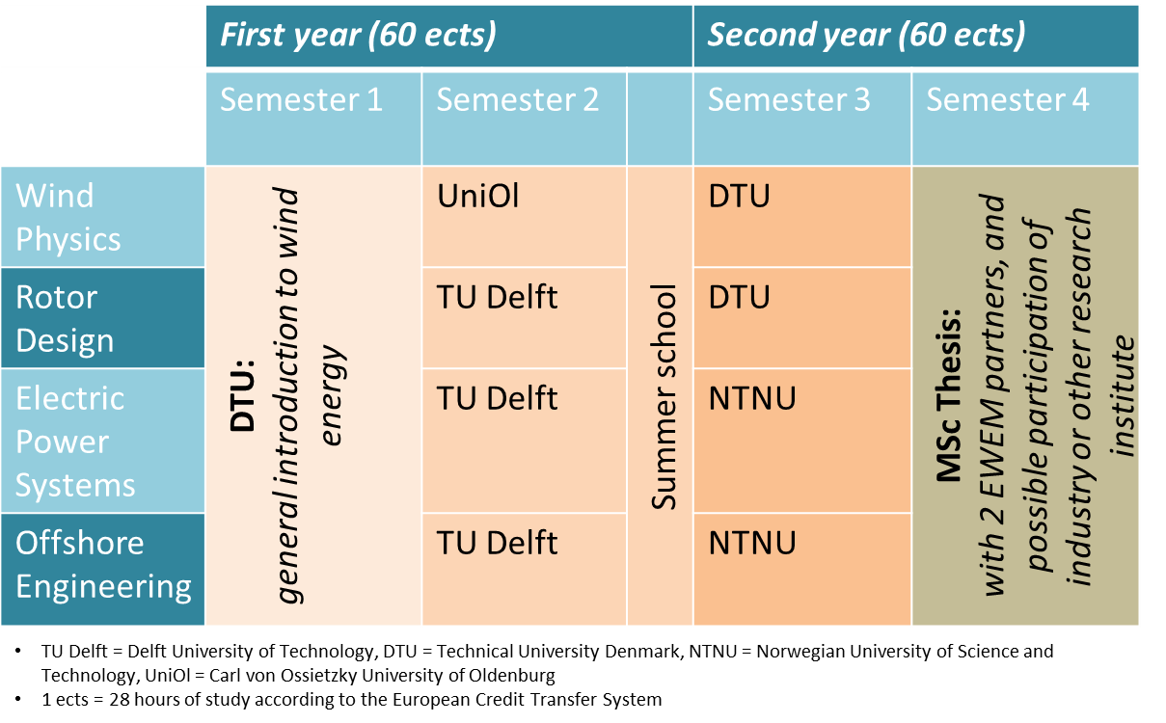
Program Structure
Notes:
1 programme, 4 universities, 4 tracks, 3 mobility paths.
Take 1 or 2 examples, explain the schedule.
Summer school this year will probably take us to Fraunhofer IWES in Bremerhaven to take a look at big testing facilities.

Slide 14
Awarded Degrees
Track | Degree 1 | Degree 2
Wind Physics | MSc Wind Energy Engineering from DTU | MSc Engineering Physics from UniOl
Rotor Design | MSc Wind Energy Engineering from DTU | MSc Aerospace Engineering from TU Delft
Electric Power Systems | MSc Electrical Engineering from TU Delft | MSc Technology-Wind Energy from NTNU
Offshore Engineering | MSc Offshore Engineering and Dredging from TU Delft | MSc Technology-Wind Energy from NTNU
Notes:
EWEM is NOT a degree!
LOCAL degrees have been a prerequisite in order to establish EWEM.

Slide 15
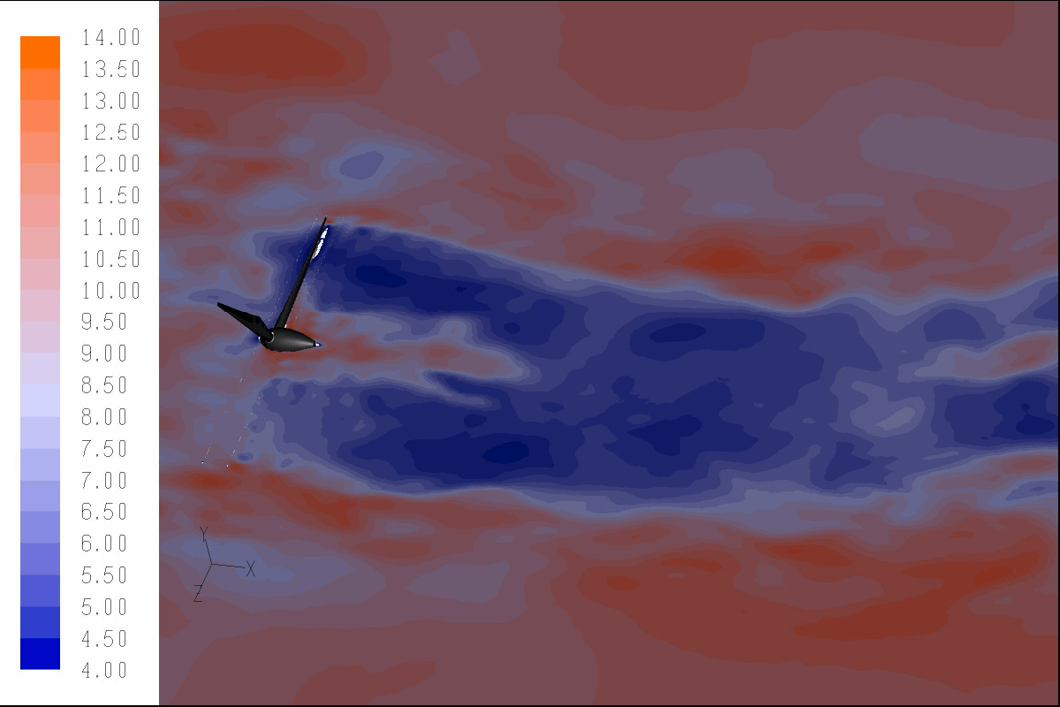
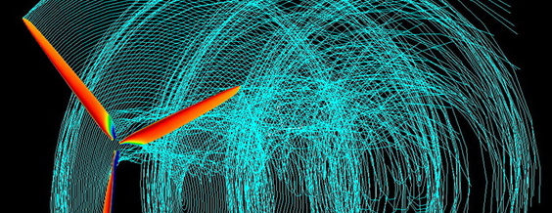
Required BSc Background
1/2
Wind Physics:
Mechanical Engineering
Aerospace Engineering
Mathematics
Physics
Rotor Design:
Mechanical Engineering
Aerospace Engineering
Physics
Similar backgrounds accepted if proven relevant.
Notes:
Details on minimum number of ECTS in specific key courses to be found on the website

Slide 16
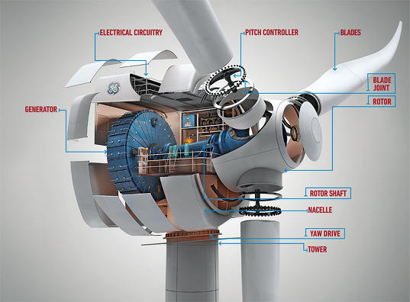
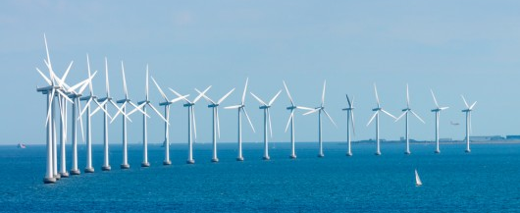
Required BSc Background
2/2
Electric Power Systems Electrical Engineering
Physics
Offshore Engineering
Civil Engineering
Structural Engineering
Mechanical Engineering
Physics
Similar backgrounds accepted if proven relevant.
Notes:
We have had AE students in OE, but you need to prove you have what it takes.
Details on minimum number of ECTS in specific key courses to be found on the website

Slide 17



































Associate Partners
Notes:
Associate partners involved in guest lectures, summer schools, possible internships or MSc thesis subjects, etc.

Slide 18
Associate Partners
Opportunities for your engagement within EWEM:
If you are not associated yet, try to change that.
Host students for internships or master thesis.
Host visiting scholars for teaching purposes.
Use scholarship to travel to one of the four European universities
for teaching purposes.
Give guest lectures at the Summer School.
Promote PhD and Post-Doc positions.
Notes:
Associate partners involved in guest lectures, summer schools, possible internships or MSc thesis subjects, etc.

Slide 19
Some key issues for successful cooperation in joint programmes -- lessons learned from EWEM:
  Create added value for students: attractive universities and high quality of the program.
  Resources are (as usually) critical: professors, lecturers, staff, rooms,…
  Key issue: local programmes have to be existing – and they need to fit together without lots of new courses to be created.
  Collaboration builds on trust that has been developping over the years.
  Need to overcome local administrative and legal barriers :
    Different semester calenders / module structure / different credit systems
    Business model to divide tuition (Oldenburg: no additional costs??)
  Industry not ready yet to fund scholarships.
  Exchange with associated partners needs to be intensified.

Slide 20
Online Certificate „Advanced Wind Energy“ – Development in progress
Part 3

Slide 21
Online-Certificate Advanced Wind Energy
Bridge Module
Wind Energy Utilisation
3 ECTS
Fluid Dynamics I
3 ECTS
Computational Fluid Dynamics (CFDI)
3 ECTS
Track I: Energy Meteorology
Track II: Wind Energy Systems
Energy Meteorology and Numerical Methods for Wind Energy 1
3 ECTS
Design of Wind Energy Systems
3 ECTS
Energy Meteorology and Numerical Methods for Wind Energy 2
Aeroelastic Simulations of Wind Turbines
3 ECTS
3 ECTS
Extension Module
Measurements and Validation for Advanced Wind Energy
(Lab & Field Project)
8 ECTS
Σ 23 ECTS

Slide 22
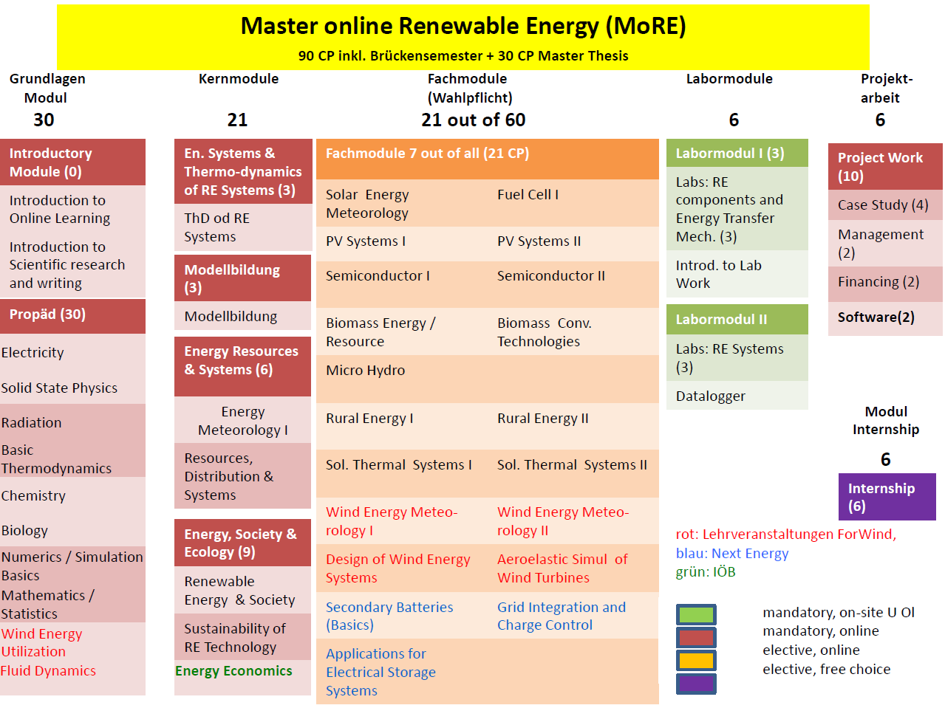

Slide 23
Conclusion
Collaboration wanted!

Slide 24
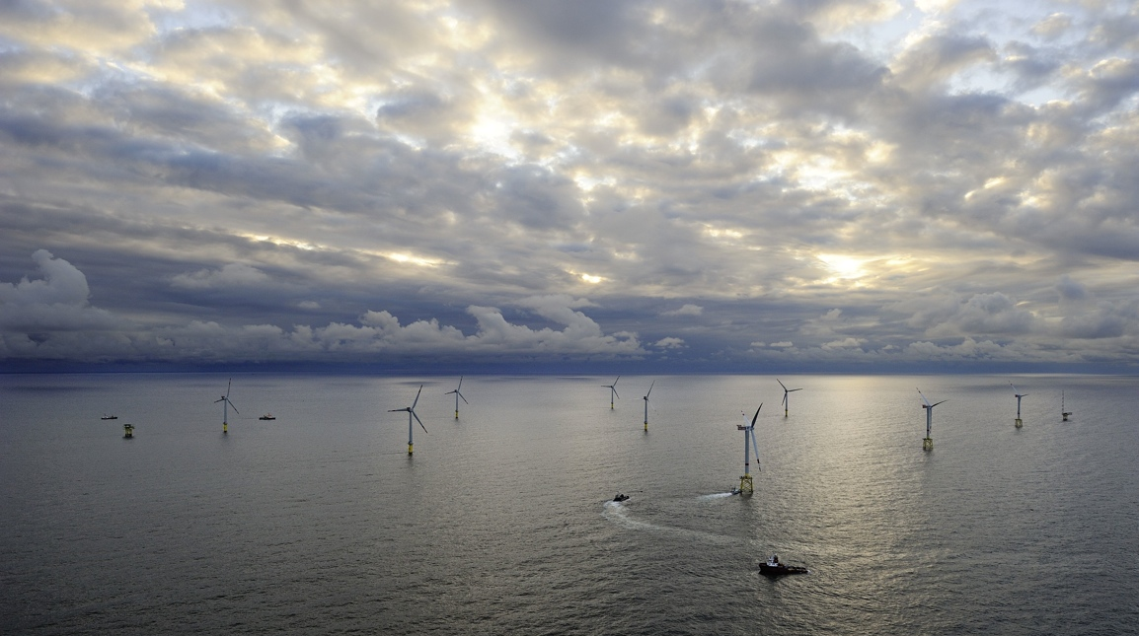
Thank You! Questions?
Moses Kärn
moses.kaern@forwind.de
www.windenergymaster.eu
www.windstudium.de
www.offshore-wind-studies.com

