Slide 1
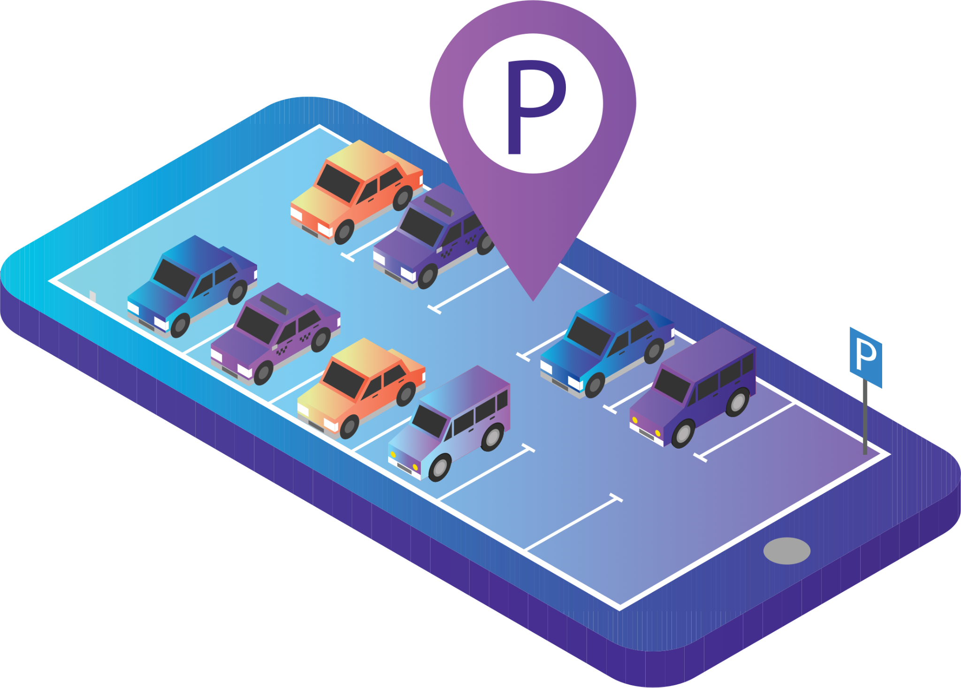
Smart Parking Recommender Mobile App
James Jang
Drew Loomis
Nam Tran
Avi Mehta
Bowen Lin
CS 4624 - Multimedia/Hypertext
Mohamed Farag
Virginia Tech, Blacksburg VA 24061
Mar 28, 2023

Slide 2
Outline
Background
Deliverables
Design / Implementation
Backend
Flask / Python Script
Frontend
User Interface
Future Plans
Lessons Learned
Acknowledgements
References

Slide 3


Background
Parking is a headache in high traffic areas such as campus.
At peak hours, parking becomes an even bigger issue because spots are not as readily available.
James Madison University has a live tracker of the available parking spaces in each parking garage.

Slide 4
Deliverables
Help students and faculty find the most convenient parking spot.
Create a mobile application that takes the user’s current location and time of arrival as input for a machine learning model to predict the most optimal parking spot.
Analyze the relationship between parking space occupancy and time to reveal trends for the most optimal parking solution.

Slide 5
Design / Implementation
We are utilizing the MERN stack, consisting of MongoDB, Express, React (Native), and Node.
We will be using MongoDB Atlas, which is a cloud version of the database platform.
One backend server is hosted on an Express/Node.js server, which is an API endpoint server to communicate to the Flask backend and calculate values for our ML prediction.
Python script is hosted on a Flask server that grabs predicted values via a GET request that can be called from an endpoint from the backend.

Slide 6
Flask / Python Script
Python script hosted on Flask server
Functions:
train() - reads CSV files and fits all dataframes for time-series forecasting (singleton pattern)
load() - loads the models from the JSON files
predict() - extends all models by given number of minutes, calculates predicted values, and returns the last value for each parking garage

Slide 7
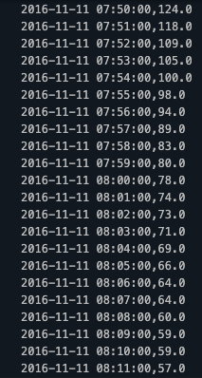
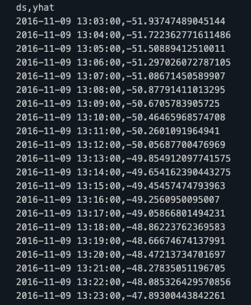
Example Forecast Output
ds = date and time
yhat = predicted values
Input CSV file
Output CSV file

Slide 8
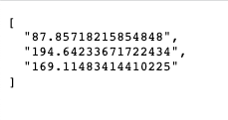
Flask GET Request
Test Coordinates:
Forbes Center for the Performing Arts
http://127.0.0.1:5000/predict?latitude=38.44067386074501&longitude=-78.87656271457665
predict function will be called from backend
request from backend will be fetched by frontend to rank garages + display data to user

Slide 9
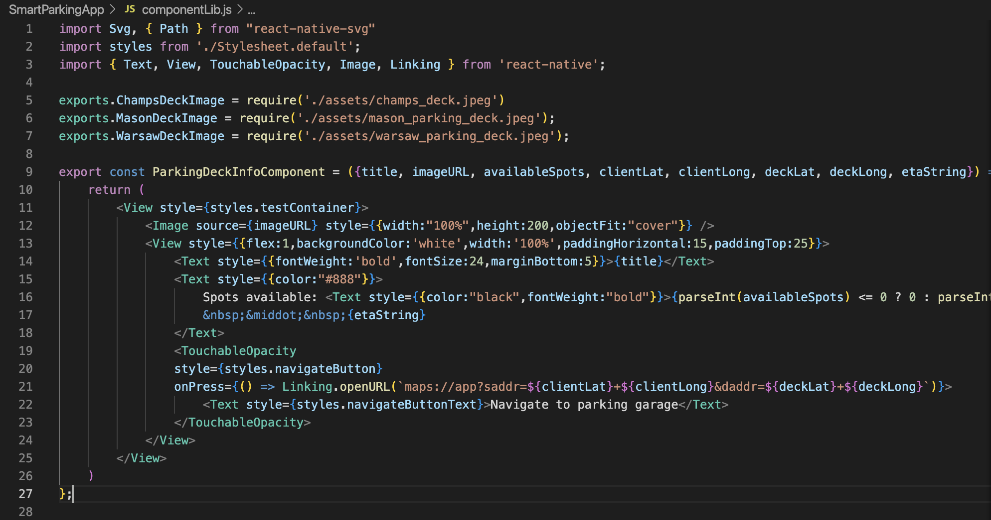
Frontend
Built in React Native (JavaScript), allowing for the application to be built on iOS and Android
Code organized into component library
Screenshot of our parking deck page component

Slide 10
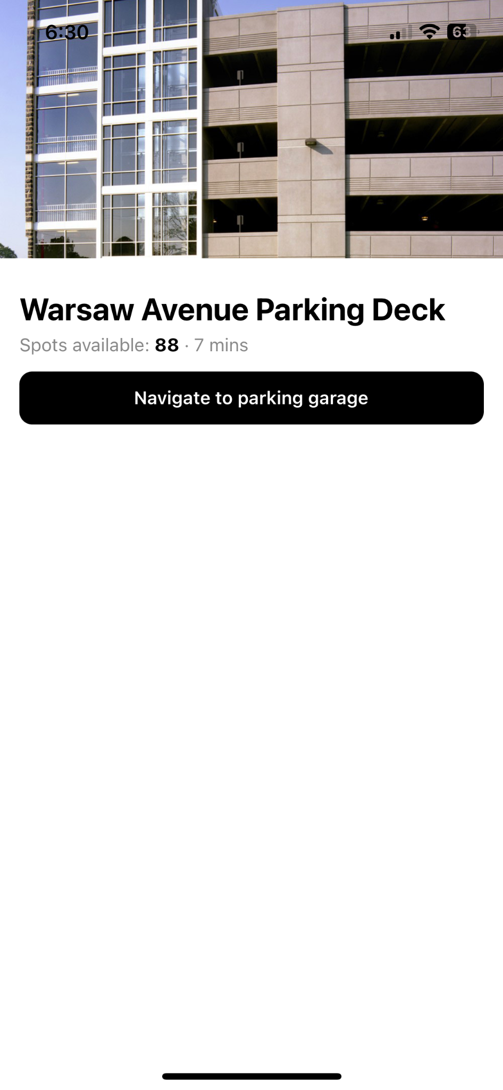
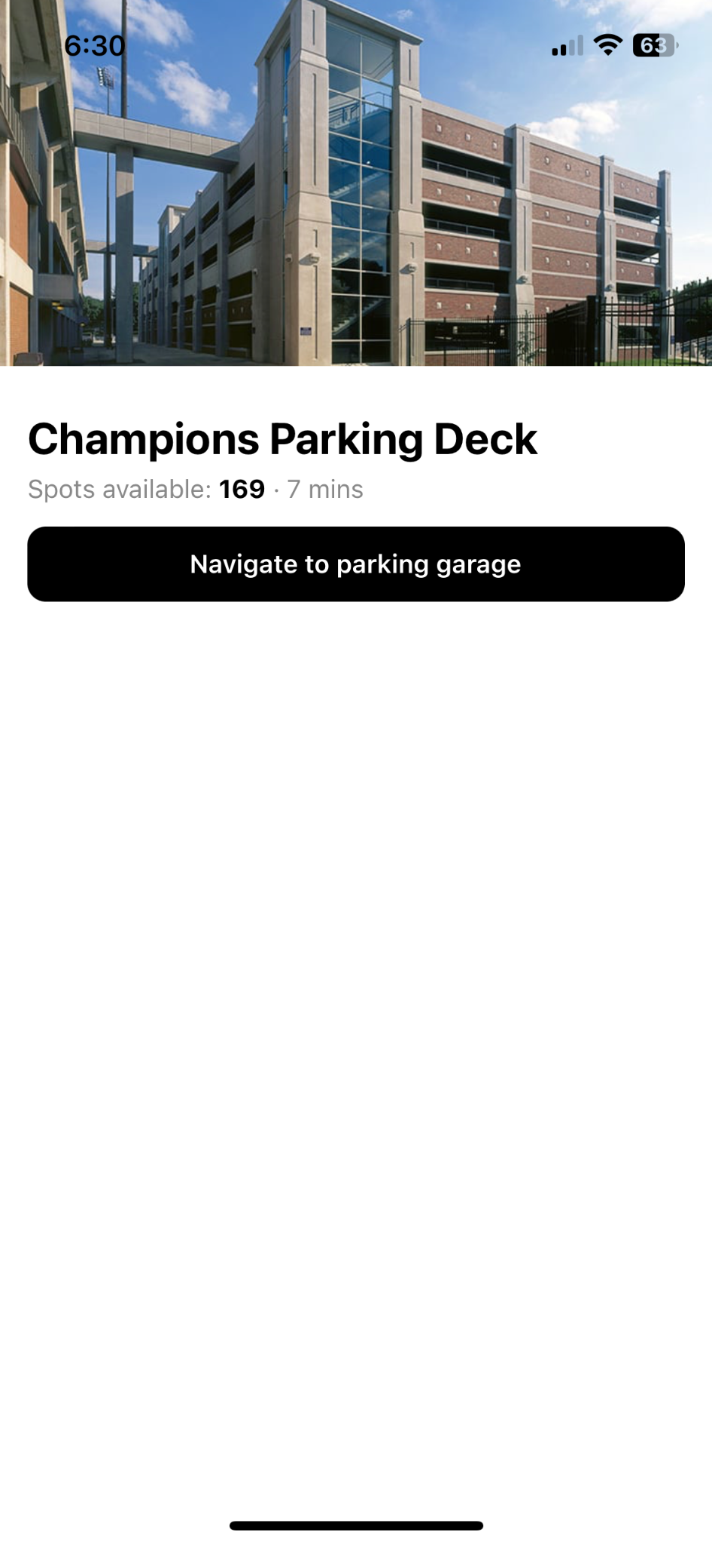
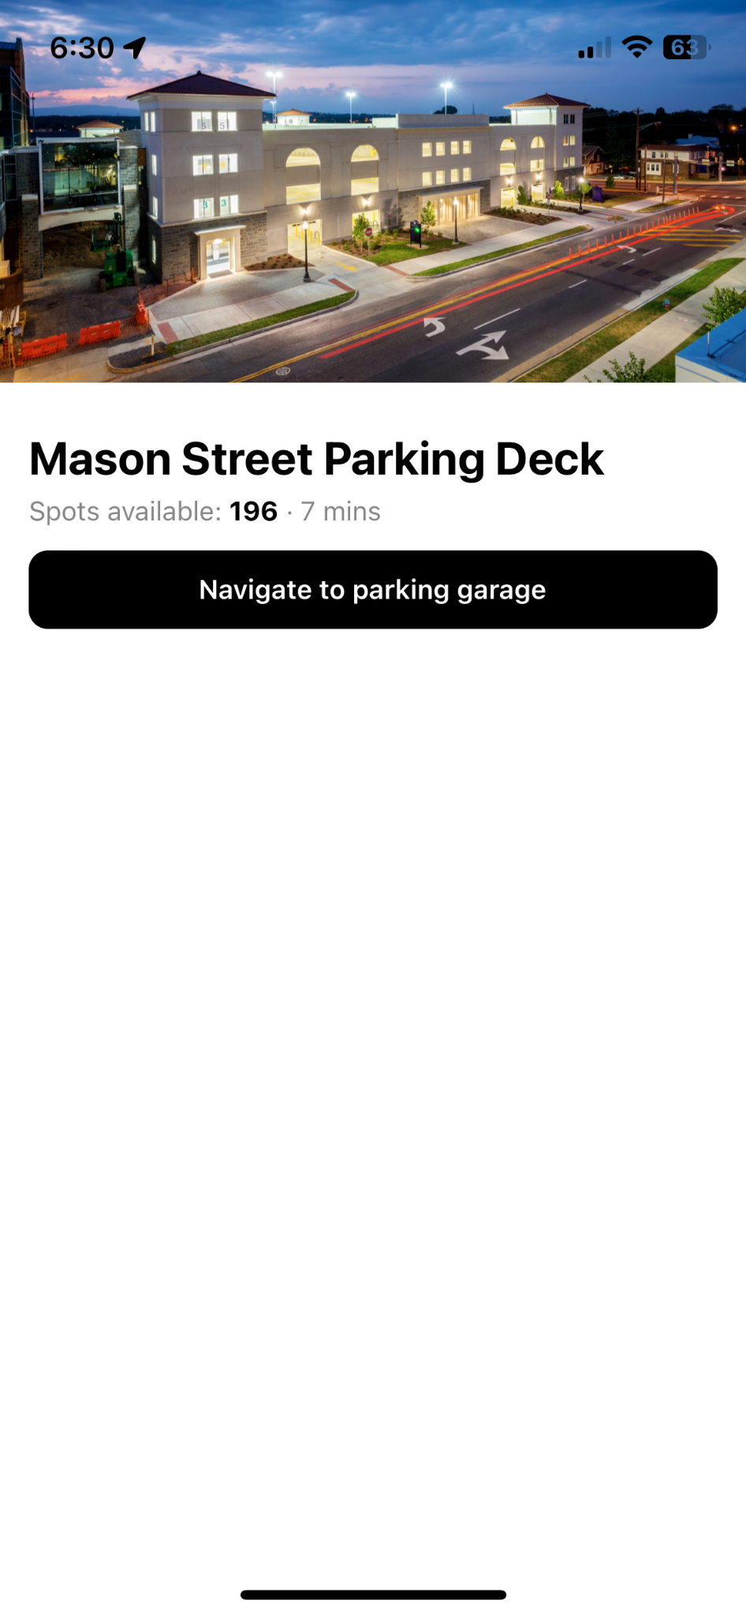
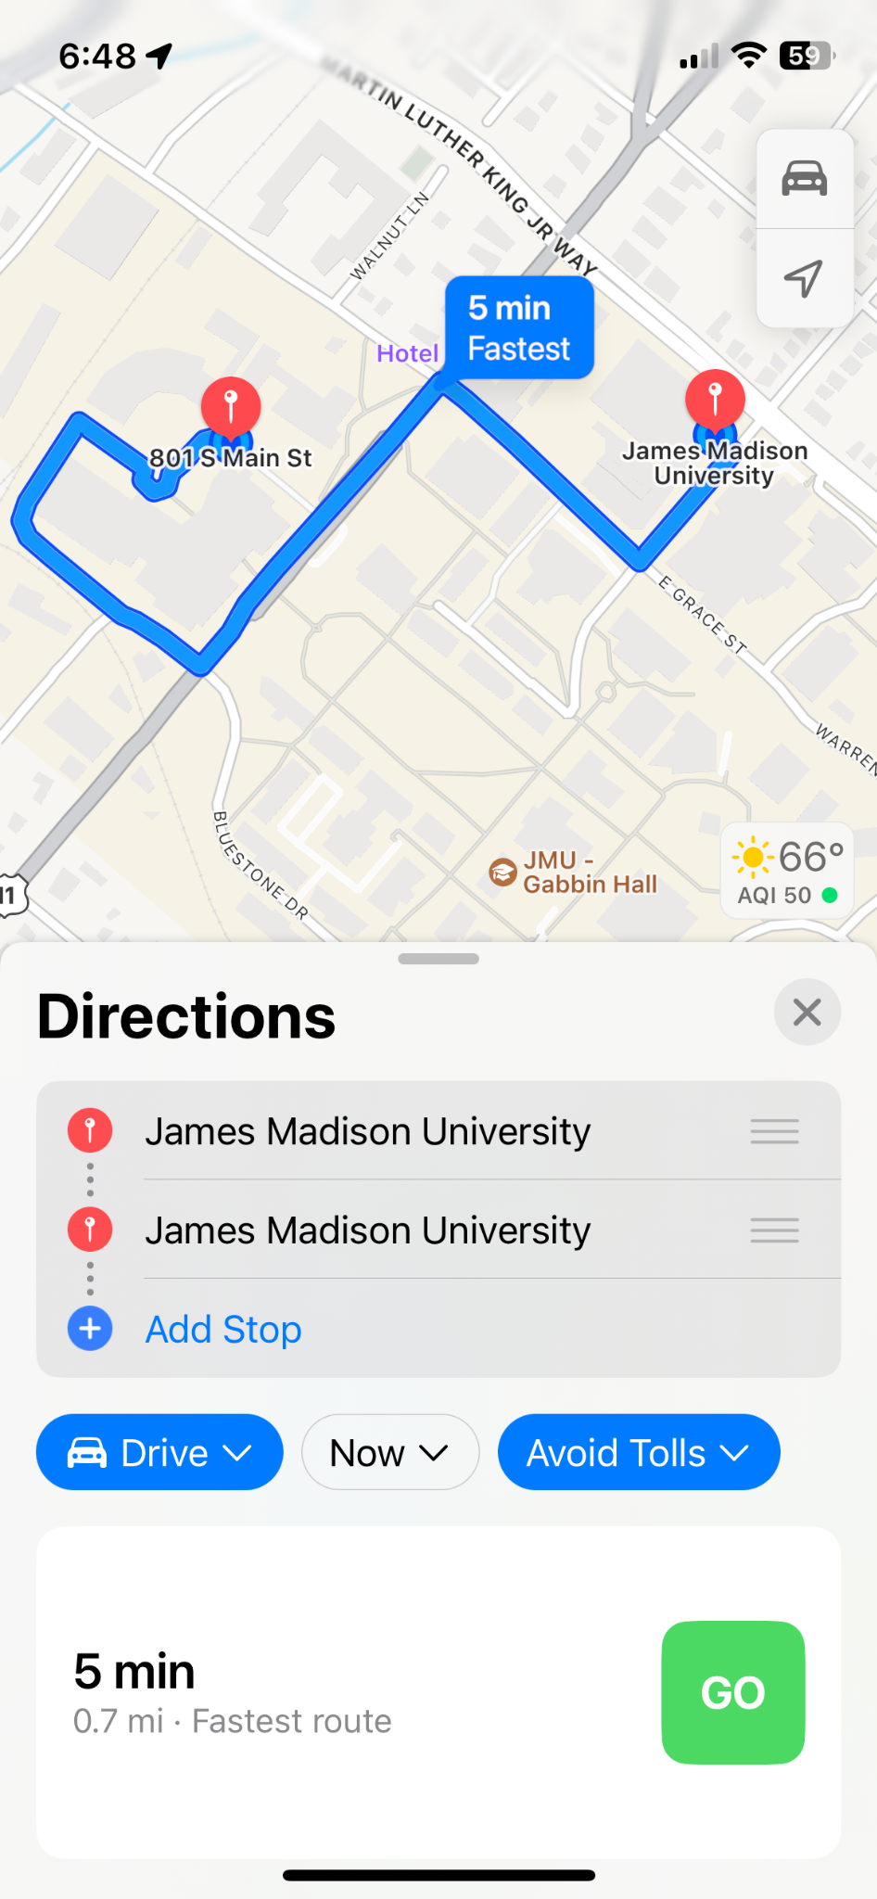
User Interface / Frontend

Slide 11
Future Plans
Cut down on time it takes to run the program as a whole to be more in line with other mapping applications
Take into account where someone has a class or needs to go to when we are predicting the best parking garage
Adding other parking garages to possible recommendations
Take in live, real time data from JMU’s parking service API

Slide 12
Lessons Learned
Working with new technologies, frameworks, and libraries
Time management
Communication with team members and client
Keeping track of all the dependencies
Therefore, need to resolve issues ASAP to reduce blockers that prevent further development / testing

Slide 13

Acknowledgements
Client / Instructor:
Dr. Mohamed Farag
mmagdy@vt.edu
UTA:
Ansh Gwash
anshgwash@vt.edu

Slide 14
References
Dyouri, Abdelhadi. “How To Make a Web Application Using Flask in Python 3.” DigitalOcean, DigitalOcean, 20 Dec. 2022, https://www.digitalocean.com/community/tutorials/how-to-make-a-web-application-using-flask-in-python-3.
14.7. Input For A Flask Web Application. 14.7. Input For A Flask Web Application - How to Think like a Computer Scientist: Interactive Edition. (n.d.). Retrieved April 16, 2023, from https://runestone.academy/ns/books/published/thinkcspy/WebApps/07-InputForAFlaskWebApplication.html
“Prophet Quick Start.” Prophet, 28 Feb. 2023, https://facebook.github.io/prophet/docs/quick_start.html#python-api.

