Slide 1
Efficient Web Archive Searching
CS 4624: Multimedia, Hypertext, and Information Access
Dr. Edward Fox
Ming Cheng, Xiaolin Zhou, Jinyang Li, Yijing Wu, Lin Zhang
Virginia Tech, Blacksburg, VA 24061
May 7, 2020

Slide 2
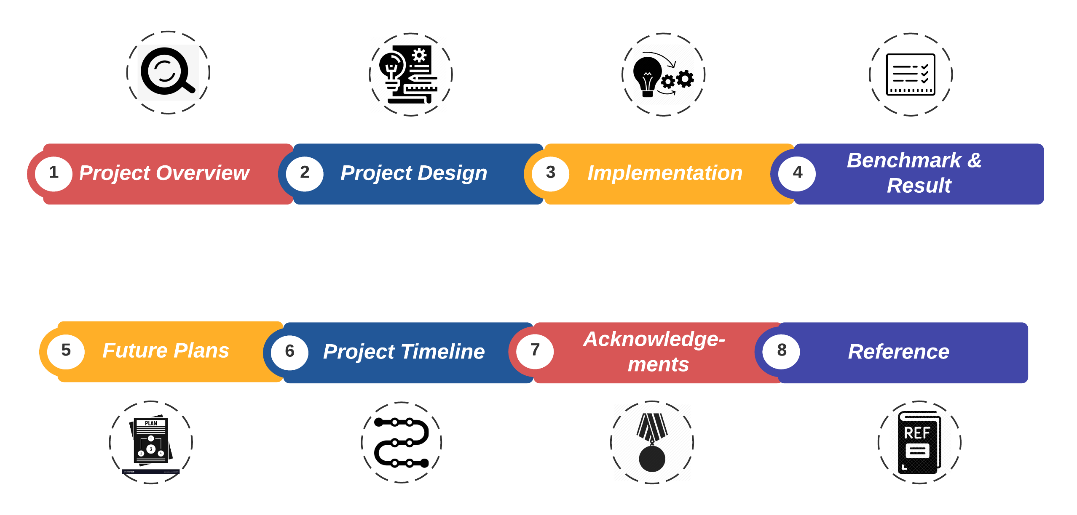
Outline

Slide 3
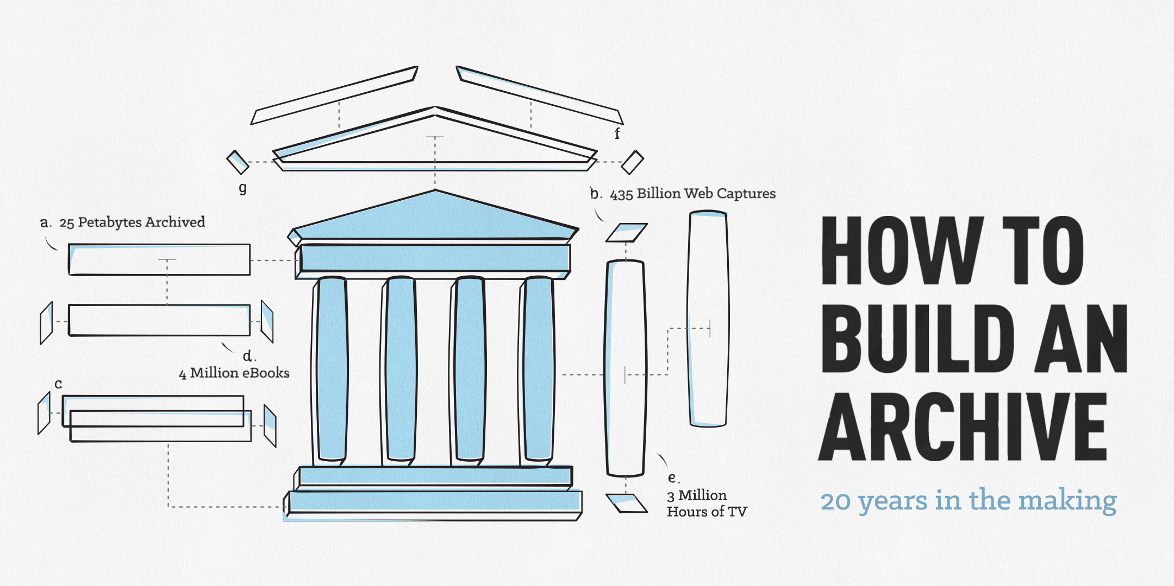
Project Overview

Slide 4



Project Design
Hashing
BenchMark Result

Slide 5

Implementation
Our Implementation:
  Simple Hash
Existing algorithms:
  Spooky Hash
  Murmur Hash
  City Hash
  XXHash

Slide 6
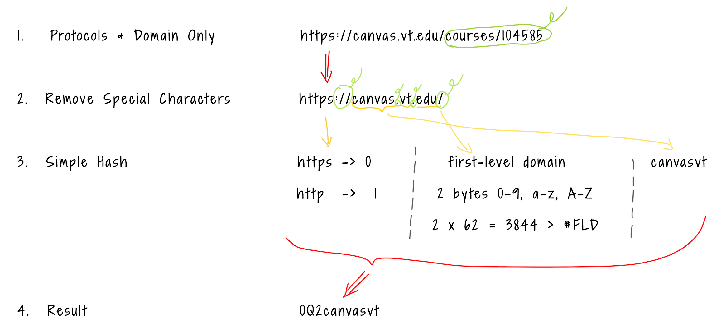
Simple Hash Algorithm Breakdown

Slide 7
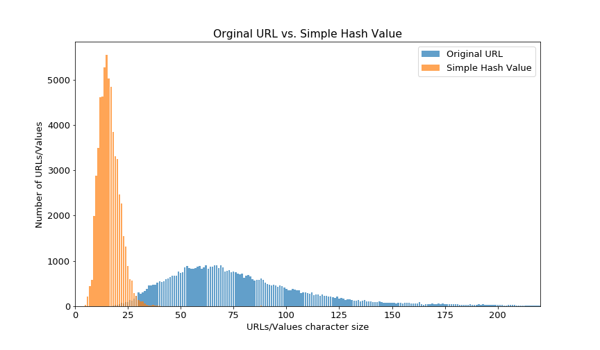
Simple Hash

Slide 8
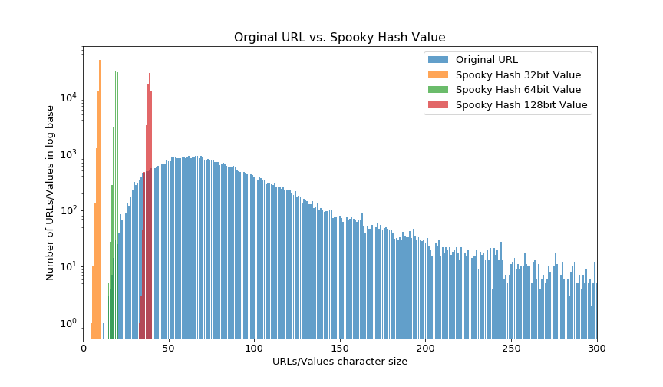
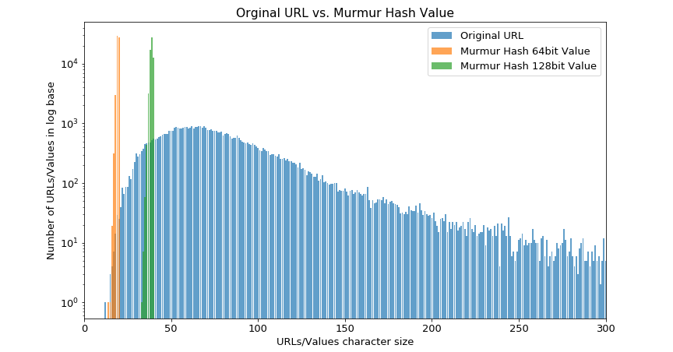
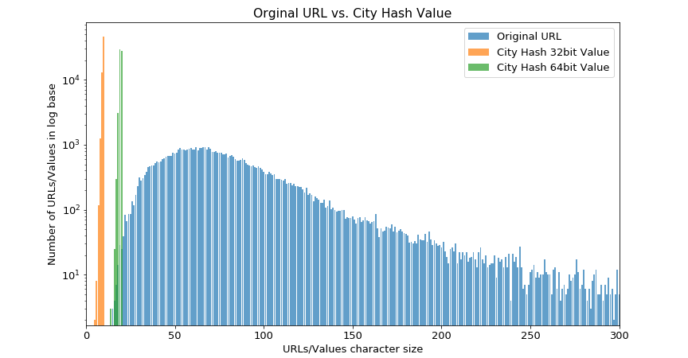
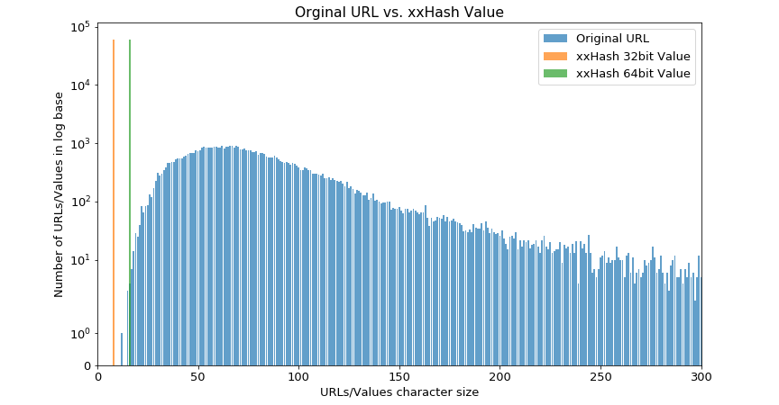
Spooky Hash, Murmur Hash, City Hash, XX Hash

Slide 9
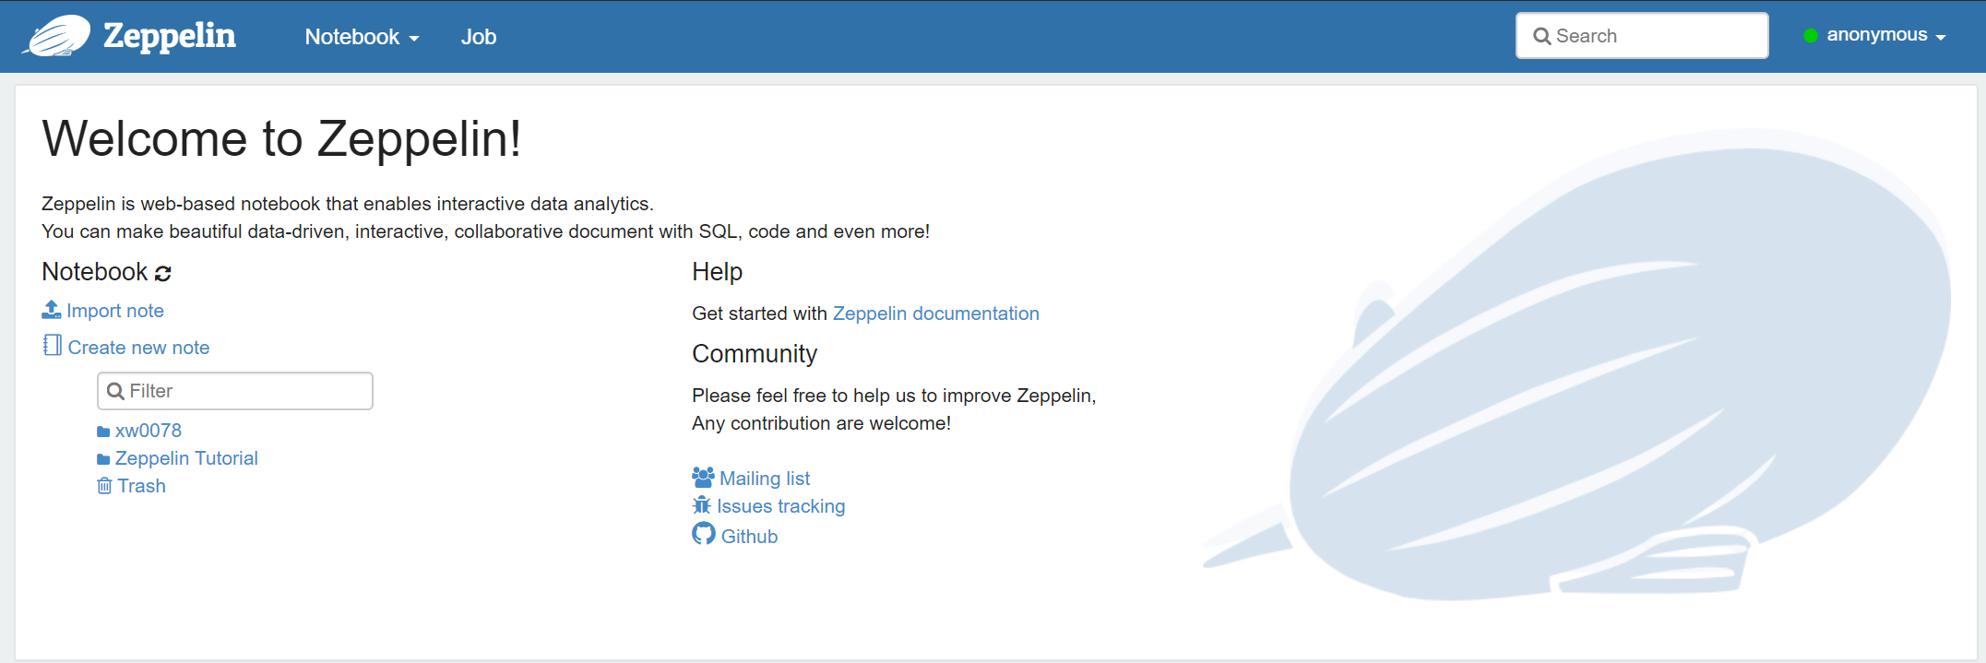
Benchmark
Tool: Zeppelin
All hash results + original database Combined.parquet
Run Zeppelin Web Server, and go to: localhost:8080
Load Parquet file, random pick 1000 samples
Clean cache, start query by originalURL and hash results
Calculate average single URL query time

Slide 10
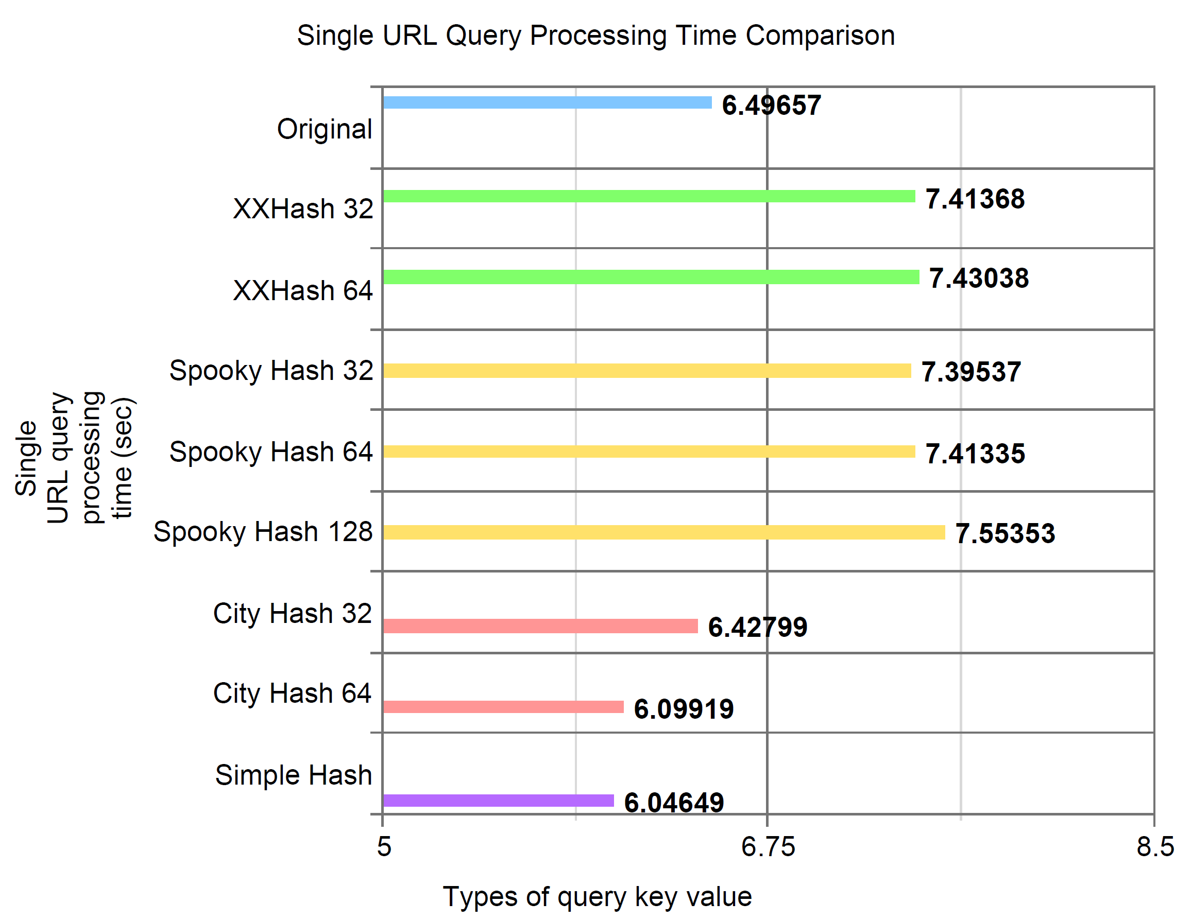
Result Based on 250 randomly selected samples.

Slide 11
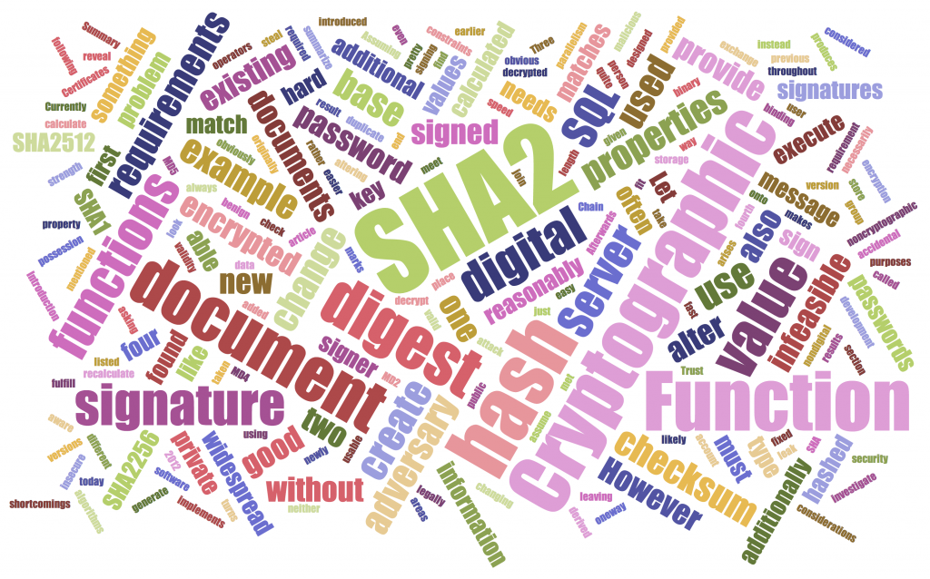
Future Plans
Reduce collisions.
Larger benchmark database.
Run benchmark multiple times and take the average.

Slide 12
Project Timeline
2/7
2/14
2/27
3/13
3/20
Understand project goal
Collect & review paper
Decide/define a suitable hashing algorithm
Algorithm implementation
Test
hashing algorithm implementation
5/4
5/2
4/26
4/10
4/3
ICAT Day
Finalize VTechWorks
Final report
Benchmark
Interim report

Slide 13



Acknowledgements
  Client
  Xinyue Wang
  Supervisor
  Dr. Edward A. Fox
  Consultant
  Dr. Lenwood S. Heath

Slide 14
Reference
Miguel C, Daniel G, Francisco C, and Mário S. (2013). A survey of web archive search architectures.
Retrieved From: https://doi.org/10.1145/2487788.2488116
Helge H, Vinay G, and Avishek A. (2016). ArchiveSpark: Efficient Web Archive Access, Extraction
and Derivation. Retrieved From: https://doi.org/10.1145/2910896.2910902
Ben-David, A., & Huurdeman, H. (2014). Web Archive Search as Research: Methodological and
Theoretical Implications. Retrieved From: https://doi.org/10.7227/ALX.0022
Elliot J and Scott K. (2009). Architecture of the internet archive. Retrieved From:
https://doi.org/10.1145/1534530.1534545

Slide 15


