Slide 1

Choices by Design, a Primer:
Finding and Using Openly Licensed Resources
October 20, 2014
Anita Walz arwalz@vt.edu
(I am not an attorney. This presentation does not constitute legal advice.)

Slide 2

Anita Walz
Assessment, Open Education & Online Learning Environments Librarian
Virginia Tech Libraries
arwalz@vt.edu
This image is in the public domain.

Slide 3
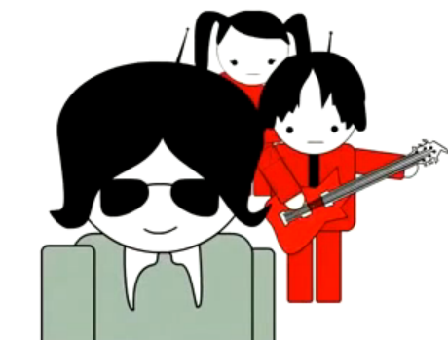
An invitation to learn about:
Copyright basics
What’s does openly-licensed mean?
Citing others’ work (aka “attribution”)
Finding openly-licensed works
© Screenshot from “Get Creative” Creative Commons CC BY-NC-SA

Slide 4
Can it be copyrighted?
Yes
Literary works, musical, and dramatic works
Choreographical & pantomime & works
Pictoral, graphic and sculptural works
Sound recordings
Motion pictures and other audiovisual works
Computer programs
Architectural works
No
Ideas, procedures, and methods
Titles, names, slogans (may be trademarked)
Facts, news, and research data
Works in the public domain http://librarycopyright.net/resources/digitalslider
Unrecorded, unwritten, un“fixed” works

Slide 5

Copyright Basics
Copyright holder’s exclusive rights (life + 70 years)
Reproduce
Distribute
Publically perform
Publically display . . . the work
Publically perform sound recordings by means of a digital audio transmission
Create derivative works
© Screenshot from “Get Creative” Creative Commons CC BY-NC-SA

Slide 6
Copyright Exemptions
Chapter 17 of U.S. Code
Also valuable (but not an exemption): Documentation of how you arrived at the exemption you used – that you acted “in good faith”
Section 107: Fair use
Section 108: Library copying
Section 109(a): First sale doctrine
Section 109(c): Exemption for public displays
Section 110(1): Displays/performances in face to face teaching
Section 110(2): Displays/performances in distance learning
Section 117: Computer software
Section 120: Architectural works
Section 121: Special formats for persons who are blind or have other disabilities
Case Law
Transformative use

Slide 7
You may want to (legally) …
Reproduce
Distribute
Publically perform
Publically display
Publically perform by means of a digital audio transmission, and/or
Create derivations of . . .
. . . works for which someone else owns copyright
© Screenshot from “Get Creative” Creative Commons CC BY-NC-SA

Slide 8
4 Ways to (legally) respond:
1) Obtain permission/license rights
2) Identify an exempt or fair use in U.S. Copyright law
3) Link to a website, library website, library reserves & eReserves
4) Use openly licensed materials or materials from the public domain

Slide 9
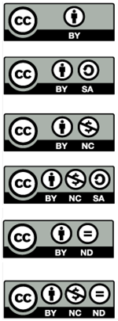
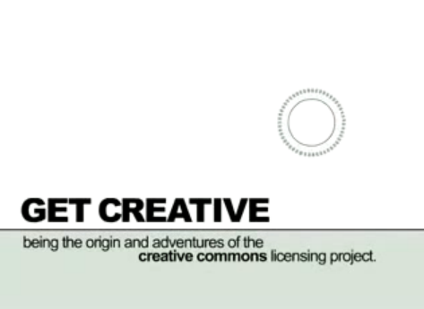
Creative Commons Licenses
© Creative Commons CC BY-NC-SA
http://mirrors.creativecommons.org/getcreative
Notes:
How many have seen/used these symbols?

Slide 10
6 Creative Commons Licenses
Attribution “CC-BY”
Attribution ShareAlike “CC BY-SA”
Attribution Noncommercial “CC BY-NC”
Attribution NonCommercial ShareAlike “CC BY-NC-SA”
Attribution NoDerivatives “CC BY-ND”
Attribution NonCommercial NoDerivatives “CC BY-NC-ND”

Slide 11
6 Creative Commons Licenses
Attribution “CC-BY”
This license lets others distribute, remix, tweak, and build upon a work, even commercially, as long as they credit the original author for the original creation. This is the most accommodating of licenses offered, in terms of what others can do with a work licensed under Attribution.
Notes:
© University of Michigan CC BY
http://www.lib.umich.edu/copyright/using-cc-licensed-material
http://creativecommons.org/licenses/by/4.0

Slide 12
6 Creative Commons Licenses
Attribution “CC-BY”
This license lets others distribute, remix, tweak, and build upon a work, even commercially, as long as they credit the original author for the original creation. This is the most accommodating of licenses offered, in terms of what others can do with a work licensed under Attribution.
Attribution ShareAlike “CC BY-SA”
This license lets others remix, tweak, and build upon a work even for commercial reasons, as long as they credit the original author and license their new creations under the identical terms. This license is often compared to open source software licenses. All new works based on a work licensed this way will carry the same license, so any derivatives will also allow commercial use.
Notes:
© University of Michigan CC BY
http://www.lib.umich.edu/copyright/using-cc-licensed-material
http://creativecommons.org/licenses/by/4.0

Slide 13
6 Creative Commons Licenses
Attribution “CC-BY”
This license lets others distribute, remix, tweak, and build upon a work, even commercially, as long as they credit the original author for the original creation. This is the most accommodating of licenses offered, in terms of what others can do with a work licensed under Attribution.
Attribution ShareAlike “CC BY-SA”
This license lets others remix, tweak, and build upon a work even for commercial reasons, as long as they credit the original author and license their new creations under the identical terms. This license is often compared to open source software licenses. All new works based on a work licensed this way will carry the same license, so any derivatives will also allow commercial use.
Attribution Noncommercial “CC BY-NC”
This license lets others remix, tweak, and build upon a work non-commercially, and although their new works must also acknowledge the original author and be non-commercial, they don’t have to license their derivative works on the same terms.
Notes:
© University of Michigan CC BY
http://www.lib.umich.edu/copyright/using-cc-licensed-material
http://creativecommons.org/licenses/by/4.0

Slide 14
6 Creative Commons Licenses
Attribution “CC-BY”
This license lets others distribute, remix, tweak, and build upon a work, even commercially, as long as they credit the original author for the original creation. This is the most accommodating of licenses offered, in terms of what others can do with a work licensed under Attribution.
Attribution ShareAlike “CC BY-SA”
This license lets others remix, tweak, and build upon a work even for commercial reasons, as long as they credit the original author and license their new creations under the identical terms. This license is often compared to open source software licenses. All new works based on a work licensed this way will carry the same license, so any derivatives will also allow commercial use.
Attribution Noncommercial “CC BY-NC”
This license lets others remix, tweak, and build upon a work non-commercially, and although their new works must also acknowledge the original author and be non-commercial, they don’t have to license their derivative works on the same terms.
Attribution NonCommercial ShareAlike “CC BY-NC-SA”
This license lets others remix, tweak, and build upon a work non-commercially, as long as they credit the original author and license their new creations under the identical terms. Others can download and redistribute this work just like the by-nc-nd license, but they can also translate, make remixes, and produce new stories based on the work. All new work based on the original will carry the same license, so any derivatives will also be non-commercial in nature.
Notes:
© University of Michigan CC BY
http://www.lib.umich.edu/copyright/using-cc-licensed-material
http://creativecommons.org/licenses/by/4.0

Slide 15
6 Creative Commons Licenses
Attribution “CC-BY”
This license lets others distribute, remix, tweak, and build upon a work, even commercially, as long as they credit the original author for the original creation. This is the most accommodating of licenses offered, in terms of what others can do with a work licensed under Attribution.
Attribution ShareAlike “CC BY-SA”
This license lets others remix, tweak, and build upon a work even for commercial reasons, as long as they credit the original author and license their new creations under the identical terms. This license is often compared to open source software licenses. All new works based on a work licensed this way will carry the same license, so any derivatives will also allow commercial use.
Attribution Noncommercial “CC BY-NC”
This license lets others remix, tweak, and build upon a work non-commercially, and although their new works must also acknowledge the original author and be non-commercial, they don’t have to license their derivative works on the same terms.
Attribution NonCommercial ShareAlike “CC BY-NC-SA”
This license lets others remix, tweak, and build upon a work non-commercially, as long as they credit the original author and license their new creations under the identical terms. Others can download and redistribute this work just like the by-nc-nd license, but they can also translate, make remixes, and produce new stories based on the work. All new work based on the original will carry the same license, so any derivatives will also be non-commercial in nature.
Attribution NoDerivatives “CC BY-ND”
This license allows for redistribution, commercial and non-commercial, as long as it is passed along unchanged and in whole, with credit to the original author.
Notes:
© University of Michigan CC BY
http://www.lib.umich.edu/copyright/using-cc-licensed-material
http://creativecommons.org/licenses/by/4.0

Slide 16
6 Creative Commons Licenses
© University of Michigan CC BY
http://www.lib.umich.edu/copyright/using-cc-licensed-material
http://creativecommons.org/licenses/by/4.0
Attribution “CC-BY”
This license lets others distribute, remix, tweak, and build upon a work, even commercially, as long as they credit the original author for the original creation. This is the most accommodating of licenses offered, in terms of what others can do with a work licensed under Attribution.
Attribution ShareAlike “CC BY-SA”
This license lets others remix, tweak, and build upon a work even for commercial reasons, as long as they credit the original author and license their new creations under the identical terms. This license is often compared to open source software licenses. All new works based on a work licensed this way will carry the same license, so any derivatives will also allow commercial use.
Attribution Noncommercial “CC BY-NC”
This license lets others remix, tweak, and build upon a work non-commercially, and although their new works must also acknowledge the original author and be non-commercial, they don’t have to license their derivative works on the same terms.
Attribution NonCommercial ShareAlike “CC BY-NC-SA”
This license lets others remix, tweak, and build upon a work non-commercially, as long as they credit the original author and license their new creations under the identical terms. Others can download and redistribute this work just like the by-nc-nd license, but they can also translate, make remixes, and produce new stories based on the work. All new work based on the original will carry the same license, so any derivatives will also be non-commercial in nature.
Attribution NoDerivatives “CC BY-ND”
This license allows for redistribution, commercial and non-commercial, as long as it is passed along unchanged and in whole, with credit to the original author.
Attribution NonCommercial NoDerivatives “CC BY-NC-ND”
This license is the most restrictive of the six main licenses, allowing redistribution. This license is often called the “free advertising” license because it allows others to download works and share them with others as long as they mention the original author and link back to them, but they can’t change them in any way or use them commercially.
Notes:
© University of Michigan CC BY
http://www.lib.umich.edu/copyright/using-cc-licensed-material
http://creativecommons.org/licenses/by/4.0

Slide 17
How to attribute openly licensed works
  Credit the author or other parties (as they specify)
  List the title & URL of the work (if available)
  Identify the license & URL of the license
  (See also https://wiki.creativecommons.org/Best_practices_for_attribution and making notices machine readable: https://wiki.creativecommons.org/Marking_Works_Technical

Slide 18
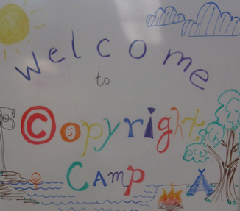
How to attribute openly licensed works
Use of ANY and ALL Creative Commons licensed works requires attribution
  Credit the author or other parties (as they specify)
  indicate the title & URL of the work (if available)
  Indicate the license & URL of the license
  Examples:
  © "Copyright Camp" by Greg Grossmeier from http://www.flickr.com/photos/grggrssmr/4846187035, used under a Creative Commons Attribution-ShareAlike license: http://creativecommons.org/licenses/by-sa/3.0 (Adapted)
  OR
  Adapted from © Copyright Camp by Greg Grossmeier CC BY-SA
  (See also https://wiki.creativecommons.org/Best_practices_for_attribution and making notices machine readable: https://wiki.creativecommons.org/Marking_Works_Technical
Notes:
© University of Michigan CC BY http://www.lib.umich.edu/copyright/using-cc-licensed-material http://creativecommons.org/licenses/by/4.0
See also: http://wiki.creativecommons.org/Best_practices_for_attribution

Slide 19
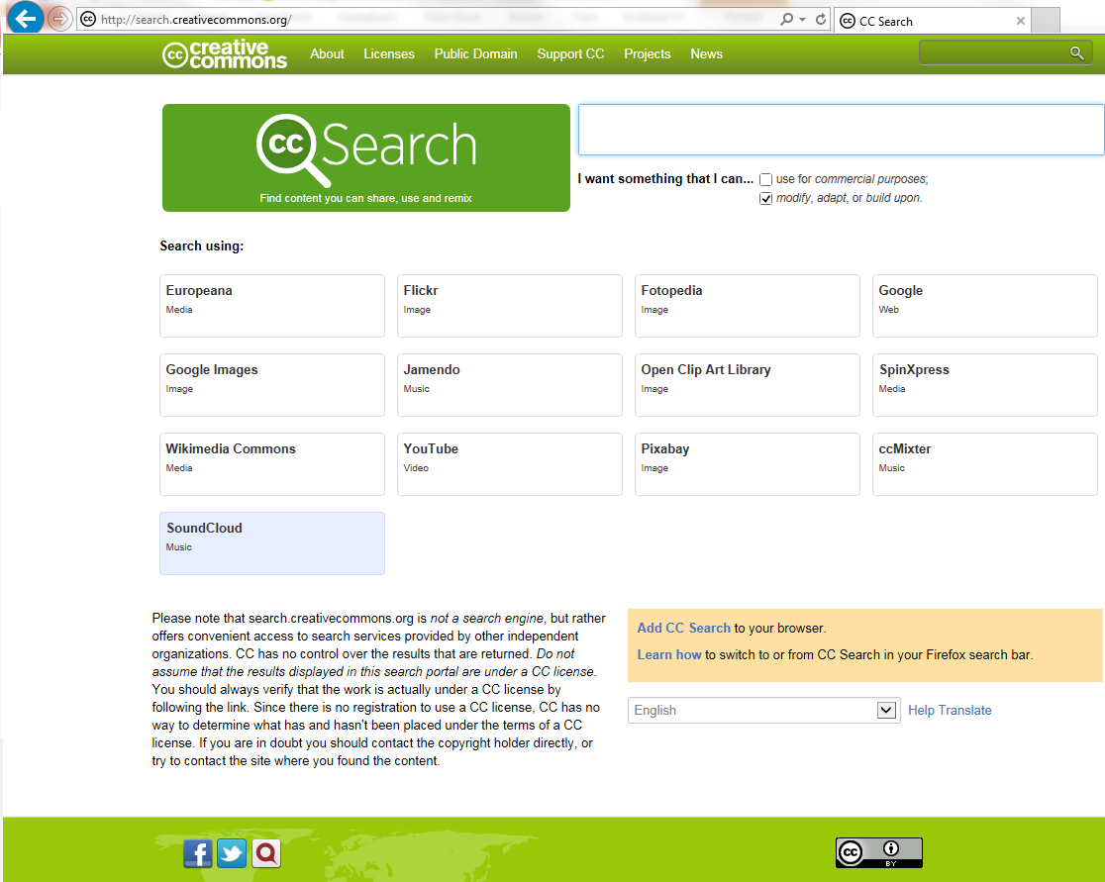
Finding openly-licensed works
[Search screen] © Creative Commons http://search.creativecommons.org CC BY

Slide 20
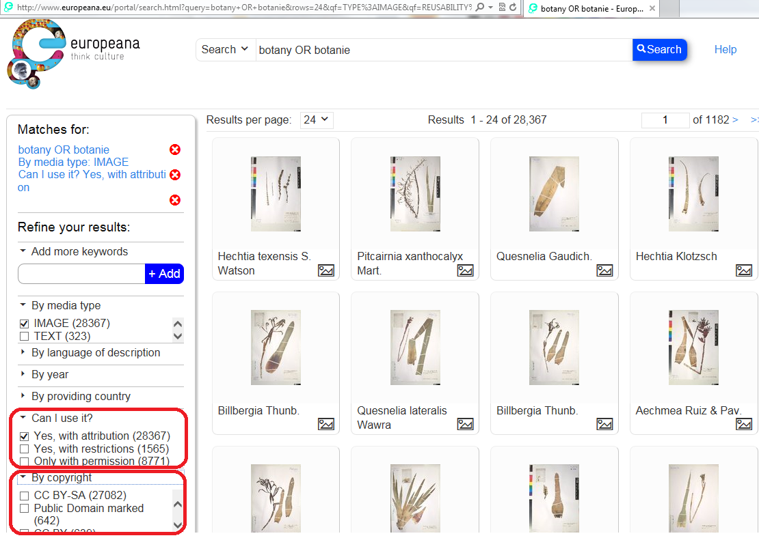
Finding openly-licensed works
[Search screen] © europeana http://europeana.eu

Slide 21
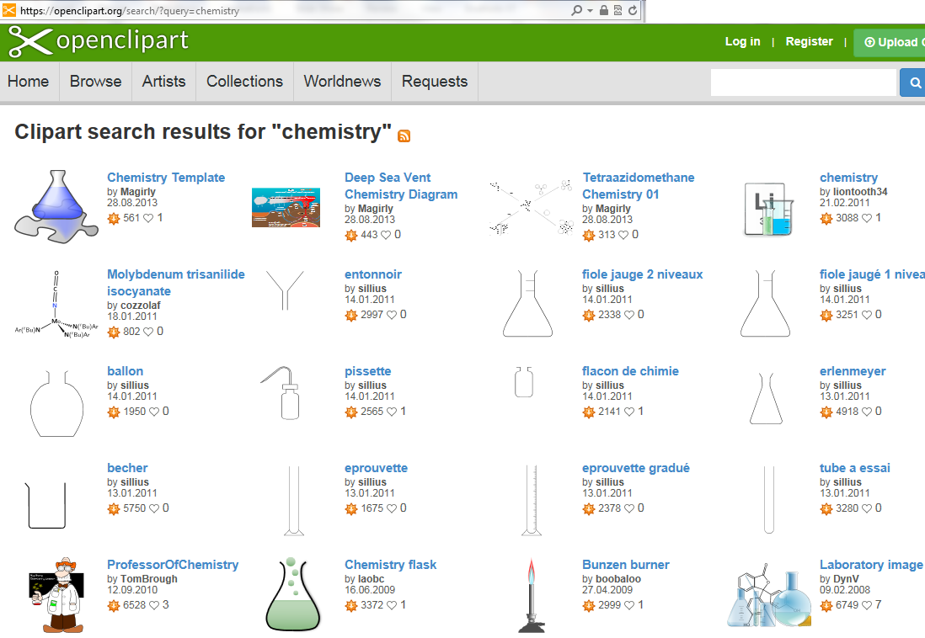
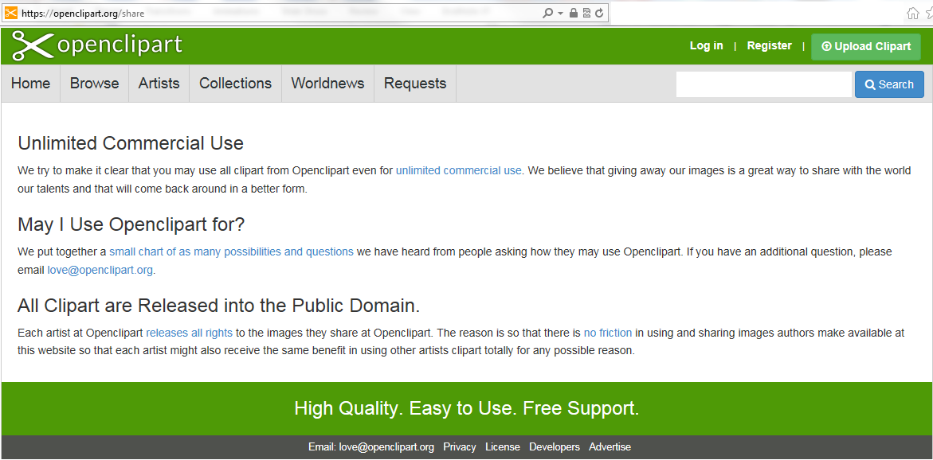
Finding openly-licensed works
https://openclipart.org

Slide 22
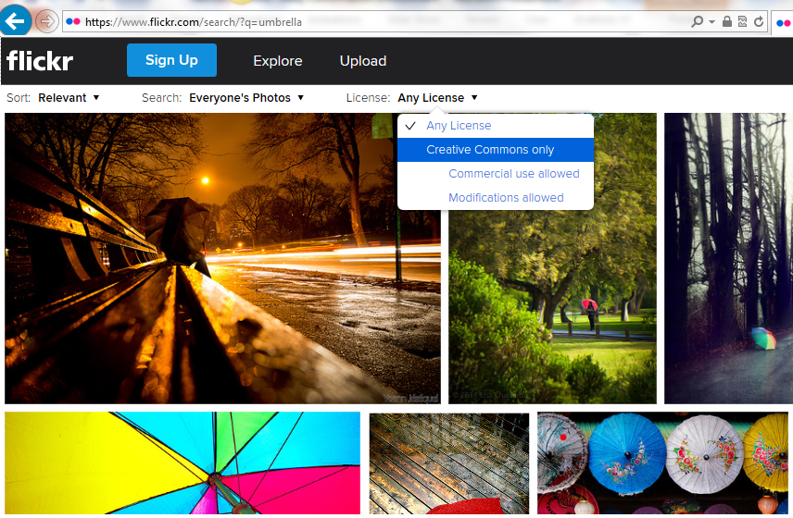
Finding openly-licensed works
http://www.flickr.com

Slide 23
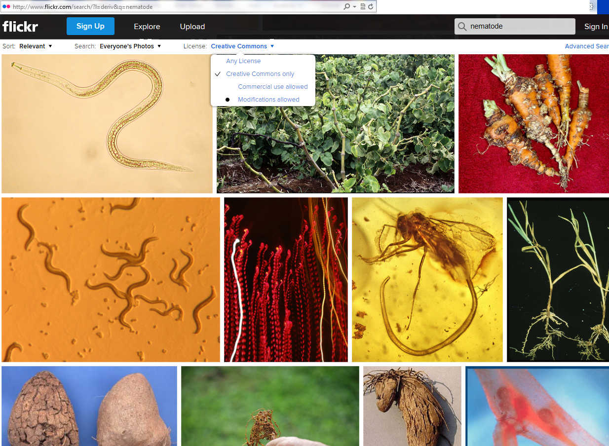
Finding openly-licensed works
http://www.flickr.com

Slide 24
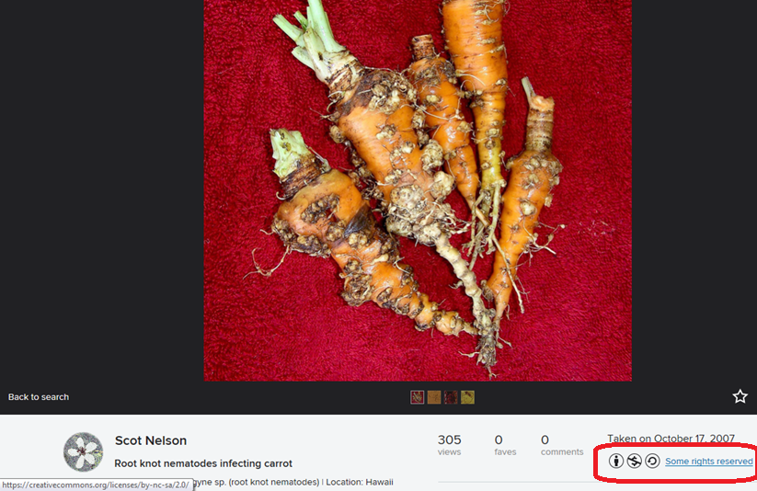
Finding openly-licensed works
http://www.flickr.com

Slide 25
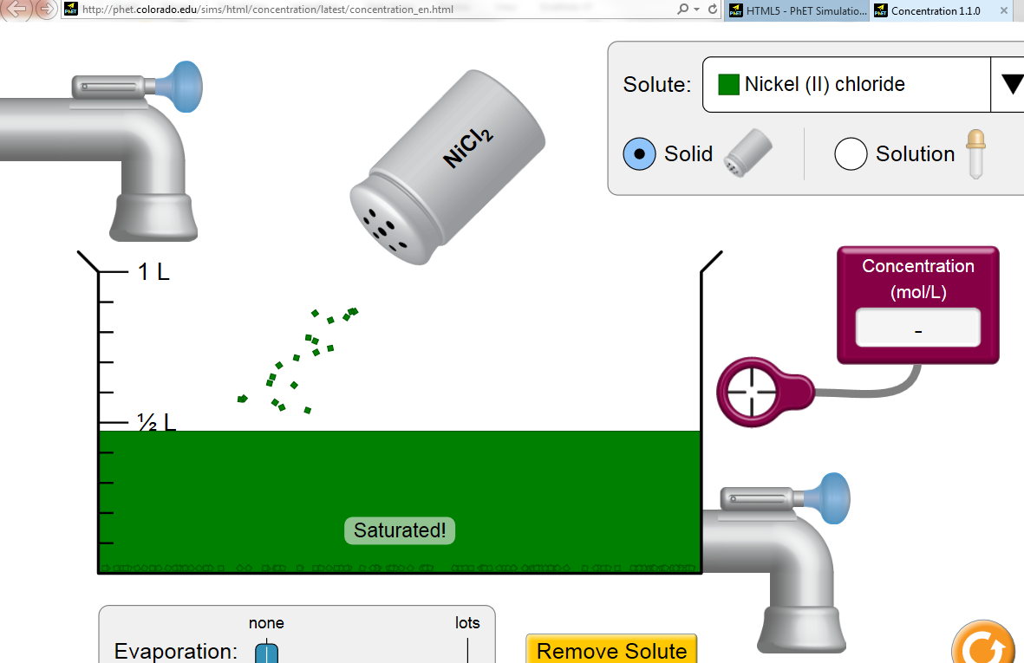
Finding openly-licensed works
“Concentration” ©University of Colorado CC BY
Notes:
http://phet.colorado.edu/sims/html/concentration/latest/concentration_en.html
http://phet.colorado.edu/en/simulations/category/html

Slide 26
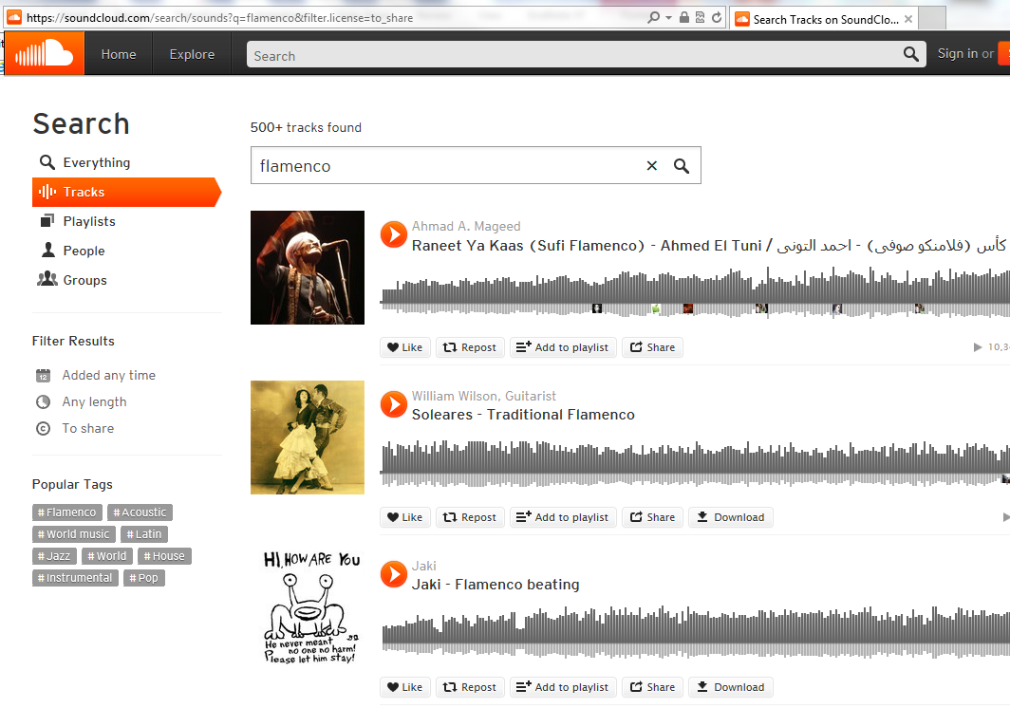
Finding openly-licensed works
https://soundcloud.com
Notes:
YouTube video on how to use ccMixter: https://www.youtube.com/watch?v=liAyK_VFy88
What is a remix? 5:00-5:31
Programs discussed:
Audacity http://audacity.sourceforge.net (free)
Reaper (low cost $)

Slide 27
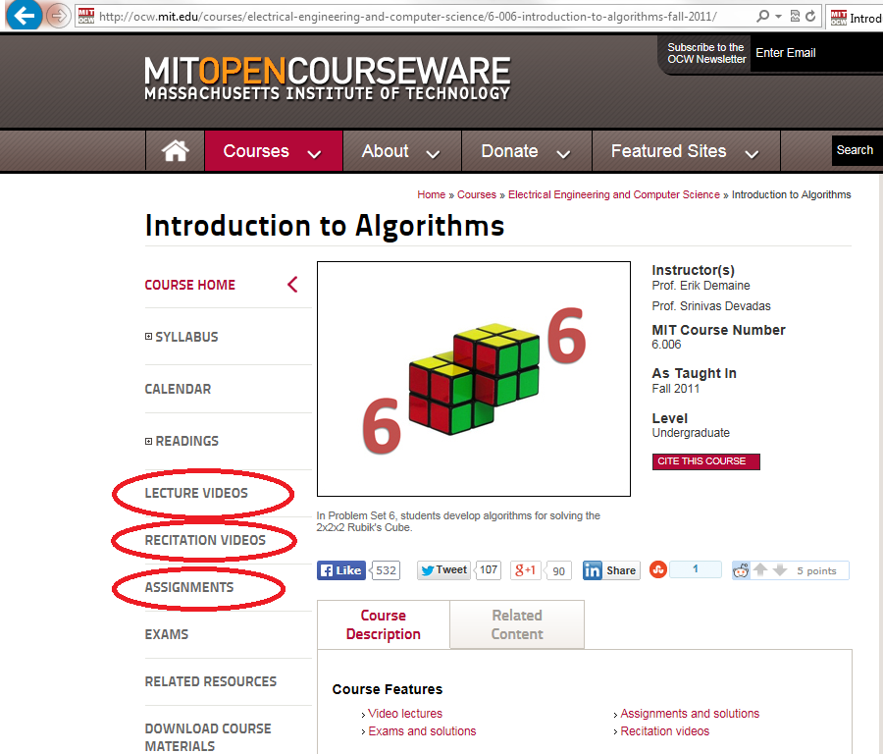
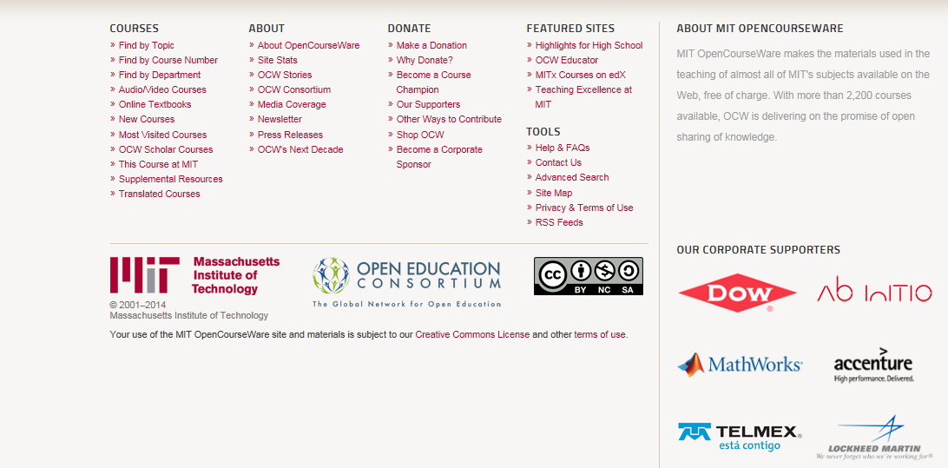
Finding openly-licensed works
“Introduction to Algorithms” © MIT CC BY-NC-SA
http://ocw.mit.edu
Notes:
http://ocw.mit.edu/courses/electrical-engineering-and-computer-science/6-006-introduction-to-algorithms-fall-2011/
Sample lecture: http://ocw.mit.edu/courses/electrical-engineering-and-computer-science/6-006-introduction-to-algorithms-fall-2011/lecture-videos/lecture-1-algorithmic-thinking-peak-finding/
Sample recitation: http://ocw.mit.edu/courses/electrical-engineering-and-computer-science/6-006-introduction-to-algorithms-fall-2011/assignments/MIT6_006F11_ps1.pdf
Quiz: http://ocw.mit.edu/courses/electrical-engineering-and-computer-science/6-006-introduction-to-algorithms-fall-2011/exams/MIT6_006F11_quiz1.pdf

Slide 28
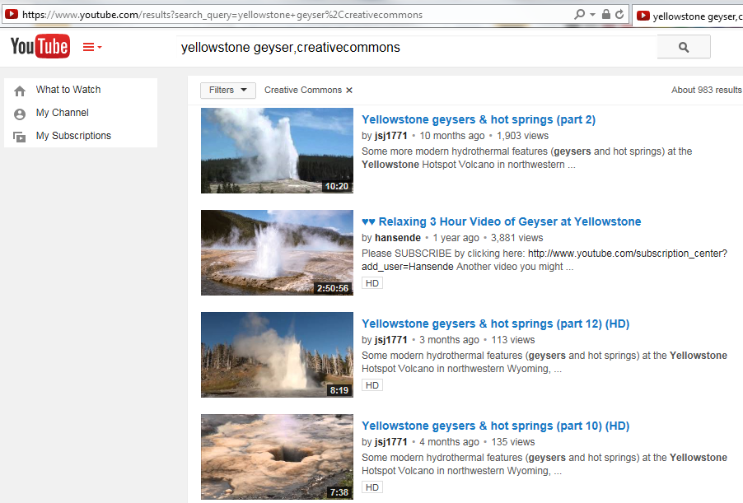
Finding openly-licensed works

Slide 29
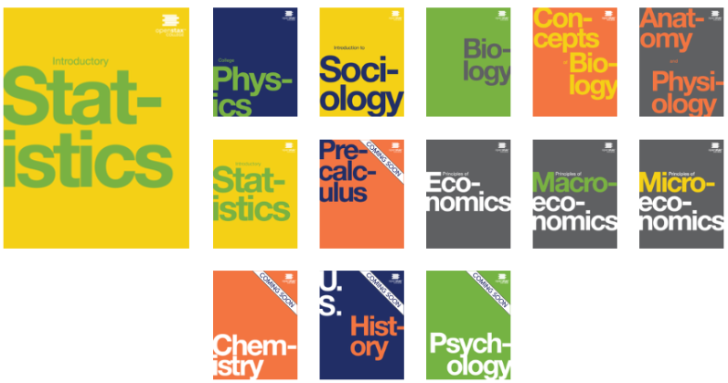
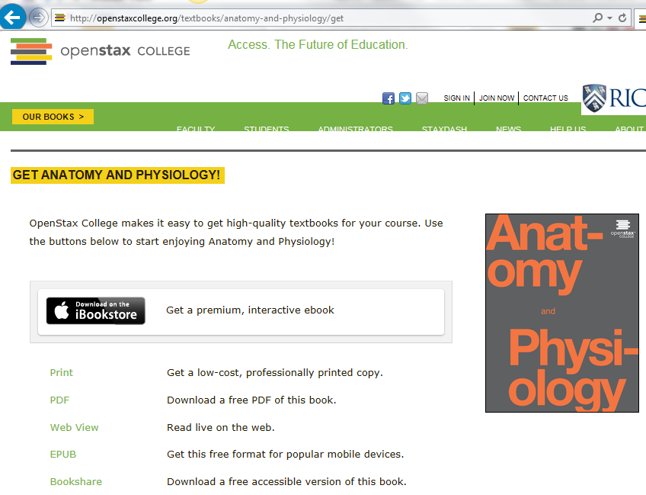
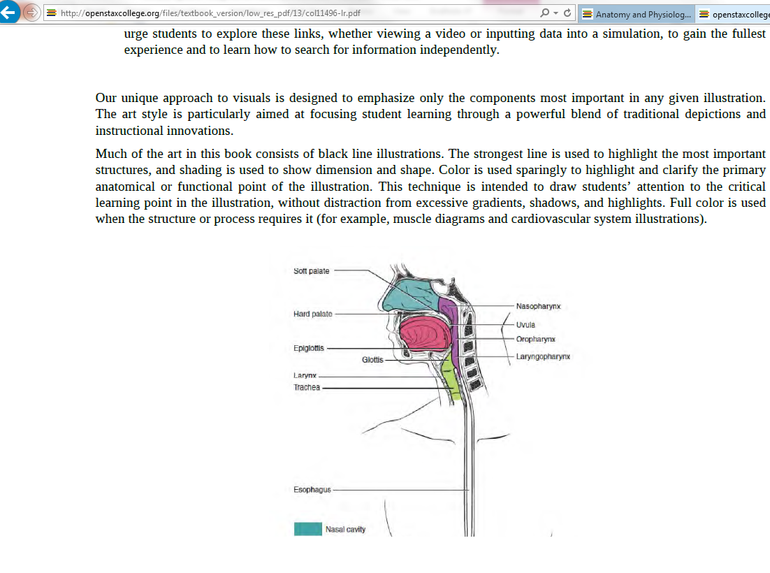
Finding openly-licensed works
http://openstaxcollege.org
Notes:
http://www.openstaxcollege.org/books

Slide 30
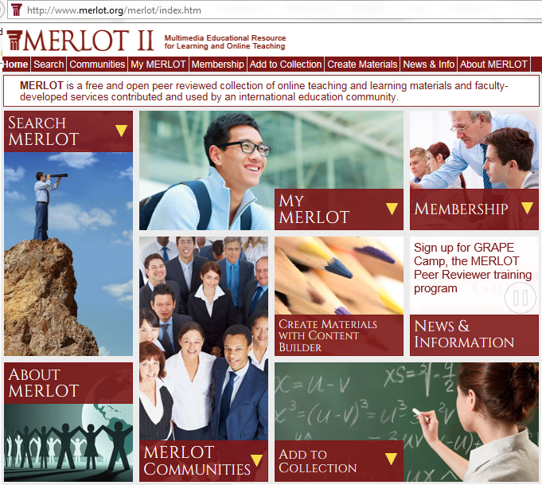
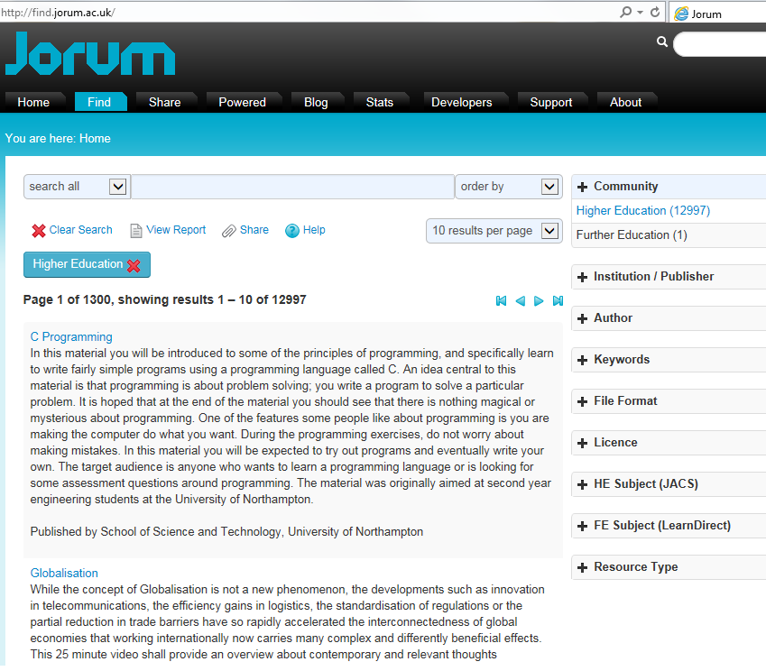
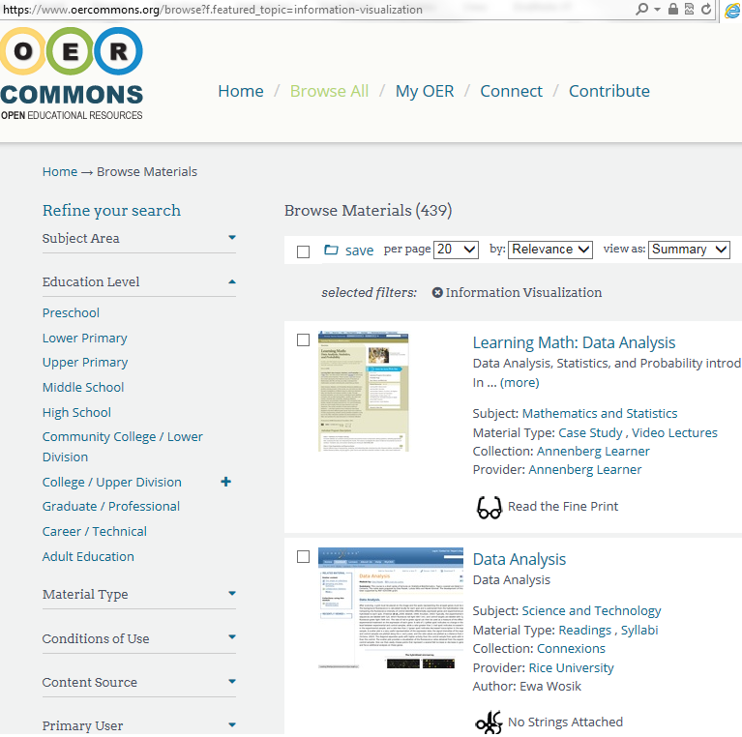
Finding openly-licensed works
http://www.oercommons.org
http://www.jorum.ac.uk
http://www.merlot.org

Slide 31
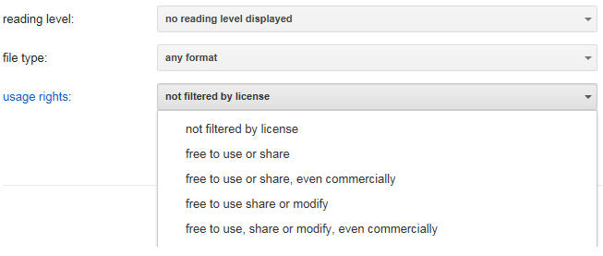
Finding openly-licensed works
Google Advanced Search
https://www.google.com/advanced_search (scroll down to “usage rights”)
https://www.google.com/advanced_image_search (scroll down to “usage rights”)
More info: https://support.google.com/websearch/answer/29508?hl=
Notes:
Examples:
MATLAB tutorial
3D files helicopter
Architecture ancient Rome
Thermodynamics simulations

Slide 32
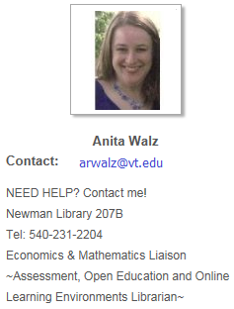
Finding openly-licensed works
Search by type:
Images OR media OR music OR video (find CCMixter, SoundCloud, Flickr & YouTube here!)
Creative Commons Search http://search.creativecommons.org
Syllabus
- Saylor Foundation http://www.saylor.org/courses
- Advanced Google search (filter by rights) https://www.google.com/advanced_search
- MIT OpenCourseWare http://ocw.mit.edu
Simulations
- PhET-Physics, chemistry, biology, earth science (University of Colorado) http://phet.colorado.edu
Short Video
KHAN Academy http://www.khanacademy.org
Vimeo http://www.vimeo.com
TED Talks https://www.ted.com/about/our-organization/our-policies-terms/ted-talks-usage-policy
Open Textbooks (full text, no cost, online)
- OpenStaxCollege (Rice University) http://openstaxcollege.org/books
- Open Textbook Library (University of MN) http://open.umn.edu/opentextbooks
- MERLOT II (California State University) http://www.merlot.org/merlot/index.htm
(select Material Type: “Open textbook”)
Virginia Tech Library’s Guide to Finding OER http://guides.lib.vt.edu/oer

Slide 33

. . . an alternative way for authors to share and for users to save time & money
Find, review, adopt,
customize, use
& share
Find, review, adopt
customize, use
& share
Find, review, adopt
customize, use
& share
Create, use
& share
Find, review, adopt,
customize, use
& share
© Screenshot from “Get Creative” Creative Commons CC BY-NC-SA
Notes:
Creating has everything to do with teaching & learning.
Faculty rely on textbooks, learning resources etc etc. We understand that you could create all of your instructional materials yourself . . . but that maybe you choose not to.

Slide 34
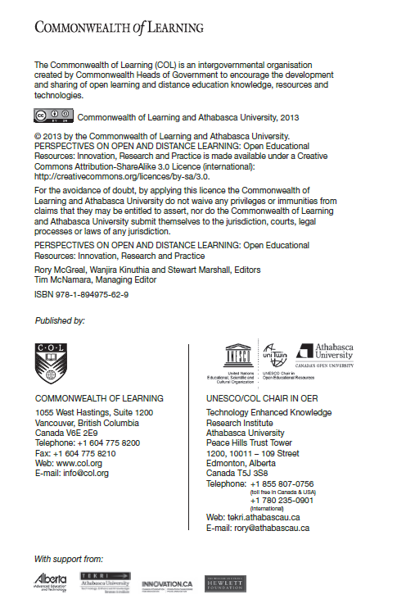
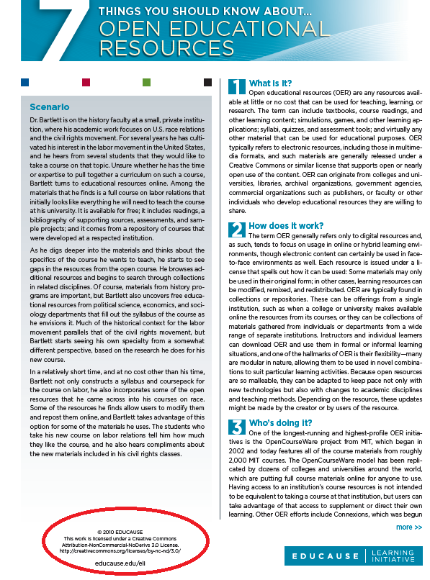
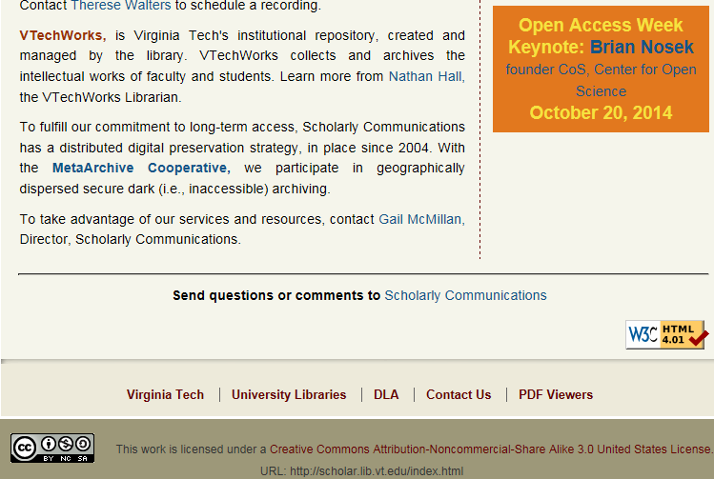
How and why to openly license?
Marking your work with a CC license
https://wiki.creativecommons.org/Marking_your_work_with_a_CC_license

Slide 35
Sharing so your work can be found
Local: VTechWorks
http://vtechworks.lib.vt.edu/register
MERLOT or OER Commons
http://www.merlot.com http://www.oercommons.org
Your discipline’s sharing networks
How do you already share?

Slide 36
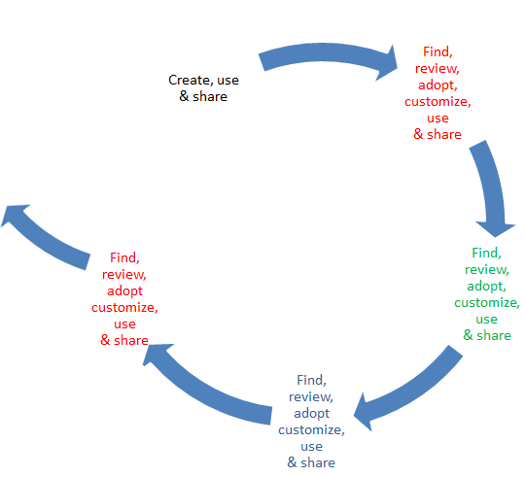
What will you . . .
Look for?
Create, use & share?

Slide 37
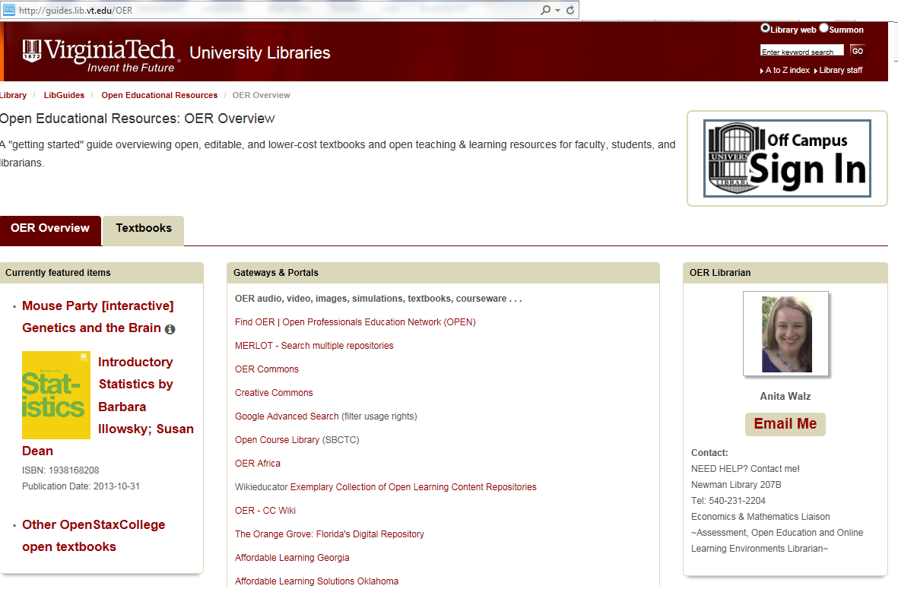
Thank you! (and Questions?)

