Slide 1

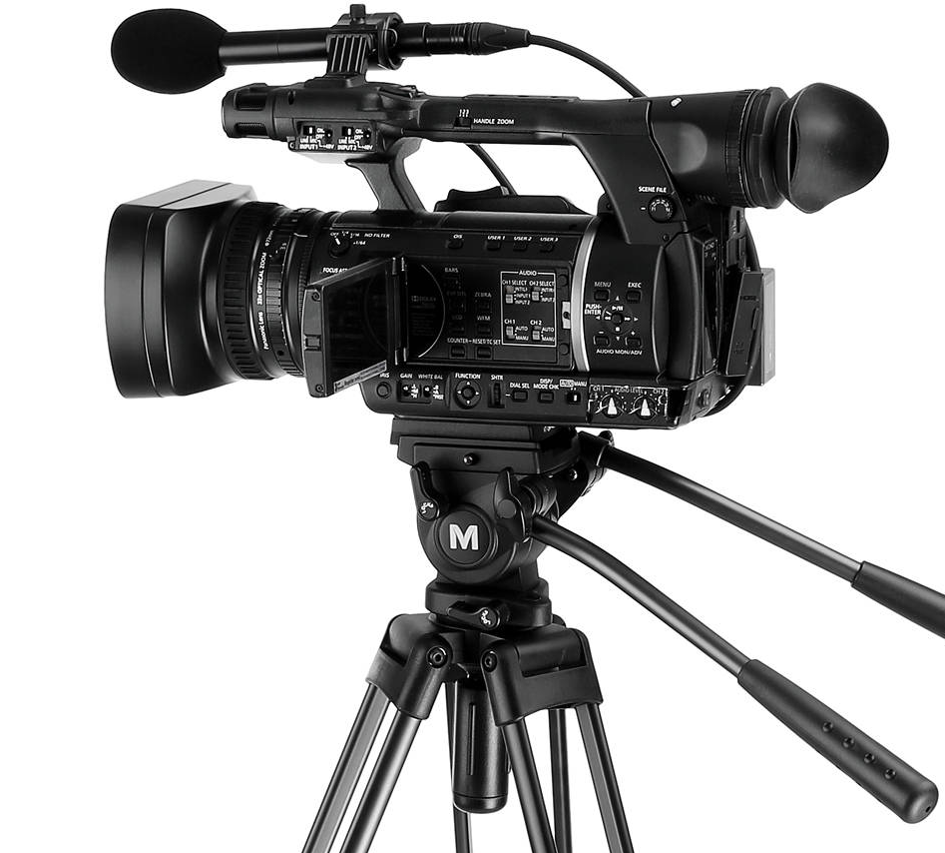
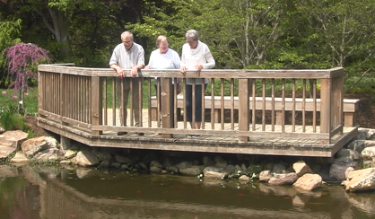
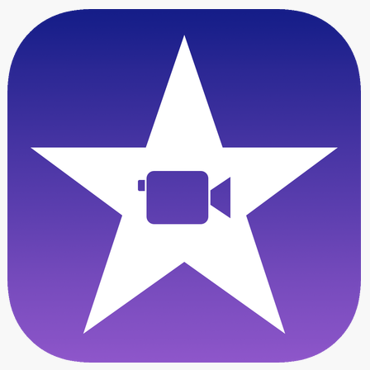

General Information
Adult Day Services
MEMORY MASTERCLASS
PROMOTIONAL VIDEO
Key Components of Video
Group Members: Maddie Kulik, Jose Zurita, Pablo Castillo
Instructor: Dr. Edward Fox
Class: CS 4624 Multimedia, Hypertext, and Information Access
Client: Adult Day Services,
Sara Amos & Ila Schepisi
Introduction & Raising Awareness
The main goal of our project was to create promotional material for the Memory Masterclass program so that ADS can reach individuals diagnosed with MCI earlier in their lifetime.
Aesthetic: Homey + Active
Specifically wanted a “homey” atmosphere + an active lifestyle; Wanted the essence of the video to communicate the quality of life they strive to help the members of their class achieve.
Why Memory Masterclass?
Content that explains why Memory Masterclass is beneficial to people over 55 years old, specifically highlighting brain health
Class Curriculum
Combination of interviews from ADS professionals explaining what the class consists of + interviews from past participants + footage of actual classes
Interviews & Testimonials
Actual participants speak about their experiences from Memory Masterclass. This involved recruiting former students who were willing to share their experiences and bringing them into the facilities on filming day.
Abstract
This promotional video is a marketing tool developed for Adult Day Services at Virginia Tech. The content focuses on promoting their Memory Masterclass program to potential applicants, specifically adults over 55 years who are experiencing mild cognitive impairment (MCI). This video will be featured on their recently updated website, and is mainly meant to promote the services of Adult Day Services and increase website traffic and participant recruitment.
Skills/Technology Implemented
Videography
Recording footage
Cleaning and condensing
Managing lighting & sound
iMovie Editing
Enhancing sound quality
Cohesively combining clips
Adding effects like music & fading
Main Project Objectives
The main goal of our project was to create promotional material for the Memory Masterclass program so that ADS can reach individuals diagnosed with MCI earlier in their lifetime.
Documentation
Creating repository for film on google drive
Recording progress
Design Requirements
Final Deliverables
Time Constraints: Limit to 4 minutes
Include comprehensive amount of information and plenty of stock footage to display activities
Aesthetic: Homey atmosphere + active lifestyle
Video Content
MCI info, interviews, & live footage of classes
Quality: high quality to ensure longevity of video usage
4-minute Video
Used for AARP presentation
Showcased on ADS website
Includes key components of Memory Masterclass experience
Technical Documentation
User Manual
Developer Manual

